Slide 1
Scenario Fuzzing

Slide 2
Term definition
Scenario in general
Actors interacts with systems
All supported interactions (no concrete parameters) be organized as a directed acyclic dependency graph
Node: interactions
Edge: semantic dependency relation (e.g., dataflow dependency)
A scenario is one or multiple interaction path/sequence in the dependency graph that forms only one instead of multiple graphs
Notes:
What’s semantic dependency? -> Need to summarize from traces, e.g., data dependency is one subset, if every data dependency has a semantic. TODO: need traces
should have at least one interaction that is semantically related to interactions from all other sequences directly or indirectly.
is semantically dependent on or affects interactions from all other sequences directly or indirectly
Under a context (for partial seq), an interaction (API or API+entity) sequence between an actor (TODO multiple actors) and systems that satisfies:
And for every two continuous interactions A and B, B is semantically dependent (purpose) on A
No repeated actions
Higher level representation, xxx
Login, search, add to cart, checkout
Login, search, search, add to cart, checkout

Slide 3
Term definition
Semantic dependency
Explicit dependency
Data dependency, e.g., get a token X after login, search with token X
...
Implicit dependency
e.g, send an email to X, X pull his email list
Need insights for defining more dependencies by analyzing scenario testcases provided by the production team
If there isn't more other dependency except data dependency, there would be less difference from existing works.

Slide 4
Term definition
Test cases (scenario testcases): Instantiate interaction paths of a scenario by
Expanding each interaction path with loops
Scenario: Login, Search, Add to cart, Checkout
Expansion: Login, Search, Search, Add to cart, Checkout
Concretizing parameters
Scenario testcase: Login with account A, search product X, search product Y, add search result Z of Y to the cart, checkout for Z
A scenario testcase == directed acyclic graph == dependency graph == execution order graph (partial order, concurrency)
Notes:
What’s semantic dependency? -> Need to summarize from traces, e.g., data dependency is one subset, if every data dependency has a semantic. TODO: need traces
Under a context (for partial seq), an interaction (API or API+entity) sequence between an actor (TODO multiple actors) and systems that satisfies:
And for every two continuous interactions A and B, B is semantically dependent (purpose) on A
No repeated actions
Higher level representation, xxx
Login, search, add to cart, checkout
Login, search, search, add to cart, checkout

Slide 5
Difference from general API fuzzing
Each scenario testcase corresponds to a scenario
Different use cases:
General API fuzzing:
Corner-case and malformed testcases for security-oriented testing
Local testing: Infinite testing times with redundant testcases
Scenario fuzzing:
Scenario test cases for functionality/performance testing
e.g., health check and performance testing
Online testing: Limited testing times with representative scenario testcases

Slide 6
Daily sync

Slide 7
Current Goal
Finding the missing dependencies in existing works
Orinal plan: get the swagger of mail APIs and 3S and then to check if there are non-data dependencies -> a little bit time consuming to manually extract -> ask LLM to extract, but not precise
Instead
Run and re-check existing works (RESTler and MINER)
Statical extraction: Return-value-to-argument dependencies
Dynamic extraction: If B dependes on A, A->B sequence should return success
This probably can catch most dependencies.
But it's hard to know all dependencies with dynamic extraction as the search space are large

Slide 8
Current Goal
A few questions regarding our project definition
Do we want to get the dependency graphs statically before fuzzing?
Send emails -> search emails
Send x, y emails -> search x emails
Send x, y emails (A->B) -> search z email (B)
Are they both scenarios? According to the previous defintion, the second shouldn't. But it is still possible in real-world.
Should all scenario testcases return success?
Traces
M365 swaggers

Slide 9
ER and API Dependencies
OneDrive
Solid line: always together
Dotted line: x
Mail message
(entity state, how mails)
Get attachments of a mail message M
Reader
Producer
Consumer
Writer == create, modify, edit
Reader ==
List OneDrive files
If there are msgs, list x
Otherwise, Y
Delete attachments of a mail message M
Precondition: passing valid ids
Add an attachment A to a mail message M
Attachment
Create draft mail messages
List mail messages
Precondition: passing valid ids
Send a draft message
Delete a mail message
Notes:
Entity relations
APIs belonging to each entity has dependencies, including mandatory or optional dependencies
Given a pair of APIs, ask LLM if they are dependent (dataflow, ret2arg) or relational
Relations among entities are on their accumulated state not one single APIs
Three relations (conditions) = do something if condition is satisfied
State relation
Entity to entity: Entity relation
API to entity:
Direct data dependency -> ret2argument dependency
API to API ()
State track ….

Slide 10
APIs Preconditions
Message, mailbox, folder
Create draft mail messages
List mail messages
Send a draft message
Delete a mail message
Message, attachment
Get attachments of a mail message M
Delete attachments of a mail message M
Add an attachment A to a mail message M
List OneDrive files

Slide 11
ER and API Dependencies
Add an attachment A to a mail message M
Get attachments of a mail message M
Get a OneDrive file as an attachment
Reader
Producer
Consumer
Mail message
(State)
Attachment
OneDrive
Delete attachments of a mail message M
Add an attachment A to an event E
Create draft mail messages
List mail messages
Event
Solid line: always together
Dotted line: x
Precondition: passing valid ids
Send a draft message
Delete a mail message
Notes:
Entity relations
APIs belonging to each entity has dependencies, including mandatory or optional dependencies
Given a pair of APIs, ask LLM if they are dependent (dataflow, ret2arg) or relational
Relations among entities are on their accumulated state not one single APIs
Three relations (conditions) = do something if condition is satisfied
State relation
Entity to entity: Entity relation
API to entity:
Direct data dependency -> ret2argument dependency
API to API ()
State track ….

Slide 12
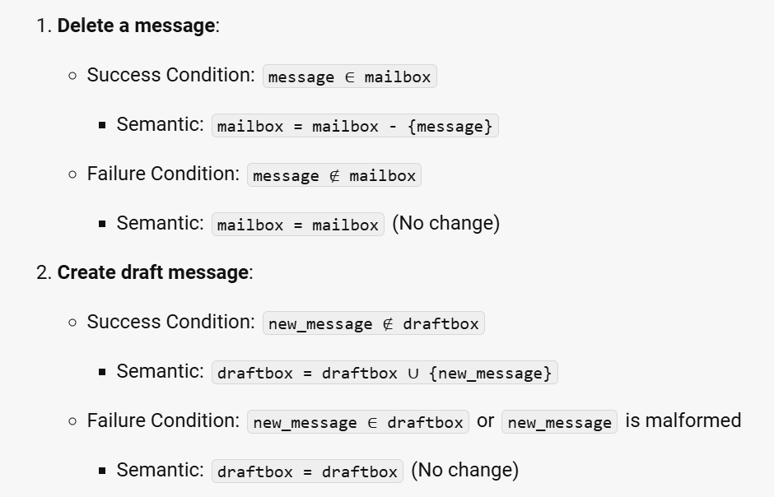
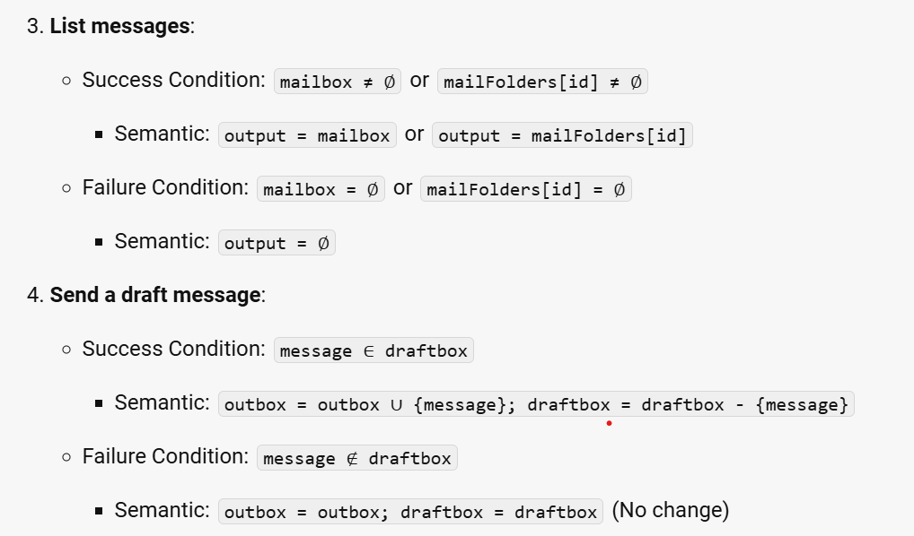
Modelling API relations
Abstract APIs as (success and error) pre-conditions and state transition on entities
Entities: mailbox, inbox, outbox, draftbox, messages
Express pre-conditions and state transitions with first order logic (FOL) expressions
What are the variables in the FOL expression? – Entities and API parameters

Slide 13
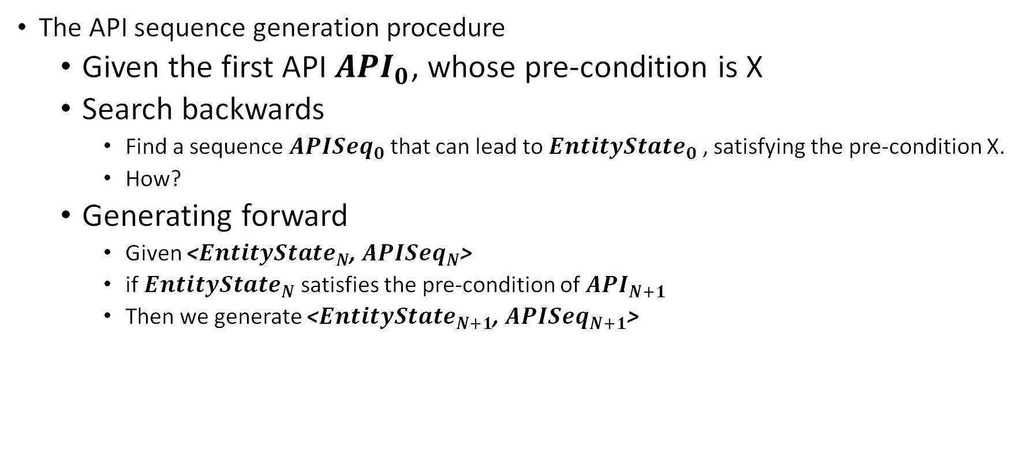
Modelling API relations
The API sequence generation procedure
Given the first API ${API}_{0}$, whose pre-condition is X
Search backwards
Find a sequence ${APISeq}_{0}$ that can lead to ${EntityState}_{0}$ , satisfying the pre-condition X.
How?
Generating forward
Given <${EntityState}_{N}$, ${APISeq}_{N}$>
if ${EntityState}_{N}$ satisfies the pre-condition of ${API}_{N+1}$
Then we generate <${EntityState}_{N+1}$, ${APISeq}_{N+1}$>

Slide 14
Questions for discussion
Do we have the access to the source code of M365?
We have to find a way to valid the extracted information.
The probe project doesn’t use the M365 graph library to access services. Instead, it constructs http requests by itself using the System.Net.Http package.
A test not only includes APIs but also other operations on their parameters and return values
Send an email
Retrieve messages in the sent folder
Check if the sent message is inside the retrieved messages to know if it’s really sent
Except reg2arg, other pre-conditions are all about some entity exist or not.
Static analysis or GPT, if GPT how to validate

Slide 15
Workload requirement for probing
Usage
Performance testing
TODO: Requirement for workloads
Health check
TODO: Requirement for workloads
Performance workload characteristics
YCSB: workloads (data + operations) for comparing different performance metrics among multiple same-purpose cloud services
Probes
Workloads run in the production systems
Account data, correlated accounts, (accounts, data, operations)
Stress testing
Is this project for generating limited workloads or continuously generating unlimited workloads?
How does “probe” work?
X

Slide 16
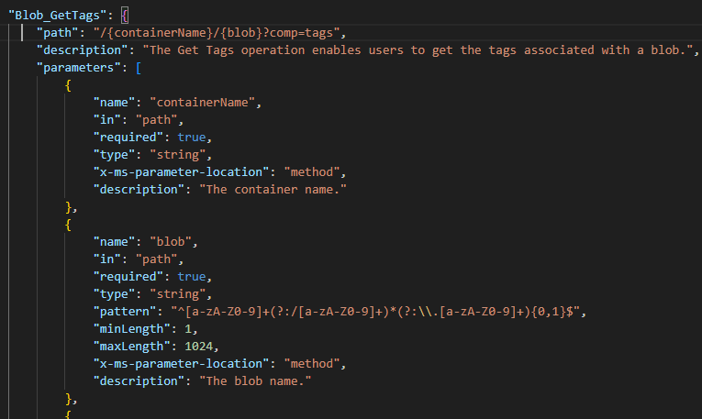
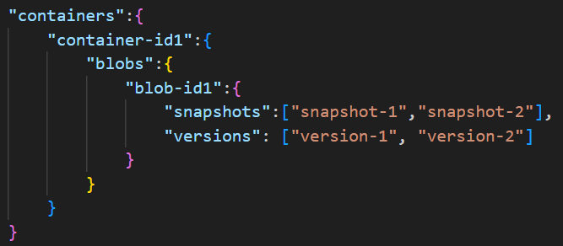
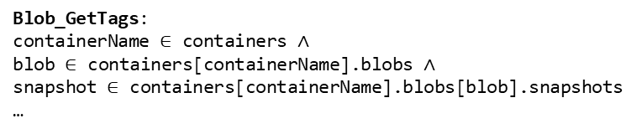
Workflow to extract pre-conds and semantic
Blob_GetTags:
containerName $∈$ containers $∧$
blob $∈$ containers[containerName].blobs $∧$
snapshot $∈$ containers[containerName].blobs[blob].snapshots
…
Swagger
Entity and attributes graph
Pre-conditions and semantic
expressed with set and logic operations on parameters, entities, and attributes

Slide 17
Questions for discussion
Set operation are sufficient to express pre-conditions and semantic
The pre-conditions are mostly about entity existence
The API semantics are mostly about list, create, get, update, delete, copy, and etc
We still don’t have the valid swagger of M365.
Tried GPT, but I can only valid its swagger syntax but not others
Other we implement on other services first or seek other ways to generate valid swaggers
Approaches
Static analysis
Do we have access to the source code of cloud services (e.g., M365)?
LLM + validation
How to validate the extracted expressions?

Slide 18
Project scope
Motivation: generating “scenario” workloads for probing cloud services
Workload features
Each workload consists of two parts:
Data/state setup -> write operations
Operations
Unlimited or limited workloads
Constraints from workload semantic
Each workload is one scenario (working on this now): relation graph
API Preconditions
Ret2argument dependency -> swagger
Entity state (e.g., existence)
API semantic
Express preconditions and semantic
Input: API description and swaggers
logic expression + set operations expressed with API parameters and entity/resource names
Constraints from targeted testing purposes/metrics
Performance: Latency?
Health (functionality): TODO what is health check? How does that usually go?
Stress testing?

Slide 19
TODO
Request the code access of Azure and M365
Request swagger

Slide 20
Entity graph generation
Generation result improvement
Refine the prompts to make the definition of entities much more clear
Ask LLM to explain why recognize them as entities
Run multiple times to vote for most possible entities
Example
[storageAgent, container, …]
{
"storageAccount": [
"container"
],
"container": [
"blob",
"metadata",
"publicAccessType",
"preventEncryptionScopeOverride",
"defaultEncryptionScope",
"systemProperties"
],
"blob": [
"metadata",
"lease",
"modificationTimestamp",
"systemProperties"
]
}

Slide 21
Discussion
Where can I create a code repo for managing code?
Expressions
Datalog: data model of an application: An introduction to Datalog (michelin.io)
Static analysis
API key

Slide 22
Entity relation
storageAccounts
accountID
{
"storageAccounts": [
[
"storageAccount",
"Container_Create",
"containerName"
]
],
"storageAccount": [
"containers"
],
"containers": [
[
"container",
"Container_Create",
"containerName"
]
],
"container": [
"blobs"
"defaultEncryptionScope",
"preventEncryptionScopeOverride",
"publicAccessType",
"metadata"
],
"blobs": [
[
"blob",
"Container_Create",
"x-ms-meta"
]
],
"blob": [
"metadata"
],
storageAccount
containers
containerName
container
blobs
blobName
blob

Slide 23
Discussion
Output token limit
GPT-4o has knowledge up to October 2023 and has a context length of 128k tokens with output token limit capped to 2,048.
New approach: extract relations with static analysis and LLM
Entity: message, folder, and etc.
Attributes of entity: modificationTime, recipient, and etc.
HTTP path → heuristics →
All entities in the path
Their hierarchy relation between entities
The only entity that all the parameters will work on
Parameters in query/header/body → LLM
Attributes

Slide 24
Discussion
POST /users/{id | userPrincipalName}/messages/{id}/attachments/createUploadSession
POST /users/{id | userPrincipalName}/messages/{id}/copy
PATCH /users/{id|userPrincipalName}/mailboxSettings
Attributes (parameters or inferred from parameters)
automaticRepliesSetting
dateFormat
delegateMeetingMessageDeliveryOptions
Language
timeFormat
timeZone
…

Slide 25
Entity extraction issues
Goal: path → entities, hierarchy, and the final target
Conflict relations
conflict entity relations: [
"events calendar, calendar events",
"calendar events, events calendar"
]
The last term
Action
POST /users/{id | userPrincipalName}/messages/{id}/copy
POST /users/{id|userPrincipalName}/calendar/getSchedule
Attribute:
GET /users/{id|userPrincipalName}/mailboxSettings/userPurpose
GET /me/mailboxSettings/automaticRepliesSetting

Slide 26
Why entities and their relations?
Final goal: API pre-conditions and semantic expression
API pre-conditions and semantic involve:
(1) The cloud service state, including the state of entities and attributes
Need to know what are the entities there.
Entities are organized in a hierarchy; to refer them, we need to know the hierarchy
M365
Extraction from doc as it contains the entity and attributes name in a specific format.
Path resolution heuristics
Azure storage
Path resolution heuristics
LLM: the result is still bad.
(2) API parameters

Slide 27
Discussion
Since we can get the entity and their relations on M365 doc, should we move on or make the entity extraction work on swagger as well.

Slide 28
Pre-condition extraction
Pre-conditions are expressed with the following python operations
Logic expression
Arithmetic operations
Python list and dictionary operations
A pre-condition might be expressed on
Parameters only:
"MaxAgeInSeconds": {
"description": "The maximum amount time that a browser should cache the preflight OPTIONS request.",
"type": "integer",
"minimum": 0
}
MaxAgeInSeconds >= 0
Parameters and entity state
Container_Create (“/{containerName}?restype=container”) creates a new container under the specified account. If the container with the same name already exists, the operation fails.
“containerName not in containers”

Slide 29
Discussion
But, to express some pre-conditions, other operations/APIs are also needed, e.g.,
Specifies the name of the source page blob snapshot. This value is a URL of up to 2 KB in length that specifies a page blob snapshot. The value should be URL-encoded as it would appear in a request URI. The source blob must either be public or must be authenticated via a shared access signature.
Specify the transactional md5 for the body, to be validated by the service.
Note that beginning with version 2009-09-19, metadata names must adhere to the naming rules for C# identifiers.
The origin domains that are permitted to make a request against the storage service via CORS. The origin domain is the domain from which the request originates. Note that the origin must be an exact case-sensitive match with the origin that the user age sends to the service. You can also use the wildcard character '*' to allow all origin domains to make requests via CORS."

Slide 30
Discussion
Carefully constructed prompts
Specify the entity, entity relation, parameters as concrete data types in a concrete language help the model to generate pre-conditions
How are we going to use the pre-conditions and API abstraction? And which concrete programming language is better for us?

Slide 31
Literature review
Workload and benchmark definition
Workload generation approaches
Workload = APIs + data
Key point for workload generation
Representative
Match to the behavior of production workloads

Slide 32
Benchmark and workload
Workloads: A workload refers to the actual tasks or operations that a system performs. This can include the data processed, the applications run, and the user interactions.
Benchmarks: A benchmark is a standard or set of standards used to measure and compare the performance of different systems or components. Benchmarks can be synthetic (designed to mimic specific types of workloads) or real-world (using actual applications and tasks).

Slide 33
Workload Generation
Initial state
Pre-conditions
API-1
API-1
…
State transitions
State-1
State-2
State-N

Slide 34
Data dependency
Explicit data dependencies
API return values to another API’s parameters
msgID = Create_draft_message(message)
Send_draft_message(msgID)
Implicit data dependencies
Dependencies between API parameters and microservice state
Need to track the state:
Create_container(containerName1, …)
Delete_Container(containerName1, …)
Container_AcquireLease(containerName1, …)

Slide 35
Discussion
How to deal with concurrency testing in the workload? If there is concurrency, how does it show up in the workload?
One workload consists of multiple API sequences, we are aware of the concurrency among the sequences
Each workload only has one sequence, multiple independent sequences run concurrently
What if the data is too large, how could we abstract it? Abstraction with concurrency?
What is the fundamental insight about this abstraction for workload synthesis?
Why not directly synthesize with actual service source code and deployment? Does such abstraction can capture all large-scale features? Or why not abstract from the source code?
How to express the delta state changes?
Even successful executions of one API can have different state transitions, for example, saveToSentItems == True/false represents different state transition

Slide 36
Discussion
How to validate the pre-condition and abstract?
Enumerate algorithm
Scenario testcase: reduction rules: context (proceeding APIs, state)
x

Slide 37
Ongoing discussion

Slide 38
Discussion
Entity and attributes can be extracted from the source code
Calendar properties: https://o365exchange.visualstudio.com/O365%20Core/_git/WeveNova?path=/sources/dev/WeveNova/core/store/ews/Calendar.cs&_a=contents&version=GBmaster
Bob properties: BlobProperties.h - Repos (visualstudio.com)
State machine might be wrong if purely building it from doc. It would mislead the testing process, for example, blob size alignment, asynchronous deletion with garbage collection? How about infer the state machine by combining doc + source code?
Do we want the graph to be highly accurate? If the state machine is highly accurate, can we utilize the abstract states as oracles?
How to send RESTful API requests and receive responses? POSTMAN

Slide 39
Discussion
What are the difficulties if we want to deploy services locally?
x

Slide 40
HttpRestProcessor.cs: HttpRestProcessor.cs - Repos (visualstudio.com)
CreateContainerImpl, ListContainersImpl
GetConditionInfoFromRequest - Search Code - Search (visualstudio.com)
BasicHttpProcessorWithAuthAndAccountContainerBase.cs: ProcessImpl
GetMethodName(this.Method)
restMethod = ChooseRestMethodHandler()
ar = BeginPerformOperation(restMethod, async.GetResumeCallback(), async.GetResumeState(asyncCalleeName));
HttpRestProcessor.cs: HttpRestProcessor.cs - Repos (visualstudio.com)
System::IAsyncResult^ BaseBlobObject::BeginSetProperties → BeginSetPropertiesImpl BaseBlobObject.cpp - Repos (visualstudio.com)
BeginCreateContainer source code:def:BeginCreateContainer - Search Code - Search (visualstudio.com)
Notes:
ChooseRestMethodHandler

Slide 41
Project overview

Slide 42
Project Overview
Research problem and scope
Synthesize finite and representative scenario [single-threaded/concurrent] workloads for cloud services in a [black-box, no instrumentation] approach to find [what kind of???] bugs.
Offline synthesis
What are the key points?
API pre-conditions
Scenario definition
→ Enumeration on APIs based on pre-conditions to generate workloads
Scenarios of functionality correctness
Advanced semantic conditions
Scenario definitions
(enumeration alg.)
Basic conditions
API relations
Scenarios of performance
Concurrency testing scenario
Notes:
The relation is beyond dependency (ret2arg).
Sequences (workloads) are not just for the sake of successful execution, but also meaningful.

Slide 43
Add high-level novelties and challenges
Why use LLM? What is the challenge in our case when using LLM?
Information (pre-condition, API semantic, ...) is describe in the doc.
Challenge: How to validate generated results to construct precise:
Entity, attributes -> code?
Prec-conditions and abstract -> ??

Slide 44
Categorize API Pre-conditions
Context-independent conditions
0 < blobContentLength <= 1024
Context-dependent conditions (dependent on previous APIs)
Direct dependency
A.K.A., producer-consumer dependency
Lexical matching
Solved by ICSE’2019 RESTler, ICSE’22 Morest
Indirect dependency
Semantically dependent
→ Need to understand semantic of APIs and their parameters
ContainerNames = List_Containers(); GetContainerProperties(ContainerName)
bobLen, … = BlockBlob_GetBlockList();
// appendPosition == bobLen;
AppendBlob_AppendBlock(appendPosition, …)
LastModified = Blob_GetProperties(blob, );
// ifModifiedSince <= LastModified;
PageBlob_UploadPages(blob, ..., ifModifiedSince)
ContainerNames = List_Containers();
// newContainer not in ContainerNames;
Create_Container(newContainer)
bobLen, … = BlockBlob_GetBlockList();
// appendLen <= Maxsize – blobLen;
AppendBlob_AppendBlock(…, appendLen)

Slide 45
Where can we find API pre-conditions?
Specification (e.g., swagger)
From the user perspective (e.g., input-output)
Succinctly describe the pre-conditions regarding:
API parameters
service states
Source code
Too much details
Mix pre-condition checking code with other functionality code

Slide 46
Holistically express all of pre-conditions?
Insight
The pre-conditions are described regarding the service states, instead of other dependent API responses.
E.g., “Specify this header value to operate only on a blob if it has been modified since the specified date/time.”
Two high-level design choices
Directly infer and express pre-conditions using API parameters and responses.
→ Less accurate as it is hard for model to comprehensively understand the multiple step inferences.
Model-based approach
Model microservices as entity state machine
Express pre-conditions based on the state machine
Why? (1) for offline generation, which needs to know the state; (2) match to the above insight

Slide 47
Abstract cloud services as state machines
States of entities and their attributes
API-provided value
Concrete value (e.g., ContainerName)
Service-generated value
Refer to the response parameters of APIs
e.g., MessageID, ModificationTimestamp
Transitions: API abstraction with pre-conditions on parameters and state
Given a state, find APIs with parameters meeting the API’s pre-conditions, e.g.,
State: containers = {“nameX”:, “nameY”: }
An API pre-condition : containerName not in containers
Constrain solving (e.g., z3)?
Or simple rules if constraints expressions are limited
Create_container(containerName1, …)
Delete_Container(containerName1, …)
Container_AcquireLease(containerName1, …)
msgID = Create_draft_message(message)
Send_draft_message(msgID)
containers = Const({“nameX”:, “nameY”: })
containerName = String()
solver.add(containerName in containers)
solver.model()
// containerName = ”NameX”

Slide 48
Workflow
Swagger
Heuristics/LLM
The hierarchy relation of entities and attributes
Covert JSON to language data structure
API pre-conditions (transition conditions)
API abstractions (states)
Model Microservices as state machines
LLM
Data structure of entities and attributes in a specific language

Slide 49
Enumeration alg. Or Entity Relation Graph
As long as the state are satisfied
Further control the relevance between near-by APIs

Slide 50
Question about the design
Q1: What is the fundamental insight about this abstraction for workload synthesis?
High-level description of the microservices without details, simplifying the synthesis processing.
Q2: Does state machine abstraction lose any critical information for workload synthesis
Not including concurrency
…
Q3: Why not abstract from the source code instead the doc, which is loosely organized?
Source code has too many details, hard to abstract away them? What kind of details
Heavy checks on request parameters, but some of them we satisfy by default, for example, such as checks on URL, client IPs.
Doc high-level semantic information
Scalability problem when using symbolic execution; Code slicing might be one possible solution
Q4: What if the data is too large, how could we abstract it?
This is a big issue
Q5: Do we consider concurrency testing? What are concurrency characteristics in microservices?
One workload consists of multiple API sequences, we are aware of the concurrency among the sequences
Each workload only has one sequence, multiple independent sequences run concurrently
Q6: How to compensate the incorrectness of relations extracted by LLM?
Q7: Clearly explain why the component needs the help of LLM?
Doc to entities and attributes → user perspective, high level
Doc to preconditions and abstract: Translate doc info to code → Hard to use heuristics to match all cases and translate them to code
Q8: what is the different comparing to general library API fuzzing?

Slide 51
Pinned TODO List
Run existing tools to see the left issues

Slide 52
Scenario Testing Project Updates

Slide 53
Outline
Introduction to cloud service and interfaces
Test cloud services in a “controlled” way
Discussion questions
Next steps and summary

Slide 54






Cloud Services and RESTful APIs
RESTful APIs
Notes:
Hosting software on cloud as a service and accessing them with RESTful APIs is the new software deployment trend.
For example, M365 software and Azure blob storage are deployed on Microsoft Azure.

Slide 55


Unfortunately, cloud services can be buggy :(
RESTful APIs
Internal server error, i.e., HTTP 500
Semantic errors: incorrect responses
Notes:
Like the local software, cloud services are having bugs, which can lead to denial of services and semantic errors.

Slide 56

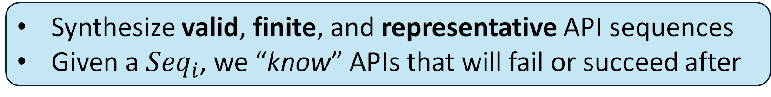
Let’s test them!
API sequences
How to select APIs for a testing sequence?
How to fill API parameters?
✗ Random
✓ Controlled
Synthesize valid, finite, and representative API sequences
Given a ${Seq}_{i}$, we “know” APIs that will fail or succeed after
Notes:
Since they are buggy, we need to test and fix them.
One promising approach is dynamic testing.
We can generate API sequences as workloads to dynamically test the targeted service.
To generate API sequences, two key questions need to be considered.
The simplest way is randomly selecting APIs and their parameters to construct an API sequence,
But that is ineffective due to the large search space and lots of invalid combinations.
Thus, we go for another extreme that synthesizes finite and representative workloads with more understanding of the service.
For example, given a Seq_i, we can almost know APIs that will fail or succeed after that seq_i.

Slide 57


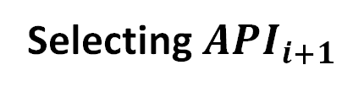
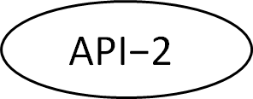
What do we need for controlled generation?
API pre-conditions
Constraints on API parameters for successfully executing the API’s aimed functionality.
$${Seq}_{i}$$
Pre-conditions
Pre-conditions
Satisfiable
Unsatisfiable
Selecting ${API}_{i+1}$
API-1
$$\text{API}\text{−2}$$
…
Notes:
To realize this controlled generation, API pre-conditions are what we need.
Pre-conditions are the constraints …

Slide 58
Categorize API Pre-conditions
Context-independent conditions
Maximum upload data length: 0 < blobContentLength <= 1T
Context-dependent conditions
Direct (producer-consumer) dependency
Lexical matching
RESTler ICSE’2019, Morest ICSE’22
Indirect dependency
Semantically dependent: Need to understand semantic of APIs and their parameters
ContainerNames = List_Containers()
GetContainerProperties(ContainerName)
ContainerNames = List_Containers();
// newContainer not in ContainerNames;
Create_Container(newContainer)
bobLen, … = BlockBlob_GetBlockList();
// appendLen <= Maxsize – blobLen;
AppendBlob_AppendBlock(…, appendLen)

Slide 59

Where can we find API pre-conditions?
User perspective
Succinct
Incomplete
Complete
Too much details
Hard to analyze
Notes:
Hard to analyze: asynchronous programming prevents static analysis, like data flow or program slicing.

Slide 60


Extract pre-conditions from doc with LLM
What should we prompt?
Pre-conditions is in the form of PL expressions.
But what are pre-condition expressions about?
Insight:
RESTful APIs are designed around resources
Pre-conditions are described regarding service resource states
E.g., ifModifiedSince: “Specify this header value to operate only on a blob if it has been modified since the specified date/time.”
Abstracting services as state machines
is another thing we need for controlled generation
Notes:
RESTful APIs (Representational State Transfer) are widely used for web services and are designed around resources.

Slide 61
Abstract cloud services as state machines
States regarding resource entities and their attributes
E.g., containers = {“container1”: {
“CreationTS”: …,
“IsDeleted”: …,
}}
States can be instantiated with:
API argument (e.g., ContainerName)
Service-generated value (e.g., msgID)
Create_container(containerName1, …)
Delete_Container(containerName1, …)
msgID = Create_draft_message(message)
Send_draft_message(msgID)

Slide 62
But wait, how to know instantiated states?
Option 1: Retrieve states using APIs
E.g., listContianers() to know all existing containers
Generating workloads on the fly (online)
Using multiple APIs to retrieve all states for selecting next API
lower testing performance
Option 2: Abstract APIs from doc to emulate state
API abstraction ≈ real API implementation
Generate API sequences before testing (offline)
Notes:
Service-generated state values still need to be retrieved with APIs on the fly.
(we can know if it’s solvable, only need to re-direct ret-2-arg)

Slide 63
Workflow
Pre-conditions in the form of Python expressions
Python Z3 solving code
API abstraction in the form of Python functions
Service
state machine
Workloads
(API seqs)
Enumeration algorithm

Slide 64
Example results – Pre-conditions
datetime.strptime(state['containers'][parameters['containerName']]['lastModified'], '%a, %d %b %Y %H:%M:%S %Z') > datetime.strptime(parameters['ifModifiedSince'], '%a, %d %b %Y %H:%M:%S %Z')
def precond_fun(parameters, state):
s = Solver()
lastModified_int = datetime.strptime(state['containers']...['lastModified’],
'%a, %d %b %Y %H:%M:%S GMT').timestamp()
ifModifiedSince_z3int = Int("ifModifiedSince_int")
s.add(ifModifiedSince_int < lastModified_int)
if s.check() == sat:
model = s.model()
ifModifiedSince_z3int = model[ifModifiedSince_int].as_long()
parameters['ifModifiedSince’] = time.strftime('%a, %d %b %Y %H:%M:%S GMT’,
ifModifiedSince_z3int)
return parameters
else:
return None

Slide 65
Example results – API Abstraction
def Container_Restore(parameters, state):
# Restore the container
container = state['containers'][parameters['containerName']]
container['isDeleted'] = False
container['restoreTimestamp’] = datetime.now(pytz.timezone('GMT')).
strftime('%a, %d %b %Y %H:%M:%S GMT')
return state

Slide 66
Discussion Questions/Challenges
LLM-generated pre-conditions and API abstraction are not accurate
Possible solutions
Pre-conditions: more shots
API abstraction: prompt with sliced source code
Any suggestions?

Slide 67
What is next?
Pre-conditions are not sufficient
Synthesizing workloads based on pre-conditions
Only guarantees execution success.
But lacks workload semantic
Extend workload synthesis with more semantic
Scenario testing
Each workload corresponds one specific testing scenario
Concurrency testing
Performance testing
Notes:
One test is one scenario
Concurrency
Create -> create -> delete

Slide 68
Summary
Research problem and scope
Synthesize finite and representative scenario workloads for cloud services offline to find various types of bugs
Solution
Model service as state machine with conditional transition
Enumerate on state machines to generate workloads by solving conditions
Scenarios of function testing
Advanced semantic conditions
Enumeration alg.
Basic conditions
Pre-conditions
Performance testing
Concurrency testing
Notes:
The relation is beyond dependency (ret2arg).
Sequences (workloads) are not just for the sake of successful execution, but also meaningful.

Slide 69
Summary – Contributions/Novelty
Existing approach
Limited to satisfy the context-dependent direct pre-conditions
Our approach
The state machine model are much more expressive
It can better guide us for generating workloads
We can add advanced semantic constraints on the state machine to generate workloads for specific testing purpose

Slide 70
How is our project different from model checking?
Model checking
Model the testing programs with formal languages (e.g., SPIN)
Assume the model == testing program
Enumerate on all possible states and check properties to find bugs
This project
Model the testing programs with general programming languages
Assume model ≈ testing programs
The model is just used as a guidance for generating tests not for finding bugs in itself
Enumerate the model to generating tests

Slide 71
How is our project different from symbolic exe?
Symbolic execution
Symbolize input parameters
Collect constraints on the parameters from program source code
Constraints are not related to historical states ….
Solving symbols for getting concrete inputs
If solving our problem, it has to symbolize APIs and their parameters, very large search space
This project
Symbolize API parameters
Collect constraints on the parameters and service states from doc
Solving symbols for getting concrete inputs

Slide 72
Scenario-based Workload Generation
for Cloud Services
Mentor : Tanakorn Leesatapornwongsa
Intern : Tao Lyu

Slide 73
Outline
Define the research question
Introduce explored solutions
Solution 1 (S1): Generation based on the state machine abstraction
Solution 2 (S2): LLM-assisted enumeration
Solution 3 (S3): Fully LLM-assisted workload generation
Lessons learned in prompt engineering

Slide 74
Cloud Service Testing
API sequences
How to select APIs for a testing sequence?
How to fill API parameters?
Random testing
Non-related APIs in a sequences
Incorrect arguments
Testing with semantic
Correlated APIs in a sequence
Valid arguments
Scenario workloads
Notes:
Why do we not prefer random testing? → low efficiency due to the large search space

Slide 75
S1: Abstract cloud services as state machines
States regarding resource entities and their attributes
E.g., containers = {“container1”: {
“CreationTS”: …,
“IsDeleted”: …,
}}
Conditional state transition
APIs’ abstraction → A set of state reads or writes.
API’s preconditions → Constraints on states and API arguments

Slide 76
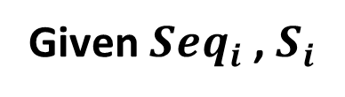
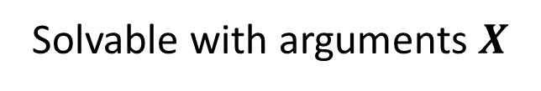
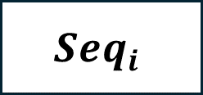
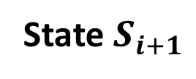
S1: Enumerate on the state machine
Solve the constraints to get valid API arguments
Given ${Seq}_{i}$, $S_{i}$
$${Seq}_{i}$$
Pre-conditions
Pre-conditions
Solvable with arguments $X$
Unsolvable
Selecting ${API}_{i+1}$
API-1
$$\text{API}\text{−2}$$
…
Execute API abstraction with X
State $S_{i+1}$
$${Seq}_{i}$$
Notes:
To realize this controlled generation, API pre-conditions are what we need.
Pre-conditions are the constraints …

Slide 77
S1: Workflow
Pre-conditions in the form of Python expressions
Python Z3 solving code
API abstraction in the form of Python functions
Service
state machine
Workloads
(API seqs)
Enumeration algorithm
LLM-assistant and one-time effort
Local computations

Slide 78
S1: Identified Issues After Impl.
LLM makes many mistakes
Loosely organized and incomplete doc → Accurate abstraction
Reverse logic when generating the precondition solving code
Possible solutions
Prompt with service source code to improve generation accuracy
Avoid generating solving code directly
Generate pre-condition codes and use symbolic executions to know the satisfiability
Ask LLM to check the satisfiability of preconditions and generate arguments if satisfiable

Slide 79
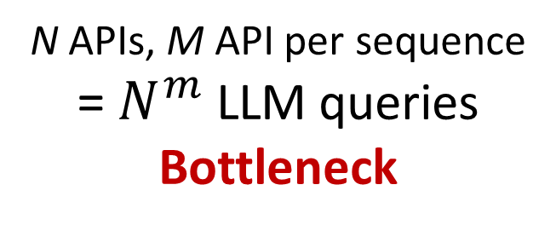
S2: LLM-assisted Enumeration
Pre-conditions in the form of Python expressions
N APIs, M API per sequence
= $N^{m}$LLM queries
Bottleneck
API abstraction in the form of Python functions
Service
state machine
Workloads
(API seqs)
Enumeration algorithm
LLM-assistant and one-time effort
Local computations
+ LLM queries

Slide 80
S3: Fully LLM-assisted Workload Generation
Pre-conditions in the form of the natural language
Use service response to correct arguments
API sequences with semantics
Workloads
Generate Arguments
LLM-assistant and one-time effort
Local computations
+ Less LLM queries

Slide 81
S3: Two kinds of corrections
Context-independent argument correction
PageBlob_UploadPages({"Content-Length": 512, "body": "a"*10,
"x-ms-range": "bytes=0-5", …})
Context-dependent argument correction
Container_Delete({"containerName":"testcontainer", …})
Container_Restore("containerName": "testcontainer",
"deleted-container-version": "deleteversion", …)

Slide 82
S3: Two kinds of corrections
Context-independent argument correction
PageBlob_UploadPages({"Content-Length": 512, "body": "a"*10,
"x-ms-range": "bytes=0-5", …})
PageBlob_UploadPages({"Content-Length": 512, "body": "a"*512, "x-ms-range": "bytes=0-511",
"x-ms-content-crc64": crc64iso.crc64("a"*512) …})
Context-dependent argument correction
Container_Delete({"containerName":"testcontainer", …})
Container_Restore("containerName": "testcontainer",
"deleted-container-version": "deleteversion", …)

Slide 83
S3: Two kinds of corrections
Context-independent argument correction
PageBlob_UploadPages({"Content-Length": 512, "body": "a"*10,
"x-ms-range": "bytes=0-5", …})
PageBlob_UploadPages({"Content-Length": 512, "body": "a"*512, "x-ms-range": "bytes=0-511",
"x-ms-content-crc64": crc64iso.crc64("a"*512) …})
Context-dependent argument correction
Container_Delete({"containerName":"testcontainer", …})
Service_ListContainersSegment({"include": "deleted", …})
Container_Restore("containerName": "testcontainer",
"deleted-container-version": "RET2ARG:Service_ListContainersSegment:
/Results/Containers/Container[Name='testcontainer' and Deleted='true']/Version/text()", …)

Slide 84
Preliminary Result
Service under testing: Azure blob storage service
Resource entities: service, account, container, page/block blob
69 RESTful APIs
Generated workloads
145 workloads: 92 successful (200) workloads while 53 failed ones
Arguments are not correct
Arguments are valid, and the purpose of the workload is to test failure scenarios
Length range: 2 - 8 APIs, averagely 4.5
Speed: 60 – 270 seconds
Notes:
92
['Container_Create', 'Container_SetMetadata', 'Container_GetProperties', 'Container_Delete', 'Service_ListContainersSegment', 'Container_Restore', 'Container_GetProperties', 'Container_Delete']
['Container_Create', 'Container_AcquireLease', 'Container_ReleaseLease']
['Container_Create', 'Container_SubmitBatch']
['Container_Create', 'Container_AcquireLease', 'Container_RenewLease', 'Container_ChangeLease', 'Container_GetProperties', 'Container_ReleaseLease', 'Container_Delete']
['Container_Create', 'Container_Delete', 'Service_ListContainersSegment', 'Container_Restore']
['Container_Create', 'PageBlob_Create', 'PageBlob_UploadPages', 'PageBlob_GetPageRanges', 'PageBlob_Resize', 'Container_GetProperties', 'Container_Delete']
['Container_Create', 'BlockBlob_Upload', 'Blob_SetMetadata', 'Blob_Download']
['Container_Create', 'PageBlob_Create', 'PageBlob_Resize', 'Blob_Download']
['Container_Create', 'AppendBlob_Create', 'AppendBlob_AppendBlock', 'Blob_Download']
['Container_Create', 'PageBlob_Create', 'Blob_SetHTTPHeaders', 'Blob_Download']
['Container_Create', 'BlockBlob_Upload', 'Blob_CreateSnapshot', 'Blob_Download']
['Container_Create', 'BlockBlob_Upload', 'Blob_SetTags', 'Blob_GetTags']
['Container_Create', 'BlockBlob_Upload', 'Blob_AcquireLease', 'Blob_ReleaseLease']
['Container_Create', 'BlockBlob_Upload', 'Blob_Download']
['Container_Create', 'BlockBlob_Upload']
['Container_Create', 'BlockBlob_Upload', 'Blob_SetTier', 'Blob_Download']
['Container_Create', 'PageBlob_Create', 'PageBlob_GetPageRanges']
['Container_Create', 'BlockBlob_Upload', 'Blob_AcquireLease']
['Container_Create', 'BlockBlob_Upload', 'Blob_SetMetadata', 'Blob_SetHTTPHeaders', 'Blob_Download']
['Container_Create', 'BlockBlob_Upload', 'Blob_SetTier', 'Blob_SetHTTPHeaders', 'Blob_Download']
['Container_Create', 'BlockBlob_Upload', 'Blob_SetMetadata', 'Blob_SetTags', 'Blob_GetTags']
['Container_Create', 'BlockBlob_Upload', 'Blob_SetHTTPHeaders', 'Blob_Download']
['Container_Create', 'BlockBlob_Upload', 'Blob_SetMetadata', 'Blob_Download', 'Container_Delete']
['Container_Create', 'AppendBlob_Create', 'AppendBlob_AppendBlock', 'AppendBlob_Seal', 'Container_Delete']
['Container_Create', 'PageBlob_Create', 'PageBlob_GetPageRanges', 'Container_Delete']
['Container_Create', 'BlockBlob_Upload', 'Blob_SetHTTPHeaders', 'Blob_CreateSnapshot', 'Container_Delete']
['Container_Create', 'BlockBlob_Upload', 'Blob_SetTags', 'Blob_GetTags', 'Container_Delete']
['Container_Create', 'BlockBlob_Upload', 'Blob_AcquireLease', 'Container_Delete']
['Container_Create', 'BlockBlob_Upload', 'Container_Delete']
['Container_Create', 'Container_AcquireLease']
['Container_Create', 'PageBlob_Create', 'PageBlob_UpdateSequenceNumber', 'PageBlob_Resize', 'Container_Delete']
['Container_Create', 'Container_SetMetadata', 'Container_Delete']
['Container_Create', 'BlockBlob_Upload', 'Blob_SetTier', 'Container_Delete']
['Container_Create', 'Container_Delete']
['Container_Create', 'Container_GetProperties', 'Container_Delete']
['Container_Create', 'Container_SetAccessPolicy', 'Container_GetAccessPolicy', 'Container_Delete']
['Container_Create', 'Container_ListBlobFlatSegment', 'Container_Delete']
['Container_Create', 'Container_ListBlobHierarchySegment', 'Container_Delete']
['Container_Create', 'Container_AcquireLease', 'Container_BreakLease', 'Container_Delete']
['Container_Create', 'PageBlob_Create', 'Container_Delete']
['Container_Create', 'Container_SubmitBatch', 'Container_Delete']
['Container_Create', 'PageBlob_Create', 'PageBlob_ClearPages', 'Container_Delete']
['Container_Create', 'Container_GetAccountInfo', 'Container_Delete']
['Container_Create', 'BlockBlob_Upload', 'Blob_Undelete', 'Container_Delete']
['Container_Create', 'BlockBlob_Upload', 'Blob_Delete', 'Container_Delete']
['Container_Create', 'BlockBlob_Upload', 'Blob_GetAccountInfo', 'Container_Delete']
['Container_Create', 'PageBlob_Create', 'PageBlob_GetPageRangesDiff', 'Container_Delete']
['Container_Create', 'Service_ListContainersSegment', 'Container_Delete']
['Container_Create', 'AppendBlob_Create', 'Container_Delete']
['Container_Create', 'BlockBlob_Upload', 'Service_GetProperties', 'Container_Delete']
['Container_Create', 'Service_GetAccountInfo', 'Container_Delete']
['Container_Create', 'BlockBlob_Upload', 'Blob_SetMetadata', 'Blob_SetHTTPHeaders', 'Blob_Download', 'Container_Delete']
['Container_Create', 'AppendBlob_Create', 'AppendBlob_AppendBlock', 'Blob_SetMetadata', 'AppendBlob_Seal', 'Container_Delete']
['Container_Create', 'PageBlob_Create', 'Blob_SetMetadata', 'PageBlob_GetPageRanges', 'Container_Delete']
['Container_Create', 'BlockBlob_Upload', 'Blob_SetHTTPHeaders', 'Blob_CreateSnapshot', 'Blob_SetMetadata', 'Container_Delete']
['Container_Create', 'BlockBlob_Upload', 'Blob_SetTags', 'Blob_GetTags', 'Blob_SetMetadata', 'Container_Delete']
['Container_Create', 'BlockBlob_Upload', 'Blob_SetMetadata', 'Container_Delete']
['Container_Create', 'Container_AcquireLease', 'Container_SetMetadata']
['Container_Create', 'PageBlob_Create', 'PageBlob_UpdateSequenceNumber', 'Blob_SetMetadata', 'PageBlob_Resize', 'Container_Delete']
['Container_Create', 'Container_SetMetadata', 'Container_SetAccessPolicy', 'Container_Delete']
['Container_Create', 'BlockBlob_Upload', 'Blob_SetTier', 'Blob_SetMetadata', 'Container_Delete']
['Container_Create', 'Container_GetProperties', 'Container_SetMetadata', 'Container_Delete']
['Container_Create', 'Container_SetAccessPolicy', 'Container_GetAccessPolicy', 'Container_SetMetadata', 'Container_Delete']
['Container_Create', 'Container_ListBlobFlatSegment', 'Container_SetMetadata', 'Container_Delete']
['Container_Create', 'Container_ListBlobHierarchySegment', 'Container_SetMetadata', 'Container_Delete']
['Container_Create', 'Container_AcquireLease', 'Container_BreakLease', 'Container_SetMetadata']
['Container_Create', 'Container_AcquireLease', 'Container_SetMetadata', 'Container_Delete']
['Container_Create', 'PageBlob_Create', 'Blob_SetMetadata', 'Container_Delete']
['Container_Create', 'Container_SubmitBatch', 'Container_SetMetadata', 'Container_Delete']
['Container_Create', 'Container_GetAccountInfo', 'Container_SetMetadata', 'Container_Delete']
['Container_Create', 'BlockBlob_Upload', 'Blob_Undelete', 'Blob_SetMetadata', 'Container_Delete']
['Container_Create', 'PageBlob_Create', 'PageBlob_ClearPages', 'Blob_SetMetadata', 'Container_Delete']
['Container_Create', 'BlockBlob_Upload', 'Blob_GetAccountInfo', 'Blob_SetMetadata', 'Container_Delete']
['Container_Create', 'PageBlob_Create', 'PageBlob_GetPageRangesDiff', 'Blob_SetMetadata', 'Container_Delete']
['Container_Create', 'Service_ListContainersSegment', 'Container_SetMetadata', 'Container_Delete']
['Container_Create', 'AppendBlob_Create', 'Blob_SetMetadata', 'Container_Delete']
['Container_Create', 'BlockBlob_Upload', 'Service_GetProperties', 'Blob_SetMetadata', 'Container_Delete']
['Container_Create', 'Service_GetAccountInfo', 'Container_SetMetadata', 'Container_Delete']
['Container_Create', 'BlockBlob_Upload', 'Blob_SetMetadata', 'Blob_SetHTTPHeaders', 'Blob_CreateSnapshot', 'Blob_Download', 'Container_Delete']
['Container_Create', 'AppendBlob_Create', 'AppendBlob_AppendBlock', 'Blob_SetMetadata', 'AppendBlob_Seal', 'Blob_Download', 'Container_Delete']
['Container_Create', 'PageBlob_Create', 'Blob_SetMetadata', 'PageBlob_GetPageRanges', 'Blob_Download', 'Container_Delete']
['Container_Create', 'BlockBlob_Upload', 'Blob_SetHTTPHeaders', 'Blob_CreateSnapshot', 'Blob_SetMetadata', 'Blob_Download', 'Container_Delete']
['Container_Create', 'BlockBlob_Upload', 'Blob_AcquireLease', 'Blob_Download', 'Container_Delete']
['Container_Create', 'PageBlob_Create', 'PageBlob_UpdateSequenceNumber', 'Blob_SetMetadata', 'PageBlob_Resize', 'Blob_Download', 'Container_Delete']
['Container_Create', 'BlockBlob_Upload', 'Blob_SetTier', 'Blob_SetMetadata', 'Blob_Download', 'Container_Delete']
['Container_Create', 'PageBlob_Create', 'PageBlob_ClearPages', 'Blob_SetMetadata', 'Blob_Download', 'Container_Delete']
['Container_Create', 'BlockBlob_Upload', 'Blob_Undelete', 'Blob_SetMetadata', 'Blob_Download', 'Container_Delete']
['Container_Create', 'BlockBlob_Upload', 'Blob_GetAccountInfo', 'Blob_SetMetadata', 'Blob_Download', 'Container_Delete']
['Container_Create', 'PageBlob_Create', 'PageBlob_GetPageRangesDiff', 'Blob_SetMetadata', 'Blob_Download', 'Container_Delete']
['Container_Create', 'AppendBlob_Create', 'Blob_SetMetadata', 'Blob_Download', 'Container_Delete']
['Container_Create', 'BlockBlob_Upload', 'Service_GetProperties', 'Blob_SetMetadata', 'Blob_Download', 'Container_Delete']
['Container_Create', 'PageBlob_Create', 'Blob_SetMetadata', 'Blob_Download', 'Container_Delete']

Slide 85
Difference from Existing Works
Understand the semantic of APIs and its argument pre-conditions
Directly generate scenario-based API sequences
create_Container, create_pageBlob, pageBlob_UploadPages, pageBlob_Resize, pageBlob_Download, and delete_Container, restore_Container
Generate arguments satisfying pre-conditions
pageBlob_UploadPages({"Content-Length": 512, "body": "a"*512,
"x-ms-range": "bytes=0-511",
"x-ms-content-crc64": crc64iso.crc64("a"*512) …})

Slide 86
Lessons Learned in Prompt Engineering
Write prompts with clear logic and use a more commanding tone
Organize your questions in a way that an LLM can solve effectively
Pure text generation
PageBlob_UploadPages({"Content-Length": 512, "body": "abbcssss",
"x-ms-content-crc64": 4381038504A3D000, …})
Text plus code generation
PageBlob_UploadPages({"Content-Length": 512, "body": "a"*512,
"x-ms-content-crc64": crc64iso.crc64("a"*512) …})

Slide 87
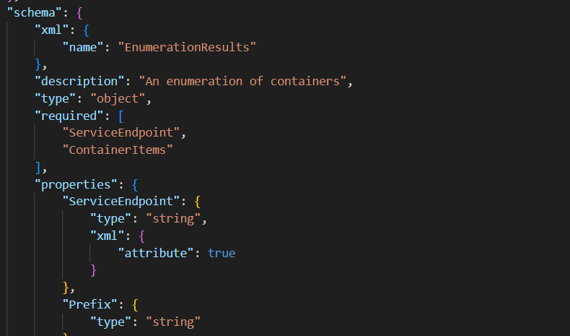
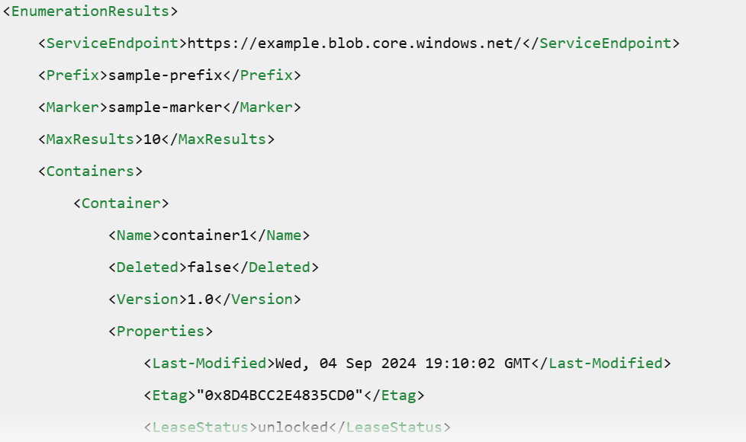
Lessons Learned in Prompt Engineering
Break your questions into multiple smaller questions
/Results/Container[Name='testcontainer]/Version/text()"
Swagger
Generated XML conforms to the swagger
Generated Xpath expression

Slide 88
Lessons Learned in Prompt Engineering
Remove prompts from your performance-critical or repeated computation paths as it can be expensive and a bottleneck
Structured outputs enhance accuracy and usability of the results
Use LLM interfaces
Specify the output in the prompt

Slide 89
Summary
Define the research problem
Explored and implemented three solutions
Run the prototype on one cloud service
Thanks everyone for supporting me during the internship!

