Slide 1
Synthetic Difference-in-Differences
American Economic Review
Arkhangelsky, Athey, Hirshberg, Imbens & Wager (2021)
Lauren Taylor
1 / 10

Slide 2

The Research Question
Did California's Proposition 99 cigarette tax reduce smoking?
Proposition 99 (1989) raised California's cigarette tax by 25 cents per pack.
The paper asks: how large was the causal effect on per-capita cigarette sales?
The challenge:
California is the only treated unit.
2 / 10
Notes:
- With just one state treated, standard regression and DiD struggle to isolate cause from coincidence — you can't easily tell whether smoking fell because of the tax or because of some other California-specific trend.

Slide 3
Other Methods
Synthetic Control
Difference-in-Differences
Builds a fake 'California' as a weighted average of other states that matched California's pre-1989 smoking trend
Produces no standard errors, so you can't test statistical significance.
Compares the before-vs-after change in California to the before-vs-after change in other states
Assumes all states would have trended identically without the tax

Slide 4
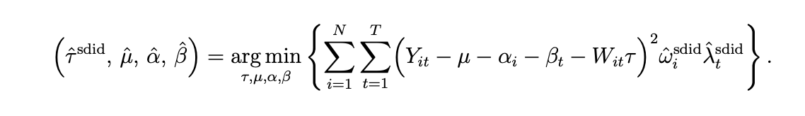
The Method: Synthetic Difference-in-Differences (SDID)
Does both at once: reweights control states AND time periods so that the comparison group closely matches California's pre-1989 trend, then applies DiD.
4 / 10
Notes:
Gets the best of both worlds: good balance AND formal inference.

Slide 5
The Data
39
31
1
U.S. States
Years (1970–2000)
Treated State (CA)
Key variables
Outcome: PacksPerCapita — annual per-capita cigarette sales (packs/year)
Treatment: binary indicator = 1 for California from 1989 onward, 0 otherwise
Pre-treatment period: 1970–1988 (19 years) Post-treatment period: 1989–2000 (12 years)
5 / 10

Slide 6
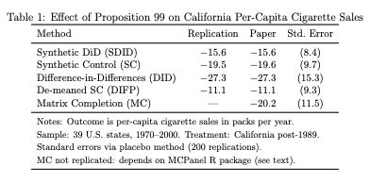
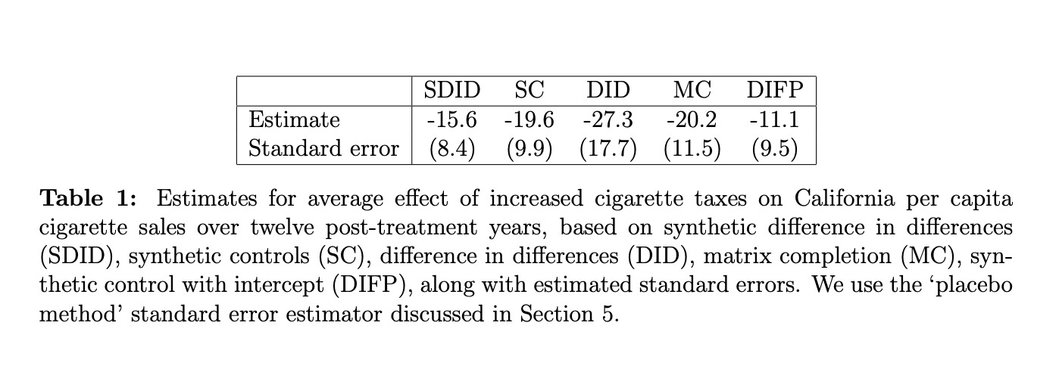
Table Replication
My Results:
The Paper’s Results
Proposition 99 reduced cigarette smoking by ~15.6 packs per person per year.
That is about 1.3 fewer packs per month — a meaningful reduction.
6 / 10
Notes:
Tab
SDID's estimate is the most credible because it directly tests and corrects for pre-trend imbalance.

Slide 7
Challenges + Conclusion
Challenges encountered
No Python package · Implemented from scratch · MC not replicable · Slow standard errors
1
Proposition 99 reduced smoking by ~15.6 packs/person/year — a real, meaningful effect.
2
SDID is more credible than DiD or SC alone because it earns the parallel-trends assumption rather than assuming it.
3
Need for working Python replication packages.
10 / 10
Notes:
Conclusion:
• Proposition 99 reduced smoking by ~15.6 packs/person/year — a real, meaningful effect.
• Estimator choice matters enormously: estimates range from −11 to −27 across five methods.
• SDID is more credible than DiD or SC alone because it earns the parallel-trends assumption rather than assuming it.
• Full replication revealed a gap: 'code is available' ≠ 'code reproduces the results' — especially across languages.
Challenges encountered during replication:
• No Python package — Authors only released an R package. Two Python ports exist but one fails to install and the other uses a different regularization method, shifting the estimate from −15.6 to −19.8.
• Implemented from scratch — Had to translate the authors' R source code (R/solver.R) line-by-line into NumPy to reproduce the correct estimate.
• MC not replicable — Matrix Completion requires a separate R package with no Python equivalent.
• Slow standard errors — Placebo SE reruns the full algorithm 200 times — about 30 seconds per estimator.

