Slide 1
Play with Java Lambda Lab #6 COMP3021 2022 Spring ChengPeng Wang(cwangch@cse.ust.hk) Yiyuan Guo(yguoaz@cse.ust.hk) Bowen Zhang(bzhangbr@cse.ust.hk) Heqing Huang(hhuangaz@cse.ust.hk)

Slide 2
Objectives of this lab
Write Lambda Expression
AND/OR operations on Predicate
Higher order function
Reduce/Map on List

Slide 3
Prior Knowledges
Lambda Expression
a -> a + 1
(<parameter list>) -> (<statements>)
If we only write 1 line in <statements>, then Java regards this as a return statement
Predicate<T>
A set of lambda expressions
Input: an object of type T
Output: a Boolean value
Higher order function
A function that receives functions as parameters
A function that returns a new function
Both …
Reduce/Map
Reduce: aggregation on List(sum, max, min, …)
Map: modify each elements in List using same pattern.
Recall Excel functions

Slide 4
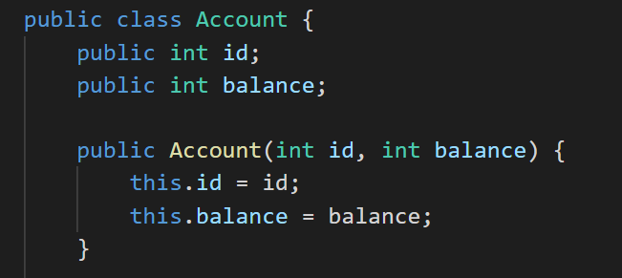
Background
We have an Account Class, representing bank accounts for customers.

Slide 5
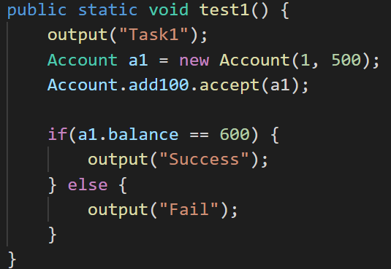
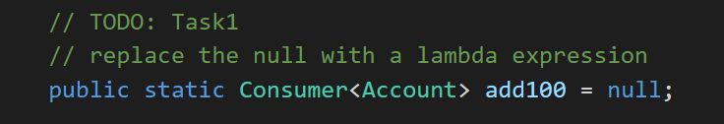
Task#1
Implement add100 by writing a lambda expression.
Its functionality:
It receives an Account object, and increase the balance by 100.
Account.add100.accept(a1);

Slide 6
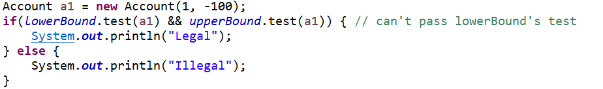
Task#2
We defined 2 Predicates to check whether a bank account is legal.
This is how we used them.

Slide 7
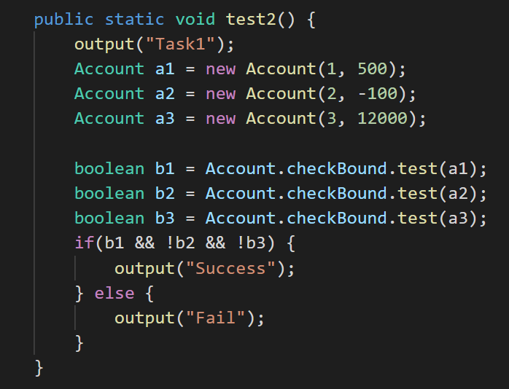
Task#2
However, what if we want to “combine” this 2 Predicates into 1?
Your task is to define checkBound using BOTH LowerBound AND upperBound.
Replace the null with an expression.

Slide 8
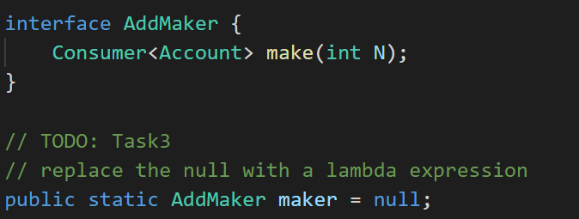
Task#3
Remember in Task#1 we implement an add100. Which can increase the balance of an account by 100. But we want to make it more flexible.
Define maker which has Type AddMaker. It takes a number N as input, and returns a function that behaves like addN.
With maker, we can define add1000 and sub1000 like this:

Slide 9
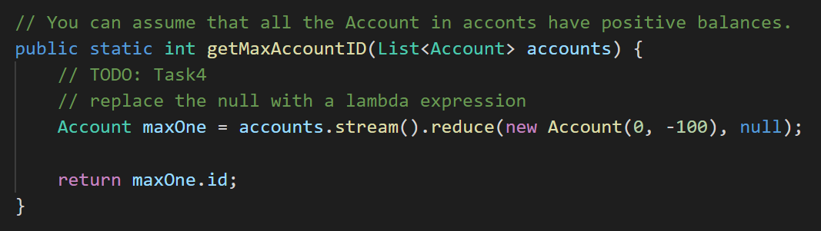
Task#4
Complete getMaxAccountID method. It takes a List of Account objects, and returns the id of the object with maximum balance.

Slide 10
Test your code
Use testLab6.java to test your code. By reading it you can understand the tasks better.

Slide 11
END OF LAB #6
Don’t forget to commit and push your code.

