Slide 1
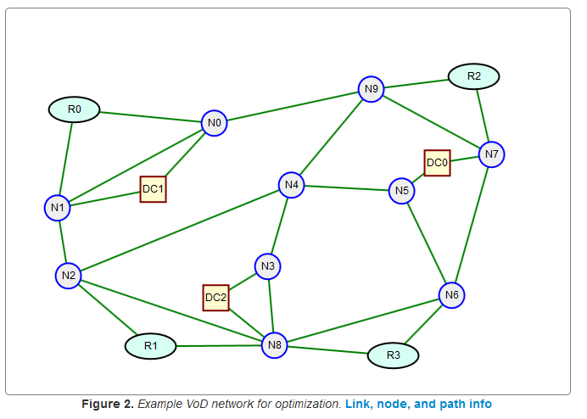
Discrete Event Simulation: An Overview
Dr. Greg Bernstein
Grotto Networking
www.grotto-networking.com

Slide 2
Outline (Tentative)
What is Simulation? Why Simulate? Types of Simulation?
Discrete Event Simulation
Discrete Event Network Simulators
Discrete Event Simulation with SimPy
Key classes: Environment, Event, Process, Resource/Store
M/M/1 Queue
M/M/1/k Queue (packet loss)
M/M/k/k Queue (blocking)

Slide 3
References
L. F. Pollacia, “A Survey of Discrete Event Simulation and State-of-the-art Discrete Event Languages,” SIGSIM Simul. Dig., vol. 20, no. 3, pp. 8–25, Sep. 1989.
Read sections 1 and 2. SimPy uses the “process interaction world view”
E. Weingartner, H. Vom Lehn, and K. Wehrle, “A performance comparison of recent network simulators,” in Communications, 2009. ICC’09. IEEE International Conference on, 2009, pp. 1–5.
SimPy
http://stefan.sofa-rockers.org/2013/12/03/how-simpy-works/
http://stefan.sofa-rockers.org/2014/01/20/simpy-environments/
https://simpy.readthedocs.org/en/latest/contents.html

Slide 4
Simulation
Definition
The process of modeling a proposed or real dynamic system and observing its behavior over time.
Key Steps
Model Development: figuring out what to including and exclude!
Experimentation
[Pollacia 1989]

Slide 5
Systems and Models
System
A collection of entities that interact and operate to accomplish some logical end. In our case some type of network.
Model
A representation of the real system that includes entities of the system and the behavior and interactions of those entities. Models are constructed to emphasize certain aspects of the system while ignoring others, based upon the goals of the study.
Validation is the process of insuring that the model represents the real system to a certain degree of accuracy.
[Pollacia 1989]

Slide 6
Why Simulate?
Most complex real-world systems cannot be modeled using a mathematical model that can be evaluated analytically.
Simulation provides estimations of performance of a system for new policies, parameters, or operating conditions.
Alternative proposed designs can be compared and evaluated.
Simulation allows experimentation without disturbing the real system.
The system can be studied using different time frames such as compressed time to speed up a study, or expanded time to observe details of a study.
[Pollacia 1989]

Slide 7
Issues with Simulation
Simulation models are often expensive and difficult to develop.
Many simulation models contain stochastic parameters and only produce estimates of a system’s true nature.
Simulation modeling can be used to compare alternatives, but not to find the optimal solution to a problem.
Simulation requires that the model must be a valid representation of the system for the output results to be accurate.
Simulation runs may be lengthy and expensive in terms of computer resources.
[Pollacia 1989]

Slide 8
Types of Simulation
Discrete (Discrete Event)
Changes to the state of the model can occur only at countable points in time.
Continuous
Changes to the state occur smoothly and continuously in time. Typically defined by differential or difference equations. Examples: analog circuit simulation, digital signal processing
Hybrid
Combines both. For example the simulation of “switching” power supplies.
[Pollacia 1989]

Slide 9
Discrete Event Simulation (DES)
System State
The system is composed of entities, each of which may have various attributes. The system state is the collection of all these attributes.
An event is an instantaneous occurrence in time that may alter the state of the system.
An event initiates an activity, which is a length of time (may be zero) during which entities engage in some operation.
A process is a sequence of events that may encompass several activities.
[Pollacia 1989]

Slide 10
DES World Views
Event Scheduling
The model contains events and is concerned with their effecton system states. Each type of event has a corresponding event routine that is called by the simulation executive. The simulation “calendar” contains a list of unconditional events.
Activity Scanning
Process Interaction
The simulation consists of a set of processes, rather than events or activities. Generally the most intuitive.

Slide 11
“Open Source” DES Simulators
ns-3 (and ns-2)
ns-3 is a discrete-event network simulator for Internet systems, targeted primarily for research and educational use.
Omnet++
OMNeT++ is a discrete event simulation environment. Its primary application area is the simulation of communication networks, …
SimPy
SimPy is a process-based discrete-event simulation framework based on standard Python.

Slide 12

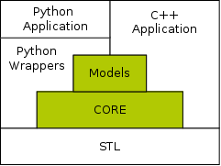
ns-3
ns-3 is a C++ library which provides a set of network simulation models implemented as C++ objects and wrapped through python.
Users normally interact with this library by writing a C++ or a python application which instantiates a set of simulation models to set up the simulation scenario of interest, enters the simulation mainloop, and exits when the simulation is completed.
http://www.nsnam.org/overview/key-technologies/

Slide 13


OMNeT++
OMNeT++ provides a component architecture for models. Components (modules) are programmed in C++, then assembled into larger components and models using a high-level language (NED). Reusability of models comes for free. OMNeT++ has extensive GUI support, and due to its modular architecture, the simulation kernel (and models) can be embedded easily into your applications.
Simulation Model Examples
The INET Framework contains models for several wired and wireless networking protocols, including UDP, TCP, SCTP, IP, IPv6, Ethernet, PPP, 802.11, MPLS, OSPF, and many others.
http://omnetpp.org/

Slide 14
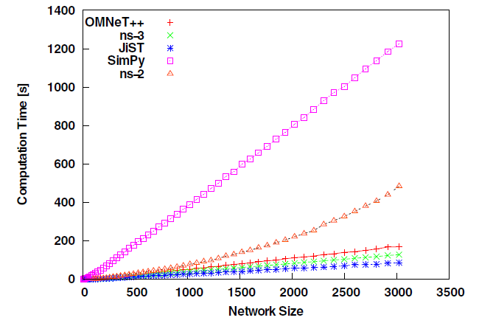
Overview and Comparison
E. Weingartner, H. Vom Lehn, and K. Wehrle, “A performance comparison of recent network simulators,” in Communications, 2009. ICC’09.
Performance Comparison:

Slide 15
Process Oriented Simulation Approaches
OS Process per Simulated Process
Very heavy weight since each process gets its own memory space.
processes interact only through system-provided inter-process communication mechanisms
A Thread per Simulated Process
context switching between threads in the same process is typically faster than context switching between processes.
threads share their address space making communication easier but a bit more dangerous
A Coroutine per Simulated Process
https://en.wikipedia.org/wiki/Coroutine
“threads are typically preemptively scheduled while coroutines are not.”
Natively supported by: JavaScript (1.7 Firefox & Chrome), Python, Ruby
Not natively supported in Java, C, or C++. Libraries do exist though.

Slide 16
Coroutines
“Coroutines are computer program components that generalize subroutines to allow multiple entry points for suspending and resuming execution at certain locations. Coroutines are well-suited for implementing more familiar program components such as cooperative tasks, exceptions, event loop, iterators, infinite lists and pipes.”
In Python 2.7 we have “generators” which come very close.
SimPy will deal with the difference and provide a complete simulation environment

Slide 17
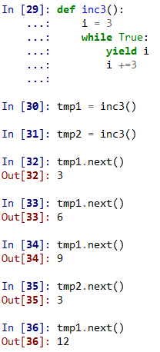
Python Generators I
A function or method which uses the yield statement is called a generator function.
Such a function, when called, always returns an iterator object which can be used to execute the body of the function: calling the iterator’s next() method will cause the function to execute until it provides a value using the yield statement.
When the function executes a return statement or falls off the end, a StopIteration exception is raised and the iterator will have reached the end of the set of values to be returned.
Python 2.7 documentation section 5.2.10

Slide 18
Python Generators II
When a generator function is called, it returns an iterator known as a generator. That generator then controls the execution of a generator function.
The execution starts when one of the generator’s methods is called. At that time, the execution proceeds to the first yield expression, where it is suspended again, returning the value of expression_list to generator’s caller.
By suspended we mean that all local state is retained, including the current bindings of local variables, the instruction pointer, and the internal evaluation stack.
When the execution is resumed by calling one of the generator’s methods, the function can proceed exactly as if the yield expression was just another external call. The value of the yield expression after resuming depends on the method which resumed the execution.
Python 2.7 documentation section 5.2.10

Slide 19
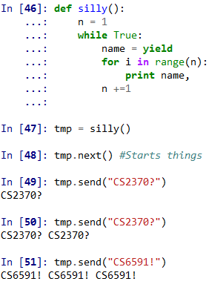
Python Generators III
All of this makes generator functions quite similar to coroutines; they yield multiple times, they have more than one entry point and their execution can be suspended.
The only difference is that a generator function cannot control where should the execution continue after it yields; the control is always transferred to the generator’s caller.
Methods
generator.next()
generator.send(value)
generator.throw(exception)
generator.close()
Python 2.7 documentation section 5.2.10

Slide 20
JavaScript Generators are Similar
Not just for “Simulation” but also
Sequential, blocking I/O: http://taskjs.org/
Games
http://jlongster.com/2012/10/05/javascript-yield.html
http://domenic.me/2013/09/06/es6-iterators-generators-and-iterables/
http://wiki.ecmascript.org/doku.php?id=harmony:generators

Slide 21
SimPy (version 3)
Includes
Simulation Environment
Keeps track of time and which process or event happens next. Has a single step option.
Process based model
Event hierarchy
Used with processes, resources, etc…
Resource models: Resource, Store, etc…
Resource models a fixed pool of one or more resources
We can use to model servers, time slots, trunks…
Store models a FIFO of items

Slide 22
M/M/1 Queue in SimPy I
Entities
Packets: objects of our simple Packet type
packet_generator: generator function for packet generation process
packet_consumer: generator function modeling the sending of a packet on the link, “consumption” of packet from the queue.
Store: to model the output FIFO on a switch
Environment: the simulation environment

Slide 23
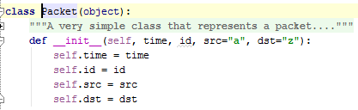
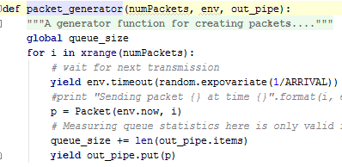
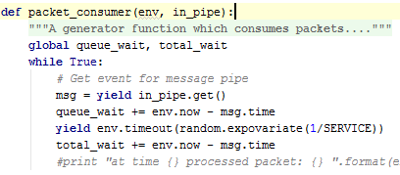
M/M/1 Queue in SimPy II
Added functions and classes
Creates a new Timeout event and “yields” it to the simulator

Slide 24
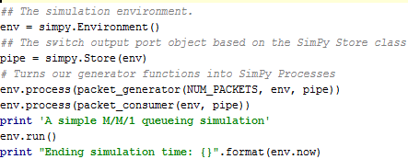
M/M/1 Queue in SimPy III
Main program
Plus additional code to print out results from simulation

Slide 25
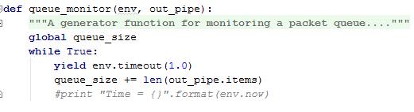
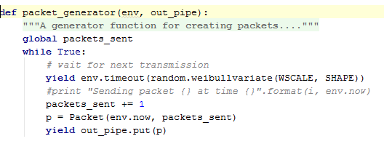
Weibull/M/1 Queue I
Monitor queue size explicitly:
Create packets indefinitely:

Slide 26
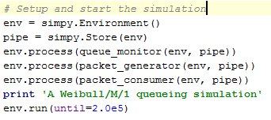

Weibull/M/1 Queue II
Run simulation for a limited amount of time:
Print results:

Slide 27
The SimPy Store Resource
Models the production and consumption of concrete Python objects.
Items put into the store can be of any type. By default, they are put and retrieved from the store in a first-in first-out order.
The capacity defines the size of the Store and must be a positive number (> 0). By default, a Store is of unlimited size.
Put operation (Event)
Used to put items into the store, if the capacity has be reached the caller will be “blocked” and its put request will be appended to the “put queue”.
Get operation (Event)
Used to get items from the store. If the store is empty the caller will be “blocked” and put on the “get queue” until there is an item to be retrieved.
https://simpy.readthedocs.org/en/latest/api_reference/simpy.resources.store.html

Slide 28
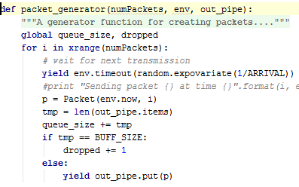
Simulating an M/M/1/N Queue
How to model a finite buffer in SimPy?
Finite capacity Store will “block” the packet generator…
We can just check the current size of the Store queue and determine if there is room
Get current queue size
If buffer at capacity, drop the packet.

Slide 29
Modeling a Limited Pool of Resources
The SimPy resources.Resource
Contains a finite pool of resources can be used by a limited number of processes at a time. Processes request these resources to become a user (or to own them) and have to release them once they are done.
A resource has a limited number of slots that can be requested by a process. The capacity defines the number of slots and must be a positive integer.
Request
Requests one of the slots, if none are available then it will be “blocked” and put in a “request queue”.
Release
Returns a slot back to the pool for use by other requesting entities.

Slide 30
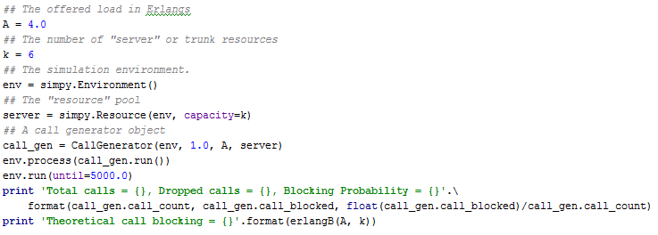
Simulating a M/M/1/k/k System
Want to investigate blocking probabilities
Need a shared pool of resources. We call this “server” below.
Need to generate “calls” that will use those resources for an exponentially distributed amount of time. This is done in the CallGenerator object call_gen.

Slide 31
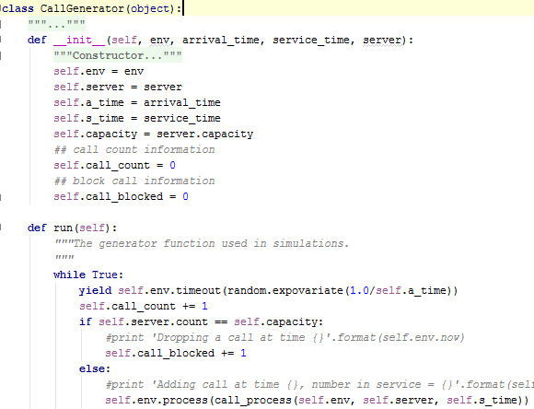
Simulating a M/M/1/k/k System II
CallGenerator
Keeps statistics and such…
Put “dynamic” behavior into its run() method
run() checks server usage to determine if next call is blocked.

Slide 32
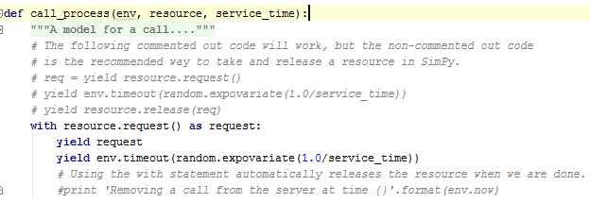
Simulating a M/M/1/k/k System III
call_process() function
Models a call requesting, holding and then releasing an individual resource.
Note that the CallGenerator class makes sure that the request is always granted

