Slide 1
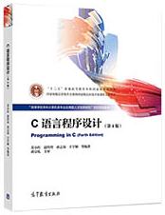


Programming in C

Slide 2
Textbook、Reference Reading and
Course arrangement
  Textbook
  《C语言程序设计(第4版)》
  苏小红等编著 高等教育出版社
  Reference Reading
  《C程序设计(第四版)》
  《 The C Programming Language 》
  Brian W.Kernighan ，清华大学出版社
  Course arrangement
  Teaching hours：44 hours
  Practice hours：20 hours

Slide 3

Grading system
Final exam（50%）
Projects（20%）
Homework and Quizz: （30%）

Slide 4
What I expect from you as a student:
  Show up for class on time
  Have already read the corresponding part of the textbook
  After the class meets, go over the material again
  Do your own homework by yourself (On time)
  Practice
  Work at a steady pace throughout the semester instead of in frantic bursts just before the final exam.

Slide 5
Chapter 01
Why do we learn C language

Slide 6
Learning content
The History of C Language
What is“Programming”
  requirements analysis, design, programming
  write code, compile, execute
3. Understanding Simple C Programs
  main function
  statement

Slide 7
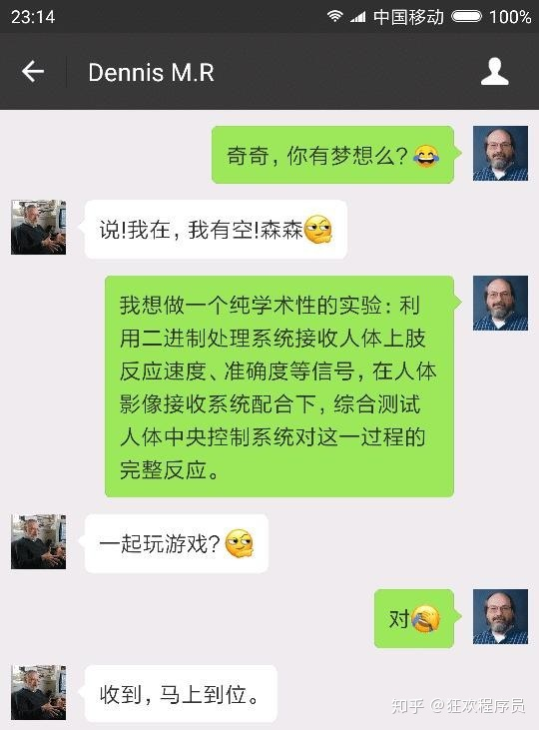

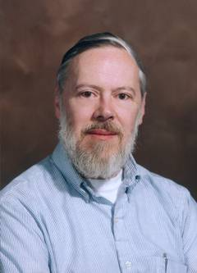
Two hardcore gamers
Ken Thompson
江湖人称 ken
Dennis M. Ritchie
江湖人称 dmr

Slide 8
What did they do ？
In 1969, ken and dmr dreamed of traveling in the universe
Ken designed a game——Space Travel, but only found a PDP-7 computer without an operating system.
This can't stop the determination to play games. To play games, Ken started writing an operating system for PDP-7.
In 1970, in order to play games faster, Ken designed B language based on BCPL language, and used it to design the first UNIX operating system.
But the game hasn't been played yet, because the inherent features of B language can't support UNIX's great dream.
Notes:
机器语言：用0、1组合编写计算机指令，让计算机干活，不同的0、1序列代表不同的含义；
编程语言：定义人类好理解的语言，然后做一个“翻译程序”，即编译器，用编译器将程序翻译成0、1序列构成的机器指令让计算机执行

Slide 9
What did they do ？
DMR is mainly responsible for improving B language.
In 1972, C language, which was designed on the basis of B language, was officially born-God's programming language.
DMR and Ken can't wait to completely rewrite UNIX in C.
In 1983, because of the great success of UNIX and C, Ken and DMR jointly won the Turing Award——the highest award in the computer industry that year

Slide 10
C Programming Language
A high-level language
  并不“高级”，只是相对低级语言在一个高的级别上进行编程
  实际上是一种介于高级语言和低级语言之间的语言
Has a long history
  诞生于20世纪70年代初，成熟于80年代
  很多重量级软件都是用C语言写的
From heaven to earth, omnipotent
  几乎没有不能用C语言实现的软件，没有不支持C语言的系统
Many popular languages and new languages have borrowed its ideas and grammar
  从C++，到Java，再到C#

Slide 11
What is fit to do
The standard of choosing a language is that what is suitable is the best
  Write the operating system and basic tools
  Systems that require high operational efficiency
    设备驱动程序，高性能、实时中间件，嵌入式领域，并发程序设计等
  Inheriting and Maintaining Existing C Code
  The most common language in communication, written test and interview

Slide 12
Software development process
需求分析（Analysis）
  该做些什么？
设计（Design）
  使用的方法和结构？
编码（Write）
  Do it!
测试（Test）
  找错!
维护（Maintenance）

Slide 13
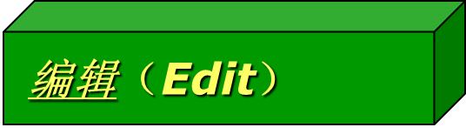
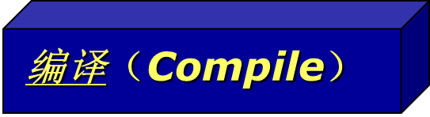
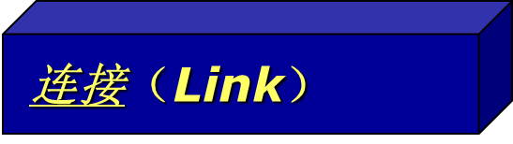
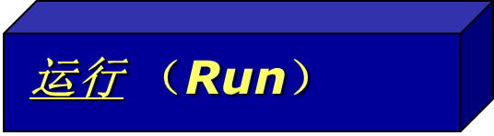
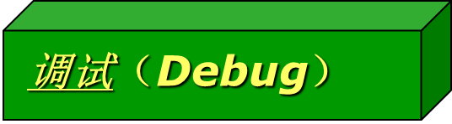
Program development steps
  Do it!
编码（Write）
人的工作
  书写扩展名为.c的源程序文件
计算机的工作
  根据语法规则检查源文件，无误后生成扩展名为.obj 的目标文件
计算机的工作
  生成扩展名为.exe的可执行文件
计算机的工作
人的工作
如果运行结果不对，通过调试工具寻找并修改错误
Notes:
编译器（Compiler）把源代码转换为可被计算机理解的机器代码，把机器代码以可执行文件（Executable File）的形式保存在磁盘上，一种程序设计语言对应一种编译器

Slide 14
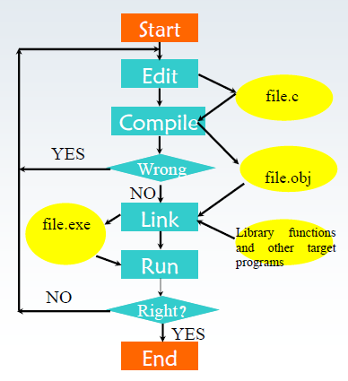
Steps of developing C program
1. Write program source code
2. Compile and Connect
3. Debug the program until all compilation errors and run errors are corrected
4. Run program

Slide 15
Compiling Environment of C Program
Visual C++
  Windows平台上最流行的C/C++集成开发环境之一
Code::Blocks（简称CB，http://www.codeblocks.org）
  是近年出现并获得关注的C/C++开发环境
  CB的功能远远优于TC，也优于VC 6.0
  CB只是一个IDE（集成开发环境），没有内置的编译器和调试器
  但可以支持多种编译器（不包括TC），例如GCC编译器和GDB调试器
Turbo C 2.0及更高版本 （或WIN-TC）
  现已少用

Slide 16
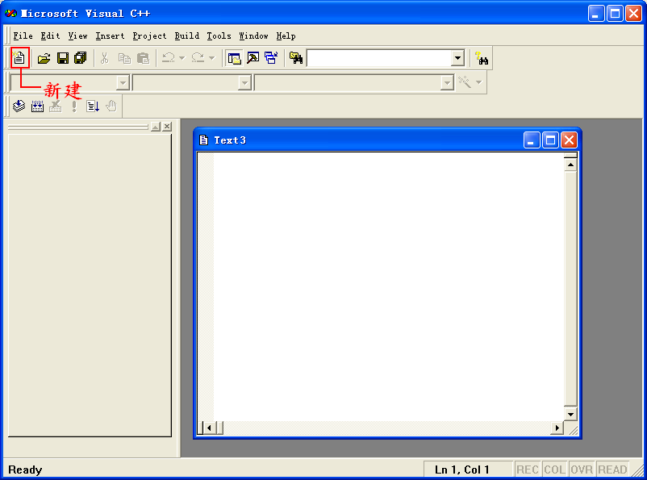
VC++ 6.0的初始界面

Slide 17
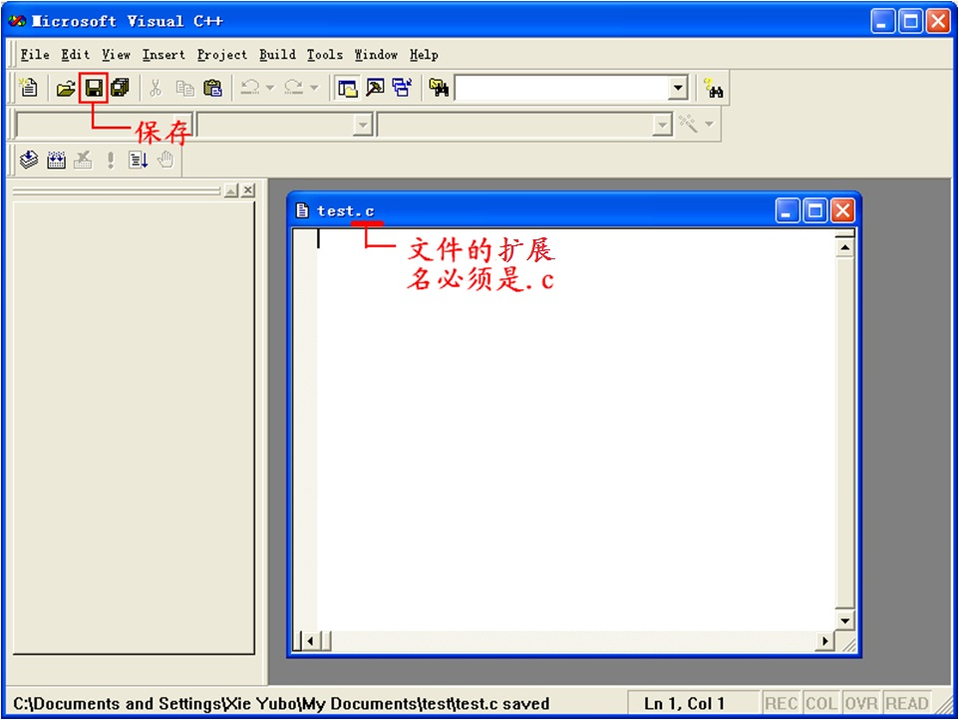

Slide 18
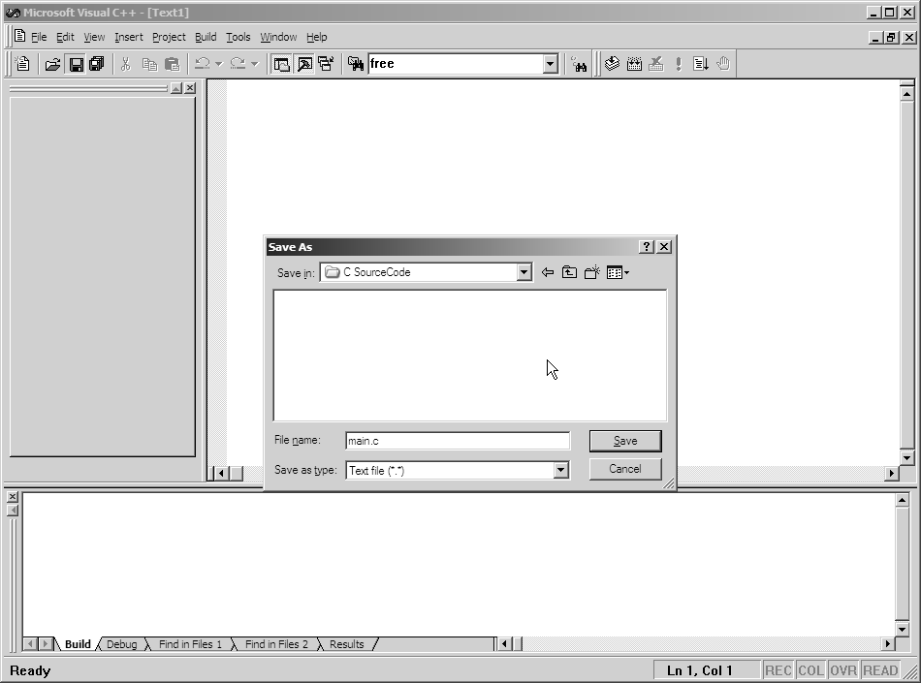
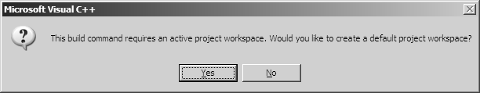
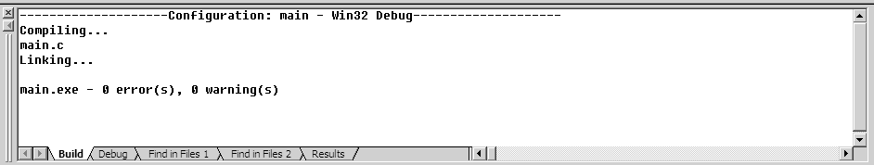
保存文件
运行
建立新文件
编译
在编译之前，VC先弹出对话框，询问是否建立一个默认的项目工作区。VC必须有项目才能编译，所以这里必须选择“Yes”。系统在保存.c文件的目录里自动生成与C源文件同名的.dsw和.dsp等文件。以后可直接打开这些文件来修改程序，不必再重复上面的过程

Slide 19
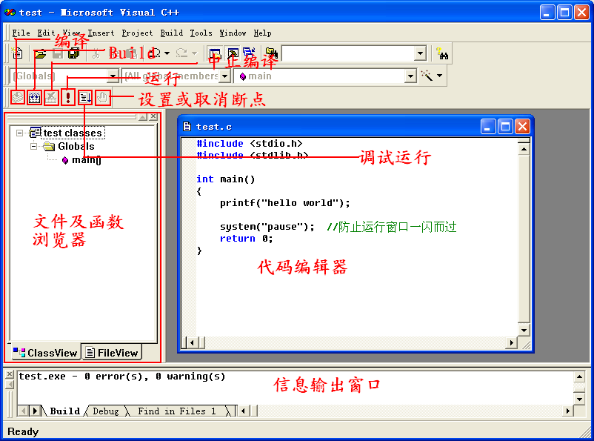

Slide 20
Introducing C
In the c program, the annotation starts with "
/ *" and ends with " * /", so that multiple
lines of annotation can be realized. In a c + +
Program ,You can also use " / /" for single-
line comments.
Preprocessing commands for c language begin with the " #".
Stdio. h is a header file
C program allows the insertion of several lines of empty
lines, it does not affect the function of the program, like
annotation. For readability of the program, in When
writing c program, can insert a certain blank line as
needed.
Example1: simple C program。
Annotation information
/* This is the first C program */
#include <stdio.h>
void main ( )
{
printf (“This is a C program!\n");
}
Preprocessing command
No return value
Main function with no parameter and no return value
the statement ends with a semicolon
Function name
Main is the name of the main function, and a C
program has one and only one main function. C
program execution time is start from the main
function, specifically from the "{", to the end of the"} ".
Function start
Internal function name
Carriage return line character
A function call
The
function
body
Parameter
End of statement mark
Printf is the internal function name of the c language because it
follows ( ), its work is display the " this is a c program! \ n " on
the computer's screen ( Dual Quotes and \ n not shown )
Function end
The results： This is a C program!

Slide 21
结构特点
    function
      A program consists of one or more functions
      There must be and can only be one main function
      Program execution begins in main and ends in main, and other functions are executed through nested calls
    Program statement
      C program consists of statements
      Use ";" As a statement terminator
    annotation
      /* */is a comment and cannot be nested
      No compiled code is generated

Slide 22
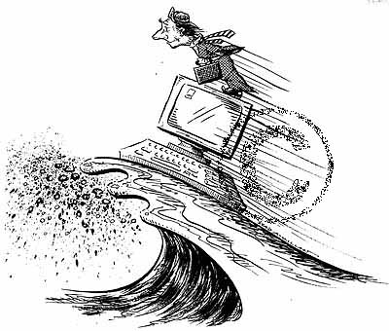
How to Learn Programming Well？
Read more
Write more
Be good at using the tools and environment around you
Knowlegde, Practice, Skill

