Slide 1
Lake Washington Chapter
10 Anniversary Celebration
Banquet

Slide 2
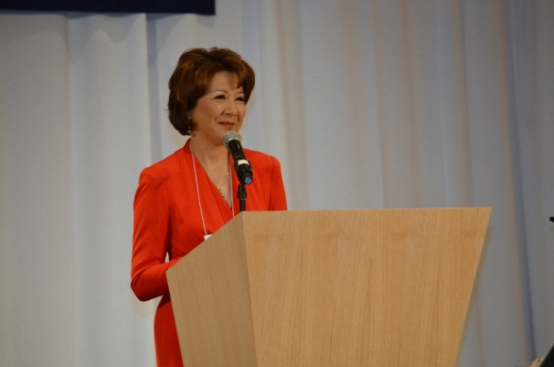
Master of Ceremony – Lori Matsukawa

Slide 3
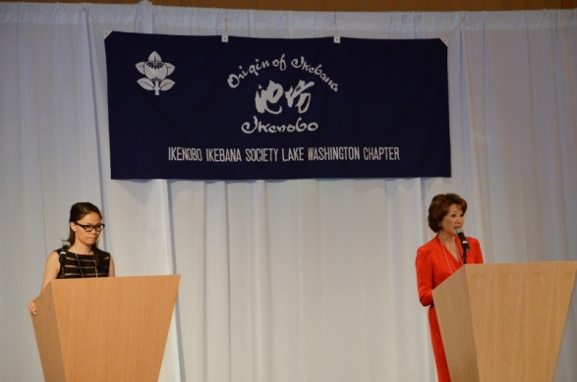
Chapter Member Keiko Arakane - translating

Slide 4
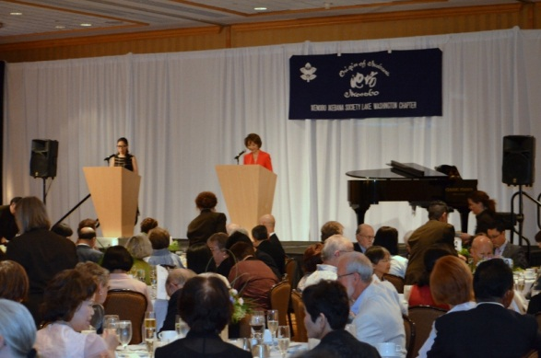

Slide 5
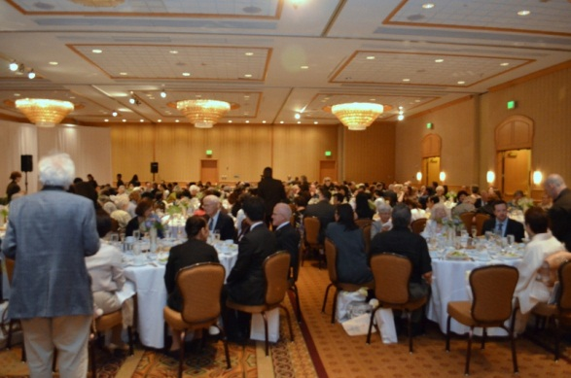

Slide 6
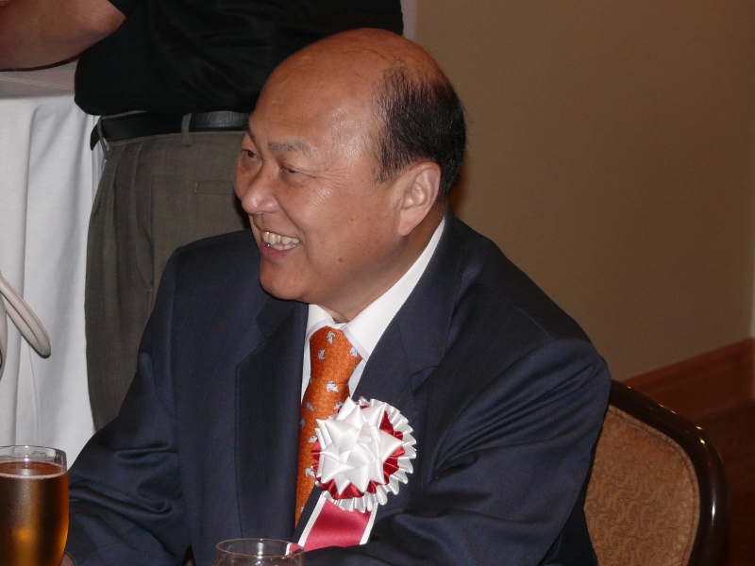
Headmaster Sen’ei Ikenobo

Slide 7
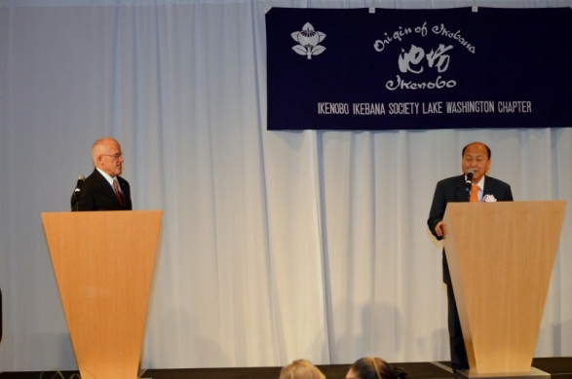
Headmaster Sen’ei Ikenobo speaking with Mr. Kenneth Jones translating

Slide 8
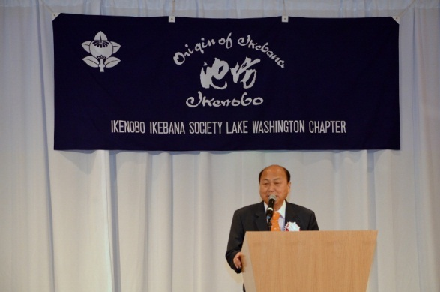

Slide 9
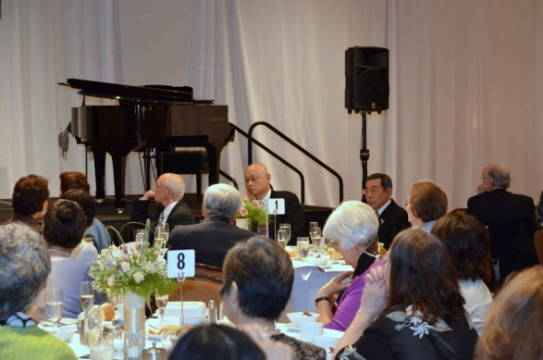

Slide 10
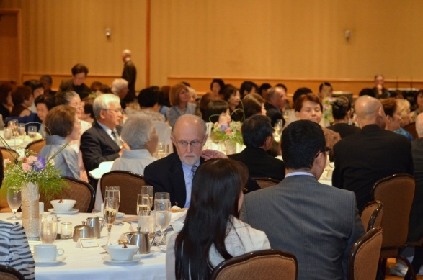

Slide 11
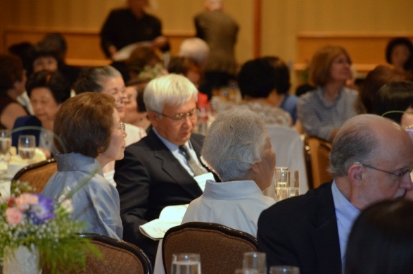

Slide 12
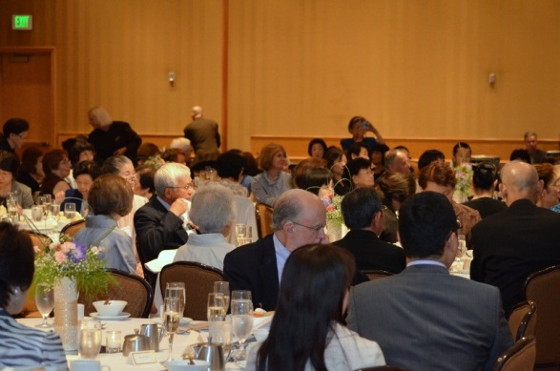

Slide 13
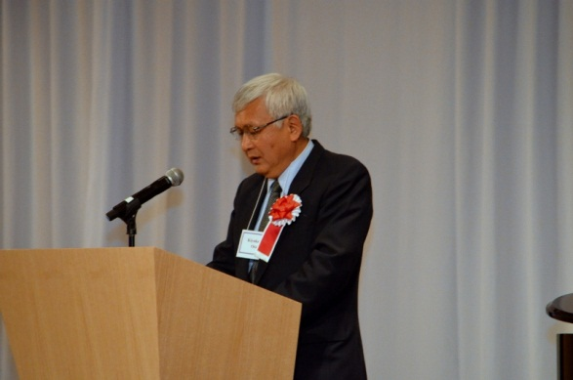
Consul General of Japan-Seattle Kiyokazu Ota speaking

Slide 14
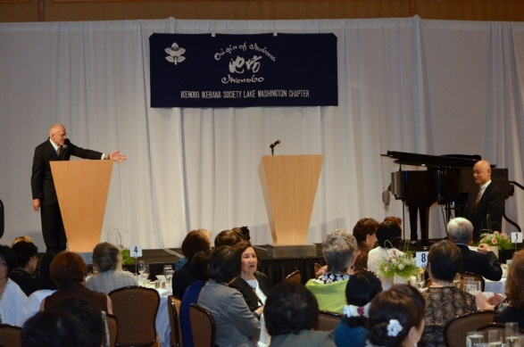
Professor Shinichi Shimizu invited to speak

Slide 15
Professor Shinichi Shimizu invited to speak

Slide 16
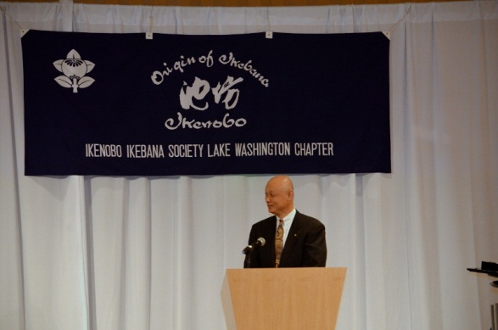
Professor Shinichi Shimizu speaking

Slide 17
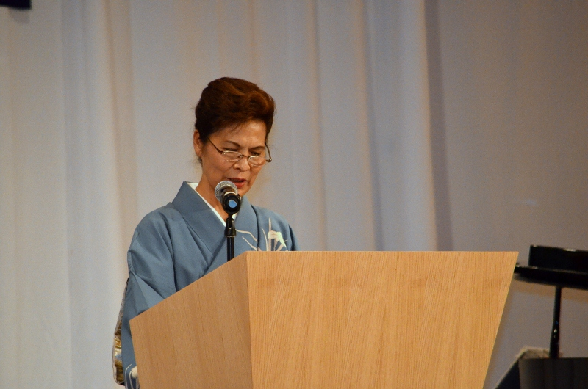
Professor Nobu Kurashige speaking

Slide 18
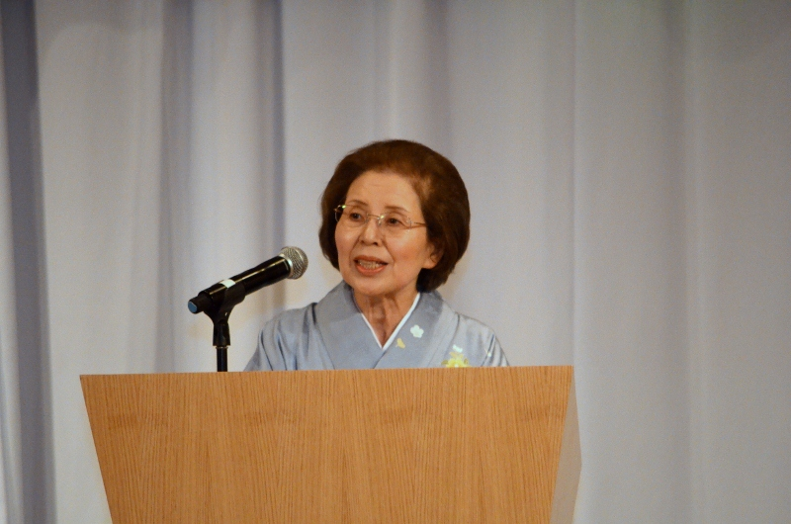
Chapter President Shigeko Price speaking

Slide 19
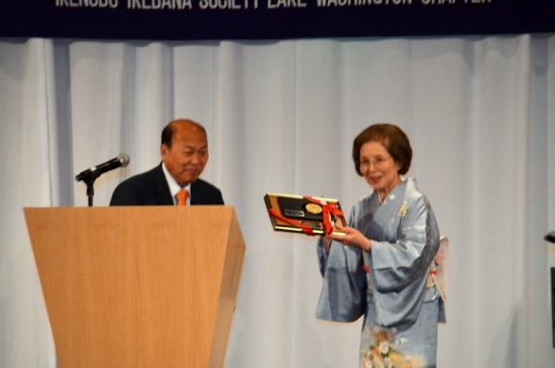
Chapter President Shigeko Price receiving plaque from Headmaster Sen’ei Ikenobo

Slide 20
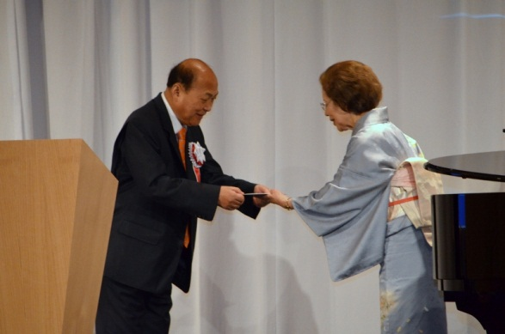
Chapter President Shigeko Price receiving honorarium from Headmaster Sen’ei Ikenobo

Slide 21
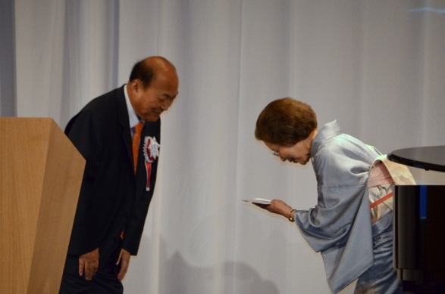
Chapter President Shigeko Price receiving honorarium from Headmaster Sen’ei Ikenobo

Slide 22
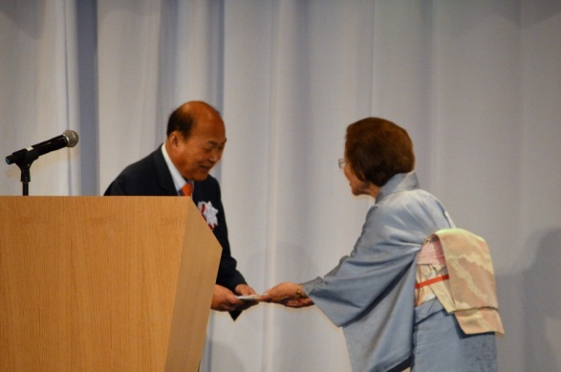
Chapter President Shigeko Price presenting honorarium from Headmaster Sen’ei Ikenobo

Slide 23
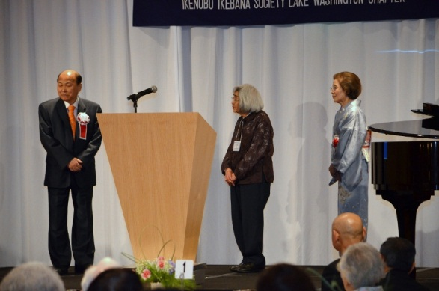
Chapter member Kazuko Bill awarded Longevity Award from Headmaster Sen’ei Ikenobo

Slide 24
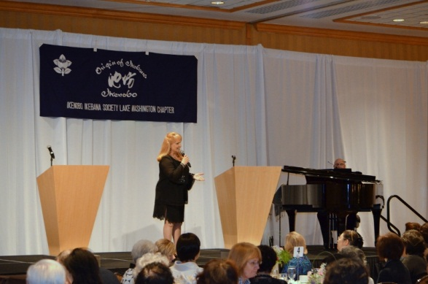
Entertainer Judy Ann Moulton

