Slide 1
Lake Washington Chapter 10th Anniversary Celebration
Demonstration by Headmaster Sen’ei Ikenobo
and Professor Shinichi Shimizu

Slide 2
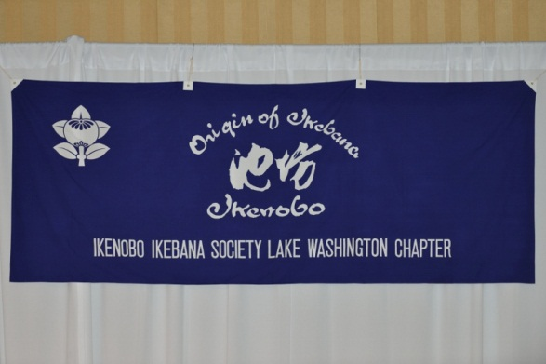

Slide 3
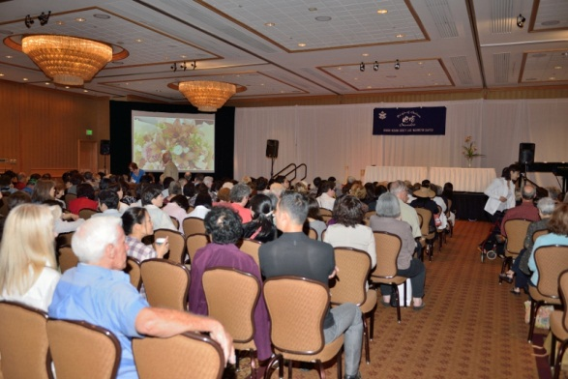
Demonstration Audience

Slide 4
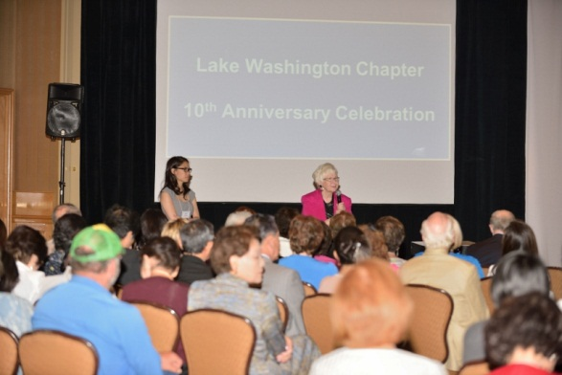
Introduction by Elaine Stamm with Keiko Arakane translating

Slide 5
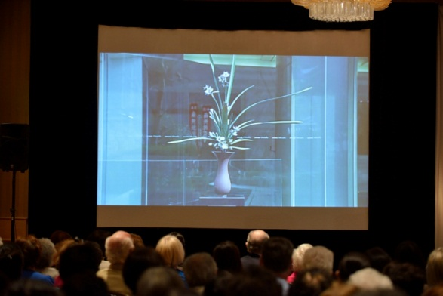
DVD of Ikenobo History

Slide 6
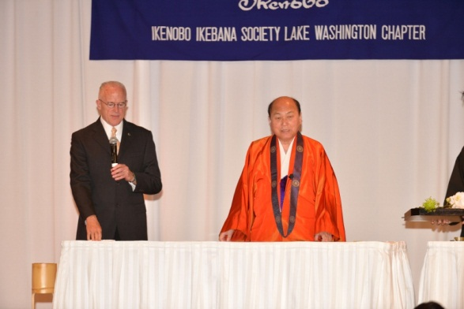
Headmaster Sen’ei Ikenobo with Mr. Kenneth Jones translating

Slide 7
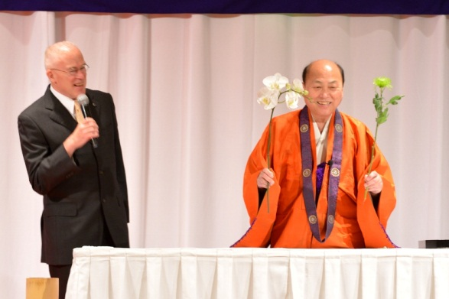

Slide 8
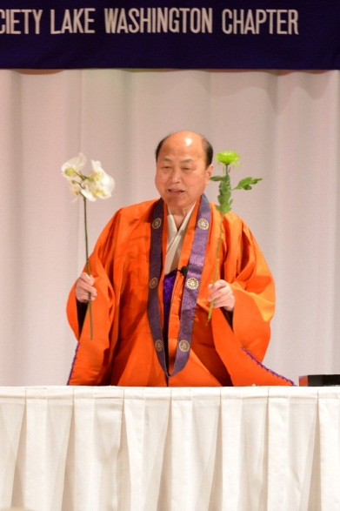

Slide 9
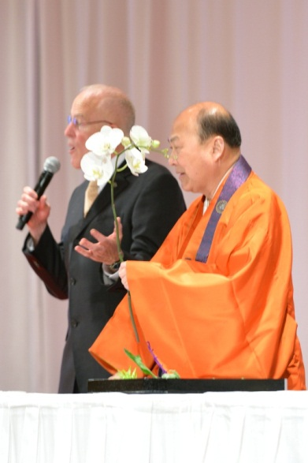

Slide 10
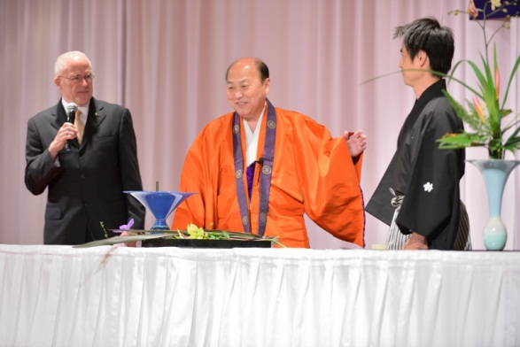
Headmaster Sen’ei Ikenobo with Mr. Jones and assistant, Mr. Sakaguchi

Slide 11
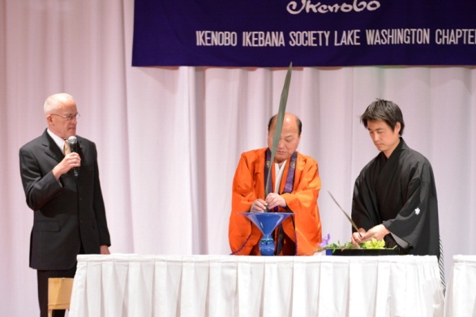

Slide 12
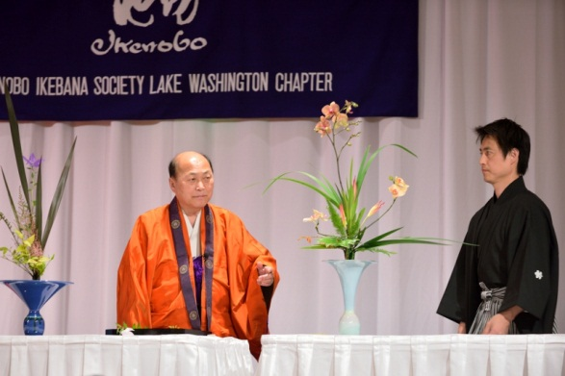

Slide 13
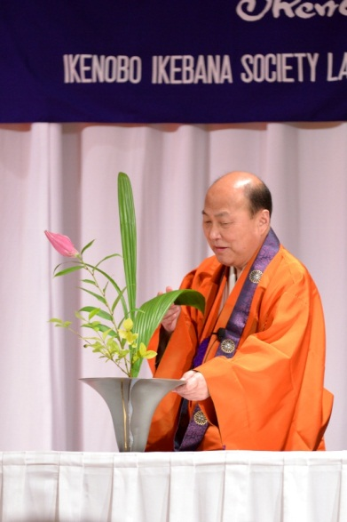

Slide 14
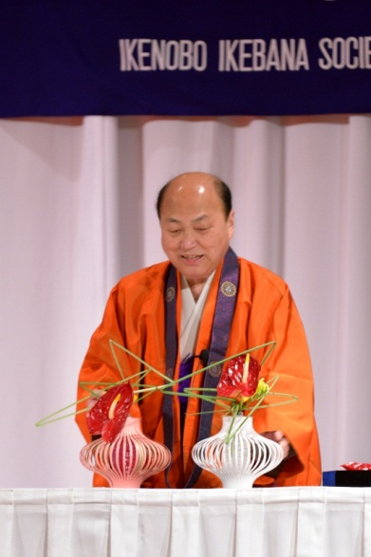

Slide 15
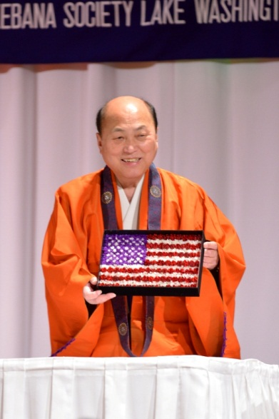
Headmaster Sen’ei Ikenobo shows American flag made from flowers

Slide 16
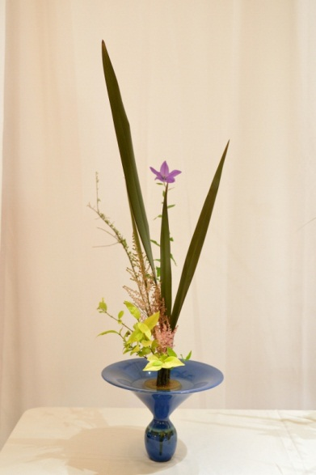
Ikebana by Headmaster

Slide 17
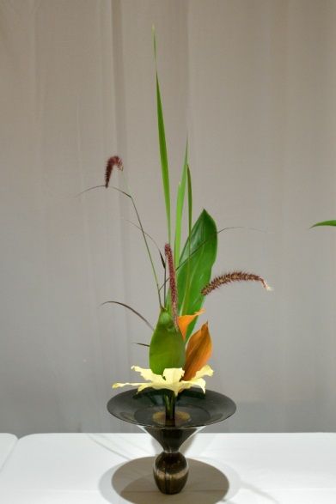
Ikebana by Headmaster

Slide 18
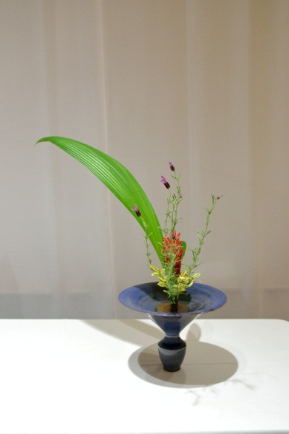
Ikebana by Headmaster

Slide 19
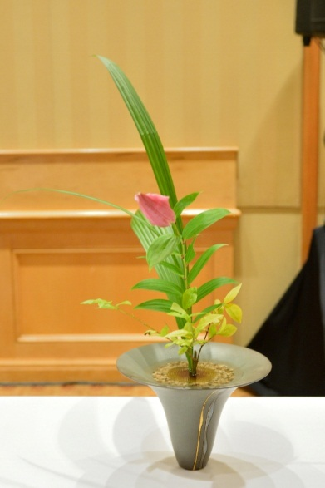
Ikebana by Headmaster

Slide 20
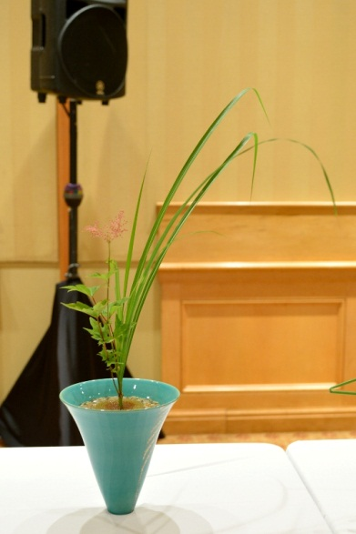
Ikebana by Headmaster

Slide 21
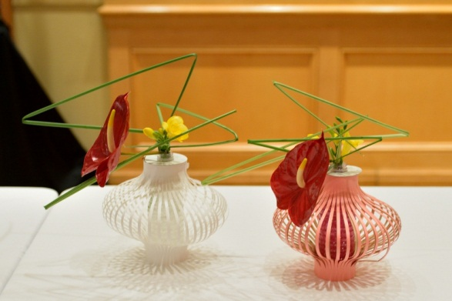
Ikebana by Headmaster

Slide 22
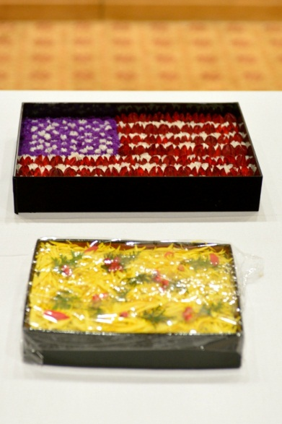
Unique use of Flowers

Slide 23
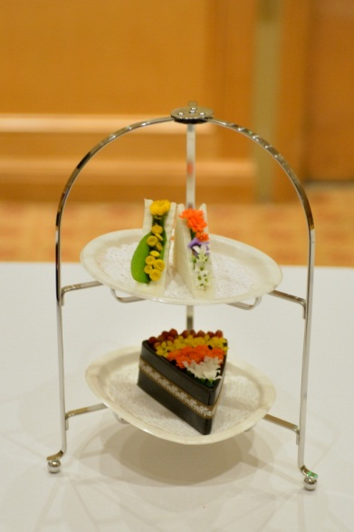
Unique use of Flowers

Slide 24
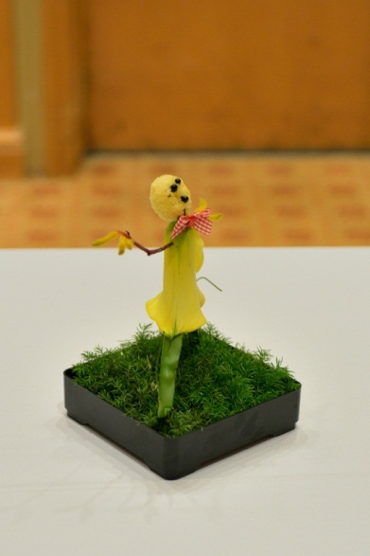
Unique use of Flowers

Slide 25
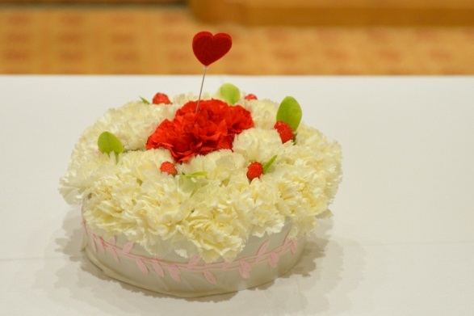
Unique use of Flowers

Slide 26
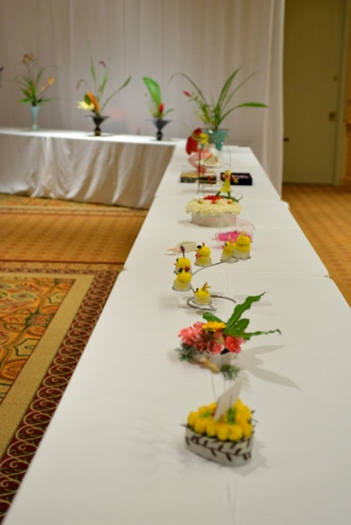
Unique use of Flowers

Slide 27
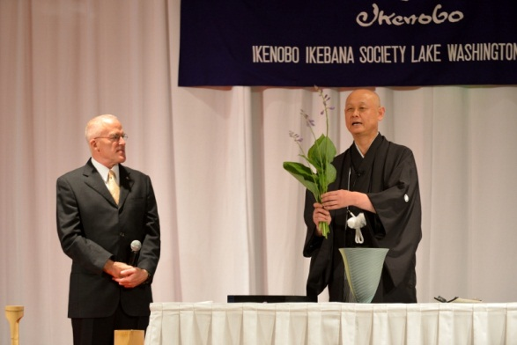
Demonstration by Professor Shinichi Shimizu with Mr. Kenneth Jones translating

Slide 28
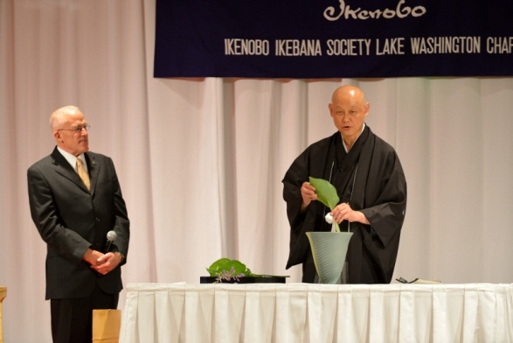

Slide 29
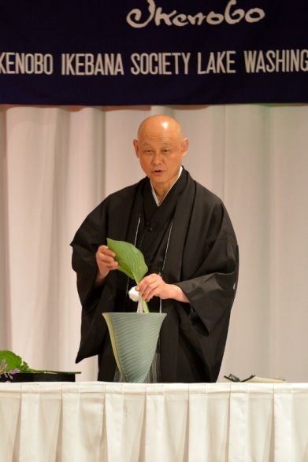

Slide 30
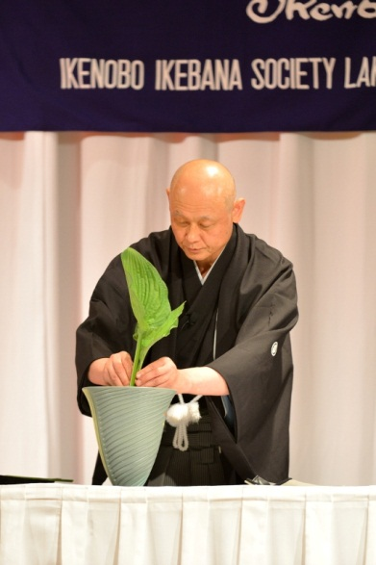

Slide 31
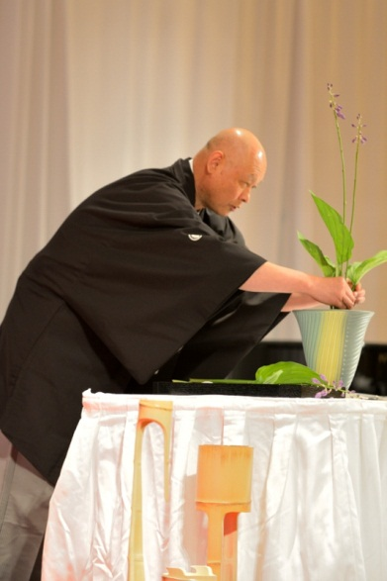

Slide 32
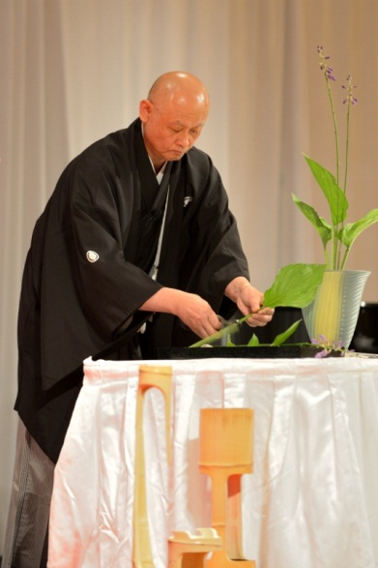

Slide 33
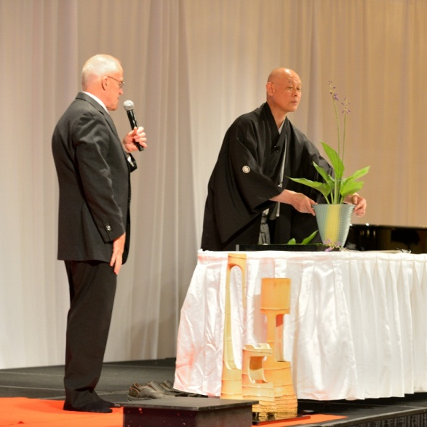

Slide 34
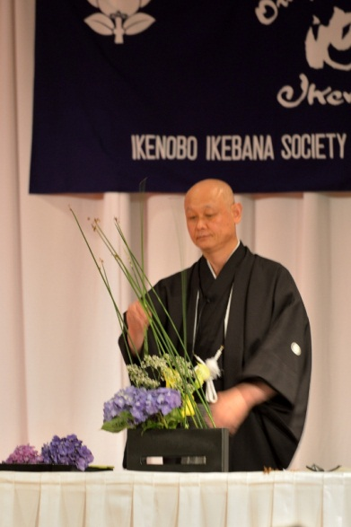

Slide 35
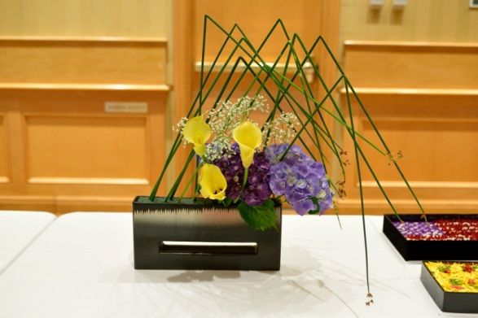
Professor Shimizu’s Ikebana

Slide 36
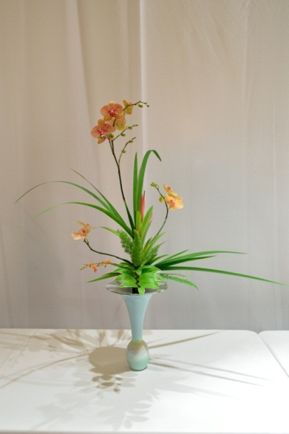
Ikebana by Professor Shinichi Shimizu

Slide 37
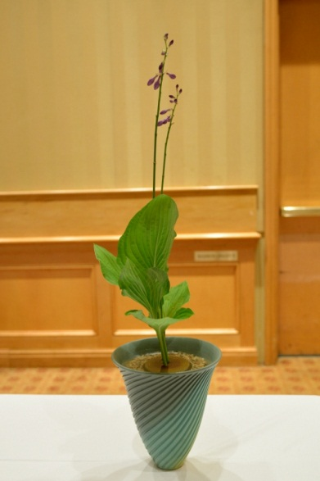
Professor Shimizu’s Ikebana

