Slide 1
Lake Washington Chapter 10 Anniversary Celebration
Reishiki-ike by
Professor Shinichi Shimizu

Slide 2
Reishiki-ike
Reishiki-ike is a formal ceremony of Ikenobo Ikebana performed in front of guests.
The purpose of the ceremony is to not only demonstrate the process that the arranger uses, but also to recall for us the early essence of the origin of ikebana: the spiritual aspect of the process being the most important element.
Observing the Reishiki-ike ceremony permits us to see beyond the beauty and harmony of the material and appreciate the process and spirit used to develop the ikebana arrangement.
Hopefully we can each improve our individual process of flower arranging by incorporating the spiritual elements of Reishiki-ike.

Slide 3
Each step in the ceremony is performed with a feeling of reverence and respect for life, the material, the process, and the guests who are present.
Respect for the guests is signified as the arranger bows to the guests at the beginning of the ceremony.
Reverence for nature is signified as each stem and material is handled gently and respectfully.
Reverence for the spirit of life is signified as water is poured carefully into the container.
Reverence for the process is signified by meticulously gathering and reverently placing the leftover material on a tray for removal.
Final spiritual purification of the completed arrangement is signified by wiping the base and stand.
Final respect for the guest is signified as the arrangement is presented for view.

Slide 4
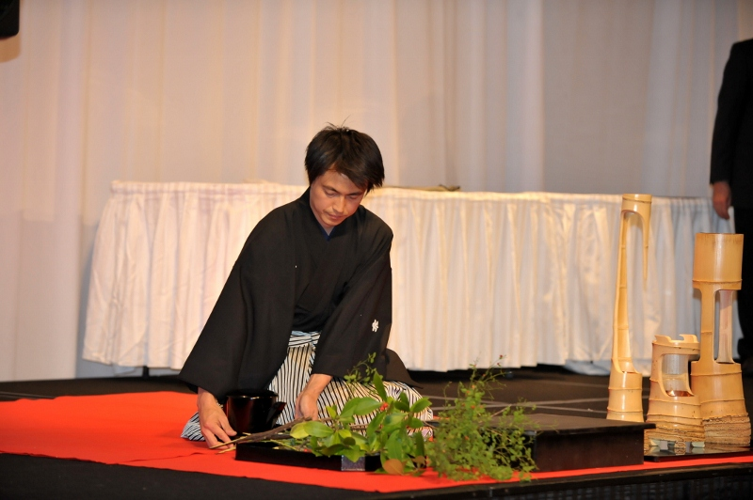
Mr. Sakaguchi prepares material for Reishiki-ike ceremony

Slide 5
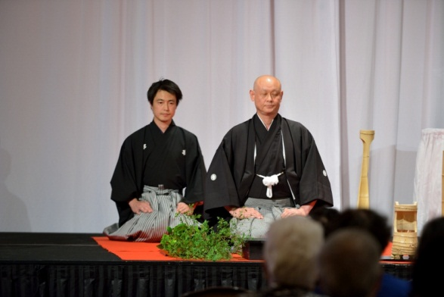
Professor Shinichi Shimizu assisted by Mr. Sakaguchi

Slide 6
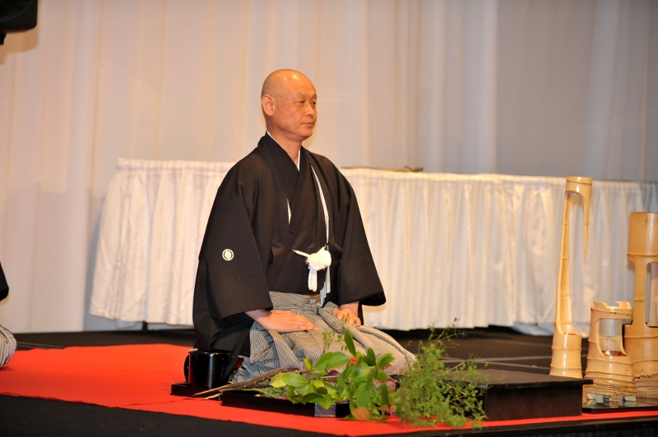

Slide 7
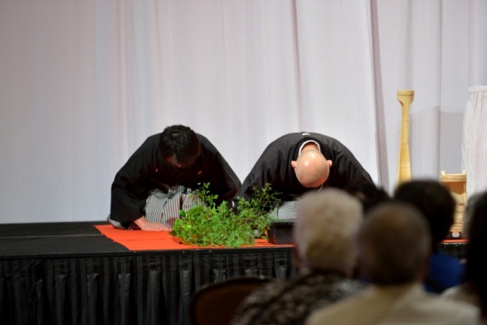

Slide 8
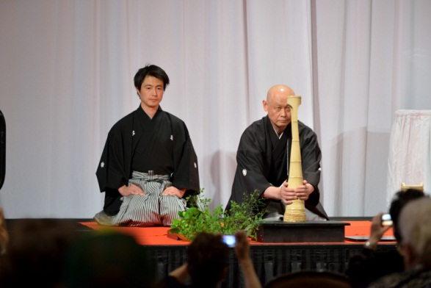
Professor Shinichi Shimizu assisted by Mr. Sakaguchi

Slide 9
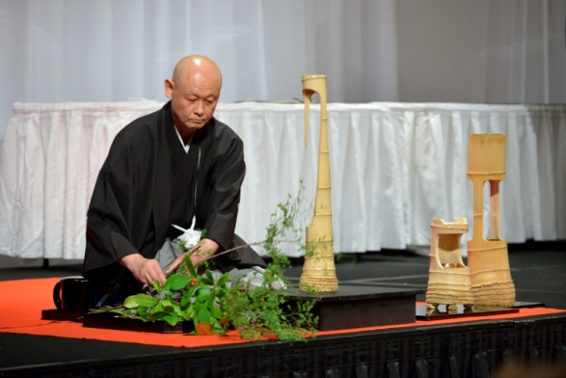

Slide 10
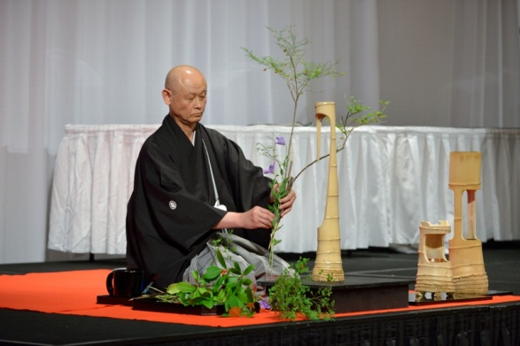

Slide 11
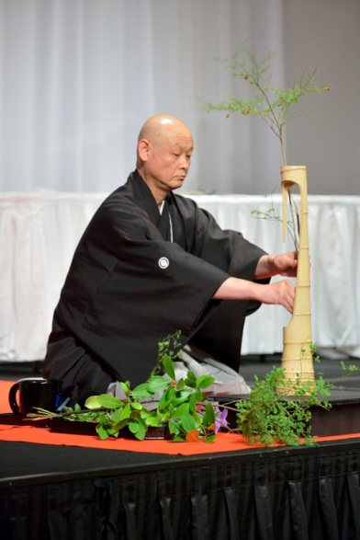

Slide 12
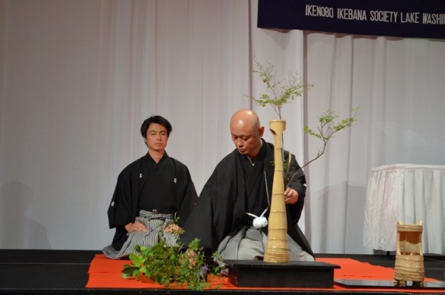

Slide 13
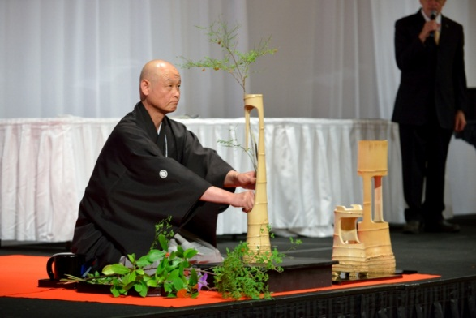

Slide 14
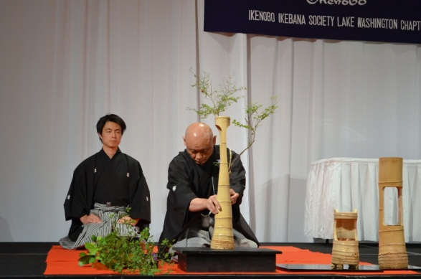

Slide 15
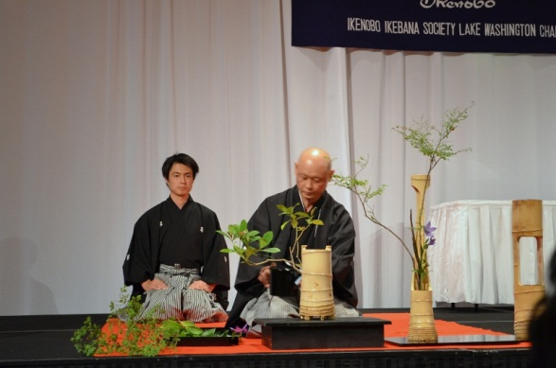
Professor Shinichi Shimizu assisted by Mr. Sakaguchi

Slide 16
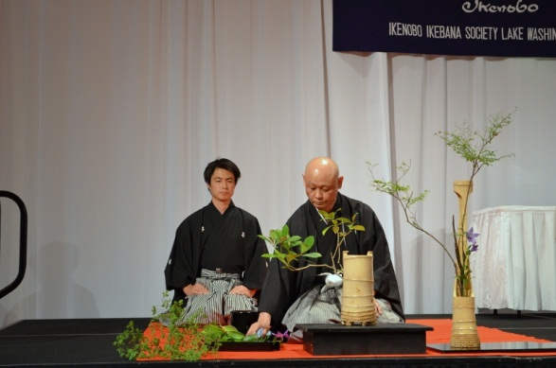

Slide 17
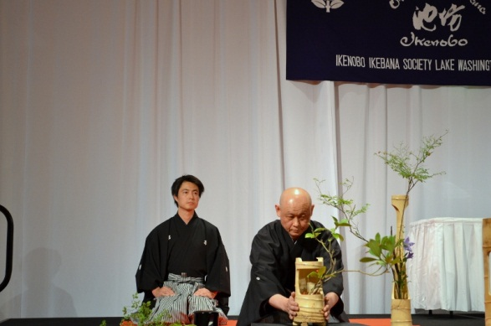

Slide 18
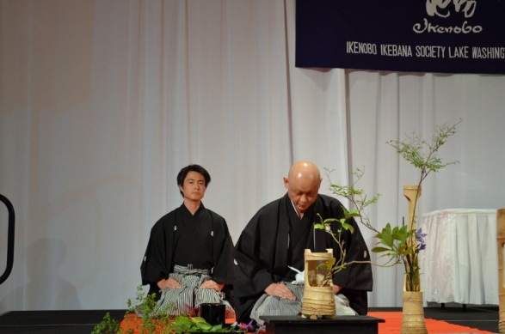

Slide 19
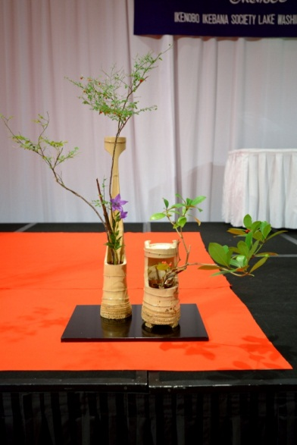

Slide 20
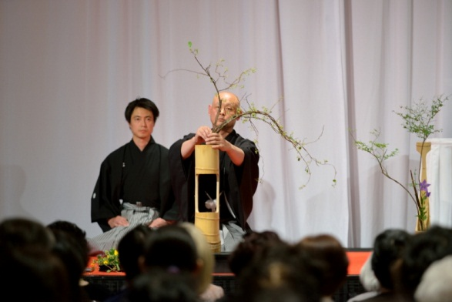
Professor Shinichi Shimizu assisted by Mr. Sakaguchi

Slide 21
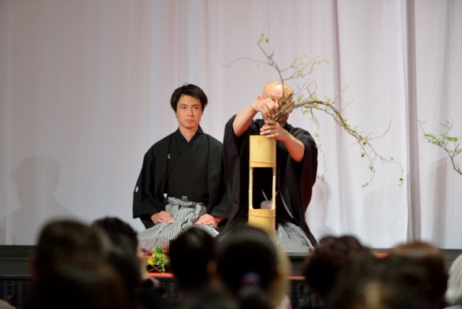

Slide 22
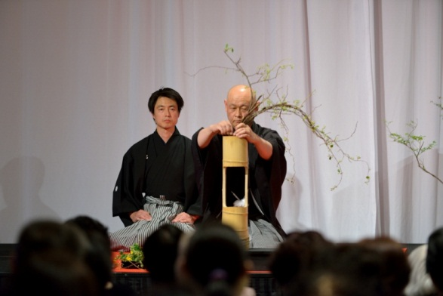

Slide 23
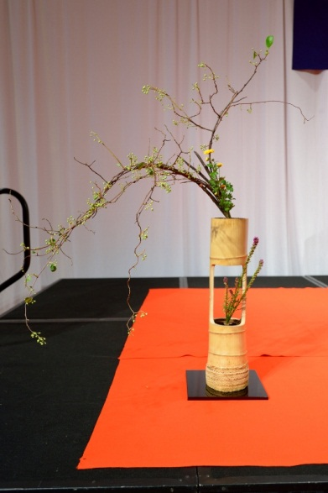

Slide 24
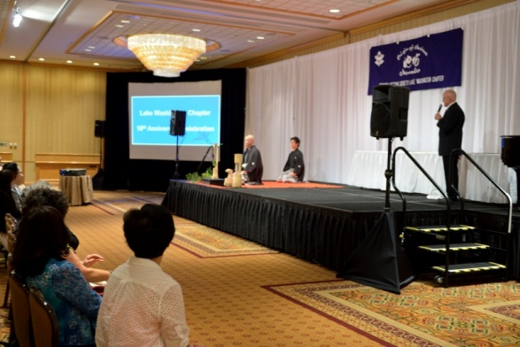

Slide 25
