Slide 1

PaddyCare AI
AI-Powered Paddy Leaf Disease Detection System
A comprehensive deep learning solution — from model training to on-device Android deployment.
Project Progression Report • September 2026
PyTorch
EfficientNet-B5
TensorFlow Lite
Kotlin + Jetpack Compose

Slide 2
01 PROBLEM
The Challenge
Rice is the staple food for over 160 million people in Bangladesh.
Bacterial Blight alone causes 20-30% crop loss annually when undetected.
Farmers lack access to expert agronomists, especially in rural areas.
Manual identification is subjective, slow, and often inaccurate.
160M+
People depend on rice
in Bangladesh
30%
Crop loss from
undetected disease
< 1%
Farmers with access
to plant pathologists

Slide 3

02 SOLUTION
Our Approach
An end-to-end AI system: from dataset curation → deep learning training → model optimization → offline Android app.
Data Collection
& Augmentation
Model Training
(EfficientNet-B5)
Model Conversion
(PyTorch → TFLite)
Android App
(Offline Inference)

Slide 4
03 MODEL
Model Architecture
Backbone: EfficientNet-B5
• 30M parameters • 456×456 input resolution
Custom Classifier Head
Dropout(0.4) → Linear(2048, 512) → SiLU
Dropout(0.3) → Linear(512, 128) → SiLU
Dropout(0.2) → Linear(128, NUM_CLASSES)
Key Design Decisions
• SiLU (Swish) activations match EfficientNet's design language
• 128-dim embedding layer enables Mahalanobis OOD detection
• Progressive dropout (0.4 → 0.3 → 0.2) for regularization
MODEL CARD
Architecture
EfficientNet-B5 + Custom Head
Input Resolution
456 × 456 × 3 (RGB)
Total Parameters
~30,000,000
Output Classes
Bacterial Blight | Healthy
Export Format
TensorFlow Lite (Float32 + INT8)
Dual Output
Logits + 128-dim Embedding

Slide 5
04 TRAINING
Two-Phase Training Strategy
PHASE 1 — Warmup (Epochs 1–10)
✦ Backbone FROZEN — only classifier head trains
✦ Learning Rate: 1e-4 (AdamW)
✦ Prevents catastrophic forgetting of ImageNet features
✦ Fast convergence on new classification head
PHASE 2 — Fine-tuning (Epochs 11–50)
✦ ALL LAYERS UNFROZEN — end-to-end training
✦ Learning Rate: 1e-5 (10× smaller)
✦ Cosine annealing scheduler (eta_min=1e-7)
✦ Gentle fine-tuning adapts backbone to paddy domain
Additional Training Techniques
Gradient
Accumulation
Weighted
Cross-Entropy
Label
Smoothing
TrivialAugment
Wide
Weighted
Random Sampler
Cosine
Annealing
Effective batch = 32
(8 × 4 steps)
Inverse-frequency
class weights
0.1 smoothing for
better calibration
State-of-the-art
auto-augmentation
Class-balanced
batches
Warm restarts
scheduler

Slide 6
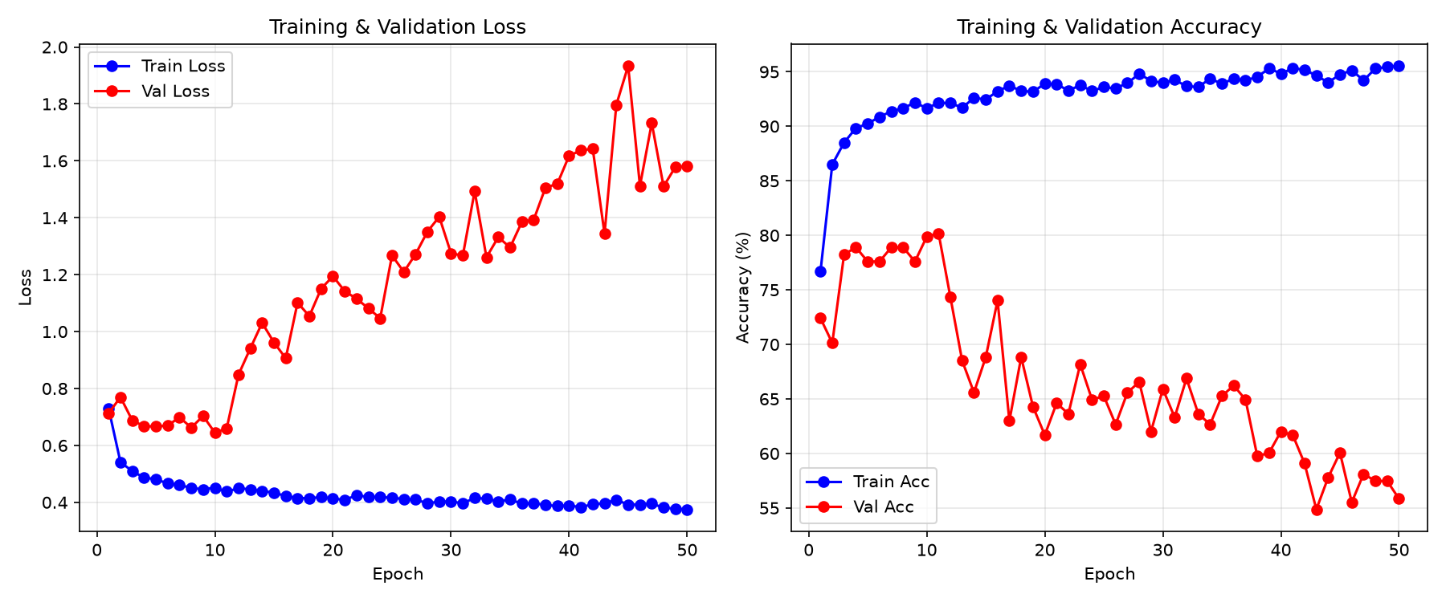
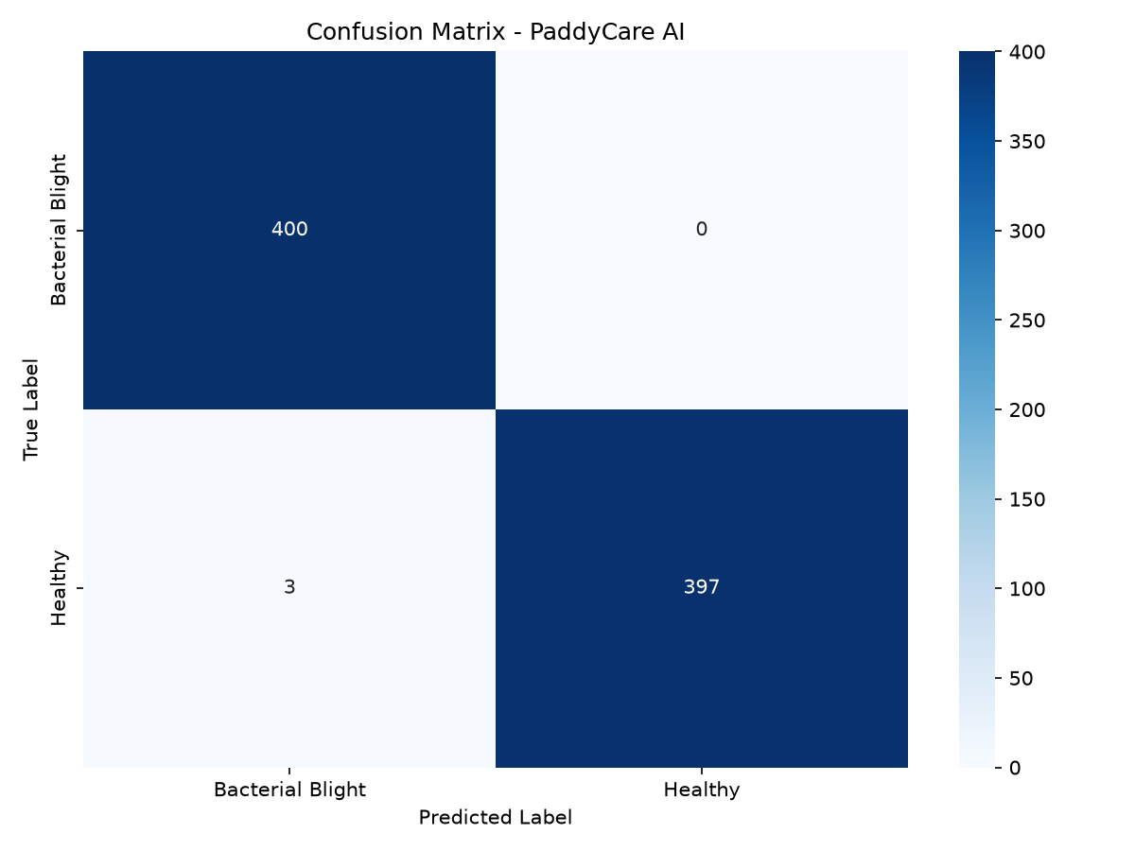
05 RESULTS
Training & Evaluation Results
OVERALL ACCURACY
Bacterial Blight
Healthy
99.62%
Precision: 0.99
Precision: 1.00
Recall: 1.00
Recall: 0.99
F1: 1.00
F1: 1.00
on validation set (800 samples)

Slide 7
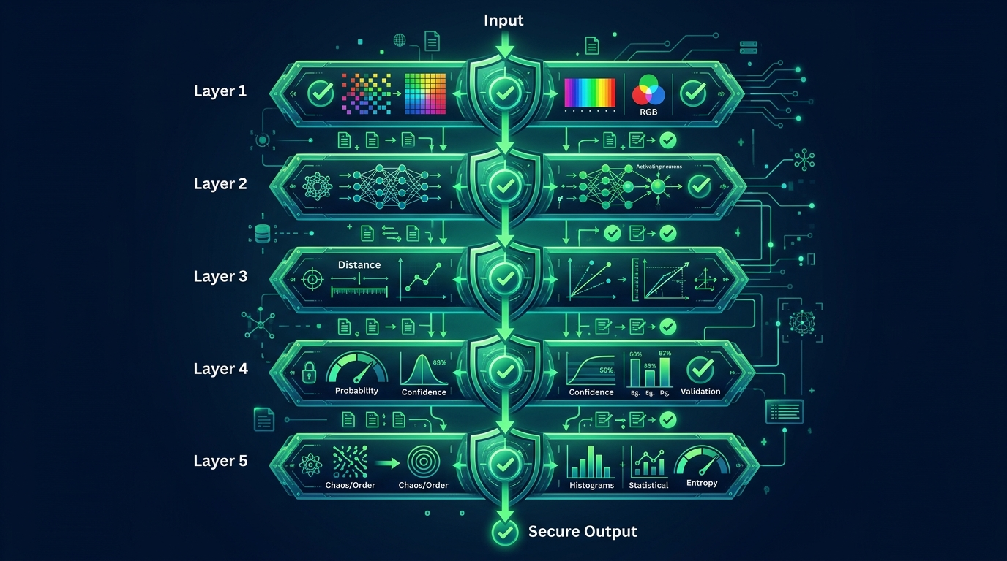
06 SAFETY
5-Layer OOD Rejection System
Ensures the model never gives confident but wrong predictions on non-paddy images.
Layer 1
HSV Color + Edge Texture Gate
Rejects non-plant images using color ratio & edge density analysis
Layer 2
Model Inference (Not Leaf Class)
Dedicated reject class trained on non-leaf images
Layer 3
Mahalanobis Distance Check
Measures embedding distance to known class distributions
Layer 4
Confidence Threshold (≥ 60%)
Rejects predictions below 60% softmax confidence
Layer 5
Shannon Entropy OOD Check
Rejects if model entropy > 0.75 × ln(N) — too uncertain

Slide 8
07 DEPLOYMENT
Model Export Pipeline
4-step automated pipeline converts the trained PyTorch model into an optimized TFLite model for Android.
1
2
3
4
Load PyTorch
Model
Export to
ONNX
Convert to
TFLite
Validate
TFLite
Load trained EfficientNet-B5
checkpoint (.pth)
Wrap in DualOutputWrapper
Export logits + embedding
ONNX → TensorFlow → TFLite
Optional INT8 quantization
Dummy inference test
Verify dual-output shapes
model.pth
model.onnx
model.tflite
✅ Ready
Output Files: model.tflite • labels.txt • class_stats.json → Copied to Android assets/

Slide 9
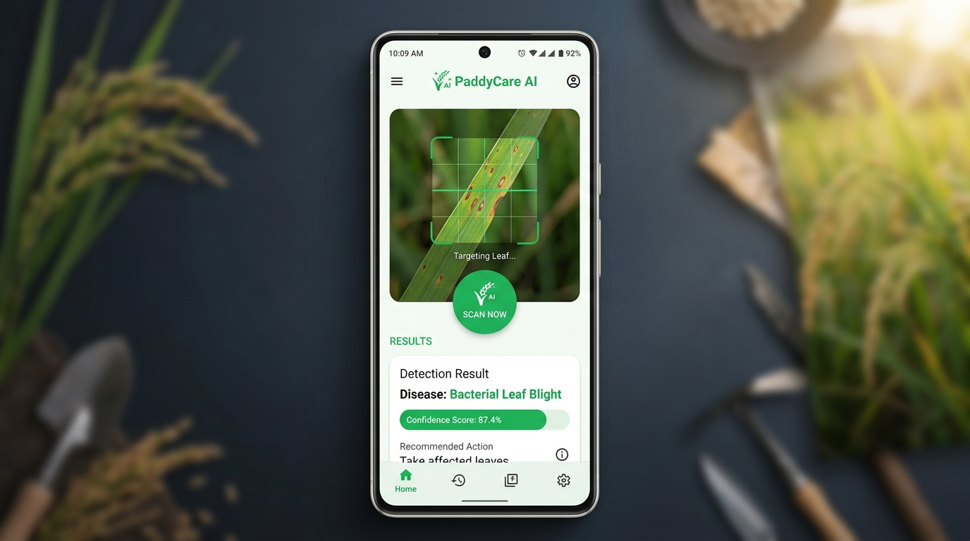
08 ANDROID APP
Native Android Application
100% Offline — No Internet Required
All AI inference runs on-device using TensorFlow Lite.
Modern Material Design 3 UI
Built with Jetpack Compose, featuring smooth animations,
confidence bars, and expandable treatment cards.
Bilingual Support (English & Bengali)
Full localization for Bangladeshi farmers.
Scan History with Room Database
Persistent local storage of all past scans.
Camera + Gallery Input
Capture live with CameraX or select from gallery.

Slide 10
09 TECHNOLOGY
Technology Stack
ML & Training
Model Export
Android App
Safety / OOD
PyTorch
ONNX
Kotlin
HSV Color Analysis
Deep learning framework
Intermediate representation format
Primary programming language
Pre-filter non-plant images
EfficientNet-B5
onnx2tf
Jetpack Compose
Mahalanobis Distance
Backbone architecture (torchvision)
ONNX to TensorFlow converter
Modern declarative UI toolkit
Embedding-based OOD detection
AdamW
TensorFlow Lite
Material Design 3
Shannon Entropy
Optimizer with decoupled weight decay
On-device inference engine
Design system
Uncertainty quantification
TrivialAugmentWide
Float32 / INT8
CameraX
Edge Texture Analysis
State-of-the-art auto-augmentation
Quantization options
Camera abstraction library
Image quality gating
WeightedRandomSampler
Room Database
Class-balanced sampling
Local persistence (scan history)

Slide 11
10 PROGRESSION
Development Progression
Phase 1: Foundation
Phase 2: Architecture Upgrade
Phase 3: Training Optimization
Phase 4: Safety & Deployment
Dataset Preparation & Initial Architecture
EfficientNet-B5 + Two-Phase Training
Advanced Techniques & Class Balancing
OOD Detection + Android App
• Collected and organized paddy leaf dataset (train/val split)
• Started with MobileNetV2 as baseline backbone
• Built basic training pipeline with standard augmentations
• Initial accuracy: ~70% validation
• Upgraded backbone to EfficientNet-B5 (30M params)
• Implemented two-phase transfer learning strategy
• Added gradient accumulation (effective batch = 32)
• Accuracy improved significantly
• Switched to AdamW optimizer
• Replaced manual augmentations with TrivialAugmentWide
• Added WeightedRandomSampler for class balance
• Added label smoothing (0.1) + cosine annealing
• Achieved 99.62% validation accuracy
• Built 5-layer OOD rejection system
• Mahalanobis distance in 128-dim embedding space
• Exported dual-output TFLite model
• Built native Kotlin/Compose Android app
• Full offline inference with bilingual UI

Slide 12
11 ACHIEVEMENTS
Key Achievements
🎯
🧠
📱
99.62%
30M
100%
Validation Accuracy
Parameters
Offline
Perfect F1-score of 1.00
for both classes
EfficientNet-B5 backbone
with custom classifier
No internet needed —
all inference on-device
🛡️
🌐
⚡
5-Layer
Bilingual
Real-time
OOD Protection
EN + BN
Inference
Multi-gate safety system
prevents false positives
Full Bengali localization
for Bangladeshi farmers
On-device TFLite inference
under 2 seconds

Slide 13
12 FUTURE
Future Roadmap
HIGH PRIORITY
Expand Disease Classes
HIGH PRIORITY
Larger Dataset
Add Blast, Brown Spot, Sheath Blight, and more disease categories to increase coverage.
Collect 5,000+ images per class from multiple regions and seasons for robust generalization.
MEDIUM
RandAugment / CutMix
MEDIUM
Model Compression
Implement advanced augmentation strategies (Recommendation #1 from accuracy improvements).
Apply INT8 quantization + pruning to reduce app size while maintaining accuracy.
LOW PRIORITY
GPS + Weather Integration
PLANNED
Google Play Store Launch
Correlate disease detection with geographic location and weather patterns for epidemiological insights.
Publish the app publicly with the Play Store publishing guide already prepared.

Slide 14
Thank You
PaddyCare AI — Empowering Farmers with AI-Powered Disease Detection
Questions & Discussion
PyTorch
EfficientNet-B5
TFLite
Kotlin
Jetpack Compose
Room DB

