Slide 1


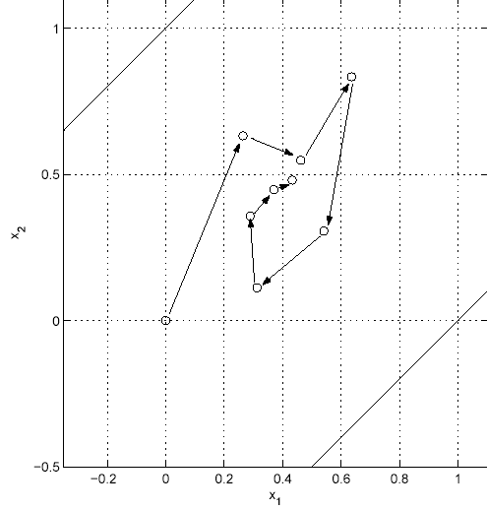
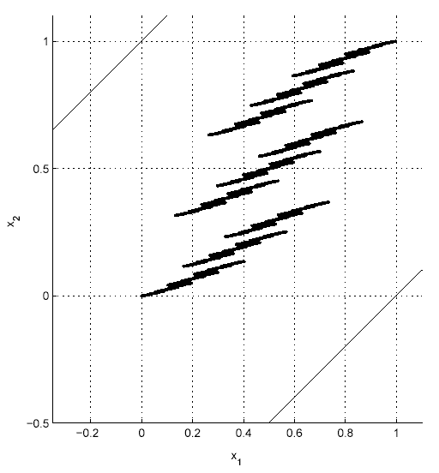
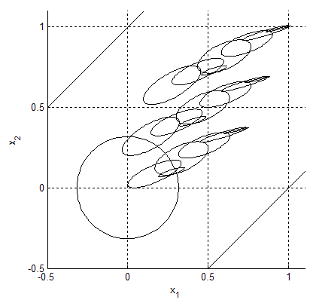
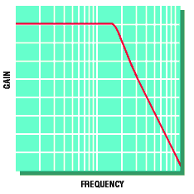
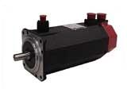
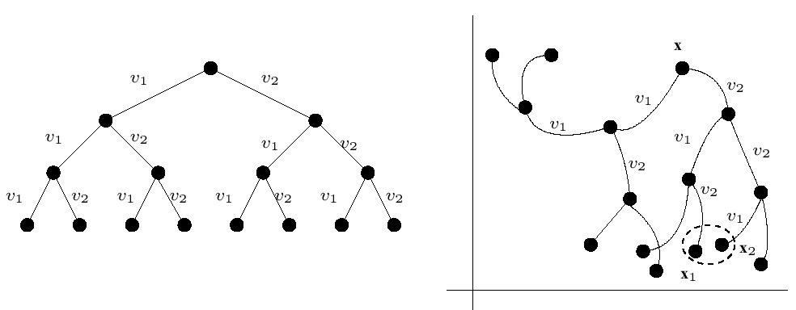
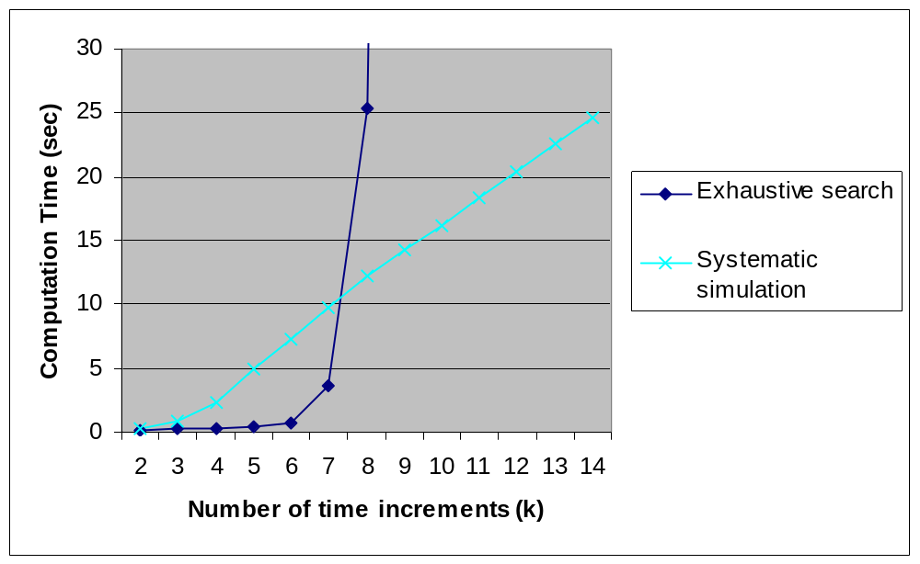
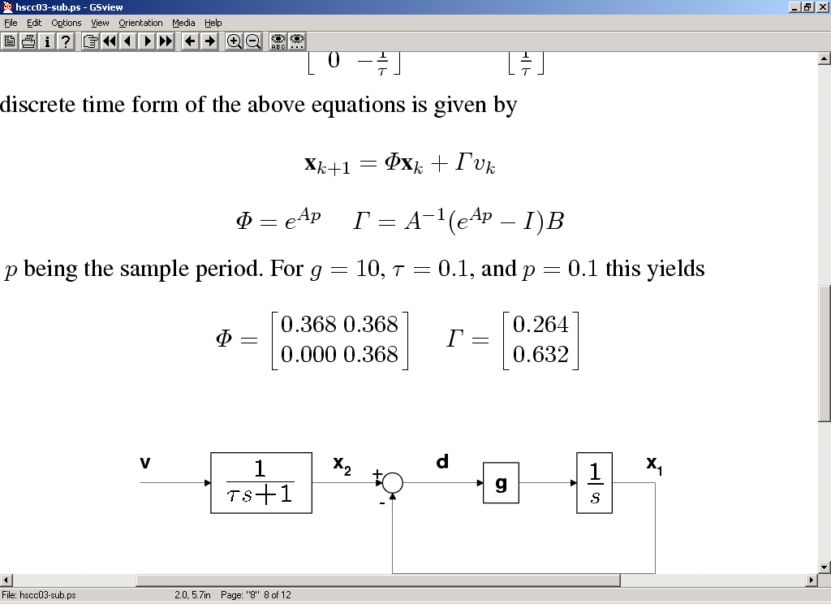

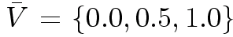

Systematic Simulation for Exploring Embedded Control System Design
James Kapinski†, Bruce H. Krogh†, Oded Maler‡, and Olaf Stursberg††
†Carnegie Mellon University, ‡Verimag, ††University of Dortmund
Overview
Problem:
  Simulation of embedded control design models not always sufficient
  Current verification techniques (e.g., flowpipe analysis, ellipsoidal techniques) computationally prohibitive
Solution:
  New technique for exploring design models
  Correctness verified by computing the set of reachable states of a system
  Approach utilizes idea of neighborhoods around simulation points
  Software tool created to implement the technique
  Forward propagation of ellipsoids is a linear operation
  Merging operation is a linear matrix inequality
Results
Systematic simulation results for servo system:
  Procedure terminates completely on 20th iteration
  Set of ellipsoids computed represents set of reachable points for all time
(a)
(b)
(a) Sample trajectory for the servo system. The diagonal lines represent the error bounds; (b) All 9841 reachable points from the origin. The points were obtained by performing simulation exhaustively from the origin for every input sequence of length eight.
The collection of ellipsoids represents a conservative estimate of the set of reachable states given any input sequence
Systematic simulation solution:
  Computes set of reachable states for system to determine whether safety constraint ever violated
Initial region which represents the set of all possible initial conditions
Motivation
Consider a servo system:
  Commanded input filtered
  Error between filtered input and position should be small
  System controls safety critical component (e.g., the aileron on an aircraft)
  Safety constraint imposed on the error; should never be greater than 1
Method
Procedure overview:
  In a breadth first manner, regions around points propagated forward for each input
  Points landing close to existing points are merged into one
  Regions around points conservatively capture behavior
The collection of ellipsoids representing the estimate of the set of reachable points for the servo system. A set of initial conditions given by a circle of radius .1.5 was used.
Systematic simulation versus existing techniques:
  Systematic simulation takes less time than exhaustive simulation
  Unlike other techniques, this one can provide results for an infinite time horizon
filter
motor
Point in the state space
Region around point
command
+
error
position
Σ
ψ₂ = v₁v₂v₂
ψ₁ = v₂v₁v₁
For the servo system case, procedure is linear, and after the 20th time increment, the procedure terminates and no further iterations are needed.
-
Servo motor system with trajectory generator
X
X
x•ψ₁ ≅ x•ψ₂
Merged regions
Comparison of computation times for the servo system example
Servo system dynamics
Future Work
Procedure for refining estimate of reachable set
Techniques for accelerating reachset computations by seeding reachset with regions where the system is invariant (e.g., Lyapunov ellipsoids)
Procedure for synthesizing controllers based on reachability procedure
Problem with existing techniques:
  Exhaustive simulation for verification expensive (6561 simulations necessary for 8 time increments), and each simulation trace only considers one initial condition
  Existing verifiers only for bounded time
(a)
(b)
(a) Tree of input sequences; (b) The set of reachable points due to the input sequences shown in (a). We consider regions around the points, and when two points are close together, we merge their regions.
Procedure details:
  Implementation uses ellipsoids to represent regions

