Slide 1
Hashes; Smothered, Covered, and Scattered: Modern Password Cracking as a Methodology
Notes:
6:31 Why is this a methodology? We may performing password cracking as a service, providing a repeatable consistent result.

Slide 2
HELLO!
Lee Wangenhiem
Security Consultant @ Optiv
Hacks things for fun as well as for a job
5 years Infosec Experience
Helps run the crackers at Optiv
Notes:
6:33

Slide 3

Why does it matter?
aspserver
Fall2019
Because it only takes one…
Notes:
6:34

Slide 4
1.
Hardware
Set Up For Success
Notes:
6:34

Slide 5
So you want to do some cracking?
The Old:
CPU – Not really worth it at all
Rainbow Tables – Mostly irrelevant
The New:
GPU – Any Desktop gaming setup will do
Cloud – Scalable but spendy
Laptops – Good for when hashes cannot leave client site
Mining Rigs – Great source of used video cards, with an income stream
Notes:
6:36

Slide 6
CLOUD
AI and Machine Learning Opening New Doors
Notes:
6:36

Slide 7
So cracking in the CLOUD?
Summer 2017:
AWS’s best GPU enabled system is the G2.8XLarge powered by 4 Nvidia GRID 520’s ($2.28)
Hashes at 16 GH’s Per Second
14 Cents per GH Hour
Fall 2017:
AWS releases their new P3.16XLarge instances powered by 8 Nvidia Tesla V100’s ($24.48)
Hashes at 633 GH’s Per Second
3 Cents per GH Hour
Optiv Built Cracker 2017:
6x1080 GPU’s in fully redundant server configuration (~$25,000)
Hashes at 250 GH’s Per Second
If used 80% of the time for 2 years
.7 Cents per GH Hour
Notes:
6:38

Slide 8
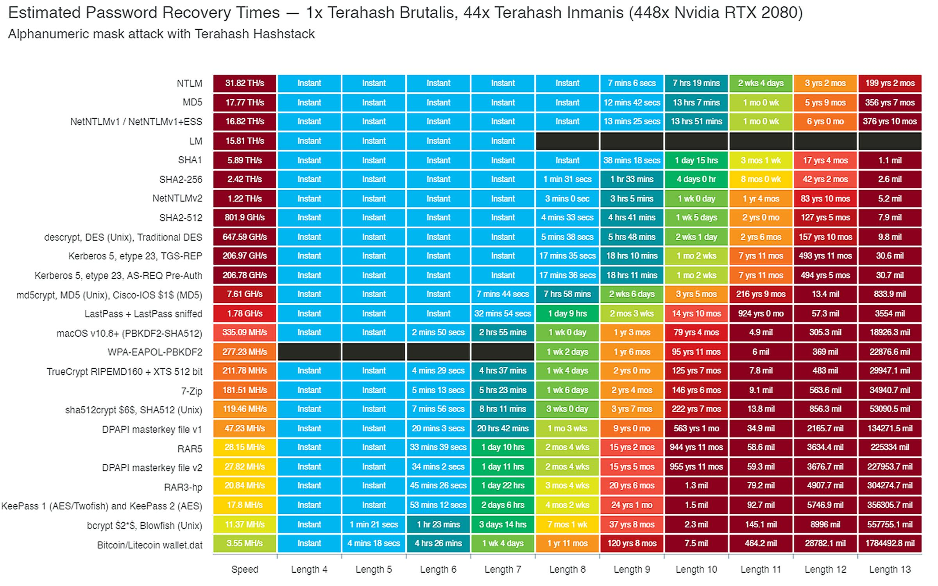
Thanks @TerahashCorp

Slide 9
2.
Glossary
So We Can Speak The Same Language
Notes:
6:38

Slide 10
A Couple Terms
Masks – The makeup of a word, broken into it’s character set
Hybrid Attack – An attack where a Brute-Force or mask is either appended or prepended to a wordlist
Wordlist – A file which contains a list of candidate words to either run by themselves or be modified with rules, typically dictionary words
Password Dump – A file which contains passwords obtained from previous cracking attempts, will contain more complex words than a wordlist
Notes:
6:42 – If ahead, talk about how Password12 in a password dump does not transform back into Password1, but instead use password in a wordlist with rules.

Slide 11
3.
Tools
Creating Your Environment
Notes:
6:42

Slide 12
Building an arsenal
“If Your Only Tool Is a Hammer Then Every Problem Looks Like a Nail”
Mark Twain
Notes:
6:42

Slide 13
The Kit
Hashcat – The Hammer
Hashtopolis – The Toolbelt
HashID – Magnifying Glass
PW_Spy – Measuring Tape
Notes:
Don’t really talk through this slide

Slide 14

Hashcat
Defacto standard. Supports almost every hash imaginable. Fast. Constant updates/improvements.
Replaced JohnTheRipper
Easy to setup and integrate with other tools
Notes:
6:44

Slide 15
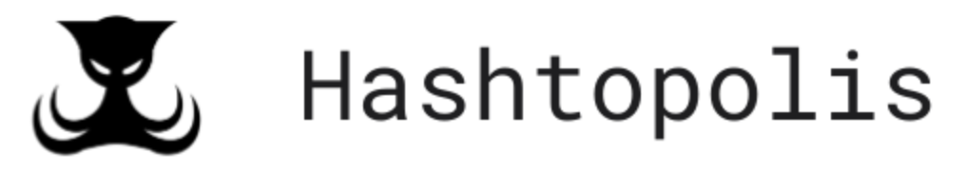
Hashtoplis
Wrapper for Hashcat
Manage agents, jobs, wordlists, and hashcat binaries from a central location
Distributed cracking made easy!!!
Notes:
6:45

Slide 16
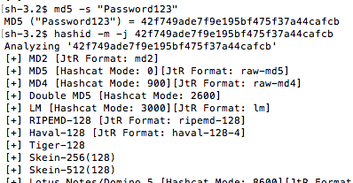
HashID
Find likely hashing algorithms
If its not helpful
Research Application – Source code?
Try a commonly used password first
Self register known password
Notes:
6:48

Slide 17
PW_spy
Tool built out of our Enterprise Password Audits
Finds:
Most common masks
Weak Passwords
Password Lengths
Base words
https://github.com/lwangenheim/pw_spy
Notes:
6:49

Slide 18
4.
Techniques
Honing Your Skills
Notes:
6:49

Slide 19
How do I begin?
What’s the best way to crack a hash?
This is a loaded question, what’s the best way to use Nmap?
Think about the engagement, are you going after one hash? Multiple hashes?
What algorithm are you trying to crack?
NTLM is MUCH faster than WPA2
Notes:
6:45

Slide 20
How do I look?
Where do we get hashes?
Hashdump – local accounts
/etc/shadow or .conf files
Mimikatz
WebApps
Responder
DCSync/NTDS
Notes:
6:45

Slide 21
Developing a Methodology
Methodology – Password Audit
Creating a repeatable process for others to follow
Looks at the entire enterprise
Very analysis based
Looking for patterns, common words, easy wins, etc.
Some claim they do pw audits but they don’t do it effectively
Need heavy hitting cracking rigs / cloud setup
Notes:
6:45

Slide 22
What do I do?
How did we get there? (quick wins)
Proprietary wordlists without rules
Adding rules to those same lists
Loopback attacks
1-8 char brute force
Masks (start with uppercase, end with digits/special chars)
Notes:
6:45

Slide 23
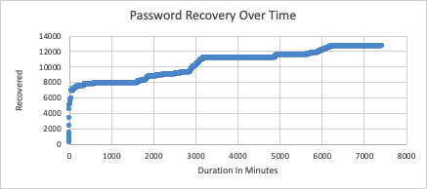
Executing the Methodology
Notes:
6:45

Slide 24
Help Your Future Self
Pot Files
Historical record of your cracked hashes
Useful to see if you’ve already cracked a hash on another engagement
Be wary of bloat, it can slow down the process as each hash is run through the existing potfile
Common Masks
Build a list of masks > 8 characters to run through
Notes:
6:45

Slide 25
5.
Demo
Notes:
7:12

Slide 26
Demo Gods Hate Me
Place your video here
Notes:
2 Terahashes = 8char in 1 hour, 9 char in 3.5 days

Slide 27
THANKS!
Any questions?
You can find me at:
@Hx_fifty

Slide 28
CREDITS
Special thanks to all the people who dedicate time to content in this presentation:
Hashcat
Hashtopolis
Optiv
Presentation template by SlidesCarnival
Photographs by Unsplash

