Slide 1


Energy-efficient execution of Federated learning tasks on mobile phones: An exploratory study.
Presented by Patrick Wapet, Post Doc at LIRIS Laboratory, INSA Lyon
In collaboration with Dr. Tran Giang Son, University of Science and Technology of Hanoi and Dr. Boris Teabe, INP Toulouse
Supervised by By Vlad Nitu,
1 / ???

Slide 2
Summary
Context: Federated Learning and mobile phones.
Problem definition: Global scheme
Challenges: Parameters, metrics, approach and measurement tools.
Experiments and observations: reported according to the parameters, graphs and partial conclusions.
Next steps: next experiments, possibly implementations and submissions.
2 / ???

Slide 3
1. Context: Federated Learning
Artificial Intelligence is more and more used in everyday life.
By default it is a system that centralizes data.
Posing the problem of privacy.
A solution: keep the data with the users.
On their devices : Mobile phones
Do the processing on these phones: Federated Learning
3 / ???

Slide 4
2. Let state the problem: general scheme
Mobile app
Mobile app
Mobile app
User space
System task
Kernel components
Governors
Scheduler
A simplified view of the Android system
Linux Kernel
Drivers / Sensors inputs
Big Core
Big Core
Core
frequency
Little Core
Little Core
Mobile Hardware
4 / ???

Slide 5

2. Let state the problem: general scheme
Mobile app
Mobile app
Mobile app
User space
System task
Kernel components
Governors
Scheduler
A simplified view of the Android system
Linux Kernel
Drivers / Sensors inputs
Big Core
Big Core
Core
frequency
Little Core
Little Core
Mobile Hardware
4 / ???

Slide 6
2. Let state the problem: general scheme
Mobile app
Federated
Learning App
Mobile app
FL task
A new federated learning application
Mobile app
FL thread
FL thread
...
FL thread
User space
System task
Kernel components
Governors
Scheduler
A simplified view of the Android system
Linux Kernel
Drivers / Sensors inputs
Big Core
Big Core
Core
frequency
Little Core
Little Core
Mobile Hardware
4 / ???

Slide 7

2. Let state the problem: general scheme
Mobile app
Federated
Learning App
Mobile app
FL task
A new federated learning application
Mobile app
FL thread
FL thread
...
FL thread
User space
System task
Kernel components
Governors
Scheduler
A simplified view of the Android system
Linux Kernel
Drivers / Sensors inputs
Big Core
Big Core
Core
frequency
Little Core
Little Core
Mobile Hardware
4 / ???

Slide 8
3.a. Let us define the metric to optimize
The metric should reflect both:
  Computing power of the FL task execution
  Electrical power absorption of the phone.
To compute this metric we have:
  The workload of the FL task: number of CPU operations.
  The total energy consumed: obtained by measurements.
Metric adopted for the project: energy efficiency
5 / ???

Slide 9
3.b. What influences the energy efficiency
The type of cores executing the task
    Intuitively Big cores consumed high amount of Energy
    Some research experiments prove that it can be a factor. [1]
The task already present of the cores.
    Energy discounted approach [2].
The core frequency.
[1] Full-System Simulation of big.LITTLE Multicore Architecture for Performance and Energy Exploration. Anastasiia Butko et al
[2] Energy Discounted Computing on Multicore Smartphones, Meng Zhu Kai Shen University of Rochester
[3] Machine Learning-Based Approaches for Energy-Efficiency Prediction and Scheduling in Composite Cores Architectures
Hossein Sayadi et al.
[4] Temperature-Aware Scheduler Based on Thermal Behavior Grouping in Multicore Systems Inchoon Yeo and Eun Jung Kim
5 / ???

Slide 10
3.b. What influences the energy efficiency
The type of cores executing the task
    Intuitively Big cores consumed high amount of Energy
    Some research experiments prove that it can be a factor. [1]
The task already present of the cores.
    Energy discounted approach [2].
The core frequency.
We wanted to limit ourselves to the previous parameters, but it was with no real basis.
[1] Full-System Simulation of big.LITTLE Multicore Architecture for Performance and Energy Exploration. Anastasiia Butko et al
[2] Energy Discounted Computing on Multicore Smartphones, Meng Zhu Kai Shen University of Rochester
[3] Machine Learning-Based Approaches for Energy-Efficiency Prediction and Scheduling in Composite Cores Architectures
Hossein Sayadi et al.
[4] Temperature-Aware Scheduler Based on Thermal Behavior Grouping in Multicore Systems Inchoon Yeo and Eun Jung Kim
5 / ???

Slide 11
3.b. What influences the energy efficiency
The type of cores executing the task
    Intuitively Big cores consumed high amount of Energy
    Some research experiments prove that it can be a factor. [1]
The task already present of the cores.
    Energy discounted approach [2].
The core frequency.
We wanted to limit ourselves to the previous parameters, but it was with no real basis.
The Number of threads of the best effort task
  Mentioned In research [3].
Core temperature [4].
[1] Full-System Simulation of big.LITTLE Multicore Architecture for Performance and Energy Exploration. Anastasiia Butko et al
[2] Energy Discounted Computing on Multicore Smartphones, Meng Zhu Kai Shen University of Rochester
[3] Machine Learning-Based Approaches for Energy-Efficiency Prediction and Scheduling in Composite Cores Architectures
Hossein Sayadi et al.
[4] Temperature-Aware Scheduler Based on Thermal Behavior Grouping in Multicore Systems Inchoon Yeo and Eun Jung Kim
5 / ???

Slide 12
2. Let state the problem: general scheme
Mobile app
Federated
Learning App
Mobile app
FL task
Mobile app
FL thread
FL thread
...
FL thread
User space
System task
Kernel components
Governors
Scheduler
Linux Kernel
Drivers / Sensors inputs
Big Core
Big Core
Core
frequency
Little Core
Little Core
Mobile Hardware
6 / ???

Slide 13
3.a. Let us define the metric to optimize on our problem scheme
Mobile app
Workload Computed
Federated
Learning App
Mobile app
FL task
Mobile app
FL thread
FL thread
FL thread
User space
System task
Kernel components
Governors
Scheduler
Linux Kernel
Drivers / Sensors inputs
Big Core
Big Core
Core
frequency
Little Core
Little Core
Mobile Hardware
6 / ???

Slide 14
3.a. Let us define the metric to optimize on our problem scheme
Mobile app
Workload Computed
Federated
Learning App
Mobile app
FL task
Mobile app
FL thread
FL thread
...
FL thread
User space
System task
Kernel components
Governors
Scheduler
Linux Kernel
Drivers / Sensors inputs
Big Core
Big Core
Core
frequency
Little Core
Little Core
Mobile Hardware
Energy consumed
6 / ???

Slide 15
3.a. Let us define the metric to optimize on our problem scheme
Overall system energy efficiency
Mobile app
Workload Computed
Federated
Learning App
Mobile app
FL task
Mobile app
FL thread
FL thread
...
FL thread
User space
System task
Kernel components
Governors
Scheduler
Linux Kernel
Drivers / Sensors inputs
Big Core
Big Core
Core
frequency
Little Core
Little Core
Mobile Hardware
Energy consumed
6 / ???

Slide 16
3.b. What influences the energy efficiency on our problem scheme
Overall system energy efficiency
Mobile app
Workload Computed
Federated
Learning App
Mobile app
FL task
Mobile app
FL thread
FL thread
...
FL thread
User space
System task
Kernel components
Governors
Scheduler
Linux Kernel
Drivers / Sensors inputs
Big Core
Big Core
Core
frequency
Little Core
Little Core
Mobile Hardware
Energy consumed
6 / ???

Slide 17
3.b. What influences the energy efficiency on our problem scheme
Overall system energy efficiency
Number of tasks are already present on the Phone, on which socket.
{
Mobile app
Workload Computed
Federated
Learning App
Mobile app
FL task
Mobile app
FL thread
FL thread
...
FL thread
User space
System task
Kernel components
Governors
Scheduler
Linux Kernel
Drivers / Sensors inputs
Big Core
Big Core
Core
frequency
Little Core
Little Core
Mobile Hardware
Energy consumed
6 / ???

Slide 18
3.b. What influences the energy efficiency on our problem scheme
Overall system energy efficiency
Number of tasks are already present on the Phone, on which socket.
{
Mobile app
Workload Computed
Federated
Learning App
Mobile app
FL task
Mobile app
FL thread
FL thread
...
FL thread
User space
Core temperature
System task
Kernel components
Governors
Scheduler
Linux Kernel
Drivers / Sensors inputs
Big Core
Big Core
Core
frequency
Little Core
Little Core
Mobile Hardware
Energy consumed
6 / ???

Slide 19
3.b. What influences the energy efficiency on our problem scheme
Overall system energy efficiency
Number of tasks are already present on the Phone, on which socket.
{
Mobile app
Workload Computed
Federated
Learning App
Mobile app
FL task
Number of threads of the FL task
N
Mobile app
FL thread
FL thread
...
FL thread
User space
Core temperature
System task
Kernel components
Governors
Scheduler
Linux Kernel
Drivers / Sensors inputs
Big Core
Big Core
Core
frequency
Little Core
Little Core
Mobile Hardware
Energy consumed
6 / ???

Slide 20
3.b. What influences the energy efficiency on our problem scheme
Overall system energy efficiency
Number of tasks are already present on the Phone, on which socket.
{
Mobile app
Workload Computed
Federated
Learning App
Mobile app
FL task
Number of threads of the FL task
N
Mobile app
FL thread
FL thread
...
FL thread
User space
Core temperature
System task
Kernel components
Scheduler
The type of core on which to schedule the task
Governors
Linux Kernel
Drivers / Sensors inputs
Big Core
Big Core
Core
frequency
Little Core
Little Core
Mobile Hardware
Energy consumed
6 / ???

Slide 21

3.b. What influences the energy efficiency on our problem scheme
Overall system energy efficiency
Number of tasks are already present on the Phone, on which socket.
{
Mobile app
Workload Computed
Federated
Learning App
Mobile app
FL task
Number of threads of the FL task
N
Mobile app
FL thread
FL thread
...
FL thread
User space
Core temperature
System task
Kernel components
Scheduler
The type of core on which to schedule the task
Governors
Linux Kernel
Drivers / Sensors inputs
Big Core
Big Core
Core frequency
Core
frequency
Little Core
Little Core
Mobile Hardware
Energy consumed
6 / ???

Slide 22
3.d Approach to resolve the problem
Make in-lab experiments by varying scenarios parameters:
  Number of interactive task present on phones
  Number of threads of the FL task
  Type of cores
  Core frequencies (when possible)
Bringing out the lessons learned about HOW those parameters influence energy efficiency.
Apply these lessons learned in the FL task scheduling decision:
  At user space Level
  At kernel Level (Scheduler, governor).
7 / ???

Slide 23
3.e Workload measurement
Benchmarks (Newly added FL task)
  Prime number computation (to quickly get an overview of cores energy efficiency) [1]
  Tensor Flow Lite model on Mobile Device [2] (to have ML-like task behavior)
  Federated Learning Tool from FLEET (for FL-like experiments) [3]
Interactive apps (Other apps)
  Interactive app simulation (with interruptions to quickly get an overview) [1]
  Widely used mobile apps (YouTube, Instagram ...)
[1] Prime number computation source code https://gitlab.liris.cnrs.fr/plwapet/benchmarking_app_to_test_big_cores/-/blob/main/app/src/main/java/com/opportunistask/scheduling/benchmarking_app_to_test_big_cores/PrimeNumberThread.java
[2] On-Device Training with TensorFlow Lite https://www.tensorflow.org/lite/examples/on_device_training/overview
[3] FLeet: Online Federated Learning via Staleness Awareness and Performance Prediction, Georgios Damaskinos, Rachid Guerraoui, Vlad Nitu et al. Source code https://github.com/gdamaskinos/fleet/
8 / ???

Slide 24
3.e Workload measurement
Phones used for experiments:
  Google Pixel 4A 5G:
    Chipset : Qualcomm SM7250 Snapdragon 765G 5G (7 nm)
    3 sockets: CPUs 0-5: 1.8048 GHz CPU 6: 2.208 GHz CPU7: 2.4 GHz
    Memory: 6GB RAM
  Samsung galaxy S8 :
    Chipset: Exynos 8895 (10 nm) – EMEA, Qualcomm MSM8998 Snapdragon 835 (10 nm) - USA & China
    2 sockets CPUs 0-3 : 1.69 GHz , CPUs 4-7: 2.314 GHz
    Memory: 4GB RAM
9 / ???

Slide 25
3.f Energy consumption measurement: system APIs
API name : “dumpsys batterystats” from Android OS
Works in almost all phones
  except in some configurations
Widely used in research [1]
We have used it for more than 7 months.
Confirms the influence of the above-mentioned parameters on the energy efficiency
But some results incompatible with reality
[1] Resource utilization and per formance, A comparative study on mobile crossplatform tools, Lucas Arvidsson, Max Bekkhus
10 / ???

Slide 26
3.f Energy consumption measurement: Power-meter
Also widely used in research [1][2]
The common installation required is expensive
  Its makes phone battery no longer usable.
Alternative 1: Software simulation of battery shutdown (Google Pixel 4A, 5G).
    Modifying internal system file : “charge_stop_level”, “charge_limit”
    USB mode power supply
    Retrieving data from powermeter
Alternative 2 : Full battery charging (Samsung)
    Retriving data from system file “cc_info”
    Retrieving data form powermeter
[1]"Energy Consumption and Conservation in WiFi Based Phones: A Measurement-Based Study By Ashima Gupta and Prasant Mohapatra"
[2] Energy-Efficient Collaborative Sensing with Mobile Phones Xiang Sheng∗
11 / ???

Slide 27
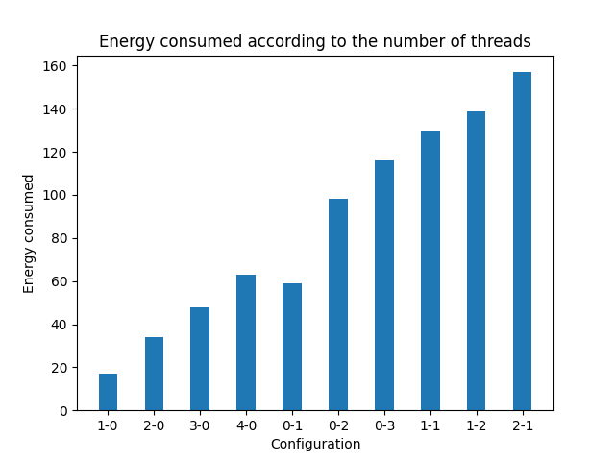
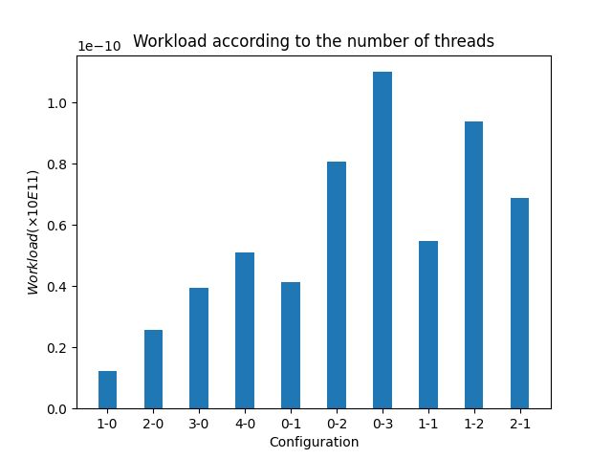
4. Experiments and observations (made using APIs)
Phone: Samsung S8
Impact of: Type or Core
Experiments duration: 10 min
Legend: Configuration 0-1 means
    0 thread on Little sockets
    1 Thread on Big Socket
12 / ???

Slide 28
4. Experiments and observations (made using APIs)
Phone: Samsung S8
Impact of: Type or Core
Experiments duration: 10 min
Legend: Configuration 0-1 means
    0 thread on Little sockets
    1 Thread on Big Socket
Big Cores consume a lot of energy compared to little cores
12 / ???

Slide 29
4. Experiments and observations (made using APIs)
Phone: Samsung S8
Impact of: Type or Core
Experiments duration: 10 min
Legend: Configuration 0-1 means
    0 thread on Little sockets
    1 Thread on Big Socket
Big cores are very fast in computation
Big Cores consume a lot of energy compared to little cores
12 / ???

Slide 30
4. Experiments and observations (made using APIs)
Phone: Samsung S8
Impact of: Number of threads
Experiments duration: 10 min
Legend: Configuration 0-1 means
    0 thread on Little sockets
    1 Thread on Big Socket
13 / ???

Slide 31
4. Experiments and observations (made using APIs)
Phone: Samsung S8
Impact of: Number of threads
Experiments duration: 10 min
Legend: Configuration 0-1 means
    0 thread on Little sockets
    1 Thread on Big Socket
The energy consumed always grows linearly with the number of threads
13 / ???

Slide 32
4. Experiments and observations (made using APIs)
Phone: Samsung S8
Impact of: Number of threads
Experiments duration: 10 min
Legend: Configuration 0-1 means
    0 thread on Little sockets
    1 Thread on Big Socket
The energy consumed always grows linearly with the number of threads
The workload computed grows linearly with the number of threads
13 / ???

Slide 33
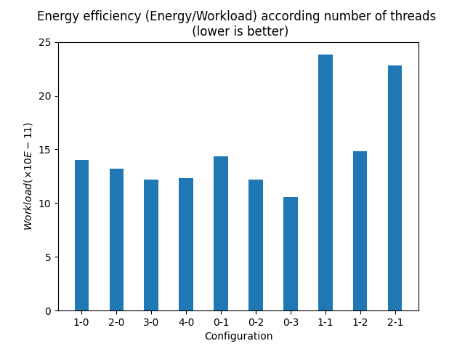
4. Experiments and observations (made using APIs)
Phone: Samsung S8
Impact of: Number of Threads
Experiments duration: 10 min
Legend: Configuration 0-1 means
    0 thread on Little sockets
    1 Thread on Big Socket
14 / ???

Slide 34
4. Experiments and observations (made using APIs)
Phone: Samsung S8
Impact of: Number of Threads
Experiments duration: 10 min
Legend: Configuration 0-1 means
    0 thread on Little sockets
    1 Thread on Big Socket
On the same socket the number of threads slightly increases with the efficiency
14 / ???

Slide 35
4. Experiments and observations (made using APIs)
Phone: Samsung S8
Impact of: Other CPU intensive tasks
Experiments duration: 10 min
Legend: Configuration 0-1 means
    0 thread on Little sockets
    1 Thread on Big Socket
15 / ???

Slide 36
4. Experiments and observations (made using APIs)
Phone: Samsung S8
Impact of: Other CPU intensive tasks
Experiments duration: 10 min
Legend: Configuration 0-1 means
    0 thread on Little sockets
    1 Thread on Big Socket
Generally we are more efficient when threads are on the same socket
15 / ???

Slide 37
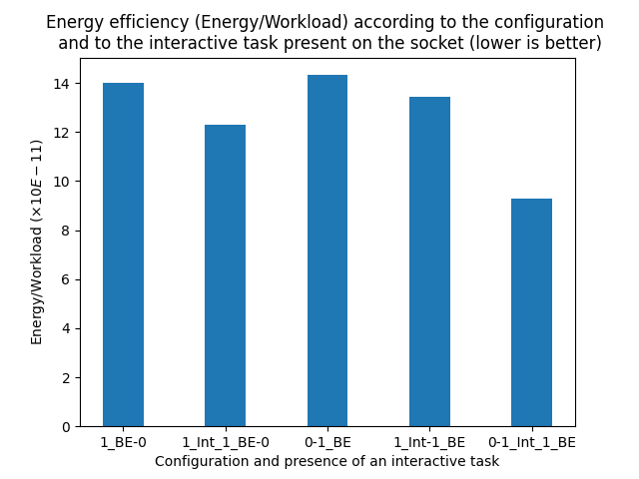
4. Experiments and observations (made using APIs)
Phone: Samsung S8
Impact of: Other interactive tasks
Experiments duration: 5 and- 10 min
Legend: Configuration 1_Int_1_BE-0 means
    1 Interactive thread on Big Socket
    1 benchmarked thread on big Socket
    0 Thread on big socket
16 / ???

Slide 38
4. Experiments and observations (made using APIs)
Phone: Samsung S8
Impact of: Other interactive tasks
Experiments duration: 5 and- 10 min
Legend: Configuration 1_Int_1_BE-0 means
    1 Interactive thread on Big Socket
    1 benchmarked thread on big Socket
    0 Thread on big socket
Generally we are more efficient when running thread with other interactive tasks on the same socket.
Generally we are more efficient when running thread with other interactive tasks on the same socket.
16 / ???

Slide 39
4. Experiments and observations (made using APIs)
Phone: Samsung S8
Impact of: Other interactive tasks
Experiments duration: 5 and- 10 min
Legend: Configuration 1_Int_1_BE-0 means
    1 Interactive thread on Big Socket
    1 benchmarked thread on big Socket
    0 Thread on big socket
Generally we are more efficient when running thread with other interactive tasks on the same socket.
Generally we are more efficient when running thread with other interactive tasks on the same socket.
Co-location is more efficient on Big Sockets
16 / ???

Slide 40
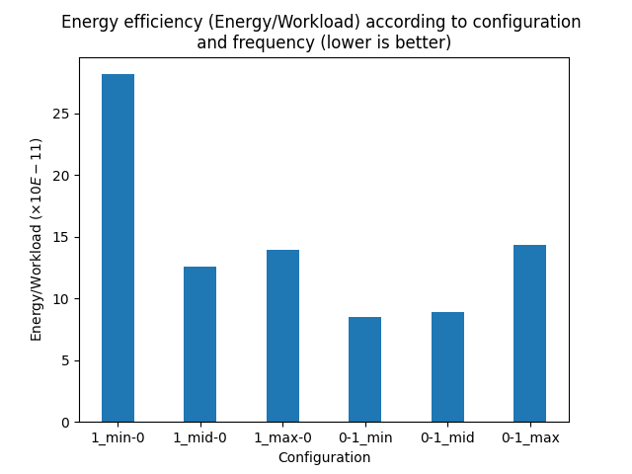
4. Experiments and observations (made using APIs)
Phone: Samsung S8
Impact of: Frequency
Experiments duration: 5 min
Legend: Configuration 0-1_mid means
  0 thread on Little sockets
  1 Thread on Big Socket
  Big socket runs with frequency at middle level.
  Mid = middle level, min = minimum level
    Max = maximum frequency
17 / ???

Slide 41
4. Experiments and observations (made using APIs)
Phone: Samsung S8
Impact of: Frequency
Experiments duration: 5 min
Legend: Configuration 0-1_mid means
  0 thread on Little sockets
  1 Thread on Big Socket
  Big socket runs with frequency at middle level.
  Mid = middle level, min = minimum level
    Max = maximum frequency
At slightly reduced frequency the Little cores are efficient
17/ ???

Slide 42
4. Experiments and observations (made using APIs)
Phone: Samsung S8
Impact of: Frequency
Experiments duration: 5 min
Legend: Configuration 0-1_mid means
  0 thread on Little sockets
  1 Thread on Big Socket
  Big socket runs with frequency at middle level.
  Mid = middle level, min = minimum level
    Max = maximum frequency
At slightly reduced frequency the Little cores are efficient
It is more efficient to reduced frequency on the Big cores as much as possible for one task.
17 / ???

Slide 43
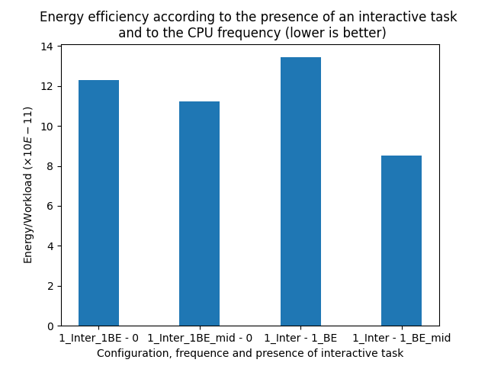
4. Experiments and observations (made using APIs)
Phone: Samsung S8
Impact of: Frequency and other tasks
Experiments duration: 5 min
Legend: Configuration 1_Inter_1BE_mid-0 means
  1 Interactive thread on Big Socket
  1 benchmarked thread on big Socket
  0 thread on Little sockets
  Little socket runs with frequency at middle level.
  Mid = middle level, min = minimum level
    Max = maximum frequency
The presence of other tasks does not influence the impact of frequency on efficiency
18 / ???

Slide 44
4. Experiments and observations (made using APIs)
Phone: Samsung S8
Impact of: Frequency and other tasks
Experiments duration: 5 min
Legend: Configuration 1_Inter_1BE_mid-0 means
  1 Interactive thread on Big Socket
  1 benchmarked thread on big Socket
  0 thread on Little sockets
  Little socket runs with frequency at middle level.
  Mid = middle level, min = minimum level
    Max = maximum frequency
The presence of other tasks does not influence the impact of frequency on efficiency
Type of Core: It is more efficient to reduced frequency
slightly on Little cores
as much as possible on the Big cores.
18 / ???

Slide 45
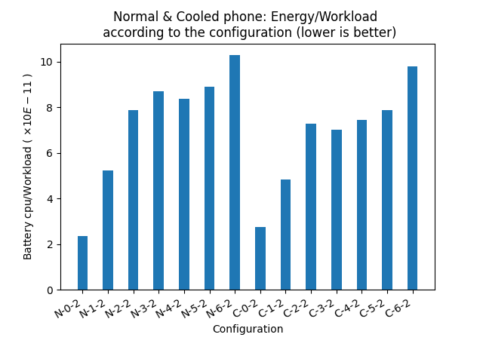
4. Experiments and observations (made using APIs)
Phone: Google Pixel
Impact of: Temperature
Experiments duration: 10 min
Legend: Configuration N-0-1 means:
Normal environment
0 thread on Little core
1 thread on Big core
Configuration C-0-1 means:
Cooled environment
0 thread on Little core
1 thread on Big core
19 / ???

Slide 46
4. Experiments and observations (made using APIs)
Phone: Google Pixel
Impact of: Temperature
Experiments duration: 10 min
Legend: Configuration N-0-1 means:
Normal environment
0 thread on Little core
1 thread on Big core
Configuration C-0-1 means:
Cooled environment
0 thread on Little core
1 thread on Big core
Low temperature cores seem much more efficient than high temperature ones
19 / ???

Slide 47
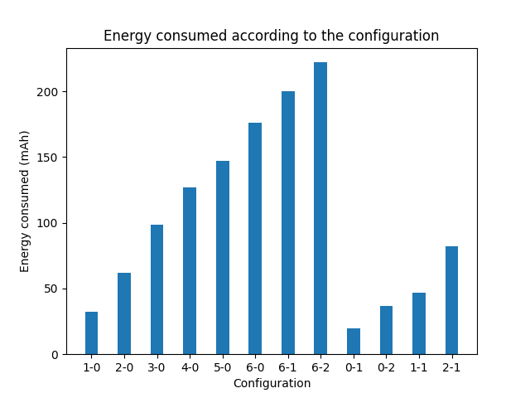
4. Strange observations made using APIs on google Pixel
Phone: Google Pixel
Impact of: Measurement method !!!
Experiments duration: 10 min
Legend: Configuration 0-1 means:
0 thread on Little core
1 thread on Big core
20 / ???

Slide 48
4. Strange observations made using APIs on google Pixel
Phone: Google Pixel
Impact of: Measurement method !!!
Experiments duration: 10 min
Legend: Configuration 0-1 means:
0 thread on Little core
1 thread on Big core
Little core seems to consume more energy than Big core.
20 / ???

Slide 49
4. Strange observations made using APIs on google Pixel
Phone: Google Pixel
Impact of: Measurement method !!!
Experiments duration: 10 min
Legend: Configuration 0-1 means:
0 thread on Little core
1 thread on Big core
Little core seems to consume more energy than Big core.
We had to restart experiments to validate previous observations
(Missing submission death-lines)
20 / ???

Slide 50
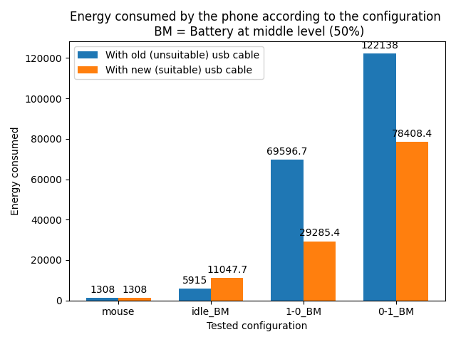
4. Experiments and observations (made using the power-meter)
Phone: Google Pixel
Impact of: Measurement method !!!
Experiments duration: 10 min
Battery level: 50
No charging: Yes by the file
charge_stop_level
Legend: Configuration 0-1_BM means:
0 thread on Little core
1 thread on Big core
Battery at Middle level
Idle = phone is idle
21 / ???

Slide 51
4. Experiments and observations (made using the power-meter)
Phone: Google Pixel
Impact of: Measurement method !!!
Experiments duration: 10 min
Battery level: 50
No charging: Yes by the file
charge_stop_level
Legend: Configuration 0-1_BM means:
0 thread on Little core
1 thread on Big core
Battery at Middle level
Idle = phone is idle
The quality of the equipment (USB cable) impact results
21 / ???

Slide 52
4. Experiments and observations (made using the power-meter)
Phone: Google Pixel
Impact of: Measurement method !!!
Experiments duration: 10 min
Battery level: 50
No charging: Yes by the file
charge_stop_level
Legend: Configuration 0-1_BM means:
0 thread on Little core
1 thread on Big core
Battery at Middle level
Idle = phone is idle
The quality of the equipment (USB cable) impact results
With the power-meter, results seem consistent with reality
21 / ???

Slide 53
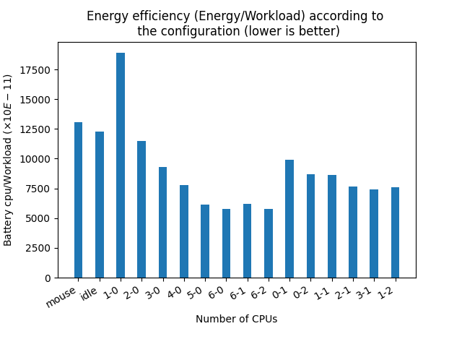
4. Experiments and observations (made using the power-meter)
Phone: Google Pixel
Impact of: Number of threads
Experiments duration: 10 min
Battery level: 50
No charging: Yes by the file
charge_stop_level
Legend: Configuration 0-1 means:
0 thread on Little core
1 thread on Big core
22 / ???

Slide 54
4. Experiments and observations (made using the power-meter)
Phone: Google Pixel
Impact of: Number of threads
Experiments duration: 10 min
Battery level: 50
No charging: Yes by the file
charge_stop_level
Legend: Configuration 0-1 means:
0 thread on Little core
1 thread on Big core
On the same socket the number of threads slightly increases with the efficiency
On the same socket the number of threads slightly increases with the efficiency
22 / ???

Slide 55
4. Experiments and observations (made using the power-meter)
Phone: Google Pixel
Impact of: Type of Cores
Experiments duration: 10 min
Battery level: 50
No charging: Yes by the file
charge_stop_level
Legend: Configuration 0-1 means:
0 thread on Little core
1 thread on Big core
23 / ???

Slide 56
4. Experiments and observations (made using the power-meter)
Phone: Google Pixel
Impact of: Type of Cores
Experiments duration: 10 min
Battery level: 50
No charging: Yes by the file
charge_stop_level
Legend: Configuration 0-1 means:
0 thread on Little core
1 thread on Big core
Big cores are much more efficient than little cores
23 / ???

Slide 57
4. Experiments and observations (made using the power-meter)
Phone: Google Pixel
Impact of: Type of Cores
Experiments duration: 10 min
Battery level: 50
No charging: Yes by the file
charge_stop_level
Legend: Configuration 0-1 means:
0 thread on Little core
1 thread on Big core
Big cores are much more efficient than little cores (for about …%)
The efficiency of the big cores influences the overall efficiency of the configuration
23 / ???

Slide 58
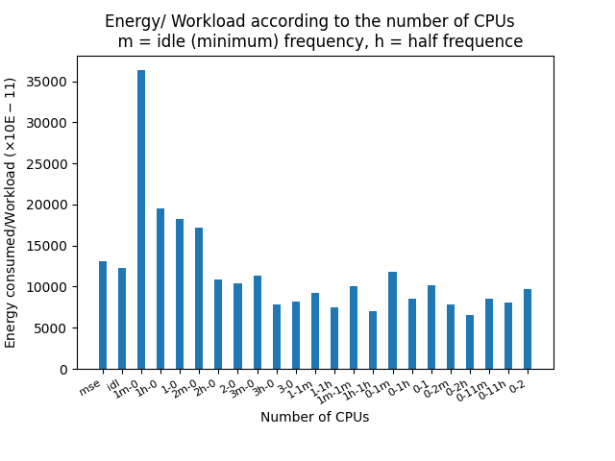
4. Experiments and observations (made using the power-meter)
Phone: Google Pixel
Impact of: Frequency
Experiments duration: 10 min
Battery level: 50
No charging: Yes by the file
charge_stop_level
Legend: Configuration 0-1m means:
0 thread on Little core
1 thread on Big core
The Big core has the min frequency
H = half frequency, nothing = max frequency
24 / ???

Slide 59
4. Experiments and observations (made using the power-meter)
Phone: Google Pixel
Impact of: Frequency
Experiments duration: 10 min
Battery level: 50
No charging: Yes by the file
charge_stop_level
Legend: Configuration 0-1m means:
0 thread on Little core
1 thread on Big core
The Big core has the min frequency
H = half frequency, nothing = max frequency
On the Little cores we are much more efficient with the maximum frequency
24 / ???

Slide 60
4. Experiments and observations (made using the power-meter)
Phone: Google Pixel
Impact of: Frequency
Experiments duration: 10 min
Battery level: 50
No charging: Yes by the file
charge_stop_level
Legend: Configuration 0-1m means:
0 thread on Little core
1 thread on Big core
The Big core has the min frequency
H = half frequency, nothing = max frequency
On the Little cores we are much more efficient with the maximum frequency
On the Big cores we are much more efficient with the mid frequency
24 / ???

Slide 61
4. Experiments and observations (made using the power-meter)
Phone: Google Pixel
Impact of: Frequency and number of Threads
Experiments duration: 10 min
Battery level: 50
No charging: Yes by the file
charge_stop_level
Legend: Configuration 0-1m means:
0 thread on Little core
1 thread on Big core
The Big core has the min frequency
H = half frequency, nothing = max frequency
25 / ???

Slide 62
4. Experiments and observations (made using the power-meter)
Phone: Google Pixel
Impact of: Frequency and number of Threads
Experiments duration: 10 min
Battery level: 50
No charging: Yes by the file
charge_stop_level
Legend: Configuration 0-1m means:
0 thread on Little core
1 thread on Big core
The Big core has the min frequency
H = half frequency, nothing = max frequency
Fixing the frequency at mid level and increasing the number of threads increases the efficiency drastically
25 / ???

Slide 63
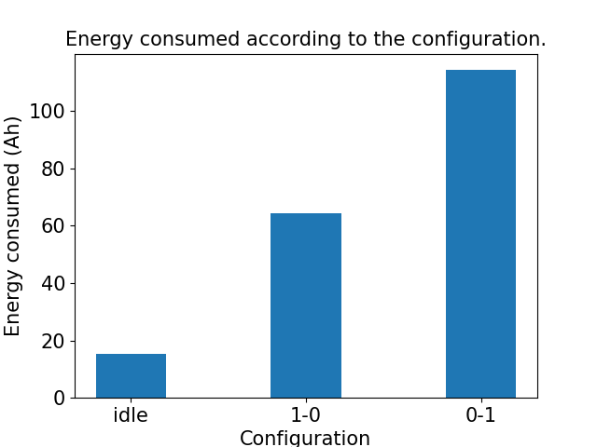
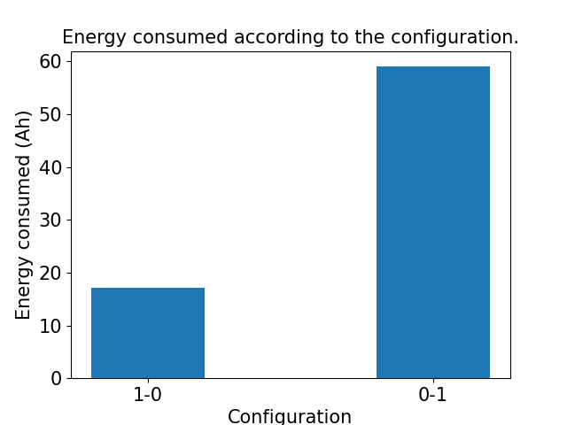
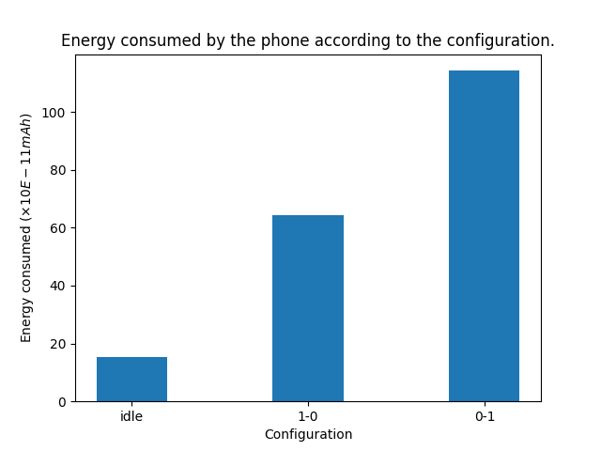
4. Next steps
Same experiments on Samsung
  Good news: No limitations on the number of configurations as with APIs.
  We use cc_info file and the power-meter
  We suspect that APIs on samsung was not far from reality in term of energy ratio.
With the power-meter
With Google APIs
26 / ???

Slide 64
4. Next steps
Made same experiments on Samsung
  Good news: No limitations on the number of configurations as with APIs.
  We use cc_info file and the power-meter
  We suspect that APIs on samsung was not far from reality in term of energy ratio.
With the power-meter
With Google APIs
Validate observations made with other Benchmaks
26 / ???

Slide 65
4. Next steps
Made same experiments on Samsung
  Good news: No limitations on the number of configurations as with APIs.
  We use cc_info file and the power-meter
  We suspect that APIs on samsung was not far from reality in term of energy ratio.
With the power-meter
With Google APIs
Validate observations made with other Benchmaks.
Valorise lessons learned and observations (publication, solution..).
26 / ???

Slide 66
Tank you for your attention.

Slide 67
General Problem Scheme
Overall system energy efficiency
Number of tasks are already present on the Phone, on which socket.
{
Mobile app
Workload Computed
Federated
Learning App
Mobile app
FL task
Number of threads to paralellise the FL task
N
Mobile app
FL thread
FL thread
...
FL thread
User space
Core temperature
System task
Kernel components
Scheduler
The type of core on which to schedule the task
Governors
Linux Kernel
Drivers / Sensors inputs
Big Core
Big Core
Core frequency
Core
frequency
Little Core
Little Core
Mobile Hardware
Energy consumed

Slide 68
2. template slide
Manually make experiments by varying scenarios parameters:
  Number of interactive task present on phones
  Number of threads to paralellise the FL task
  Type of cores
  Core frequencies
Bringing out the lessons learned
Apply these lessons learned in the FL task scheduling process:
  At user space Level
  At kernel Level (Scheduler, governor).

