Slide 1


Energy-efficient execution of Federated learning tasks on mobile phones: An exploratory study.
Presented by Patrick Wapet, Post Doc at LIRIS Laboratory, INSA Lyon In collaboration with Dr. Tran Giang Son, University of Science and Technology of Hanoi and Dr. Boris Teabe, INP Toulouse Supervised by By Vlad Nitu,
2 / ???

Slide 2
Summary
Context: Federated Learning and mobile phones.
Problem definition: Global scheme
Challenges: Parameters, metrics, approach and measurement tools.
Experiments and observations: reported according to the parameters, graphs and partial conclusions.
Next steps: next experiments, possibly implementations and submissions.

Slide 3
1. Context: Federated Learning
Artificial Intelligence is more and more used in everyday life.
By default it is a system that centralizes data.
Posing the problem of privacy.
A solution: keep the data with the users.
On their devices : Mobile phones
Do the processing on these phones: Federated Learning

Slide 4
2. Let state the problem: general scheme
Mobile app
Mobile app
Mobile app
User space
System task
Kernel components
Governors
Scheduler
Linux Kernel
Drivers / Sensors inputs
Big Core
Big Core
Core
frequency
Little Core
Little Core
Mobile Hardware

Slide 5
2. Let state the problem: general scheme
Mobile app
Federated
Learning App
Mobile app
FL task
Mobile app
FL thread
FL thread
...
FL thread
User space
System task
Kernel components
Governors
Scheduler
Linux Kernel
Drivers / Sensors inputs
Big Core
Big Core
Core
frequency
Little Core
Little Core
Mobile Hardware

Slide 6
3.a. Let us define the metric to optimize
The metric should reflect both:
Computing power of the FL task execution
Electrical power absorption of the phone.
To compute this metric we have:
The workload of the FL task: number of CPU operations.
The total energy consumed: obtained by measurements.
Metric adopted for the project: energy efficiency
${energy}_{eff}=\frac{Energyconsumed}{workloadcomputed}=\frac{Powerabsorbed}{Computingpower}$

Slide 7
2. Let state the problem: general scheme
Mobile app
Federated
Learning App
Mobile app
FL task
Mobile app
FL thread
FL thread
...
FL thread
User space
System task
Kernel components
Governors
Scheduler
Linux Kernel
Drivers / Sensors inputs
Big Core
Big Core
Core
frequency
Little Core
Little Core
Mobile Hardware

Slide 8
3.a. Let us define the metric to optimize on our problem scheme
Mobile app
Workload Computed
Federated
Learning App
Mobile app
FL task
Mobile app
FL thread
FL thread
FL thread
User space
System task
Kernel components
Governors
Scheduler
Linux Kernel
Drivers / Sensors inputs
Big Core
Big Core
Core
frequency
Little Core
Little Core
Mobile Hardware

Slide 9
3.a. Let us define the metric to optimize on our problem scheme
Mobile app
Workload Computed
Federated
Learning App
Mobile app
FL task
Mobile app
FL thread
FL thread
...
FL thread
User space
System task
Kernel components
Governors
Scheduler
Linux Kernel
Drivers / Sensors inputs
Big Core
Big Core
Core
frequency
Little Core
Little Core
Mobile Hardware
Energy consumed

Slide 10
3.a. Let us define the metric to optimize on our problem scheme
Overall system energy efficiency
Mobile app
Workload Computed
Federated
Learning App
Mobile app
FL task
Mobile app
FL thread
FL thread
...
FL thread
User space
System task
Kernel components
Governors
Scheduler
Linux Kernel
Drivers / Sensors inputs
Big Core
Big Core
Core
frequency
Little Core
Little Core
Mobile Hardware
Energy consumed

Slide 11
3.b. What influences the energy efficiency
The type of cores executing the task
Intuitively Big cores consumed high amount of Energy
Some research experiments prove that it can be a factor. [1]
The task already present of the cores.
Energy discounted approach [2].
The core frequency.
[1] Full-System Simulation of big.LITTLE Multicore Architecture for Performance and Energy Exploration. Anastasiia Butko et al [2] Energy Discounted Computing on Multicore Smartphones, Meng Zhu Kai Shen University of Rochester
[3] Machine Learning-Based Approaches for Energy-Efficiency Prediction and Scheduling in Composite Cores Architectures
Hossein Sayadi et al. [4] Temperature-Aware Scheduler Based on Thermal Behavior Grouping in Multicore Systems Inchoon Yeo and Eun Jung Kim
<number>

Slide 12
3.b. What influences the energy efficiency
The type of cores executing the task
Intuitively Big cores consumed high amount of Energy
Some research experiments prove that it can be a factor. [1]
The task already present of the cores.
Energy discounted approach [2].
The core frequency.
We wanted to limit ourselves to the previous parameters, but it was with no real basis.
[1] Full-System Simulation of big.LITTLE Multicore Architecture for Performance and Energy Exploration. Anastasiia Butko et al [2] Energy Discounted Computing on Multicore Smartphones, Meng Zhu Kai Shen University of Rochester
[3] Machine Learning-Based Approaches for Energy-Efficiency Prediction and Scheduling in Composite Cores Architectures
Hossein Sayadi et al. [4] Temperature-Aware Scheduler Based on Thermal Behavior Grouping in Multicore Systems Inchoon Yeo and Eun Jung Kim
<number>

Slide 13
3.b. What influences the energy efficiency
The type of cores executing the task
Intuitively Big cores consumed high amount of Energy
Some research experiments prove that it can be a factor. [1]
The task already present of the cores.
Energy discounted approach [2].
The core frequency.
We wanted to limit ourselves to the previous parameters, but it was with no real basis.
The Number of threads of the best effort task
Mentioned In research [3].
Core temperature [4].
[1] Full-System Simulation of big.LITTLE Multicore Architecture for Performance and Energy Exploration. Anastasiia Butko et al [2] Energy Discounted Computing on Multicore Smartphones, Meng Zhu Kai Shen University of Rochester
[3] Machine Learning-Based Approaches for Energy-Efficiency Prediction and Scheduling in Composite Cores Architectures
Hossein Sayadi et al. [4] Temperature-Aware Scheduler Based on Thermal Behavior Grouping in Multicore Systems Inchoon Yeo and Eun Jung Kim
<number>

Slide 14
3.b. What influences the energy efficiency on our problem scheme
Overall system energy efficiency
Mobile app
Workload Computed
Federated
Learning App
Mobile app
FL task
Mobile app
FL thread
FL thread
...
FL thread
User space
System task
Kernel components
Governors
Scheduler
Linux Kernel
Drivers / Sensors inputs
Big Core
Big Core
Core
frequency
Little Core
Little Core
Mobile Hardware
Energy consumed

Slide 15
3.b. What influences the energy efficiency on our problem scheme
Overall system energy efficiency
Number of tasks are already present on the Phone, on which socket.
{
Mobile app
Workload Computed
Federated
Learning App
Mobile app
FL task
Mobile app
FL thread
FL thread
...
FL thread
User space
System task
Kernel components
Governors
Scheduler
Linux Kernel
Drivers / Sensors inputs
Big Core
Big Core
Core
frequency
Little Core
Little Core
Mobile Hardware
Energy consumed
<number>

Slide 16
3.b. What influences the energy efficiency on our problem scheme
Overall system energy efficiency
Number of tasks are already present on the Phone, on which socket.
{
Mobile app
Workload Computed
Federated
Learning App
Mobile app
FL task
Mobile app
FL thread
FL thread
...
FL thread
User space
Core temperature
System task
Kernel components
Governors
Scheduler
Linux Kernel
Drivers / Sensors inputs
Big Core
Big Core
Core
frequency
Little Core
Little Core
Mobile Hardware
Energy consumed

Slide 17
3.b. What influences the energy efficiency on our problem scheme
Overall system energy efficiency
Number of tasks are already present on the Phone, on which socket.
{
Mobile app
Workload Computed
Federated
Learning App
Mobile app
FL task
Number of threads of the FL task
N
Mobile app
FL thread
FL thread
...
FL thread
User space
Core temperature
System task
Kernel components
Governors
Scheduler
Linux Kernel
Drivers / Sensors inputs
Big Core
Big Core
Core
frequency
Little Core
Little Core
Mobile Hardware
Energy consumed

Slide 18
3.b. What influences the energy efficiency on our problem scheme
Overall system energy efficiency
Number of tasks are already present on the Phone, on which socket.
{
Mobile app
Workload Computed
Federated
Learning App
Mobile app
FL task
Number of threads of the FL task
N
Mobile app
FL thread
FL thread
...
FL thread
User space
Core temperature
System task
Kernel components
Scheduler
The type of core on which to schedule the task
Governors
Linux Kernel
Drivers / Sensors inputs
Big Core
Big Core
Core
frequency
Little Core
Little Core
Mobile Hardware
Energy consumed

Slide 19
3.b. What influences the energy efficiency on our problem scheme
Overall system energy efficiency
Number of tasks are already present on the Phone, on which socket.
{
Mobile app
Workload Computed
Federated
Learning App
Mobile app
FL task
Number of threads of the FL task
N
Mobile app
FL thread
FL thread
...
FL thread
User space
Core temperature
System task
Kernel components
Scheduler
The type of core on which to schedule the task
Governors
Linux Kernel
Drivers / Sensors inputs
Big Core
Big Core
Core frequency
Core
frequency
Little Core
Little Core
Mobile Hardware
Energy consumed

Slide 20
3.d Approach to resolve the problem
Make in-lab experiments by varying scenarios parameters:
Number of interactive task present on phones
Number of threads of the FL task
Type of cores
Core frequencies (when possible)
Bringing out the lessons learned about HOW those parameters influence energy efficiency.
Apply these lessons learned in the FL task scheduling decision:
At user space Level
At kernel Level (Scheduler, governor).

Slide 21
3.e Workload measurement
Benchmarks (In lab Mobile Apps)
Prime number computation (to quickly get an overview of cores energy efficiency) [1]
Tensor Flow Lite model on Mobile Device [2] (to have ML-like task behavior)
Federated Learning Tool from FLEET (for FL-like experiments) [3]
[1] Prime number computation source code https://gitlab.liris.cnrs.fr/plwapet/benchmarking_app_to_test_big_cores/-/blob/main/app/src/main/java/com/opportunistask/scheduling/benchmarking_app_to_test_big_cores/PrimeNumberThread.java
[2] On-Device Training with TensorFlow Lite https://www.tensorflow.org/lite/examples/on_device_training/overview
[3] FLeet: Online Federated Learning via Staleness Awareness and Performance Prediction, Georgios Damaskinos, Rachid Guerraoui, Vlad Nitu et al. Source code https://github.com/gdamaskinos/fleet/

Slide 22
3.e Workload measurement
Phones used for experiments:
Google Pixel 4A 5G:
Chipset : Qualcomm SM7250 Snapdragon 765G 5G (7 nm)
3 sockets: CPUs 0-5: 1.8048 GHz CPU 6: 2.208 GHz CPU7: 2.4 GHz
Memory: 6GB RAM
Samsung galaxy S8 :
Chipset: Exynos 8895 (10 nm) – EMEA, Qualcomm MSM8998 Snapdragon 835 (10 nm) - USA & China
2 sockets CPUs 0-3 : 1.69 GHz , CPUs 4-7: 2.314 GHz
Memory: 4GB RAM

Slide 23
3.f Energy consumption measurement: system APIs
API name : “dumpsys batterystats” from Android OS
Works in almost all phones
except in some configurations
Widely used in research [1]
We have used it for more than 7 months.
Confirms the influence of the above-mentioned parameters on the energy efficiency
But some results incompatible with reality
[1] Resource utilization and per formance, A comparative study on mobile crossplatform tools, Lucas Arvidsson, Max Bekkhus

Slide 24
3.f Energy consumption measurement: Power-meter
Also widely used in research [1][2]
The common installation required is expensive
Its makes phone battery no longer usable.
Alternative 1: Software simulation of battery shutdown (Google Pixel 4A, 5G).
Modifying internal system file : “charge_stop_level”, “charge_limit”
USB mode power supply
Retrieving data from powermeter
Alternative 2 : Full battery charging (Samsung)
Retriving data from system file “cc_info”
Retrieving data form powermeter
[1]"Energy Consumption and Conservation in WiFi Based Phones: A Measurement-Based Study By Ashima Gupta and Prasant Mohapatra"
[2] Energy-Efficient Collaborative Sensing with Mobile Phones Xiang Sheng∗

Slide 25
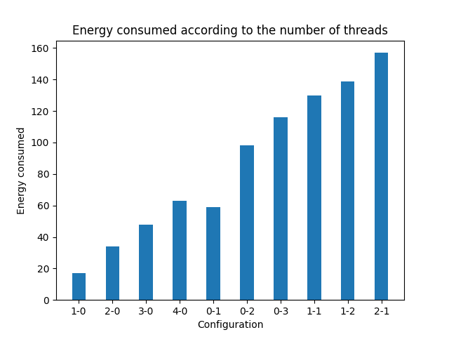
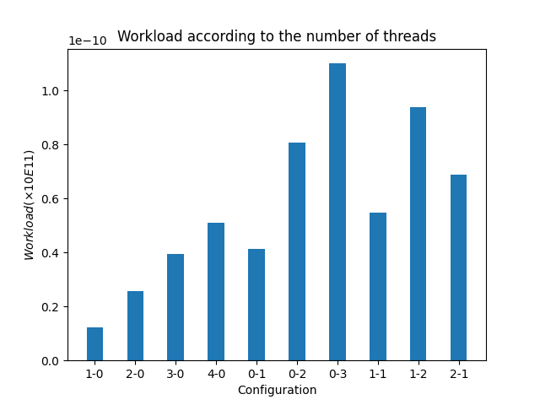
4. Experiments and observations (made using APIs)
Phone: Samsung S8 Impact of: Type or Core
Experiments duration: 10 min Legend: Configuration 0-1 means
0 thread on Little sockets
1 Thread on Big Socket

Slide 26
4. Experiments and observations (made using APIs)
Phone: Samsung S8 Impact of: Type or Core
Experiments duration: 10 min Legend: Configuration 0-1 means
0 thread on Little sockets
1 Thread on Big Socket
Big Cores consume a lot of energy compared to little cores

Slide 27
4. Experiments and observations (made using APIs)
Phone: Samsung S8 Impact of: Type or Core
Experiments duration: 10 min Legend: Configuration 0-1 means
0 thread on Little sockets
1 Thread on Big Socket
Big cores are very fast in computation
Big Cores consume a lot of energy compared to little cores

Slide 28
4. Experiments and observations (made using APIs)
Phone: Samsung S8 Impact of: Number of threads
Experiments duration: 10 min Legend: Configuration 0-1 means
0 thread on Little sockets
1 Thread on Big Socket

Slide 29
4. Experiments and observations (made using APIs)
Phone: Samsung S8 Impact of: Number of threads
Experiments duration: 10 min Legend: Configuration 0-1 means
0 thread on Little sockets
1 Thread on Big Socket
The energy consumed always grows linearly with the number of threads

Slide 30
4. Experiments and observations (made using APIs)
Phone: Samsung S8 Impact of: Number of threads
Experiments duration: 10 min Legend: Configuration 0-1 means
0 thread on Little sockets
1 Thread on Big Socket
The energy consumed always grows linearly with the number of threads
The workload computed grows linearly with the number of threads

Slide 31
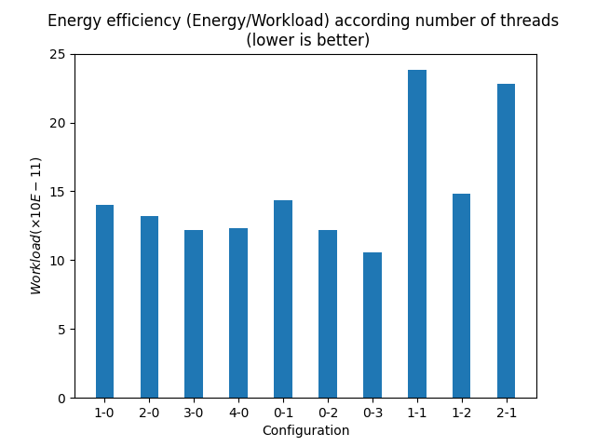
4. Experiments and observations (made using APIs)
Phone: Samsung S8 Impact of: Number of Threads
Experiments duration: 10 min Legend: Configuration 0-1 means
0 thread on Little sockets
1 Thread on Big Socket

Slide 32
4. Experiments and observations (made using APIs)
Phone: Samsung S8 Impact of: Number of Threads
Experiments duration: 10 min Legend: Configuration 0-1 means
0 thread on Little sockets
1 Thread on Big Socket
On the same socket the number of threads slightly increases with the efficiency

Slide 33
4. Experiments and observations (made using APIs)
Phone: Samsung S8 Impact of: Other CPU intensive tasks
Experiments duration: 10 min Legend: Configuration 0-1 means
0 thread on Little sockets
1 Thread on Big Socket

Slide 34
4. Experiments and observations (made using APIs)
Phone: Samsung S8 Impact of: Other CPU intensive tasks
Experiments duration: 10 min Legend: Configuration 0-1 means
0 thread on Little sockets
1 Thread on Big Socket
Generally we are more efficient when threads are on the same socket

Slide 35
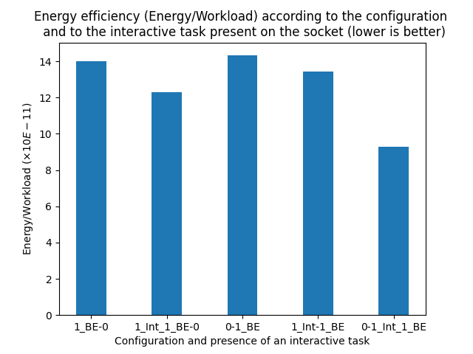
4. Experiments and observations (made using APIs)
Phone: Samsung S8 Impact of: Other interactive tasks
Experiments duration: 5 and- 10 min Legend: Configuration 1_Int_1_BE-0 means
1 Interactive thread on Big Socket
1 benchmarked thread on big Socket
0 Thread on big socket

Slide 36
4. Experiments and observations (made using APIs)
Phone: Samsung S8 Impact of: Other interactive tasks
Experiments duration: 5 and- 10 min Legend: Configuration 1_Int_1_BE-0 means
1 Interactive thread on Big Socket
1 benchmarked thread on big Socket
0 Thread on big socket
Generally we are more efficient when running thread with other interactive tasks on the same socket.
Generally we are more efficient when running thread with other interactive tasks on the same socket.

Slide 37
4. Experiments and observations (made using APIs)
Phone: Samsung S8 Impact of: Other interactive tasks
Experiments duration: 5 and- 10 min Legend: Configuration 1_Int_1_BE-0 means
1 Interactive thread on Big Socket
1 benchmarked thread on big Socket
0 Thread on big socket
Generally we are more efficient when running thread with other interactive tasks on the same socket.
Generally we are more efficient when running thread with other interactive tasks on the same socket.
Co-location is more efficient on Big Sockets

Slide 38
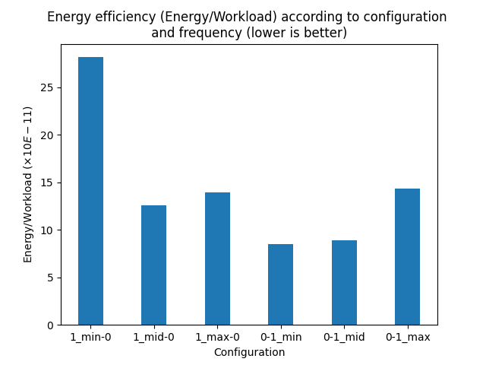
4. Experiments and observations (made using APIs)
Phone: Samsung S8 Impact of: Frequency
Experiments duration: 5 min Legend: Configuration 0-1_mid means
0 thread on Little sockets
1 Thread on Big Socket
Big socket runs with frequency at middle level.
Mid = middle level, min = minimum level
Max = maximum frequency

Slide 39
4. Experiments and observations (made using APIs)
Phone: Samsung S8 Impact of: Frequency
Experiments duration: 5 min Legend: Configuration 0-1_mid means
0 thread on Little sockets
1 Thread on Big Socket
Big socket runs with frequency at middle level.
Mid = middle level, min = minimum level
Max = maximum frequency
At slightly reduced frequency the Little cores are efficient

Slide 40
4. Experiments and observations (made using APIs)
Phone: Samsung S8 Impact of: Frequency
Experiments duration: 5 min Legend: Configuration 0-1_mid means
0 thread on Little sockets
1 Thread on Big Socket
Big socket runs with frequency at middle level.
Mid = middle level, min = minimum level
Max = maximum frequency
At slightly reduced frequency the Little cores are efficient
It is more efficient to reduced frequency on the Big cores as much as possible for one task.

Slide 41
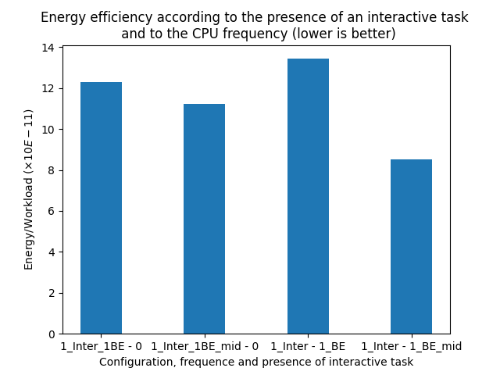
4. Experiments and observations (made using APIs)
Phone: Samsung S8 Impact of: Frequency and other tasks
Experiments duration: 5 min Legend: Configuration 1_Inter_1BE_mid-0 means
1 Interactive thread on Big Socket
1 benchmarked thread on big Socket
0 thread on Little sockets
Little socket runs with frequency at middle level.
Mid = middle level, min = minimum level
Max = maximum frequency
The presence of other tasks does not influence the impact of frequency on efficiency

Slide 42
4. Experiments and observations (made using APIs)
Phone: Samsung S8 Impact of: Frequency and other tasks
Experiments duration: 5 min Legend: Configuration 1_Inter_1BE_mid-0 means
1 Interactive thread on Big Socket
1 benchmarked thread on big Socket
0 thread on Little sockets
Little socket runs with frequency at middle level.
Mid = middle level, min = minimum level
Max = maximum frequency
The presence of other tasks does not influence the impact of frequency on efficiency
Type of Core: It is more efficient to reduced frequency
slightly on Little cores
as much as possible on the Big cores.

Slide 43
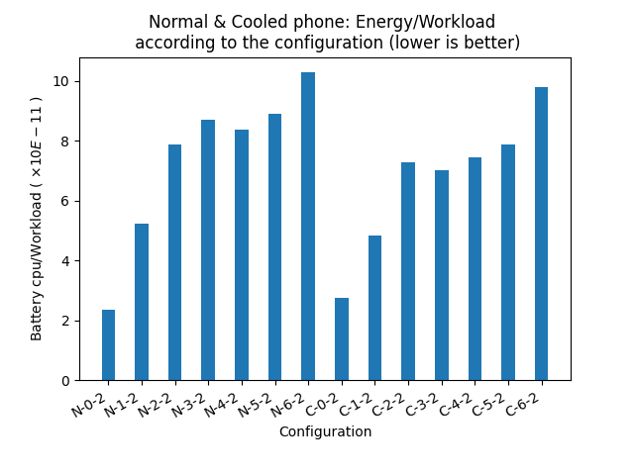
4. Experiments and observations (made using APIs)
Phone: Google Pixel Impact of: Temperature
Experiments duration: 10 min Legend: Configuration N-0-1 means:
Normal environment
0 thread on Little core
1 thread on Big core Configuration C-0-1 means:
Cooled environment
0 thread on Little core
1 thread on Big core

Slide 44
4. Experiments and observations (made using APIs)
Phone: Google Pixel Impact of: Temperature
Experiments duration: 10 min Legend: Configuration N-0-1 means:
Normal environment
0 thread on Little core
1 thread on Big core Configuration C-0-1 means:
Cooled environment
0 thread on Little core
1 thread on Big core
Low temperature cores seem much more efficient than high temperature ones

Slide 45
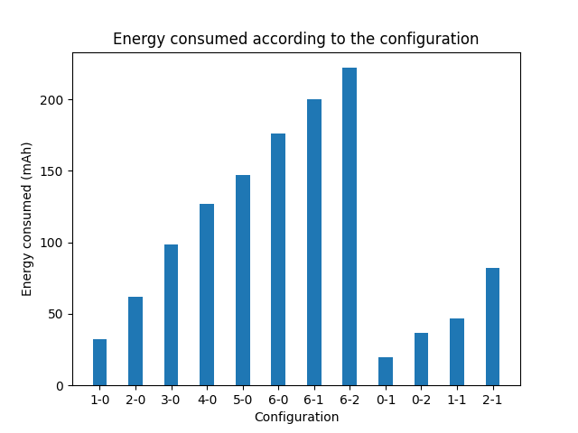
4. Strange observations made using APIs on google Pixel
Phone: Google Pixel Impact of: Measurement method !!!
Experiments duration: 10 min Legend: Configuration 0-1 means:
0 thread on Little core
1 thread on Big core

Slide 46
4. Strange observations made using APIs on google Pixel
Phone: Google Pixel Impact of: Measurement method !!!
Experiments duration: 10 min Legend: Configuration 0-1 means:
0 thread on Little core
1 thread on Big core
Little core seems to consume more energy than Big core.

Slide 47
4. Strange observations made using APIs on google Pixel
Phone: Google Pixel Impact of: Measurement method !!!
Experiments duration: 10 min Legend: Configuration 0-1 means:
0 thread on Little core
1 thread on Big core
Little core seems to consume more energy than Big core.
We had to restart experiments to validate previous observations (Missing submission death-lines)

Slide 48
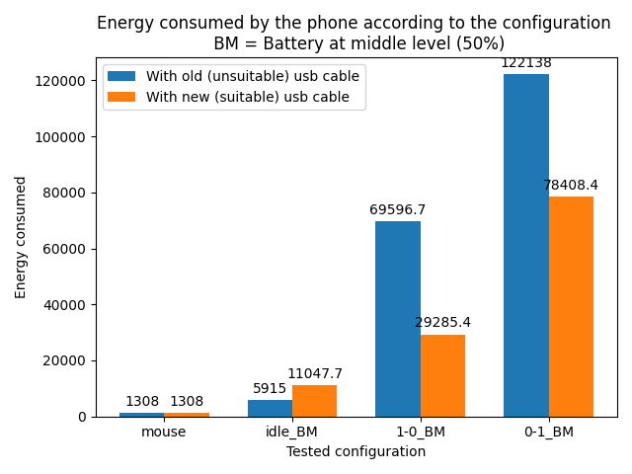
4. Experiments and observations (made using the power-meter)
Phone: Google Pixel Impact of: Measurement method !!!
Experiments duration: 10 min
Battery level: 50
No charging: Yes by the file charge_stop_level Legend: Configuration 0-1_BM means:
0 thread on Little core
1 thread on Big core
Battery at Middle level
Idle = phone is idle

Slide 49
4. Experiments and observations (made using the power-meter)
Phone: Google Pixel Impact of: Measurement method !!!
Experiments duration: 10 min
Battery level: 50
No charging: Yes by the file charge_stop_level Legend: Configuration 0-1_BM means:
0 thread on Little core
1 thread on Big core
Battery at Middle level
Idle = phone is idle
The quality of the equipment (USB cable) impact results

Slide 50
4. Experiments and observations (made using the power-meter)
Phone: Google Pixel Impact of: Measurement method !!!
Experiments duration: 10 min
Battery level: 50
No charging: Yes by the file charge_stop_level Legend: Configuration 0-1_BM means:
0 thread on Little core
1 thread on Big core
Battery at Middle level
Idle = phone is idle
The quality of the equipment (USB cable) impact results
With the power-meter, results seem consistent with reality

Slide 51
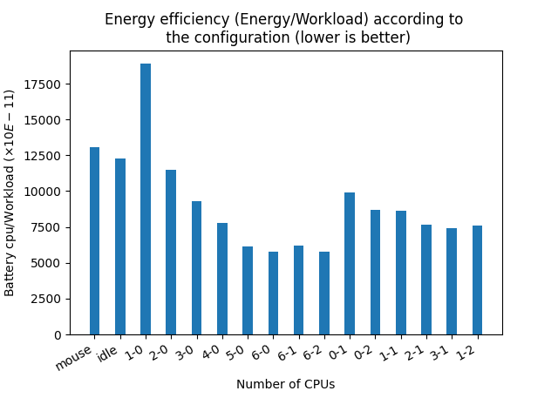
4. Experiments and observations (made using the power-meter)
Phone: Google Pixel Impact of: Number of threads
Experiments duration: 10 min
Battery level: 50
No charging: Yes by the file charge_stop_level Legend: Configuration 0-1 means:
0 thread on Little core
1 thread on Big core

Slide 52
4. Experiments and observations (made using the power-meter)
Phone: Google Pixel Impact of: Number of threads
Experiments duration: 10 min
Battery level: 50
No charging: Yes by the file charge_stop_level Legend: Configuration 0-1 means:
0 thread on Little core
1 thread on Big core
On the same socket the number of threads slightly increases with the efficiency
On the same socket the number of threads slightly increases with the efficiency

Slide 53
4. Experiments and observations (made using the power-meter)
Phone: Google Pixel Impact of: Type of Cores
Experiments duration: 10 min
Battery level: 50
No charging: Yes by the file charge_stop_level Legend: Configuration 0-1 means:
0 thread on Little core
1 thread on Big core

Slide 54
4. Experiments and observations (made using the power-meter)
Phone: Google Pixel Impact of: Type of Cores
Experiments duration: 10 min
Battery level: 50
No charging: Yes by the file charge_stop_level Legend: Configuration 0-1 means:
0 thread on Little core
1 thread on Big core
Big cores are much more efficient than little cores

Slide 55
4. Experiments and observations (made using the power-meter)
Phone: Google Pixel Impact of: Type of Cores
Experiments duration: 10 min
Battery level: 50
No charging: Yes by the file charge_stop_level Legend: Configuration 0-1 means:
0 thread on Little core
1 thread on Big core
Big cores are much more efficient than little cores (for about …%)
The efficiency of the big cores influences the overall efficiency of the configuration

Slide 56
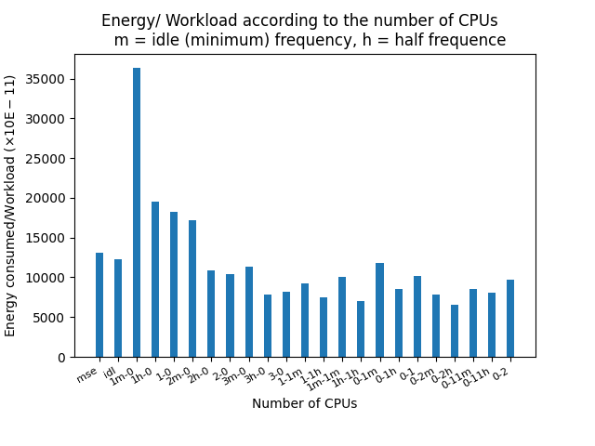
4. Experiments and observations (made using the power-meter)
Phone: Google Pixel Impact of: Frequency
Experiments duration: 10 min
Battery level: 50
No charging: Yes by the file charge_stop_level Legend: Configuration 0-1m means:
0 thread on Little core
1 thread on Big core
The Big core has the min frequency
H = half frequency, nothing = max frequency

Slide 57
4. Experiments and observations (made using the power-meter)
Phone: Google Pixel Impact of: Frequency
Experiments duration: 10 min
Battery level: 50
No charging: Yes by the file charge_stop_level Legend: Configuration 0-1m means:
0 thread on Little core
1 thread on Big core
The Big core has the min frequency
H = half frequency, nothing = max frequency
On the Little cores we are much more efficient with the maximum frequency

Slide 58
4. Experiments and observations (made using the power-meter)
Phone: Google Pixel Impact of: Frequency
Experiments duration: 10 min
Battery level: 50
No charging: Yes by the file charge_stop_level Legend: Configuration 0-1m means:
0 thread on Little core
1 thread on Big core
The Big core has the min frequency
H = half frequency, nothing = max frequency
On the Little cores we are much more efficient with the maximum frequency
On the Big cores we are much more efficient with the mid frequency

Slide 59
4. Experiments and observations (made using the power-meter)
Phone: Google Pixel Impact of: Frequency and number of Threads
Experiments duration: 10 min
Battery level: 50
No charging: Yes by the file charge_stop_level Legend: Configuration 0-1m means:
0 thread on Little core
1 thread on Big core
The Big core has the min frequency
H = half frequency, nothing = max frequency

Slide 60
4. Experiments and observations (made using the power-meter)
Phone: Google Pixel Impact of: Frequency and number of Threads
Experiments duration: 10 min
Battery level: 50
No charging: Yes by the file charge_stop_level Legend: Configuration 0-1m means:
0 thread on Little core
1 thread on Big core
The Big core has the min frequency
H = half frequency, nothing = max frequency
Fixing the frequency at mid level and increasing the number of threads increases the efficiency drastically

Slide 61
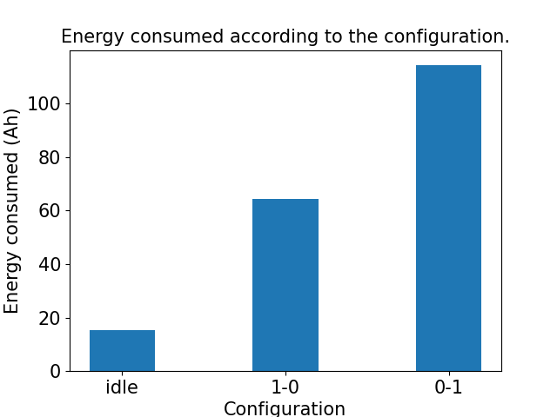
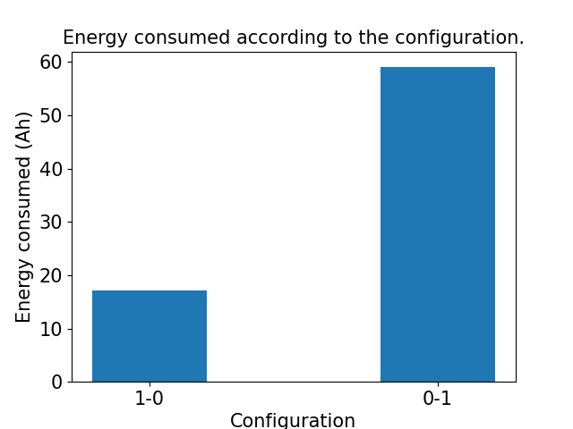
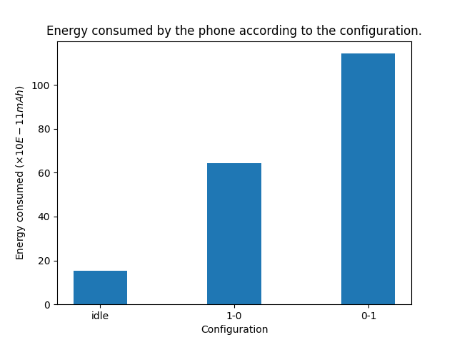
4. Next steps
Same experiments on Samsung
Good news: No limitations on the number of configurations as with APIs. We use cc_info file and the power-meter
We suspect that APIs on samsung was not far from reality in term of energy ratio.
With the power-meter
With Google APIs

Slide 62
4. Next steps
Made same experiments on Samsung
Good news: No limitations on the number of configurations as with APIs. We use cc_info file and the power-meter
We suspect that APIs on samsung was not far from reality in term of energy ratio.
With the power-meter
With Google APIs
Validate observations made with other Benchmaks

Slide 63
4. Next steps
Made same experiments on Samsung
Good news: No limitations on the number of configurations as with APIs. We use cc_info file and the power-meter
We suspect that APIs on samsung was not far from reality in term of energy ratio.
With the power-meter
With Google APIs
Validate observations made with other Benchmaks
Valorise lesson learned and observations (publication, solution..).

Slide 64
Tank you for your attention.

Slide 65
General Problem Scheme
Overall system energy efficiency
Number of tasks are already present on the Phone, on which socket.
{
Mobile app
Workload Computed
Federated
Learning App
Mobile app
FL task
Number of threads to paralellise the FL task
N
Mobile app
FL thread
FL thread
...
FL thread
User space
Core temperature
System task
Kernel components
Scheduler
The type of core on which to schedule the task
Governors
Linux Kernel
Drivers / Sensors inputs
Big Core
Big Core
Core frequency
Core
frequency
Little Core
Little Core
Mobile Hardware
Energy consumed

Slide 66
2. template slide
Manually make experiments by varying scenarios parameters:
Number of interactive task present on phones
Number of threads to paralellise the FL task
Type of cores
Core frequencies
Bringing out the lessons learned
Apply these lessons learned in the FL task scheduling process:
At user space Level
At kernel Level (Scheduler, governor).

