Slide 1



Energy-efficient execution of Federated learning tasks on mobile phones: An exploratory study.
Presented by Patrick Wapet, Post Doc at LIRIS Laboratory, INSA Lyon
In collaboration with Dr. Tran Giang Son, University of Science and Technology of Hanoi and Dr. Boris Teabe, INP Toulouse
Supervised by By Vlad Nitu,
1 / 17

Slide 2
Summary
Context: Federated Learning and mobile phones.
Problem definition: Global scheme
Challenges: Parameters, metrics, approach and measurement tools.
Experiments and observations: reported according to the parameters, graphs and partial conclusions.
Next steps: next experiments, possibly implementations and submissions.
2 / 17

Slide 3
1. Context: Federated Learning
Artificial Intelligence is more and more used in everyday life.
By default it is a system that centralizes data.
Posing the problem of privacy.
A solution: keep the data with the users.
On their devices : Mobile phones
Do the processing on these phones: Federated Learning
3 / 17

Slide 4
2. Let state the problem: general scheme
Mobile app
Mobile app
Mobile app
User space
System task
Kernel components
Governors
Scheduler
A simplified view of the Android system
Linux Kernel
Drivers / Sensors inputs
Big Core
Big Core
Core
frequency
Little Core
Little Core
Mobile Hardware
4 / 17

Slide 5

2. Let state the problem: general scheme
Mobile app
Mobile app
Mobile app
User space
System task
Kernel components
Governors
Scheduler
A simplified view of the Android system
Linux Kernel
Drivers / Sensors inputs
Big Core
Big Core
Core
frequency
Little Core
Little Core
Mobile Hardware
4 / 17

Slide 6
2. Let state the problem: general scheme
Mobile app
Federated
Learning App
Mobile app
FL task
A new federated learning application
Mobile app
FL thread
FL thread
...
FL thread
User space
System task
Kernel components
Governors
Scheduler
A simplified view of the Android system
Linux Kernel
Drivers / Sensors inputs
Big Core
Big Core
Core
frequency
Little Core
Little Core
Mobile Hardware
4 / 17

Slide 7

2. Let state the problem: general scheme
Mobile app
Federated
Learning App
Mobile app
FL task
A new federated learning application
Mobile app
FL thread
FL thread
...
FL thread
User space
System task
Kernel components
Governors
Scheduler
A simplified view of the Android system
Linux Kernel
Drivers / Sensors inputs
Big Core
Big Core
Core
frequency
Little Core
Little Core
Mobile Hardware
4 / 17

Slide 8
3.a. Let us define the metric to optimize
The metric should reflect both:
  Computing power of the FL task execution
  Electrical power absorption of the phone.
To compute this metric we have:
  The workload of the FL task: number of CPU operations.
  The energy consumed by the system: obtained by measurements.
Metric adopted for the project: energy efficiency
5 / 17

Slide 9
3.b. What influences the energy efficiency
The type of cores executing the task
    Intuitively Big cores consumed high amount of Energy
    Some research experiments prove that it can be a factor. [1]
The task already present of the cores.
    Energy discounted approach [2].
The core frequency.
[1] Full-System Simulation of big.LITTLE Multicore Architecture for Performance and Energy Exploration. Anastasiia Butko et al
[2] Energy Discounted Computing on Multicore Smartphones, Meng Zhu Kai Shen University of Rochester
[3] Machine Learning-Based Approaches for Energy-Efficiency Prediction and Scheduling in Composite Cores Architectures
Hossein Sayadi et al.
[4] Temperature-Aware Scheduler Based on Thermal Behavior Grouping in Multicore Systems Inchoon Yeo and Eun Jung Kim
5 / 17

Slide 10
3.b. What influences the energy efficiency
The type of cores executing the task
    Intuitively Big cores consumed high amount of Energy
    Some research experiments prove that it can be a factor. [1]
The task already present of the cores.
    Energy discounted approach [2].
The core frequency.
We wanted to limit ourselves to the previous parameters, but it was with no real basis.
[1] Full-System Simulation of big.LITTLE Multicore Architecture for Performance and Energy Exploration. Anastasiia Butko et al
[2] Energy Discounted Computing on Multicore Smartphones, Meng Zhu Kai Shen University of Rochester
[3] Machine Learning-Based Approaches for Energy-Efficiency Prediction and Scheduling in Composite Cores Architectures
Hossein Sayadi et al.
[4] Temperature-Aware Scheduler Based on Thermal Behavior Grouping in Multicore Systems Inchoon Yeo and Eun Jung Kim
5 / 17

Slide 11
3.b. What influences the energy efficiency
The type of cores executing the task
    Intuitively Big cores consumed high amount of Energy
    Some research experiments prove that it can be a factor. [1]
The task already present of the cores.
    Energy discounted approach [2].
The core frequency.
We wanted to limit ourselves to the previous parameters, but it was with no real basis.
The Number of threads of the best effort task [3].
Core temperature [4].
[1] Full-System Simulation of big.LITTLE Multicore Architecture for Performance and Energy Exploration. Anastasiia Butko et al
[2] Energy Discounted Computing on Multicore Smartphones, Meng Zhu Kai Shen University of Rochester
[3] Machine Learning-Based Approaches for Energy-Efficiency Prediction and Scheduling in Composite Cores Architectures
Hossein Sayadi et al.
[4] Temperature-Aware Scheduler Based on Thermal Behavior Grouping in Multicore Systems Inchoon Yeo and Eun Jung Kim
5 / 17

Slide 12
2. Let state the problem: general scheme
Mobile app
Federated
Learning App
Mobile app
FL task
Mobile app
FL thread
FL thread
...
FL thread
User space
System task
Kernel components
Governors
Scheduler
Linux Kernel
Drivers / Sensors inputs
Big Core
Big Core
Core
frequency
Little Core
Little Core
Mobile Hardware
6 / 17

Slide 13
3.a. Let us define the metric to optimize on our problem scheme
Mobile app
Workload Computed
Federated
Learning App
Mobile app
FL task
Mobile app
FL thread
FL thread
FL thread
User space
System task
Kernel components
Governors
Scheduler
Linux Kernel
Drivers / Sensors inputs
Big Core
Big Core
Core
frequency
Little Core
Little Core
Mobile Hardware
6 / 17

Slide 14
3.a. Let us define the metric to optimize on our problem scheme
Mobile app
Workload Computed
Federated
Learning App
Mobile app
FL task
Mobile app
FL thread
FL thread
...
FL thread
User space
System task
Kernel components
Governors
Scheduler
Linux Kernel
Drivers / Sensors inputs
Big Core
Big Core
Core
frequency
Little Core
Little Core
Mobile Hardware
Energy consumed
6 / 17

Slide 15
3.a. Let us define the metric to optimize on our problem scheme
Overall system energy efficiency
Mobile app
Workload Computed
Federated
Learning App
Mobile app
FL task
Mobile app
FL thread
FL thread
...
FL thread
User space
System task
Kernel components
Governors
Scheduler
Linux Kernel
Drivers / Sensors inputs
Big Core
Big Core
Core
frequency
Little Core
Little Core
Mobile Hardware
Energy consumed
6 / 17

Slide 16
3.b. What influences the energy efficiency on our problem scheme
Overall system energy efficiency
Mobile app
Workload Computed
Federated
Learning App
Mobile app
FL task
Mobile app
FL thread
FL thread
...
FL thread
User space
System task
Kernel components
Governors
Scheduler
Linux Kernel
Drivers / Sensors inputs
Big Core
Big Core
Core
frequency
Little Core
Little Core
Mobile Hardware
Energy consumed
6 / 17

Slide 17
3.b. What influences the energy efficiency on our problem scheme
Overall system energy efficiency
Number of tasks are already present on the Phone, on which socket.
{
Mobile app
Workload Computed
Federated
Learning App
Mobile app
FL task
Mobile app
FL thread
FL thread
...
FL thread
User space
System task
Kernel components
Governors
Scheduler
Linux Kernel
Drivers / Sensors inputs
Big Core
Big Core
Core
frequency
Little Core
Little Core
Mobile Hardware
Energy consumed
6 / 17

Slide 18
3.b. What influences the energy efficiency on our problem scheme
Overall system energy efficiency
Number of tasks are already present on the Phone, on which socket.
{
Mobile app
Workload Computed
Federated
Learning App
Mobile app
FL task
Mobile app
FL thread
FL thread
...
FL thread
User space
Core temperature
System task
Kernel components
Governors
Scheduler
Linux Kernel
Drivers / Sensors inputs
Big Core
Big Core
Core
frequency
Little Core
Little Core
Mobile Hardware
Energy consumed
6 / 17

Slide 19
3.b. What influences the energy efficiency on our problem scheme
Overall system energy efficiency
Number of tasks are already present on the Phone, on which socket.
{
Mobile app
Workload Computed
Federated
Learning App
Mobile app
FL task
Number of threads of the FL task
N
Mobile app
FL thread
FL thread
...
FL thread
User space
Core temperature
System task
Kernel components
Governors
Scheduler
Linux Kernel
Drivers / Sensors inputs
Big Core
Big Core
Core
frequency
Little Core
Little Core
Mobile Hardware
Energy consumed
6 / 17

Slide 20
3.b. What influences the energy efficiency on our problem scheme
Overall system energy efficiency
Number of tasks are already present on the Phone, on which socket.
{
Mobile app
Workload Computed
Federated
Learning App
Mobile app
FL task
Number of threads of the FL task
N
Mobile app
FL thread
FL thread
...
FL thread
User space
Core temperature
System task
Kernel components
Scheduler
The type of core on which to schedule the task
Governors
Linux Kernel
Drivers / Sensors inputs
Big Core
Big Core
Core
frequency
Little Core
Little Core
Mobile Hardware
Energy consumed
6 / 17

Slide 21
3.b. What influences the energy efficiency on our problem scheme
Overall system energy efficiency
Number of tasks are already present on the Phone, on which socket.
{
Mobile app
Workload Computed
Federated
Learning App
Mobile app
FL task
Number of threads of the FL task
N
Mobile app
FL thread
FL thread
...
FL thread
User space
Core temperature
System task
Kernel components
Scheduler
The type of core on which to schedule the task
Governors
Linux Kernel
Drivers / Sensors inputs
Big Core
Big Core
Core frequency
Core
frequency
Little Core
Little Core
Mobile Hardware
Energy consumed
6 / 17

Slide 22
3.d Approach to resolve the problem
Make in-lab experiments by varying scenarios parameters:
  Number of interactive task present on phones
  Number of threads of the FL task
  Type of cores
  Core frequencies
  Temperature
Bringing out the lessons learned about HOW those parameters influence energy efficiency.
Apply these lessons learned in the FL task scheduling decision:
  At user space Level
  At kernel Level (Scheduler, governor).
7 / 17

Slide 23
3.e Workload measurement
Benchmarks (Newly added FL task)
  Prime number computation (to quickly get an overview of cores energy efficiency) [1]
  Tensor Flow Lite model on Mobile Device [2] (to have ML-like task behavior)
  Federated Learning Tool from FLEET (for FL-like experiments) [3]
Interactive apps (Other apps)
  Interactive app simulation (with interruptions to quickly get an overview) [1]
  Widely used mobile apps (YouTube, Instagram ...)
Phone 1: Google Pixel 4A 5G:
  3 sockets: CPUs 0-5: 1.8048 GHz; CPU 6: 2.208 GHz;CPU7: 2.4 GHz
  Memory: 6GB RAM
Phone 2: Samsung galaxy S8
  2 sockets CPUs 0-3 : 1.69 GHz , CPUs 4-7: 2.314 GHz
  Memory: 4GB RAM
[1] Prime number computation source code https://gitlab.liris.cnrs.fr/plwapet/benchmarking_app_to_test_big_cores/-/blob/main/app/src/main/java/com/opportunistask/scheduling/benchmarking_app_to_test_big_cores/PrimeNumberThread.java
[2] On-Device Training with TensorFlow Lite https://www.tensorflow.org/lite/examples/on_device_training/overview
[3] FLeet: Online Federated Learning via Staleness Awareness and Performance Prediction, Georgios Damaskinos, Rachid Guerraoui, Vlad Nitu et al. Source code https://github.com/gdamaskinos/fleet/
8 / 17

Slide 24
3.f Energy consumption measurement:
Power-meter tool
Also widely used in research [2][3]
The common installation required is expensive
  Its makes phone battery no longer usable.
Alternative 1: Software simulation of battery shutdown (Google Pixel 4A, 5G).
    Modifying internal system file : “charge_stop_level”, “charge_limit”
    USB mode power supply
    Retrieving data from power-meter
Alternative 2 : Full battery charging (Samsung)
    Retriving data from system file “cc_info”
    Retrieving data form power-meter
system API “dumpsys batterystats” from Android OS
Widely used in research [1]
We have used it for more than 7 months.
Confirms the influence of the above-mentioned parameters on the energy efficiency
But some results incompatible with reality
[1] Resource utilization and per formance, A comparative study on mobile crossplatform tools, Lucas Arvidsson, Max Bekkhus
[2]"Energy Consumption and Conservation in WiFi Based Phones: A Measurement-Based Study By Ashima Gupta and Prasant Mohapatra"
[3] Energy-Efficient Collaborative Sensing with Mobile Phones Xiang Sheng
9 / 17

Slide 25
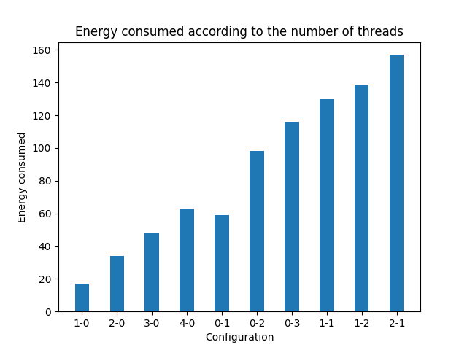
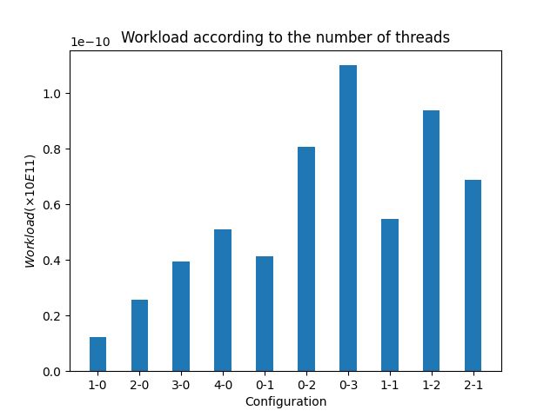
4. Experiments and observations (made using APIs)
Phone: Samsung S8
Impact of: Type or Core
Experiments duration: 10 min
Legend: Configuration 0-1 means
    0 thread on Little sockets
    1 Thread on Big Socket
10 / 17

Slide 26
4. Experiments and observations (made using APIs)
Phone: Samsung S8
Impact of: Type or Core
Experiments duration: 10 min
Legend: Configuration 0-1 means
    0 thread on Little sockets
    1 Thread on Big Socket
Big Cores consume a lot of energy compared to little cores
10 / 17

Slide 27
4. Experiments and observations (made using APIs)
Phone: Samsung S8
Impact of: Type or Core
Experiments duration: 10 min
Legend: Configuration 0-1 means
    0 thread on Little sockets
    1 Thread on Big Socket
Big Cores consume a lot of energy compared to little cores
Big cores are very fast in computation
10 / 17

Slide 28
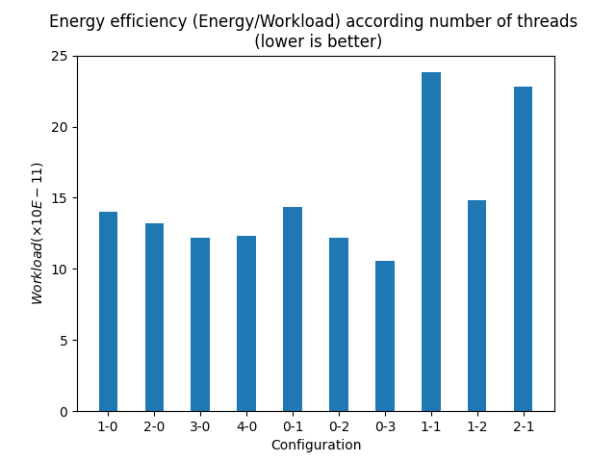
4. Experiments and observations (made using APIs)
Phone: Samsung S8
Impact of: Number of Threads
Experiments duration: 10 min
Legend: Configuration 0-1 means
    0 thread on Little sockets
    1 Thread on Big Socket
11 / 17

Slide 29
4. Experiments and observations (made using APIs)
Phone: Samsung S8
Impact of: Number of Threads
Experiments duration: 10 min
Legend: Configuration 0-1 means
    0 thread on Little sockets
    1 Thread on Big Socket
On the same socket the number of threads slightly increases with the efficiency
11 / 17

Slide 30
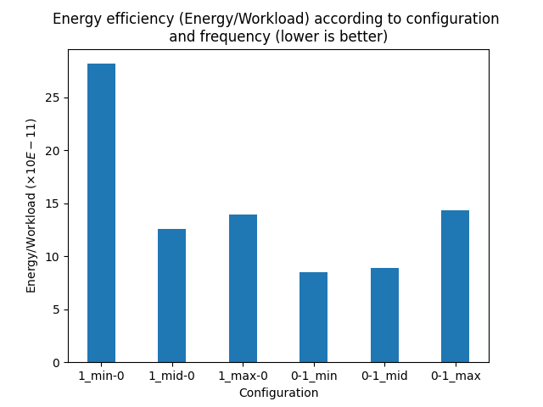
4. Experiments and observations (made using APIs)
Phone: Samsung S8
Impact of: Frequency
Experiments duration: 5 min
Legend: Configuration 0-1_mid means
  0 thread on Little sockets
  1 Thread on Big Socket
  Big socket runs with frequency at middle level.
  Mid = middle level, min = minimum level
    Max = maximum frequency
12 / 17

Slide 31
4. Experiments and observations (made using APIs)
Phone: Samsung S8
Impact of: Frequency
Experiments duration: 5 min
Legend: Configuration 0-1_mid means
  0 thread on Little sockets
  1 Thread on Big Socket
  Big socket runs with frequency at middle level.
  Mid = middle level, min = minimum level
    Max = maximum frequency
At slightly reduced frequency the Little cores are efficient
12/ 17

Slide 32
4. Experiments and observations (made using APIs)
Phone: Samsung S8
Impact of: Frequency
Experiments duration: 5 min
Legend: Configuration 0-1_mid means
  0 thread on Little sockets
  1 Thread on Big Socket
  Big socket runs with frequency at middle level.
  Mid = middle level, min = minimum level
    Max = maximum frequency
At slightly reduced frequency the Little cores are efficient
It is more efficient to reduced frequency on the Big cores as much as possible for one task.
12 / 17

Slide 33
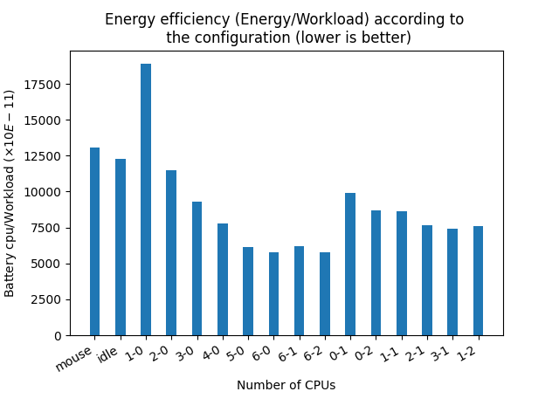
4. Experiments and observations (made using the power-meter)
Phone: Google Pixel
Impact of: Number of threads
Experiments duration: 10 min
Battery level: 50
No charging: Yes by the file
charge_stop_level
Legend: Configuration 0-1 means:
0 thread on Little core
1 thread on Big core
13 / 17

Slide 34
4. Experiments and observations (made using the power-meter)
Phone: Google Pixel
Impact of: Number of threads
Experiments duration: 10 min
Battery level: 50
No charging: Yes by the file
charge_stop_level
Legend: Configuration 0-1 means:
0 thread on Little core
1 thread on Big core
On the same socket the number of threads slightly increases with the efficiency
On the same socket the number of threads slightly increases with the efficiency
13/ 17

Slide 35
4. Experiments and observations (made using the power-meter)
Phone: Google Pixel
Impact of: Type of Cores
Experiments duration: 10 min
Battery level: 50
No charging: Yes by the file
charge_stop_level
Legend: Configuration 0-1 means:
0 thread on Little core
1 thread on Big core
14 / 17

Slide 36
4. Experiments and observations (made using the power-meter)
Phone: Google Pixel
Impact of: Type of Cores
Experiments duration: 10 min
Battery level: 50
No charging: Yes by the file
charge_stop_level
Legend: Configuration 0-1 means:
0 thread on Little core
1 thread on Big core
Big cores are much more efficient than little cores
14 / 17

Slide 37
4. Experiments and observations (made using the power-meter)
Phone: Google Pixel
Impact of: Type of Cores
Experiments duration: 10 min
Battery level: 50
No charging: Yes by the file
charge_stop_level
Legend: Configuration 0-1 means:
0 thread on Little core
1 thread on Big core
Big cores are much more efficient than little cores
The efficiency of the big cores influences the overall efficiency of the configuration
14 / 17

Slide 38
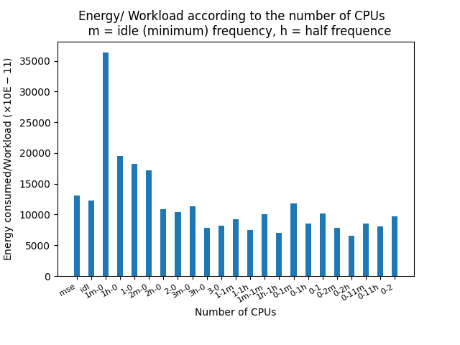
4. Experiments and observations (made using the power-meter)
Phone: Google Pixel
Impact of: Frequency
Experiments duration: 10 min
Battery level: 50
No charging: Yes by the file
charge_stop_level
Legend: Configuration 0-1m means:
0 thread on Little core
1 thread on Big core
The Big core has the min frequency
H = half frequency, nothing = max frequency
15 / 17

Slide 39
4. Experiments and observations (made using the power-meter)
Phone: Google Pixel
Impact of: Frequency
Experiments duration: 10 min
Battery level: 50
No charging: Yes by the file
charge_stop_level
Legend: Configuration 0-1m means:
0 thread on Little core
1 thread on Big core
The Big core has the min frequency
H = half frequency, nothing = max frequency
On the Little cores we are much more efficient with the maximum frequency
15 / 17

Slide 40
4. Experiments and observations (made using the power-meter)
Phone: Google Pixel
Impact of: Frequency
Experiments duration: 10 min
Battery level: 50
No charging: Yes by the file
charge_stop_level
Legend: Configuration 0-1m means:
0 thread on Little core
1 thread on Big core
The Big core has the min frequency
H = half frequency, nothing = max frequency
On the Little cores we are much more efficient with the maximum frequency
On the Big cores we are much more efficient with the mid frequency
15 / 17

Slide 41
4. Experiments and observations (made using the power-meter)
Phone: Google Pixel
Impact of: Frequency and number of Threads
Experiments duration: 10 min
Battery level: 50
No charging: Yes by the file
charge_stop_level
Legend: Configuration 0-1m means:
0 thread on Little core
1 thread on Big core
The Big core has the min frequency
H = half frequency, nothing = max frequency
Fixing the frequency at mid level and increasing the number of threads increases the efficiency drastically
16 / 17

Slide 42
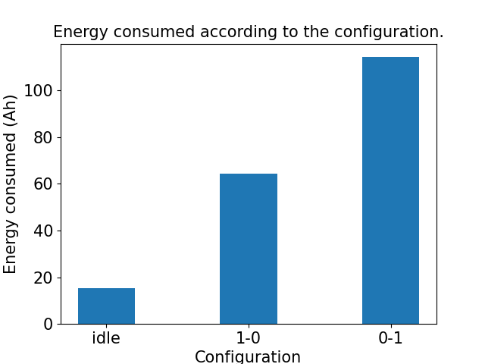
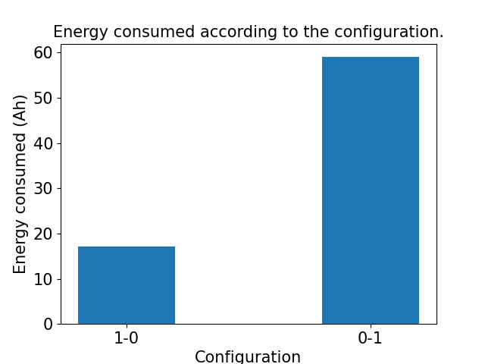
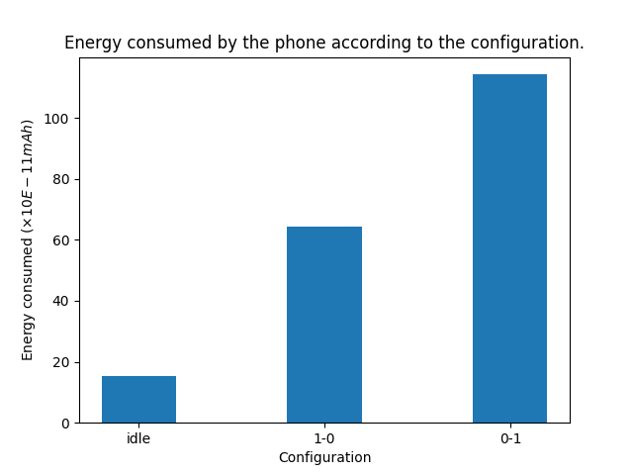
4. Next steps
Same experiments on Samsung
  Good news: No limitations on the number of configurations as with APIs.
  We use cc_info file and the power-meter
  We suspect that APIs on samsung was not far from reality in term of energy ratio.
With the power-meter
With Google APIs
17 / 17

Slide 43
4. Next steps
Made same experiments on Samsung
  Good news: No limitations on the number of configurations as with APIs.
  We use cc_info file and the power-meter
  We suspect that APIs on samsung was not far from reality in term of energy ratio.
With the power-meter
With Google APIs
Validate observations made with other Benchmaks
17 / 17

Slide 44
4. Next steps
Made same experiments on Samsung
  Good news: No limitations on the number of configurations as with APIs.
  We use cc_info file and the power-meter
  We suspect that APIs on samsung was not far from reality in term of energy ratio.
With the power-meter
With Google APIs
Validate observations made with other Benchmaks.
Valorise lessons learned and observations (publication, solution..).
17 / 17

Slide 45
Tank you for your attention.

Slide 46
General Problem Scheme
Overall system energy efficiency
Number of tasks are already present on the Phone, on which socket.
{
Mobile app
Workload Computed
Federated
Learning App
Mobile app
FL task
Number of threads to paralellise the FL task
N
Mobile app
FL thread
FL thread
...
FL thread
User space
Core temperature
System task
Kernel components
Scheduler
The type of core on which to schedule the task
Governors
Linux Kernel
Drivers / Sensors inputs
Big Core
Big Core
Core frequency
Core
frequency
Little Core
Little Core
Mobile Hardware
Energy consumed

