Slide 1
PHarness
01
agent SDLC control plane
PHarness
P
An agent harness as an SDLC control plane
Local-first today. Cluster-native by design.
Meetup framing
A casual technical story about why PHarness exists, what has been built, and where the hard engineering problems actually are.

Slide 2
PHarness
02
agent SDLC control plane
TALK TRACK
The claim
The hard part is not making a model call a tool.
preserve operator intent
enforce policy boundaries
make actions replayable
attach durable evidence
keep rollback context visible

Slide 3
PHarness
03
agent SDLC control plane
STORY
Why build this?
Agent tools blur trust domains that should stay separate.
Chat
Local automation
Delivery operations
Useful for exploration, weak as an audit boundary.
Fast feedback against a repo, shell, git, and tests.
Needs policy, evidence, approvals, and rollback.

Slide 4
PHarness
04
agent SDLC control plane
TALK TRACK
Philosophy
Small runtime, explicit boundaries, durable state.
small surface area beats plugin sprawl
typed actions beat opaque shell commands
policy belongs in the runtime, not the prompt
autonomy should be bounded by explicit envelopes
chat is secondary to runs, evidence, and audit

Slide 5
PHarness
05
agent SDLC control plane
TALK TRACK
What PHarness is
A local-first Rust agent harness designed to grow into a Kubernetes-native delivery runtime.
Fireworks-first model provider
one-action-per-turn agent loop
file, shell, git, patch, and typed read capabilities
conservative safety policy and approval resume
durable SQLite-backed sessions, events, artifacts, diffs, observations, gates, grants, and audit

Slide 6
PHarness
06
agent SDLC control plane
TALK TRACK
What it is not
The non-goals are as important as the goals.
not a plugin marketplace
not an MCP-first runtime
not a chat UI with tools bolted on
not a hidden permission bypass
not an autonomous production deployer

Slide 7
PHarness
07
agent SDLC control plane
TALK TRACK
Current state
The control-plane slice exists now.
run API, worker execution, and SSE event streaming
Fireworks native tool calling as default
approval queues and exact action resume
typed read-only Kubernetes, Argo, Tekton, Prometheus, and Loki capabilities
durable observations, incidents, remediation plans, work plans, change sets, approval gates, permission grants, and audit events

Slide 8
PHarness
08
agent SDLC control plane
ARCHITECTURE
Local-first, cluster-native
V1 runs locally, but the nouns are shaped for the cluster.
ExecutionTarget
ResourceRef
ArtifactRef
CapabilityKind
RunScope
The point is to avoid painting V1 into a corner while still keeping the first useful implementation small.

Slide 9
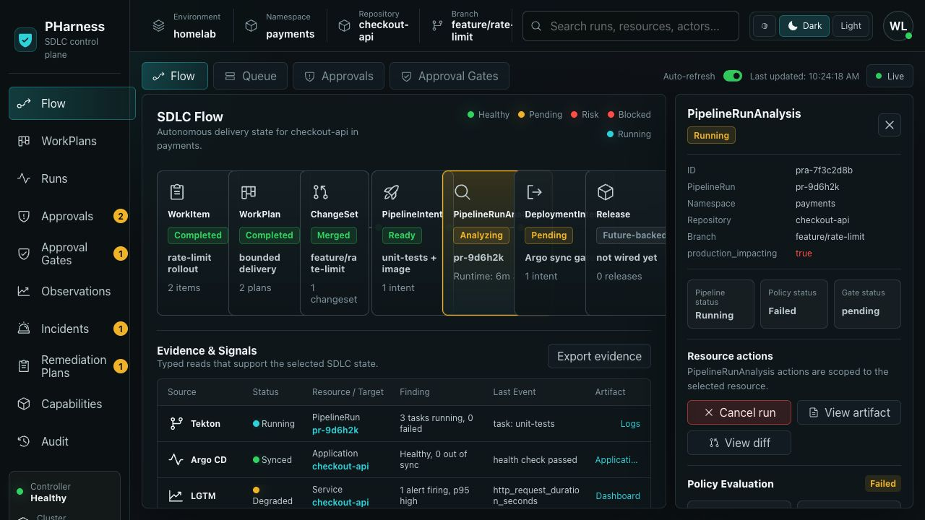
PHarness
09
agent SDLC control plane
PRODUCT
What the operator sees
Flow, Queue, Approvals, and Approval Gates are lenses over the same resources.

Slide 10
PHarness
10
agent SDLC control plane
RESOURCE MODEL
The SDLC shape
Future CRDs, current database resources.
WorkItem
WorkPlan
ChangeSet
PipelineIntent
PipelineRunAnalysis
DeploymentIntent
Release
Observation
Incident
RemediationPlan
WorkPlan
read-only fact
candidate
draft
handoff
PermissionGrant bounds autonomy
ApprovalGate gates risky transitions
AuditEvent records decisions

Slide 11
PHarness
11
agent SDLC control plane
RUNTIME
Runtime architecture
The model proposes. The runtime decides. The store remembers.
CLI / API / UI
Run Queue
Worker
Fireworks
AgentAction
SafetyPolicy
ToolExecutor
Store: events, artifacts, audit

Slide 12
PHarness
12
agent SDLC control plane
FLOW
One action per turn
A narrow loop makes policy, replay, and approval resume tractable.
1
2
3
4
model request
one proposed AgentAction
shape validation
policy evaluation
5
6
execute / pause / deny
append result

Slide 13
PHarness
13
agent SDLC control plane
TALK TRACK
Policy is a runtime contract
A resumed run should not inherit config drift by accident.
read-only actions allowed
file writes ask by default
network and destructive shell commands ask
privileged and secret-shaped actions deny
typed cluster reads allow unless secret-shaped
grants cannot override denials

Slide 14
PHarness
14
agent SDLC control plane
GOVERNANCE
Two approval surfaces
Tool approvals and governance gates are different resources.
Tool approval
Approval gate
May this paused run execute this exact action?
Decision verbs: approve / deny
Has this governance checkpoint been satisfied?
Decision verbs: satisfy / waive / reject

Slide 15
PHarness
15
agent SDLC control plane
TALK TRACK
Typed capabilities
Production delivery should not become a pile of shell wrappers.
kubernetes_get
argo_get_app
tekton_get_pipeline_runs
tekton_get_task_runs
tekton_analyze_pipeline_run
prometheus_query / prometheus_inventory
loki_log_summary

Slide 16
PHarness
16
agent SDLC control plane
TALK TRACK
Tekton analysis example
Turn scattered cluster facts into structured SDLC evidence.
PipelineRun status, reason, and timing
TaskRun status counts
repo URL, commit SHA, image reference, and digest
deployment target and rollout health
Argo sync and health
registry-aware image alignment

Slide 17
PHarness
17
agent SDLC control plane
TALK TRACK
Trusted autonomy
The goal is bounded autonomy, not fewer prompts by default.
scoped to environment, repo, branch, and namespace
scoped to WorkPlan or ChangeSet
scoped to capability kind and action
time-bounded and auditable
invalidated when material plans change
today: local file writes only

Slide 18
PHarness
18
agent SDLC control plane
STORY
Technical challenges
The interesting parts are mostly boring operational details.
Model protocols
Approval resume
Cluster output
Drift and aliases
Tool support, malformed arguments, streaming assembly, and one-action discipline.
Persist and resume the exact reviewed action, not a later model interpretation.
Parse before redaction, compact the payload, and deny secret-shaped reads early.
Registry host aliases should reduce false drift without hiding real mismatches.

Slide 19
PHarness
19
agent SDLC control plane
FLOW
What I would demo
Show that the runtime knows what happened.
1
2
3
4
run read-only task
show event stream
show policy decision
trigger write approval
5
6
7
8
inspect preview diff
approve and resume
show final diff and audit trail
show typed cluster read

Slide 20
PHarness
20
agent SDLC control plane
STORY
Roadmap
Keep V1 useful while moving toward governed cluster execution.
Near term
V2
V3
WorkPlan and ChangeSet readiness, scoped grant negative smokes, stronger evidence retrieval, more dogfooding.
Kubernetes worker pods, per-run workspace sandboxes, API/UI services, optional Postgres.
Tekton intents, Argo deployment intents, database operator capabilities, LGTM loops, CRD-backed resources.

Slide 21
PHarness
21
agent SDLC control plane
TALK TRACK
The risk
The obvious failure mode is overbuilding.
keep the policy model readable
make every action explainable
add cluster capabilities one at a time
keep V1 locally useful
delete abstractions that do not make production workflows safer or clearer

Slide 22
PHarness
22
agent SDLC control plane
TALK TRACK
Takeaways
Useful agent autonomy needs a control plane.
typed actions
scoped trust
durable evidence
explicit approvals
replayable runs
cluster-native resource vocabulary
The model is the planner and actor. PHarness is the system that keeps it inside a governed operational story.

