Slide 1

MSC ROBOTICS · DISSERTATION PRESENTATION
Learning-Based Scheduling
and Motion Coordination
of Mobile Robots in Smart Factories
Evidence from a Webots smart-factory testbed with 3, 5 and 8 mobile robots
Wenbin Lin · H00484764
MSc Robotics
Heriot-Watt University Dubai
Dissertation defence · 2026
Notes:
Introduce the implemented research system: Webots, not the ROS/Gazebo platform discussed in the early proposal. Frame learning-based superiority as a hypothesis, not an assumption.

Slide 2
Why scheduling and motion must be studied together
02
BACKGROUND AND RESEARCH QUESTION
● Dynamic transport requests compete for robots, docks, corridors and charging stations.
● A short assignment can still create queueing, head-on conflicts or blocked loading points.
● Higher fleet density increases combinatorial assignment choices and physical interaction.
● Research question: can learning-based scheduling improve throughput and coordination over classical methods?
Allocation
Which available robot should serve each transport task?
Coordination
How can assigned robots share constrained routes safely?
Evaluation
Does a better assignment remain better after physical execution?
Scheduling quality is measured at the factory level.
Wenbin Lin · MSc Robotics · Heriot-Watt University Dubai
2
Notes:
Explain why allocation and navigation cannot be evaluated independently. The dissertation tests five hypotheses covering throughput, delays, utilisation, scalability and congestion.

Slide 3
Objectives and implemented contributions
03
PROPOSED, IMPLEMENTED AND EXPERIMENTAL METHODOLOGY
PROPOSED
IMPLEMENTED
EVALUATED
Learning-based allocation integrated with multi-robot motion coordination.
Webots factory · 12 schedulers · grid A* · reservations · DWA · charging · recovery.
30-min Scene A/B/C runs plus abstract RL training and validation logs.
● Efficient task allocation under dynamic Poisson demand.
● Executable routes with collision avoidance and deadlock recovery.
● Fair comparison across rule-based, optimisation, metaheuristic and RL schedulers.
● Evidence-led conclusions without assuming RL superiority.
Early ROS/Gazebo intent is future work; Webots is the authoritative implemented platform.
Wenbin Lin · MSc Robotics · Heriot-Watt University Dubai
3
Notes:
Separate intent from implementation. The contribution is the closed-loop integration and evaluation, not a new RL algorithm.

Slide 4
Implemented smart-factory environment
04
VERIFIED FROM CONFIG.PY AND SMART_FACTORY.WBT
Layout
WS1
WS2
WS3
6 workstations · 8 storage docks · 2 charging stations
7
1
S1/S5
S2/S6
3
S3/S7
S4/S8
Robot
TurtleBot3 Waffle differential drive · max linear speed 0.26 m/s
CS1
CS2
Motion network
5
6
0.25 m occupancy grid plus corridor/dock graph
8
2
4
Safety
0.30 m goal tolerance · path reservations · local LiDAR/DWA
WS4
WS5
WS6
Diagram reconstructed from repository coordinates.
Wenbin Lin · MSc Robotics · Heriot-Watt University Dubai
4
Notes:
Walk through the real implemented layout. Dock nodes stop other robots treating pickup and delivery points as ordinary corridors.
Possible examiner question: Why use both a graph and a grid?
Suggested answer: The graph supports semantic locations and CBS reasoning; the grid captures free-space obstacles and produces executable detours.

Slide 5
Scenes A, B and C
05
SAME FACTORY; INCREASING FLEET DENSITY AND TASK ARRIVAL RATE
A
3 robots
B
5 robots
C
8 robots
30 s mean interval
15 s mean interval
8 s mean interval
≈2 requests/min
≈4 requests/min
≈7.5 requests/min
First task at t=0; later arrivals sampled exponentially
First task at t=0; later arrivals sampled exponentially
First task at t=0; later arrivals sampled exponentially
Demand composition: storage→workstation 40% · workstation→storage 35% · workstation→workstation 25%
Wenbin Lin · MSc Robotics · Heriot-Watt University Dubai
5
Notes:
Emphasise that the interval is a Poisson-process mean. Scenes differ only in active robot count and demand intensity, supporting a controlled scalability comparison.

Slide 6
Closed-loop system architecture
06
CENTRAL SCHEDULING WITH DISTRIBUTED SAFE EXECUTION
TASK
GENERATOR
TASK
QUEUE
SCHEDULER
PATH +
RESERVATION
ROBOT
CONTROLLERS
WEBOTS
FACTORY
pose · battery · arrival · braking · replanning feedback
Assignment transaction
Motion coordination
Local safety
Commit only after route and radio dispatch succeed.
Grid A*, lifelong reservations, delay search and recovery.
Waypoint tracking, DWA, peer prediction and emergency braking.
Wenbin Lin · MSc Robotics · Heriot-Watt University Dubai
6
Notes:
Explain the two-layer controller. The Supervisor owns task state and global coordination; each robot owns sensors and wheel commands.
Possible examiner question: Can an invalid RL action move a robot?
Suggested answer: No. Action masking, assignment validation, path feasibility and command dispatch all precede commitment; deterministic fallbacks remain available.

Slide 7
Twelve implemented scheduling algorithms
07
TAXONOMY AND EXPECTED SCALING BEHAVIOUR
RULE-BASED
MATHEMATICAL
MARKET-BASED
METAHEURISTIC
LEARNING
FCFS · Nearest
Round Robin · Greedy · Random
Hungarian
Auction
GA · SA
SARSA · DQN · PPO
Fast and transparent; local decisions may become myopic.
Global one-to-one minimum-cost matching.
Iterative robot bids with prices and time budget.
Anytime global search; quality–latency trade-off.
Offline-learned policies; generalisation must be tested.
O(1)–pairwise
O(n³)
budgeted
budgeted
fast inference
All algorithms share feasibility checks; cost-based methods use route, priority, waiting and congestion terms.
Wenbin Lin · MSc Robotics · Heriot-Watt University Dubai
7
Notes:
Classify only implemented algorithms. FCFS is the FIFO-equivalent label used by the repository. Round Robin and Random are included in the dataset but omitted from some charts for readability.

Slide 8
Classical and metaheuristic allocation
08
HOW GLOBAL SEARCH TRADES COMPUTATION FOR ASSIGNMENT QUALITY
Hungarian
GENETIC ALGORITHM
SIMULATED ANNEALING
Build C(i,j) for robot i and task j; solve a global one-to-one minimum-cost matching. Runtime grows cubically with matrix dimension.
Seed
population
Rank by
cost
Top 25%
elites
Order
crossover
10% swap
mutation
Greedy
seed
Swap task
positions
Evaluate
ΔE
Accept if better
or p=e−ΔE/T
Cool T
Runtime defaults: population 48 · ≤50 generations · 10 ms budget
Runtime defaults: T₀=10 · α=0.985 · ≤2,000 iterations · 5 ms budget
Auction
Announce tasks → estimate costs → bid using task prices → assign provisional winners until stable or budget expires.
Evidence boundary
The runtime JSON records final assignments and latency, not generation-by-generation GA fitness or iteration-by-iteration SA cost. No convergence curve is fabricated.
Shared cost
travel − priority bonus − waiting bonus + congestion penalty
Wenbin Lin · MSc Robotics · Heriot-Watt University Dubai
8
Notes:
Explain that both metaheuristics are anytime algorithms constrained by millisecond budgets. The GA individual is a task permutation; crossover is order-based and mutation swaps two positions.
Possible examiner question: Why is there no GA/SA convergence graph?
Suggested answer: The code did not persist intermediate optimisation traces. Only final Webots performance and computation latency are defensible.

Slide 9
Learning-based scheduling
09
FIVE CONCEPTS MAPPED TO THE IMPLEMENTED AGENTS
1
STATE
2
ACTION
3
REWARD
4
EXPLORATION
5
LEARNING
Fixed robot/task slots; position, state, battery, queue and candidate features
Choose a robot-slot/task-slot pair, plus an explicit no-op
Completion and valid assignment versus distance, waiting and invalid actions
ε-greedy for SARSA/DQN; stochastic policy entropy for PPO
SARSA table · DQN Q-network · PPO policy/value network
SARSA
DQN
PPO
On-policy TD: updates from the next action actually selected; potentially conservative under exploratory congestion.
Replay buffer, target network and ε-greedy action masking approximate Q-values for discrete assignments.
Policy/value network, GAE and clipped policy updates support a larger fixed observation representation.
Wenbin Lin · MSc Robotics · Heriot-Watt University Dubai
9
Notes:
Connect each learning idea to the actual scheduling environment. Training occurs in an abstract factory-grid event environment; frozen checkpoints are then used for Webots inference.
Possible examiner question: Why might SARSA be conservative?
Suggested answer: Its update follows the exploratory behaviour policy, so risky exploratory outcomes influence values directly, unlike off-policy Q-learning.

Slide 10
Reward design and RL training pipeline
10
ACTUAL CHAMPION-TRAINING REWARD CONFIGURATION
OBSERVE
SELECT
ASSIGN
ADVANCE
REWARD
UPDATE
Champion DQN / SARSA reward
Safety and invalid-decision terms
+12.0 task completion
+0.75 valid assignment
+0.4 × priority
+0.3 × capped task-age bonus
−0.05 × route distance
−0.02 × waiting time
−5.0 invalid action
−2.0 unnecessary no-op
−100 collision
0.0 deadlock (handled as recoverable)
R = positive progress − operational cost
PPO uses the same environment family; checkpoint-specific training history does not store a separate reward-config block.
Wenbin Lin · MSc Robotics · Heriot-Watt University Dubai
10
Notes:
Explain reward shaping as a scheduling objective, not direct wheel control. Collision receives a severe penalty; deadlock has zero reward weight because the runtime treats it as recoverable.
Possible examiner question: Why reward completion and valid assignment separately?
Suggested answer: The small dense assignment reward improves credit assignment; the larger completion reward preserves the final operational objective.

Slide 11
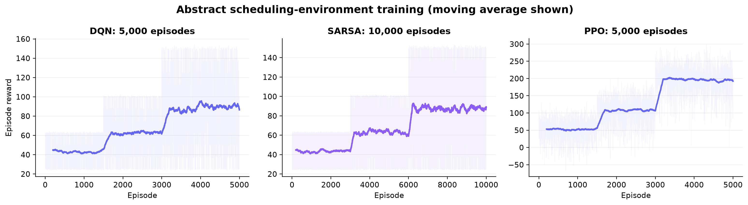
Reinforcement-learning training evidence
11
CHAMPION RUNS IN THE ABSTRACT SCHEDULING ENVIRONMENT
DQN
5,000 ep · 868.6 s
SARSA
10,000 ep · 210.4 s
PPO
5,000 ep · 5,000 updates
best val. reward 85.29
best val. reward 85.35
best val. score 60.07
Curves show episode reward and moving average; validation checkpoints were held out from training selection.
Wenbin Lin · MSc Robotics · Heriot-Watt University Dubai
11
Notes:
Do not compare absolute PPO reward directly with DQN/SARSA because logging and checkpoint configurations differ. Focus on stability and the existence of full-length training evidence.

Slide 12
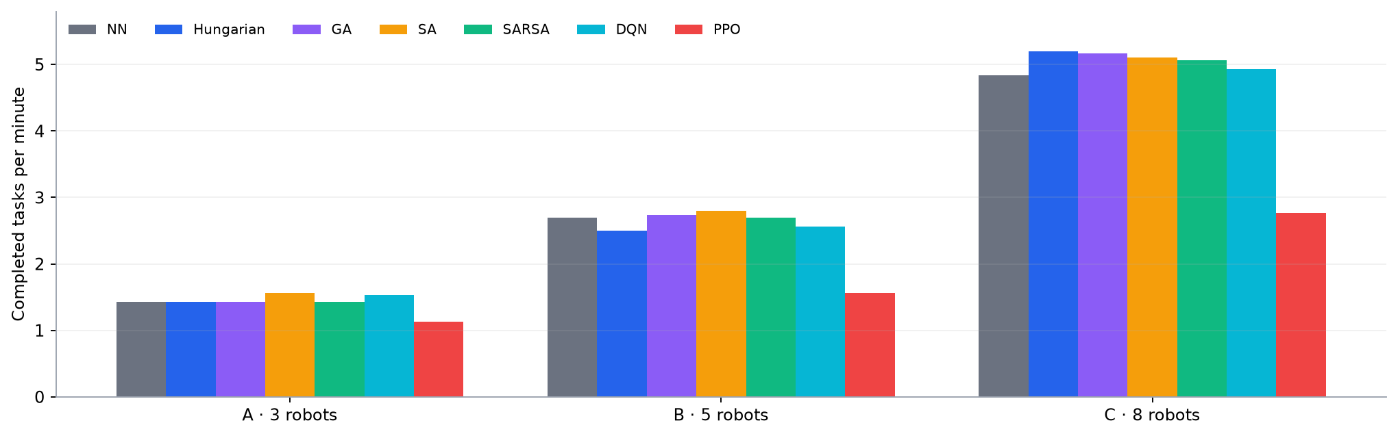
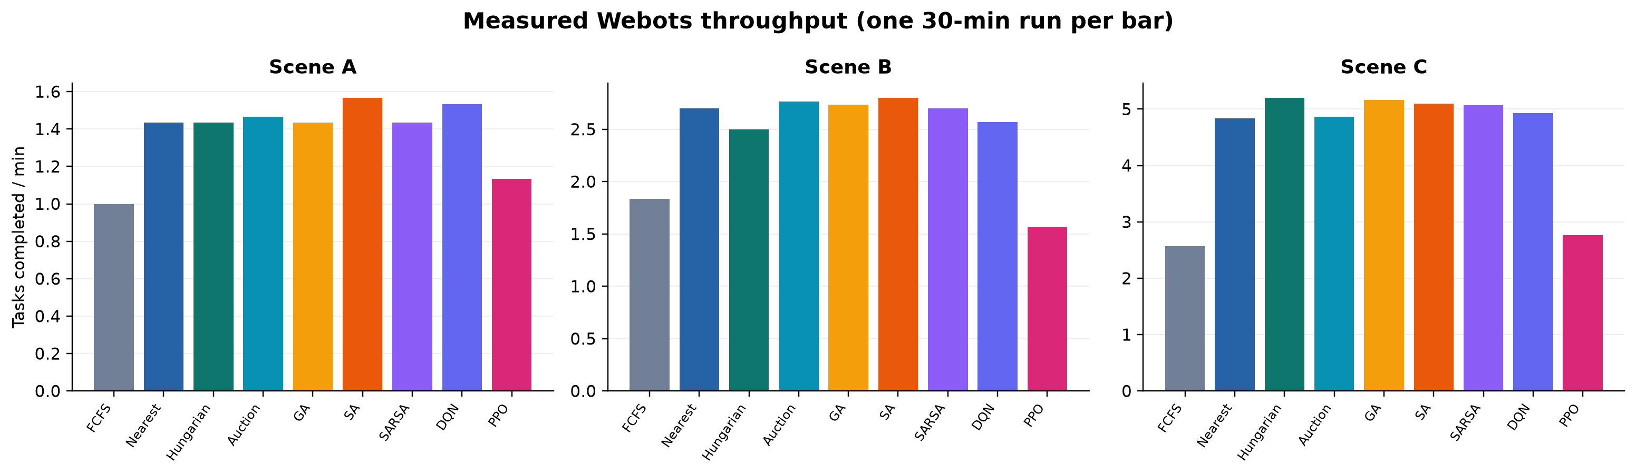
Measured throughput across factory loads
12
SELECTED STRONG BASELINES AND LEARNING METHODS · 30-MINUTE WEBOTS RUNS
Scene A
DQN: 1.53 vs SA: 1.57
Scene B
SARSA: 2.70 vs SA: 2.80
Scene C
SARSA: 5.07 vs Hungarian: 5.20
97.9% of the measured best
96.4% of the measured best
97.4% of the measured best
Point estimates only: one measured run per algorithm–scene pair; synthetic PPO records are excluded.
Wenbin Lin · MSc Robotics · Heriot-Watt University Dubai
12
Notes:
This is the primary measured result. SA leads low and medium density, while Hungarian leads the high-density scene. This evidence does not support blanket RL superiority.
Possible examiner question: Are these differences statistically significant?
Suggested answer: Not established. Each algorithm–scene cell has one matched-duration run; repeated recorded seeds are required for confidence intervals.

Slide 13
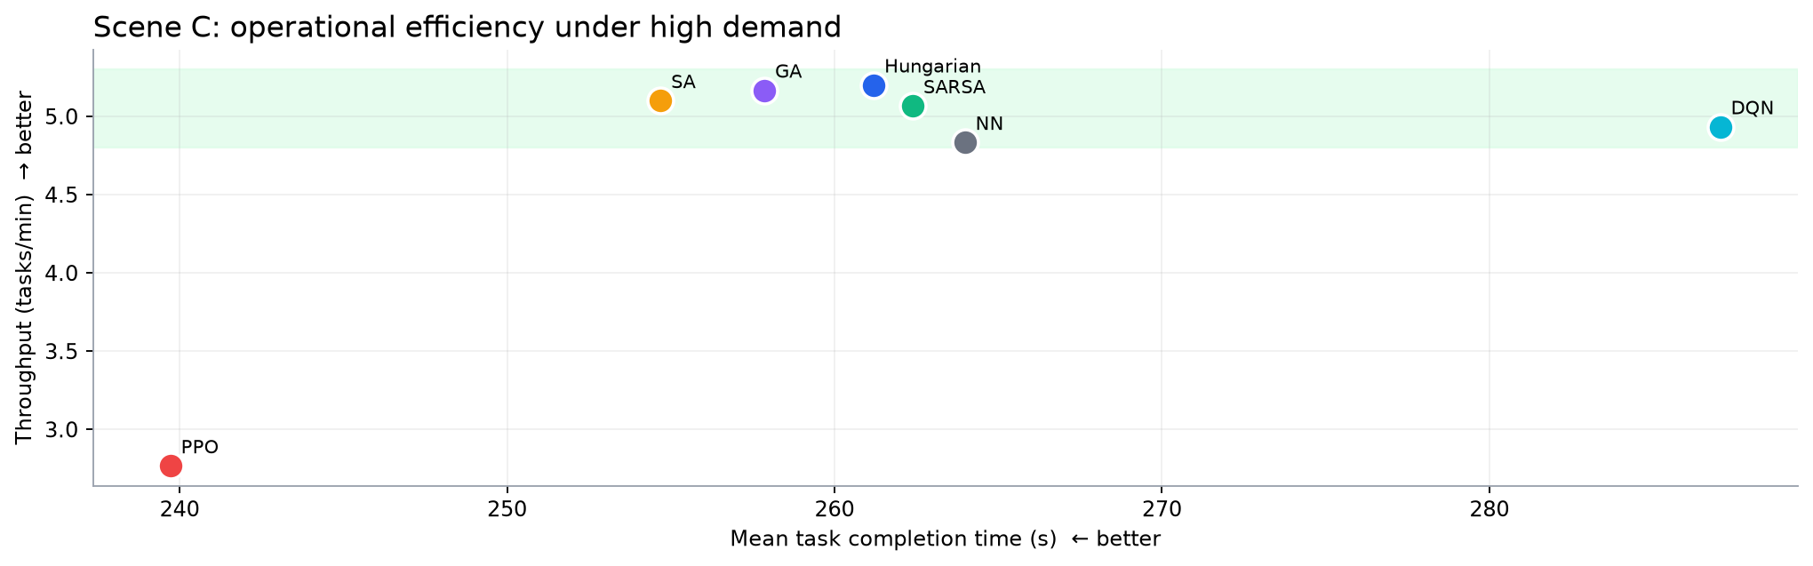
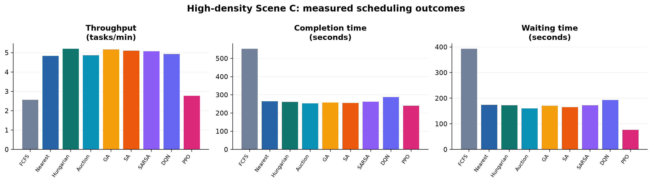
High-density Scene C: completion efficiency
13
THROUGHPUT AND END-TO-END COMPLETION TIME · UPPER-LEFT IS THE TARGET REGION
SARSA
DQN
Interpretation
5.07 tasks/min: within 2.6% of the best measured throughput.
4.93 tasks/min: within 5.1%, while learning a reusable policy offline.
RL is competitive, but current evidence does not establish superiority over search-based methods.
Wenbin Lin · MSc Robotics · Heriot-Watt University Dubai
13
Notes:
Separate assignment delay from end-to-end completion. PPO allocates tasks quickly, but Hungarian completes more under heavy load; assignment quality must include executable downstream travel.

Slide 14
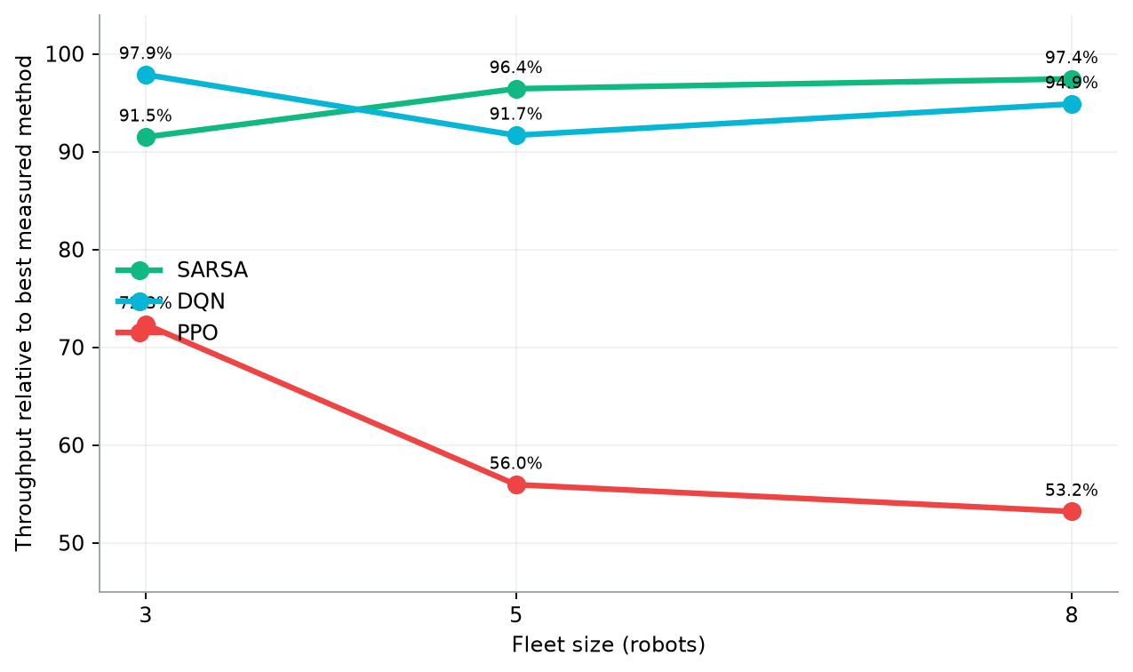
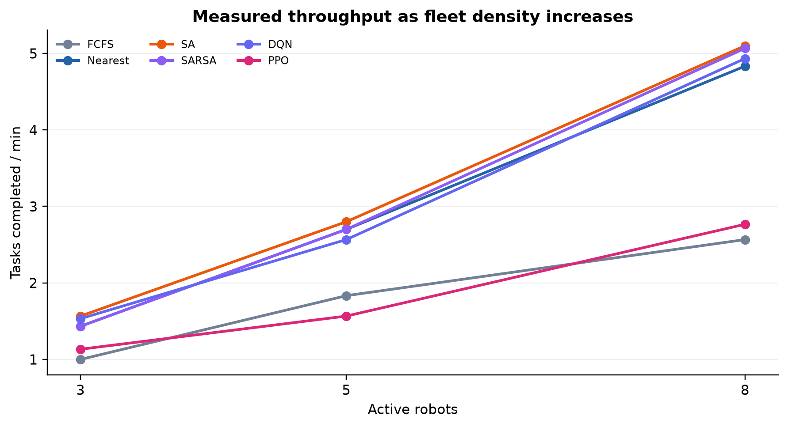
Coordination and scalability analysis
14
FLEET SIZE 3 → 5 → 8 ROBOTS
Competitive performance
SARSA remains close to the best measured method as the fleet grows: 91.5%, 96.4%, then 97.4%.
Learning advantage
Training moves search effort offline; masked inference can reuse congestion, battery and task features online.
Coordination boundary
All schedulers share the same A*, reservations, DWA and recovery stack; gains therefore arise mainly from allocation.
RL closes the throughput gap, but multi-seed evidence is still required.
Wenbin Lin · MSc Robotics · Heriot-Watt University Dubai
14
Notes:
Explain that higher throughput partly reflects more robots, while demand also increases. The correct comparison is algorithm behaviour within each scenario and the trend across scenarios.
Possible examiner question: Did better scheduling reduce conflicts?
Suggested answer: The current conflict counters are mostly zero and separation violations are non-zero, so H5 cannot be robustly confirmed from these logs.

Slide 15
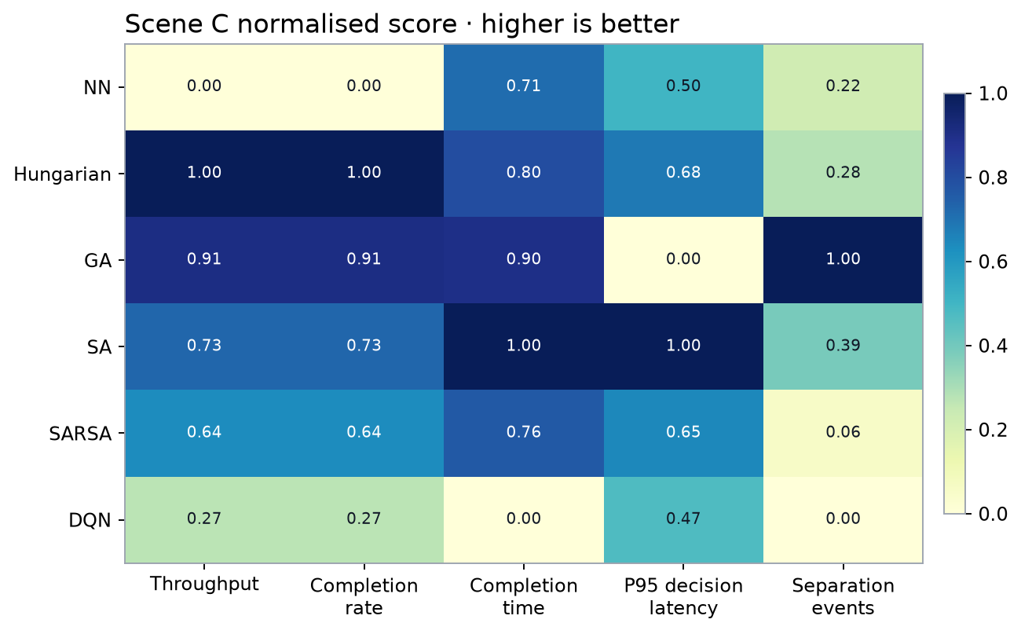
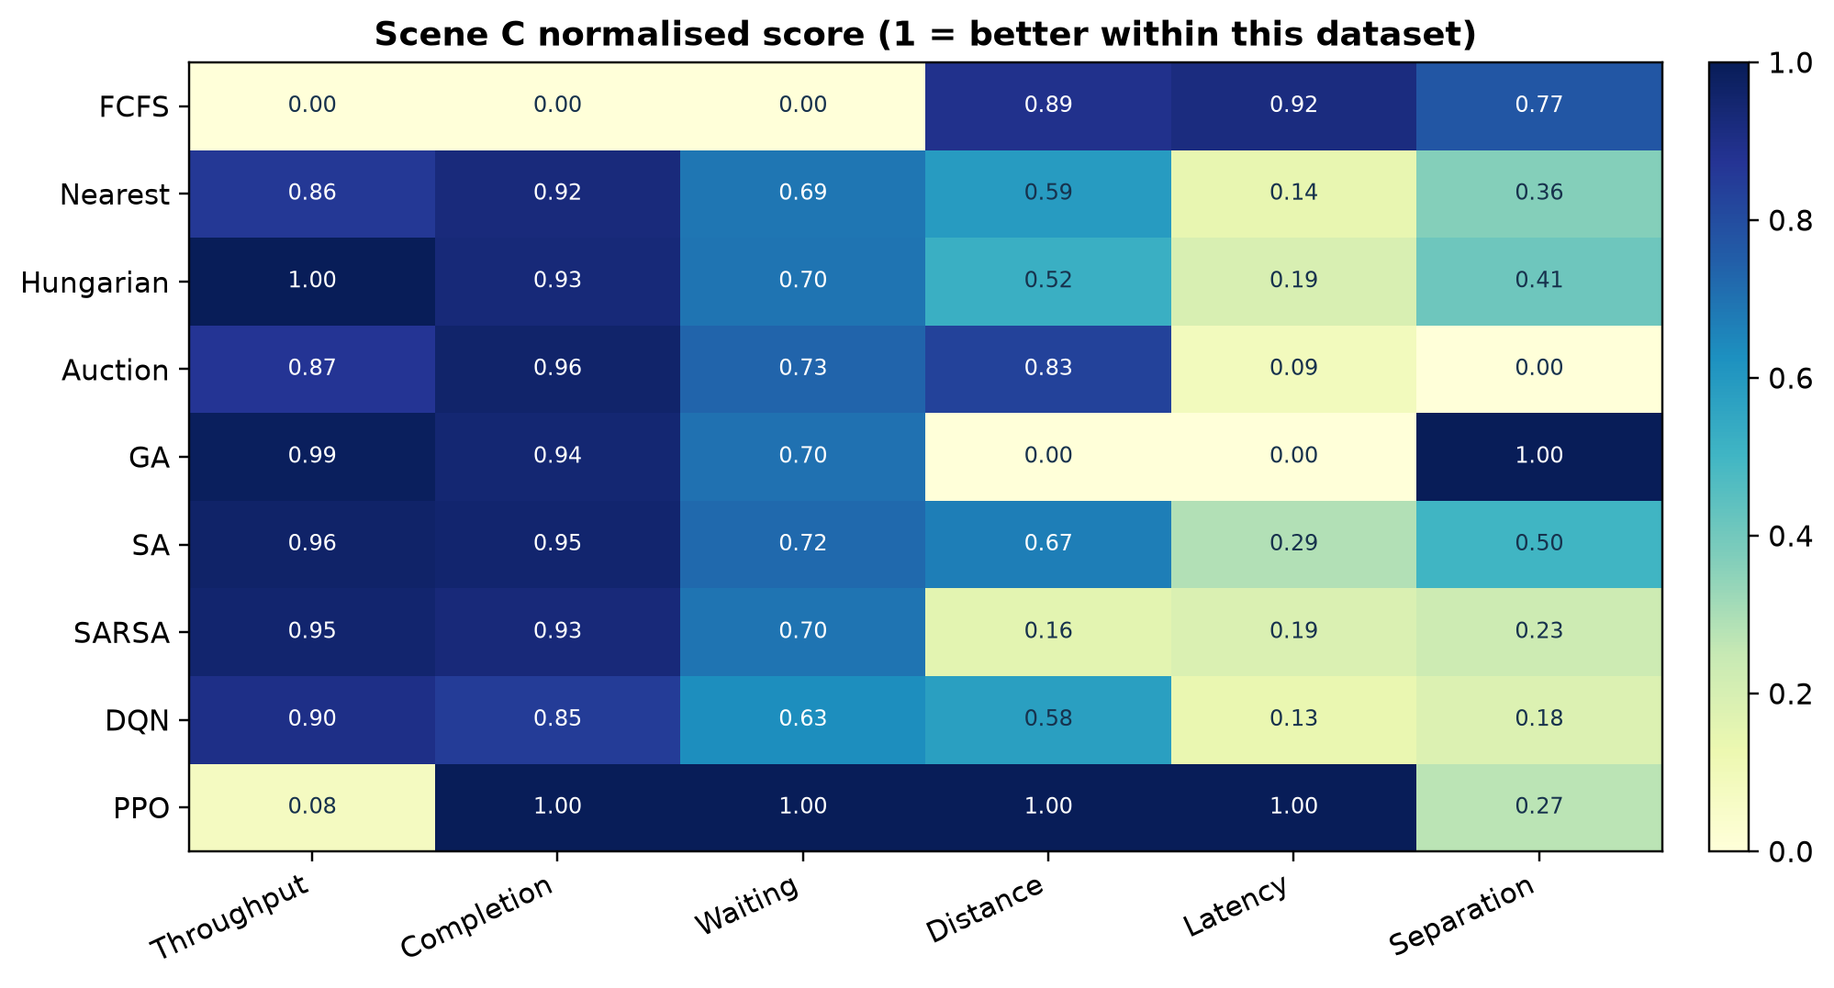
Selected-method comparison in Scene C
15
NORMALISED MEASURED METRICS · WAITING TIME EXCLUDED · 1 MEANS BETTER WITHIN THIS DATASET
Throughput
RL is competitive
SARSA reaches 97.4% and DQN 94.9% of the best.
Adaptation
Potential advantage
State features support battery-, queue- and congestion-aware decisions.
Deployment
Safe by design
Action masking, validation and deterministic fallback protect execution.
Evidence
Not yet conclusive
A single seed cannot prove a general learning advantage.
PPO
Redesigned
Pairwise PPO now shares the 278-state/161-action environment; full re-evaluation remains.
Completion time, decision latency and separation events: lower is better.
Wenbin Lin · MSc Robotics · Heriot-Watt University Dubai
15
Notes:
Use the heatmap as a multi-objective summary, not a universal ranking. Normalisation is within Scene C, and separation score reverses the recorded violation count.

Slide 16
Conclusions, limitations and next steps
16
EVIDENCE-BASED ANSWER TO THE RESEARCH QUESTION
● The project implements a complete allocation-to-motion Webots loop. ● SA leads Scenes A/B and Hungarian leads C in the current point estimates. ● SARSA and DQN approach the best throughput, particularly under high load. ● RL has not yet surpassed online search because training abstracts physical delay and the reward only approximates final throughput.
Primary limitation
One measured run per cell; seed metadata and confidence intervals are unavailable.
Next experiments
Run ≥5 matched seeds; align checkpoint selection with Webots throughput; add reward and coordination ablations.
Future engineering
Domain-randomised motion time, graph/GNN policies, charging-aware MARL, and ROS 2 hardware validation.
Thank you · Questions?
Key references: Kuhn (1955); Kirkpatrick et al. (1983); Mnih et al. (2015); Schulman et al. (2017); Sutton & Barto (2018).
Wenbin Lin · MSc Robotics · Heriot-Watt University Dubai
16
Notes:
Conclude with the nuanced answer: learning improved one important operational metric—waiting—but the current Webots point estimates favour classical optimisation for throughput. State the exact evidence needed before stronger claims.
Possible examiner question: What is the strongest defensible contribution?
Suggested answer: The integrated, safety-filtered comparison framework and its evidence that assignment metrics and completed throughput can diverge after physical execution.

