Slide 1

MSC ROBOTICS · DISSERTATION PRESENTATION
Learning-Based Scheduling
and Motion Coordination
of Mobile Robots in Smart Factories
Evidence from a Webots smart-factory testbed with 3, 5 and 8 mobile robots
Wenbin Lin · H00484764
MSc Robotics
Heriot-Watt University Dubai
Dissertation defence · 2026
Notes:
Introduce the implemented research system: Webots, not the ROS/Gazebo platform discussed in the early proposal. Frame learning-based superiority as a hypothesis, not an assumption.

Slide 2
Why scheduling and motion must be studied together
02
BACKGROUND AND RESEARCH QUESTION
● Dynamic transport requests compete for robots, docks, corridors and charging stations.
● A short assignment can still create queueing, head-on conflicts or blocked loading points.
● Higher fleet density increases combinatorial assignment choices and physical interaction.
● Research question: can learning-based scheduling improve throughput and coordination over classical methods?
Allocation
Which available robot should serve each transport task?
Coordination
How can assigned robots share constrained routes safely?
Evaluation
Does a better assignment remain better after physical execution?
Scheduling quality is measured at the factory level.
Wenbin Lin · MSc Robotics · Heriot-Watt University Dubai
2
Notes:
Explain why allocation and navigation cannot be evaluated independently. The dissertation tests five hypotheses covering throughput, delays, utilisation, scalability and congestion.

Slide 3
Objectives and implemented contributions
03
PROPOSED, IMPLEMENTED AND EXPERIMENTAL METHODOLOGY
PROPOSED
IMPLEMENTED
EVALUATED
Learning-based allocation integrated with multi-robot motion coordination.
Webots factory · 12 schedulers · grid A* · reservations · DWA · charging · recovery.
30-min Scene A/B/C runs plus abstract RL training and validation logs.
● Efficient task allocation under dynamic Poisson demand.
● Executable routes with collision avoidance and deadlock recovery.
● Fair comparison across rule-based, optimisation, metaheuristic and RL schedulers.
● Evidence-led conclusions without assuming RL superiority.
Early ROS/Gazebo intent is future work; Webots is the authoritative implemented platform.
Wenbin Lin · MSc Robotics · Heriot-Watt University Dubai
3
Notes:
Separate intent from implementation. The contribution is the closed-loop integration and evaluation, not a new RL algorithm.

Slide 4
Implemented smart-factory environment
04
VERIFIED FROM CONFIG.PY AND SMART_FACTORY.WBT
Layout
WS1
WS2
WS3
6 workstations · 8 storage docks · 2 charging stations
7
1
S1/S5
S2/S6
3
S3/S7
S4/S8
Robot
TurtleBot3 Waffle differential drive · max linear speed 0.26 m/s
CS1
CS2
Motion network
5
6
0.25 m occupancy grid plus corridor/dock graph
8
2
4
Safety
0.30 m goal tolerance · path reservations · local LiDAR/DWA
WS4
WS5
WS6
Diagram reconstructed from repository coordinates.
Wenbin Lin · MSc Robotics · Heriot-Watt University Dubai
4
Notes:
Walk through the real implemented layout. Dock nodes stop other robots treating pickup and delivery points as ordinary corridors.
Possible examiner question: Why use both a graph and a grid?
Suggested answer: The graph supports semantic locations and CBS reasoning; the grid captures free-space obstacles and produces executable detours.

Slide 5
Scenes A, B and C
05
SAME FACTORY; INCREASING FLEET DENSITY AND TASK ARRIVAL RATE
A
3 robots
B
5 robots
C
8 robots
30 s mean interval
15 s mean interval
8 s mean interval
≈2 requests/min
≈4 requests/min
≈7.5 requests/min
First task at t=0; later arrivals sampled exponentially
First task at t=0; later arrivals sampled exponentially
First task at t=0; later arrivals sampled exponentially
Demand composition: storage→workstation 40% · workstation→storage 35% · workstation→workstation 25%
Wenbin Lin · MSc Robotics · Heriot-Watt University Dubai
5
Notes:
Emphasise that the interval is a Poisson-process mean. Scenes differ only in active robot count and demand intensity, supporting a controlled scalability comparison.

Slide 6
Closed-loop system architecture
06
CENTRAL SCHEDULING WITH DISTRIBUTED SAFE EXECUTION
TASK
GENERATOR
TASK
QUEUE
SCHEDULER
PATH +
RESERVATION
ROBOT
CONTROLLERS
WEBOTS
FACTORY
pose · battery · arrival · braking · replanning feedback
Assignment transaction
Motion coordination
Local safety
Commit only after route and radio dispatch succeed.
Grid A*, lifelong reservations, delay search and recovery.
Waypoint tracking, DWA, peer prediction and emergency braking.
Wenbin Lin · MSc Robotics · Heriot-Watt University Dubai
6
Notes:
Explain the two-layer controller. The Supervisor owns task state and global coordination; each robot owns sensors and wheel commands.
Possible examiner question: Can an invalid RL action move a robot?
Suggested answer: No. Action masking, assignment validation, path feasibility and command dispatch all precede commitment; deterministic fallbacks remain available.

Slide 7
Twelve implemented scheduling algorithms
07
TAXONOMY AND EXPECTED SCALING BEHAVIOUR
RULE-BASED
MATHEMATICAL
MARKET-BASED
METAHEURISTIC
LEARNING
FCFS · Nearest
Round Robin · Greedy · Random
Hungarian
Auction
GA · SA
SARSA · DQN · PPO
Fast and transparent; local decisions may become myopic.
Global one-to-one minimum-cost matching.
Iterative robot bids with prices and time budget.
Anytime global search; quality–latency trade-off.
Offline-learned policies; generalisation must be tested.
O(1)–pairwise
O(n³)
budgeted
budgeted
fast inference
All algorithms share feasibility checks; cost-based methods use route, priority, waiting and congestion terms.
Wenbin Lin · MSc Robotics · Heriot-Watt University Dubai
7
Notes:
Classify only implemented algorithms. FCFS is the FIFO-equivalent label used by the repository. Round Robin and Random are included in the dataset but omitted from some charts for readability.

Slide 8
Classical and metaheuristic allocation
08
HOW GLOBAL SEARCH TRADES COMPUTATION FOR ASSIGNMENT QUALITY
Hungarian
GENETIC ALGORITHM
SIMULATED ANNEALING
Build C(i,j) for robot i and task j; solve a global one-to-one minimum-cost matching. Runtime grows cubically with matrix dimension.
Seed
population
Rank by
cost
Top 25%
elites
Order
crossover
10% swap
mutation
Greedy
seed
Swap task
positions
Evaluate
ΔE
Accept if better
or p=e−ΔE/T
Cool T
Runtime defaults: population 48 · ≤50 generations · 10 ms budget
Runtime defaults: T₀=10 · α=0.985 · ≤2,000 iterations · 5 ms budget
Auction
Announce tasks → estimate costs → bid using task prices → assign provisional winners until stable or budget expires.
Evidence boundary
The runtime JSON records final assignments and latency, not generation-by-generation GA fitness or iteration-by-iteration SA cost. No convergence curve is fabricated.
Shared cost
travel − priority bonus − waiting bonus + congestion penalty
Wenbin Lin · MSc Robotics · Heriot-Watt University Dubai
8
Notes:
Explain that both metaheuristics are anytime algorithms constrained by millisecond budgets. The GA individual is a task permutation; crossover is order-based and mutation swaps two positions.
Possible examiner question: Why is there no GA/SA convergence graph?
Suggested answer: The code did not persist intermediate optimisation traces. Only final Webots performance and computation latency are defensible.

Slide 9
Learning-based scheduling
09
FIVE CONCEPTS MAPPED TO THE IMPLEMENTED AGENTS
1
STATE
2
ACTION
3
REWARD
4
EXPLORATION
5
LEARNING
Fixed robot/task slots; position, state, battery, queue and candidate features
Choose a robot-slot/task-slot pair, plus an explicit no-op
Completion and valid assignment versus distance, waiting and invalid actions
ε-greedy for SARSA/DQN; stochastic policy entropy for PPO
SARSA table · DQN Q-network · PPO policy/value network
SARSA
DQN
PPO
On-policy TD: updates from the next action actually selected; potentially conservative under exploratory congestion.
Replay buffer, target network and ε-greedy action masking approximate Q-values for discrete assignments.
Policy/value network, GAE and clipped policy updates support a larger fixed observation representation.
Wenbin Lin · MSc Robotics · Heriot-Watt University Dubai
9
Notes:
Connect each learning idea to the actual scheduling environment. Training occurs in an abstract factory-grid event environment; frozen checkpoints are then used for Webots inference.
Possible examiner question: Why might SARSA be conservative?
Suggested answer: Its update follows the exploratory behaviour policy, so risky exploratory outcomes influence values directly, unlike off-policy Q-learning.

Slide 10
Reward design and RL training pipeline
10
ACTUAL CHAMPION-TRAINING REWARD CONFIGURATION
OBSERVE
SELECT
ASSIGN
ADVANCE
REWARD
UPDATE
Champion DQN / SARSA reward
Safety and invalid-decision terms
+12.0 task completion
+0.75 valid assignment
+0.4 × priority
+0.3 × capped task-age bonus
−0.05 × route distance
−0.02 × waiting time
−5.0 invalid action
−2.0 unnecessary no-op
−100 collision
0.0 deadlock (handled as recoverable)
R = positive progress − operational cost
PPO uses the same environment family; checkpoint-specific training history does not store a separate reward-config block.
Wenbin Lin · MSc Robotics · Heriot-Watt University Dubai
10
Notes:
Explain reward shaping as a scheduling objective, not direct wheel control. Collision receives a severe penalty; deadlock has zero reward weight because the runtime treats it as recoverable.
Possible examiner question: Why reward completion and valid assignment separately?
Suggested answer: The small dense assignment reward improves credit assignment; the larger completion reward preserves the final operational objective.

Slide 11
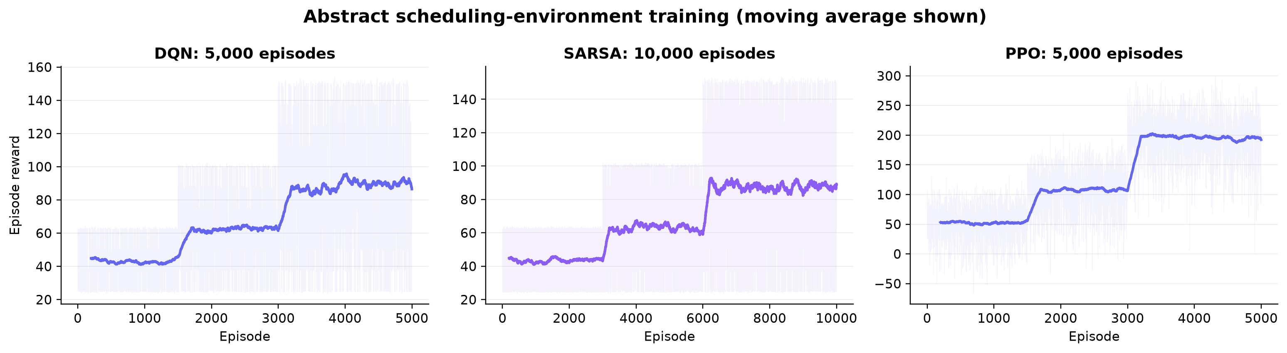
Reinforcement-learning training evidence
11
CHAMPION RUNS IN THE ABSTRACT SCHEDULING ENVIRONMENT
DQN
5,000 ep · 868.6 s
SARSA
10,000 ep · 210.4 s
PPO
5,000 ep · 5,000 updates
best val. reward 85.29
best val. reward 85.35
best val. score 60.07
Curves show episode reward and moving average; validation checkpoints were held out from training selection.
Wenbin Lin · MSc Robotics · Heriot-Watt University Dubai
11
Notes:
Do not compare absolute PPO reward directly with DQN/SARSA because logging and checkpoint configurations differ. Focus on stability and the existence of full-length training evidence.

Slide 12
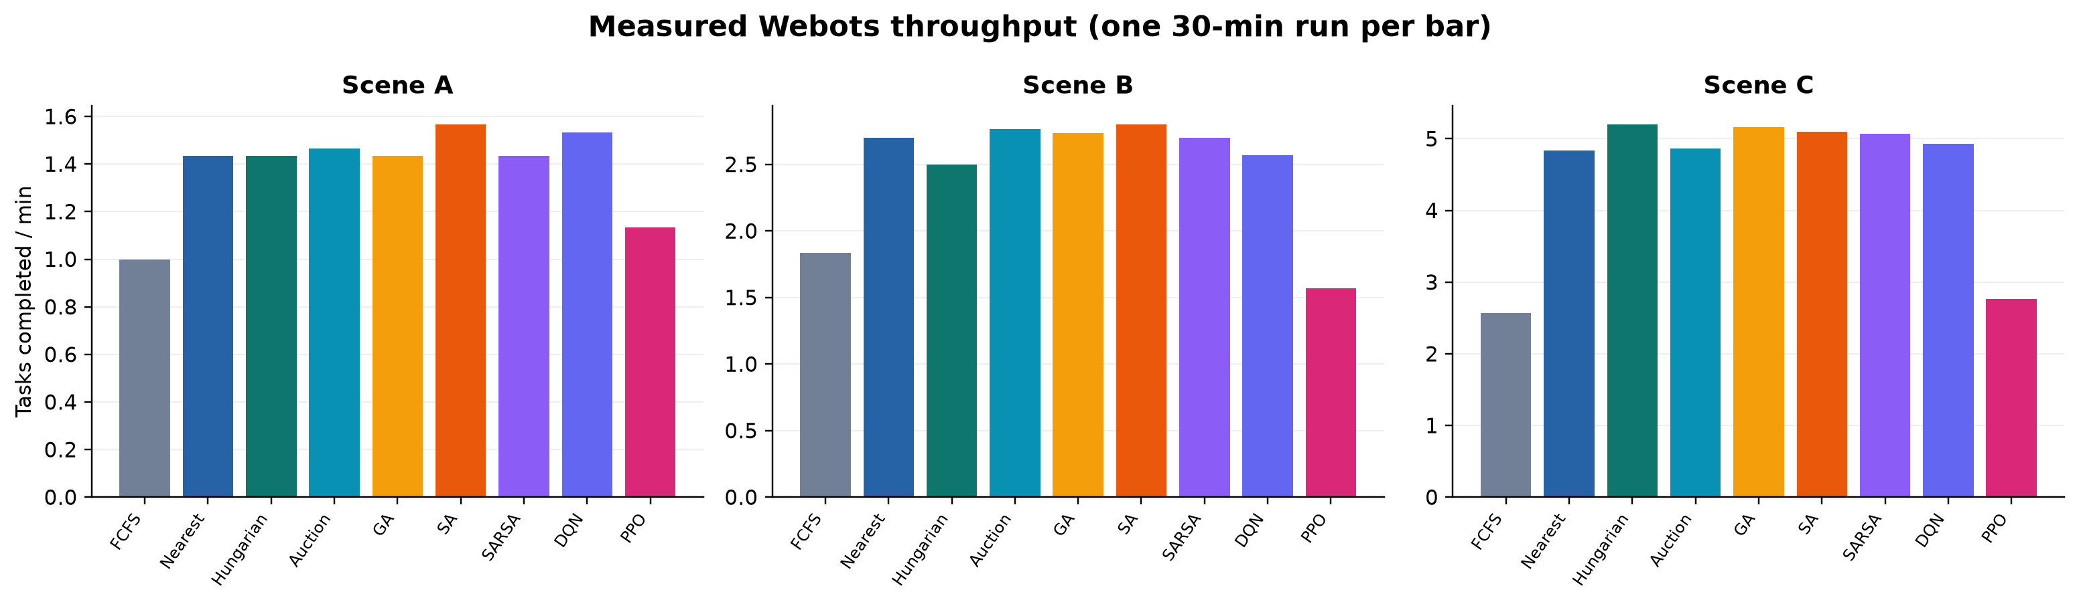
Measured scheduling performance
12
THIRTY-MINUTE WEBOTS RUNS; ONE RUN PER ALGORITHM–SCENE PAIR
Scene A
SA: 1.57 tasks/min
Scene B
SA: 2.80 tasks/min
Scene C
Hungarian: 5.20 tasks/min
highest measured
highest measured
highest measured
No error bars: seeds were not stored and repeated matched runs are unavailable.
Wenbin Lin · MSc Robotics · Heriot-Watt University Dubai
12
Notes:
This is the primary measured result. SA leads low and medium density, while Hungarian leads the high-density scene. This evidence does not support blanket RL superiority.
Possible examiner question: Are these differences statistically significant?
Suggested answer: Not established. Each algorithm–scene cell has one matched-duration run; repeated recorded seeds are required for confidence intervals.

Slide 13
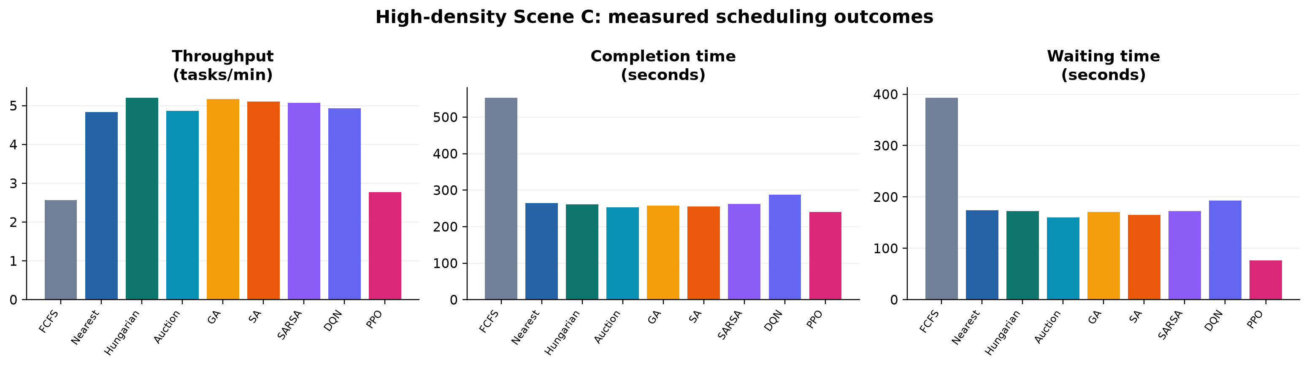
High-density Scene C: throughput versus delay
13
LEARNING CHANGES THE TRADE-OFF, NOT EVERY METRIC IN THE SAME DIRECTION
Hungarian
PPO
Interpretation
5.20 tasks/min; 172.7 s mean wait — strongest measured completion throughput.
76.1 s mean wait; 2.77 tasks/min — fastest assignment, lower completion throughput.
Low waiting is insufficient if trips, charging or coordination limit completions before the horizon.
Wenbin Lin · MSc Robotics · Heriot-Watt University Dubai
13
Notes:
Separate assignment delay from end-to-end completion. PPO allocates tasks quickly, but Hungarian completes more under heavy load; assignment quality must include executable downstream travel.

Slide 14
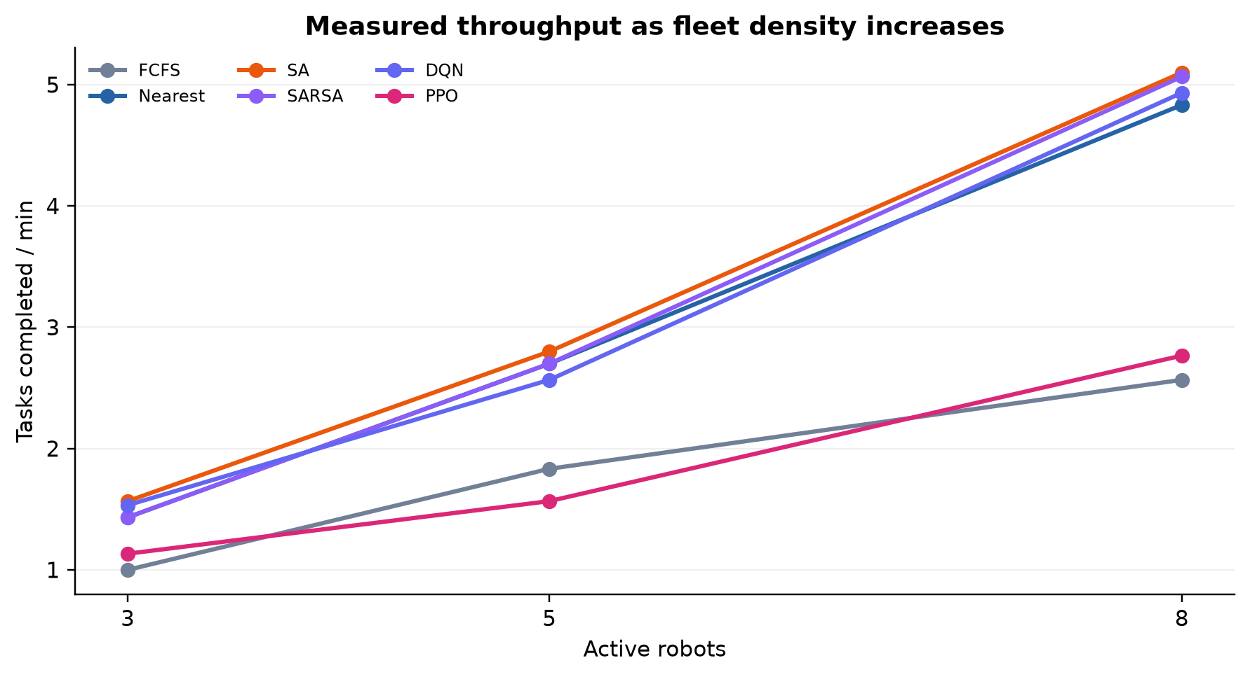
Coordination and scalability analysis
14
FLEET SIZE 3 → 5 → 8 ROBOTS
Scaling result
Hungarian rises to 5.20 tasks/min in Scene C; its global matching benefits from a larger candidate set.
RL result
PPO throughput grows modestly, while DQN and SARSA remain below the best classical methods in Scene C.
Safety evidence
Deadlocks are recorded as zero, but pair-distance violations remain non-zero for several runs.
H4 is not supported by the current point estimates.
Wenbin Lin · MSc Robotics · Heriot-Watt University Dubai
14
Notes:
Explain that higher throughput partly reflects more robots, while demand also increases. The correct comparison is algorithm behaviour within each scenario and the trend across scenarios.
Possible examiner question: Did better scheduling reduce conflicts?
Suggested answer: The current conflict counters are mostly zero and separation violations are non-zero, so H5 cannot be robustly confirmed from these logs.

Slide 15
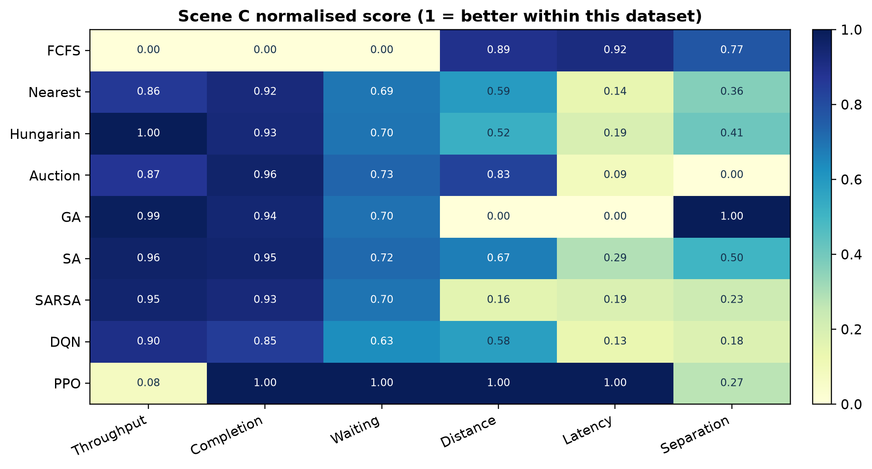
Overall comparison and hypothesis assessment
15
NORMALISED SCENE C EVIDENCE; 1 MEANS BETTER WITHIN THE MEASURED DATASET
H1 Throughput
Not supported overall
Classical Hungarian is highest in C.
H2 Delay
Partially supported
PPO has lowest B/C waiting time.
H3 Utilisation
Inconclusive
Idle metric is near zero and weakly discriminative.
H4 Scalability
Not supported
RL does not retain the best C throughput.
H5 Congestion
Inconclusive
Conflict logging lacks variation; separation violations persist.
Completion/wait/distance/latency: lower is better.
Wenbin Lin · MSc Robotics · Heriot-Watt University Dubai
15
Notes:
Use the heatmap as a multi-objective summary, not a universal ranking. Normalisation is within Scene C, and separation score reverses the recorded violation count.

Slide 16
Conclusions, limitations and next steps
16
EVIDENCE-BASED ANSWER TO THE RESEARCH QUESTION
● The project delivers a verified closed loop from dynamic task generation to safe Webots execution.
● SA achieved the highest measured throughput in Scenes A/B; Hungarian led Scene C.
● PPO reduced measured waiting time in B/C, but did not maximise completed-task throughput.
● Scheduling affects downstream coordination, yet the present logs do not prove RL scalability or conflict reduction.
Primary limitation
One run per algorithm–scene cell; seed metadata absent; no GA/SA intermediate traces.
Next experiments
≥5 recorded seeds; confidence intervals; consistent safety counters; ablation of reward and coordination layers.
Future engineering
Heterogeneous robots, charging-aware allocation, MARL/GNN policies and ROS 2 hardware validation.
Thank you · Questions?
Key references: Kuhn (1955); Kirkpatrick et al. (1983); Mnih et al. (2015); Schulman et al. (2017); Sutton & Barto (2018).
Wenbin Lin · MSc Robotics · Heriot-Watt University Dubai
16
Notes:
Conclude with the nuanced answer: learning improved one important operational metric—waiting—but the current Webots point estimates favour classical optimisation for throughput. State the exact evidence needed before stronger claims.
Possible examiner question: What is the strongest defensible contribution?
Suggested answer: The integrated, safety-filtered comparison framework and its evidence that assignment metrics and completed throughput can diverge after physical execution.

