Slide 1

MSC ROBOTICS · THESIS PRESENTATION
Learning-Based Scheduling
and Motion Coordination
of Mobile Robots in Smart Factories
A simulation-based study of task allocation, coordinated routing and safe multi-robot execution
Wenbin Lin | H00484764
MSc Robotics
Heriot-Watt University Dubai
Graduate Research Presentation · 2026
Notes:
Introduce the research topic, student identity, and the central claim: scheduling decisions and robot motion must be designed as one coordinated system.

Slide 2
02
Why multi-robot scheduling matters
BACKGROUND AND MOTIVATION
● Flexible factories replace fixed conveyors with mobile robot fleets.
● Dynamic transport requests compete for robots, corridors, docks and charging resources.
● A locally efficient assignment may create global congestion or unsafe encounters.
● The research challenge is to improve throughput without separating scheduling from physical execution.
Core idea · allocate intelligently, route safely, execute synchronously
Wenbin Lin · MSc Robotics · Heriot-Watt University Dubai
2

Slide 3
03
Research question and objectives
FROM ALLOCATION TO COORDINATED EXECUTION
How can learning-based scheduling improve factory productivity and robot coordination compared with rule-based approaches?
01
02
03
04
Model
Schedule
Coordinate
Evaluate
Build a reproducible smart-factory simulator with dynamic transport demand.
Implement rule-based, optimisation, metaheuristic and reinforcement-learning schedulers.
Integrate assignment with grid routing, reservations, local avoidance and recovery.
Compare throughput, waiting time, decision latency, safety and workload balance.
Scope decision: Webots is the implemented validation platform; ROS 2 / Gazebo is positioned as a future portability and sim-to-real extension.
Wenbin Lin · MSc Robotics · Heriot-Watt University Dubai
3

Slide 4
04
Experimental scenarios A / B / C
INCREASING FLEET SIZE AND DEMAND INTENSITY
A
Small fleet
B
Medium fleet
C
Large fleet
3 robots
5 robots
8 robots
Mean arrival: 30 s
Mean arrival: 15 s
Mean arrival: 8 s
≈ 2 tasks/min
≈ 4 tasks/min
≈ 7.5 tasks/min
Poisson arrivals
Poisson arrivals
Poisson arrivals
Wenbin Lin · MSc Robotics · Heriot-Watt University Dubai
4

Slide 5
05
Factory, robots and transport tasks
WHAT THE SIMULATOR REPRESENTS
FACTORY FLOOR
R
Robot platform
WS1
WS2
WS3
Differential drive · 0.26 m/s max · wheel radius 0.033 m · wheelbase 0.287 m
S1
S2
S3
S4
T
Task types
Storage → workstation · workstation → storage · workstation → workstation
CS1
CS2
E
Energy model
S5
S6
S7
S8
25% low-battery trigger · 15% task-abort threshold · charge to 95%
WS4
WS5
WS6
D
Demand model
Valid pickup–delivery pairs generated by an exponential inter-arrival process
Wenbin Lin · MSc Robotics · Heriot-Watt University Dubai
5

Slide 6
06
End-to-end system architecture
A CLOSED LOOP FROM DEMAND TO PHYSICAL FEEDBACK
Task layer
Decision layer
Coordination layer
Execution layer
Feedback layer
Poisson task generator
Pending task queue
Scheduler registry
Feasibility validation
Grid A* + reservations
Conflict prediction
Waypoint controller
LiDAR + DWA
Robot state + battery
Metrics + recovery
continuous state feedback and replanning
Design principle: a scheduling decision is committed only after a feasible path exists and the navigation command is successfully dispatched.
Wenbin Lin · MSc Robotics · Heriot-Watt University Dubai
6

Slide 7
07
Robot lifecycle and safety stack
CLASSICAL CONTROL PROTECTS LEARNING-BASED DECISIONS
IDLE
PICKUP
CARRYING
DELIVERY
REST
LOW BATTERY BRANCH
RETURN TO CS
CHARGING
AVAILABLE
1
Predict
2
Avoid
3
Replan
4
Recover
10 s trajectory scan
Peer braking + LiDAR
No-progress monitor
Safe relocation after 5 s
Wenbin Lin · MSc Robotics · Heriot-Watt University Dubai
7

Slide 8
08
Scheduling algorithms implemented
FROM TRANSPARENT BASELINES TO ADAPTIVE POLICIES
Rule-based
Optimisation
Metaheuristic
Learning-based
FCFS
Round Robin
Random
Nearest Neighbour
Greedy
Hungarian
Auction
Genetic Algorithm
Simulated Annealing
PPO
DQN
SARSA
Fast
Deterministic
Global search
Adaptive
Current default usage
Common runtime choice: FCFS / Hungarian-style safe fallback · Research comparison: GA, SA, Auction and RL policies
Wenbin Lin · MSc Robotics · Heriot-Watt University Dubai
8

Slide 9
09
Five reinforcement-learning options
HOW LEARNING CAN SUPPORT ROBOT SCHEDULING
PPO
DQN
SARSA
Stable policy-gradient training
Value learning with replay
On-policy temporal-difference
Large continuous state representations
Discrete robot–task assignment actions
Risk-aware learning under the behaviour policy
A2C
QMIX / MAPPO
Actor–critic with low variance
Cooperative multi-agent learning
Fast online policy/value updates
Decentralised robots with a shared objective
Implemented in this project: PPO, DQN and SARSA · A2C and cooperative MARL are proposed extensions
Wenbin Lin · MSc Robotics · Heriot-Watt University Dubai
9

Slide 10
10
Reinforcement-learning loop
STATE → ACTION → SAFE EXECUTION → REWARD
STATE
POLICY
ACTION
SAFETY FILTER
REWARD
robot positions
battery · task queue
PPO / DQN / SARSA
select robot–task pair
or no-op
feasibility + path check
+ completion
− wait / distance / collision
next state and long-term return
Why learning helps
Why classical control remains
Hybrid principle
Optimises delayed effects: queue growth, future travel and resource contention.
Guarantees executable paths and reacts to centimetre-scale hazards.
Learning proposes; validation and motion coordination enforce safety.
Wenbin Lin · MSc Robotics · Heriot-Watt University Dubai
10

Slide 11
11
Evaluation design and evidence status
WHAT IS MEASURED — AND WHAT REMAINS TO BE TESTED
Inputs held constant
Primary metrics
Experimental protocol
Same factory layout
Same robot dynamics
Same task-generation model
Same coordination layer
Throughput · completion rate
Waiting / completion time
P95 scheduling latency
Workload CV · safety distance
30-minute simulation horizon
Fixed scenario definitions
Recorded JSON outputs
Multi-seed repetition planned
CURRENT EVIDENCE
OPEN EVIDENCE GAP
Scenario A contains nine baseline runs plus one preliminary PPO_RL deployment run.
Matched multi-seed RL evaluation across Webots A/B/C is not yet complete.
Therefore, measured claims and expected RL benefits are reported separately.
Wenbin Lin · MSc Robotics · Heriot-Watt University Dubai
11

Slide 12
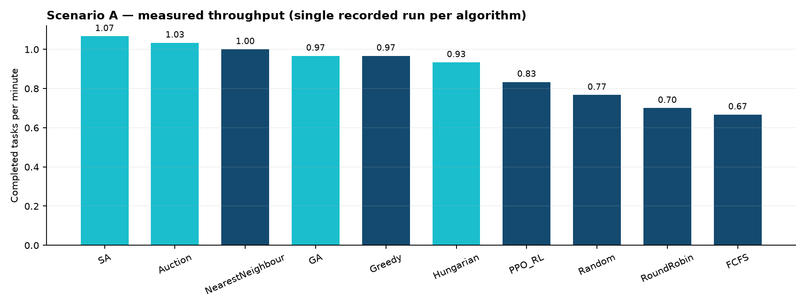
12
Measured scheduling performance
SCENARIO A — NINE BASELINES PLUS PPO_RL
Highest recorded: SA · 1.07 tasks/min
Interpretation is preliminary: each bar is one recorded 30-minute run, not yet a balanced multi-seed confidence interval.
Wenbin Lin · MSc Robotics · Heriot-Watt University Dubai
12

Slide 13
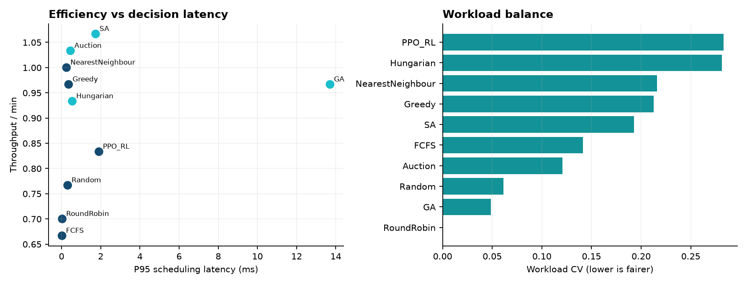
13
Efficiency is not a single number
LATENCY, THROUGHPUT, FAIRNESS AND SAFETY TRADE-OFFS
Observed pair-distance violations: 21
A production scheduler must deliver useful assignments within the controller budget and must not destabilise the shared motion layer.
Wenbin Lin · MSc Robotics · Heriot-Watt University Dubai
13

Slide 14
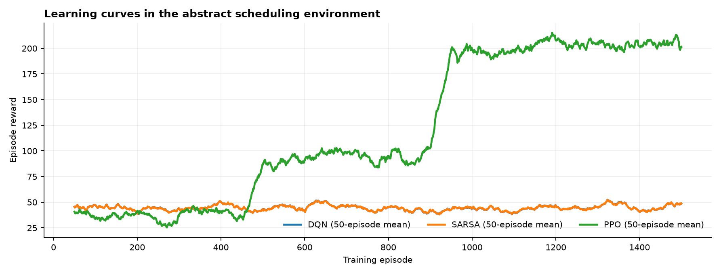
14
Traditional scheduling vs reinforcement learning
MEASURED TRAINING EVIDENCE AND EXPECTED SYSTEM-LEVEL ADVANTAGES
Potential RL advantage
● Optimises long-term return rather than one-step distance.
● Can encode battery, queue pressure and future congestion.
● Inference is fast after offline training.
● Adapts policy behaviour across changing demand patterns.
Evidence boundary
Claims require matched multi-seed Webots A/B/C tests against the baselines.
Research position: RL should improve assignment quality; classical coordination remains the safety envelope.
Wenbin Lin · MSc Robotics · Heriot-Watt University Dubai
14

Slide 15
CONCLUSIONS & FUTURE WORK
A hybrid learning-and-control framework
● The project integrates dynamic scheduling with executable multi-robot motion coordination.
● Traditional algorithms provide interpretable, measurable baselines and robust fallbacks.
● PPO, DQN and SARSA establish the learning pipeline; matched Webots comparison is the next milestone.
● Future work: repeated A/B/C trials, confidence intervals, curriculum learning, MARL, ROS 2 / Gazebo portability and hardware validation.
Thank you · Questions and discussion
Wenbin Lin · H00484764 · MSc Robotics
Notes:
Conclude with the hybrid-system contribution, explicitly distinguish completed evidence from planned RL evaluation, and invite questions.

