Slide 1
Project 3: DefiLotto
By Leith Bakhit, Lawrence Cummings, Emanuel Korlewala, Anne Lam, Kevin Walsh and Frank Xu

Slide 2
L

Slide 3
Economics of the Lottery
Before America existed, lotteries were crucial for financing the British settlement of North America.
First Computerized Lottery held 1975 - NJ
The average American spent $219.54 on the lottery in 2017. - $71,826,676,000
State governments take in about a third of each lottery jackpot.
85% of winners choose to remain anonymous.

Slide 4
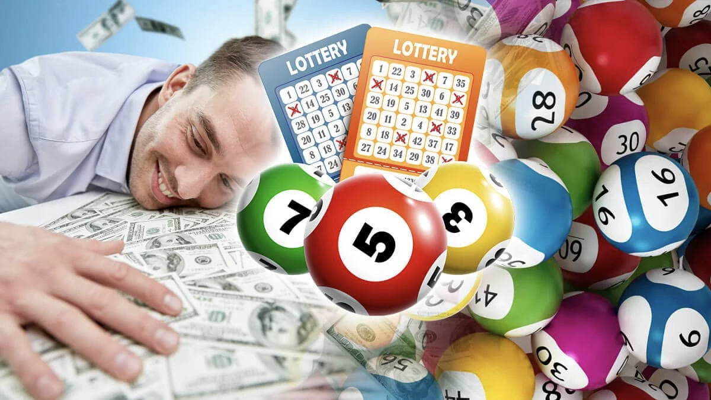
Everybody loves the lottery, right?!

Slide 5
What’s wrong with the normal lottery?
An inside job can influence the winning numbers chosen/dates/etc.
Hot Lotto was rigged 5 different times by one of its staff members, Eddie Tipton, who worked as the information-security director for the Multi-State Lottery Association.
High overhead cost, consisting of but not limited to:
Staff to maintain the servers for the lotteries
Staff to maintain the tickets and packaging
Television draws, radio and online ads
Staff to create new games
Some states require that lottery winner’s identity be released publicly
Can lead to friends, family members, or even strangers targeting lottery winners for their newfound wealth
Freedom of Information Act (FOIA)

Slide 6
A Perfect Lottery
Incorruptible:
No way to rig the lottery
Forgery Prevention
Tokens cannot be reproduced
Low Overhead Costs
No need for staff to maintain the servers or create new games
Efficient Method of Payment
Direct through cryptocurrency wallet
Flexibility in Structure
Different payout possibilities, such as winner-takes-all, no-loss, tiered with a 1st/2nd/3rd prize

Slide 7
The Process Flow of the Lottery
The lottery is activated via a function in solidity
Players enter the lottery by buying an NFT Token
These tokens are put in a list object as they are minted dynamically through the purchase step
A winner is declared by picking randomly a token from the list object
The lottery is deactivated - no more tokens can be purchased
The accumulated funds are stored in the contract as players trade ETH for tokens
Balance of the pot is transferred to the address owning the winning token.

Slide 8


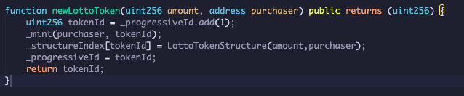
The Code - Creating a Non-Fungible Token

Slide 9
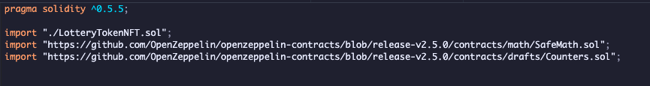
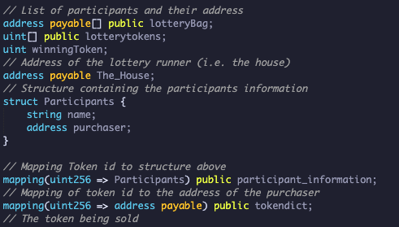
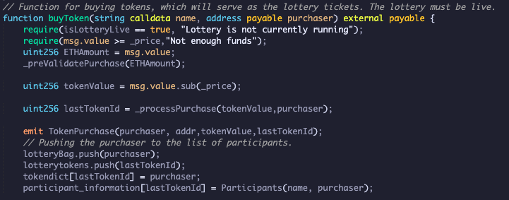
The Code - Creating a Market

Slide 10

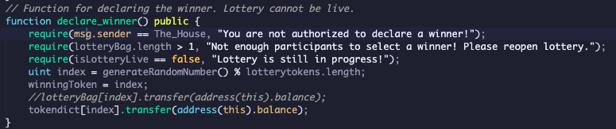
The Code - Selecting a Winner

Slide 11
Demonstration

Slide 12
Future Applications
No loss lottery system: buy in is never lost and the winnings are generated by the investments within the total jackpot.
Tiered winning lottery to transfer percentages of the winnings to multiple winners (i.e 1st place, 2nd place, etc)
Borderless lottery to open the entry to players around the world.
Built in payout to the house - Lotto runner could take a percentage of the winnings before paid out.
The contract would essentially wipe out the possibility of unclaimed prizes due to automatic transfer upon winning tokens being drawn.

