Slide 1
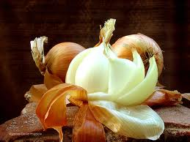
Peeling Onion Architecture
Laurence Blackledge

Slide 2
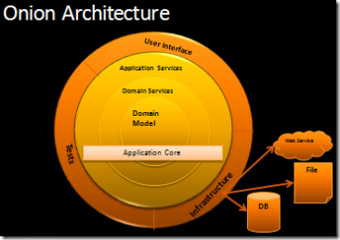
Peeling Onion Architecture
So what is “Onion Architecture”?
Coined by Jeffery Palermo in a series of blog articles (Jul ’08)
So called because it heavily encourages layers of separation between:
Core: Domain model, classes, interfaces for everything, business logic
Infrastructure: implementations of interfaces from core, mainly data persistence
UI: Whatever tech you want, but it can only reference core
http://jeffreypalermo.com/blog/the-onion-architecture-part-1/

Slide 3



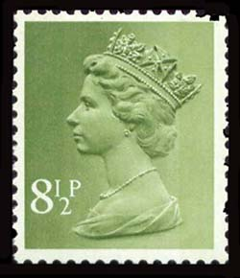
Peeling Onion Architecture
Principles:
Core Objects are Queen
Each layer can only speak to the ones below it:
Data access implements Core interfaces
UI depends on Core interfaces
Dependency injection handles the interface resolution at runtime
Like most ideas in programming it’s built on others:
Alistair Cockburn’s “Hexagonal Architecture” for tech-agnostic applications
Domain-Driven Design: domain logic is the center of an application
LSP, IoC and DI from SOLID

Slide 4
Peeling Onion Architecture
{ } ?
http://jeffreypalermo.com/blog/the-onion-architecture-part-1/
http://alistair.cockburn.us/Hexagonal+architecture
http://www.matthidinger.com/archive/2011/05/17/Onion-Architecture-code-and-slides-from-Chicago-Code-Camp.aspx
Laurence Blackledge @l_blackledge
https://github.com/lwblackledge/PeelingOnionArchitecture

