Slide 1
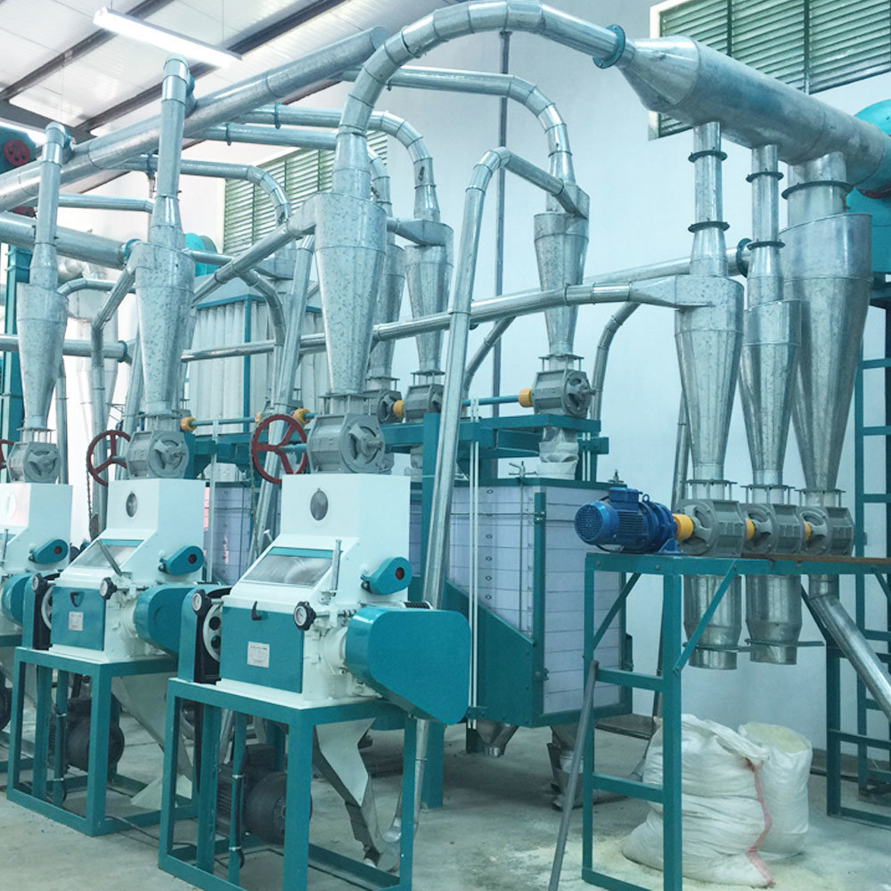

SMITTAN SOLUTIONS LTD
Company Profile
By John Gikunda

Slide 2

Company
Background
Smittan Solutions Limited is a leading specialist in :-
1. Sales and marketing team Recruitment, management/empowerment 2.promotions,branding and route-to-market strategies
3. Credit Management, Mitigation and assessment
4. Debt Collection
5.Pay as you go credit management in Kenya.
With extensive experience across FMCG, fresh produce, microfinance, Internet service provider (ISP), and clean energy, we are committed to delivering quality and integrity.
Our expertise enables us to meet the diverse needs of both consumers and businesses, while driving profitability, sustainability, and economic growth in Kenya.
.

Slide 3

Mission
At Smittan Solutions Limited, our mission is to provide organizations with exceptional Route-to-market strategies, promotional support, and market insights with an impeccable sales team.
We are committed to maintaining the highest standards in sales, market activations, credit and customer retention.
Our goal is to be a trusted partner in the Sales and Marketing sector, upholding international standards while advancing sales processes and driving commercial growth towards profitability.

Slide 4

Products
Market Mapping: We help organizations identify existing opportunities and uncover untapped potential.
2. Market Activations: Our tailored sales teams specialize in activating dormant customers and onboarding new target customers, consistently meeting set sales targets.
3. Roadshows, Promotions, and Merchandising: We offer top-tier marketing services and merchandising solutions to help organizations raise brand awareness.
4. Route-to-Market Strategy & Distribution Restructuring: We optimize route-to-market strategies and restructure commercial operations to ensure maximum productivity of the sales team at the lowest possible costs.
5. Credit Management- ensure clean portfolios with professional debt collection skills

Slide 5

Target
Market
Our company targets both B2B and B2C organizations looking to optimize their income streams, particularly in sales and marketing/Business development to achieve maximum profitability. We provide resources, accessibility, and affordability, all while maintaining the highest standards of quality and quantity..
This Photo by Unknown Author is licensed under CC BY-SA

Slide 6
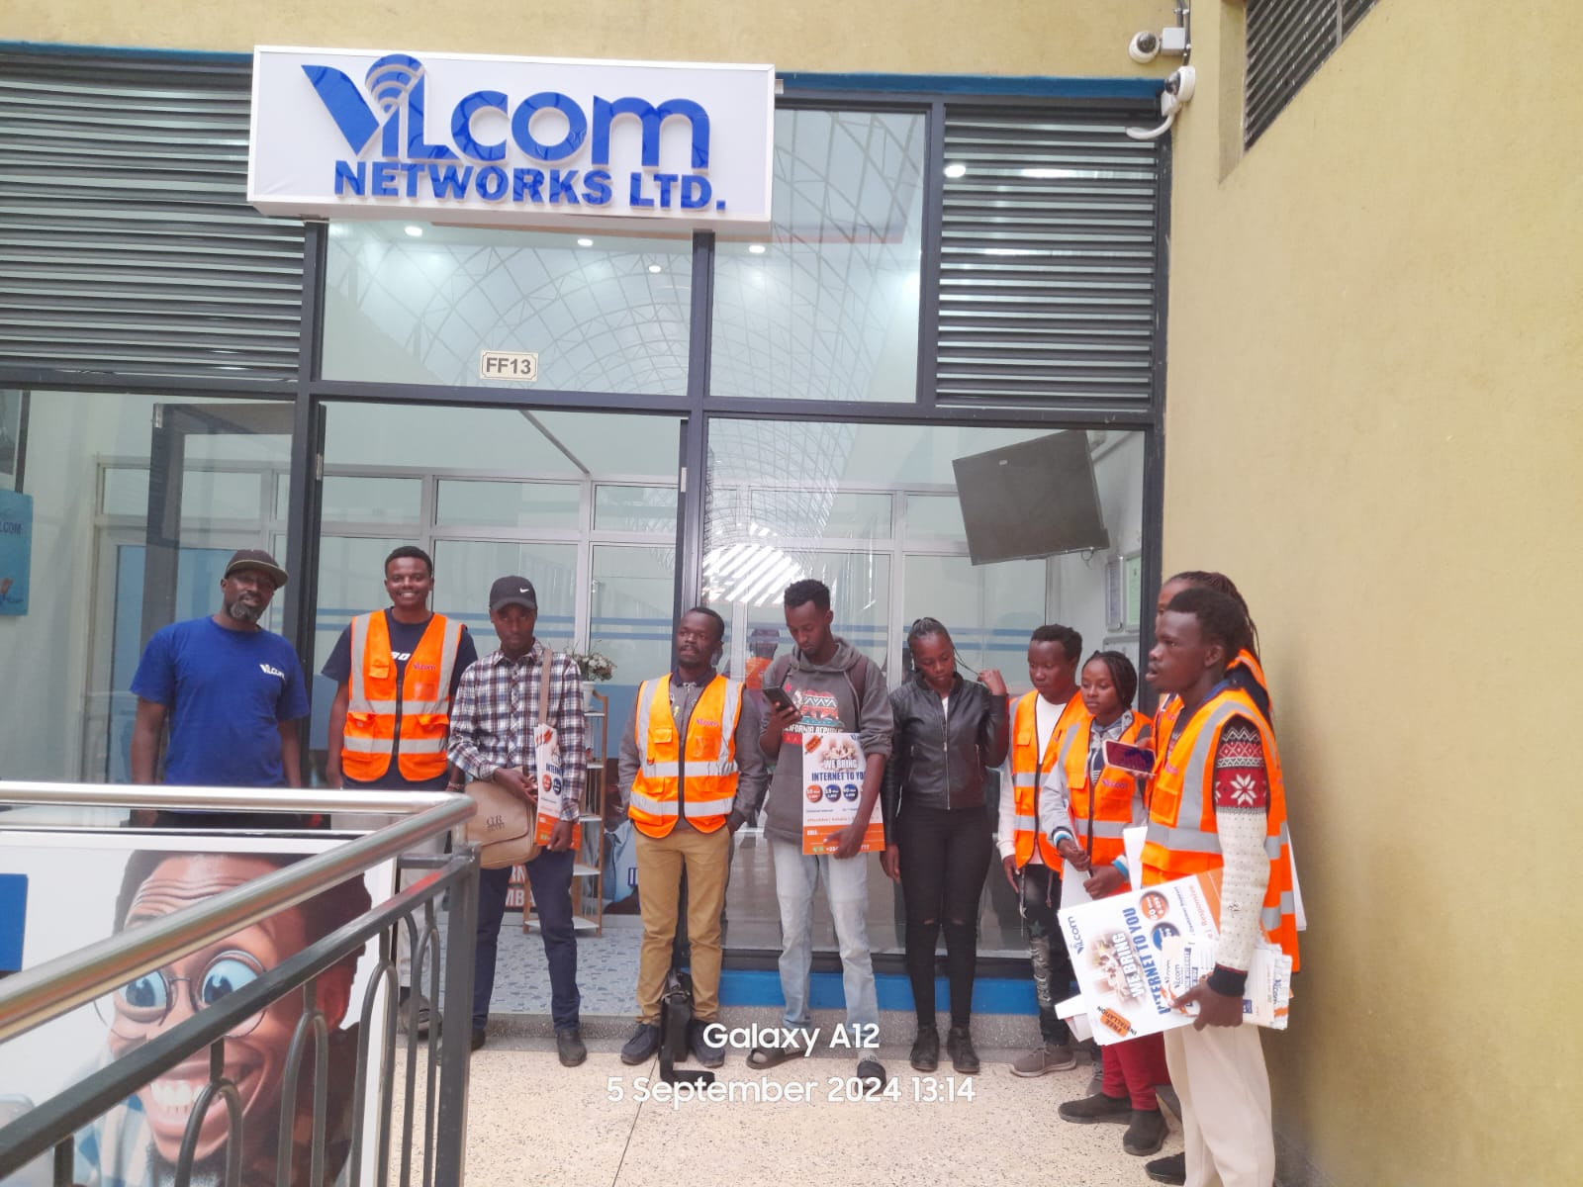
Projects
Vilcom Networks
We have partnered with Vilcom Networks to drive market outreach, customer recruitment, and activations in Meru and Isiolo Counties.

Slide 7

Meet The Team
Smittan Solutions Limited
John Gikunda
MD and Founder
Brian Kariuki
Felix Kiprop
Project Manager
Territory Manager (isiolo/Meru)

Slide 8

Sustainability
Practices
At Smittan, sustainability is central to our operations. We prioritize responsible sourcing of skilled talent, uphold integrity, and implement best practices to ensure 100% fulfillment of our promises to clients.

Slide 9
Quality
Assurance
Stringent quality control measures are ingrained in our processes, guaranteeing consistency and integrity in every project ensuring 100% delivery of our objectives.

Slide 10

Customer
Satisfaction
Customer satisfaction forms the cornerstone of our business ethos. We are committed to surpassing customer expectations through competitive pricing, dependable service, and proactive support.

Slide 11

Community
Engagement
As a socially conscious entity, we actively engage with local communities, empowering small businesses through training, market access, and Market insights, thus fostering urban development and poverty alleviation.

Slide 12

Future
Plans
We envision expanding our operations across Africa, with the goal of acquiring more businesses and delivering lasting solutions in sales and marketing. Our aim is to ensure sustainability and profitability for our partners.

Slide 13
Contacts
Ruaka Town, Kiambu County, Kenya
P.O. BOX 55534 - 00200 Nairobi, Kenya
Phone: +254 704 444 724/0704 698 288
Email: smittaninvestment@gmail.com

