Slide 1

Fintech HACKATHON 2026
Cover design
These slide designs and messages are inspirational only. Please modify text boxes and positioning as needed based on the message and overall composition. Always consider the legibility and contrast of copy and content for maximum usability.
Any and all photography in these designs is given as an example. While you can use them, it’s better to change the photography to match your content.
To do so, right click on the picture or placeholder to change/insert a photo.
Where to find photography:
Photo library
Getty images (Recommended), Shutterstock, Adobe images (check with your M&C design team):
Further cover examples and inspiration are available in Extras file in your Powerpoint -> File -> New from template…
Business case introduction
Dorota Grzybowska, Wrocław, 17.01.2026

Slide 2
Agenda
01
Bussiness case introduction
02
Hackathon goal and Overview
03
Inputs
04
Output

Slide 3
Business Case Introduction
01

Slide 4

Instant Payments & Fraud Risks
Speed Increases Fraud Risk
Instant payment (e.g. SEPA Instant, Faster Payments) move money immediately, which leaves very little time to stop fraud.
Rise of APP Fraud
This increases APP fraud (Authorized Push Payment), where customers are tricked into sending money themselves.
FRAML Transaction Monitoring
To address this, banks need near‑real‑time transaction monitoring
They are moving from separated Fraud and AML teams to a FRAML aproach (Fraud + AML combined)

Slide 5
KEY TERMS
Cheating to steal money.
Tricking someone into sending money
Using stolen card details
Faking identity or documents
Anti‑Money Laundering – stoping „dirty” money
Money Laundering :
Moving money through multiple accounts to hide its source
Sending funds across borders to avoid detection
Buying expensive assets (property, cars, art)
Fraud
Understanding: Fraud & AML
AML
FRAML

Slide 6
Hackathon Goal and Overview
02

Slide 7

Hackathon Goal
Business goal:
Build a Fraud Detection Engine that :
analyzes payment transactions & detects suspicious activity
Operates in under 20 seconds, based on the given FRAML rules
Business Value:
Regulatory compliance
Financial loss prevention
Improved customer trust
Notes:
Image source: Microsoft 365 content library Build a Fraud Detection Engine that analyzes payment transactions and detects suspicious activity based on FRAML rules in less than 20 seconds. Business value includes financial loss prevention, increased customer satisfaction, faster reaction to suspicious transactions, and regulatory compliance. This solution aims to enhance security and efficiency within payment systems.

Slide 8
Inputs & Outputs
Organizer inputs
Expected outputs
1
File with Transactions
Payments to be verified
1
Fraud detection engine.
Working model implemented in Python
2
Files Specifications
For the input file
For output file with results
2
File with results
List if all transactions with results
3
Documentation
Instruction , FRAML Rules
3
Alert dashboard
Visualization

Slide 9
Inputs
02

Slide 10
Input files from Organizers
1.hackathon_transactions.csv
Includes payment transactions to be verified
2.HACKATHON_INSTRUCTIONS.pdf
Step‑by‑step instructions for scoring engine
3. INPUT&OUTPUT_FILES_specification.xlsx
Specification of input file (1.hackathon_transactions.csv)
Specification of output result file.
4.HACKATHON_FRAML_RULES.xlsx
List of FRAML rules with description
5. HACKATHON_ALERT_DASHBOARD.pdf
Alert dasboard requirements

Slide 11
FRAML rules
„If it looks suspicious, flag it”
Checks used by banks to spot financial crime.
Detect unusual or risky patterns
Early fraud and money‑laundering detection
Hackathon scope:
14 rules → 5 mandatory, 9 optional
Mixed difficulty
Single‑transaction vs customer‑history‑based rules

Slide 12
Outputs
03

Slide 13
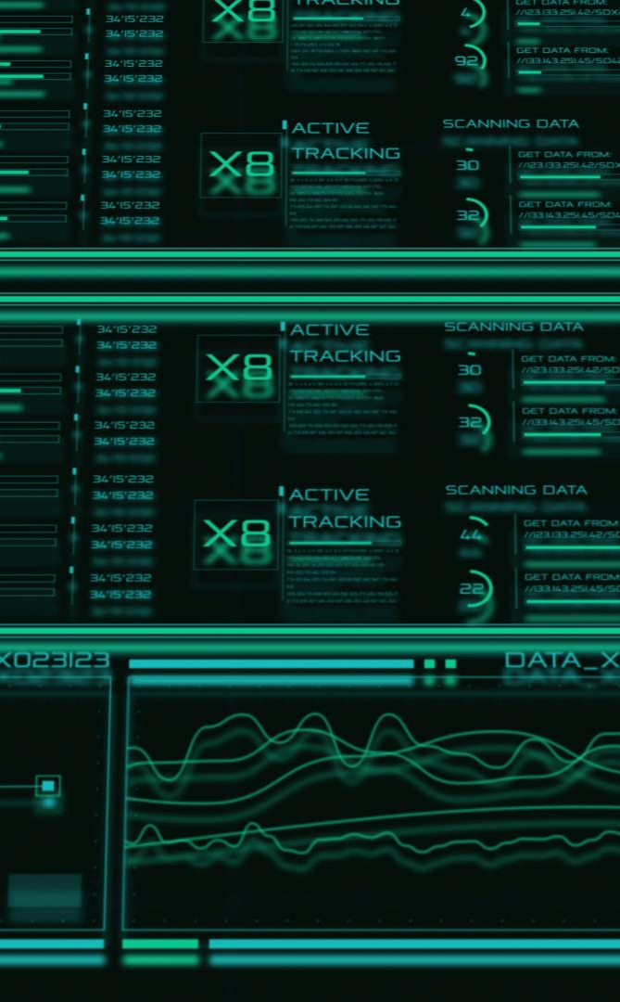
Expected Output
Fraud detection engine.
Working model implemented in Python
CSV File with results
List if all transactions with the rules triggered and fraud flag
Alert dashboard
Visualization
Mandatory and Optional requirements
Notes:
Image source: Microsoft 365 content library A results file captures output data for analysis and reporting. The Scoring Engine evaluates performance or compliance based on set rules, providing objective scores. An alert dashboard displays notifications and anomalies in real-time, enabling quick responses to issues and ensuring efficient monitoring across the system.

Slide 14
ALERT DASHBOARD – inspirations ☺
https://blog.amlbot.com/amlbot-continuous-transaction-monitoring/
Https://www.slideteam.net/dashboard-for-monitoring-fraud-and-money-implementing-bank-transaction-monitoring.html
https://www.corribpoint.com/features

Slide 15

Good Luck! ☺
Impact slides
These slide designs and messages are inspirational only. Please modify text boxes and positioning as needed based on the message and overall composition. Always consider the legibility and contrast of copy and content for maximum usability.
Any and all photography in these designs is given as an example. While you can use them, it’s better to change the photography to match your content.
To do so, right click on the picture or placeholder to change/insert a photo.
Where to find photography:
Photo library
Getty images (Recommended), Shutterstock, Adobe images (check with your M&C design team):
Further examples and inspiration are available in Extras file in your Powerpoint -> File -> New from template…
Make it real.

