Slide 1
A Software Architecture for Heterogeneous Engineering Workflow Interoperability & Model Provenance
Andy Gallo, David Hughes, Richard Arthur (GE Research, USA)
Notes:
Hello and welcome. The title of our presentation is “A Software Architecture for Heterogeneous Engineering Workflow Interoperability and Model Provenance”. We intend to discuss today what is implied from that title – platforms for enabling workflows across heterogeneous systems while maintaining data traceability throughout.

Slide 2
The Problem The Goal
Cambrian explosion of computing options & complexity in HPC
Distributed computing increases difficulty of data management, findability, reusability - aka “FAIR”
Raises barriers to entry, inhibits full utilization & democratization of resources
Need traceability & model fidelity sufficient to trust; e.g., digital test in lieu of physical, must include model validation, UQ, and decision provenance
Control complexity with a loosely coupled data, tooling & compute architecture fronted by a secure API
To yield actionable insights at all stages of the provenancial digital thread, automatically capture metadata
Ease adoption with multiple interoperable & equivalent workflow representations / UIs
“The workflow is the app.”
Notes:
High performance computing and other systems tailored for scientific and engineering purposes are individually and collectively in a nearly continuous state of change - in the hardware, operating systems, key foundational libraries, as well as in the applications we wish to execute on these systems. This includes engineering workflows which are themselves evolving applications.
The goal of supporting truly portable and repeatable workflows, executable nearly anywhere, at any time in the future under conditions as they existed at the time of the original workflow execution, with the intent of producing the same result as the original is at the moment out of reach, and not the topic of this presentation. Neither is workflow representation the primary concern – there can exist many ways to express the same workflow and to provide varying human interfaces for workflow construction suitable for different purposes and user audiences.
What is of concern here is the ability to write the distributed workflow across heterogeneous systems at all, in any somewhat efficient manner, let alone sustainably. The barriers to entry of running simulation jobs on today’s HPC systems is a formidable impediment – from organizational barriers and security perimeters, to data classification constraints and concerns, to the consistent or easy availability of certain base libraries, to often significant variations in job scheduling syntax especially in the presence of hardware accelerators.
Furthermore, most often these engineering applications are not run in isolation but rather include essential pre- and post-processing steps. Thus, in a broad and distributed sense, “the workflow is the app”, some pieces of which might be best run on alternate computing platforms. This improves performance and efficiency but at a cost of complexity.
Treating the workflow as an application means considering its programmatic and human interfaces. Heterogeneity in compute and user populations means a single interface is unlikely to cover all systems, users, domains, and scenarios. Thus, we see the need for a specification of that workflow interface while allowing various implementations to be purpose-built perhaps as open source, or perhaps as a vendor-provided value-added offering. Loose coupling of defined system interfaces would be an appropriate key feature of an architecture which intends to address broad diversity in usage patterns.

Slide 3
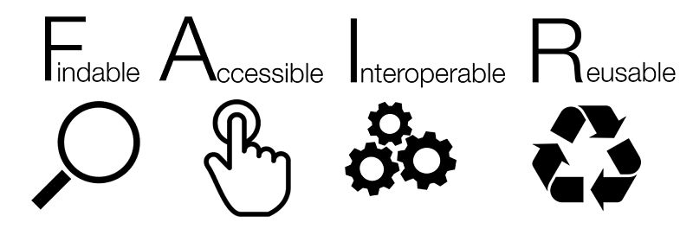
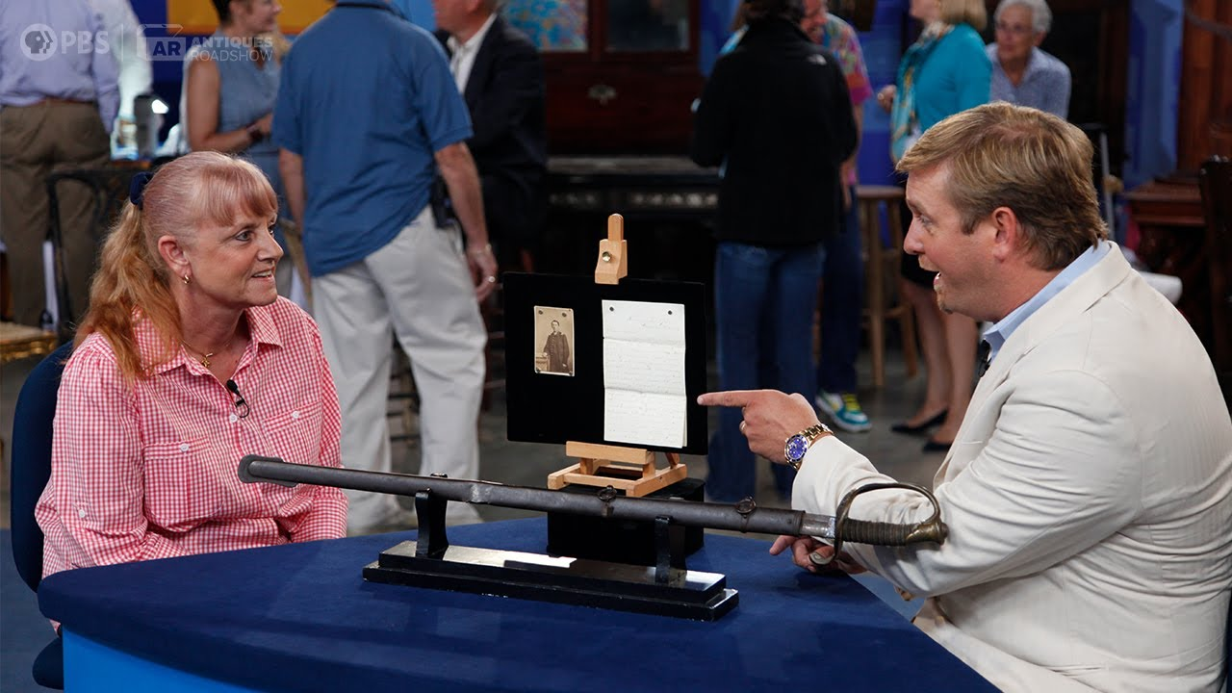
Metadata
Metadata about everything
Data
Models
Apps, workflows
Compute nodes & systems
Jobs
Provenancial 5 W's & How
Who, what, where, when, how
But not the elusive “why”
Automatic capture
Control flow & data flow = digital thread
Below radar of workflow author / user
Adherence to FAIR principles
Increase trust in results
Notes:
In model-based systems engineering, many different digital entities can be considered data, and von Neumann teaches their equivalency. These might include, but are not limited to applications, workflows which compose those applications, input and output data which results from execution steps, data-derived models which are evaluated and deployed as surrogates in even further workflows, and so forth.
Metadata describes the model or data entity – not only obvious values such as when the data was created, but other discernible values such as who created or modified the model, what application or tool was used in that activity, where on which fully-specified computing device did it occur, in addition to other user-arbitrary and domain-specific characteristics. There is also metadata about how the workflow was executed – both its intended potential and its actual. (We’ll get back to the capturing of the often elusive “why”.)
From this metadata we can determine the provenance for the model – its demonstrable origins – the specific sequence of workflows and workflow steps, with their constituent applications and upstream input and output data, which ultimately produced this specific version of the model. By tracking both metadata about data entities and their creation lineage, as well as metadata about the job itself, we can facilitate both control flow and data flow traceability.
Tracking the provenance of a data entity does not necessarily require a formal workflow tool – but a comprehensive workflow tool sensitive to data provenance concerns would incorporate such runtime and data tracking as an implicit and automatic part of the system, below the threshold of the user’s normal need for concern, allowing the engineering user to focus on their domain of expertise and the problem at hand, while depending on the tool for traceability. Such a tool would adhere to FAIR principles for data management – being findable, accessible, interoperable, and reusable.

Slide 4
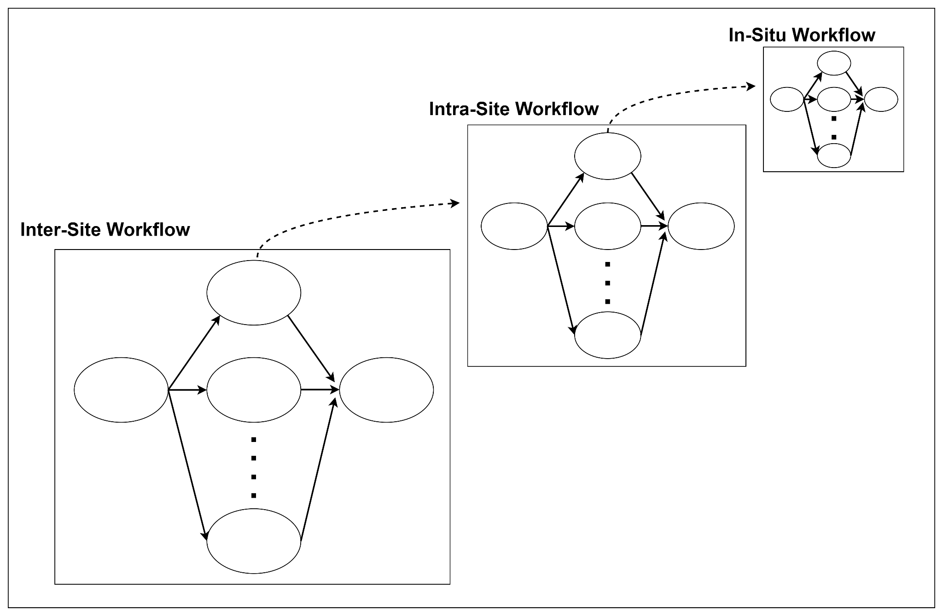
Three Types of Workflow
Type 1: In-Situ
Example:
Iterative optimization of a design space exploration and visualization using in situ analysis and steerage of high fidelity CFD
Type 2: Intra-Site
Example:
Workflow composed of high fidelity, GPU-accelerated CFD visualized using in situ techniques and used to inform the training of a NN-informed design space exploration of cooling hole placement
Type 3: Inter-Site
Example:
Workflow that enables democratization of inter-agency resources - e.g., MxN app readiness (2021-2023 NERSC grant)
Notes:
What we seek therefore is a framework for authoring scientific and engineering workflows which can make interoperable use of available distributed and heterogeneous computing facilities while maintaining data management and traceability throughout.
Based on industrial design engineering experience, we propose a software architecture consisting of three convergent workflow types – in-situ, enterprise or intra-site, and inter-site.
The first type, in-situ workflows are executed within a running computing allocation. For example, on a shared HPC system, a user is allocated 20 nodes on which they orchestrate a workflow of several parallelizable and serial applications. From the point of view of the job scheduler, or operating system, this is a single job or process, with a single identifier. However, within the allocation, more than one sub-job may be running, each with its own sub-identifier.
The second type of workflow, intra-site, involves multiple distinct jobs run in parallel or serial, independently or in logical sequences. An example is coordinating multiple jobs on an HPC system which is of course the function of the scheduler – for example “run job 3 when job 1 and 2 complete and free the necessary resources”. In an intra-site workflow, we are executing within an enterprise, and there is a single managed pool of job identifiers for the entire site.
The third and final type of workflow is inter-site, those which span enterprises, i.e., span distinct computing systems each with their own job management, and yet, a workflow can be constructed which utilizes more than one of these sites in concert.
An inter-site workflow would permit jobs run on one site system to trigger the execution of jobs on another site, and for provenancial data management to be comprehensive over all sites. In order for this to be true, we need to cast the individual sites into some standard model, at minimum to reconcile their individual job state machines into a canonical interoperable form. Even better would be a site and scheduler-neutral abstraction over job execution, which we will put forward in the next section, including its required reference implementation middleware.

Slide 5
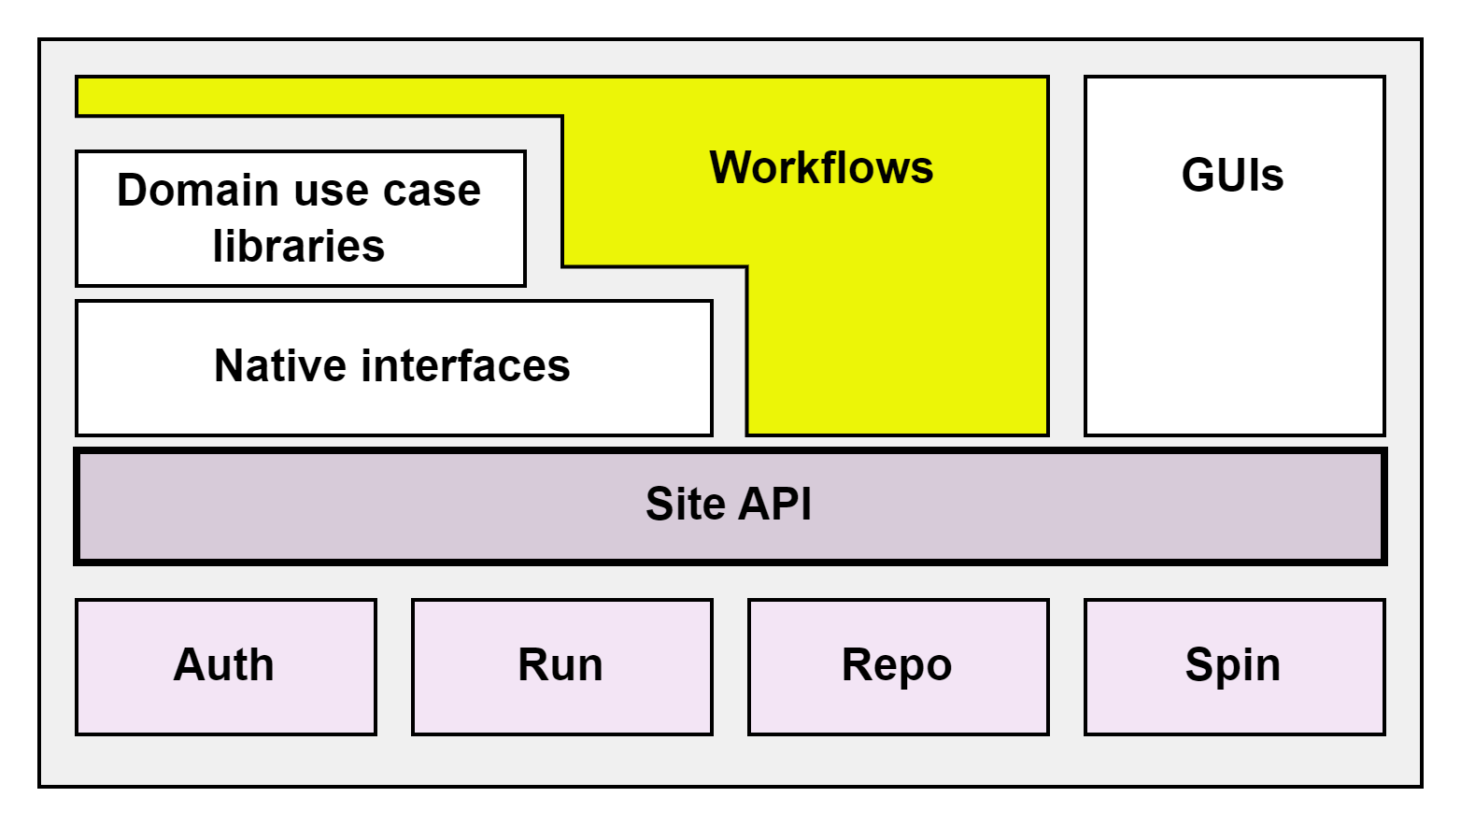
Four Pillars of an Interoperable Site
Auth
authenticate
authorize / tenancy
Run
execute job
execute on event
check job status
Repo
put, get
notate with metadata
find
Spin
list compute options
allocate, free
Notes:
For a site to interoperate in a loosely coupled inter-site workflow – be it a local user site, or a corporate, government, or cloud-managed computing facility – the site must provide interfaces covering four architectural pillars including security, runtime, data, and resource management, conveniently abbreviated for conversation as Auth, Run, Repo, and Spin. Upon these four pillars are layered generic, language-native, and domain-specific interfaces for both automated programmatic workflows as well as human interactions. Multiple interface options means there is flexibility and multiple ways to express a given workflow depending on the needs of the user community. An emphasis on interfaces rather than implementation means these interfaces can be utilized within any other workflow tool which permits programmatic extensibility.
Each of the four site pillars, or interfaces, can be simplistically described by a small set of functional verbs. Auth requires “login”, perhaps a predicate “is logged in” to confirm the validity of the user and its membership in a tenancy. A typical successful Auth interaction might return a secure token which can be used to invoke other API endpoints, such as that used to run jobs.
For its part, Run exposes “run job”, “cancel job” and “get job status” verbs. To this we add “set, unset, and list event handler”, which implies an inter-site workflow-enabling middleware component which monitors normalized job status and fires registered event handlers as jobs. For example, an event handler might periodically check to see if certain data as represented by its metadata has appeared in the system, and then initiate a job to process the data.
The Repo interface exposes put, get, notate, and find, which similarly implies the existence of middleware which can respond to the metadata notation and subsequent search request. Actual data blobs, either data or even code, reside in the storage medium of choice - for example the filesystem, or an S3 bucket, a database, an HTTP endpoint, a container registry, and so forth. These are referenced in their location by an address stored in the corresponding metadata. Interoperability is further enhanced by defining a standard for metadata exchange between sites.
The Spin subsystem, which is the only non-essential pillar, provides a catalog of computing and other services which can be instantiated, and functions to allocate and free them. By loosely coupling Spin, we avoid the challenge of achieving consensus between the incumbent operators of HPC or cloud aggregator systems and instead focus on the facilitation of access, description of capabilities to be run, and capture of the essential data and metadata required to advance the workflow and overarching design practice.
Abstractions cover some healthy percentage of the use cases, with the ability to cover the remainder by way of custom arguments. This pass-through option in the interface gives the user full access to the most performant system features, albeit with some loss of interoperability. Thus, the user is still in control of where the sweet spot is in terms of performance versus other architectural qualities, though an emphasis on today’s performance often comes with the trade-off of tomorrow’s sustainability.

Slide 6
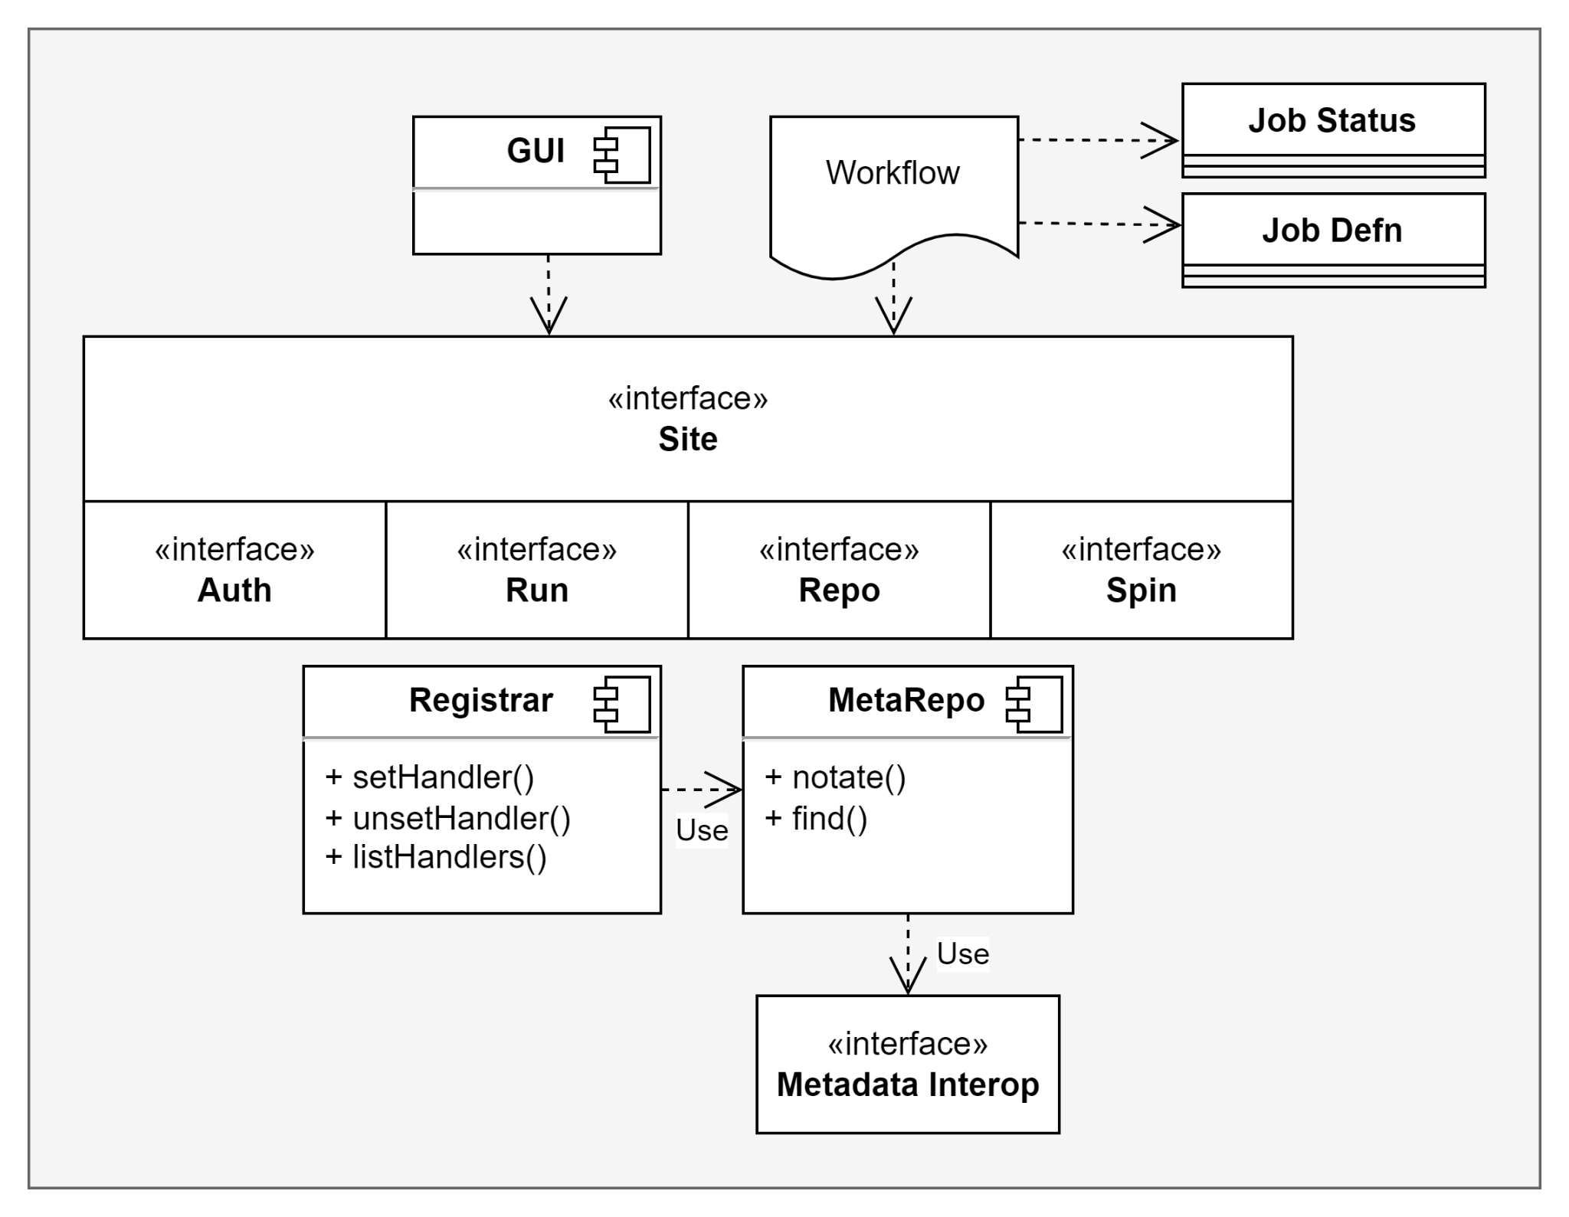
Site Integration
Site implements (or reuses) a driver for each of Auth, Run, Repo, & optionally Spin interfaces
Site uses GUI, Registrar, and MetaRepo middleware from the reference implementation or provides their own
Workflows are authored against the API using a common job definition & status object
Notes:
Any commercial, open source, or custom solution which adheres to, or can be made to bend to a published open interface which addresses these four pillars can interoperate in a distributed heterogeneous workflow. This implementation-agnostic view differentiates our approach. We illustrate here the general approach of incorporating unique and pre-existing tooling and computing systems into the framework and show how data provenance and model traceability can be maintained throughout the execution process.
A site which intends to expose its functionality to inter-site workflows needs to provide an implementation of the Auth, Run, Repo, and optionally Spin interfaces. Given the existence of a site API it has been our experience that a site driver can be produced in a mere few hundred lines of Python code, and our reference implementation shows several examples. While a site typically already internally handles authentication, provides a runtime manager or scheduler, and has some kind of data storage even if it's just filesystem, the site and executors of workflows benefit from adoption of a metadata store and event monitoring middleware. Our reference implementation contains both and provides for inter-instance metadata exchange between sites. Run subsystem job identifiers are notated in the metadata by the framework at the time of Repo data put or get, which includes both the apps and their versions as well as the data and its version. The “who”, “what”, “where”, “when”, and “how” of the workflow, along with custom user metadata, are captured in a provenancial log.

Slide 7
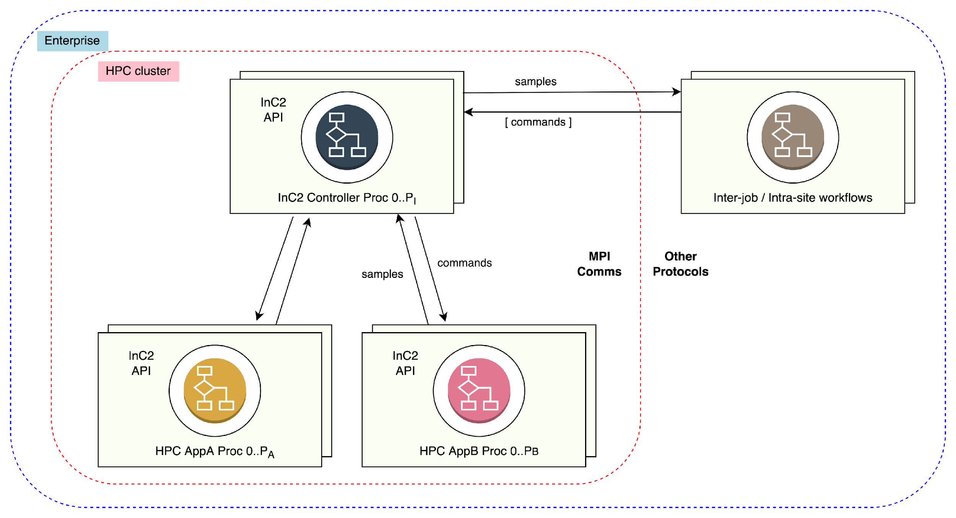
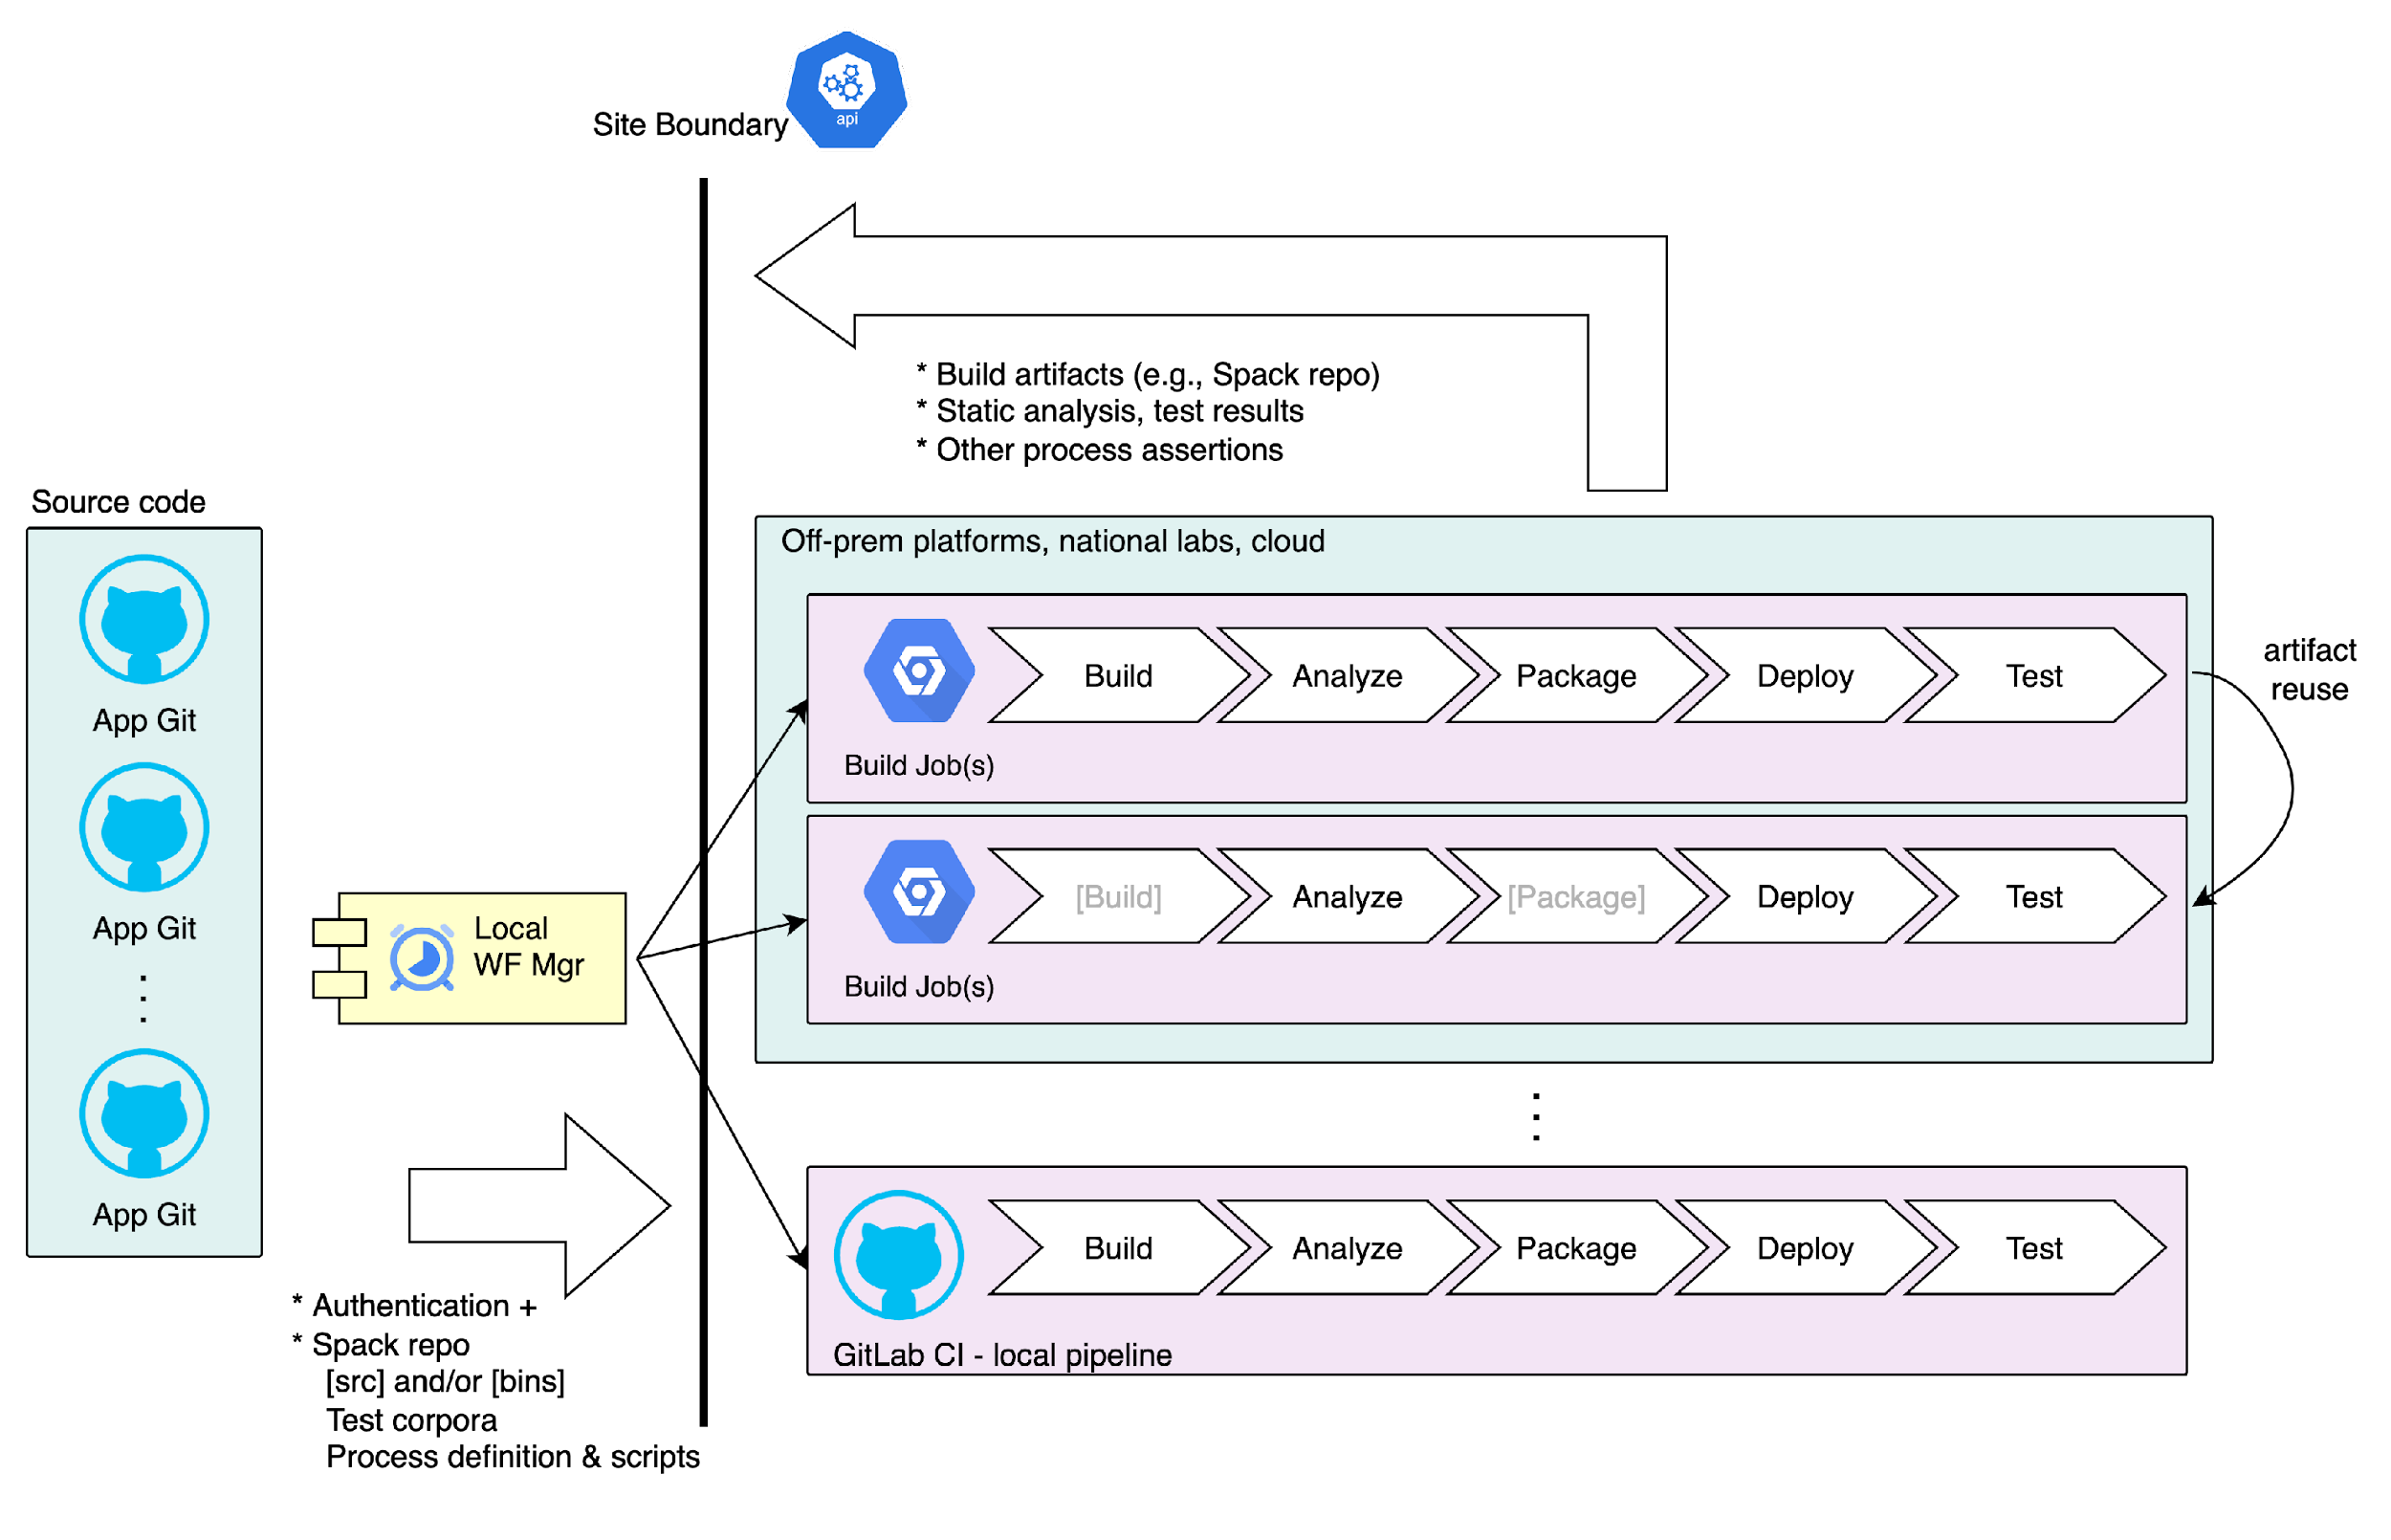
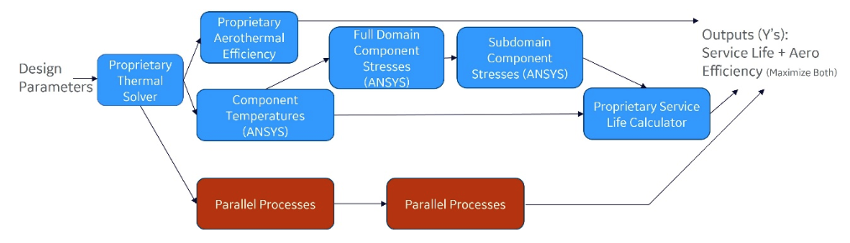
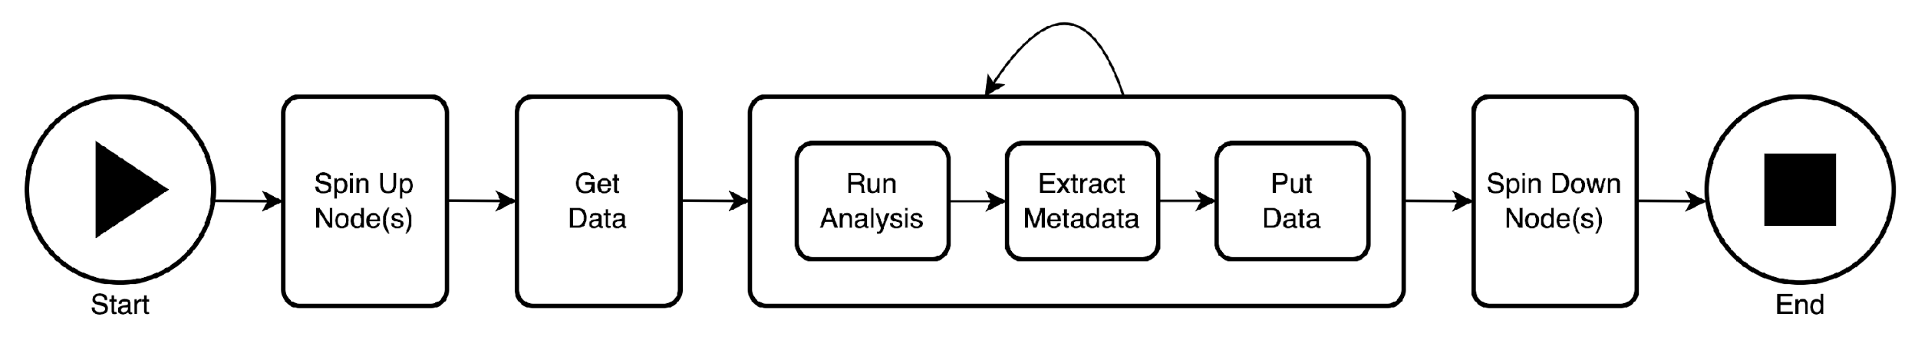
Example Workflows
A
B
D
C
Notes:
Let’s look at some examples of the three types of workflows enabled by the framework, starting clockwise from top left:
An in-situ workflow for CFD analysis includes an in-house C++ app fitted with our in-situ library which is co-launched by an MPMD controller written with the same library but in the Python language. The controller monitors interim output, tests conditions relative to bounds, and emits these results against an intra-site API. A human interface – generated declaratively – presents the results to the user, asks for guidance, and communicates these directions back to the in-situ controller.
In the next example, a build and test CI/CD pipeline is constructed as an inter-site workflow, distributing source code changes to target sites, initiating builds followed by testing and other QC steps, and eventual deployment. Thus the continuous readiness of M applications on N platforms is maintained.
On the bottom right, a workflow instantiates its own computational resources from a cafeteria of options using the Spin API. Once stood up, jobs are run, and subsequently the resources are freed as part of the final workflow step, permitting the user to completely control their own cost function.
Finally, a physics-based application is driven in a design of experiment workflow which explores a potential design space. Each metadata-decorated sample is used as input to the physics application producing an output which together are used to train a machine learning surrogate. The physics-based analysis and ML training portions of the workflow are performed on hardware tailored for the purpose.

Slide 8
Future Work & Conclusion
Domain-agnostic metadata interoperability standard
Inter-site job scheduler, job requirements & site capability metadata standard
Programming & visualizing dynamic workflows
Decision provenance - capturing the “why”
Distributed workflows & increasing system complexity requires barrier-lowering
interoperability abstractions with integrated data management
“The workflow is the app.”
Notes:
Several aspects of the work may continue with collaboration:
A metadata interoperability standard. The reference implementation defines an exchange format for metadata between adherent metadata repositories. The coalescing around a particular standard is a community activity. Additionally, where models are decorated with metadata describing their domain of applicability, assessments of their precision, UQ, records of their use in real world workflow applications, and so forth, an interoperability standard for assessing and notating those characteristics of the model is needed. This goes beyond the syntax of the metadata interchange to the actual semantic meaning of the model attributes being tracked.
A dynamic runtime scheduler which is aware of inter-site workflows has access to metadata about the sites available, and access to metadata about the job intended to be run, then optimizations in job allocation across sites can be performed. This suggests the need for a standard format for this site and job metadata, and a reference implementation of an inter-site scheduler which can take advantage of this information.
Visualizing workflows with dynamic futures. In this framework, workflows can set handlers to fire on workflow events. These events may or may not occur. Event handlers themselves can be created at runtime dynamically, and even canceled or otherwise evicted. New jobs can be initiated at any time. The scale of the workflow may be large. There exists the question of how best to visualize the static and dynamic workflow for the human consumer..
Decision provenance. While the architecture described has the capability to manage and make use of many kinds of metadata including for data provenance, and while the metadata which is easy to collect is collected automatically, the question of “why” is often critical but elusive. Some assistive agent, implemented likely with today’s generative AI backed by modern language models seems highly useful in tracking decision provenance and workflow code assist, and its use by real world researchers and engineering practitioners can be explored.
In conclusion, heterogeneity in the increasingly complex MBSE computing landscape requires simplifying architectures and tooling to increase interoperability, lower barriers to entry, improve productivity for seasoned users, and provide FAIR data management. Using the design described here, workflows are supported in-situ and within and across enterprises. Using this four-pillar site framework, models which drive engineering decisions and manufacturing processes are managed like data, decorated with metadata which describes itself and its origins from both control and data flow perspectives. The results are more interoperable workflows across a changing and heterogeneous computing landscape, with tight control of the critical model data which results from these efforts.
Thank you.

