Slide 1
Experience Deploying Heterogeneous Platforms for Design Engineering Workflows: A Software Refactoring Andy Gallo GE Research

Slide 2

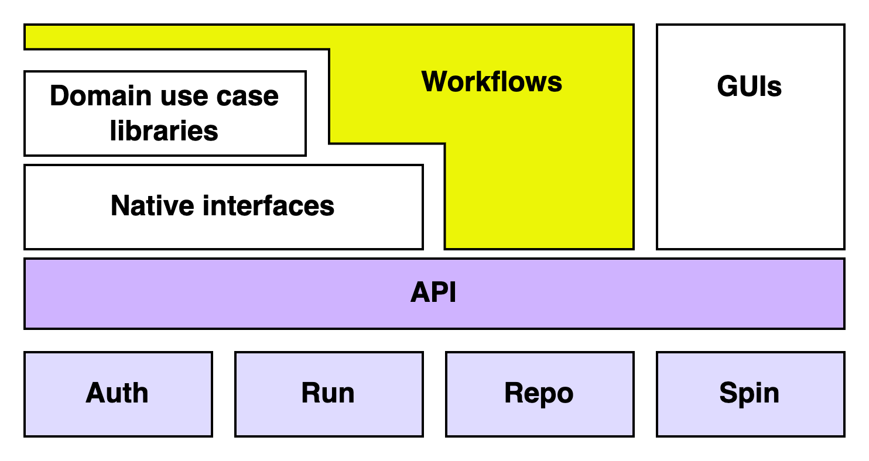



Designing a heterogenous workflow platform
Architectural Themes
Compute “Site” Software Architecture
Workflow Types
“Cambrian explosion”, high barriers to entry
Architectural “API View” Workflow as a sequence of system utterances, organized into 4 subsystems, each with a small set of system verbs embodied in an API
Type 1: Intra-Job
Example:
Iterative optimization of a design space exploration and visualization using in situ analysis and steerage of high fidelity CFD
Type 2: Intra-Site
Example:
Workflow composed of high fidelity, GPU-accelerated CFD visualized using in situ techniques and used to inform the training of a NN-informed design space exploration of cooling hole placement
Type 3: Inter-Site
Example:
Workflow that enables democratization of inter-agency resources - see: MxN app readiness (2021-2023 NERSC grant)
Heterogeneous complexity → loosely coupled modular data, tooling & compute fronted by a secure API
To yield actionable insights at all stages of the digital thread → metadata for {data, tools, compute, et al} – 5Ws, provenance
Software Defined Everything – compute, network, M apps on N platforms
Need traceability & model fidelity sufficient to trust; digital test in lieu of physical
Value in ML trained from and used to train simulations, must include model validation, UQ, and decision provenance.
“The workflow is the app.”
Subsystems
Auth: authenticate & authorize use within tenancies Run: async job exec & chaining (data & control flow) Repo: put / get / find data & metadata Spin: (de)provision resources
Interfaces
Flexible IDEs, Python, & Web interfaces
Allows for domain-specific utilities, libraries
Supports diverse user communities & integrations

Slide 3
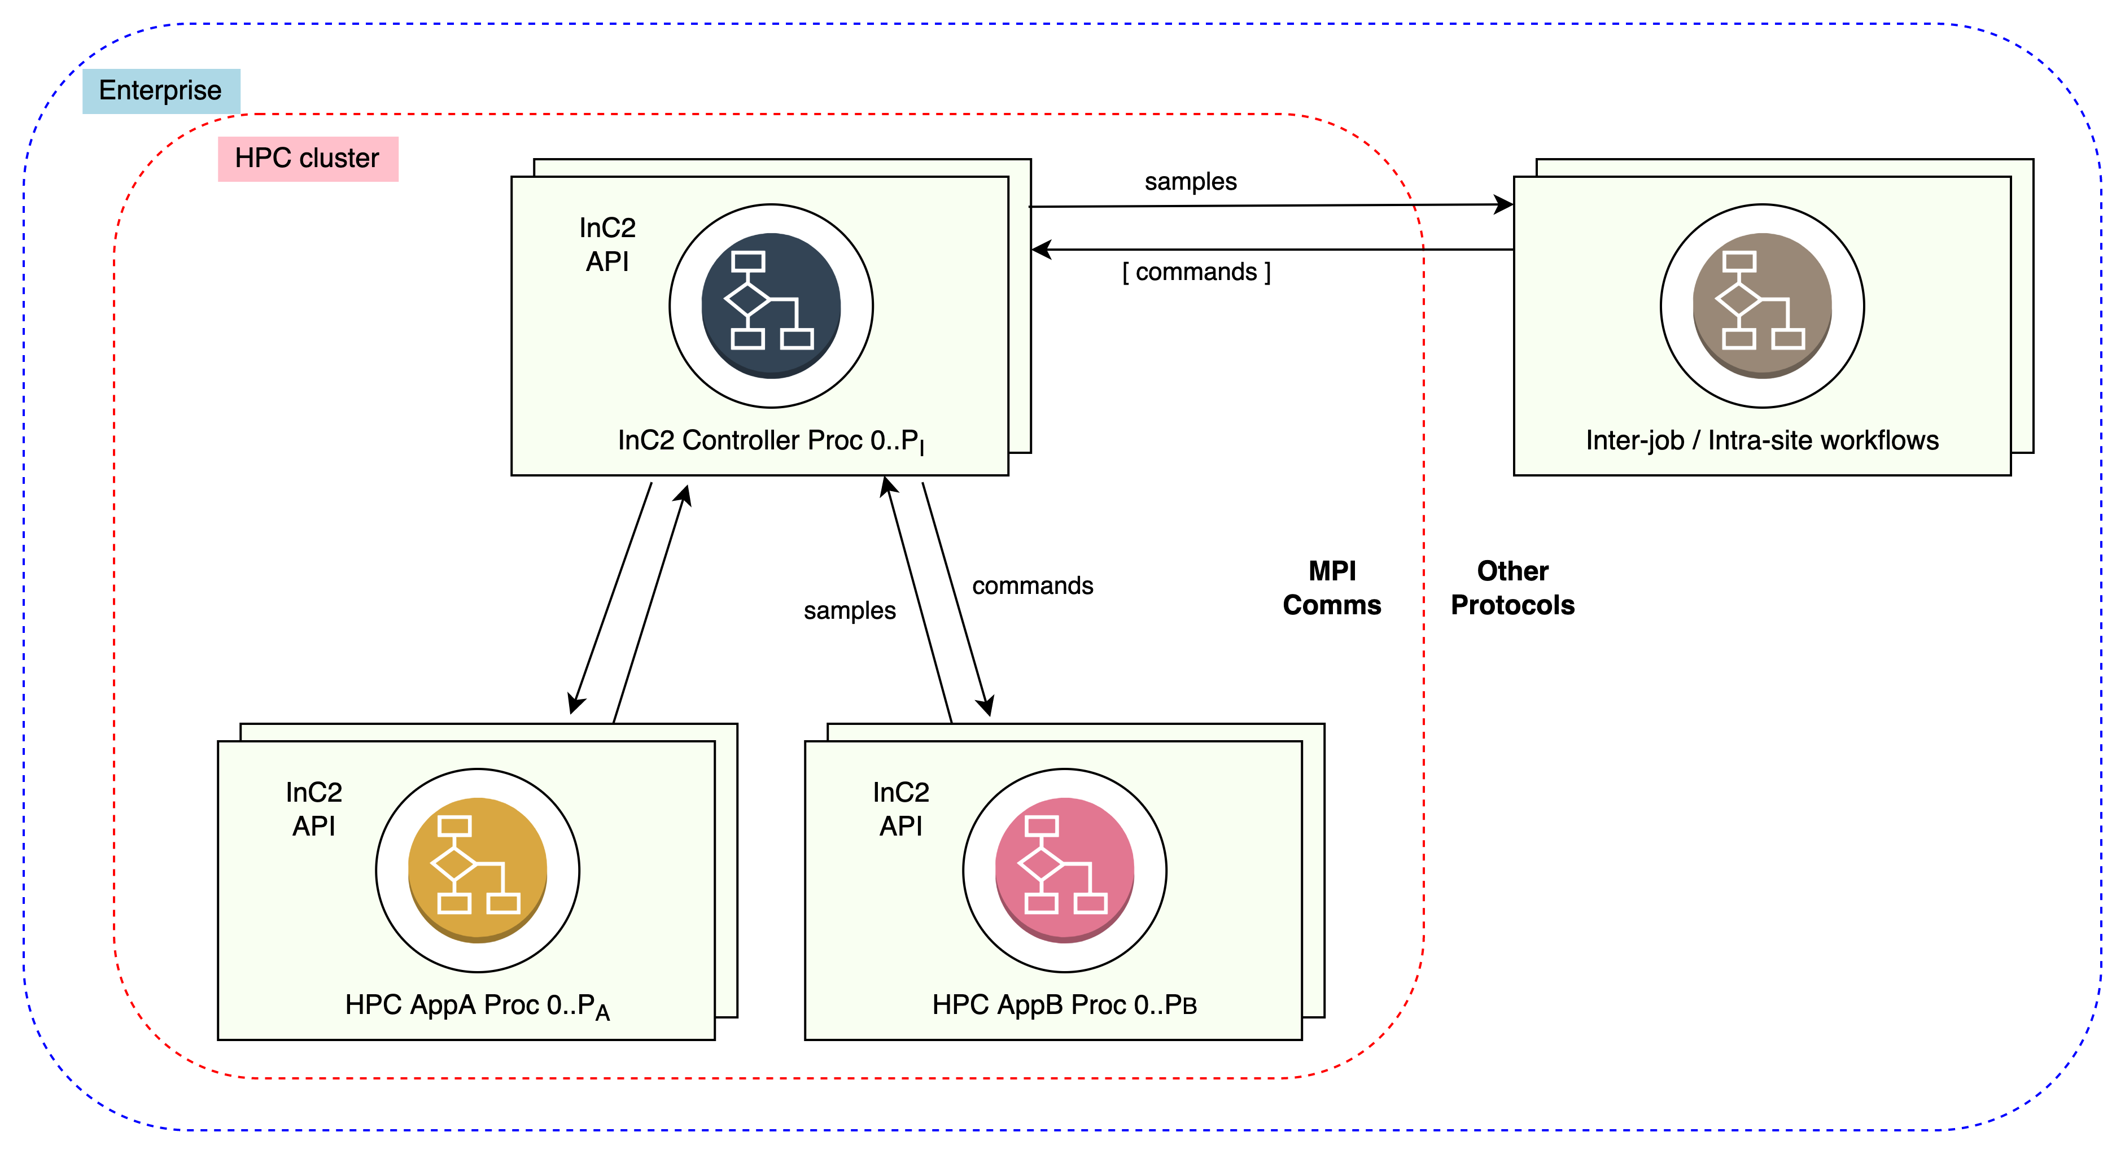
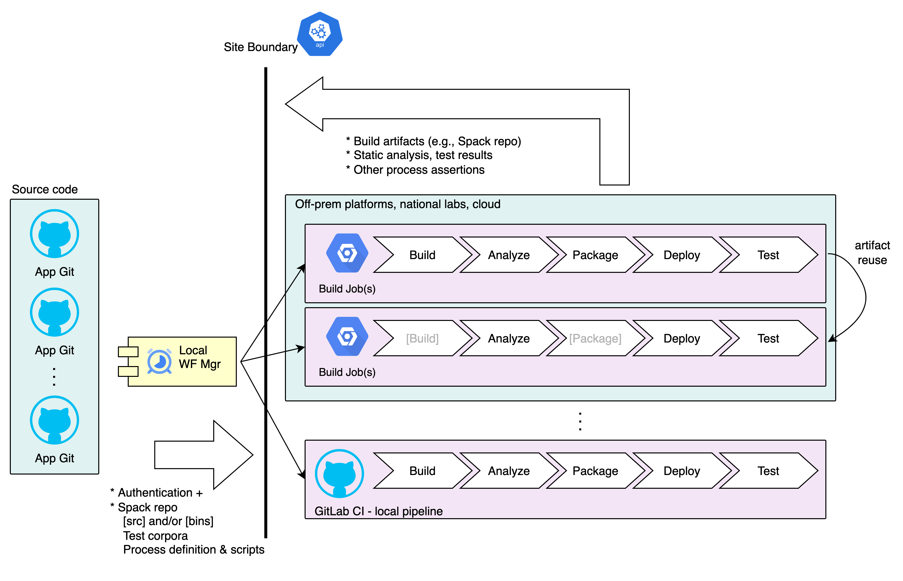
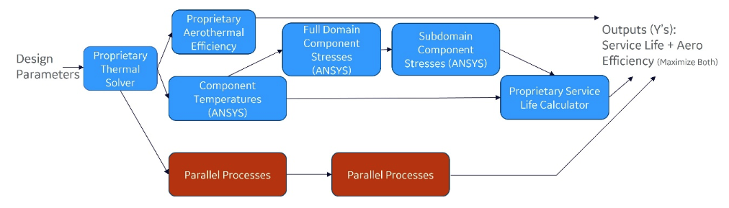
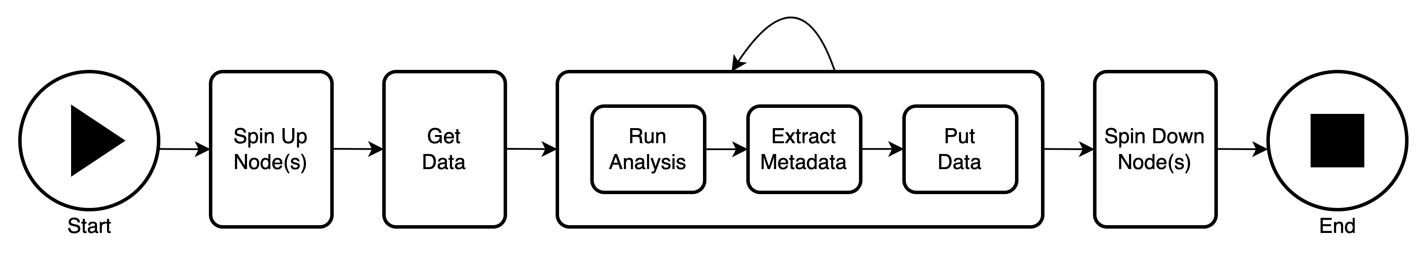
GE’s “DT4D” System Workflow Examples
A further exploration of workflow types & uses
A
B
D
( C )

Slide 4
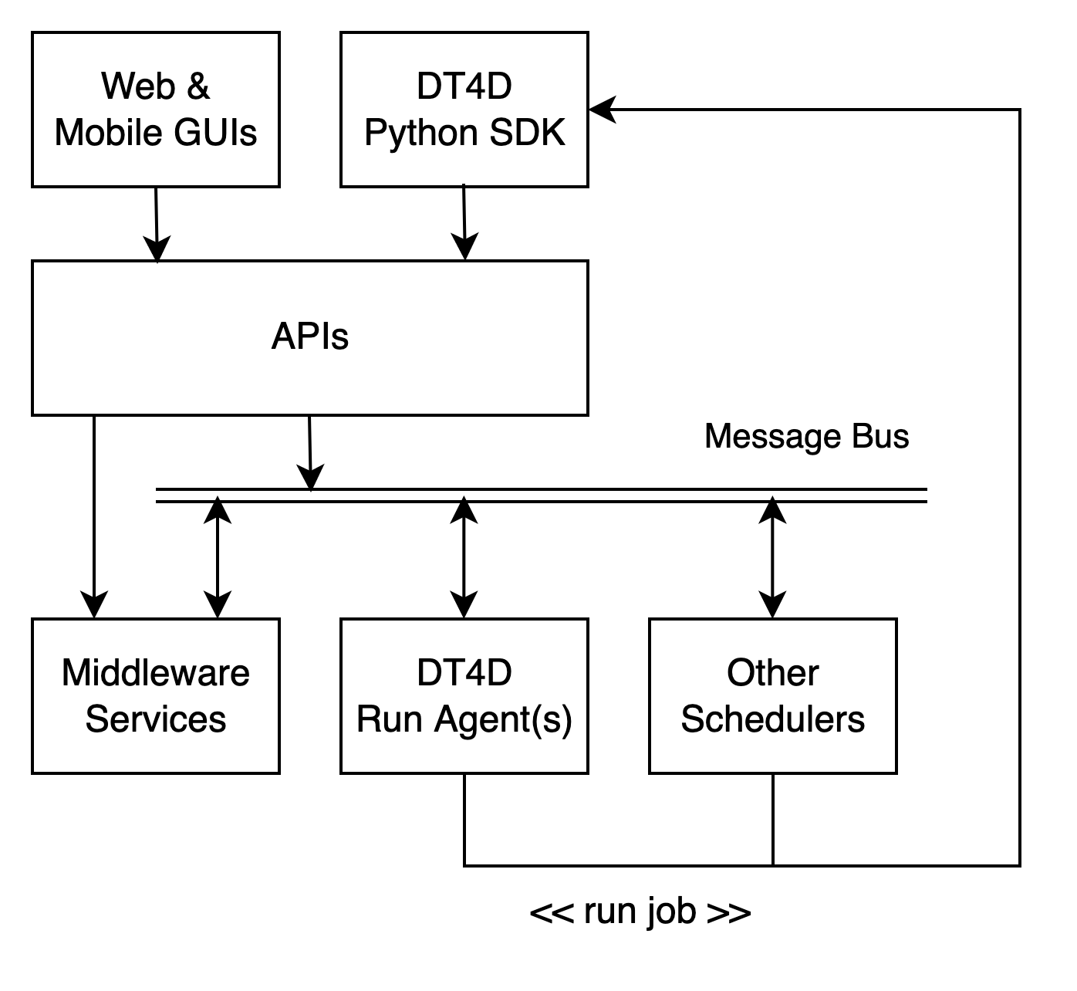
Type 3 Workflow Tooling
Type 3
Site Façade
Next Steps & Areas for Collaboration
Further refactoring of the workflow types & subsystems model; unification of tooling
Messaging
Resource Types
Standard APIs →
Zero trust security →
Metadata using FAIR principles →
Plug-and-play MxN CI/CD →
Multi-order modeling, model quality assess & notate
Workflow visualization & navigation
Spin
Democratization
GE’s DT4D “type 2” intra-site system fronted by inter-site façade

