Slide 1
SMC2022 Paper “in a nutshell” aka Industrial Experience Deploying Heterogeneous Platforms for Use in Multi-Modal Power Systems Design Workflows plus suggested next steps
GE Internal and Proprietary Information – not for Public Release

Slide 2
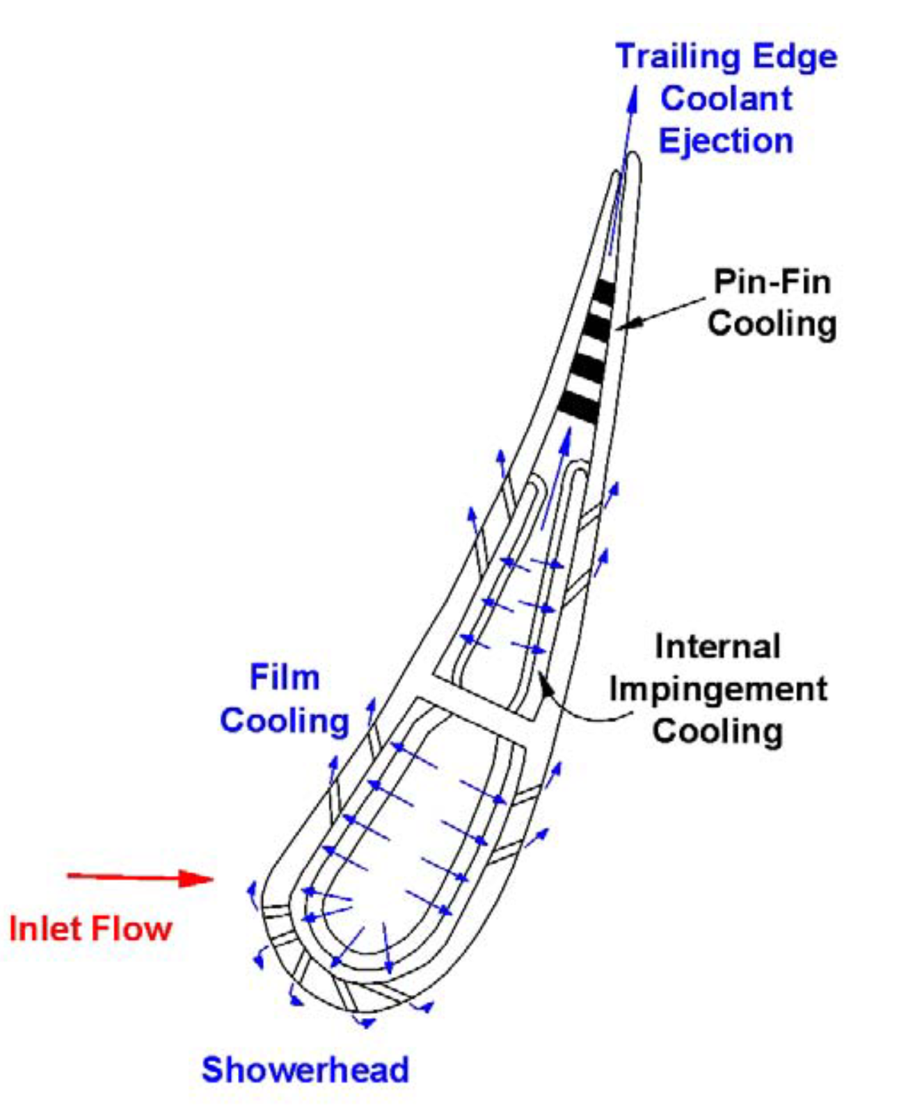
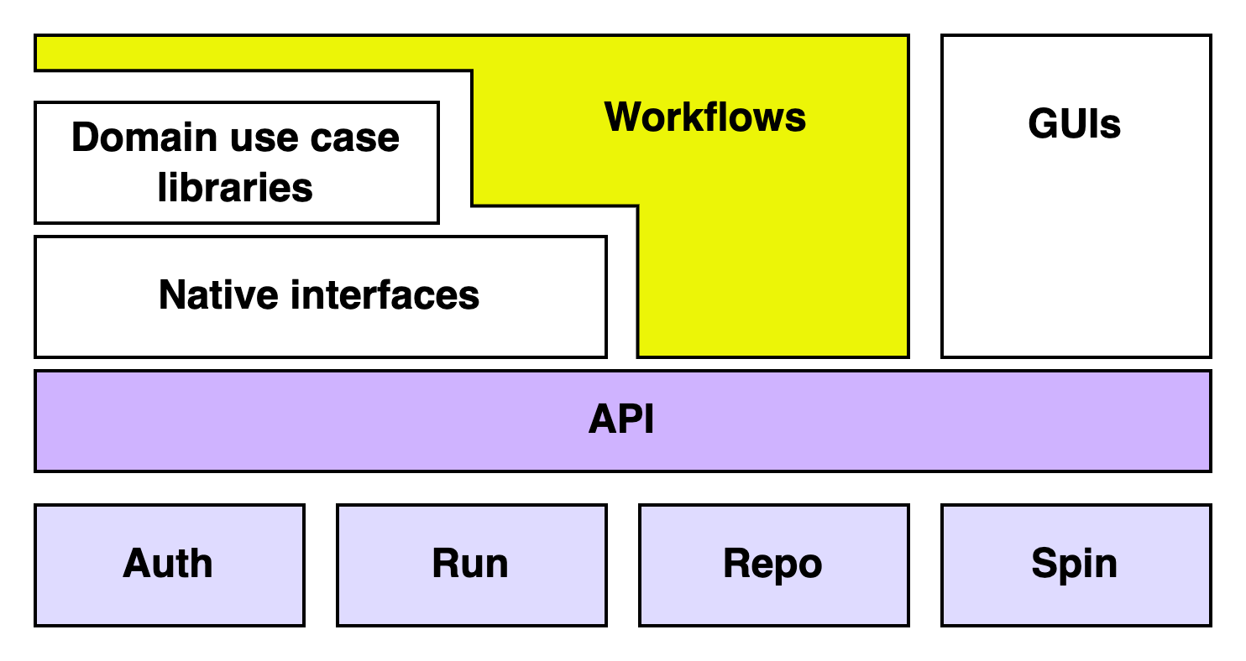
Take-Aways
Enterprise Context (Tucker)
Software Architecture (Gallo)
Use Cases (Claydon, Gallo / Hughes)
Loosely couple heterogeneous data, tooling & compute to yield actionable insights at all stages of the digital thread
Describe data, tooling, compute, etc. with metadata (the Five W’s, FAIR principles) & functional verbs (API)
Integration of ML into workflows
“The workflow is the app.”
Model fidelity sufficient to trust; digital test in lieu of physical
Workflows in 3 types:
1: Intra-job (i.e., in-situ) – e.g., inC2
2: Intra-site (i.e., an enterprise)
– e.g., DT4D, HAL
3: Inter-site – e.g., “lwfm”
Refactoring of similar-to APIs incl. DT4D, NERSC SFAPI yields 4-part framework with small verb set
Auth – users, tenancies
Run – exec & chain jobs
Repo – put/get/find data & metadata
Spin – provision resources
Each collaborating Site implements (or inherits) the API (incl. “local” Site)
e.g., two Sites share same Auth, different Run, same Repo
e.g., two Site share same Run, different Auth & Repo
Type 2 workflow with DT4D Site:
Physics-based CFD sim runs on HPC (HAL) to produce training data
ML surrogate trained & validated from the data
Py4DT4D coordinates workflow
Type 3 workflow with lwfm:
MxN app readiness (2021 NERSC grant)
SFAPI exposes Perlmutter as a Site, plus a local Site (and/or DT4D Site), to show multi-site CI/CD for a simple app
lwfm provides Python abstraction over Auth / Run / Repo / Spin for workflows, SFAPI provides the implementation

Slide 3
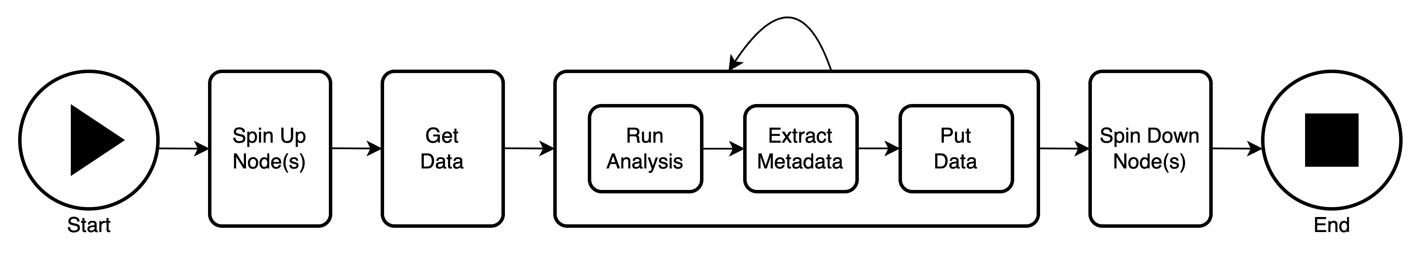
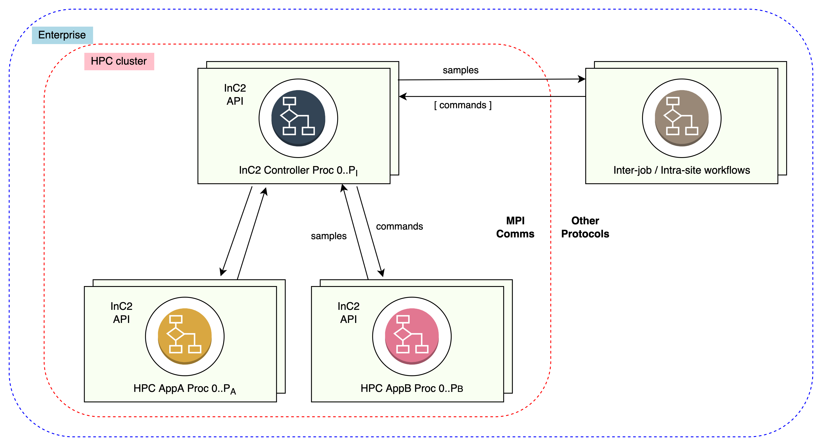
Conceptual Workflows (1)
“Spin” Workflow Type 2
Spin: nodes are provisioned (e.g., in cloud),
Repo: localize data (as needed)
Run: some number of jobs
Repo: store & tag results
Spin: down, controlling the cost function
“inC2 + DT4D” Type 1 & 2 Workflow
Run: HAL as the type 2 Run provider, runs user Python script (Python inC2) which co-launches sim app(s) on subset(s) of allocation
Auth: inC2 script includes Py4DT4D lib, token
Run: inC2 script emits status w. declarative GUI payload
Run: user interacts with GUI, emits message back to inC2 script
Run: inC2 script controls running simulation(s)

Slide 4
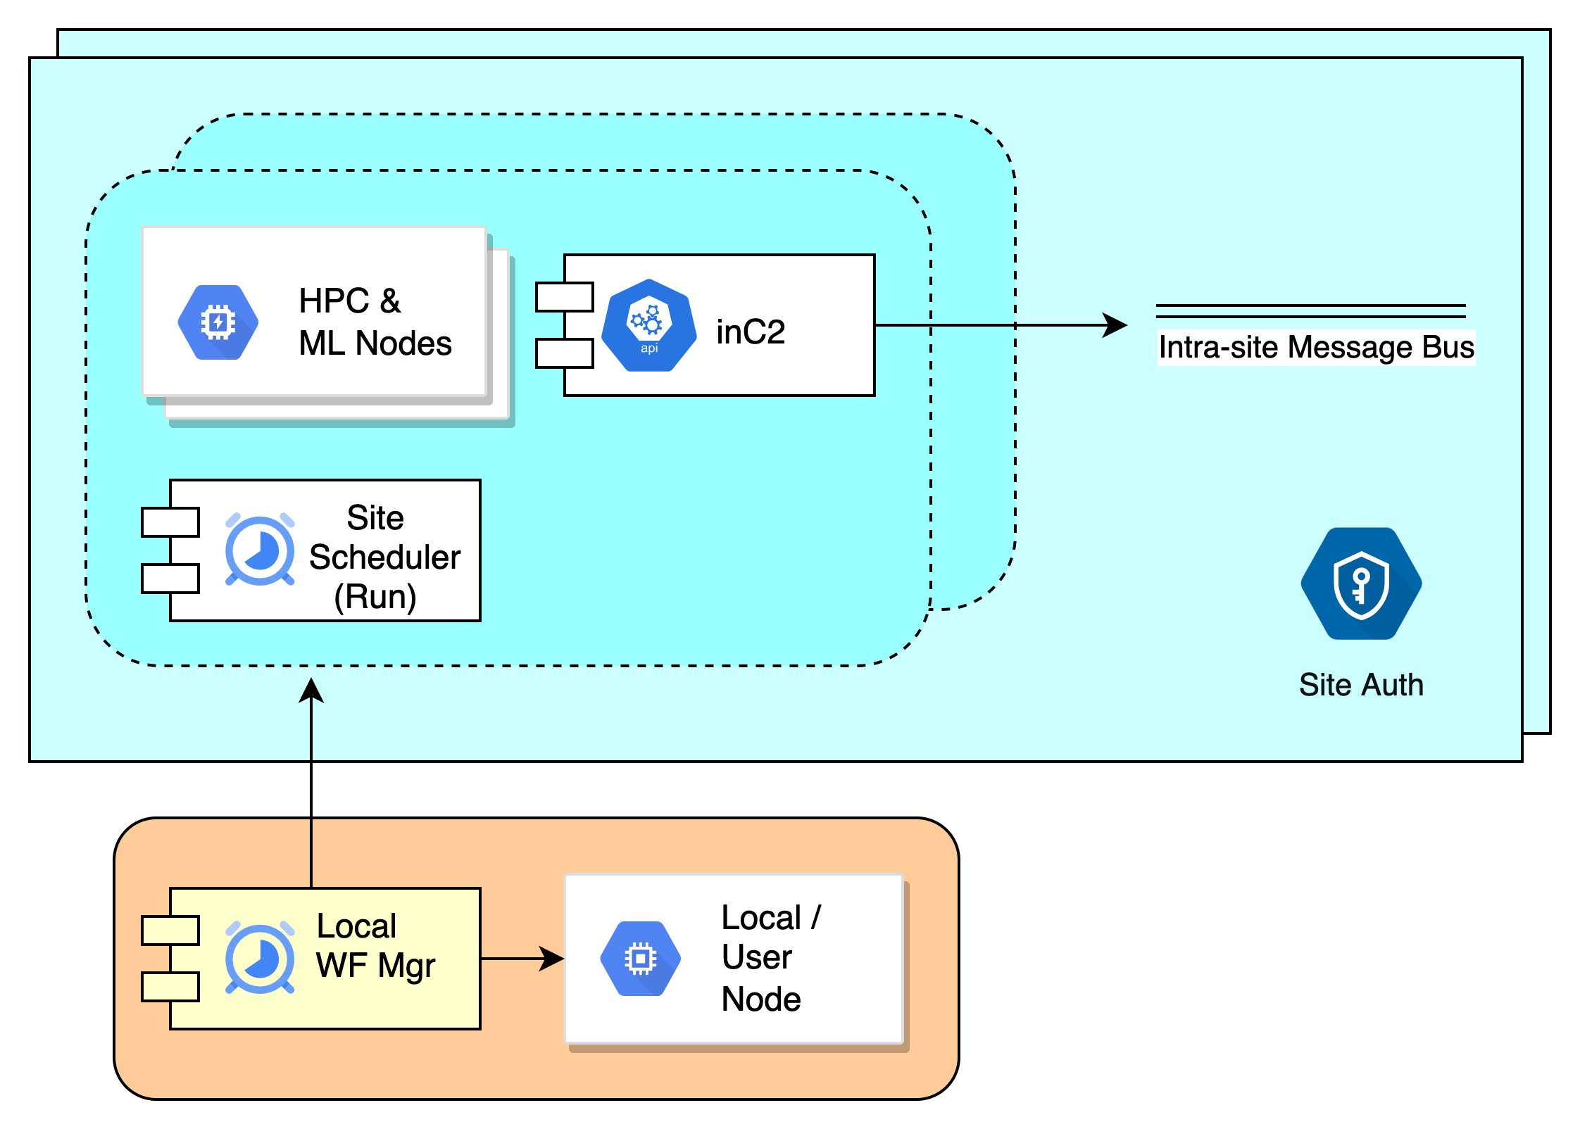
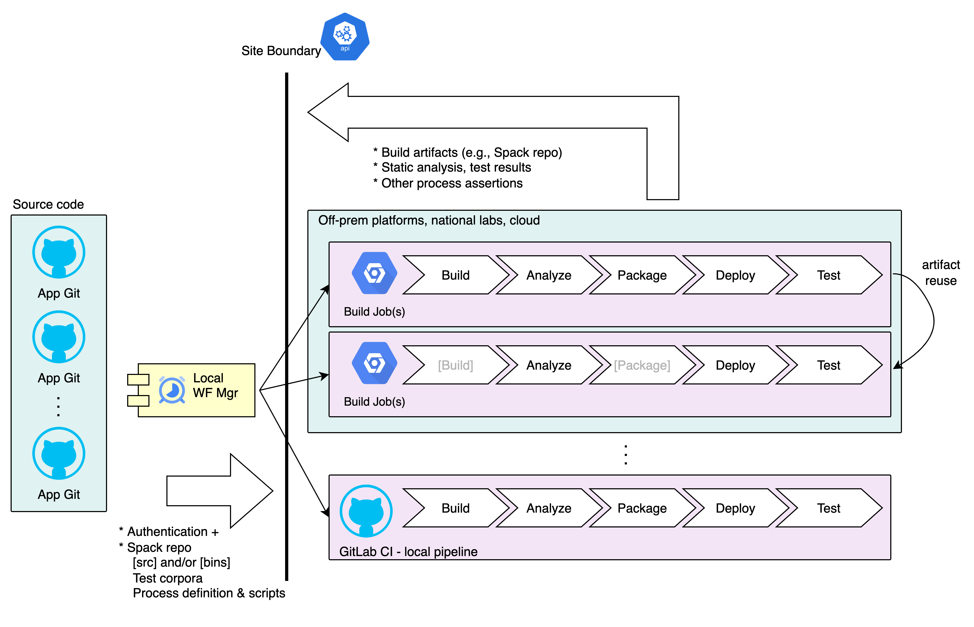
Conceptual Workflows (2)
Type 3 Inter-Site Workflow with lwfm
Auth: each Site provides own authentication
Run: each Site provides own runtime – compute resource classes may be specifically referenced (e.g., “run on GPU nodes”)
Run: lwfm provides normalized job status, chaining
[Note: lwfm re-implements the DT4D “Registrar” (job chaining) & Run Repo (status messages) in a cross-site manner; as a refactoring, a lwfm GUI could subsume the DT4D GUI]
Type 3 Workflow: MxN CI/CD
Auth: each Site provides own auth
Run: each Site runs a type 2 CI/CD workflow
Run: lwfm coordinates & rolls up results

Slide 5
Potential Next Steps & Design Questions
Auth
Run
Repo
Spin
What is the tenancy approach for “non-DT4D HAL users”? Since a HAL job can run Py4DT4D, it can put data. What is the operational impact: by default, does SSO = tenancy?
In a post-GE, post-IDM world, what is the internal GRC Auth impl?
Will DT4D hierarchical tenancies be required (yes) (and if so, will RBAC, for admins, data stewards, etc.)? (yes)
“Message bus” is a type 2 construct – will Azure be its own Site, i.e., type 3?
Will all HAL instances be in the same Site?
How often will future post-GE BUs run workflows across BU and GRC systems implying need for type 3 tooling?
How to best visualize & navigate (ad & post hoc) type 2 & 3 workflows incl. their triggered futures?
Implement full & “fuzzy” job trigger model
SimRepo w. data object locality (i.e., MetaRepo references multiple locations, Repo serves up most local copy)
API / Py4 wrapper for data movement jobs
Bulk metadata grooming
Hierarchical metadata
Meta Tree View GUI – dynamically generate navigable (sub)folders of files from metadata structure
Select from a cafeteria (e.g., subset of Azure), w. cost estimates, runtime logging for billing
API / Py4 wrapper for provisioning jobs
Tenancy: a “type 2” collection of one or more
users with a common interest (e.g., a team),
and a common data classification.

