Slide 1
What is API?
How to use?
How to design?
Development process
E-Mail
Demo
Q&A
About API

Slide 2
API (Application Programming Interface)
Specific usage rules
Define the rules of use in advance
Hiding implementation details
Just focus on the results
Providing Service
Simple and fast

Slide 3
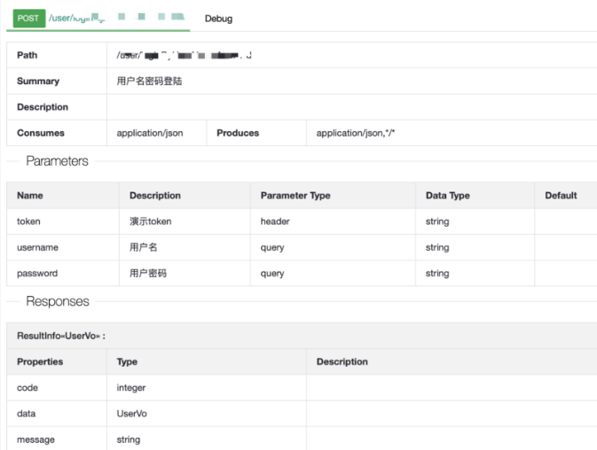
As a consumer should pay attention to
Understand and follow the API documentation
Token based
Easy to use and suit for non-critical data interfaces
More secure, the client does not touch the password. Can be widely used between services
Get certified and authorized
OAuth
Call frequency and quota restrictions
JWT
Not only can you verify your identity but you can also store additional information
Error handling

Slide 4
How to design
Refactor
More reasonable code logic.
SUCCESS
Cache
Reduce the number of complex queries. But pay attention to data consistency.
Readability
Quick to know the usage of the interface
Asynchronous
Response
Parallel execution by MQ or multiple thread
Know the current status clearly
Sharding
Performance
Increase reading and writing efficiency
Better user experience
Scaling
Expand the number of instances and increase API load

Slide 5
API Development process
25%
Requirements analysis
50%
Design & Development & Testing
15%
Release preparation
10%
Deployment & Verification

Slide 6
API Development

