Slide 1
What is API?
Why we need it?
How to design?
Demo
API Acquaintance
E-Mail

Slide 2
API (Application Programming Interface)
Specific usage rules
Define the rules of use in advance
Hiding implementation details
Just focus on the results
Providing Service
Simple and fast

Slide 3
Why we need API
01
02
Changes in interaction
Resource protection
From pushing to called
More standardized authentication
04
03
Version control
Standardization
Easier to connect to new services
For a service or a single interface

Slide 4
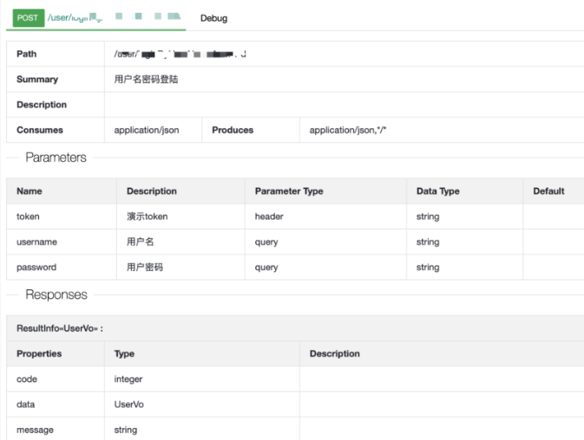
How to design APIs
Basic
Develop API specifications and related documents
Token based
API address / Request type / Header / Parameters / Response
Easy to use and suit for non-critical data interfaces
More secure, the client does not touch the password. Can be widely used between services
OAuth
Use appropriate authorization methods
JWT
Token-based / Oauth / JWT etc
Not only can you verify your identity but you can also store additional information
Set call frequency and quota limits
Prevent the API from being called maliciously

Slide 5
How to design APIs
Performance
Refactor
More reasonable code logic.
Cache
Reduce the number of complex queries. But pay attention to data consistency.
Concurrent
Ability to handle multiple requests at same time
Asynchronous
QPS
Parallel execution by MQ or multiple thread
Queries per second
Sharding
TPS
Increase reading and writing efficiency
Transaction per second
Scaling
Expand the number of instances and increase API load

Slide 6
Process of producing an API
General
Design
Testing
Step 2
Step 4
Step 1
Step 3
Step 5
Requirement analysis
Coding
Deployment

Slide 7
Process of producing an API
Special
Design&Development&Testing
Step 2
Step 1
Step 3
Requirement analysis
Deployment

Slide 8
Thanks

