Slide 1




Types of Data Analytics
Descriptive
Explains what happened.
Diagnostic
Explains why it happened.
Predictive
Forecasts what might happen.
Prescriptive
Recommends an action based on the forecast.
1) Descriptive Analytics: Describing or summarizing the existing data using data analytic tools to better understand what is going on or what has happened.
2) Diagnostic Analytics: Focus on past performance to determine what happened and why.
3) Predictive Analytics: Emphasizes on predicting the possible outcome using statistical models and machine learning techniques.
4) Prescriptive Analytics: It is a type of predictive analytics that is used to recommend one or more course of action on analyzing the data.
See References: Four Types of Data Analytics: (Anushka Mehta, 2017)

Slide 2
Descriptive Analytics
Simplest form of analytics
Purpose: Summarize findings and understand what’s going on
Involves:
wrangling data into understandable chunks
descriptions based on aggregations of past performance
Diagnostic Analytics
Why something happened in the past
Looks for root causes of the events
Factors/Events that contributed to outcome

Slide 3
Predictive Analytics
Predict future outcomes
Built on preliminary descriptive analytics
Involves:
Devising models that extrapolate from data the future occurrence of events
Machine learning and relies on existing data
Prescriptive Analytics
Suggest future solutions
Uses feedback system to constantly learn and update relationship between the action and the outcome
Suggests outcomes for specified course of action or a particular outcome

Slide 4
What is the role of data Analyst?
“Data analysts work with data to help their organizations make better business decisions. Using techniques from a range of disciplines, including computer programming, mathematics, and statistics, data analysts draw conclusions from data to describe, predict, and improve business performance.” (Thor Olavsrud, 2019)
Most in-demand Skills
Python
Databases
Statistical Analysis
Data Visualization (including Tableau)

Slide 5
Typical Data Analyst Responsibilities
Analyzing data using statistical techniques and providing reports
Create reports, dashboards, and other visualizations in support of decision-making efforts.
Developing and implementing databases and data collection systems
Acquiring data from primary and secondary sources and maintain data systems
Identifying, analyzing, and interpreting trends or patterns in complex data sets
Filtering and cleaning data
Working with management to prioritize business and information needs
Locating and defining new process improvement opportunities

Slide 6
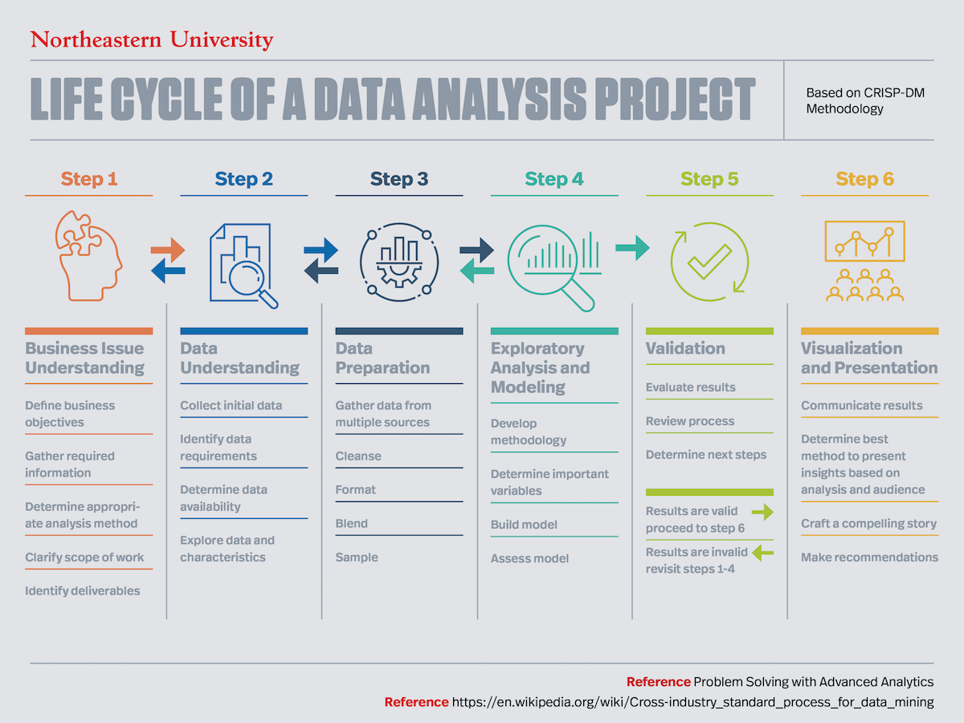
(“Understanding the Lifecycle of a Data Analysis Project,” 2020)

Slide 7
References
Anushka Mehta. (2017, October 13). Analytics Insight. Retrieved September 17, 2020, from Analytics Insight website: https://www.analyticsinsight.net/four-types-of-business-analytics-to-know/#:~:text=Depending%20on%20the%20stage%20of,%2C%20diagnostic%2C%20predictive%20and%20prescriptive.
‌Thor Olavsrud. (2019, September 25). What is a data analyst? A key role for data-driven business decisions. Retrieved September 17, 2020, from CIO website: https://www.cio.com/article/3439818/what-is-a-data-analyst-a-key-role-for-data-driven-business-decisions.html#:~:text=Data%20analysts%20work%20with%20data,predict%2C%20and%20improve%20business%20performance.
‌Understanding the Lifecycle of a Data Analysis Project. (2020, August 7). Retrieved September 17, 2020, from Northeastern University Graduate Programs website: https://www.northeastern.edu/graduate/blog/data-analysis-project-lifecycle/

