Slide 1
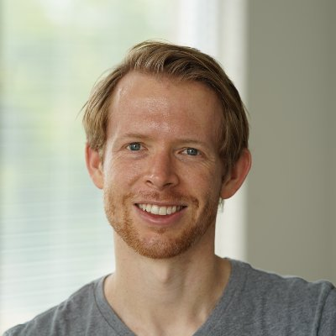
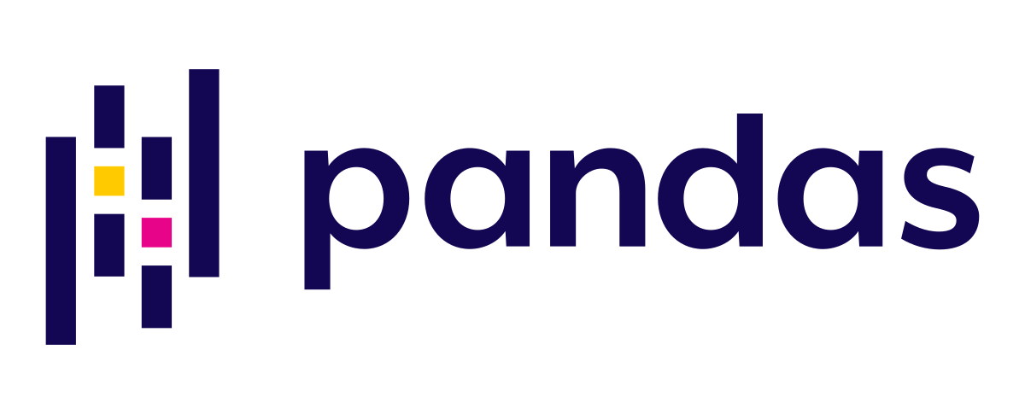
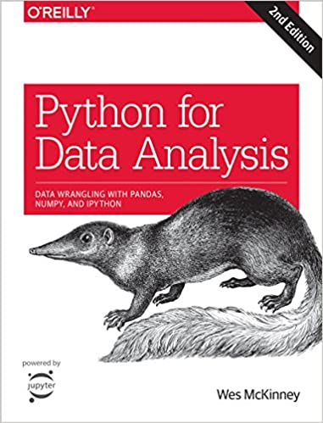
Wes Mckinney

Slide 2
What python libraries make up Pandas?

Slide 3
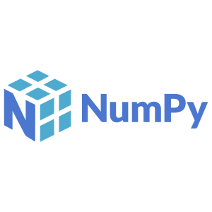

Travis Oliphant
Creator of Numpy,
Scipy, and Numba.
Founder of Anaconda,
OpenTeams, Quansight,
and Numfocus
The fundamental package for scientific computing with Python

Slide 4
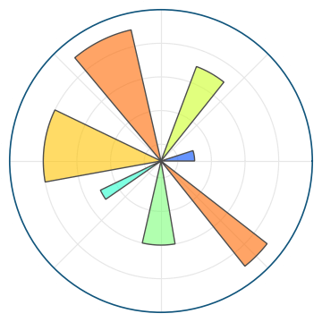
Matplotlib

Slide 5
Matplotlib

Slide 6
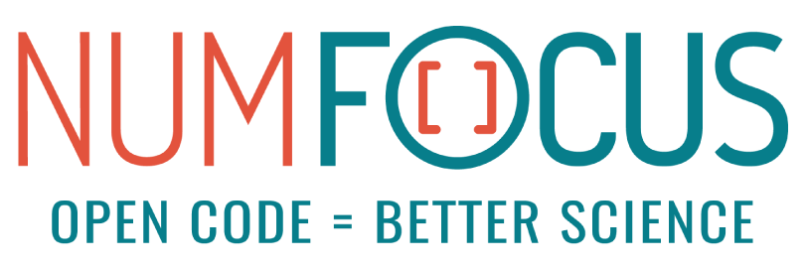
Numfocus.org
NumFOCUS envisions an inclusive scientific and research community that utilizes actively supported open source software to make impactful discoveries for a better world.

