Slide 1
Foundations of Data AnalyticS

Slide 2
Topics
What is data and where does it comes from?
What is Data Analytics?
Explain the importance of Data Analytics in today's economy.
Discuss how data can be used to inform data-driven decision making

Slide 3
DATA
It has become commonplace to refer to data as the ‘new oil’ of the global economy
Data is now increasingly recognized as a significant asset enabling further innovation across ancillary fields such as artificial intelligence, which can drive the improvement of services through process efficiency and deliver better results for customers
Data is now a critical corporate asset.
It comes from the web, billions of phones, sensors, payment systems, cameras, and a huge array of other sources—and its value is tied to its ultimate use.
While data itself will become increasingly commoditized, value is likely to accrue to the owners of scarce data, to players that aggregate data in unique ways, and especially to providers of valuable analytics.
Organizational challenges Disruptive business models Enhanced decision making THE AGE OF ANALYTICS: COMPETING IN A DATA-DRIVEN WORLD
Kiran Bhageshpur. (2019, November 15). Council Post: Data Is The New Oil -- And That’s A Good Thing. Forbes.
‌

Slide 4
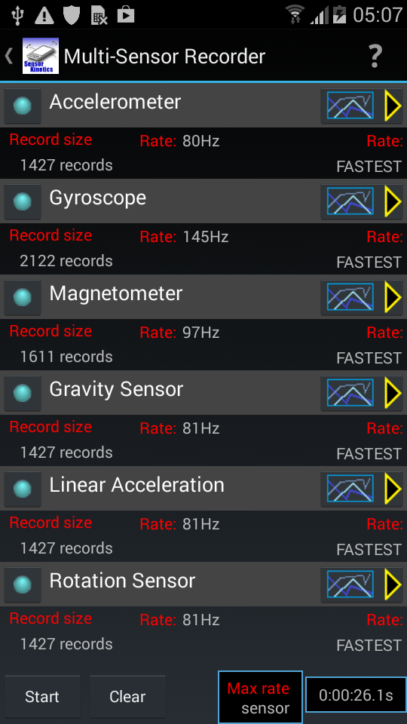
Sensor Data Demo
Sensor Kinetics App – Mirroring360

Slide 5
DATA
is a collection of facts, such as numbers, words, measurements, observations or just descriptions of things.
Data can be qualitative or quantitative.
Qualitative data is descriptive information (it describes something)
Quantitative data is numerical information (numbers)
Discrete data can only take certain values (like whole numbers)
Continuous data can take any value (within a range)
Put simply: Discrete data is counted, Continuous data is measured
“What Is Data?” Mathsisfun.Com, 2017, www.mathsisfun.com/data/data.html. Accessed 6 Sept. 2020.
‌

Slide 6
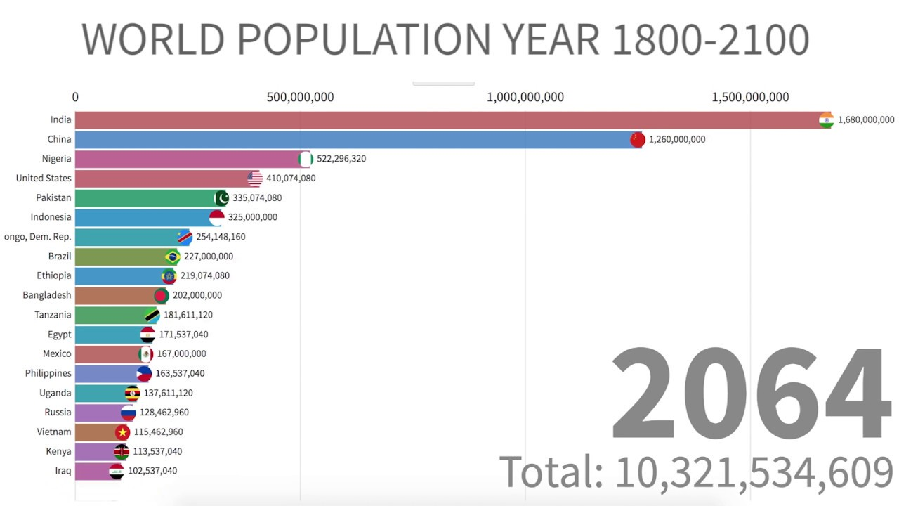

Slide 7
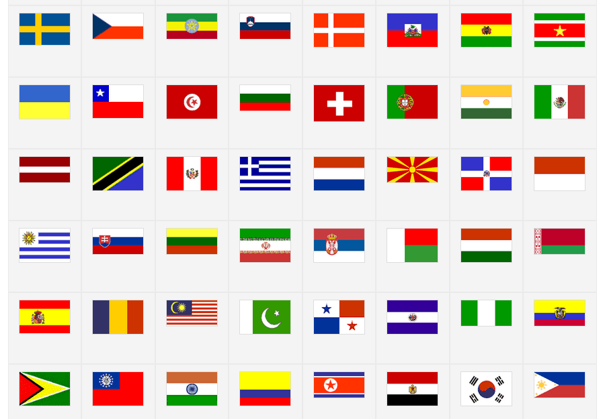

Slide 8
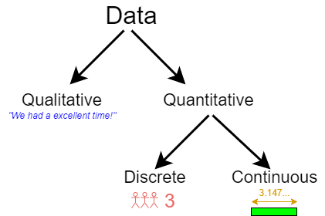
Data
Notes:
Discrete data is information that can only take certain values. ... This type of data is often represented using tally charts, bar charts or pie charts. Continuous data is data that can take any value. Height, weight, temperature and length are all examples of continuous data.

Slide 9
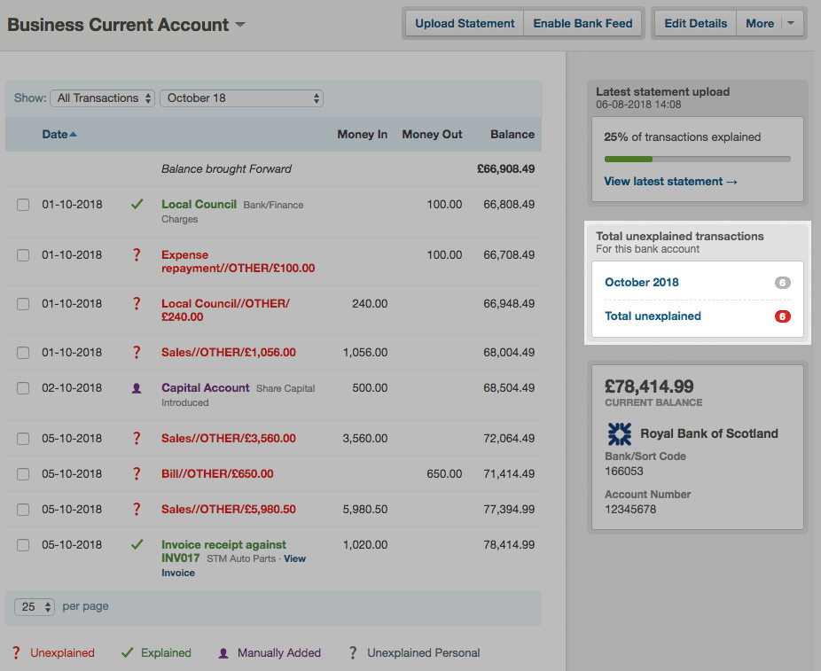


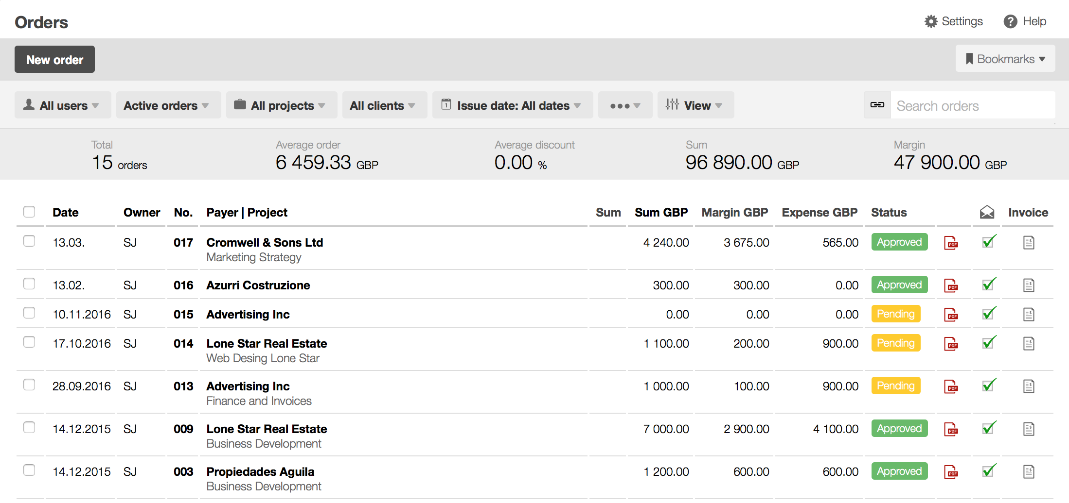

Types of Data

Slide 10
What is Data Analytics?
The process of examining datasets to draw conclusions about the information they contain. Data analytic techniques enable you to take raw data and uncover patterns to extract valuable insights from it.
The focus of Data Analytics lies in inference, which is the process of deriving conclusions that are solely based on what the researcher already knows.
What Is Data Analytics? - 4 Ways to Use Data Analytics. (2019, September 23). Retrieved September 6, 2020, from Lotame website: https://www.lotame.com/what-is-data-analytics/
‌

Slide 11
What is Data Analytics?
The applications of data analytics are broad. Analyzing big data can optimize efficiency in many different industries. Improving performance enables businesses to succeed in an increasingly competitive world. Data analytics is being used with great success in a number of different fields.
One of the earliest adopters is the financial sector. Data analytics has a huge role in the banking and finance industries, used to predict market trends and assess risk. Credit scores are an example of data analytics that affects everyone. These scores use many data points to determine lending risk. Data analytics is also used to detect and prevent fraud to improve efficiency and reduce risk for financial institutions.
The use of data analytics goes beyond maximizing profits and ROI, however. Data analytics can provide critical information for healthcare (health informatics), crime prevention, and environmental protection. These applications of data analytics use these techniques to improve our world.
What is Data Analytics? - Master’s in Data Science. (2019). Retrieved September 6, 2020, from Master’s in Data Science website: https://www.mastersindatascience.org/resources/what-is-data-analytics/
‌

Slide 12
the importance of Data Analytics in today's economy.
Data analytics is important because it helps businesses optimize their performances. Implementing it into the business model means companies can help reduce costs by identifying more efficient ways of doing business and by storing large amounts of data.
A company can also use data analytics to make better business decisions and help analyze customer trends and satisfaction, which can lead to new—and better—products and services.
For instance data analysis can help companies better understand their customers, evaluate their ad campaigns, personalize content, create content strategies and develop products. Ultimately, businesses can use data analytics to boost business performance and improve their bottom line.
How Data Analytics Work. (2020). Retrieved September 6, 2020, from Investopedia website: https://www.investopedia.com/terms/d/data-analytics.asp
‌

Slide 13
Data Driven Decisions Making
Know Your Mission
Identify Data Sources
Clean and Organize Data
Perform Statistical Analysis
Draw Conclusions
Data-Driven Decision Making: A Primer for Beginners. (2019, August 22). Retrieved September 7, 2020, from Northeastern University Graduate Programs website: https://www.northeastern.edu/graduate/blog/data-driven-decision-making/
‌

Slide 14
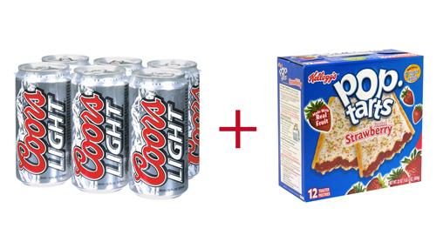
Data-Driven Decisions
Walmart
Question:
What do people buy before a big storm?
How do we supply stores ahead of future storms?
Data:
Product Purchasing Data
Results:
7-Fold Increase in Strawberry Pop-Tarts sales
Top-selling item was Beer
Decision: The retailer began sending trucks loaded with these items to stores in areas where hurricanes were forecast, and sales were brisk
Quick Guide to Data-Driven Management | Smartsheet. (2019). Retrieved September 7, 2020, from Smartsheet website: https://www.smartsheet.com/data-driven-decision-making-management
‌
Notes:
Sometimes, the results of data-driven decision making are a little less glamorous, but nonetheless constitute home runs for a business. In 2004, for example, Walmart used product purchasing data from areas where hurricanes had struck in order to find out what people bought when they stocked up before a storm. The company wanted to use predictive analytics to determine how to supply stores ahead of future storms. They found that in addition to staples, like flashlights, stores saw heavy demand for unexpected items. Sales of strawberry Pop-Tarts jumped seven-fold as a tasty nonperishable that doesn’t require cooking, and beer was the top-selling item. The retailer began sending trucks loaded with these items to stores in areas where hurricanes were forecast, and sales were brisk

Slide 15
Data-Driven Decisions
BUCO – a hardware retailer with 46 locations across South Africa,
Question
Are men or women were their most frequent customers?
Which locations had the most loyal customers, and from what suburbs the most valuable customers to a given store were coming.
Data: Came from “Nedbank” – BUCO’s Bank
amassed a treasure trove of transactional data it could share with merchants:
the type of card being used, the time of the transaction, the size of the purchase, the retailer, the location
Customer’s age, gender, race, marital status, and income bracket
Results/Decisions:
At certain location most of business was not derived from local residents that, in fact, half of his business was coming from residents that lived in a town 10 kilometers away,
At certain locations, a large portion of our clientele was female, so we introduced a Saturday craft workshop featuring chalk paint
A Data-Driven Approach to Customer Relationships: A Case Study of Nedbank’s Data Practices in South Africa - ProQuest. (2017). Retrieved September 7, 2020, from Georgetown.edu website: https://www-proquest-com.proxy.library.georgetown.edu/docview/1875399247/323317C7647E4FFBPQ/1?accountid=11091
‌

Slide 16
References
“A Data-Driven Approach to Customer Relationships: A Case Study of Nedbank’s Data Practices in South Africa - ProQuest.” Georgetown.Edu, 2017, www-proquest-com.proxy.library.georgetown.edu/docview/1875399247/323317C7647E4FFBPQ/1?accountid=11091. Accessed 11 Sept. 2020.
“Data-Driven Decision Making: A Primer for Beginners.” Northeastern University Graduate Programs, 22 Aug. 2019, www.northeastern.edu/graduate/blog/data-driven-decision-making/. Accessed 11 Sept. 2020.
“How Data Analytics Work.” Investopedia, 2020, www.investopedia.com/terms/d/data-analytics.asp. Accessed 11 Sept. 2020.
Kiran Bhageshpur. “Council Post: Data Is The New Oil -- And That’s A Good Thing.” Forbes, 15 Nov. 2019, www.forbes.com/sites/forbestechcouncil/2019/11/15/data-is-the-new-oil-and-thats-a-good-thing/#1d4ada1f7304. Accessed 11 Sept. 2020.

Slide 17
References
Organizational Challenges Disruptive Business Models Enhanced Decision Making THE AGE OF ANALYTICS: COMPETING IN A DATA-DRIVEN WORLD.
“Quick Guide to Data-Driven Management | Smartsheet.” Smartsheet, 2019, www.smartsheet.com/data-driven-decision-making-management. Accessed 11 Sept. 2020.
“What Is Data?” Mathsisfun.Com, 2017, www.mathsisfun.com/data/data.html. Accessed 6 Sept. 2020.
“What Is Data Analytics? - 4 Ways to Use Data Analytics.” Lotame, 23 Sept. 2019, www.lotame.com/what-is-data-analytics/. Accessed 11 Sept. 2020.
“What Is Data Analytics? - Master’s in Data Science.” Master’s in Data Science, 2019, www.mastersindatascience.org/resources/what-is-data-analytics/. Accessed 11 Sept. 2020.
‌

