Slide 1
FYP Update
Citation Provenance
WING Meeting 25 May 2012
Heng Low Wee

Slide 2
Outline
Motivation
Problem
Goal
Related Work
Progress So Far
  Analysis
  Modeling the Problem
  Tackling the Problem
What’s Next?

Slide 3
Motivation
Reading experience
Inconvenient & troublesome to look up cited paper
Interrupts reading

Slide 4
Problem
Citations in paper
  What/where is the cited information?
To gain better insight
  Might need to read entire cited paper
  time-consuming

Slide 5
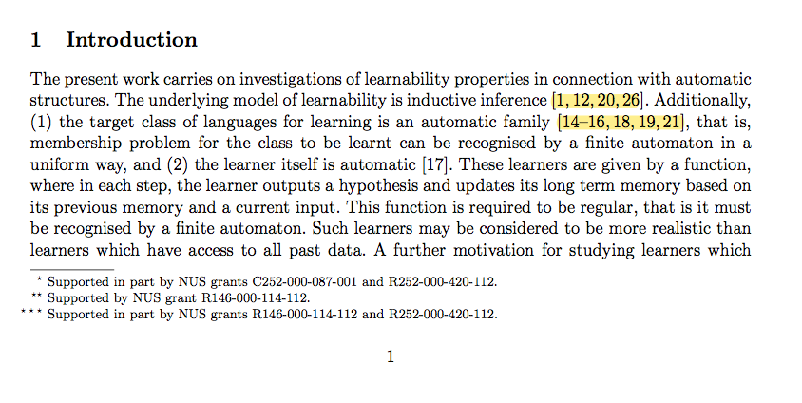
Problem (Example)
“Automatic Learning of Subclasses of Pattern Languages”, J Case et al, 2011

Slide 6
Goal
Reading tool
  Improve reading experience
  Save time
Determine & provide Citation Provenance
  Where/what is the cited information
  Display results according to context

Slide 7
Related Work
Content-Sensitive In-Browser Summariser (CSIBS)
    (Stephen Wan et al, 2009) & (Stephen Wan et al, 2010)
  Display a preview of the cited paper
    Paper meta-data: Abstract, author names, publishing year
    A few sentence in preview -> possible locations of cited info

Slide 8
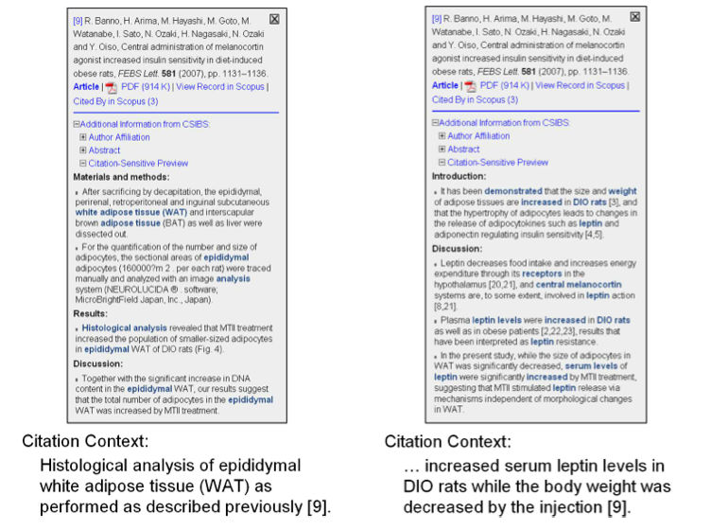
CSIBS (Preview)

Slide 9
Why CSIBS?
Similar motivation
Performs similar task
Take-aways
  Initial studies conducted conclude that there is a demand for such a feature
  CSIBS’s preview – intuitive, smooth, aids understanding

Slide 10
Progress so far (Analysis)
2 types of citation
  General & Specific
Task of locating cited information
  Determine type of citation (General or Specific?)
  Specific info must come from some part of cited paper (fragment, section)
  Some ranking system -> which is the best fragment? Location of fragment?

Slide 11
Progress so far (Analysis) Example
General

Slide 12
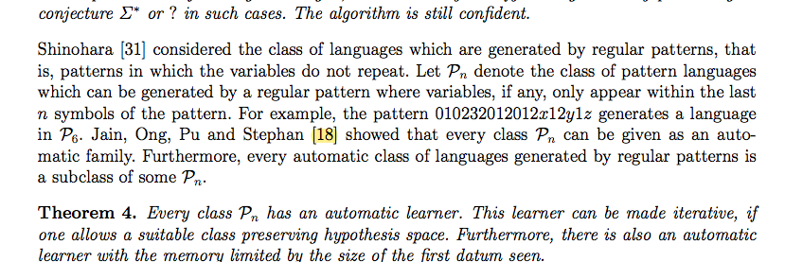
Progress so far (Analysis) Example
Specific

Slide 13
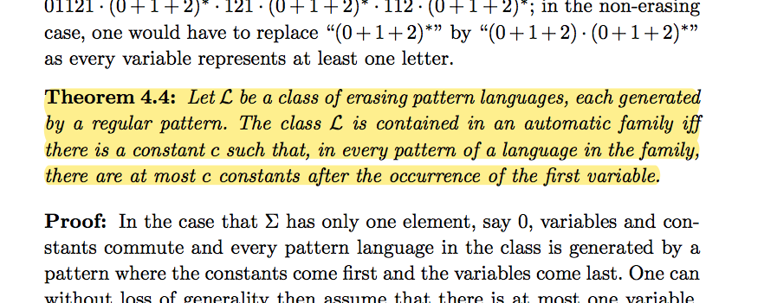
Progress so far (Analysis) Example
“On Automatic Families”, Jain et al, 2010

Slide 14
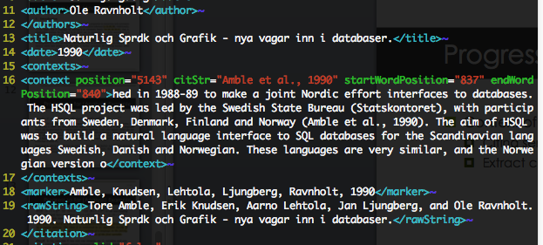
Progress so far (Analysis)
Context of citation?
  Citing sentence
  Extract citation’s information using ParsCit

Slide 15
Progress so far (Modeling)
Citing sentence -> “search query”
Cited paper -> “search domain”
Like a group of documents, to search for the most correct document

Slide 16
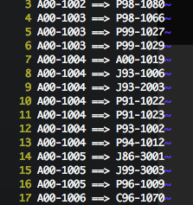
Progress so far (Tackling)
Corpus: ACL Anthology Reference Corpus
Why?
  Interlink info (e.g. A00-1001 ==> J82-3002) → Convenient

Slide 17
Progress so far (Tackling)
Cosine Similarity
  Common technique for Information Retrieval tasks
  Models into 2 vectors, V_{q} and V_{f}
  Each term is one dimension, magnitude is term frequency
  TF-IDF weight [ tf-idf = tf x log (N/df) ]
  Place emphasis on rare (important) words

Slide 18
What’s Next?
Improvements?
  TF-IDF on citing sentence
  Citation density
  Keywords in citing sentence (e.g. established, demonstrated, showed)
  Citation Classification/Type (Function/purpose)
  ….
Next immediate step?
  Evaluation -> need annotated data

Slide 19
Collecting Annotations
NUS Students
Amazon Mturk
(Show site)

