Slide 1
Citation Provenance
FYP Practice
WING Meeting 01 November 2012
Heng Low Wee

Slide 2
Introduction
Citations in research/scientific papers
  Gives credit; uphold intellectual property
Citations refer to cited paper for information
  Most citations are mere mentions
  If specific, not immediately clear where this information is in the cited paper
  Difficult to find the exact text in cited paper to justify the citation (Wan et al, 2009)
  Citation usually don’t include position of the info in the cited article…. (Wan et al, 2009)

Slide 3
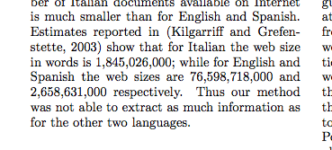
Introduction (Example)
ACL C04-1201

Slide 4
Introduction
Citation Provenance – source of the citation
  Task: To locate the cited info in the cited paper that justifies the citation
  Improves reading experience by showing where exactly is the cited information
Aim: To identify which section or paragraph in the cited paper is the cited information

Slide 5
Outline
Introduction
Related Work
Problem Analysis
Approach
Evaluation
Discussion & Conclusion

Slide 6
Related Work
Citation Classification

Slide 7
Outline
Introduction
Related Work
Problem Analysis
Approach
Evaluation
Discussion & Conclusion

Slide 8

Problem Analysis

Slide 9
Outline
Introduction
Related Work
Problem Analysis
Approach
Evaluation
Discussion & Conclusion

Slide 10
Approach

Slide 11
Outline
Introduction
Related Work
Problem Analysis
Approach
Evaluation
Discussion & Conclusion

Slide 12
Evaluation

Slide 13
Outline
Introduction
Related Work
Problem Analysis
Approach
Evaluation
Discussion & Conclusion

Slide 14
Discussion

Slide 15
Conclusion

Slide 16
Features Added
Citation Density
  The no. of inline citations / no. of lines in the context
  Intuition: High density hints it is a general citation
  (Dong & Schafer, 2011) [ACL I11-1070]
Difference in Publishing Year
  Intuition: Large difference suggests citing older and fundamental work; less discussion on citing paper thus general citation

Slide 17
Features Added
Location of Inline Citation
  The section in which the inline citation belongs
  Intuition: If located in Introduction, suggests general citation
  (Dong & Schafer, 2011) [ACL I11-1070]
Title Overlap & Author Overlap
  Jaccard distance between citing’s and cited’s
  Intuition: Similar titles suggests closely related work, refers to cited for specific contributions; Same authors hints closely related work

Slide 18
Features Added
Average TF-IDF weight for contexts and fragments in cited paper
  Intuition: Specific citations refer to ‘high valued’ terms in cited paper
Cosine Similarity

Slide 19
Annotating Data
Previous scheme
  Annotate plain text file using labels + line number range
  Annotating by line range → difficult to determine whether prediction matches annotation because they are not discrete
  Annotation task is very challenging
4 annotation labels
  General (0), Specific-Yes (1), Specific-No (2), Undetermined (3)
For each citing context in citing paper, for each text block in cited paper: annotate with label

Slide 20







Annotating Data
L₁
L₂
:
:
L_{j}
:
:
L_{n}
Citing
Cited

Slide 21
Annotating Data
Currently:
  6632 annotated records
    ~62% General, ~3% Specific-Yes, ~34% Specific-No, ~0.6% Undetermined
Undetermined data points are removed; Specific-No data points are regarded as General
  Reduced to binary classification
Notes:
----- Meeting Notes (28/9/12 14:55) -----
try on yes vs no first.

Slide 22
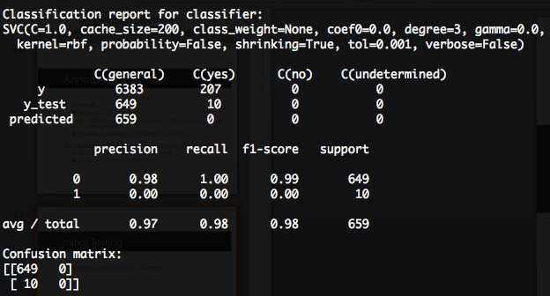
Initial Testing
90% train; 10% test; SVC; 1 iteration
0 – General, 1 – Specific-Yes

Slide 23
Analysis
Unable to predict any ‘Specific-Yes’
Number of ‘Yes’ instances too little.
Feature set unable to distinguish General vs Specific

Slide 24
What’s Next
To investigate further: where and how specific citations are made
Features that can better distinguish general vs specific citations

