Slide 1
FYP Update
Citation Provenance
WING Meeting 28 Sept 2012
Heng Low Wee

Slide 2
Previous Update
Motivation
  Reading experience; Interrupts reading when looking up cited paper.
  Goal: Predict type of citation; Location of cited information
Problem Analysis
  General/Specific citations
  Citing context as query, fragments of cited paper as ‘documents’ to be matched

Slide 3
Previous Update (Continued)
Corpus
  ACL Anthology Reference Corpus, processed with ParsCit to extract citing contexts, and fragments of cited paper
Approach
  1st feature considered: Cosine Similarity
Annotations

Slide 4
Outline
Previous Update
Features Added
Annotating Data
Initial Testing
Analysis
What’s Next?

Slide 5
Features Added
Citation Density
  The no. of inline citations / no. of lines in the context
  Intuition: High density hints it is a general citation
  (Dong & Schafer, 2011) [ACL I11-1070]
Difference in Publishing Year
  Intuition: Large difference suggests citing older and fundamental work; less discussion on citing paper thus general citation

Slide 6
Features Added
Location of Inline Citation
  The section in which the inline citation belongs
  Intuition: If located in Introduction, suggests general citation
  (Dong & Schafer, 2011) [ACL I11-1070]
Title Overlap & Author Overlap
  Jaccard distance between citing’s and cited’s
  Intuition: Similar titles suggests closely related work, refers to cited for specific contributions; Same authors hints closely related work

Slide 7
Features Added
Average TF-IDF weight for contexts and fragments in cited paper
  Intuition: Specific citations refer to ‘high valued’ terms in cited paper
Cosine Similarity

Slide 8
Annotating Data
Previous scheme
  Annotate plain text file using labels + line number range
  Annotating by line range → difficult to determine whether prediction matches annotation because they are not discrete
  Annotation task is very challenging
4 annotation labels
  General (0), Specific-Yes (1), Specific-No (2), Undetermined (3)
For each citing context in citing paper, for each text block in cited paper: annotate with label

Slide 9







Annotating Data
L₁
L₂
:
:
L_{j}
:
:
L_{n}
Citing
Cited

Slide 10
Annotating Data
Currently:
  6632 annotated records
    ~62% General, ~3% Specific-Yes, ~34% Specific-No, ~0.6% Undetermined
Undetermined data points are removed; Specific-No data points are regarded as General
  Reduced to binary classification

Slide 11
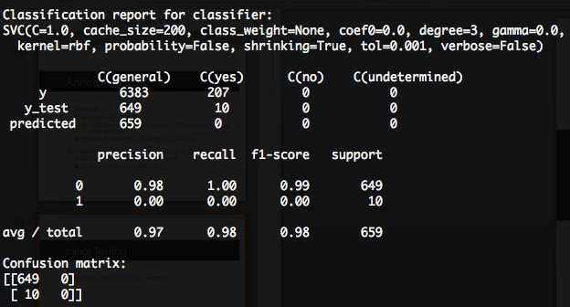
Initial Testing
90% train; 10% test; SVC; 1 iteration
0 – General, 1 – Specific-Yes

Slide 12
Analysis
Unable to predict any ‘Specific-Yes’
Number of ‘Yes’ instances too little.
Feature set unable to distinguish General vs Specific

Slide 13
What’s Next
To investigate further: where and how specific citations are made
Features that can better distinguish general vs specific citations

