Slide 1
SIGDL Meeting
20 July 2012
“Ensemble-style Self-training on Citation Classification”
Cailing Dong & Ulrich Schafer

Slide 2
Outline
Introduction
Corpus and Annotation
Feature Set Construction
Citation Classification
Summary

Slide 3
Introduction
Describe the importance of citation analysis: paper browsing aids, reading recommendations, understand & reproduce findings → important text feature for readers
Touch on related works: Four-dimension citation schema (Moravcsik & Murugesan, 1975), location of citation sentences, POS tagging of surrounding words, self-citation.
Contributions:
1. Small but comprehensive feature set
2. Robust supervised classification
3. Ensemble-style self-training classification model

Slide 4
Corpus and Annotation
Definition of Citation Functions: based on one of the 4-dimension schema, “organic or perfunctory” → 4 classes (Background, Fundamental Idea, Technical Basis, Comparison)
Corpus: ACL Anthology
ParsCit + commercial PDF-to-txt + text parser → break papers into 6 predefined sections → citation sentences have its corresponding section category
Annotation Schema
Not just citation sentence, but also the paragraph and the whole section → same perspective as much as possible
2 annotators, N=1768. kappa=0.757

Slide 5
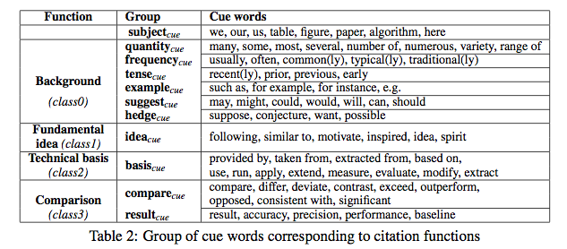
Feature Set Construction
Textual Features
1. Boolean feature – for each group: exists any cue word in citation sentence?
2. Weight – no. of cue words from the group in citation sentence
3. Boolean feature + weight – more subject_{cue} in neighbour sentences → more
likely citation sentence is related to current work

Slide 6
Feature Set Construction
Physical Features
1. Location of citation sentence
2. Popularity – no. of references cite in the same sentence
3. Density – no. of different references in the citation+neighbour sentences
4. AvgDens
Syntactic Features
POS Tagging
Boolean feature – whether sentence pattern matches POS sequence of citation sentences

Slide 7
Citation Classification
Effectiveness of Syntactic Feature
Test feature set, with & without Syntactic Feature, using 5 classification models → Results show that with Syntactic outperforms without for all the datasets with different sizes of training data → Robust feature set
Ensemble-style Self-training for Citation Classification
1. Basic self-training algo (baseline) vs Ensemble-style self-training algo
2. Ensemble learning tries to improve prediction accuracy by combining different supervised learning algo
3. Problem: final results could be worse if model learns repeatedly from wrong decisions → devised ensemble-style self-training algo

Slide 8
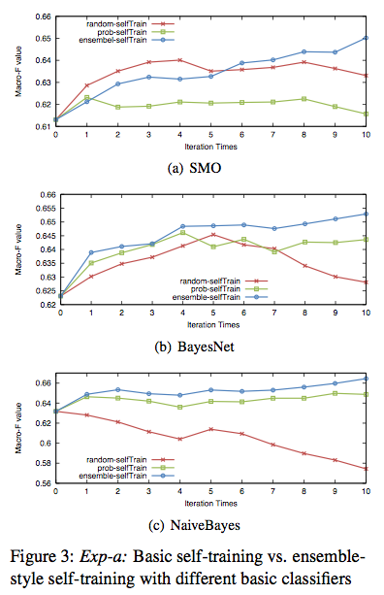
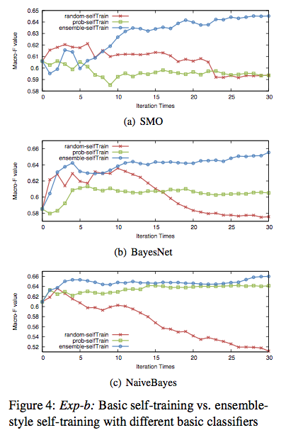

Experiments

Slide 9
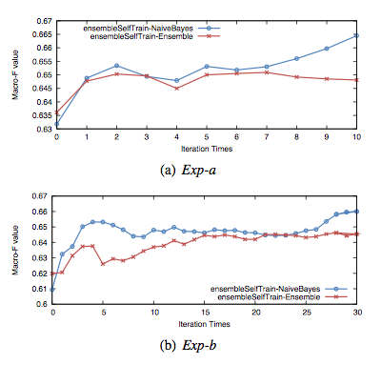
Experiments

Slide 10
Summary
Small yet comprehensive feature set (textual, physical, syntactic)
Robustness of classifiers on the feature set even with small training set (10% of 1768)
Ensemble-style self-training algo

