Slide 1
Ch. 7: Support Vector Machines Ch. 8: Decision Trees
EECS 4486
Fall 2024

Slide 2
Support Vector Machines
Support Vector Classifiers (7.1)

Slide 3
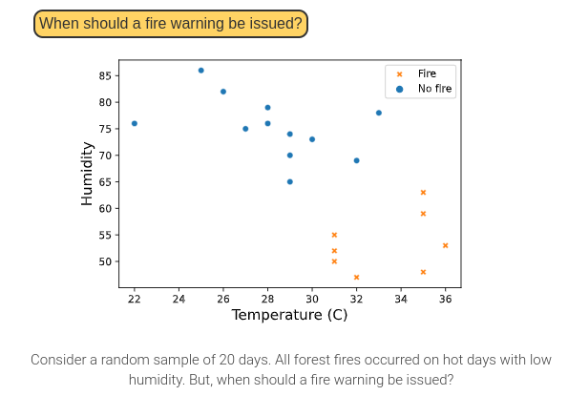
Maximal margin classifier for forest fires

Slide 4
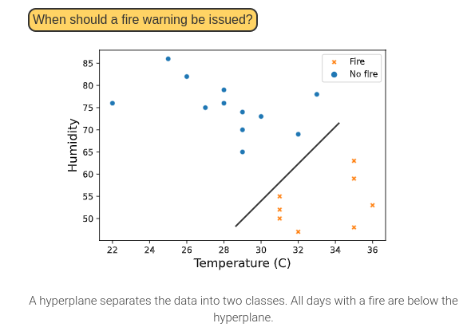
Maximal margin classifier for forest fires

Slide 5
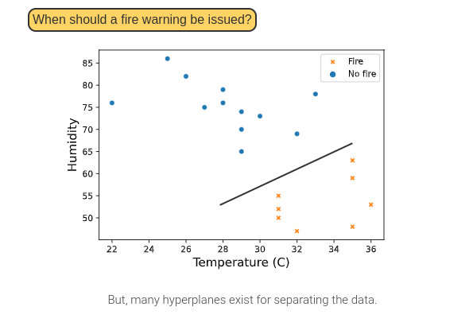
Maximal margin classifier for forest fires

Slide 6
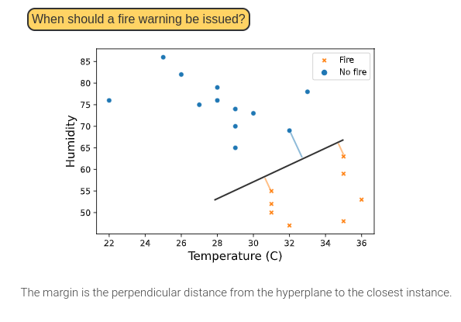
Maximal margin classifier for forest fires

Slide 7
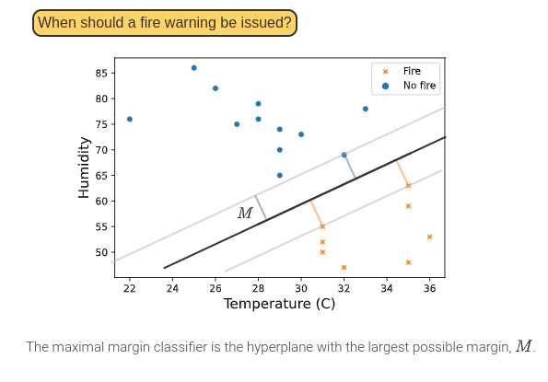
Maximal margin classifier for forest fires

Slide 8
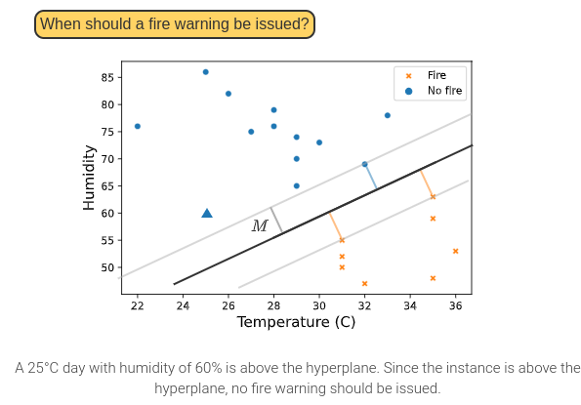
Maximal margin classifier for forest fires

Slide 9
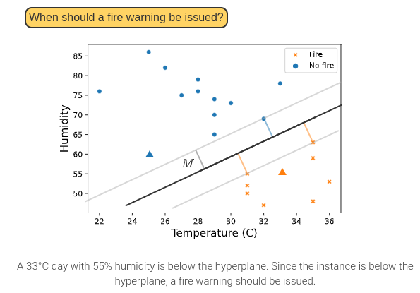
Maximal margin classifier for forest fires

Slide 10
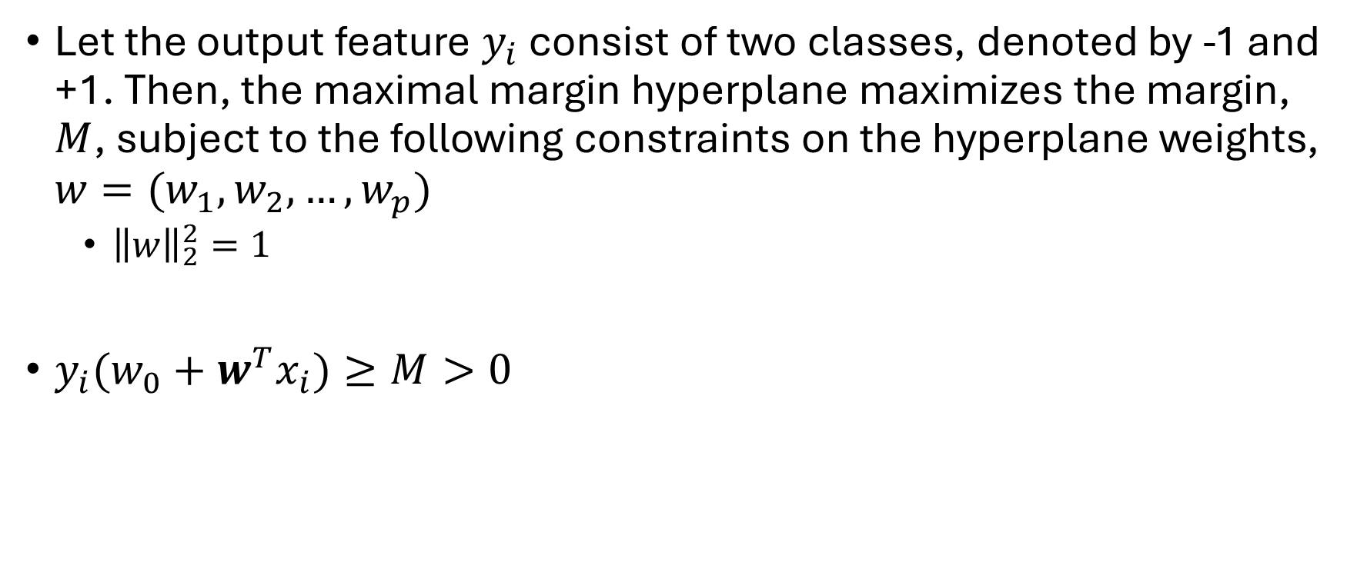
Maximal margin classifier equations
Let the output feature $y_{i}$ consist of two classes, denoted by -1 and +1. Then, the maximal margin hyperplane maximizes the margin, $M$, subject to the following constraints on the hyperplane weights, $w=(w_{1}, w_{2}, …,w_{p})$
${\left\|w\right\|}_{2}^{2}=1$
$y_{i}(w_{0}+w^{T}x_{i})≥M>0$

Slide 11
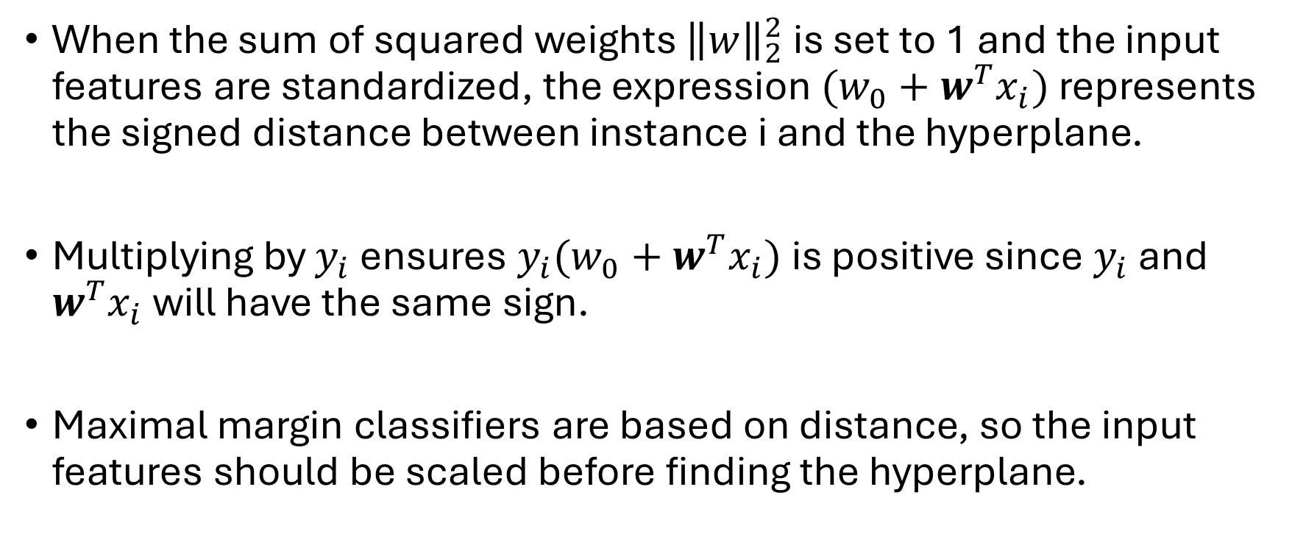
Maximal margin classifier equations
When the sum of squared weights ${\left\|w\right\|}_{2}^{2}$ is set to 1 and the input features are standardized, the expression $(w_{0}+w^{T}x_{i})$ represents the signed distance between instance i and the hyperplane.
Multiplying by $y_{i}$ ensures $y_{i}(w_{0}+w^{T}x_{i})$is positive since $y_{i}$ and $w^{T}x_{i}$ will have the same sign.
Maximal margin classifiers are based on distance, so the input features should be scaled before finding the hyperplane.

Slide 12
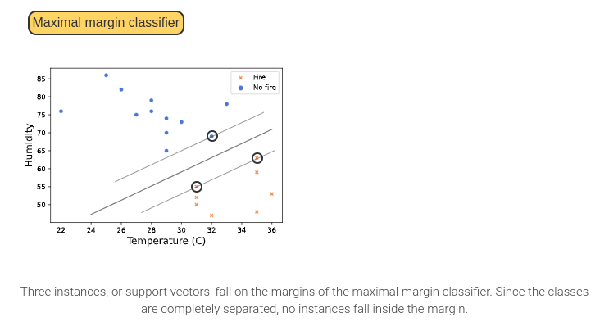
Support Vector Classifier

Slide 13
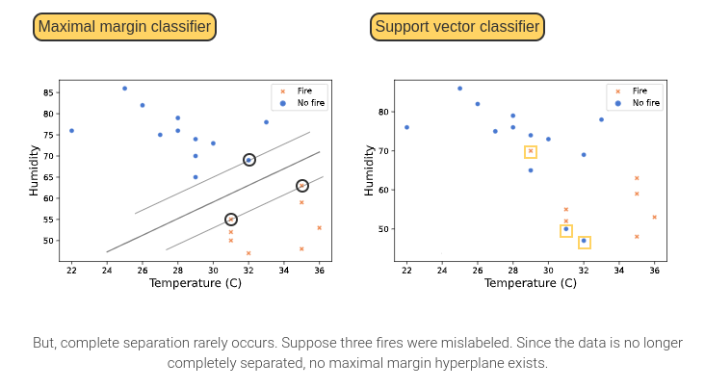
Support Vector Classifier

Slide 14
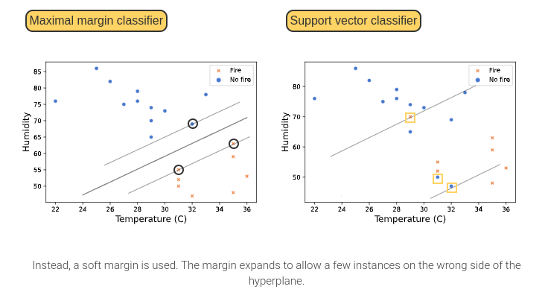
Support Vector Classifier

Slide 15
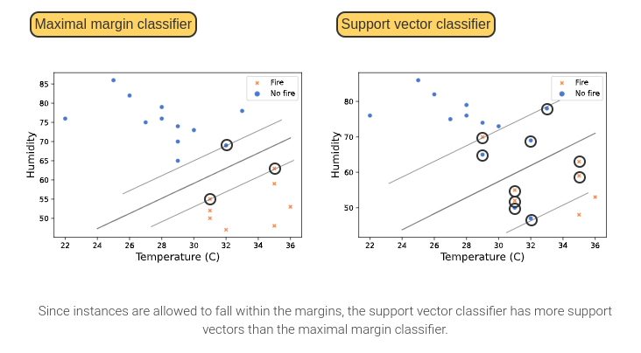
Support Vector Classifier

Slide 16
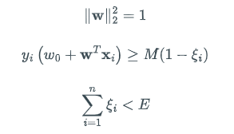
Support Vector Classifier Equations
Unlike the maximal margin classifier, a support vector classifier allows for some instances to fall within the margin. The support vector hyperplane relaxes the margin by allowing the margin constraint to vary for instances in the margin.

Slide 17
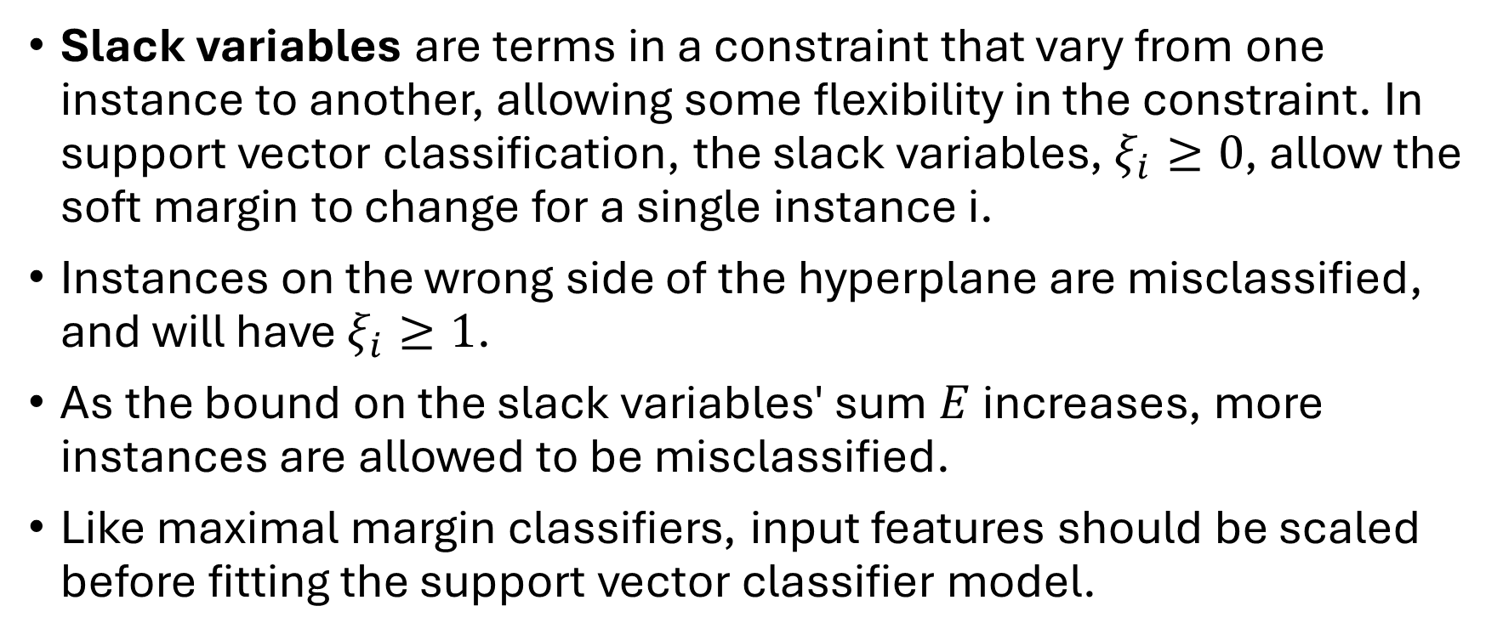
Support Vector Classifier Equations
Slack variables are terms in a constraint that vary from one instance to another, allowing some flexibility in the constraint. In support vector classification, the slack variables, $ξ_{i}≥0$, allow the soft margin to change for a single instance i.
Instances on the wrong side of the hyperplane are misclassified, and will have $ξ_{i}≥1$.
As the bound on the slack variables' sum $E$ increases, more instances are allowed to be misclassified.
Like maximal margin classifiers, input features should be scaled before fitting the support vector classifier model.

Slide 18
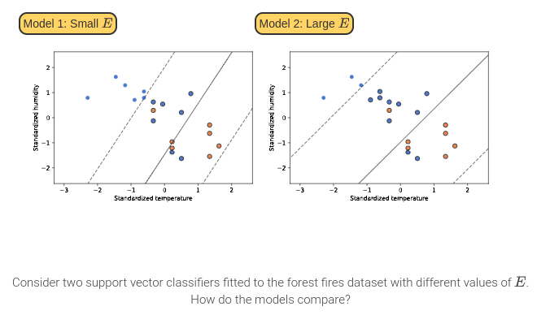
Effect of E on the support vector classifier

Slide 19
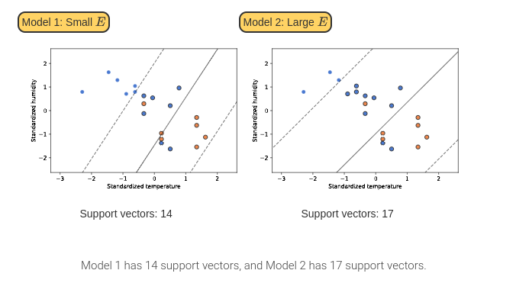
Effect of E on the support vector classifier

Slide 20
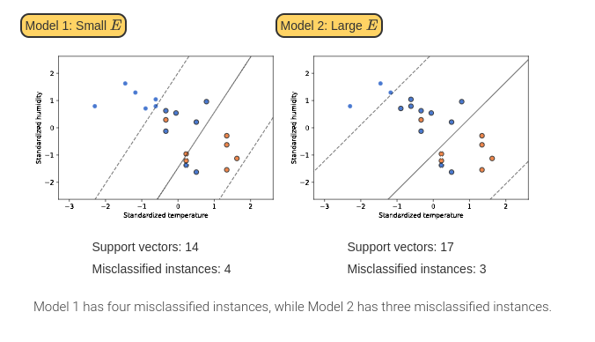
Effect of E on the support vector classifier

Slide 21
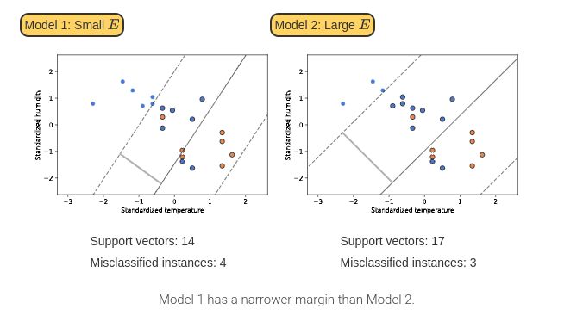
Effect of E on the support vector classifier

Slide 22
Advantages and Disadvantages of SVM
Support vector classifiers are flexible models and can be extended to more than one class using a one vs. the rest approach.
One vs. the rest classification fits a model c times using a dummy variable for each of the output feature’s c classes.
Support vector classifiers can also be modified to use a nonlinear decision boundary, which may improve overall performance.
Notes:
Non-linear decision boundary
Kernel trick

Slide 23
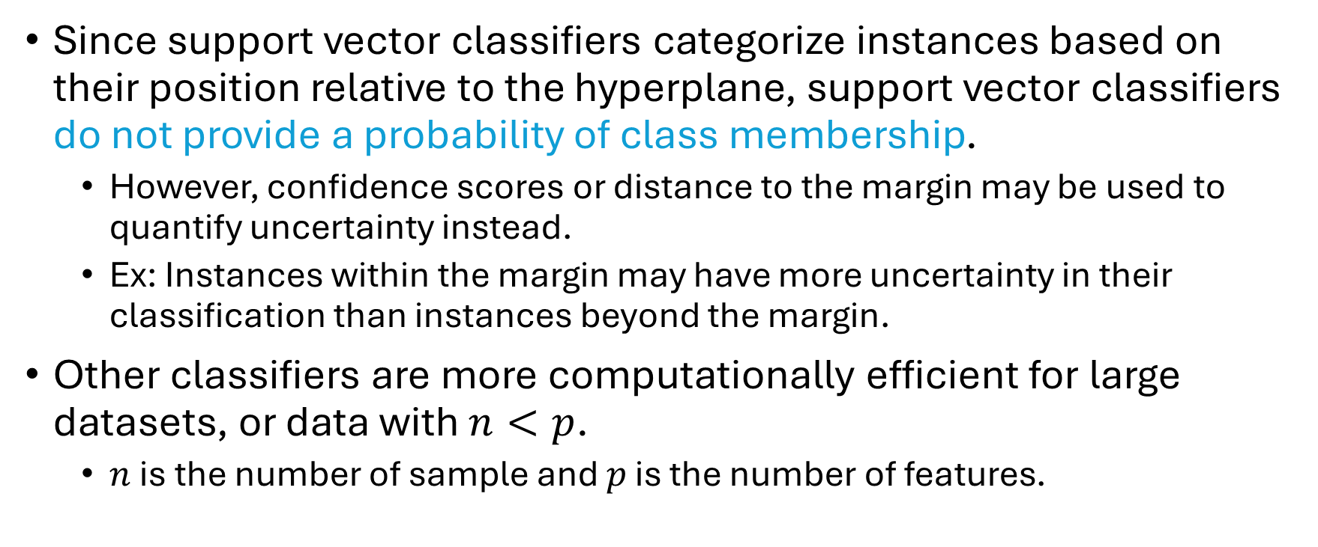
Advantages and Disadvantages of SVM
Since support vector classifiers categorize instances based on their position relative to the hyperplane, support vector classifiers do not provide a probability of class membership.
However, confidence scores or distance to the margin may be used to quantify uncertainty instead.
Ex: Instances within the margin may have more uncertainty in their classification than instances beyond the margin.
Other classifiers are more computationally efficient for large datasets, or data with $n<p$.
$n$ is the number of sample and $p$ is the number of features.
Notes:
What is n < p?

Slide 24
Decision Trees
Decision Trees for Classification (8.1)

Slide 25
Definitions
A tree is a hierarchical structure with no loops made up of two objects: nodes and edges.
An edge is a directed link from a parent node to a child node. Most nodes in a tree have one parent node and multiple child nodes.
The root node is the node with no parent node.
A leaf is a node that has no outgoing edges to child nodes.
The depth of a node is the number of edges that must be followed to reach that node from the root node.
A decision tree is a tree where each parent node has a question that determines the edge that should be taken from that node.
The nodes in a decision tree are called decision nodes.
In a decision tree, the leaves communicate the decision that results from the questions answered from the root node to the leaf.

Slide 26
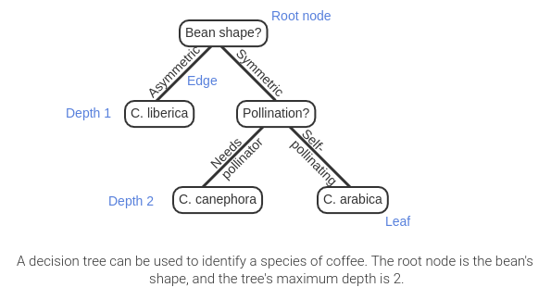
Using a decision tree to identify coffee species

Slide 27
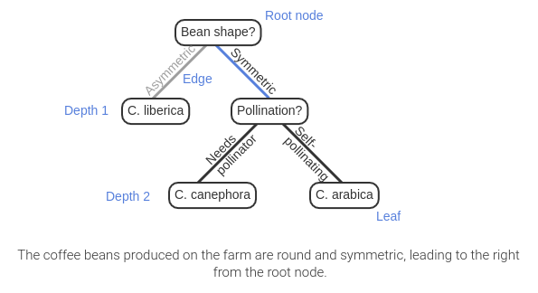
Using a decision tree to identify coffee species

Slide 28
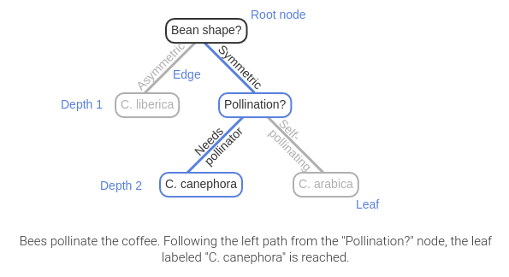
Using a decision tree to identify coffee species

Slide 29
Decision Tree Classifiers
Decision tree classifiers are decision trees that are built for classification tasks.

Slide 30
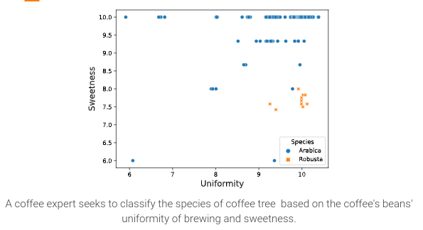
Decision Tree Classifier

Slide 31
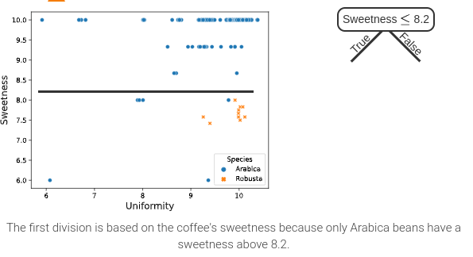
Decision Tree Classifier

Slide 32
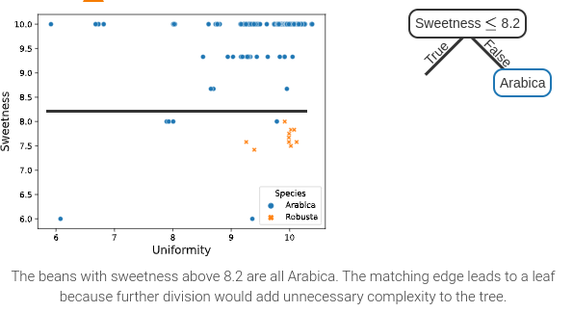
Decision Tree Classifier

Slide 33
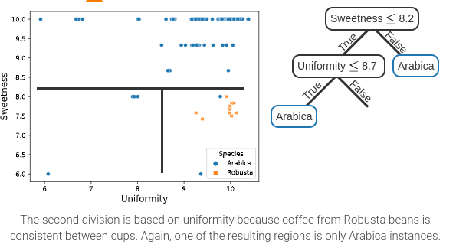
Decision Tree Classifier

Slide 34
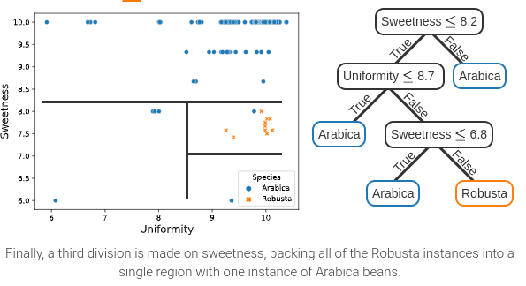
Decision Tree Classifier

Slide 35
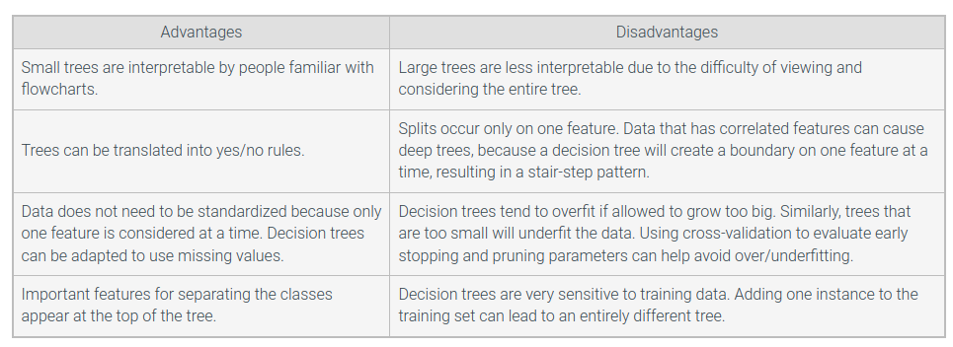
Advantages and Disadvantages

