Slide 1
Chapter 3: Regression Models
EECS 4486
Fall 2024

Slide 2
3. Regression Models
Linear Regression
Elastic net regression (regularization)
K-nearest neighbors for regression

Slide 3
3.1 Linear Regression

Slide 4
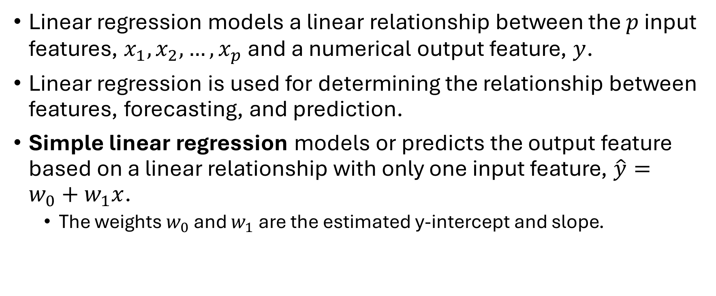
Linear Regression
Linear regression models a linear relationship between the $p$ input features, $x_{1},x_{2}, …, x_{p}$ and a numerical output feature, $y$.
Linear regression is used for determining the relationship between features, forecasting, and prediction.
Simple linear regression models or predicts the output feature based on a linear relationship with only one input feature, $\hat{y}=w_{0}+w_{1}x$.
The weights $w_{0}$ and $w_{1}$ are the estimated y-intercept and slope.

Slide 5
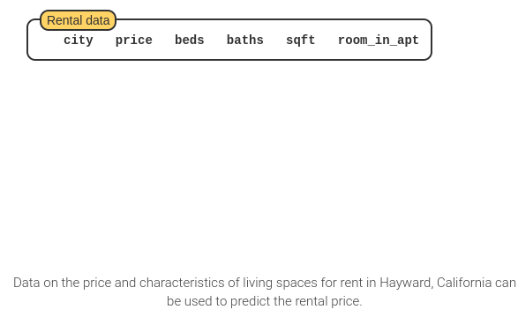
Linear Regression

Slide 6
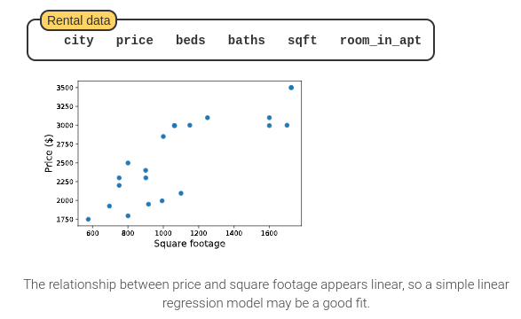
Linear Regression

Slide 7
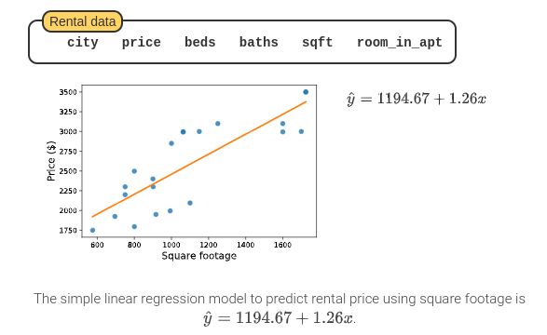
Linear Regression

Slide 8
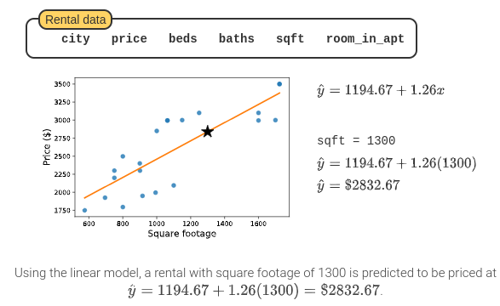
Linear Regression

Slide 9
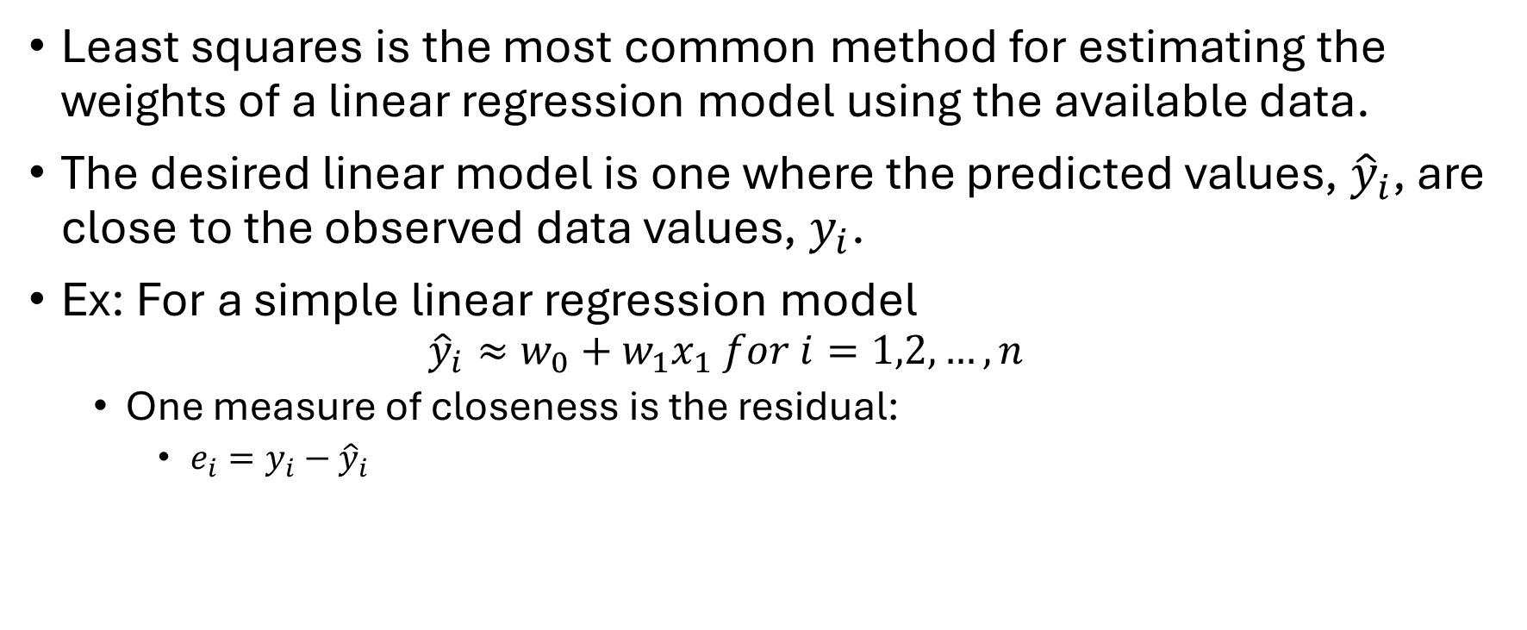
Least Square
Least squares is the most common method for estimating the weights of a linear regression model using the available data.
The desired linear model is one where the predicted values, ${\hat{y}}_{i}$, are close to the observed data values, $y_{i}$.
Ex: For a simple linear regression model
$${\hat{y}}_{i}≈w_{0}+w_{1}x_{1} for i=1,2,…,n$$
One measure of closeness is the residual:
$e_{i}=y_{i}−{\hat{y}}_{i}$

Slide 10

Least Square
For a simple linear model, least squares selects weights $w_{0}$ and $w_{1}$ such that the sum of the squared residuals is minimized.
$$RSS=\sum_{i=1}^{n}{{\left(y_{i}−{\hat{y}}_{i}\right)}^{2}=}\sum_{i=1}^{n}{{\left(y_{i}−{\left(w_{0}+w_{1}x_{i}\right)}_{i}\right)}^{2}}$$

Slide 11
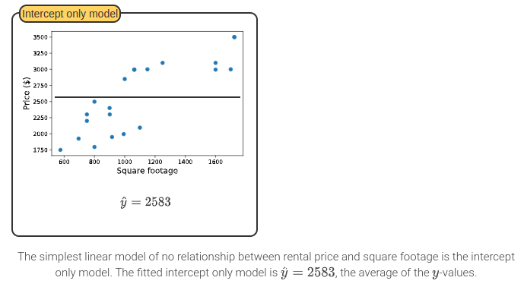
Least Square

Slide 12
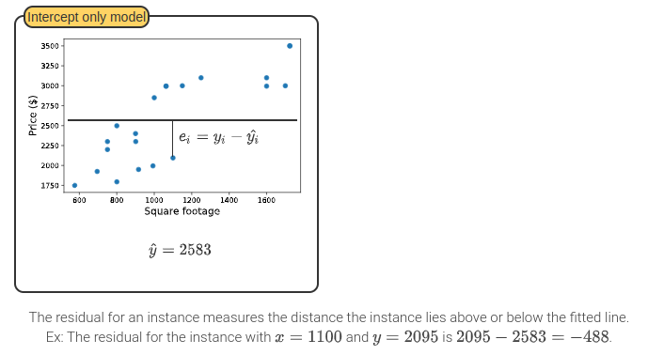
Least Square

Slide 13
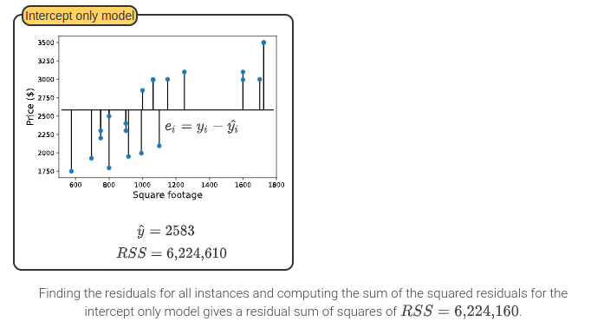
Least Square

Slide 14
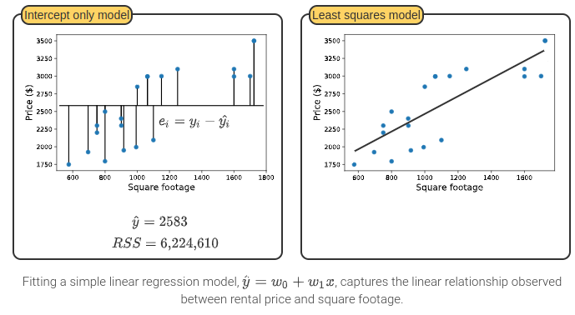
Least Square

Slide 15
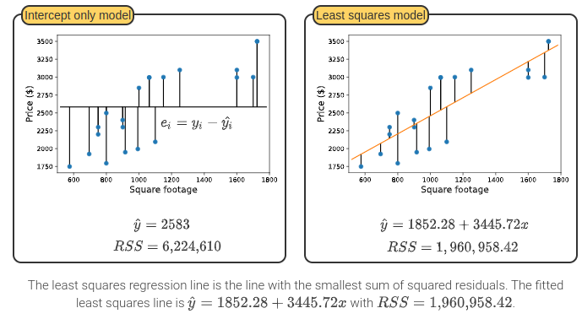
Least Square

Slide 16

Residual and RSS
Residual:
$e_{i}=y_{i}−{\hat{y}}_{i}$
Least square:
The sum of the squared residuals (RSS)
$RSS=\sum_{i=1}^{n}{{\left(y_{i}−{\hat{y}}_{i}\right)}^{2}=}\sum_{i=1}^{n}{{\left(y_{i}−{\left(w_{0}+w_{1}x_{i}\right)}_{i}\right)}^{2}}$

Slide 17
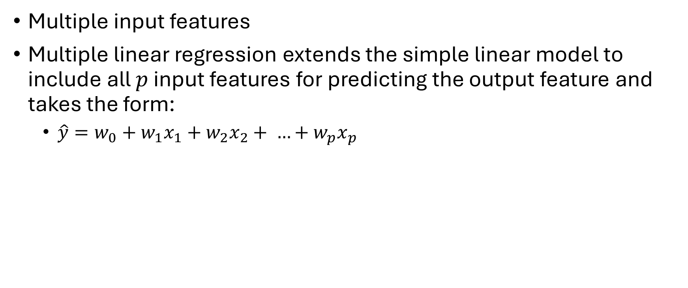
Multiple Regression
Multiple input features
Multiple linear regression extends the simple linear model to include all $p$ input features for predicting the output feature and takes the form:
$\hat{y}=w_{0}+w_{1}x_{1}+w_{2}x_{2}+ …+w_{p}x_{p}$

Slide 18
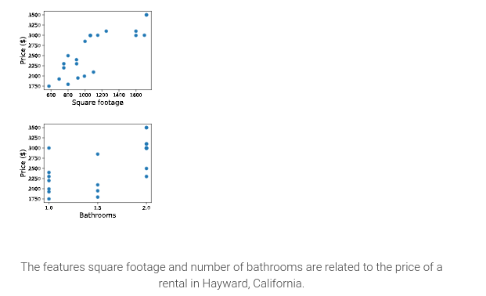
Multiple Regression

Slide 19
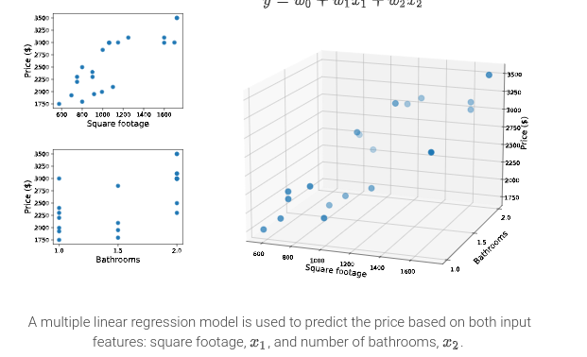
Multiple Regression

Slide 20
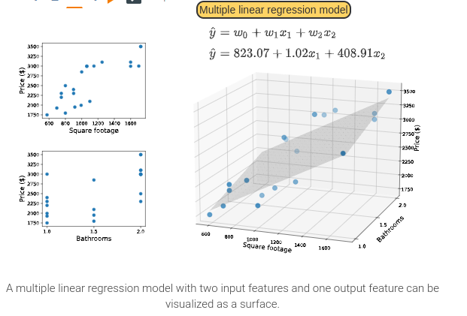
Multiple Regression

Slide 21
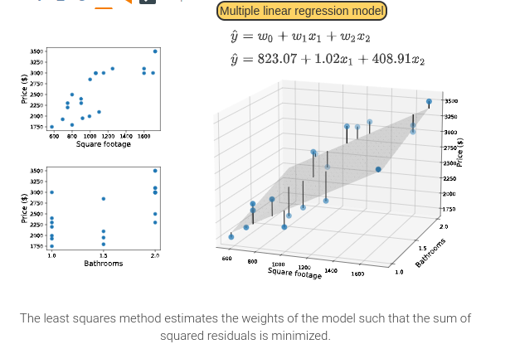
Multiple Regression

Slide 22
Advantages and Disadvantages of Linear Regression
Linear regression methods perform well when the relationship between the output and the input features is linear and assumptions are reasonably met.
Linear regression models are also computationally efficient and straightforward to interpret.
However, linear regression methods also have limitations. Linear regression methods are:
sensitive to outliers and extreme instances,
sensitive to multicollinearity, which occurs when input features are correlated, and susceptible to noise and overfitting.
Techniques to address these limitations do exist.
Ex: Regularization techniques prevent the regression weights from being too large, which addresses overfitting.

Slide 23
3. Regression Models
Linear Regression
Elastic net regression (regularization)
K-nearest neighbors for regression

Slide 24
3.2 Elastic Net Regression (Regularization)

Slide 25

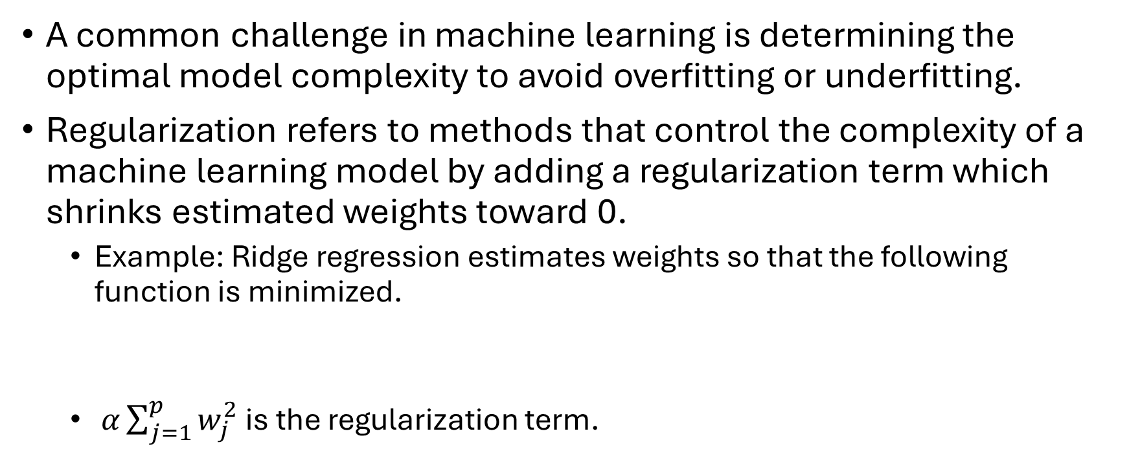
Regularization
A common challenge in machine learning is determining the optimal model complexity to avoid overfitting or underfitting.
Regularization refers to methods that control the complexity of a machine learning model by adding a regularization term which shrinks estimated weights toward 0.
Example: Ridge regression estimates weights so that the following function is minimized.
$α\sum_{j=1}^{p}{w_{j}^{2}}$ is the regularization term.

Slide 26
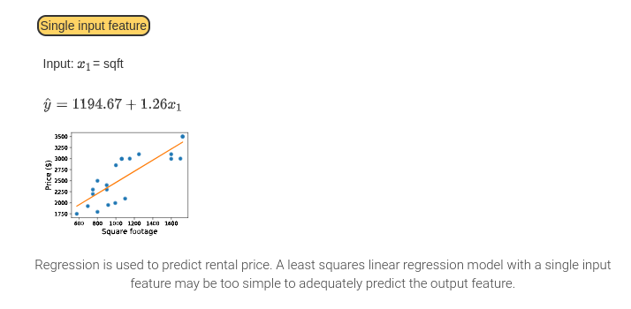
Regularization

Slide 27
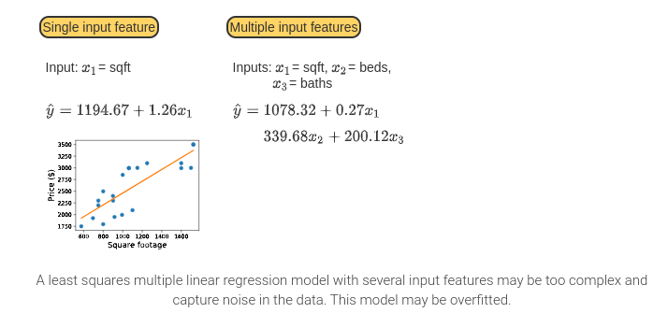
Regularization

Slide 28
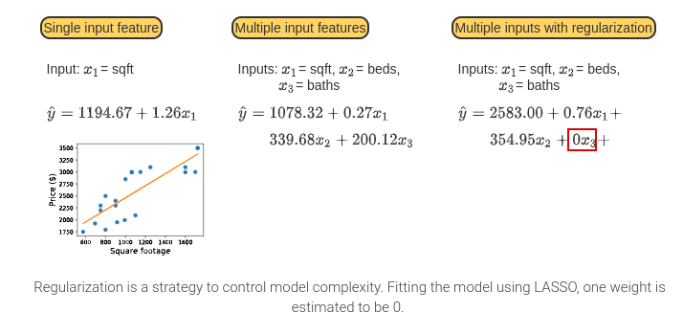
Regularization

Slide 29
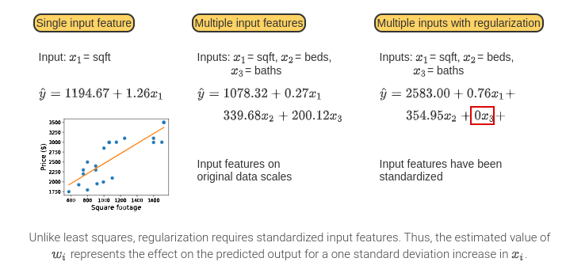
Regularization

Slide 30
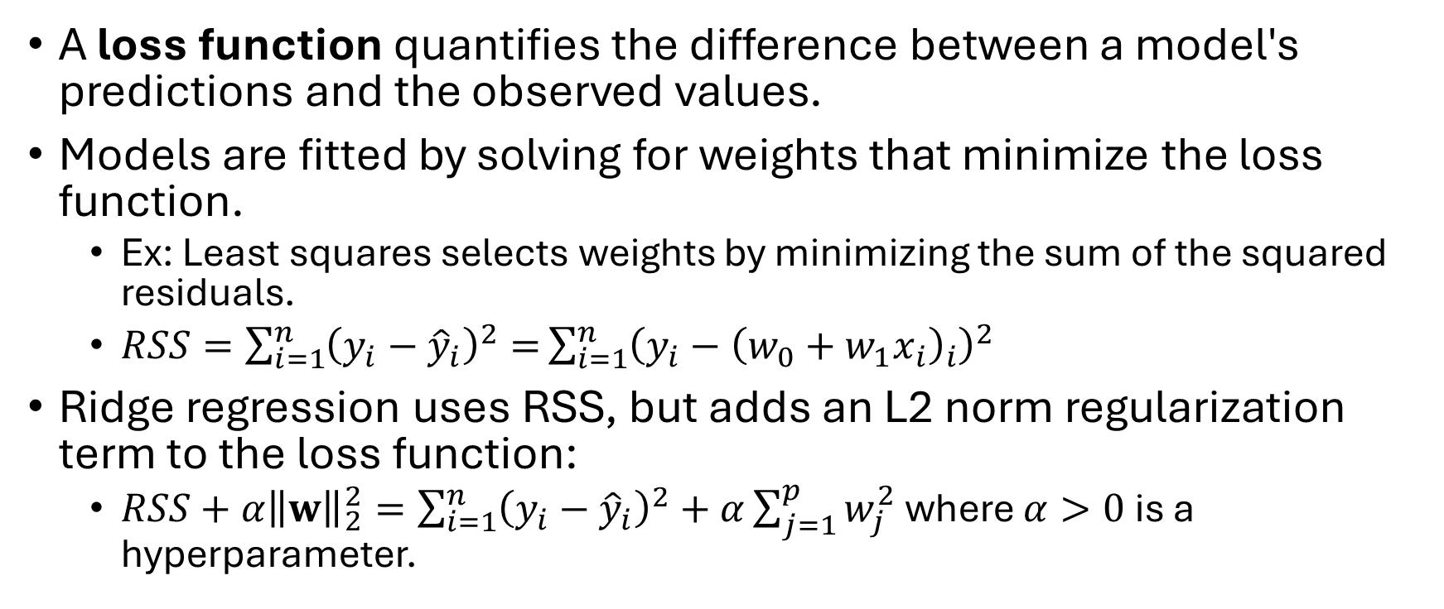
Ridge Regression
A loss function quantifies the difference between a model's predictions and the observed values.
Models are fitted by solving for weights that minimize the loss function.
Ex: Least squares selects weights by minimizing the sum of the squared residuals.
$RSS=\sum_{i=1}^{n}{{\left(y_{i}−{\hat{y}}_{i}\right)}^{2}=}\sum_{i=1}^{n}{{\left(y_{i}−{\left(w_{0}+w_{1}x_{i}\right)}_{i}\right)}^{2}}$
Ridge regression uses RSS, but adds an L2 norm regularization term to the loss function:
$RSS+α{\left\|w\right\|}_{2}^{2}=\sum_{i=1}^{n}{{\left(y_{i}−{\hat{y}}_{i}\right)}^{2}+α\sum_{j=1}^{p}{w_{j}^{2}}}$ where $α>0$ is a hyperparameter.

Slide 31
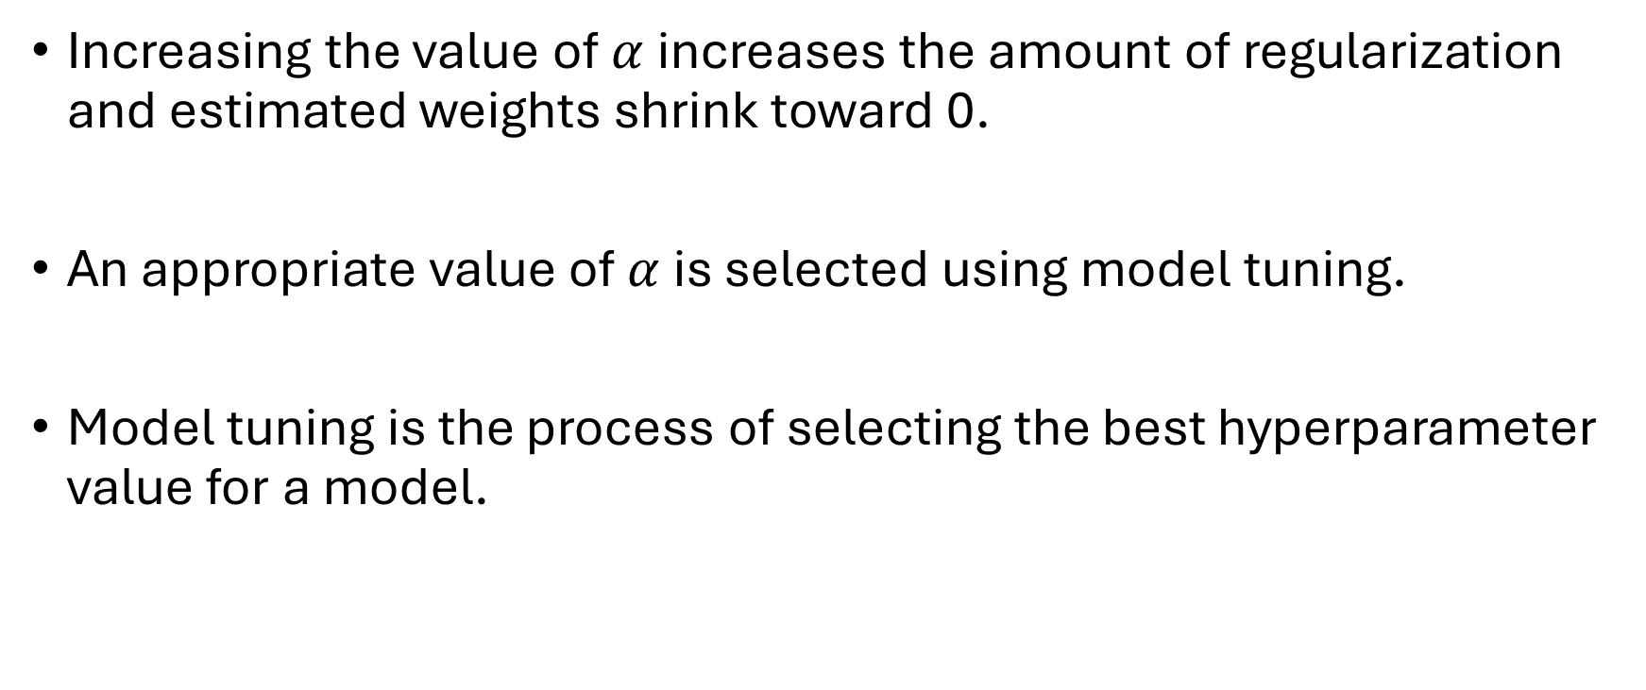
Model Tuning
Increasing the value of $α$ increases the amount of regularization and estimated weights shrink toward 0.
An appropriate value of $α$ is selected using model tuning.
Model tuning is the process of selecting the best hyperparameter value for a model.

Slide 32
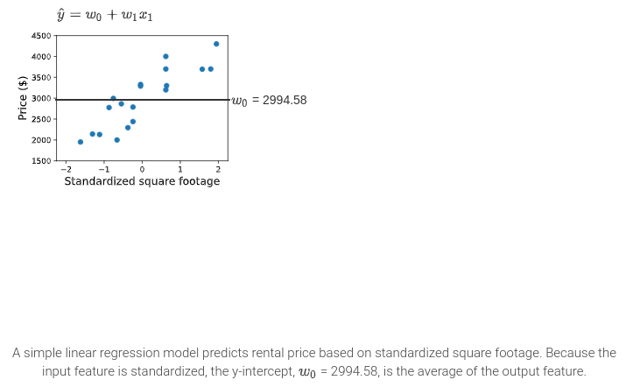
Ridge Regression
Predicting rental price with ridge regression

Slide 33
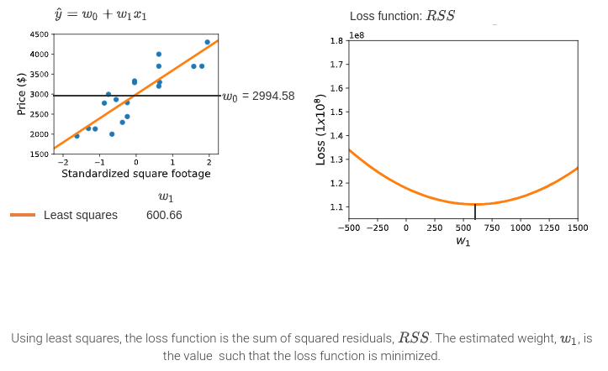
Ridge Regression

Slide 34
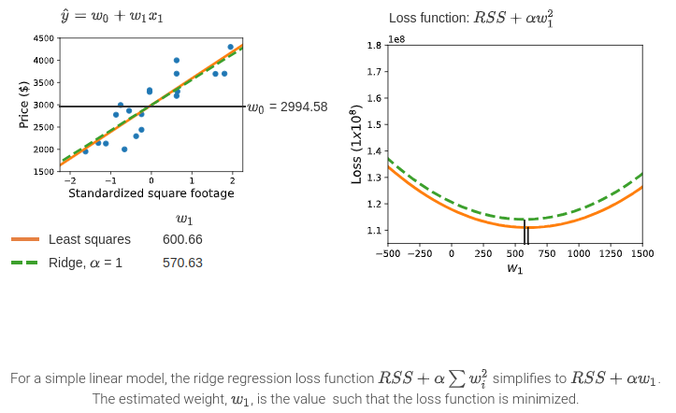
Ridge Regression

Slide 35
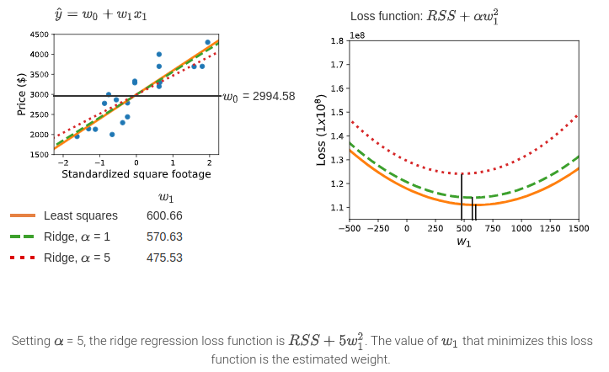
Ridge Regression

Slide 36
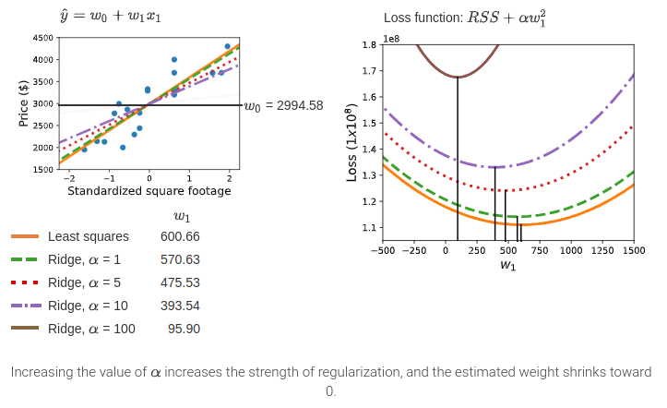
Ridge Regression

Slide 37
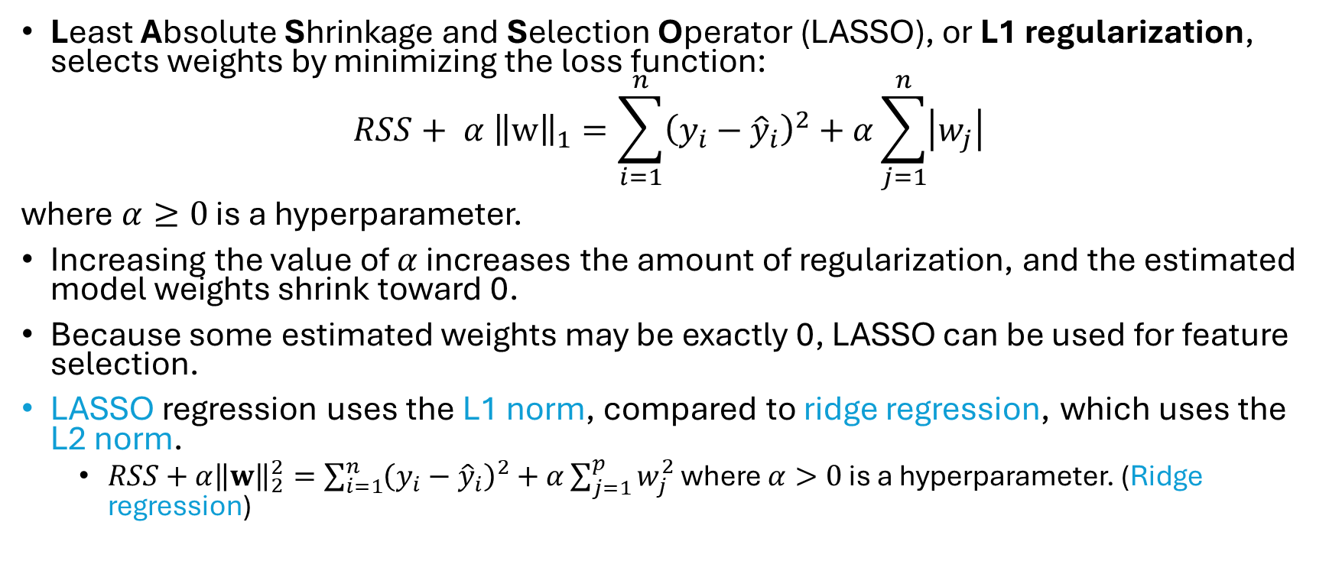
LASSO Regression
Least Absolute Shrinkage and Selection Operator (LASSO), or L1 regularization, selects weights by minimizing the loss function:
$$RSS+ α {\left\|w\right\|}_{1}=\sum_{i=1}^{n}{{\left(y_{i}−{\hat{y}}_{i}\right)}^{2}+α\sum_{j=1}^{n}{\left|w_{j}\right|}}$$
where $α≥0$ is a hyperparameter.
Increasing the value of $α$ increases the amount of regularization, and the estimated model weights shrink toward 0.
Because some estimated weights may be exactly 0, LASSO can be used for feature selection.
LASSO regression uses the L1 norm, compared to ridge regression, which uses the L2 norm.
$RSS+α{\left\|w\right\|}_{2}^{2}=\sum_{i=1}^{n}{{\left(y_{i}−{\hat{y}}_{i}\right)}^{2}+α\sum_{j=1}^{p}{w_{j}^{2}}}$ where $α>0$ is a hyperparameter. (Ridge regression)

Slide 38
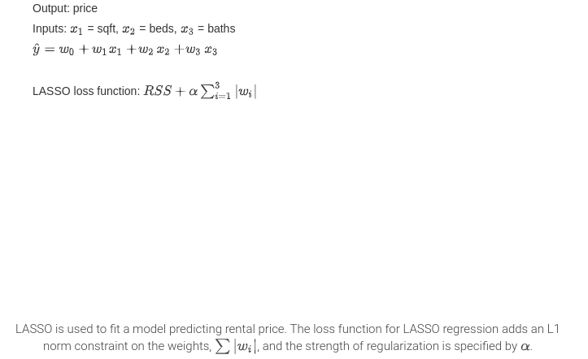
LASSO Regression

Slide 39
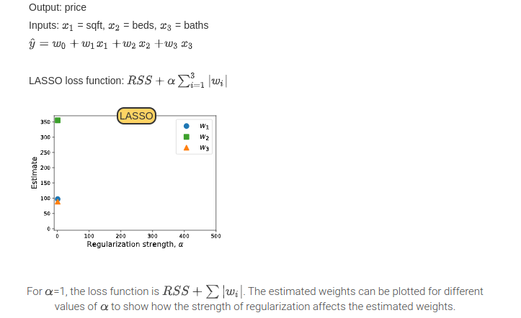
LASSO Regression

Slide 40
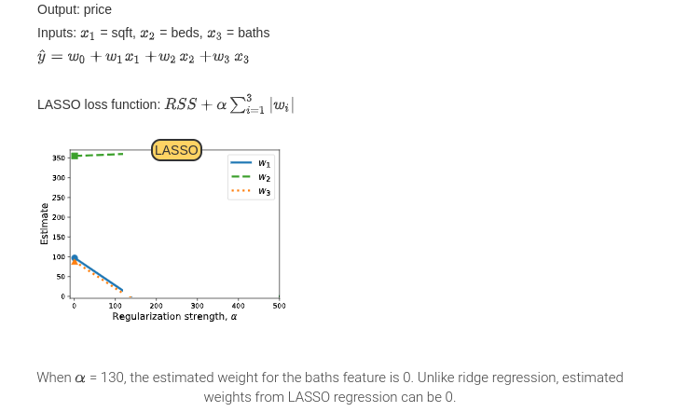
LASSO Regression

Slide 41
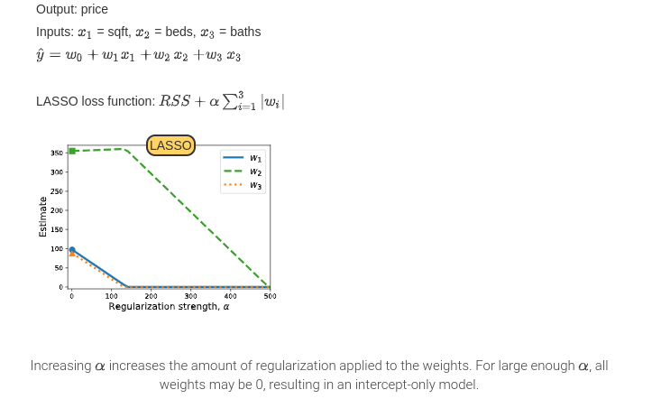
LASSO Regression

Slide 42
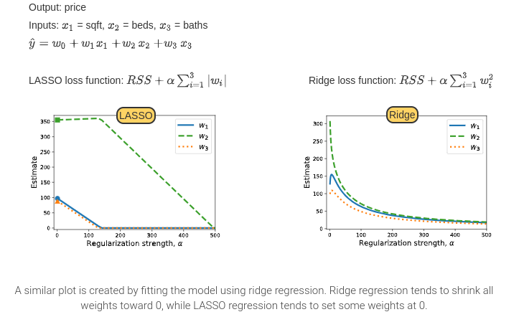
LASSO Regression

Slide 43
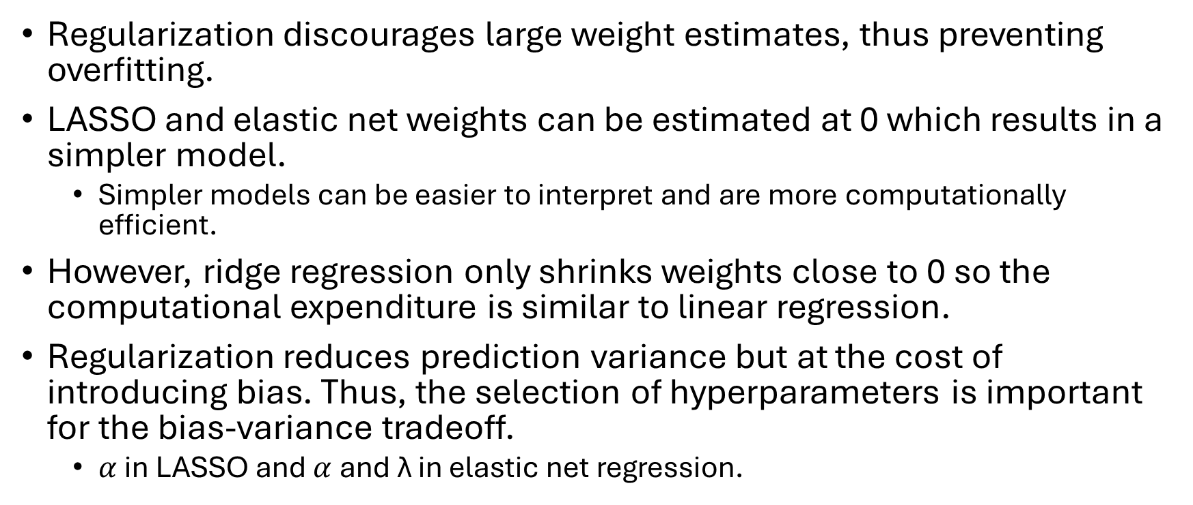
Advantages and Disadvantages of Regularization
Regularization discourages large weight estimates, thus preventing overfitting.
LASSO and elastic net weights can be estimated at 0 which results in a simpler model.
Simpler models can be easier to interpret and are more computationally efficient.
However, ridge regression only shrinks weights close to 0 so the computational expenditure is similar to linear regression.
Regularization reduces prediction variance but at the cost of introducing bias. Thus, the selection of hyperparameters is important for the bias-variance tradeoff.
$α$ in LASSO and $α$ and λ in elastic net regression.

Slide 44
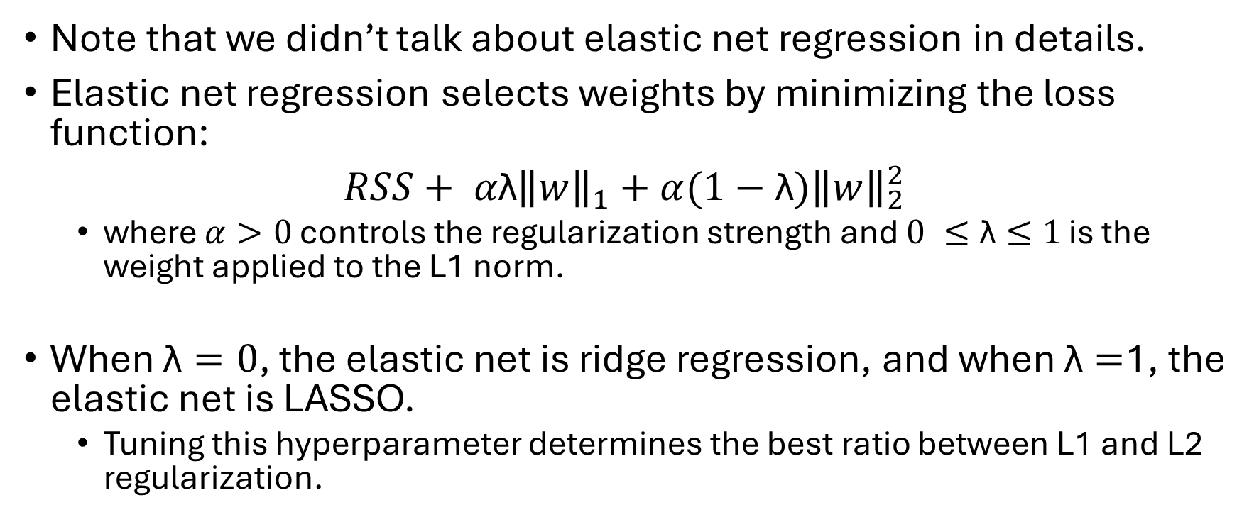
Elastic Net Regression
Note that we didn’t talk about elastic net regression in details.
Elastic net regression selects weights by minimizing the loss function:
$RSS+ α\text{λ}{\left\|w\right\|}_{1}+α(1−\text{λ}){\left\|w\right\|}_{2}^{2}$
where $α>0$ controls the regularization strength and $0 ≤\text{λ}≤1$ is the weight applied to the L1 norm.
When $\text{λ}=0$, the elastic net is ridge regression, and when $\text{λ}=$1, the elastic net is LASSO.
Tuning this hyperparameter determines the best ratio between L1 and L2 regularization.

Slide 45
3. Regression Models
Linear Regression
Elastic net regression (regularization)
K-nearest neighbors for regression

Slide 46
3.3 K-nearest Neighbors for Regression

Slide 47
K-nearest Neighbors for Regression
k-nearest neighbors regression predicts the value of a numeric output feature based on the average output for other instances with the most similar, or nearest, input features.
The nearest instances, or neighbors, are identified using a distance measure with the input features.
The average value of the output feature for the nearest instances becomes the prediction.
The k-nearest neighbors regression prediction is a numeric value compared to k-nearest neighbors for classification that predicts a class.

Slide 48
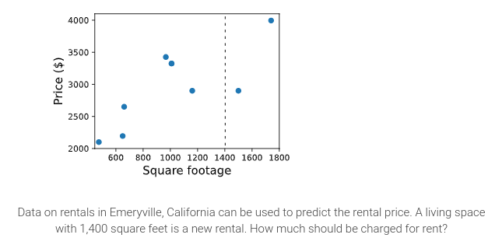
K-nearest Neighbors for Regression

Slide 49
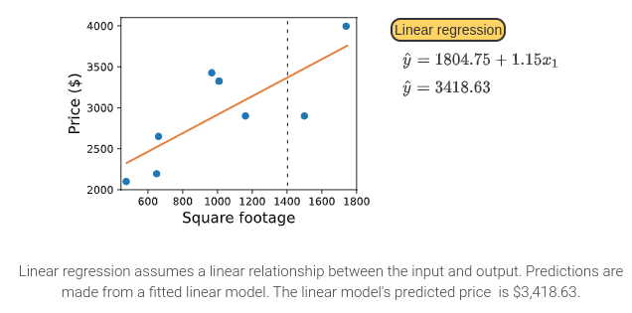
K-nearest Neighbors for Regression

Slide 50
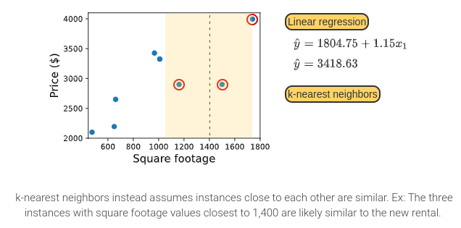
K-nearest Neighbors for Regression

Slide 51
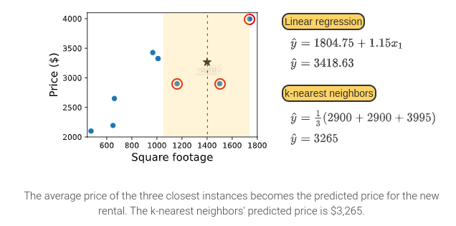
K-nearest Neighbors for Regression

Slide 52
K-nearest Neighbors for Regression: Distance Measure
How to select the nearest neighbors is the same as k-nearest neighbor for classification.
using distance measures:
Euclidean distance
Manhattan distance
Minkowski distance.

Slide 53
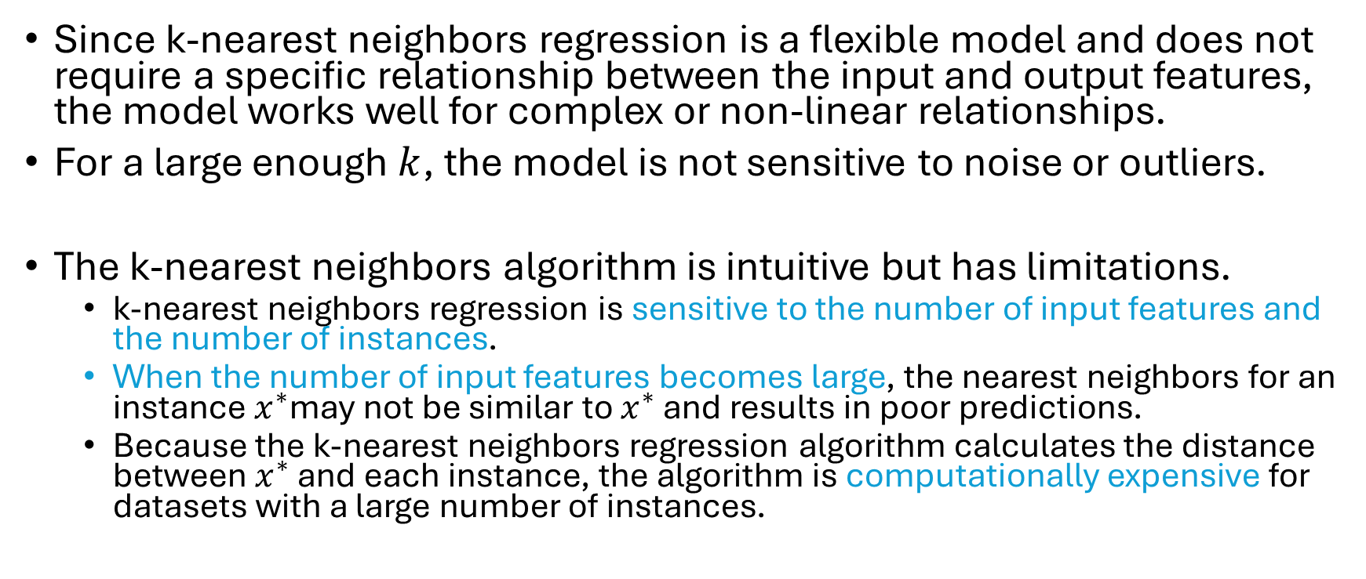
Advantages and Disadvantages
Since k-nearest neighbors regression is a flexible model and does not require a specific relationship between the input and output features, the model works well for complex or non-linear relationships.
For a large enough $k$, the model is not sensitive to noise or outliers.
The k-nearest neighbors algorithm is intuitive but has limitations.
k-nearest neighbors regression is sensitive to the number of input features and the number of instances.
When the number of input features becomes large, the nearest neighbors for an instance $x^{∗}$may not be similar to $x^{∗}$ and results in poor predictions.
Because the k-nearest neighbors regression algorithm calculates the distance between $x^{∗}$ and each instance, the algorithm is computationally expensive for datasets with a large number of instances.

Slide 54
Chapter 10.3 Gradient Descent

Slide 55
Gradient Descent
Gradient descent is an optimization algorithm that optimizes a function by updating weights based on the function's derivative, also called the gradient.
In machine learning, gradient descent is used to find the optimal weights for a model to minimize a loss function.

Slide 56
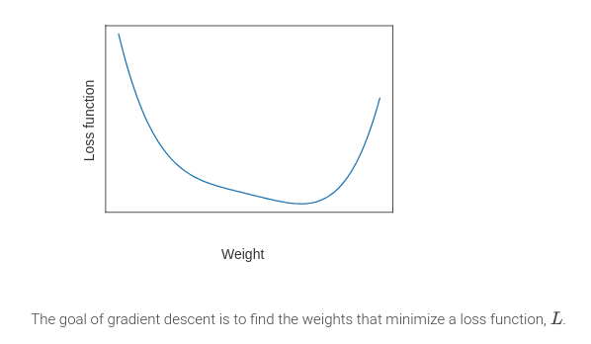
Gradient Descent Algorithm

Slide 57
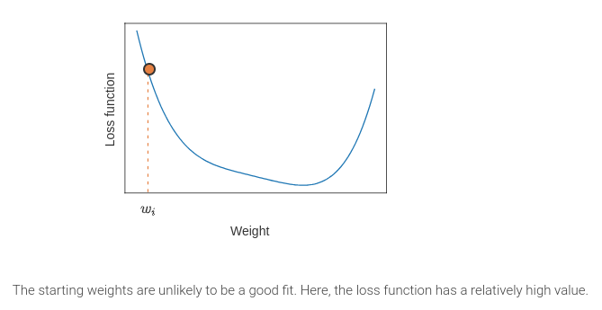
Gradient Descent Algorithm

Slide 58
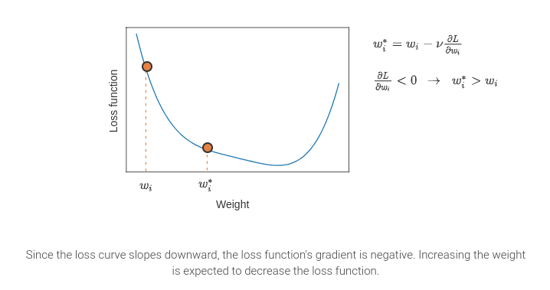
Gradient Descent Algorithm

Slide 59
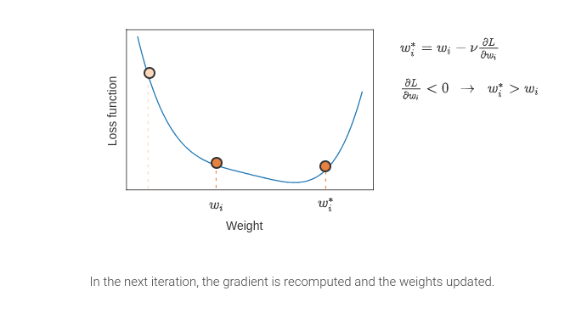
Gradient Descent Algorithm

Slide 60
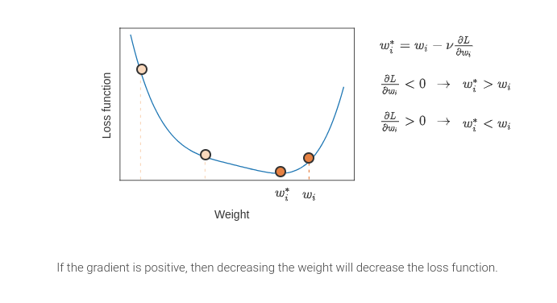
Gradient Descent Algorithm

Slide 61
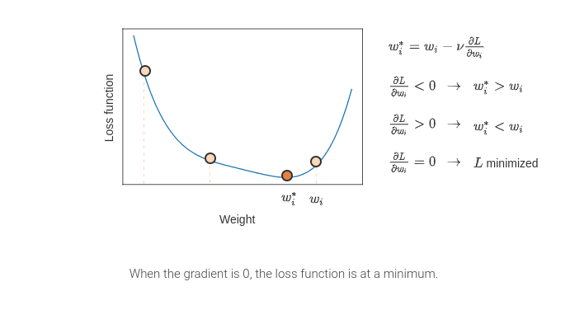
Gradient Descent Algorithm

Slide 62
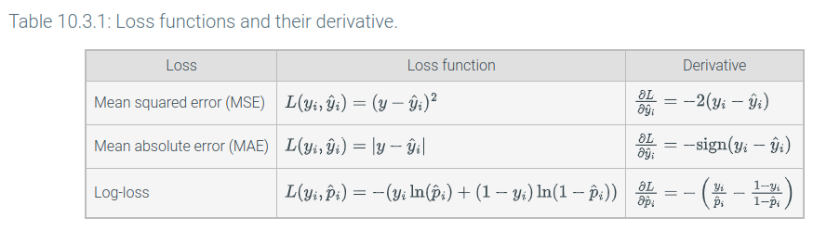
Calculating Gradients

Slide 63







(for fixed , this is a function of x)
(function of the parameters )
Andrew Ng

Slide 64



(for fixed , this is a function of x)
(function of the parameters )
Andrew Ng

Slide 65



(for fixed , this is a function of x)
(function of the parameters )
Andrew Ng

Slide 66



(for fixed , this is a function of x)
(function of the parameters )
Andrew Ng

Slide 67
Support Vector Machines
Support Vector Classifiers (7.1)

Slide 68

Maximal margin classifier for forest fires

Slide 69

Maximal margin classifier for forest fires

Slide 70

Maximal margin classifier for forest fires

Slide 71

Maximal margin classifier for forest fires

Slide 72

Maximal margin classifier for forest fires

Slide 73

Maximal margin classifier for forest fires

Slide 74

Maximal margin classifier for forest fires

Slide 75
Advantages and Disadvantages of SVM
Support vector classifiers are flexible models and can be extended to more than one class using a one vs. the rest approach.
One vs. the rest classification fits a model c times using a dummy variable for each of the output feature’s c classes.
Support vector classifiers can also be modified to use a nonlinear decision boundary, which may improve overall performance.

Slide 76

Advantages and Disadvantages of SVM
Since support vector classifiers categorize instances based on their position relative to the hyperplane, support vector classifiers do not provide a probability of class membership.
However, confidence scores or distance to the margin may be used to quantify uncertainty instead.
Ex: Instances within the margin may have more uncertainty in their classification than instances beyond the margin.
Other classifiers are more computationally efficient for large datasets, or data with $n<p$.
$n$ is the number of sample and $p$ is the number of features.
Notes:
What is n < p?

Slide 77
Decision Trees
Decision Trees for Classification (8.1)

Slide 78
Definitions
A tree is a hierarchical structure with no loops made up of two objects: nodes and edges.
An edge is a directed link from a parent node to a child node. Most nodes in a tree have one parent node and multiple child nodes.
The root node is the node with no parent node.
A leaf is a node that has no outgoing edges to child nodes.
The depth of a node is the number of edges that must be followed to reach that node from the root node.
A decision tree is a tree where each parent node has a question that determines the edge that should be taken from that node.
The nodes in a decision tree are called decision nodes.
In a decision tree, the leaves communicate the decision that results from the questions answered from the root node to the leaf.

Slide 79

Using a decision tree to identify coffee species

Slide 80

Using a decision tree to identify coffee species

Slide 81

Using a decision tree to identify coffee species

Slide 82
Decision Tree Classifiers
Decision tree classifiers are decision trees that are built for classification tasks.

Slide 83

Decision Tree Classifier

Slide 84

Decision Tree Classifier

Slide 85

Decision Tree Classifier

Slide 86

Decision Tree Classifier

Slide 87

Decision Tree Classifier

Slide 88

Advantages and Disadvantages

