Slide 1
Machine Learning Basics
Lwin Moe
York University
October 3, 2023

Slide 2
Machine Learning 1 Outline
What is ML?
Classification vs. Regression
Types of Machine Learning
Supervised Learning
Unsupervised Learning
Semi-supervised Learning
Reinforcement Learning

Slide 3
Machine Learning 1 Outline
Building blocks of ML
Scalars, Vectors and Sets
Loss Functions
Derivative and Gradient Descent

Slide 4
Machine Learning 2 Outline
Evaluation metrics
Precision, Recall, and Accuracy
Training
Cross validation
Underfitting, Overfitting, Regularization
Model selection

Slide 5
Machine Learning 2 Outline
Model-based vs. Instance-based Learning
Shallow vs. Deep Learning
Fundamental Algorithms
Linear Regression
Logistic Regression
Decision Tree
Support Vector Machines
k-Nearest Neighbors

Slide 6
Machine Learning 2 Outline
Deep Learning and Neural Networks
Feed Forward Network
Multi-Layer Perceptron

Slide 7
Machine Learning 2 Outline
Tutorials
Linear Regression (using scikit-learn library)
SVM (using scikit-learn library)

Slide 8
Resources
The Hundred-Page Machine Learning Book
https://themlbook.com/
http://themlbook.com/wiki/doku.php (read the chapters online)
Andrew Ng’s Machine Learning Specialization Lectures
https://www.youtube.com/playlist?list=PLkDaE6sCZn6FNC6YRfRQc_FbeQrF8BwGI

Slide 9
Evaluation Metrics
Confusion matrix
Precision, recall, accuracy, F1-score

Slide 10
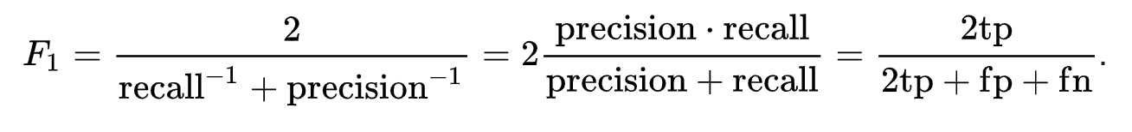
Confusion Matrix
True Labels
 | Positive | Negative
Positive | TP (50) | FP (30)
Negative | FN (10) | TN (100)
Predictions
Accuracy
= (TP + TN) / Total Samples
= (50 + 100) / (50 + 30 + 10 + 100)
= 0.789
Precision
= TP / (TP + FP)
= 50 / (50 + 30) = 0.625
Recall
= TP / (TP + FN)
= 50 / (50 + 10) = 0.833
Total samples: 50 + 30 + 10 + 100 = 190

Slide 11
Training
Training, Validation and Test sets
Example: 80%, 10%, 10%
References:
https://en.wikipedia.org/wiki/Training,_validation,_and_test_data_sets
https://machinelearningmastery.com/difference-test-validation-datasets/

Slide 12
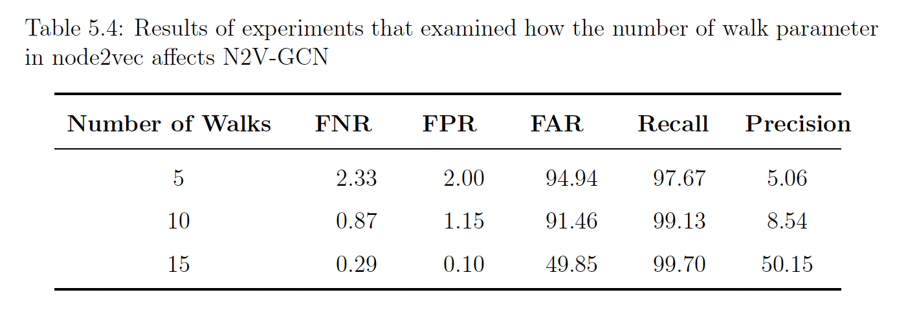
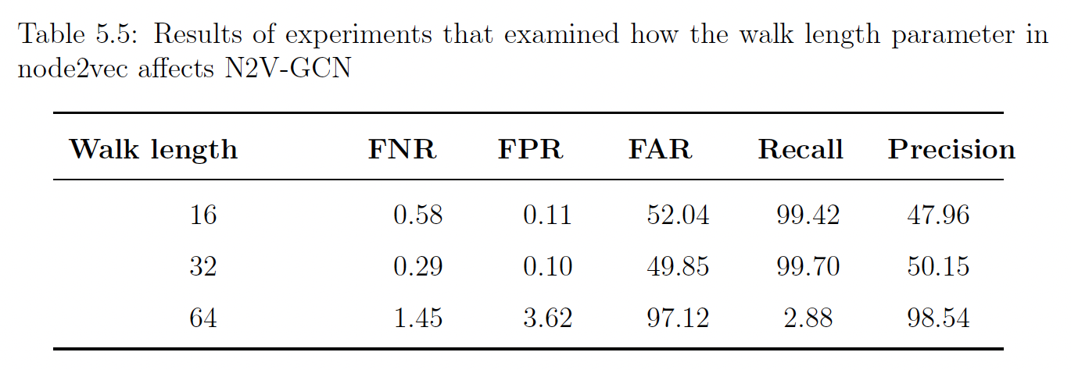
Validation

Slide 13

K-fold Cross Validation
https://scikit-learn.org/stable/modules/cross_validation.html
Notes:
Cross-validation is a powerful preventative measure against overfitting.
The idea is clever: Use your initial training data to generate multiple mini train-test splits. Use these splits to tune your model.
In standard k-fold cross-validation, we partition the data into k subsets, called folds. Then, we iteratively train the algorithm on k-1 folds while using the remaining fold as the test set (called the “holdout fold”).
Cross-validation allows you to tune hyperparameters with only your original training set. This allows you to keep your test set as a truly unseen dataset for selecting your final model.

Slide 14
Model Selection and Hyperparameter Tuning
Remember we talked about underfitting, overfitting last week?

Slide 15
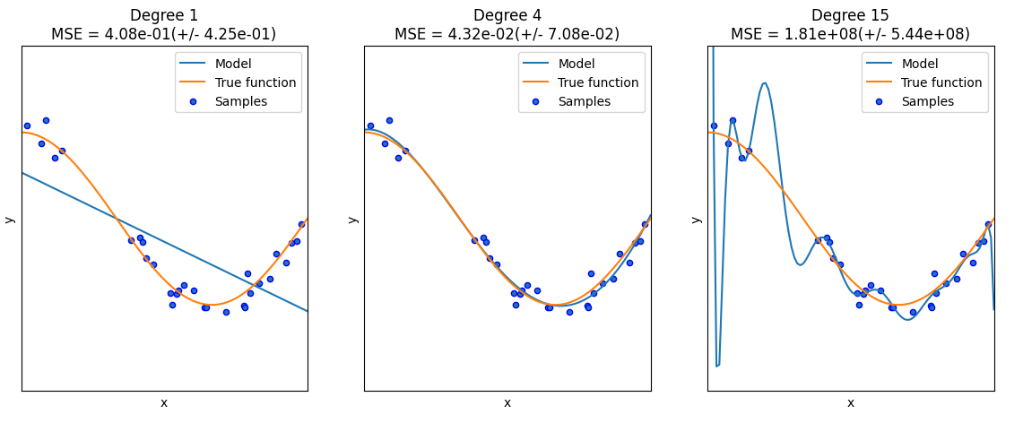
Underfitting and Overfitting
https://scikit-learn.org/stable/auto_examples/model_selection/plot_underfitting_overfitting.html
Notes:
https://elitedatascience.com/overfitting-in-machine-learning
https://www.simplilearn.com/tutorials/machine-learning-tutorial/overfitting-and-underfitting#what_is_underfitting

Slide 16
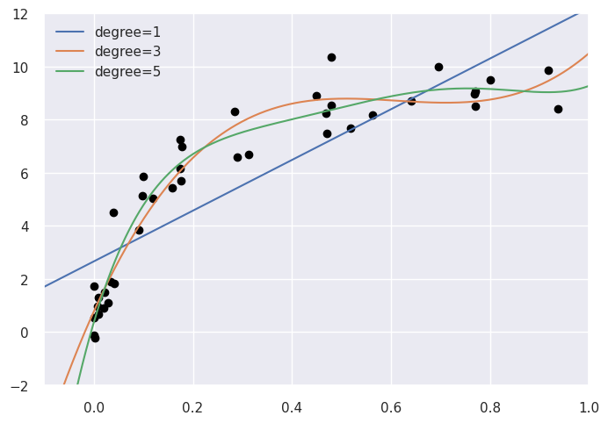
Model Selection

Slide 17
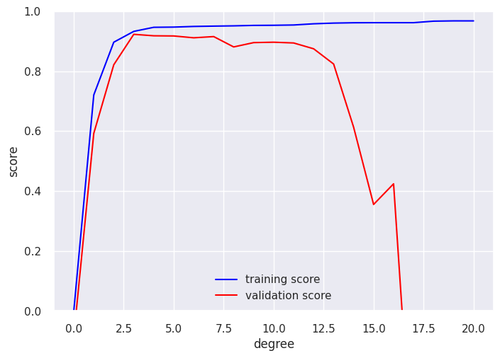
Validation Curve

Slide 18
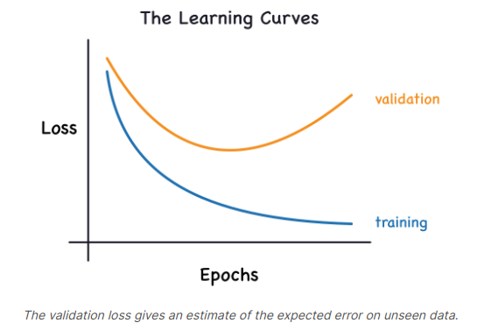
Learning curve (loss)

Slide 19
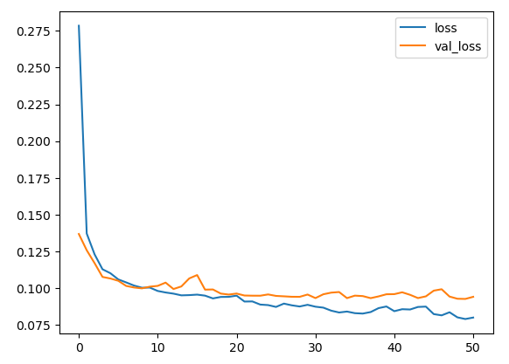
Learning curve (loss)
Loss
Epochs
https://www.kaggle.com/code/ryanholbrook/overfitting-and-underfitting

Slide 20
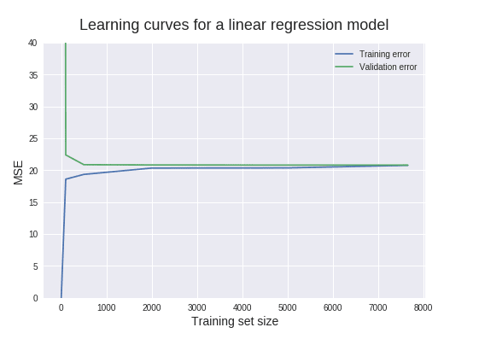
Learning curve (loss)
https://www.dataquest.io/blog/learning-curves-machine-learning/

Slide 21
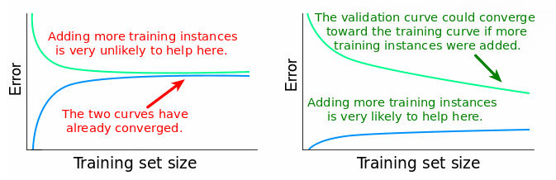
Learning curve (loss)
https://www.dataquest.io/blog/learning-curves-machine-learning/

Slide 22
Model Selection
Model selection
Regularization?
L1 regularization
L2 regularization
Dropout
Collect more training data?

Slide 23
Model-based vs. Instance-based

Slide 24

Model-based
Hypothesis:
$f(x)= θ_{0}+ θ_{1} x$
$θ_{i}$ : parameters
How to choose $θ_{i}$ ?

Slide 25
Model-based
The idea is to choose f(x) is close to our training example (x,y)
x | y
1 | 7
2 | 15
3 | 32
4 | 39
5 | 56

Slide 26
Model-based
Regression Line

Slide 27
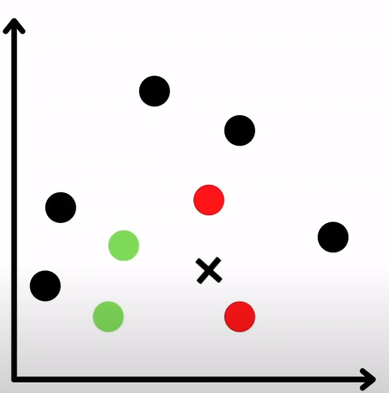
Instance-based
https://www.youtube.com/watch?v=zmKkvPTzgho

Slide 28
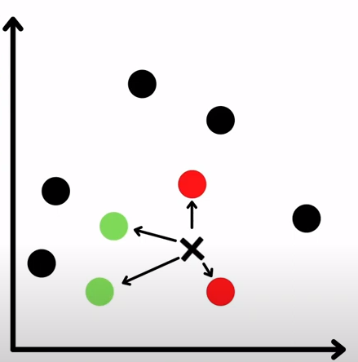
Instance-based
https://www.youtube.com/watch?v=zmKkvPTzgho

Slide 29
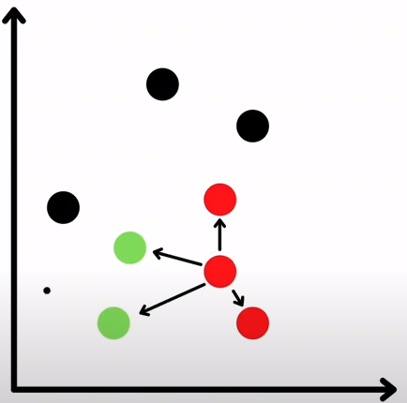
Instance-based
https://www.youtube.com/watch?v=zmKkvPTzgho

Slide 30
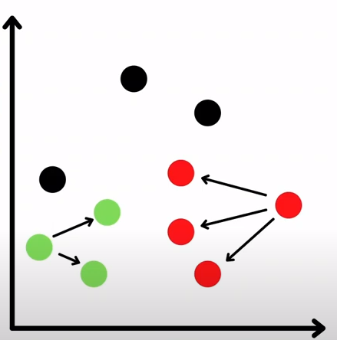
Instance-based
https://www.youtube.com/watch?v=zmKkvPTzgho

Slide 31
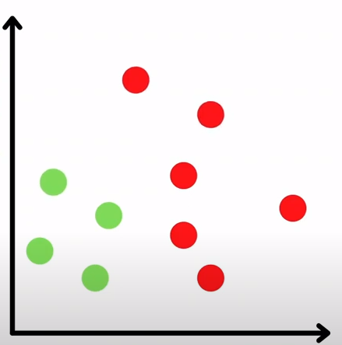
Instance-based
https://www.youtube.com/watch?v=zmKkvPTzgho

Slide 32
Model-based vs. Instance-based
Model-based
Use training data to create a model that has parameters learned from the training data.
e.g. Linear Regression, SVM
Instance-based Learning
k-Nearest Neighbors (kNN): looks at the close neighborhood of the input example in the space of feature vectors.

Slide 33
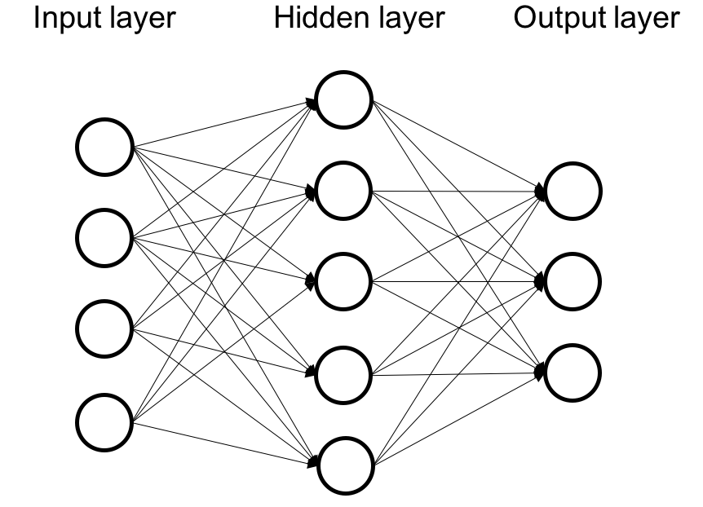
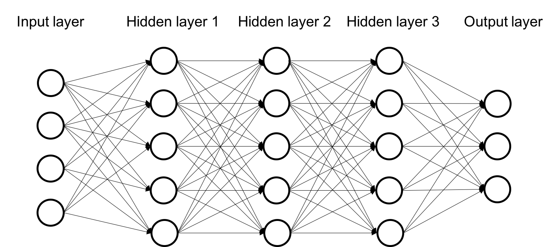
Shallow vs. Deep Learning
Shallow
Deep
Notes:
Also called hidden layers.

Slide 34
Shallow Learning

Slide 35
Shallow Learning
Regression

Slide 36
Shallow Learning
Regression

Slide 37
Shallow Learning
The model learns the parameters directly from the features of the training examples.
Notes:
Also called hidden layers.

Slide 38
Deep Learning
Notes:
Square feet (size), # of bedrooms.

Slide 39
Deep Learning
Deep
more than one layer, e.g. Neural network.
Parameters are learned not directly from the features of the training examples, but from the outputs of the preceding layers.

Slide 40
Shallow vs. Deep Learning
Shallow
the model learns the parameters directly from the features of the training examples.
Deep
more than one layer, e.g. Neural network.
Parameters are learned not directly from the features of the training examples, but from the outputs of the preceding layers.
Notes:
Also called hidden layers.

Slide 41
Fundamental Algorithms
Linear Regression
Logistic Regression
Decision Tree Learning
Support Vector Machine
k-Nearest Neighbors

Slide 42
Linear Regression
Example walk through using scikit-learn library

Slide 43
Supervised Learning
Regression

Slide 44
Supervised Learning
Regression

Slide 45

Linear Regression
$y=w_{0}+w_{1}x_{1}+w_{2}x_{2}+ …+w_{n}x_{n}$
y: dependent variable
x_{i}: independent variables
w_{i}: the coefficients (weights)

Slide 46
The key idea
The idea is to choose f(x) is close to our training example (x,y)
x | y
1 | 7
2 | 15
3 | 32
4 | 39
5 | 56

Slide 47
Regression Line

Slide 48

Mean Squared Error (MSE)
$MSE=\frac{1}{n}\sum_{i=1}^{n}{{\left(Y_{i}− {\hat{Y}}_{i}\right)}^{2}}$

Slide 49
Cost Function Intuition
The following 4 slides are from Andrew Ng’s machine learning course.

Slide 50

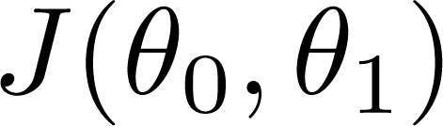


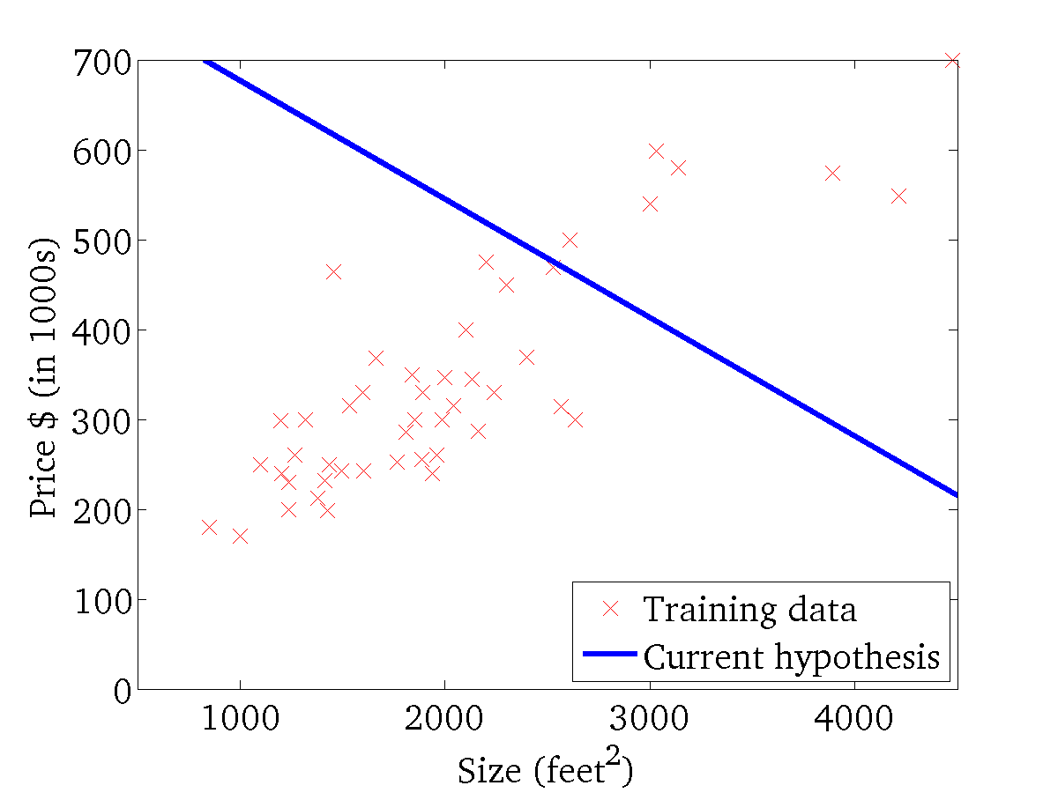
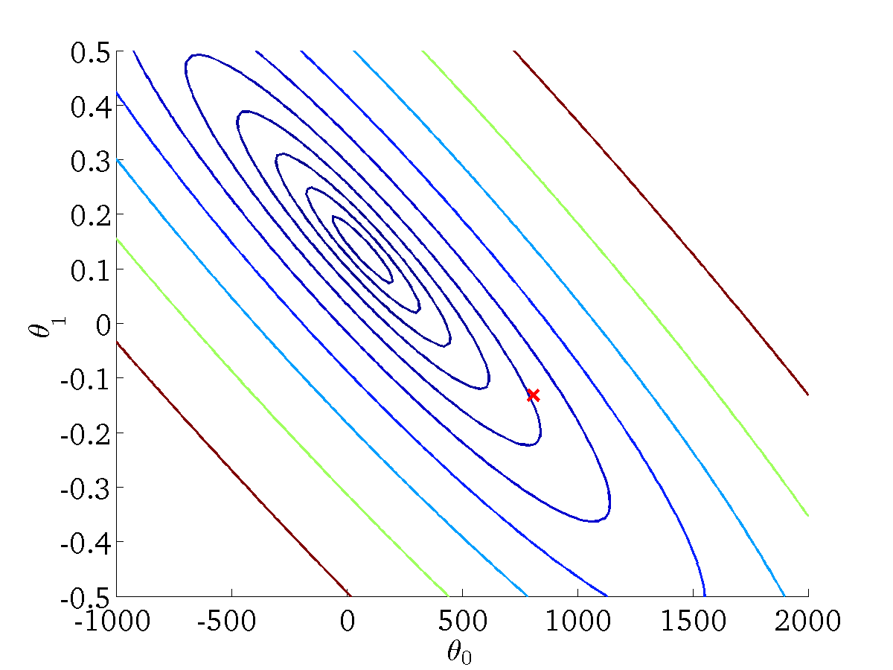
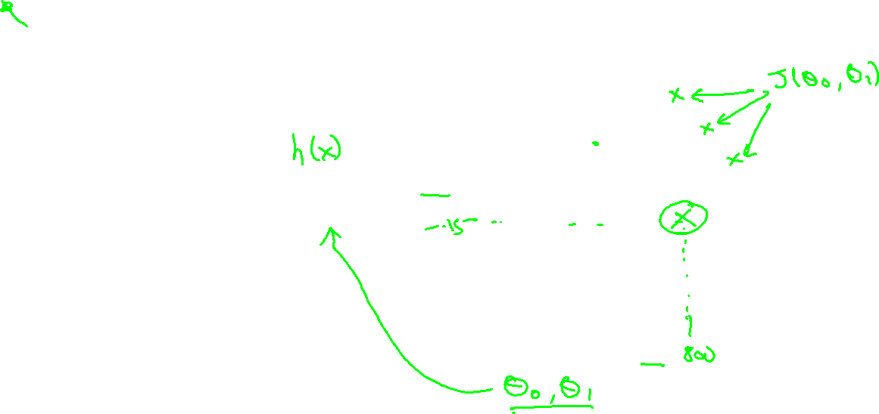
(for fixed , this is a function of x)
(function of the parameters )
Andrew Ng

Slide 51
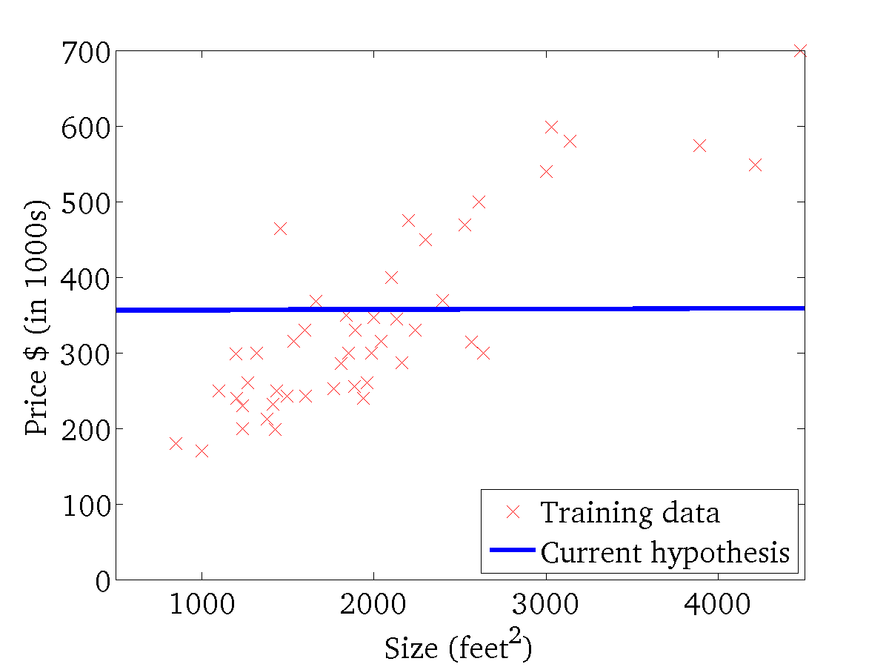
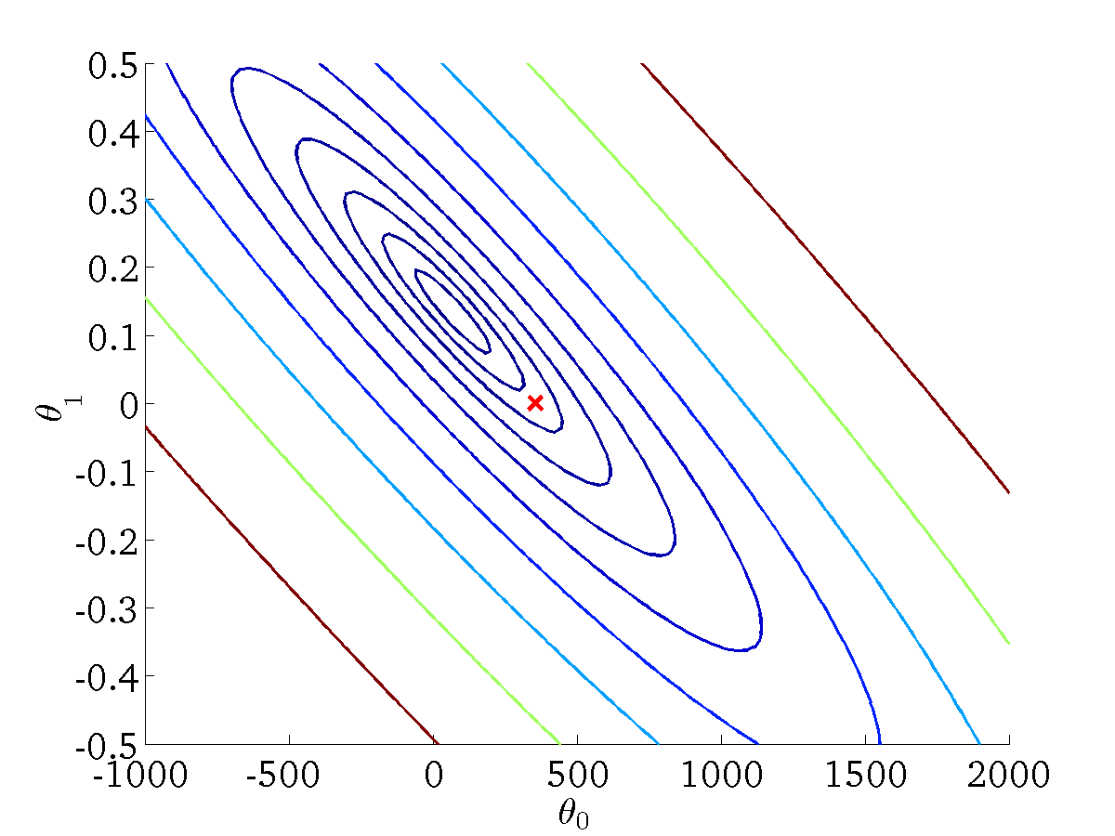
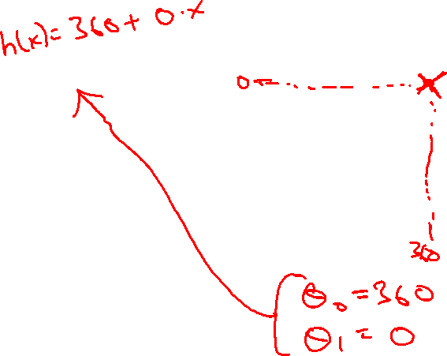
(for fixed , this is a function of x)
(function of the parameters )
Andrew Ng

Slide 52
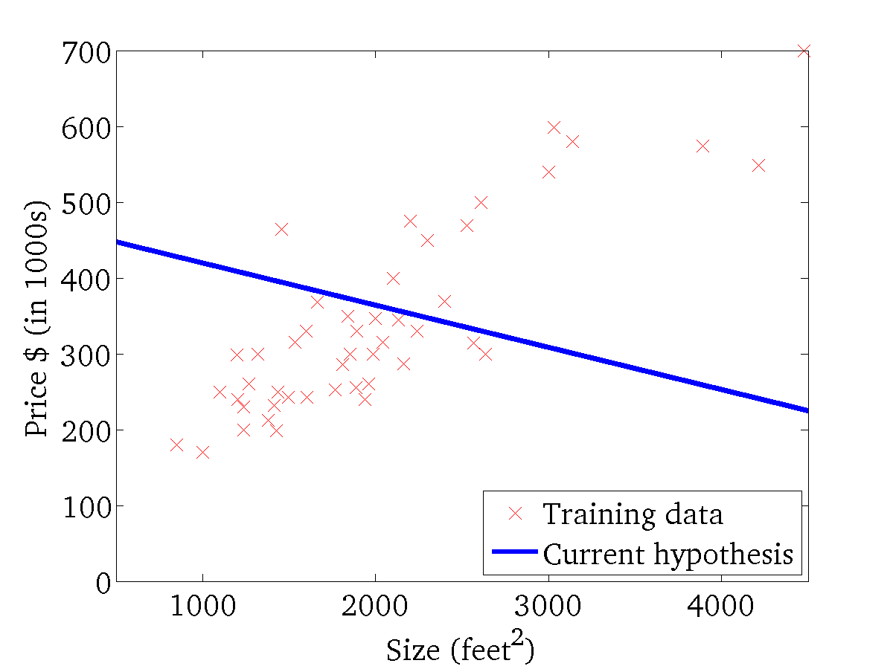

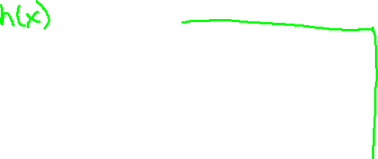
(for fixed , this is a function of x)
(function of the parameters )
Andrew Ng

Slide 53
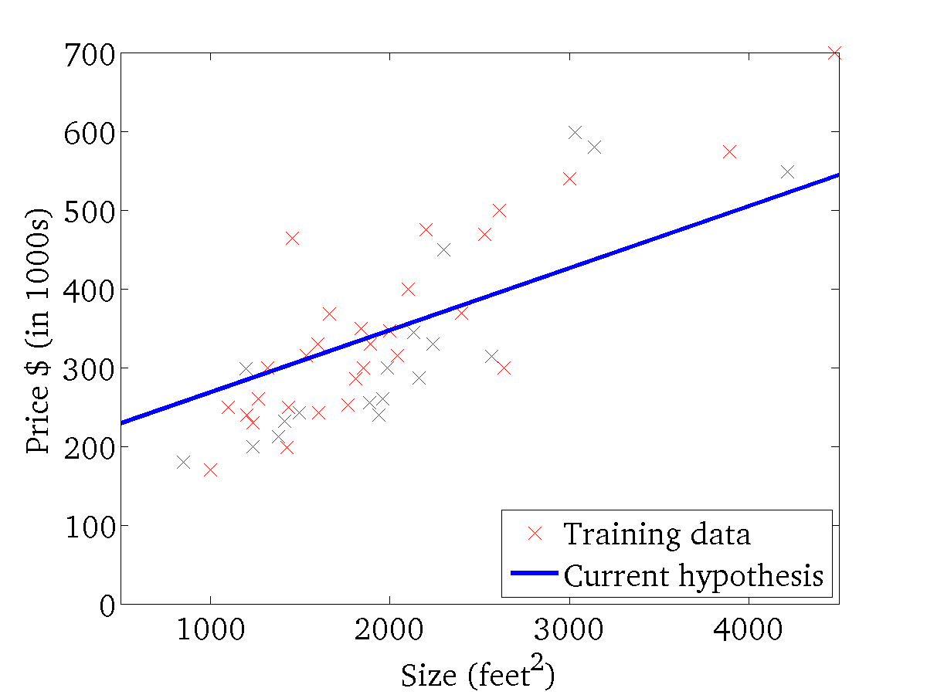
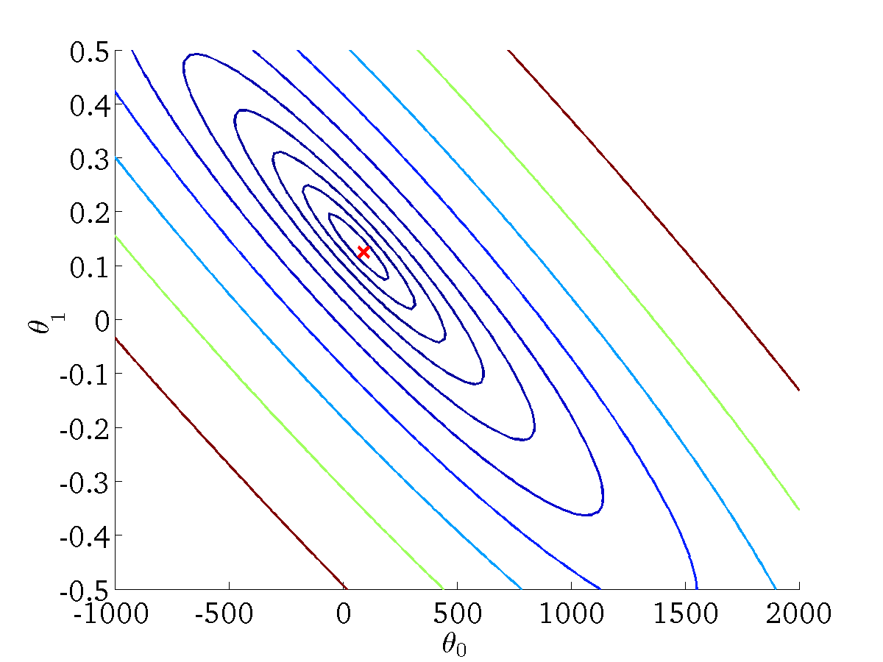
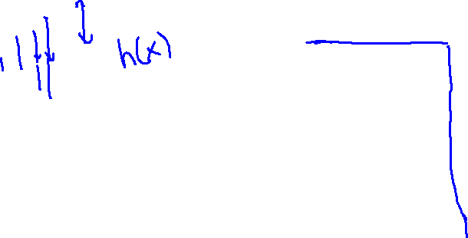
(for fixed , this is a function of x)
(function of the parameters )
Andrew Ng

Slide 54
Logistic Regression
Patient No. | Tumor Size | Malignant
1 | 1.8 | 1
2 | 0.7 | 0
3 | 0.3 | 0

Slide 55
Plotting the data

Slide 56
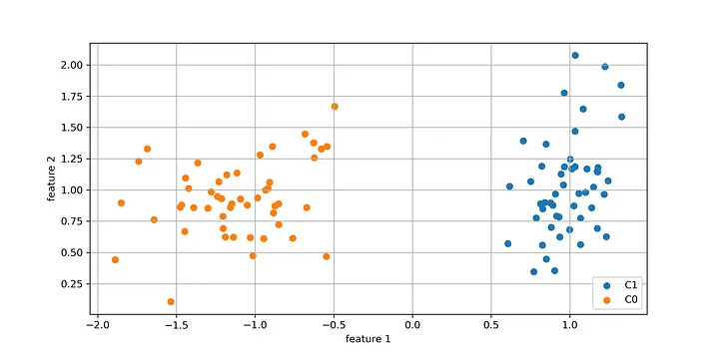
Plotting the data
In most real-world cases, there will be more than one features.

Slide 57
Logistic Regression
Classification

Slide 58
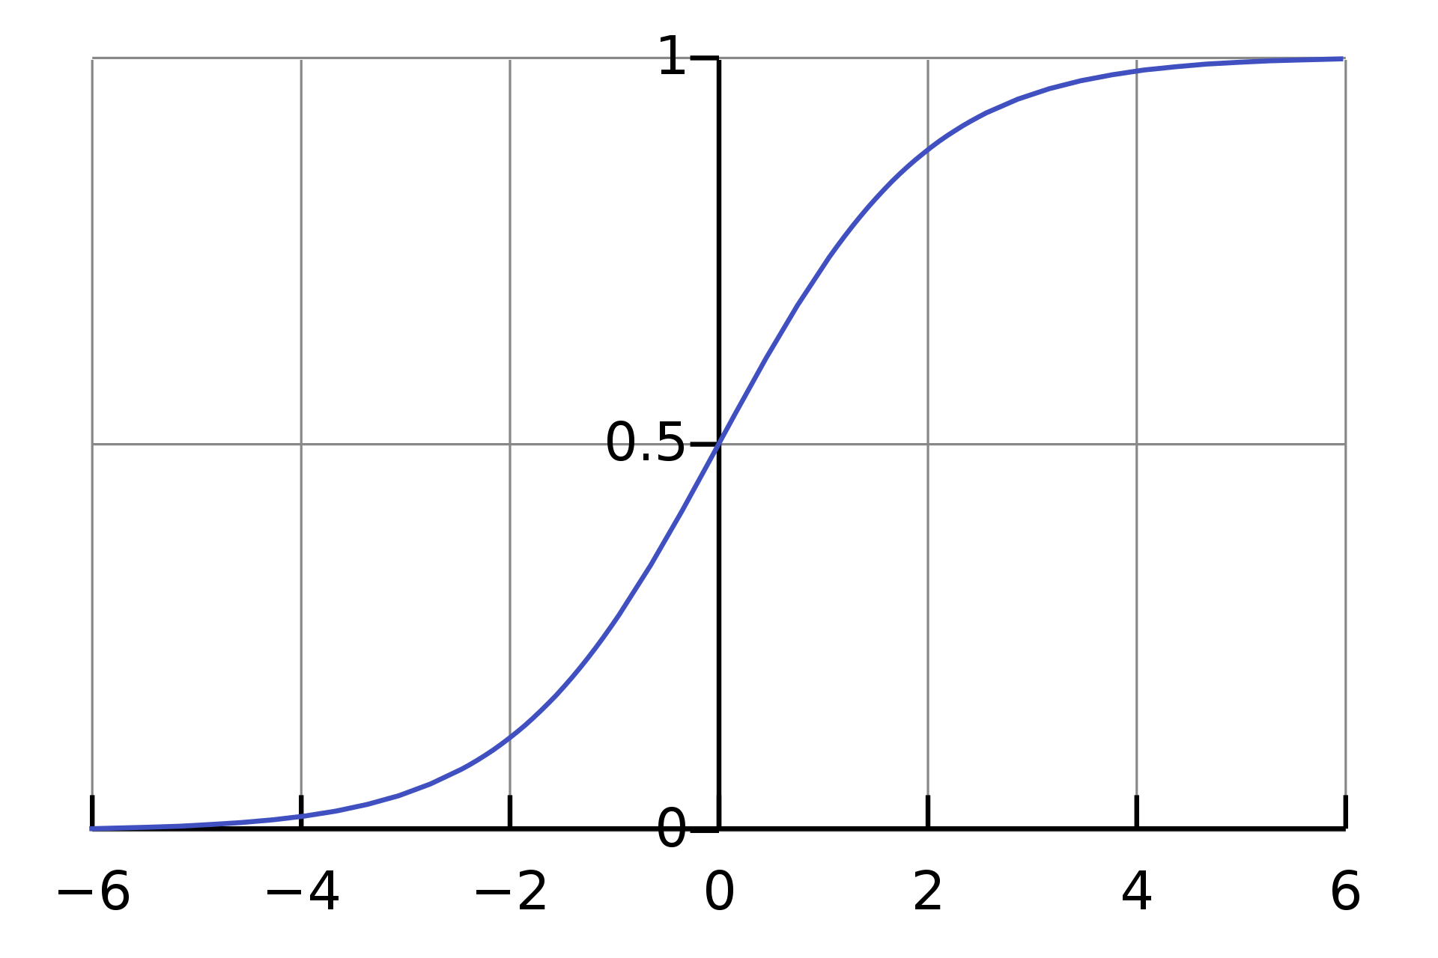

Logistic Regression
Classification algorithm
0$<h\left(x\right)≤1$
$h_{θ}\left(x\right)= \frac{1}{1+ e^{−θ^{T}}x}$

Slide 59

Logistic Regression
$h_{θ}\left(x\right)=0.7$
70% chance of tumor being malignant.

Slide 60
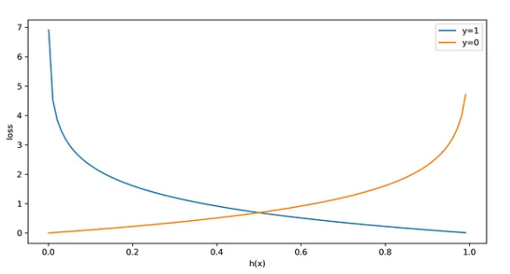
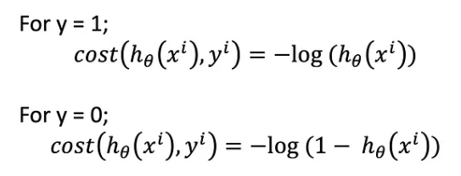
Loss Function
We used mean squared error (MSE) for linear regression.
What are we going to use for logistic regression?
Maximum likelihood

Slide 61

Loss function
So the loss function for logistic regression is
https://towardsdatascience.com/logistic-regression-and-decision-boundary-eab6e00c1e8

Slide 62
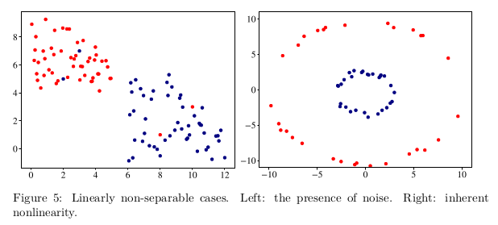
SVM
What if there’s noise in the data and no hyperplane can perfectly separate positive examples from negative ones?
What if the data cannot be separated using a plane, but could be separated by a higher-order polynomial?

Slide 63
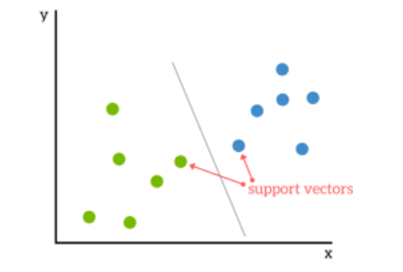
SVM: Support Vectors
https://www.kdnuggets.com/2016/07/support-vector-machines-simple-explanation.html

Slide 64
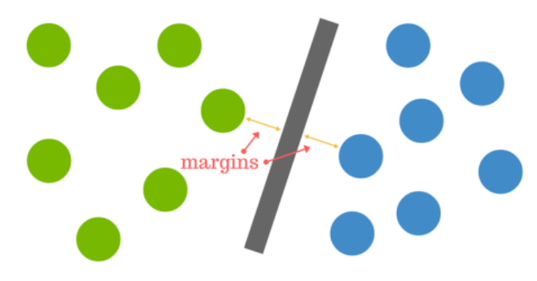
SVM: Plane
https://www.kdnuggets.com/2016/07/support-vector-machines-simple-explanation.html

Slide 65
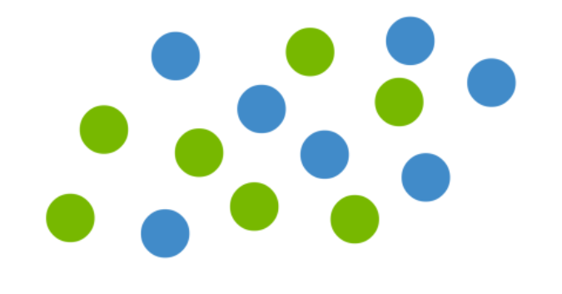
Not linearly separable
https://www.kdnuggets.com/2016/07/support-vector-machines-simple-explanation.html

Slide 66
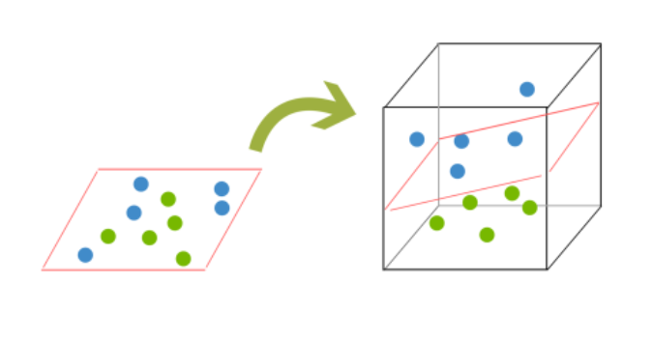
Kernels
https://www.kdnuggets.com/2016/07/support-vector-machines-simple-explanation.html

Slide 67
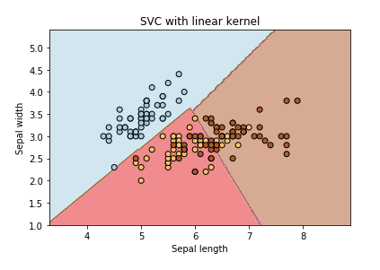
Linear Kernel
https://www.kaggle.com/code/residentmario/kernels-and-support-vector-machine-regularization

Slide 68
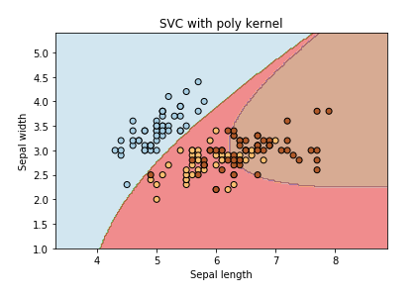
Polynomial Kernel
https://www.kaggle.com/code/residentmario/kernels-and-support-vector-machine-regularization

Slide 69
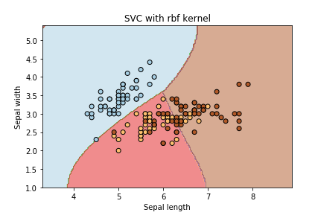
RBF Kernel
- Radial Basis Function (Gaussian)
- default in sklearn
https://www.kaggle.com/code/residentmario/kernels-and-support-vector-machine-regularization

Slide 70
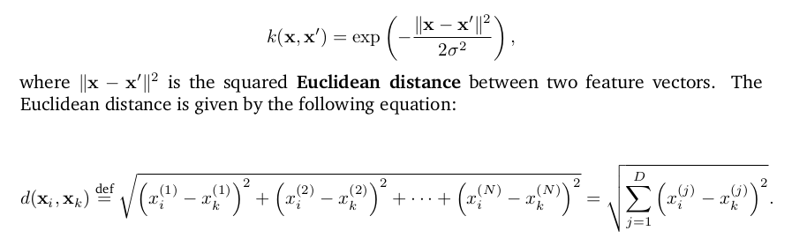
RBF Kernel
By varying the hyperparameter σ, the data analyst can choose between getting a smooth or curvy decision boundary in the original space.

Slide 71

SVM
$wx−b=0$
Satisfy the following constraints:
$wx_{i}−b≥1 if y_{i}=+1$
$wx_{i}−b≤−1 if y_{i}=−1$
We also need to minimize $\left\|w\right\|$

Slide 72
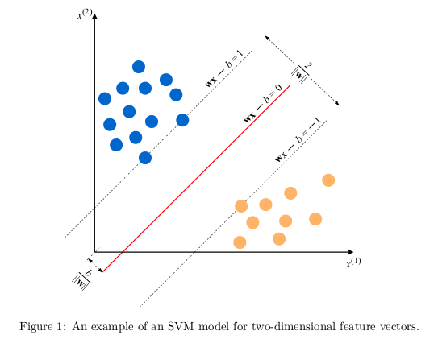
SVM
From The Hundred-Page Machine Learning Book

Slide 73
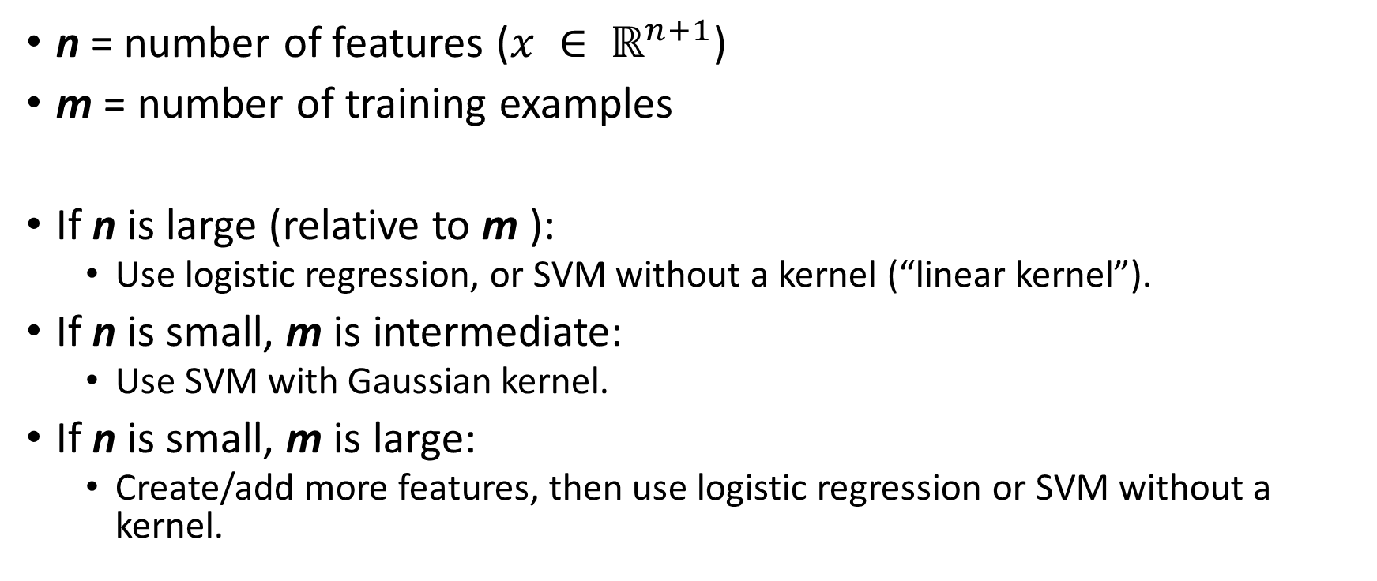
SVM vs. Logistic Regression
n = number of features ($x ∈ ℝ^{n+1}$)
m = number of training examples
If n is large (relative to m ):
Use logistic regression, or SVM without a kernel (“linear kernel”).
If n is small, m is intermediate:
Use SVM with Gaussian kernel.
If n is small, m is large:
Create/add more features, then use logistic regression or SVM without a kernel.
Andrew Ng

Slide 74
Decision Trees
Let’s look at this example and build a decision tree:
Let’s do some entropy and information gain calculations.
Weather | Parents | Decision
Rain | No | Stay_home
Overcast | No | Stay_home
Sunny | Yes | Go_out

Slide 75
Decision Trees
Parents
yes
no
weather
weather
sunny
rain
overcast
Go_out
Stay_home
Stay_home

Slide 76
Neural Networks and Deep Learning
Neural Networks
Feed-forward Neural Networks
Multilayer Perceptron (MLP)

Slide 77

Neural Networks
Figure from: https://www.sciencelearn.org.nz/images/5156-neural-network-diagram

Slide 78

Multilayer Perceptron
The Hundred-Page Machine Learning Book

Slide 79
Neural Networks and Back Propagation
If you have time, watch this tutorial on neural nets and back propagation:
https://www.youtube.com/watch?v=VMj-3S1tku0

Slide 80
Deep Learning
Deep Learning
Convolution Neural Network (CNN)
Long Short-Term Memory (LSTM)

Slide 81
Linear Regression
Tutorial (Jupyter Notebook)
https://colab.research.google.com/drive/1Xcgnkm2GxOBJtLxnTAx5vztnw4cOsWgm?usp=sharing
Useful resources
Animation
https://mlu-explain.github.io/linear-regression/

Slide 82
SVM tutorial
Jupyter Notebook based on
https://scikit-learn.org/stable/auto_examples/classification/plot_digits_classification.html
https://colab.research.google.com/drive/1Xcgnkm2GxOBJtLxnTAx5vztnw4cOsWgm?usp=sharing

Slide 83
Code Samples
Underfitting, Overfitting
https://colab.research.google.com/drive/1oMWxppsnhsrU3lkEy0uzwJbcrMRUqr3C?usp=sharing
Validation Curve
https://colab.research.google.com/drive/171dADTSrX6sCF3Rll5SQTnpjr-KIhmut?usp=sharing
Linear Regression, SVM, kNN
https://colab.research.google.com/drive/1Xcgnkm2GxOBJtLxnTAx5vztnw4cOsWgm?usp=sharing

