Slide 1
Machine Learning Basics
Lwin Moe
York University
October 3, 2023

Slide 2
Machine Learning 1 Outline
What is ML?
Classification vs. Regression
Types of Machine Learning
Supervised Learning
Unsupervised Learning
Semi-supervised Learning
Reinforcement Learning

Slide 3
Machine Learning 1 Outline
Building blocks of ML
Scalars, Vectors and Sets
Loss Functions
Derivative and Gradient Descent

Slide 4
Machine Learning 2 Outline
Training
Cross validation
Underfitting, Overfitting, Regularization
Metrics
Precision, Recall, and Accuracy

Slide 5
Machine Learning 2 Outline
Model-based vs. Instance-based Learning
Shallow vs. Deep Learning
Fundamental Algorithms
Linear Regression
Logistic Regression
Decision Tree
Support Vector Machines
k-Nearest Neighbors

Slide 6
Machine Learning 2 Outline
Deep Learning and Neural Networks
Feed Forward Network
Multi-Layer Perceptron

Slide 7
Machine Learning 2 Outline
A simple case study (tutorials)
Linear Regression (using scikit-learn library)
SVM (using scikit-learn library)

Slide 8
Resources
The Hundred-Page Machine Learning Book
https://themlbook.com/
http://themlbook.com/wiki/doku.php (read the chapters online)
Andrew Ng’s Machine Learning Specialization Lectures
https://www.youtube.com/playlist?list=PLkDaE6sCZn6FNC6YRfRQc_FbeQrF8BwGI

Slide 9
AI and Machine Learning
What is artificial intelligence?
“Artificial intelligence (AI) is the theory and development of computer systems capable of performing tasks that historically required human intelligence, such as recognizing speech, making decisions, and identifying patterns.”
Cited from https://www.coursera.org/articles/what-is-artificial-intelligence
AI technologies include:
Machine learning
Deep learning
Natural Language Processing (NLP)

Slide 10
AI and Machine Learning
AI applications
Speech Recognition
Computer Vision
Recommendation engines
Automated stock trading

Slide 11
Machine Learning
What is machine learning?
the process of solving a practical problem by
1) gathering a dataset, and
2) algorithmically building a statistical model based on that dataset.

Slide 12
Types of Machine Learning
Supervised Learning
All data is labeled.
Unsupervised Learning
All data is unlabeled.
Semi-supervised Learning
A small portion of data is labeled.
Reinforcement Learning
The machine “lives” in an environment.
State of the environment
Action
Rewards
The goal is to learn a “policy”.

Slide 13
Supervised Learning
How does supervised learning work?
All data is labeled.
Training
Features

Slide 14
Supervised Learning
Regression

Slide 15
Supervised Learning
Regression

Slide 16
Supervised Learning
Classification

Slide 17
Supervised Learning
Examples of supervised learning problems:
Regression problems
Classification problems
Linear Regression
Logistic Regression
Neural Networks
Support Vector Machines (SVM)

Slide 18
Unsupervised Learning
Clustering problem
No labeled data
Market segmentation
Social network analysis

Slide 19
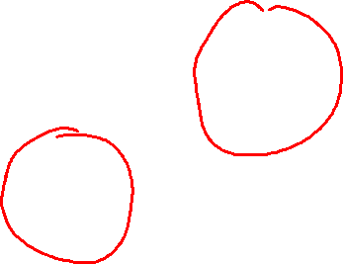
Unsupervised Learning
x₂
x₁

Slide 20
Unsupervised Learning
k-Means
Principal Component Analysis (PCA)
Anomaly Detection

Slide 21
Semi-supervised Learning
A small portion of data is labeled.
Speech Recognition
Labelling audio is resource intensive
Starting with a base model trained on 100 hours of audio
Self-training with 500 hours of unlabeled audio data
Text classification
Training with a small amount of labeled data and a large amount of unlabeled data.

Slide 22
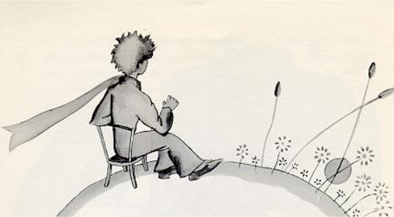
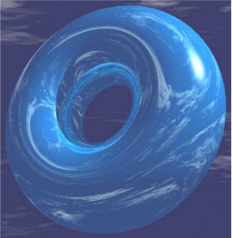
Reinforcement Learning
Little Prince lands on a torus, a donut shaped planet divided into nine regions (states)
Example by Larry Moss (Indiana University)

Slide 23
Reinforcement Learning
He has a map of the planet. It shows the immediate reward for each state.
-1 a | -1 b | Great food 10 c
-1 d | Sand -5 e | Monster -4 f
Avg food 5 g | -1 h | -1 i
At each step, the Little Prince has a choice to go N, S, E, or W. He cannot stay stationary.
Since the planet is a torus (donut), going N in state a leads to g , going W leads to c, etc.
Example by Larry Moss (Indiana University)

Slide 24
Reinforcement Learning
The machine “lives” in an environment.
State of the environment
Action
Rewards
The goal is to learn a “policy”.
Algorithms:
Markov Decision Process
Q-Learning

Slide 25
Building Blocks of ML
Scalars, Vectors and Sets

Slide 26
Scalars
Simple numerical value
10, 15
Variables
x, y, a, b, c

Slide 27
Vectors
An ordered list of scalars
Two-dimensional vector: a = [2, 3]
Notation: w^{(j)}, x^{(j)}
a⁽¹⁾ = 2, a⁽²⁾ = 3

Slide 28
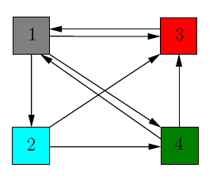
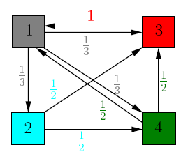
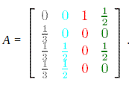
Matrix
Example from “The $25,000,000,000 Eigenvector: The Linear Algebra behind Google”

Slide 29
Tensor
import numpy as np
A = np.array([
[[1,2,3], [4,5,6], [7,8,9]],
[[11,12,13], [14,15,16], [17,18,19]],
[[21,22,23], [24,25,26], [27,28,29]],
])
print(A.shape)
print(A)
Shape: (3, 3, 3)

Slide 30
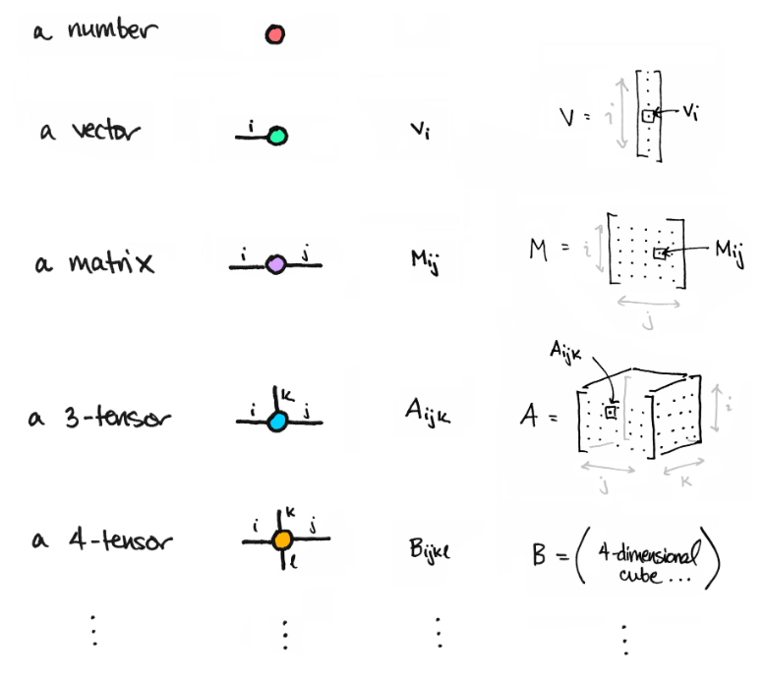
Scalar, vector, matrix, tensor
https://www.math3ma.com/blog/matrices-as-tensor-network-diagrams

Slide 31
Sets
An unordered collection of unique elements
{x₁, x₂, x₃, x₄, …, x_{n}}

Slide 32
Building Blocks of ML
Loss Functions (Cost function)

Slide 33
A toy dataset
x | y
1 | 7
2 | 15
3 | 32
4 | 39
5 | 56

Slide 34
Scatter Plot

Slide 35

Hypothesis
Hypothesis:
$f(x)= θ_{0}+ θ_{1} x$
$θ_{i}$ : parameters
How to choose $θ_{i}$ ?

Slide 36
The key idea
The idea is to choose f(x) is close to our training example (x,y)
x | y
1 | 7
2 | 15
3 | 32
4 | 39
5 | 56

Slide 37
Regression Line

Slide 38

Mean Squared Error (MSE)
$MSE=\frac{1}{n}\sum_{i=1}^{n}{{\left(Y_{i}− {\hat{Y}}_{i}\right)}^{2}}$

Slide 39
Cost Function Intuition
The following 4 slides are from Andrew Ng’s machine learning course.

Slide 40

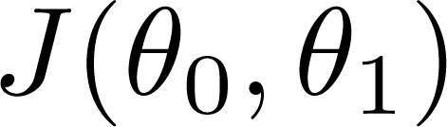


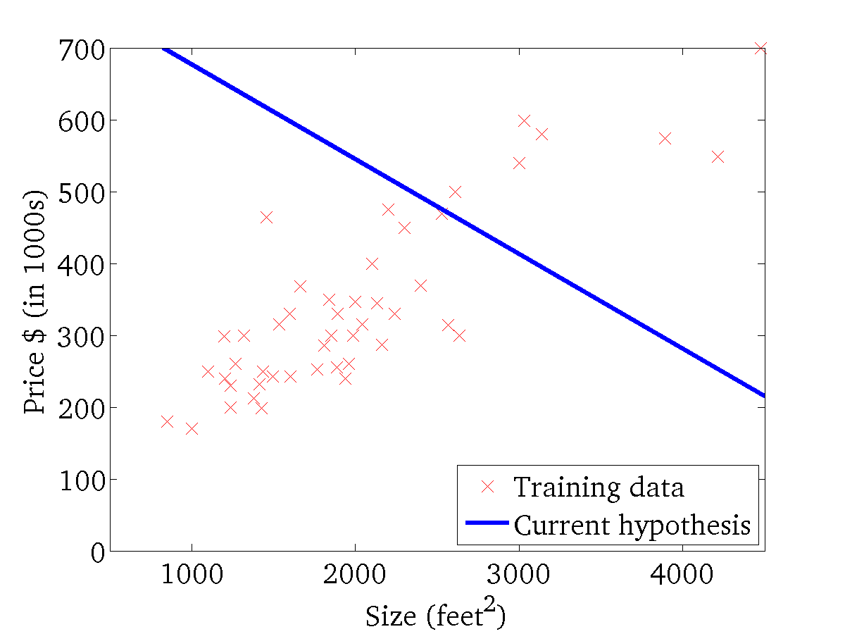
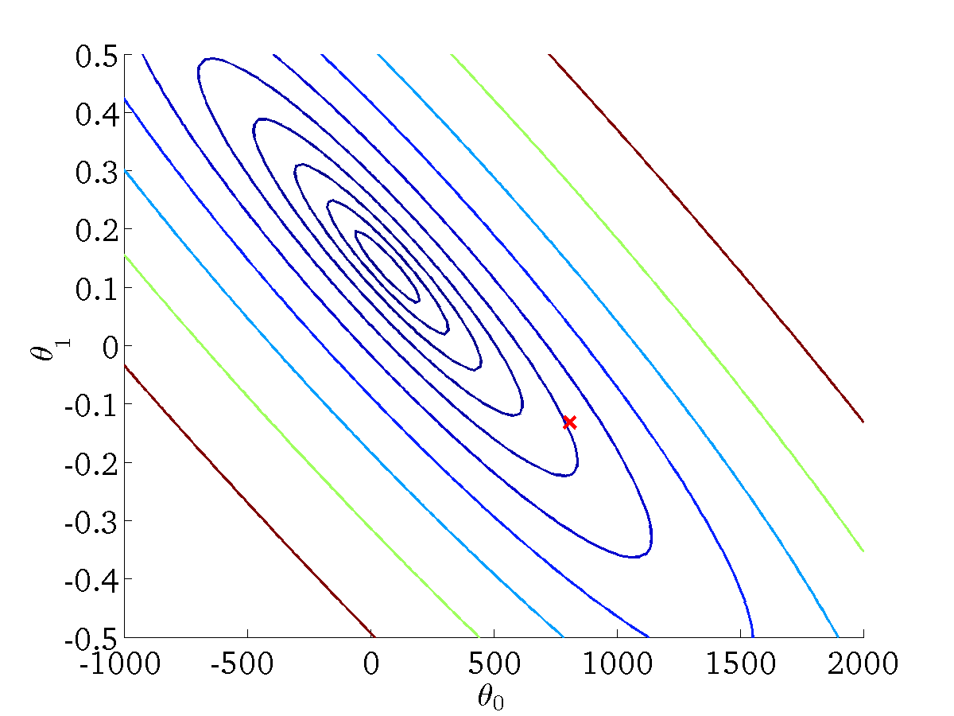
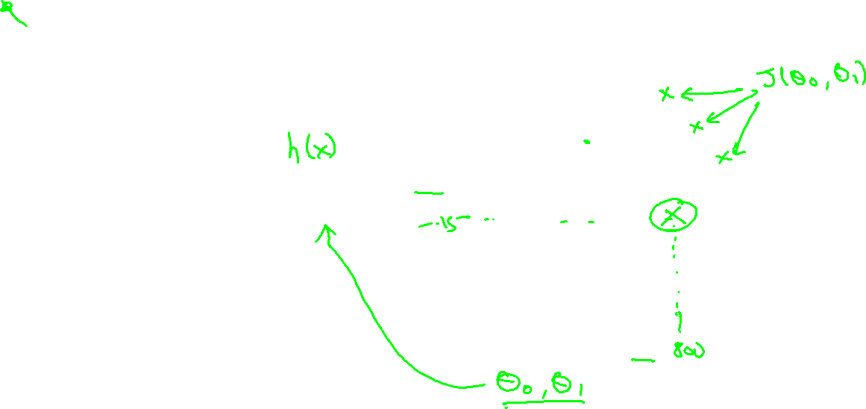
(for fixed , this is a function of x)
(function of the parameters )
Andrew Ng

Slide 41
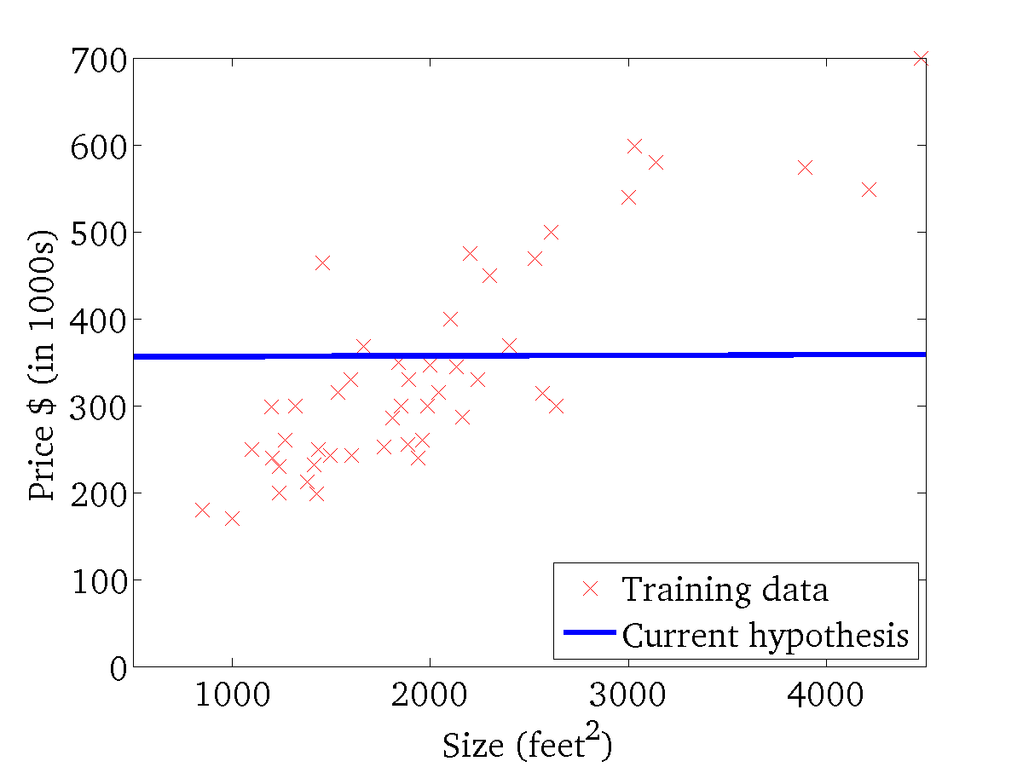
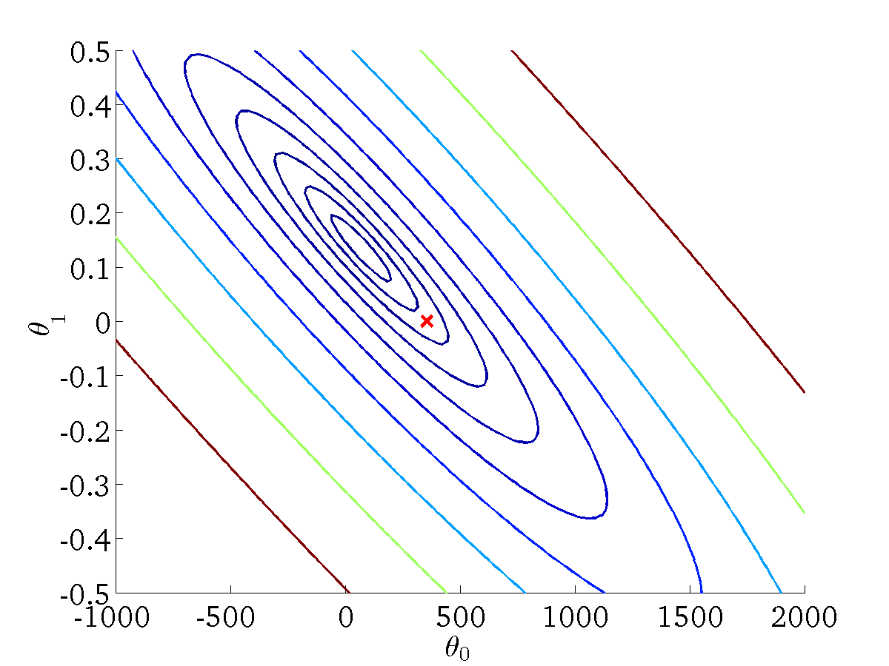
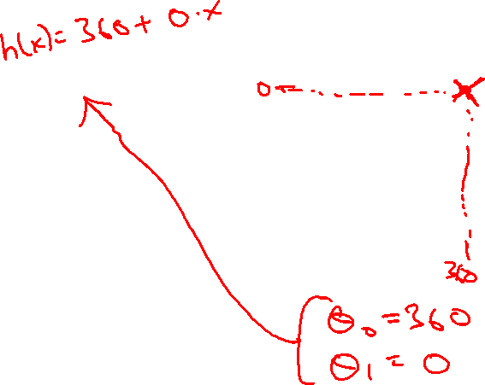
(for fixed , this is a function of x)
(function of the parameters )
Andrew Ng

Slide 42
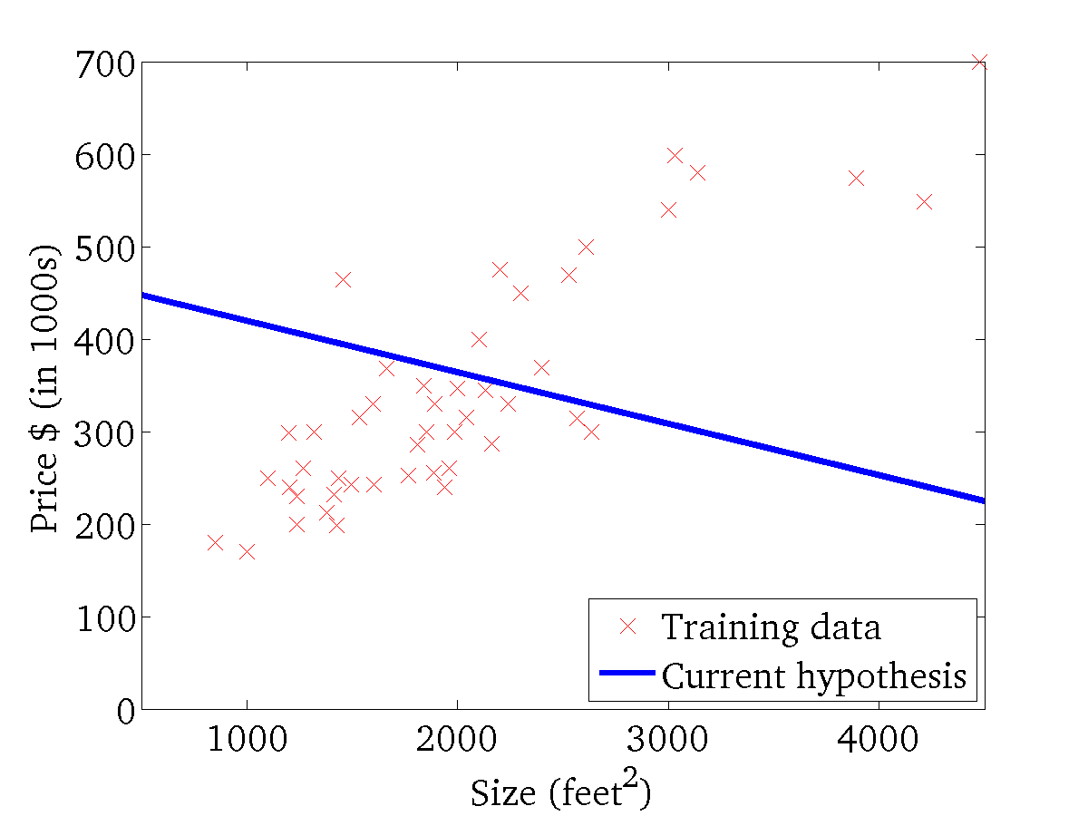

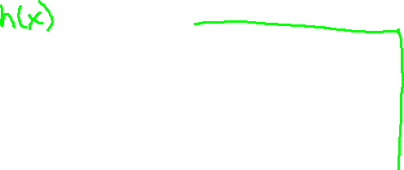
(for fixed , this is a function of x)
(function of the parameters )
Andrew Ng

Slide 43
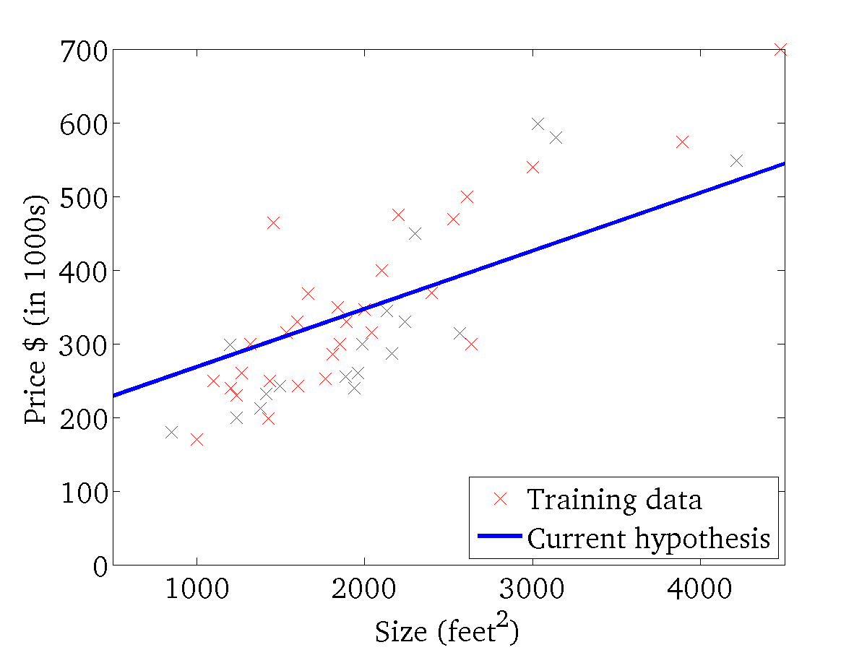
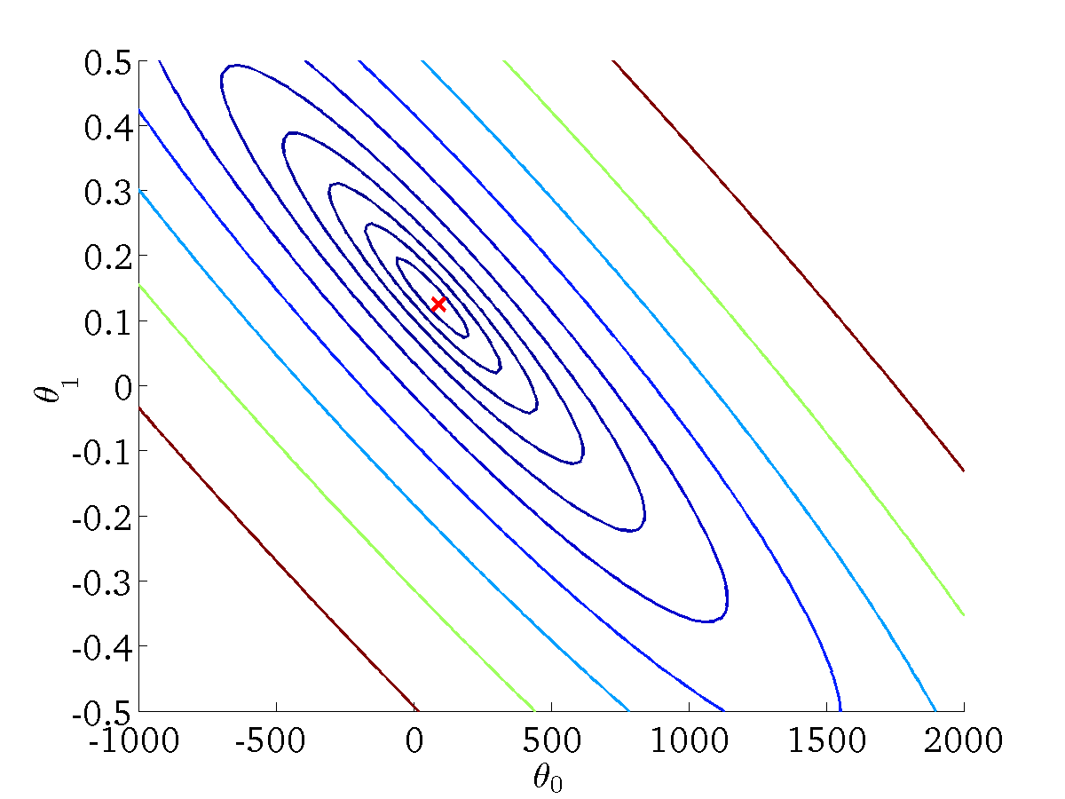
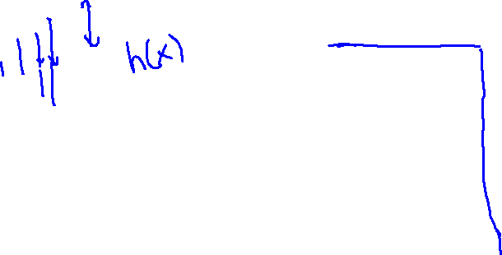
(for fixed , this is a function of x)
(function of the parameters )
Andrew Ng

Slide 44
Building Blocks of ML
Derivative and Gradient Descent
Batch gradient descent
All training examples
Stochastic gradient descent
Take one example at a time
Mini-batch gradient descent
Mini batches of fixed size
Convergence
Global minimum
Local minimum

Slide 45

Gradient Descent
Start with some $θ_{0}$ and $θ_{1}$
For example, $θ_{0}=0$ and $θ_{1}=0$
Keep changing $θ_{0}$ and $θ_{1}$ to reduce your cost function J until we reach the “minimum”.

Slide 46
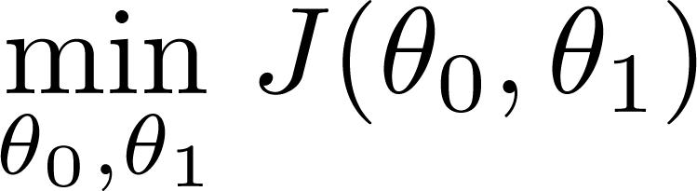
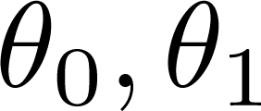
Have some function
Want
Outline:
Start with some
Keep changing to reduce until we hopefully end up at a minimum
Andrew Ng

Slide 47
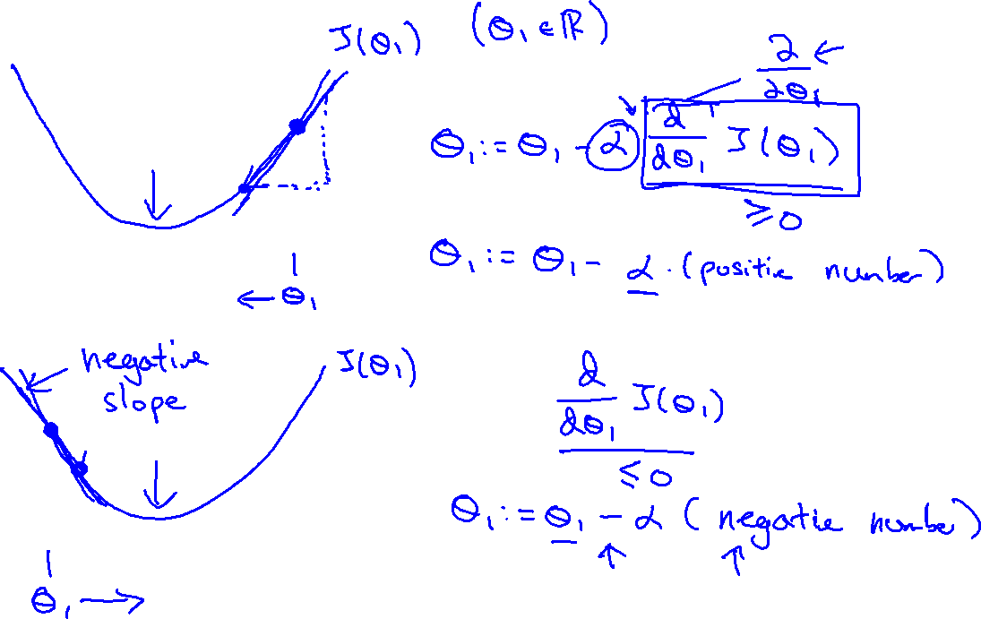
Andrew Ng

Slide 48
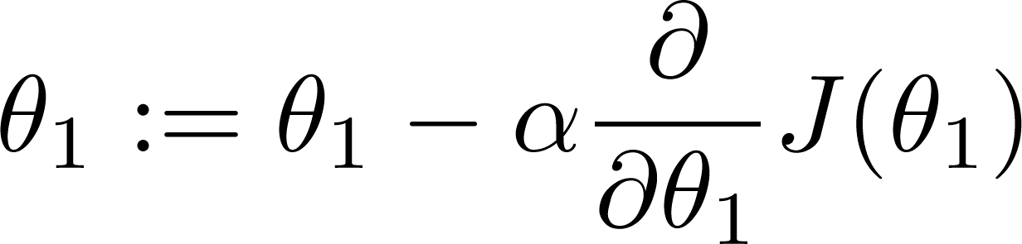

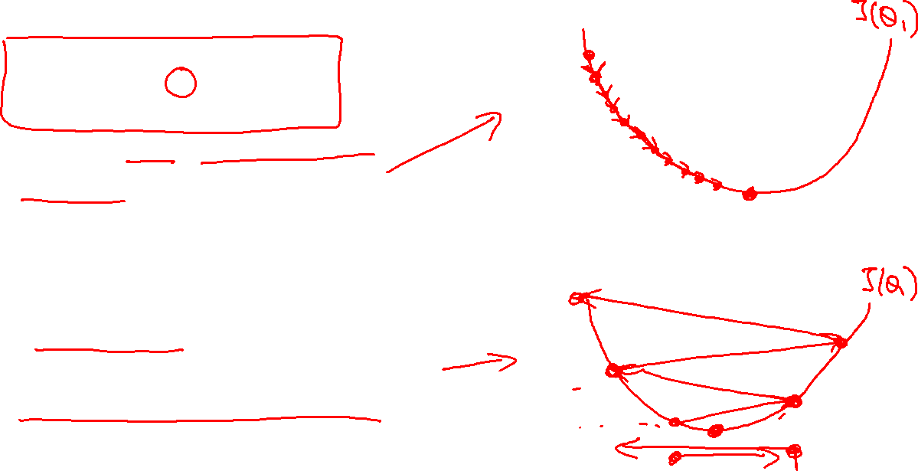
If α is too small, gradient descent can be slow.
If α is too large, gradient descent can overshoot the minimum. It may fail to converge, or even diverge.
Andrew Ng

Slide 49
Building Blocks of ML
Underfitting, Overfitting, Regularization

Slide 50
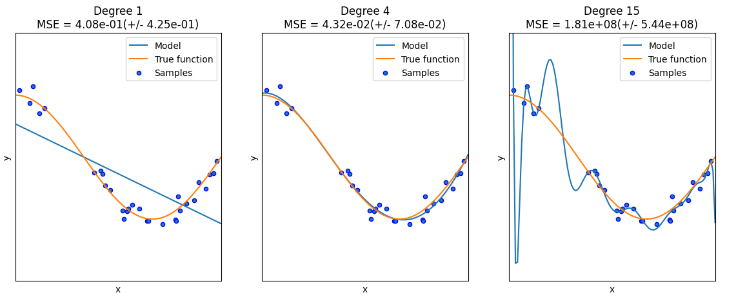
Underfitting and Overfitting
https://scikit-learn.org/stable/auto_examples/model_selection/plot_underfitting_overfitting.html

Slide 51
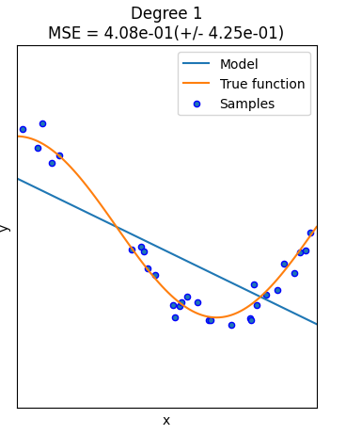
Underfitting
High bias
Strong preconception

Slide 52
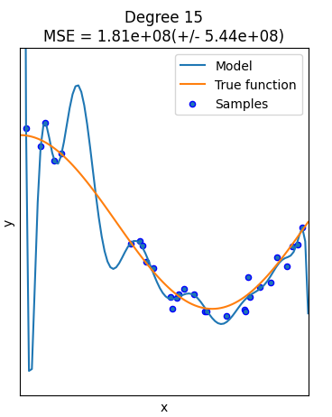
Overfitting
High variance
The space of your hypothesis is too large or variable.

Slide 53
Regularization
Addressing overfitting
Reduce features
Manually select features
Model selection algorithm
Regularization
Keep all the features
Reduce the values of the parameters w
w₀ + w₁ x + w₂ x^2 + w₃ * x^3 + w₄ x^4
Make w₃ and w₄ small

Slide 54
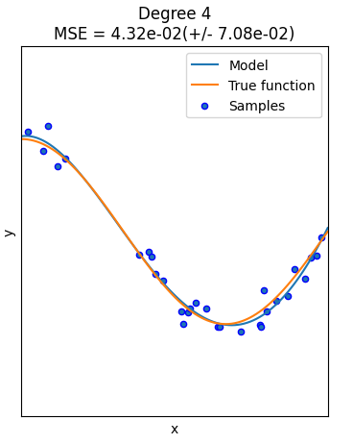
Regularization
No underfitting
No overfitting

