Slide 1
Machine Learning Basics
Lwin Moe
York University
October 3, 2023

Slide 2
Machine Learning 1 Outline
What is ML?
Classification vs. Regression
Types of Machine Learning
Supervised Learning
Unsupervised Learning
Semi-supervised Learning
Reinforcement Learning

Slide 3
Machine Learning 1 Outline
Building blocks of ML
Scalars, Vectors and Sets
Loss Functions
Derivative and Gradient Descent

Slide 4
Machine Learning 2 Outline
Training
Cross validation
Underfitting, Overfitting, Regularization
Metrics
Precision, Recall, and Accuracy

Slide 5
Machine Learning 2 Outline
Model-based vs. Instance-based Learning
Shallow vs. Deep Learning
Fundamental Algorithms
Linear Regression
Logistic Regression
Decision Tree
Support Vector Machines
k-Nearest Neighbors

Slide 6
Machine Learning 2 Outline
Deep Learning and Neural Networks
Feed Forward Network
Multi-Layer Perceptron

Slide 7
Machine Learning 2 Outline
A simple case study (tutorials)
Linear Regression (using scikit-learn library)
SVM (using scikit-learn library)

Slide 8
Resources
The Hundred-Page Machine Learning Book
https://themlbook.com/
http://themlbook.com/wiki/doku.php (read the chapters online)
Andrew Ng’s Machine Learning Specialization Lectures
https://www.youtube.com/playlist?list=PLkDaE6sCZn6FNC6YRfRQc_FbeQrF8BwGI

Slide 9
Training
Training, Validation and Test sets
Example: 80%, 10%, 10%
Cross validation
K-fold cross validation

Slide 10

K-fold cross validation

Slide 11
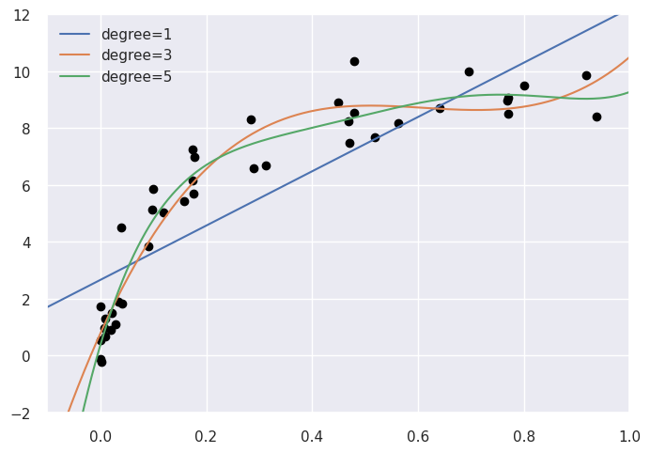
Model Selection

Slide 12
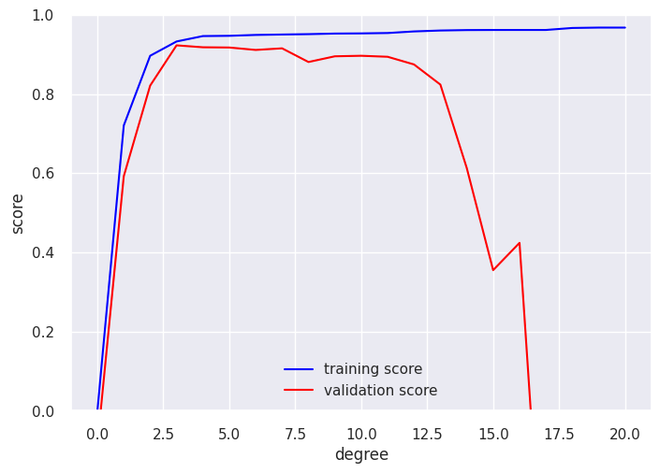
Validation Curve

Slide 13
Metrics
Confusion matrix
Precision, recall, accuracy

Slide 14
Confusion Matrix
True Labels
 | Positive | Negative
Positive | TP (50) | FP (30)
Negative | FN (10) | TN (100)
Predictions
Accuracy
= (TP + TN) / Total Samples
= (50 + 100) / (50 + 30 + 10 + 100)
= 0.789
Precision
= TP / (TP + FP)
= 50 / (50 + 30) = 0.625
Recall
= TP / (TP + FN)
= 50 / (50 + 10) = 0.833
Total samples: 50 + 30 + 10 + 100 = 190

Slide 15
Model-based vs. Instance-based
Model-based
Use training data to create a model that has parameters learned from the training data.
e.g. SVM
Instance-based Learning
k-Nearest Neighbors (kNN): looks at the close neighborhood of the input example in the space of feature vectors.

Slide 16
Shallow vs. Deep Learning
Shallow
the model learns the parameters directly from the features of the training examples.
Deep
more than one layer, e.g. Neural network.
Parameters are learned not directly from the features of the training examples, but from the outputs of the preceding layers.
Notes:
Also called hidden layers.

Slide 17
Fundamental Algorithms
Linear Regression
Logistic Regression
Decision Tree Learning
Support Vector Machine
k-Nearest Neighbors

Slide 18
Linear Regression
Example walk through using scikit-learn library

Slide 19

Linear Regression
$y=w_{0}+w_{1}x_{1}+w_{2}x_{2}+ …+w_{n}x_{n}$
y: dependent variable
x_{i}: independent variables
w_{i}: the coefficients (weights)

Slide 20
SVM
What if there’s noise in the data and no hyperplane can perfectly separate positive examples from negative ones?
What if the data cannot be separated using a plane, but could be separated by a higher-order polynomial?

Slide 21
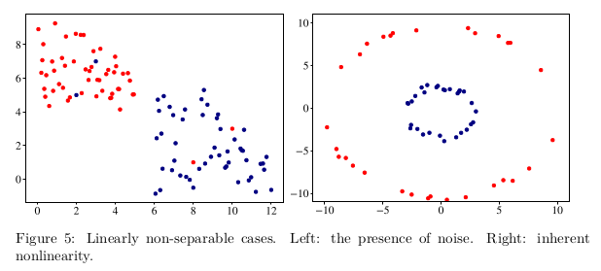
SVM

Slide 22

SVM
$wx−b=0$
Satisfy the following constraints:
$wx_{i}−b≥1 if y_{i}=+1$
$wx_{i}−b≤−1 if y_{i}=−1$
We also need to minimize $\left\|w\right\|$

Slide 24
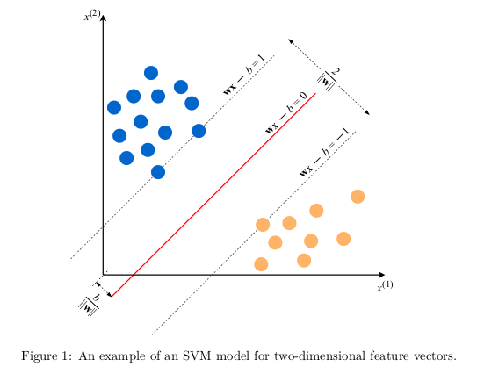
SVM
From The Hundred-Page Machine Learning Book

Slide 25
Linear Regression
Tutorial (Jupyter Notebook)
Useful resources
Animation
https://mlu-explain.github.io/linear-regression/

Slide 26
SVM tutorial
Jupyter Notebook based on
https://scikit-learn.org/stable/auto_examples/classification/plot_digits_classification.html

Slide 27
Code Samples
Underfitting, Overfitting
https://colab.research.google.com/drive/1oMWxppsnhsrU3lkEy0uzwJbcrMRUqr3C?usp=sharing
Validation Curve
https://colab.research.google.com/drive/171dADTSrX6sCF3Rll5SQTnpjr-KIhmut?usp=sharing
Linear Regression, SVM, kNN
https://colab.research.google.com/drive/1Xcgnkm2GxOBJtLxnTAx5vztnw4cOsWgm?usp=sharing

Slide 28
Neural Networks and Deep Learning
Neural Networks
Feed-forward Neural Networks
Multilayer Perceptron (MLP)

Slide 29
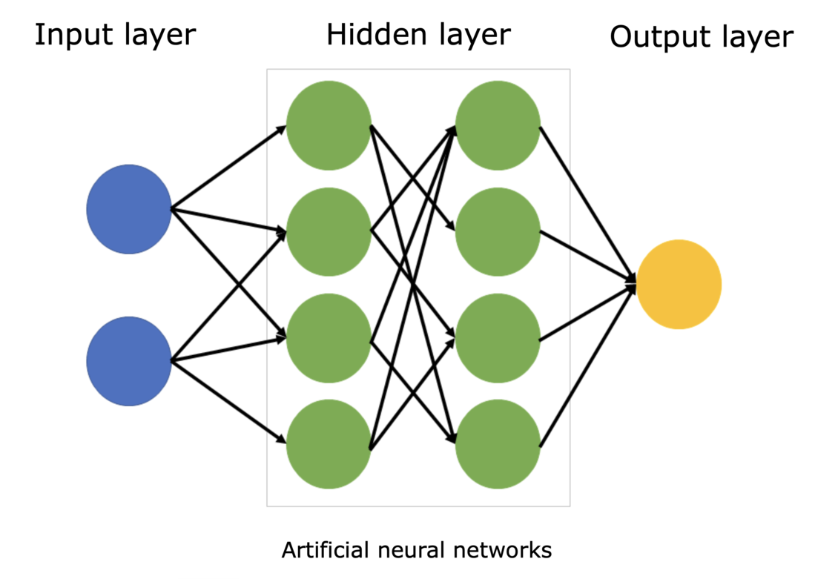
Neural Networks
Figure from: https://www.sciencelearn.org.nz/images/5156-neural-network-diagram

Slide 30
Deep Learning
Deep Learning
Convolution Neural Network (CNN)
Long Short-Term Memory (LSTM)

Slide 31
NOTE: to add SVM in detail.

