Slide 1
Machine Learning Basics
EECS 4486
Fall 2024

Slide 2
Outline
1. Introduction to Machine Learning
Types of ML
Supervised, Unsupervised, Reinforcement Learning
Features
Categorical, Numerical
Model Types
Classification
Regression
Unsupervised Models:
Clustering models, Outlier detection models, Dimension reduction.
2. Classification Models
K-nearest neighbors, logistic regression
3. Regression Models
Linear regression, Elastic net regression (regularization), k-nearest neighbors for regression.

Slide 3
Overview
Model Evaluation, Model Validation, Model Improvements
Ch. 4, 5, 6
7. Support Vector Machines
8. Decision Trees

Slide 4
Chapter 1: Introduction to Machine Learning

Slide 5
Introduction to Machine Learning
Introduction to ML
Features and model types
Modeling workflow in scikit-learn
Bias-variance tradeoff
Machine Learning Ethics

Slide 6
Machine Learning
Machine learning uses algorithms and models to make predictions and discover patterns in data.
A model is a mathematical function for describing the relationship between inputs and outputs and making predictions.
An algorithm is a procedure or set of decision rules used to carry out a machine learning task, such as making a prediction. Machine learning combines tools and theory from computer science, artificial intelligence, statistics, and mathematics to make predictions and apply knowledge to new data.

Slide 7
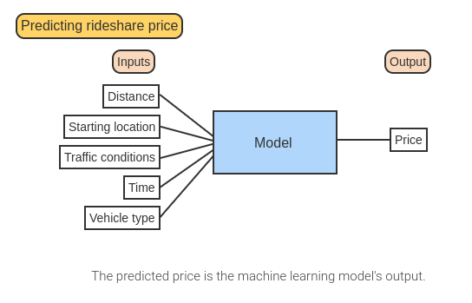
Machine Learning

Slide 8
Dataframes
A dataset is a collection of information containing features and instances.
An instance is an individual data point or observational unit. A feature, or variable, is a characteristic that is measured or observed on an instance.
Datasets are often stored in tabular format, with instances as rows and features as columns. A dataset in tabular format is also called a dataframe.

Slide 9
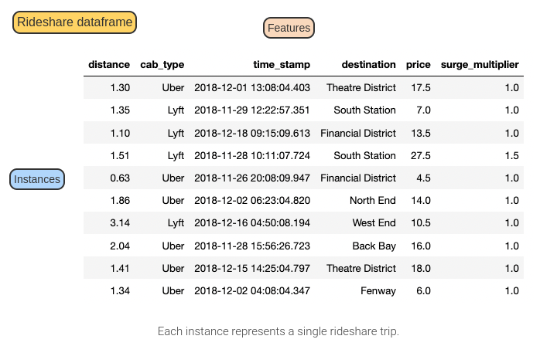
Dataframes

Slide 10
Dataframes in Python
pandas: includes functions for working with and modifying dataframes
pd.read_csv()
for importing comma-separated values or CSV files
pd.read_excel()
for importing Excel files
pd.read_json()
for importing JavaScript Object Notation or JSON files

Slide 11
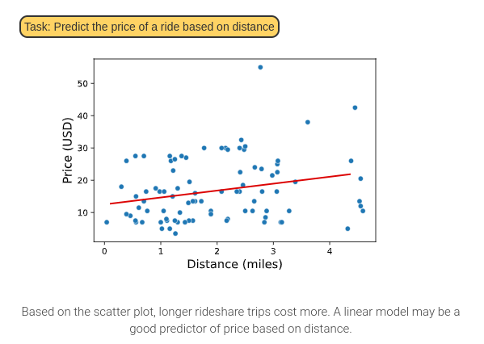
Input and Output Features
Distance: input feature
Price: output feature

Slide 12
Types of Machine Learning
Supervised learning predicts a known output feature based on input features.
Unsupervised learning describes patterns in a dataset without a known output feature.
Reinforcement learning describes algorithms that make decisions and update based on the result of the previous decision.

Slide 13
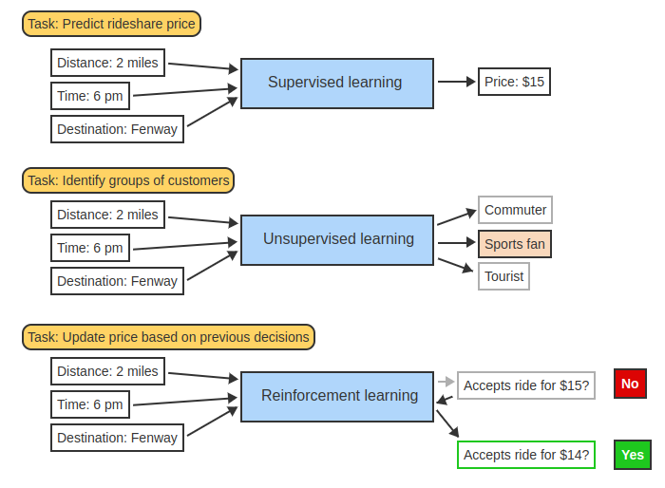
Types of Machine Learning
Predicting the price of a rideshare trip based on distance and time is a supervised learning task, since the output feature (price) is known.
Categorizing customers as "commuters", "sports fans", or "tourists" is unsupervised learning, since these categories are not an observed feature.
Adjusting the price of a rideshare after a customer has declined is reinforcement learning. The prediction is updated based on the customer's decision.

Slide 14
1. Introduction to Machine Learning
Introduction to ML
Features and model types
Modeling workflow in scikit-learn
Bias-variance tradeoff
Machine Learning Ethics

Slide 15
Feature Types
A categorical feature has non-numerical values, or numerical values without mathematical meaning. Ex: Yes/No, address, type of customer (regular, occasional, new).
A numerical feature has numerical values with mathematical meaning. Ex: Amount spent on a transaction, square footage of a house.

Slide 16
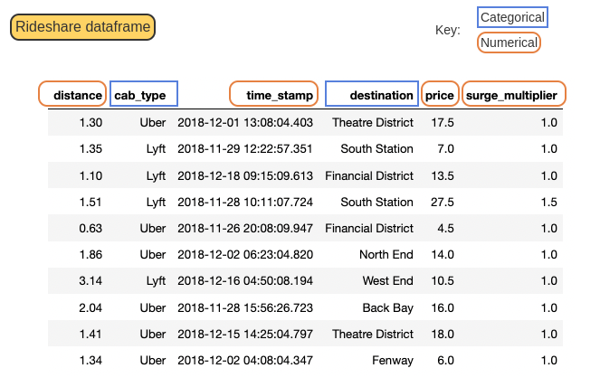
Feature Types
Categorical features have non-numerical values, such as cab type and destination.
Numerical features have numerical values with meaning, such as distance, price, and surge multiplier.
Time stamp is a numerical feature, since mathematical operations on time have meaning. Ex: 2018-12-01 is two days after 2018-11-29.

Slide 17
Plotting Features in Python
Exploratory data analysis is the process of exploring data via plots and descriptive statistics to identify potential relationships and patterns.
Two popular Python libraries for plotting data:
matplotlib is a library for creating static, dynamic, and interactive plots.
seaborn is a high-level library for creating plots that work especially well with dataframes.

Slide 18
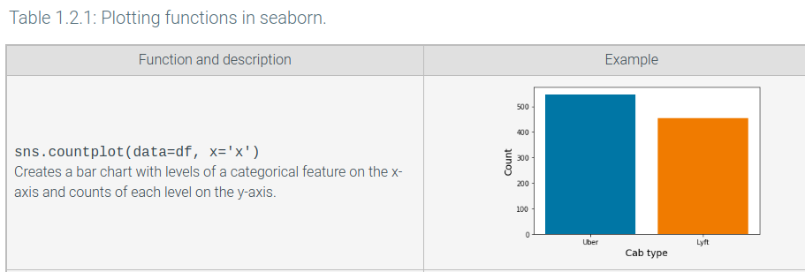
Plotting Features in seaborn
Bar chart

Slide 19
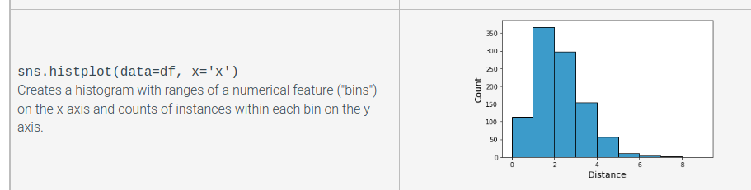
Plotting Features in seaborn
Histogram

Slide 20
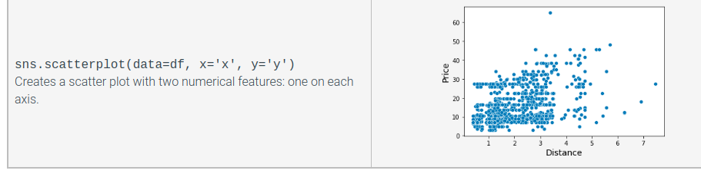
Plotting Features in seaborn
Scatter plot

Slide 21
Classification Models
Classification models are supervised machine learning models that classify instances into a predicted level, or class, of a categorical output feature based on the input features.
Classification models may predict the class directly or the probability an instance belongs to a given class.
In the probability case, predicted probabilities are compared against a threshold value to produce a class prediction.
In classification, input features may be categorical or numerical, but output features must be categorical.

Slide 22
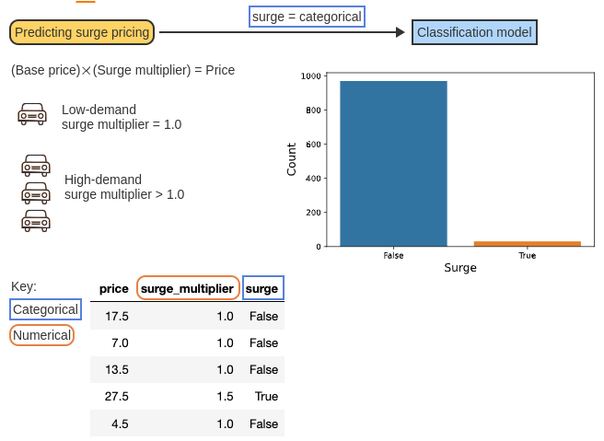
Classification Models
Rideshare companies apply a surge multiplier to adjust for times of high demand.
Surge multiplier is a numerical feature.
Surge = True if surge multiplier > 1.0, and surge = False otherwise. Surge is a categorical feature.
Most rides in the dataset did not have surge pricing applied.
Since surge is categorical, a classification model should be used to predict whether surge pricing is in effect.

Slide 23
Regression Models
Regression models are supervised learning models that predict the value of a numerical output feature based on the input features.
Example: Simple linear regression is a regression model, since the predicted values are numerical.
Like classification models, categorical or numerical input features may be used in regression.
However, the output feature for a regression model should always be numerical.

Slide 24
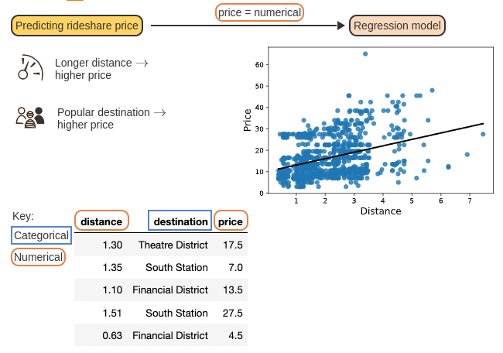
Regression Models
Rideshare trips over longer distances or to popular destinations are likely to have a higher price.
Distance is a numerical input feature, and destination is a categorical input feature. The output feature, price, is numerical.
Since price is the numerical output feature, a regression model should be used.

Slide 25
Unsupervised Models
Clustering models
Outlier detection models
Dimension reduction

Slide 26
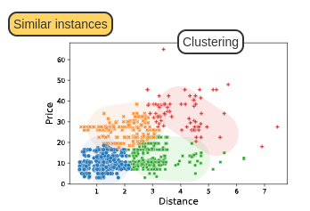
Clustering Models
Clustering groups instances based on similar values of each input feature.
Here, the rideshare data is clustered into four groups based on distance and price.
Notes:
Amazon: Customers who bought these also bought ….

Slide 27
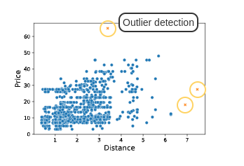
Outlier Detection
Outlier detection identifies unusual instances.
Three rideshare trips have unusually high distances or price.

Slide 28
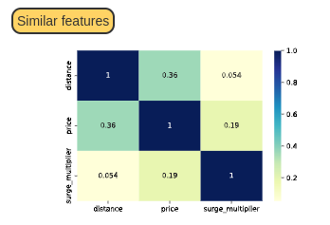
Dimension Reduction
Input features with strong correlations are similar.
The correlation between price and distance is 0.36, which is not strong.

Slide 29
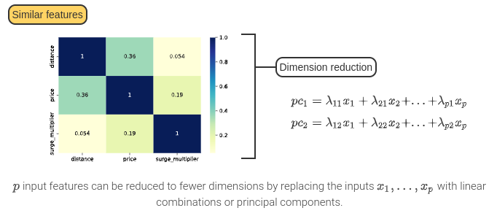
Dimension Reduction

Slide 30
1. Introduction to Machine Learning
Introduction to ML
Features and model types
Modeling workflow in scikit-learn
Bias-variance tradeoff
Machine Learning Ethics

Slide 31
Modeling Workflow in scikit-learn
The modeling workflow is a set of steps for loading, fitting, and evaluating a machine learning model or algorithm.
The modeling workflow in scikit-learn has five steps:
Define input and output features.
Initialize an estimator.
Fit the estimator.
Use the fitted estimator to make predictions.
Evaluate the fitted estimator's performance.

Slide 32
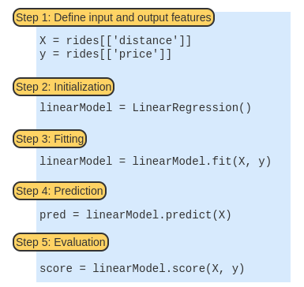
Modeling Workflow in scikit-learn

Slide 33
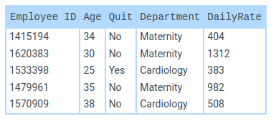
Modeling Workflow in scikit-learn
Nurses =
Input (X): Age, DailyRate
Output (y): Quit
model = LinearRegression()
X = nurses[[‘Age’, ‘DailyRate’]]
y = nurses[[‘Quit]]
y_array = np.ravel(y)
model.fit(X, y)
model.predict(X)
converts y to an array. Some scikit-learn classification models require dataframe outputs, and others require array outputs.

Slide 34
Evaluation Metrics
Accuracy
the proportion of instances correctly classified in a classification model. Accuracy ranges from 0.0 to 1.0, with higher accuracy indicating a better estimator.
R-squared
the approximate proportion of variation in the output feature explained using a regression model.
The maximum value of R-squared is 1.0, which means the estimator perfectly predicted the output feature.
Negative values of R-squared mean that the estimator predicted worse than predicting the mean output for all instances.
Notes:
R square = 1 – residual sum of squares/ total sum of squares

Slide 35
Evaluation Metrics
scikit-learn estimators return evaluation metrics using the score() method.
Classification models will return accuracy, and
Regression models will return R-squared.
classification_report
from sklearn metrics
metrics.classification_report(y_true, y_pred, zero_division=0)
Accuracy, precision, recall, F1, confusion matrix.

Slide 36
1. Introduction to Machine Learning
Introduction to ML
Features and model types
Modeling workflow in scikit-learn
Bias-variance tradeoff
Machine Learning Ethics

Slide 37
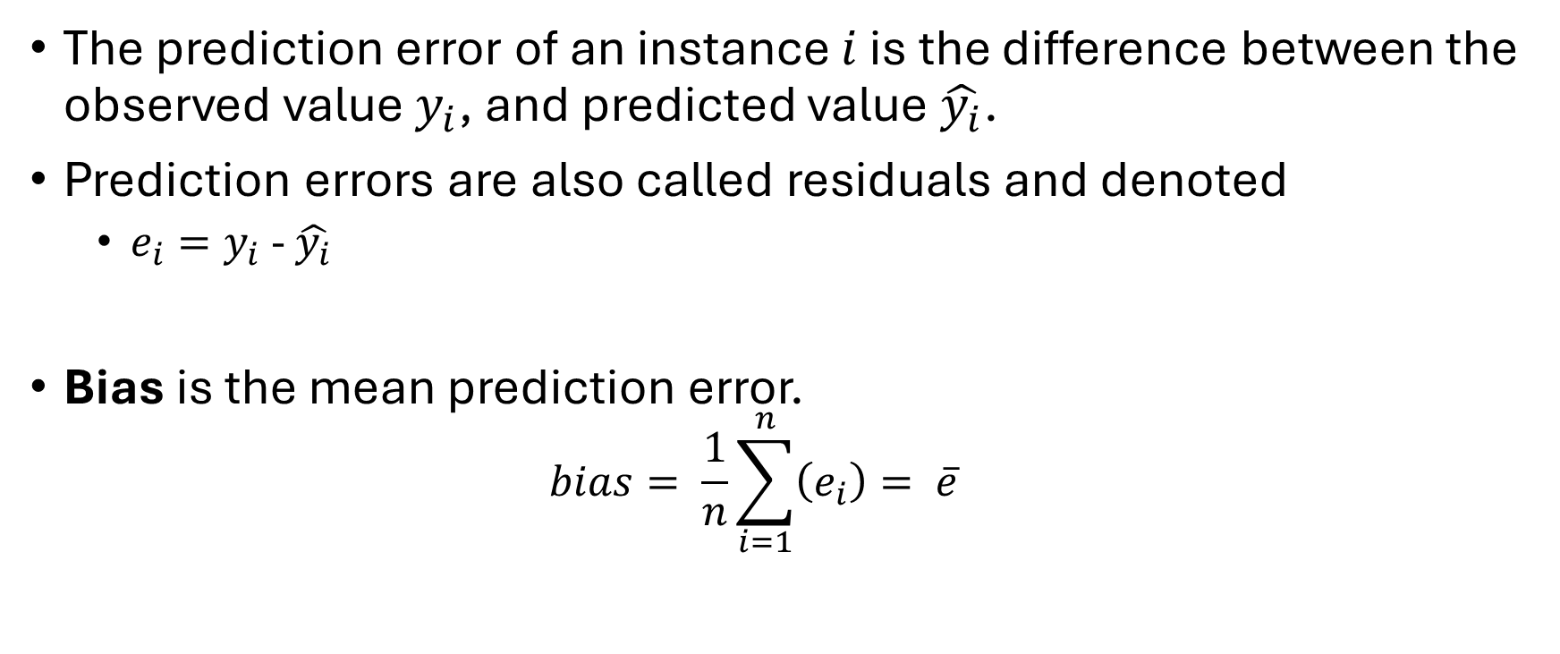
Bias-variance Tradeoff
The prediction error of an instance $i$ is the difference between the observed value $y_{i}$, and predicted value $\hat{y_{i}}$.
Prediction errors are also called residuals and denoted
$e_{i}=y_{i}$ - $\hat{y_{i}}$
Bias is the mean prediction error.
$$bias= \frac{1}{n}\sum_{i=1}^{n}{\left(e_{i}\right)}= \overline{e}$$

Slide 38
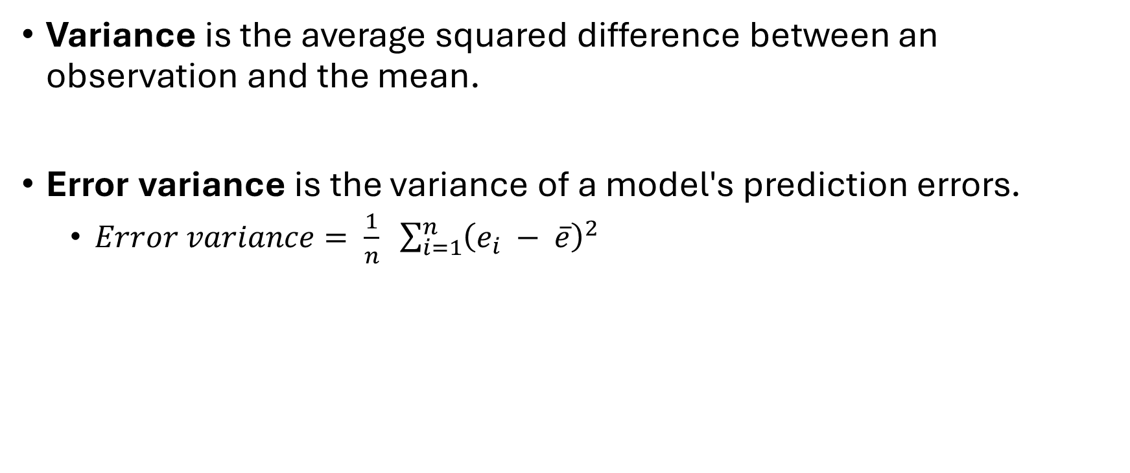
Error Variance
Variance is the average squared difference between an observation and the mean.
Error variance is the variance of a model's prediction errors.
$Error variance= \frac{1}{n} \sum_{i=1}^{n}{{\left(e_{i} − \overline{e}\right)}^{2}}$

Slide 39
Bias-variance Tradeoff
Models with low bias and low error variance have predicted values that are consistently close to the observed values.
A good model should have low bias and low error variance.

Slide 40
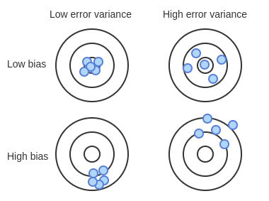
Bias-variance Tradeoff
Prediction is like attempting to hit a bullseye on a target. A good model consistently (low error variance) hits the bullseye (low bias).
A model with low bias and high error variance occasionally hits the bullseye but is less consistent.
A model with high bias and low error variance consistently hits the same spot on the target, just not the center.
The worst-case scenario is a model with high bias and high error variance. Models with high bias and error variance are inaccurate and inconsistent.

Slide 41
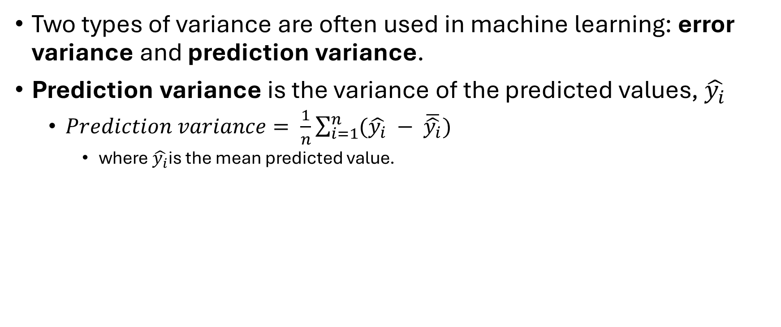
Prediction Variance
Two types of variance are often used in machine learning: error variance and prediction variance.
Prediction variance is the variance of the predicted values, $\hat{y_{i}}$
$Prediction variance= \frac{1}{n}\sum_{i=1}^{n}{(\hat{y_{i}} − \overline{\hat{y_{i}}})}$
where $\hat{y_{i}}$is the mean predicted value.

Slide 42
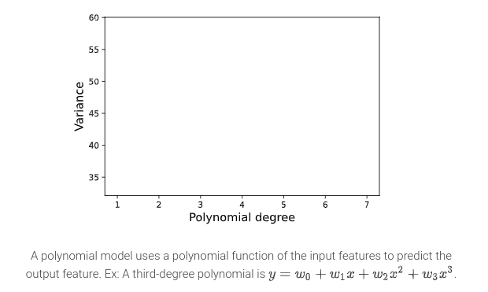
Error Variance vs. Prediction Variance

Slide 43
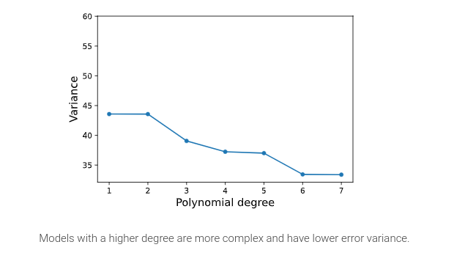
Error Variance vs. Prediction Variance

Slide 44
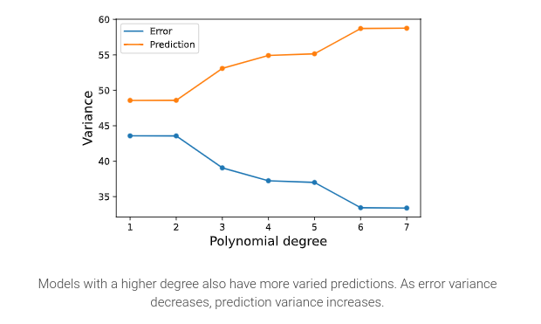
Error Variance vs. Prediction Variance

Slide 45
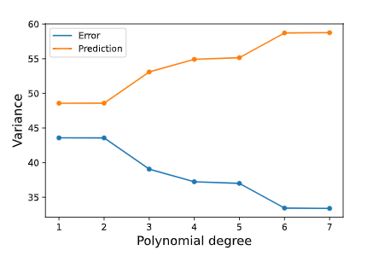
Error Variance vs. Prediction Variance
A polynomial model uses a polynomial function of the input features to predict the output feature. Ex: A third-degree polynomial is $y= w_{0}+ w_{1}x+w_{2}x^{2}+w_{3}x^{3}$
Models with a higher degree also have more varied predictions. As error variance decreases, prediction variance increases.
Models with a higher degree are more complex and have lower error variance.

Slide 46
Underfitting vs. Overfitting
Consider three models for predicting price based on distance: a linear model, a spline model, and a polynomial model.

Slide 47
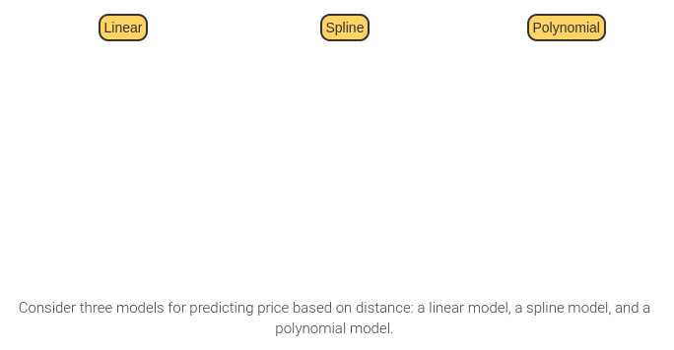
Underfitting vs. Overfitting

Slide 48
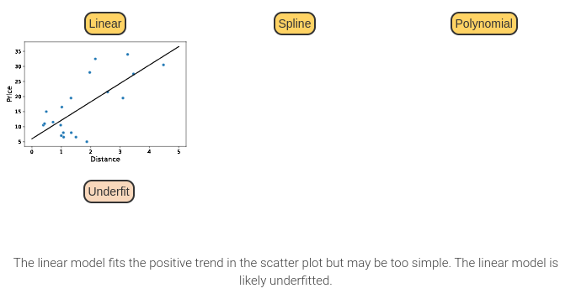
Underfitting vs. Overfitting

Slide 49
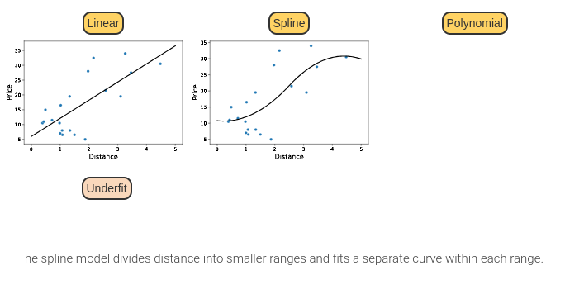
Underfitting vs. Overfitting

Slide 50
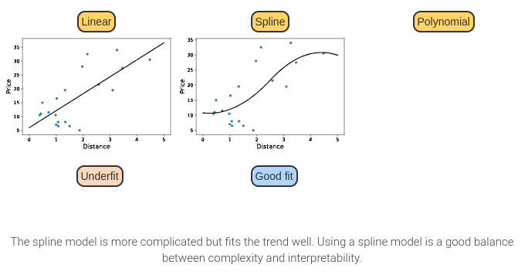
Underfitting vs. Overfitting

Slide 51
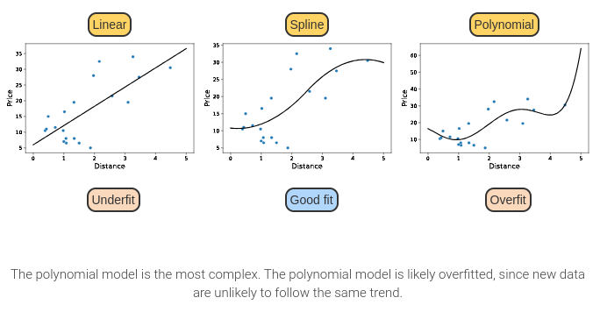
Underfitting vs. Overfitting

Slide 52
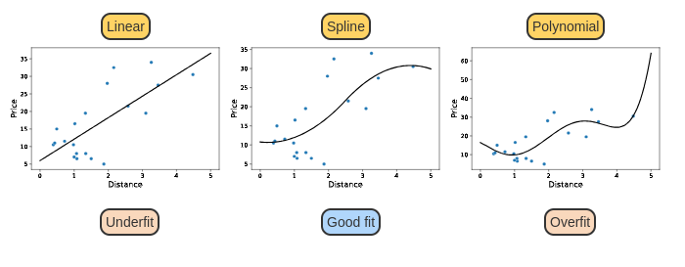
Underfitting vs. Overfitting
The linear model fits the positive trend in the scatter plot but may be too simple. The linear model is likely underfitted.
The spline model divides distance into smaller ranges and fits a separate curve within each range.
The spline model is more complicated but fits the trend well. Using a spline model is a good balance between complexity and interpretability.
The polynomial model is the most complex. The polynomial model is likely overfitted, since new data are unlikely to follow the same trend.

Slide 53

Mean Squared Error (MSE)
Mean squared error (MSE) is the average of the squared prediction errors.
$MSE= \frac{1}{n}\sum_{i=1}^{n}{{(y_{i}− \hat{y_{i}})}^{2}=\frac{1}{n}\sum_{i=1}^{n}{{\left(e_{i}\right)}^{2} }}$

Slide 54
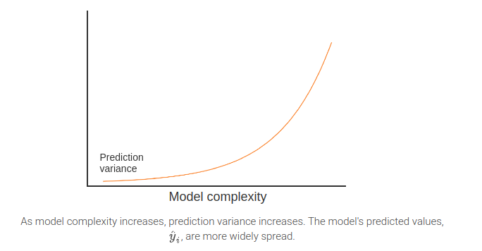
Bias-variance Tradeoff

Slide 55
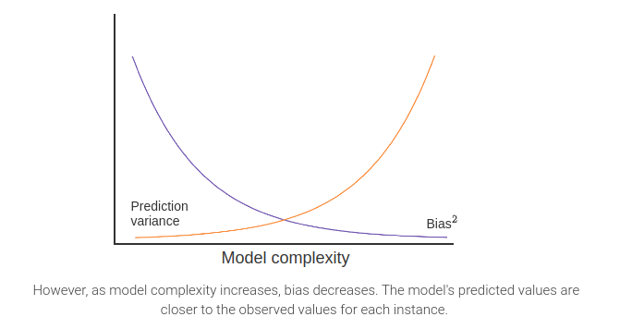
Bias-variance Tradeoff
Notes:
Bias is a prediction error.

Slide 56
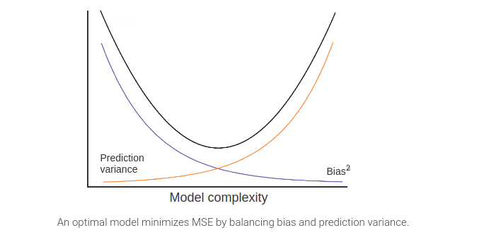
Bias-variance Tradeoff

Slide 57
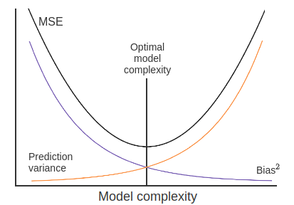
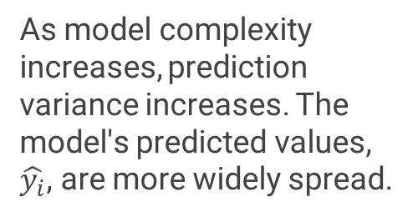
Bias-variance Tradeoff
As model complexity increases, prediction variance increases. The model's predicted values, $\hat{y_{i}}$, are more widely spread.
However, as model complexity increases, bias decreases. The model's predicted values are closer to the observed values for each instance.
An optimal model minimizes MSE by balancing bias and prediction variance.

Slide 58
1. Introduction to Machine Learning
Introduction to ML
Features and model types
Modeling workflow in scikit-learn
Bias-variance tradeoff
Machine Learning Ethics

Slide 59
Machine Learning Ethics
Accuracy: Machine learning models should have high accuracy. But accuracy should be balanced with the risk of harm.
Bias: Machine learning model outcomes should be tested for disproportionate impact. How do decisions impact people, and are certain groups disproportionately and negatively impacted?
Accessibility: Access to machine learning should not be limited. Increased access is achieved through open-source software, low-cost educational resources, etc.
Security: Machine learning systems should be protected against outside attacks.
Privacy: Data used to train a machine learning model should protect individual rights to privacy and minimize use of personal data.
Transparency: Machine learning models should be well documented, explained, and interpretable. Black box models are machine learning models that are not well documented, explainable, or interpretable. Black box models should be avoided.
Accountability: Machine learning models used in applications with human impact should be held accountable. People should have opportunities to challenge the model's decision, especially if a person has been negatively impacted by that decision.
Human control: Machine learning models should be under human control. Model decisions should be periodically reviewed, and models should be refined if bias is discovered.
Sustainability: Machine learning often requires massive datasets and computational resources that produce environmental harm.
Harm avoidance: Machine learning models may result in physical (Ex: self-driving cars), allocative (Ex: withholding resources), or representational (Ex: generating offensive text) harm. All types of harm should be tested for and avoided.

Slide 60
Next Lecture
Chapter 2: Classification models:
K-nearest neighbors
Logistic regression

