Slide 1
Chapter 2: Classification Models
EECS 4486
Fall 2024

Slide 2
Classification Models
K-nearest neighbors
Logistic regression

Slide 3
K-Nearest Neighbors

Slide 4
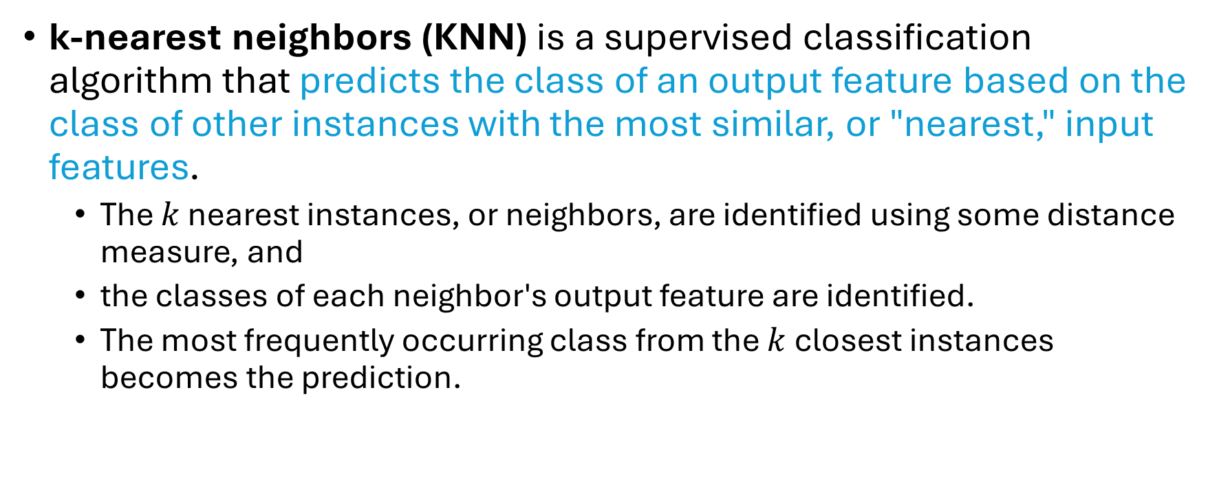
K-nearest Neighbors
k-nearest neighbors (KNN) is a supervised classification algorithm that predicts the class of an output feature based on the class of other instances with the most similar, or "nearest," input features.
The $k$ nearest instances, or neighbors, are identified using some distance measure, and
the classes of each neighbor's output feature are identified.
The most frequently occurring class from the $k$ closest instances becomes the prediction.

Slide 5
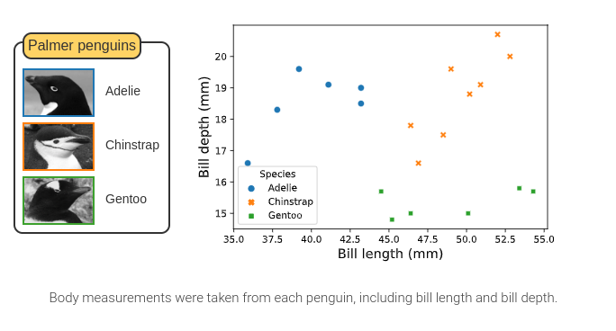
Classifying penguins based on bill length

Slide 6
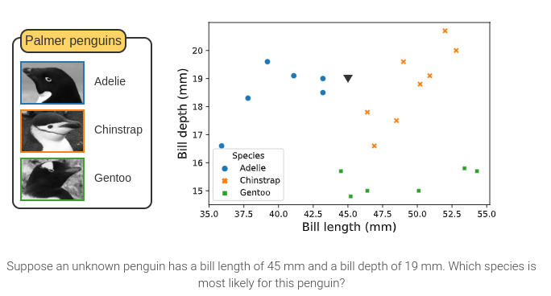
Classifying penguins based on bill length

Slide 7
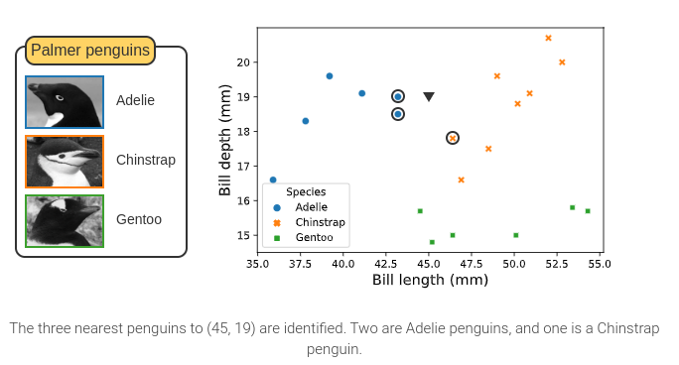
Classifying penguins based on bill length

Slide 8

Classifying penguins based on bill length

Slide 9
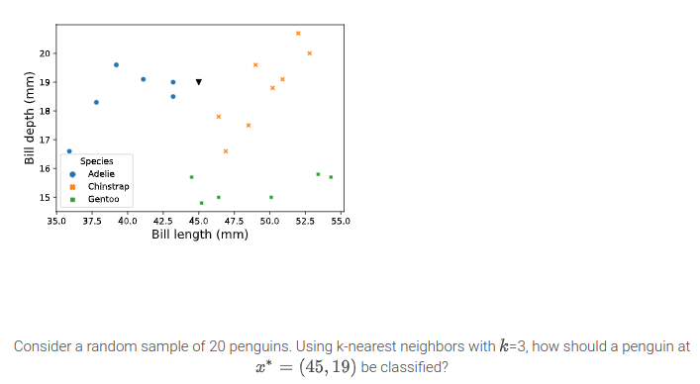
k-nearest neighbors algorithm

Slide 10
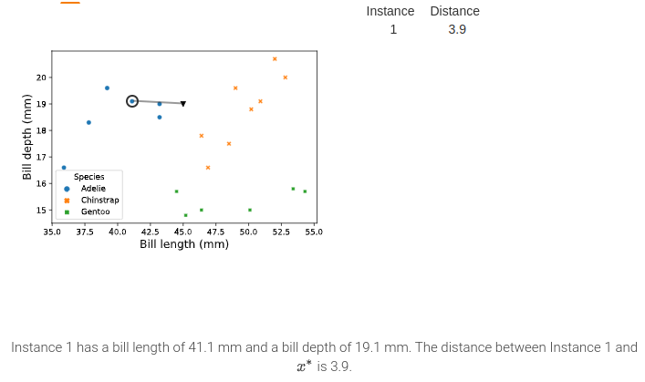
k-nearest neighbors algorithm

Slide 11
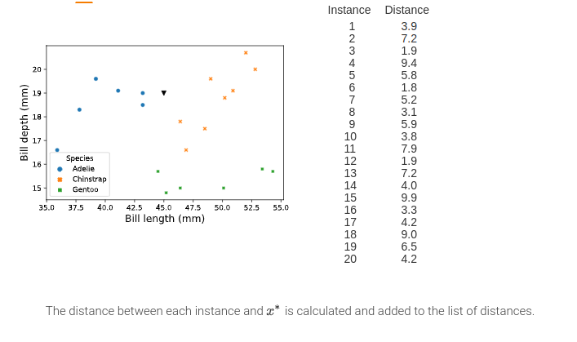
k-nearest neighbors algorithm

Slide 12
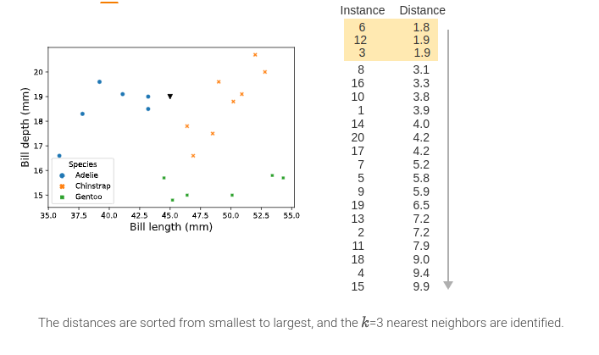
k-nearest neighbors algorithm

Slide 13
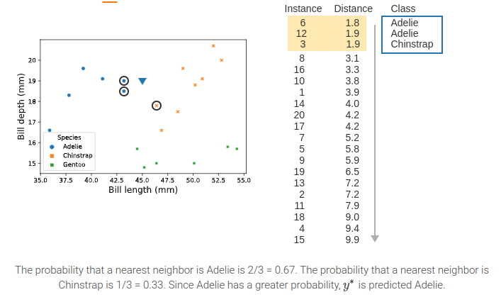
k-nearest neighbors algorithm

Slide 14
Two things to consider
Selecting an appropriate k
Distance measure

Slide 15
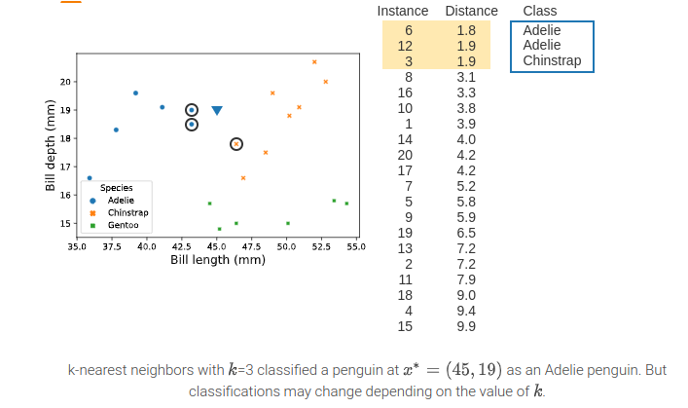
Effect of k on k-nearest neighbors classification

Slide 16
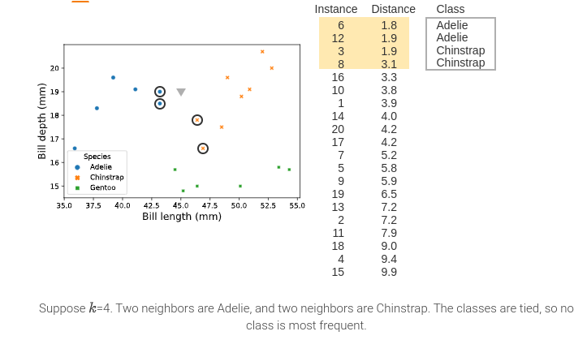
Effect of k on k-nearest neighbors classification

Slide 17
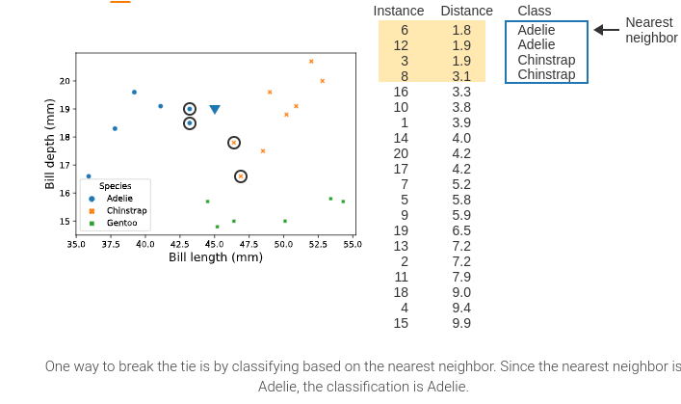
Effect of k on k-nearest neighbors classification

Slide 18
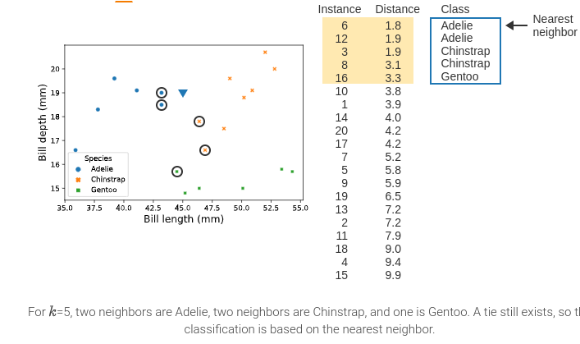
Effect of k on k-nearest neighbors classification

Slide 19
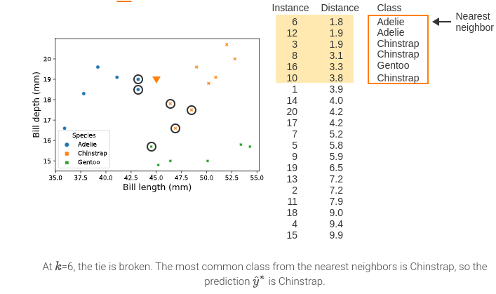
Effect of k on k-nearest neighbors classification

Slide 20
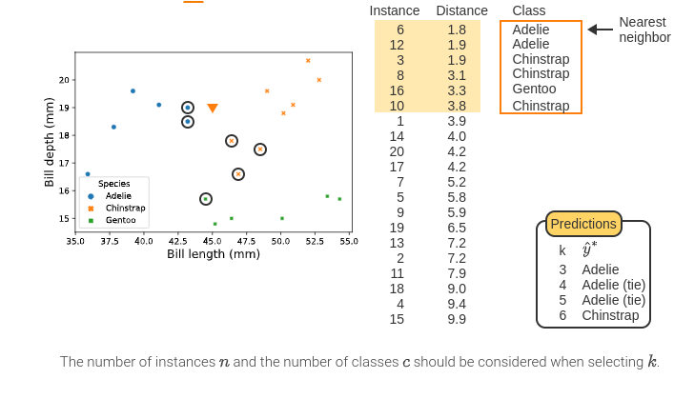
Effect of k on k-nearest neighbors classification

Slide 21
Selecting an appropriate k
A hyperparameter is a user-defined setting in a machine learning model that is not estimated during model fitting.
Changing the values of a hyperparameter affects the model's performance and predictions.
k-nearest neighbors is sensitive to two hyperparameters: the value of k and the distance measure.
Models with different values of k may result in different predictions.
Setting k too small results in predictions that are based on only a few instances and thus highly variable.
But setting k too large often leads to models that are underfit.
In practice, k is usually set between 3 and 15.

Slide 22
Decision Boundaries
Decision boundaries represent the dividing line between predicting one class vs. another class.
Decision boundaries may be visualized using a scatter plot for one or two input features, or multiple scatter plots when the number of input features p > 2.
Examining a decision boundary plot helps researchers understand the predictions of a machine learning model and identify a model's strengths and weaknesses.
Decision boundary plots are also useful tools for comparing models.

Slide 23
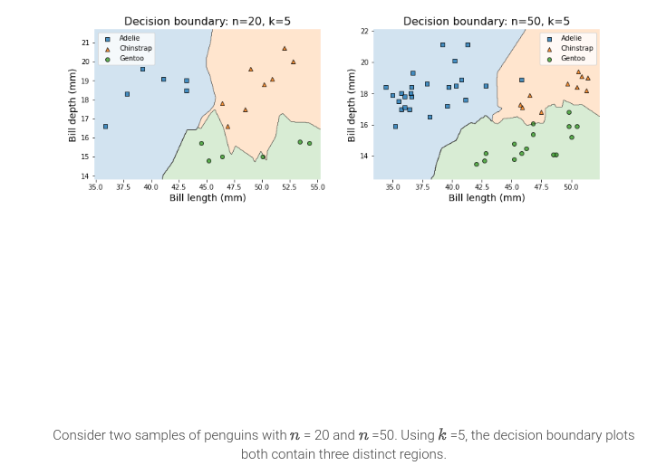
Decision Boundary Plot

Slide 24
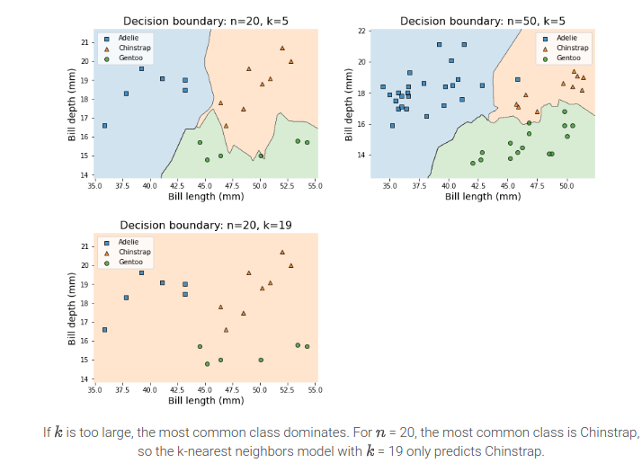
Decision Boundary Plot

Slide 25
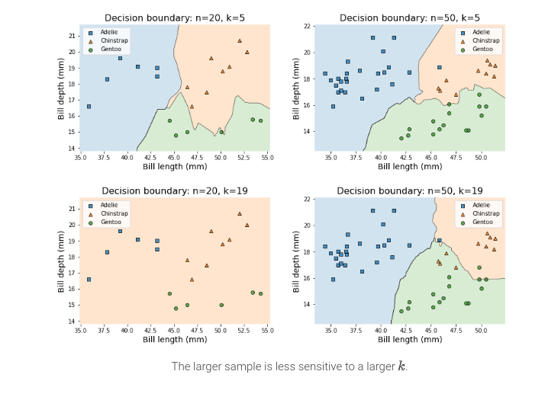
Decision Boundary Plot

Slide 26
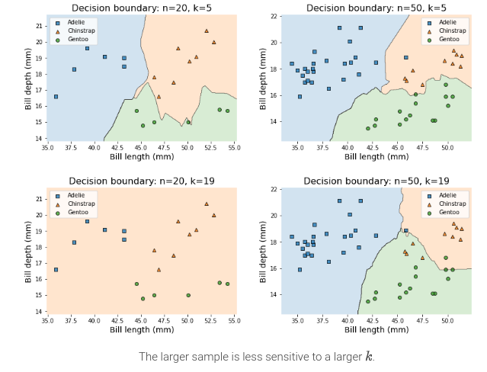
Decision Boundary Plot
The number of instances n and the number of classes c should be considered when selecting k.
n = 20, k = 5
n = 50, k = 5
n = 20, k = 19
n = 50, k = 19

Slide 27
Distance measures
KNN classifies instances based on the classes of the k closest instances. But, depending on how the distance between instances is defined, the nearest neighbors may change.
Three common distance measures for KNN classification:
Euclidean distance
Manhattan distance
Minkowski dstance

Slide 28
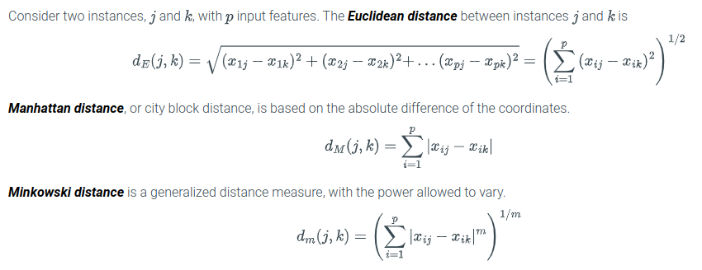
Distance measures
Euclidean distance is equivalent to Minkowski distance with m = 2
Manhattan distance is equivalent to Minkowski distance with m = 1
Different situations may call for different distance measures.

Slide 29
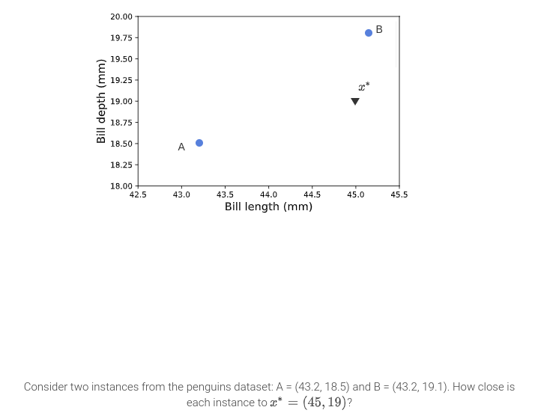
Calculating distance measures

Slide 30
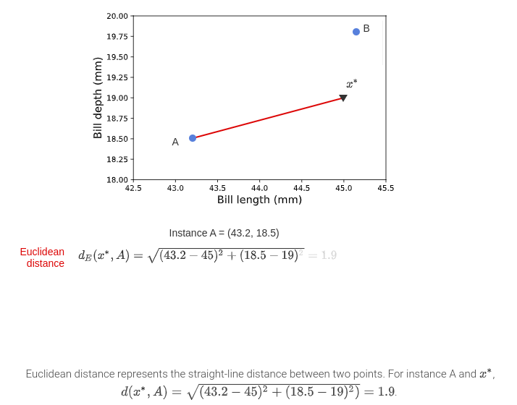
Calculating distance measures

Slide 31
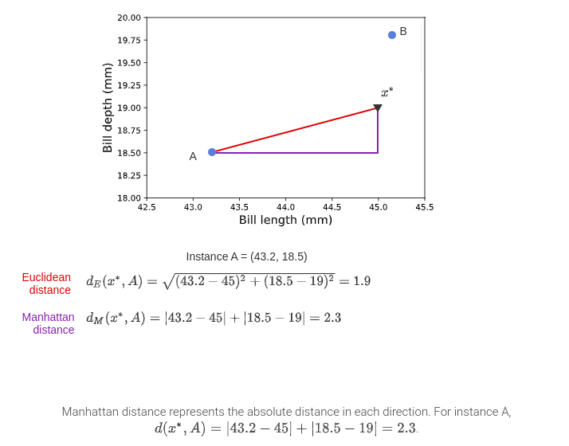
Calculating distance measures

Slide 32
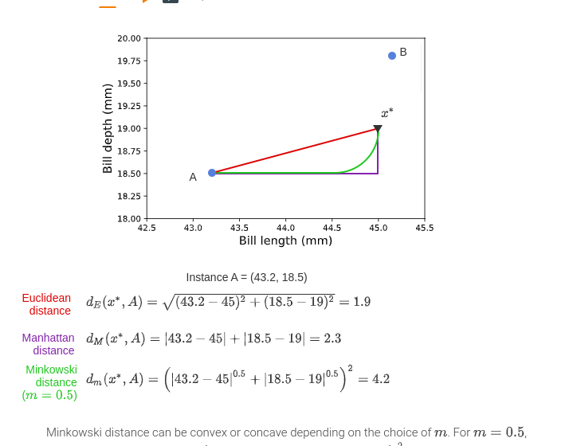
Calculating distance measures

Slide 33
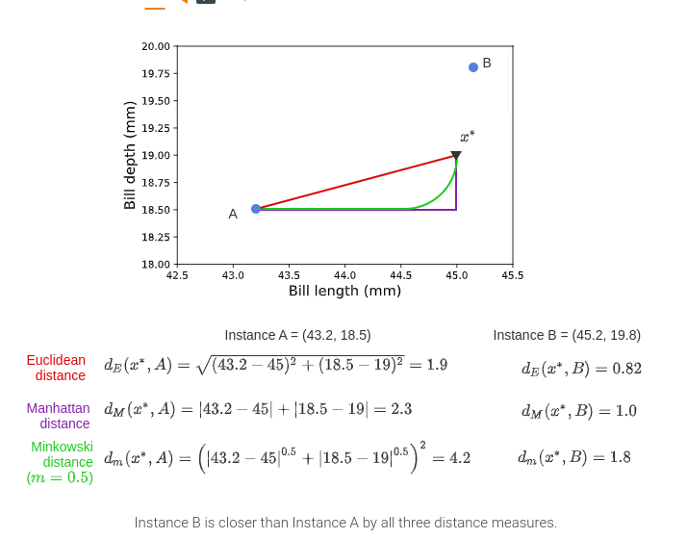
Calculating distance measures

Slide 34
Advantages and Disadvantages of a Classification Model
a flexible classification model that can predict to any number of classes
Limitations:
Distance-based algorithms make predictions based only on the most similar instances, and do not consider relationships between input and output features.
Since k-nearest neighbors only uses the input features to identify the nearest instances, k-nearest neighbors should not be used to describe relationships between input and output features.
Distance-based algorithms like k-nearest neighbors are sensitive to the unit and magnitude of measurement for each feature.
Ex: The distance value between the body mass of two penguins depends on whether body mass is measured in grams or kilograms. Input features in distance-based algorithms should be standardized before fitting a model.

Slide 35
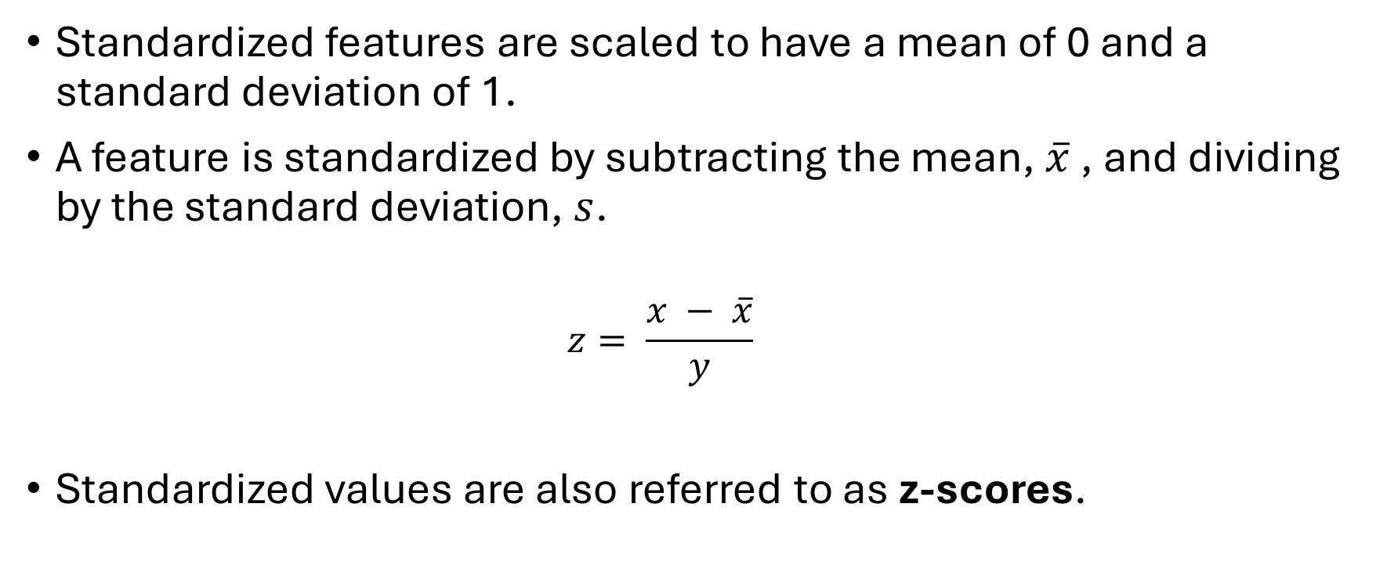
Standardized Features
Standardized features are scaled to have a mean of 0 and a standard deviation of 1.
A feature is standardized by subtracting the mean, $\overline{x}$ , and dividing by the standard deviation, $s$.
$$z= \frac{x − \overline{x}}{y}$$
Standardized values are also referred to as z-scores.

Slide 36
Logistic Regression

Slide 37
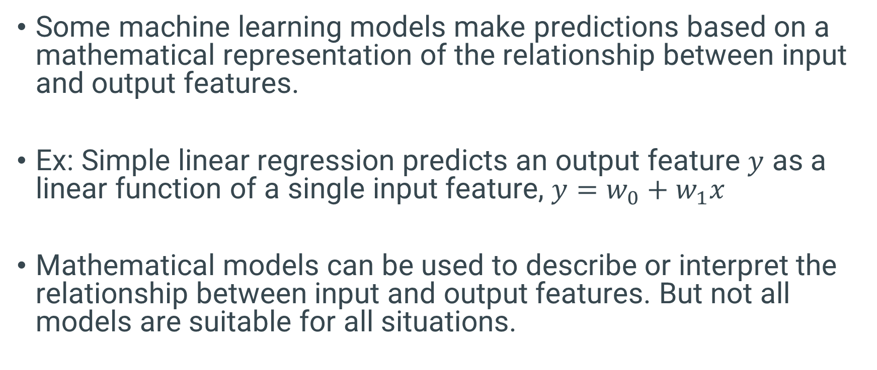
Logistic Regression
Some machine learning models make predictions based on a mathematical representation of the relationship between input and output features.
Ex: Simple linear regression predicts an output feature $y$ as a linear function of a single input feature, $y=w_{0}+w_{1}x$
Mathematical models can be used to describe or interpret the relationship between input and output features. But not all models are suitable for all situations.

Slide 38
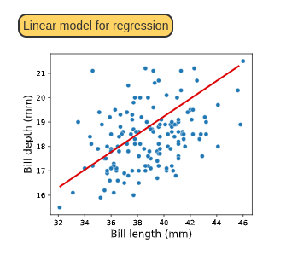
Linear Model
Linear models use a linear function of the input features to predict an output feature's value. For Adelie penguins, a linear relationship exists between bill length and bill depth.

Slide 39
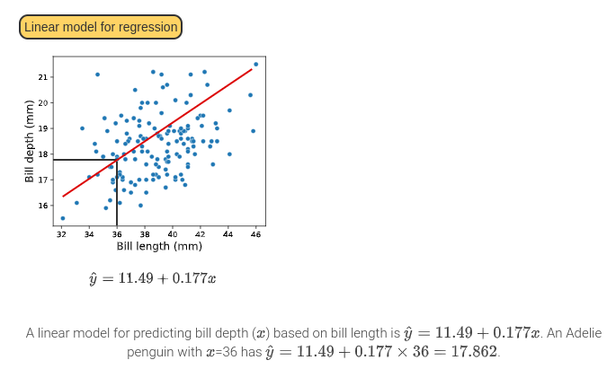
Linear Model

Slide 40
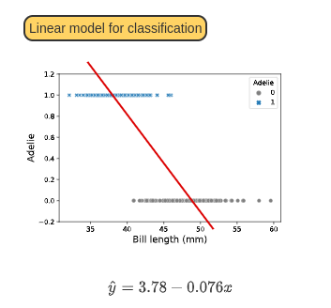
Linear Model

Slide 41
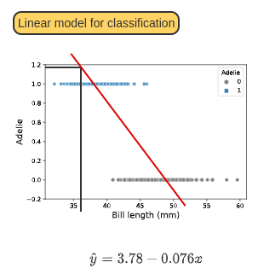
Linear Model

Slide 42
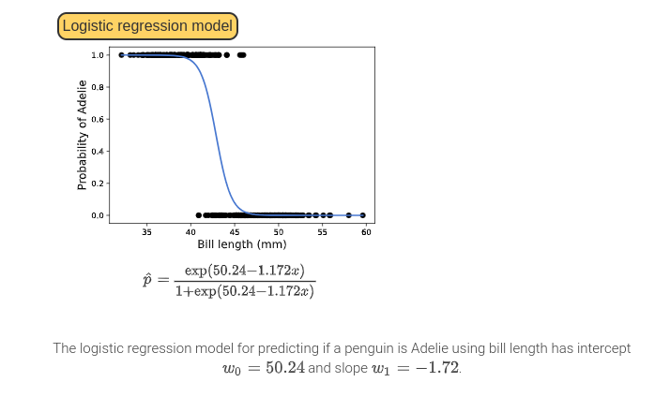
Calculating probabilities with logistic regression

Slide 43
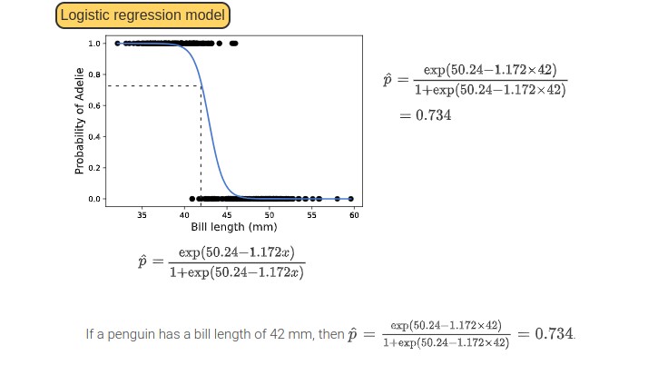
Calculating probabilities with logistic regression

Slide 44
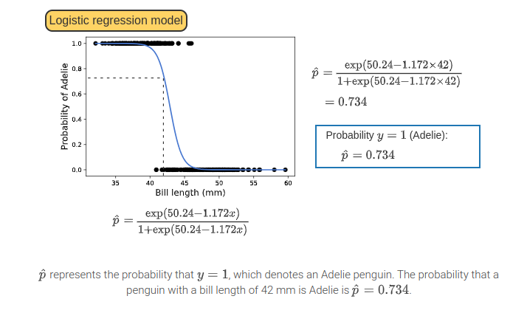
Calculating probabilities with logistic regression

Slide 45
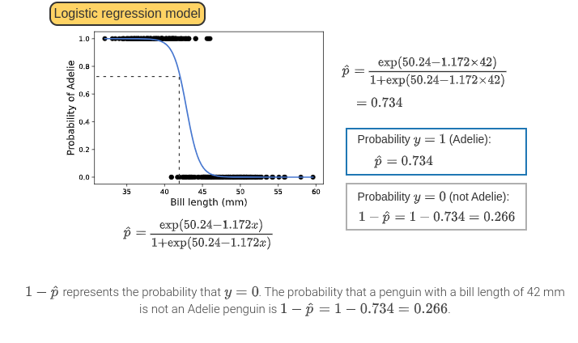
Calculating probabilities with logistic regression

Slide 46
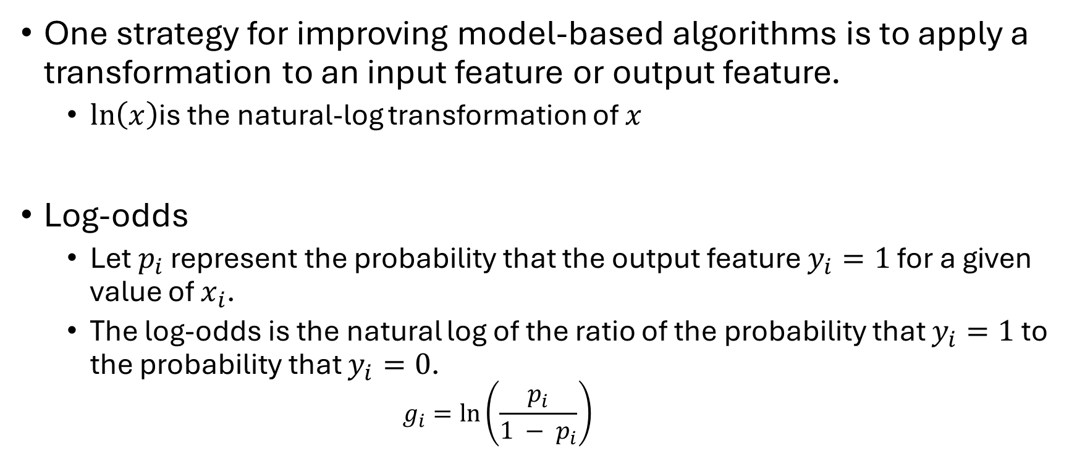
Log-odds
One strategy for improving model-based algorithms is to apply a transformation to an input feature or output feature.
$\ln\left(x\right)$is the natural-log transformation of $x$
Log-odds
Let $p_{i}$ represent the probability that the output feature $y_{i}=1$ for a given value of $x_{i}$.
The log-odds is the natural log of the ratio of the probability that $y_{i}=1$ to the probability that $y_{i}=0$.
$$g_{i}=\ln\left(\frac{p_{i}}{1 − p_{i}}\right)$$

Slide 47
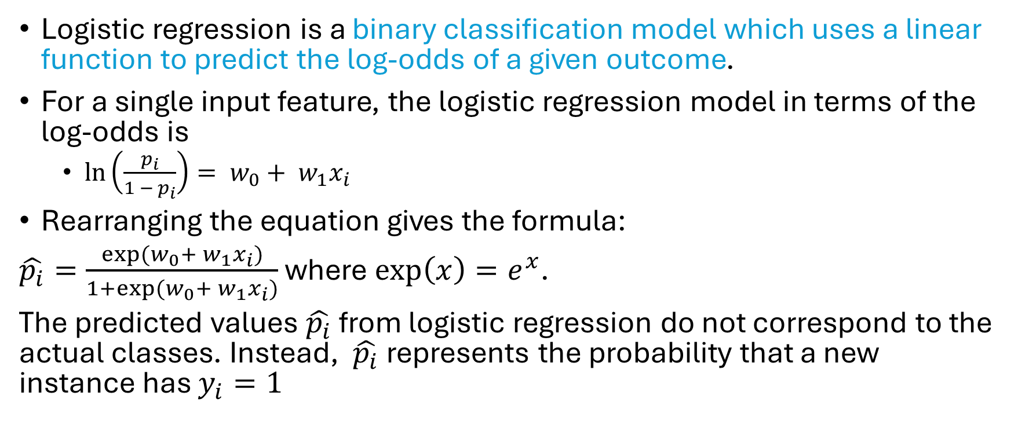
Logistic Regression
Logistic regression is a binary classification model which uses a linear function to predict the log-odds of a given outcome.
For a single input feature, the logistic regression model in terms of the log-odds is
$\ln\left(\frac{p_{i}}{1 − p_{i}}\right)= w_{0}+ w_{1}x_{i}$
Rearranging the equation gives the formula:
$\hat{p_{i}}=\frac{exp⁡(w_{0}+ w_{1}x_{i})}{1+exp⁡(w_{0}+ w_{1}x_{i})}$ where $\exp\left(x\right)=e^{x}$.
The predicted values $\hat{p_{i}}$ from logistic regression do not correspond to the actual classes. Instead, $\hat{p_{i}}$represents the probability that a new instance has $y_{i}=1$

Slide 48
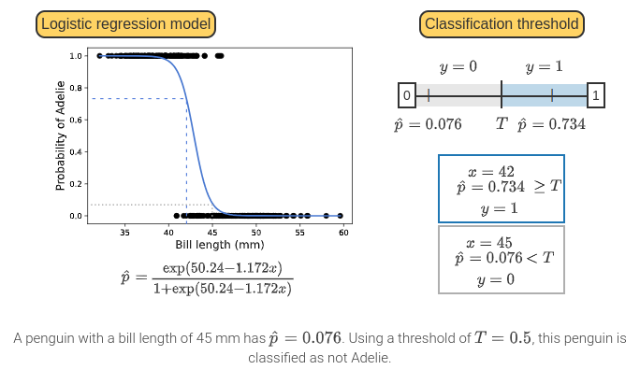
Logistic Regression

Slide 49
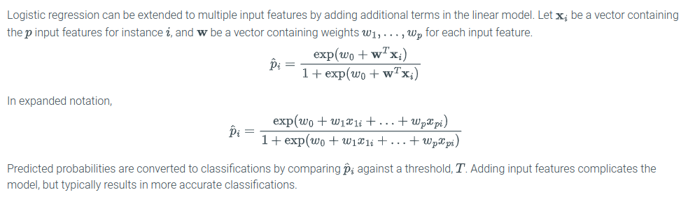
Multiple Features in Logistic Regression

Slide 50
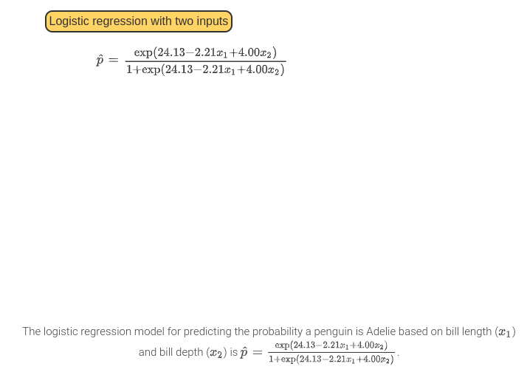
Logistic Regression with Two Inputs

Slide 51
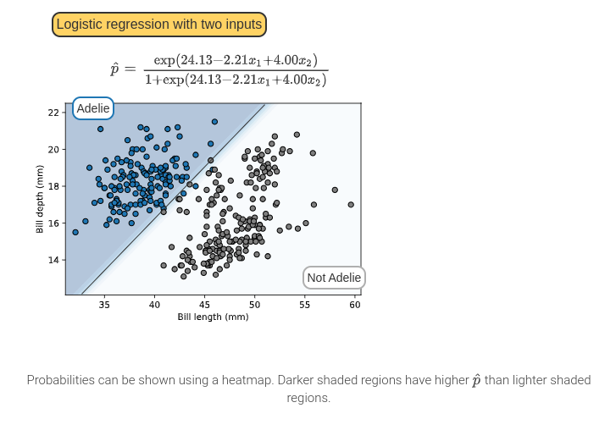
Logistic Regression with Two Inputs

Slide 52
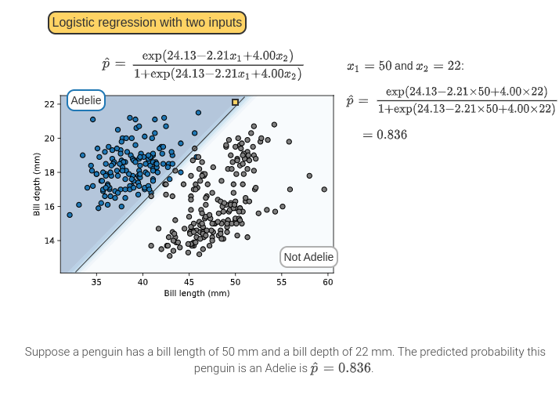
Logistic Regression with Two Inputs

Slide 53
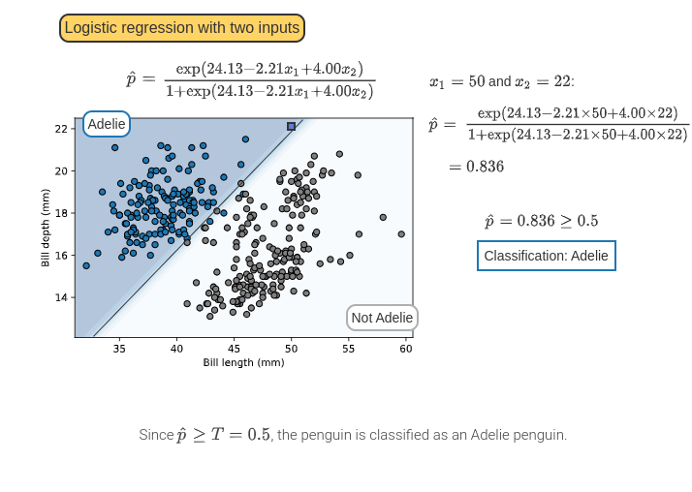
Logistic Regression with Two Inputs

Slide 54
Final Note on Logistic Regression
Logistic regression is a binary classification model and only predicts between two classes.
When more than two classes exist, separate logistic regression models must be used with each class or classes must be combined.

Slide 55
Next Lecture
Chapter 3: Regression Models
Linear Regression
Elastic net regression (regularization)
K-nearest neighbors for regression

