Slide 1
Machine Learning Basics
Lwin Moe
York University
October 3, 2023

Slide 2
Machine Learning 1 Outline
What is ML?
Classification vs. Regression
Types of Machine Learning
Supervised Learning
Unsupervised Learning
Semi-supervised Learning
Reinforcement Learning

Slide 3
Machine Learning 1 Outline
Building blocks of ML
Scalars, Vectors and Sets
Loss Functions
Derivative and Gradient Descent

Slide 4
Machine Learning 2 Outline
Evaluation metrics
Precision, Recall, and Accuracy
Training
Cross validation
Underfitting, Overfitting, Regularization
Model selection

Slide 5
Machine Learning 2 Outline
Model-based vs. Instance-based Learning
Shallow vs. Deep Learning
Fundamental Algorithms
Linear Regression
Logistic Regression
Decision Tree
Support Vector Machines
k-Nearest Neighbors

Slide 6
Machine Learning 2 Outline
Deep Learning and Neural Networks
Feed Forward Network
Multi-Layer Perceptron

Slide 7
Machine Learning 2 Outline
Tutorials
Linear Regression (using scikit-learn library)
SVM (using scikit-learn library)

Slide 8
Resources
The Hundred-Page Machine Learning Book
https://themlbook.com/
http://themlbook.com/wiki/doku.php (read the chapters online)
Andrew Ng’s Machine Learning Specialization Lectures
https://www.youtube.com/playlist?list=PLkDaE6sCZn6FNC6YRfRQc_FbeQrF8BwGI

Slide 9
Evaluation Metrics
Confusion matrix
Precision, recall, accuracy

Slide 10
Confusion Matrix
True Labels
 | Positive | Negative
Positive | TP (50) | FP (30)
Negative | FN (10) | TN (100)
Predictions
Accuracy
= (TP + TN) / Total Samples
= (50 + 100) / (50 + 30 + 10 + 100)
= 0.789
Precision
= TP / (TP + FP)
= 50 / (50 + 30) = 0.625
Recall
= TP / (TP + FN)
= 50 / (50 + 10) = 0.833
Total samples: 50 + 30 + 10 + 100 = 190

Slide 11
Training
Training, Validation and Test sets
Example: 80%, 10%, 10%
Cross validation
K-fold cross validation

Slide 12

K-fold cross validation
https://scikit-learn.org/stable/modules/cross_validation.html

Slide 13
Model Selection and Hyperparameter Tuning
Remember we talked about underfitting, overfitting last week?

Slide 14
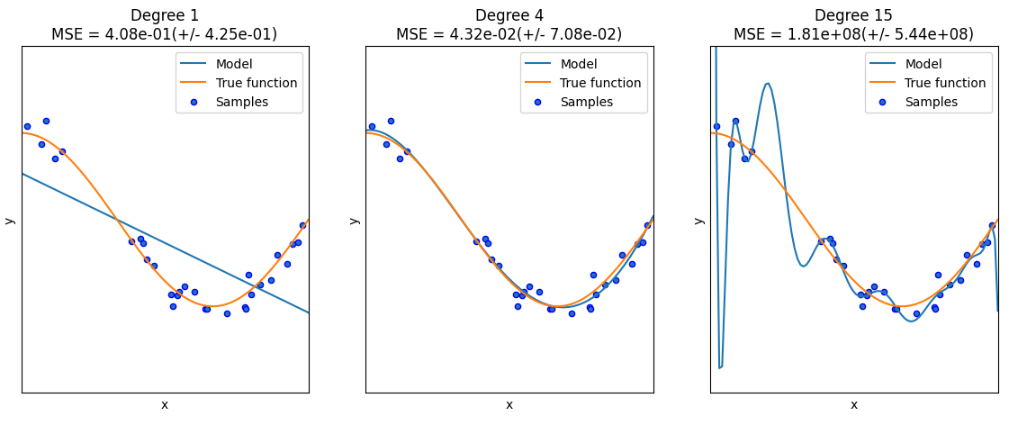
Underfitting and Overfitting
https://scikit-learn.org/stable/auto_examples/model_selection/plot_underfitting_overfitting.html

Slide 15
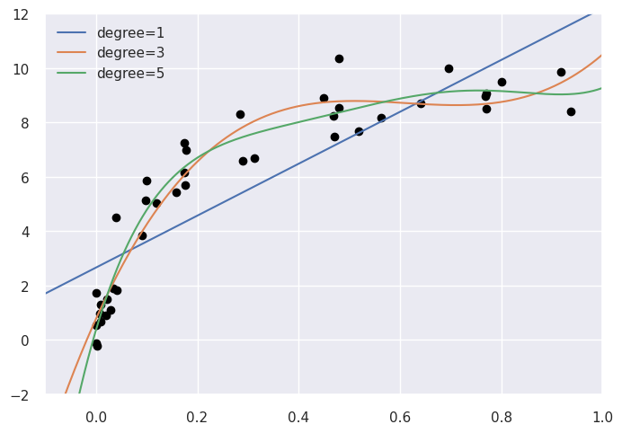
Model Selection

Slide 16
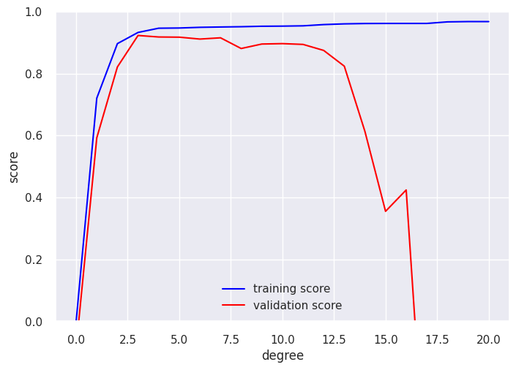
Validation Curve

Slide 17
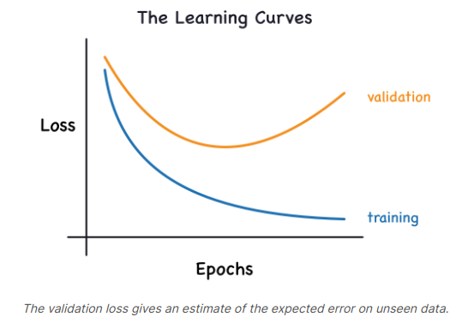
Learning curve (loss)

Slide 18
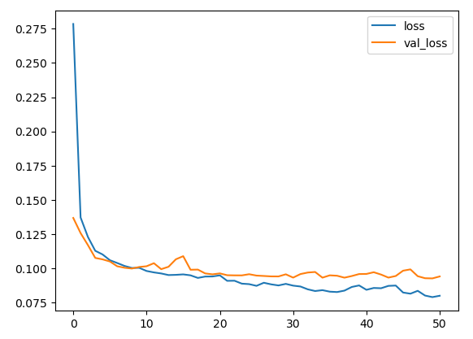
Learning curve (loss)
Loss
Epochs
https://www.kaggle.com/code/ryanholbrook/overfitting-and-underfitting

Slide 19
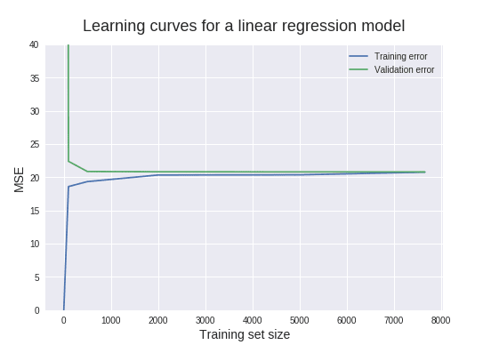
Learning curve (loss)
https://www.dataquest.io/blog/learning-curves-machine-learning/

Slide 20
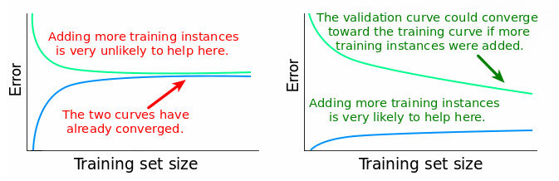
Learning curve (loss)
https://www.dataquest.io/blog/learning-curves-machine-learning/

Slide 21
Model Selection
Model selection
Regularization?
L1 regularization
L2 regularization
Dropout
Collect more training data?

Slide 22
Model-based vs. Instance-based

Slide 23

Model-based
Hypothesis:
$f(x)= θ_{0}+ θ_{1} x$
$θ_{i}$ : parameters
How to choose $θ_{i}$ ?

Slide 24
Model-based
The idea is to choose f(x) is close to our training example (x,y)
x | y
1 | 7
2 | 15
3 | 32
4 | 39
5 | 56

Slide 25
Model-based
Regression Line

Slide 26
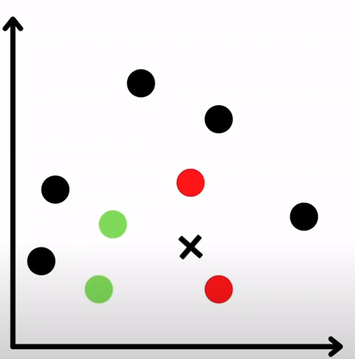
Instance-based
https://www.youtube.com/watch?v=zmKkvPTzgho

Slide 27
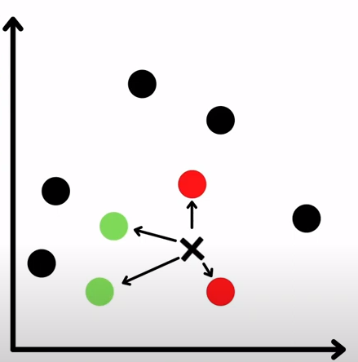
Instance-based
https://www.youtube.com/watch?v=zmKkvPTzgho

Slide 28
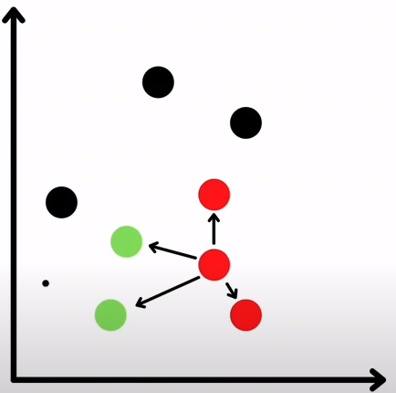
Instance-based
https://www.youtube.com/watch?v=zmKkvPTzgho

Slide 29
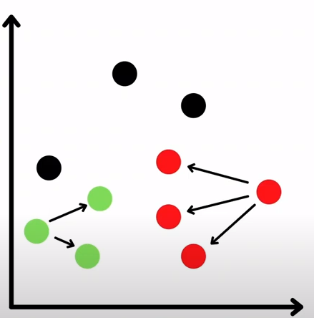
Instance-based
https://www.youtube.com/watch?v=zmKkvPTzgho

Slide 30
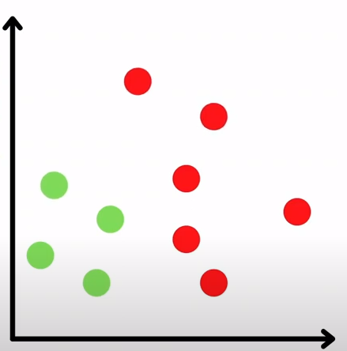
Instance-based
https://www.youtube.com/watch?v=zmKkvPTzgho

Slide 31
Model-based vs. Instance-based
Model-based
Use training data to create a model that has parameters learned from the training data.
e.g. Linear Regression, SVM
Instance-based Learning
k-Nearest Neighbors (kNN): looks at the close neighborhood of the input example in the space of feature vectors.

Slide 32
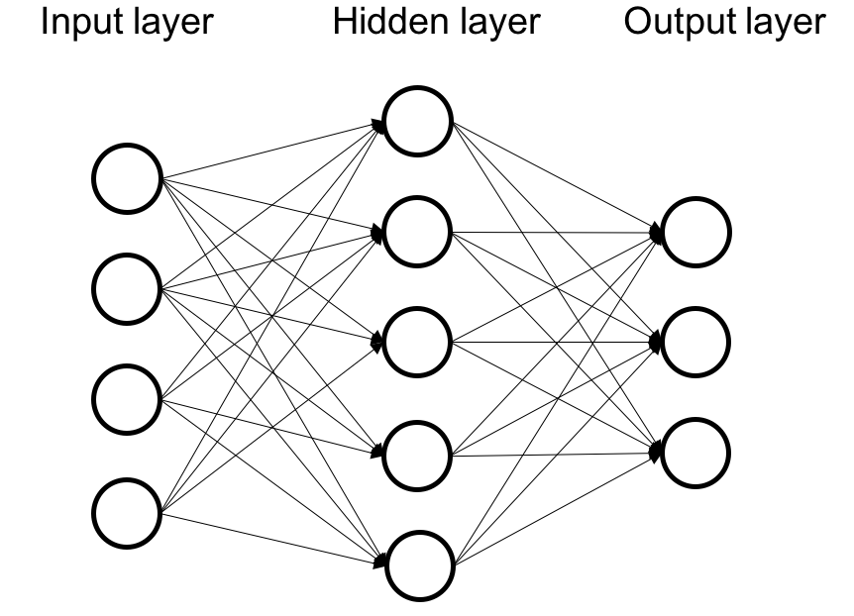
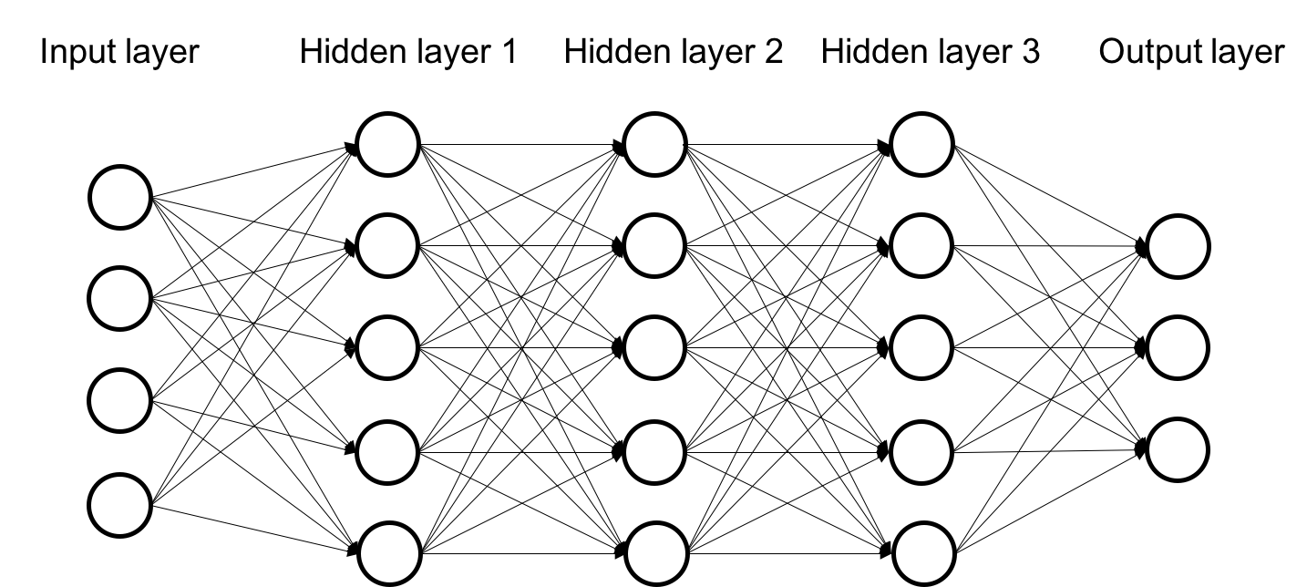
Shallow vs. Deep Learning
Shallow
Deep
Notes:
Also called hidden layers.

Slide 33
Shallow Learning

Slide 34
Shallow Learning
Regression

Slide 35
Shallow Learning
Regression

Slide 36
Shallow Learning
The model learns the parameters directly from the features of the training examples.
Notes:
Also called hidden layers.

Slide 37
Deep Learning
Notes:
Square feet (size), # of bedrooms.

Slide 38
Deep Learning
Deep
more than one layer, e.g. Neural network.
Parameters are learned not directly from the features of the training examples, but from the outputs of the preceding layers.

Slide 39
Shallow vs. Deep Learning
Shallow
the model learns the parameters directly from the features of the training examples.
Deep
more than one layer, e.g. Neural network.
Parameters are learned not directly from the features of the training examples, but from the outputs of the preceding layers.
Notes:
Also called hidden layers.

Slide 40
Fundamental Algorithms
Linear Regression
Logistic Regression
Decision Tree Learning
Support Vector Machine
k-Nearest Neighbors

Slide 41
Linear Regression
Example walk through using scikit-learn library

Slide 42
Supervised Learning
Regression

Slide 43
Supervised Learning
Regression

Slide 44

Linear Regression
$y=w_{0}+w_{1}x_{1}+w_{2}x_{2}+ …+w_{n}x_{n}$
y: dependent variable
x_{i}: independent variables
w_{i}: the coefficients (weights)

Slide 45
The key idea
The idea is to choose f(x) is close to our training example (x,y)
x | y
1 | 7
2 | 15
3 | 32
4 | 39
5 | 56

Slide 46
Regression Line

Slide 47

Mean Squared Error (MSE)
$MSE=\frac{1}{n}\sum_{i=1}^{n}{{\left(Y_{i}− {\hat{Y}}_{i}\right)}^{2}}$

Slide 48
Cost Function Intuition
The following 4 slides are from Andrew Ng’s machine learning course.

Slide 49

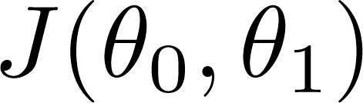


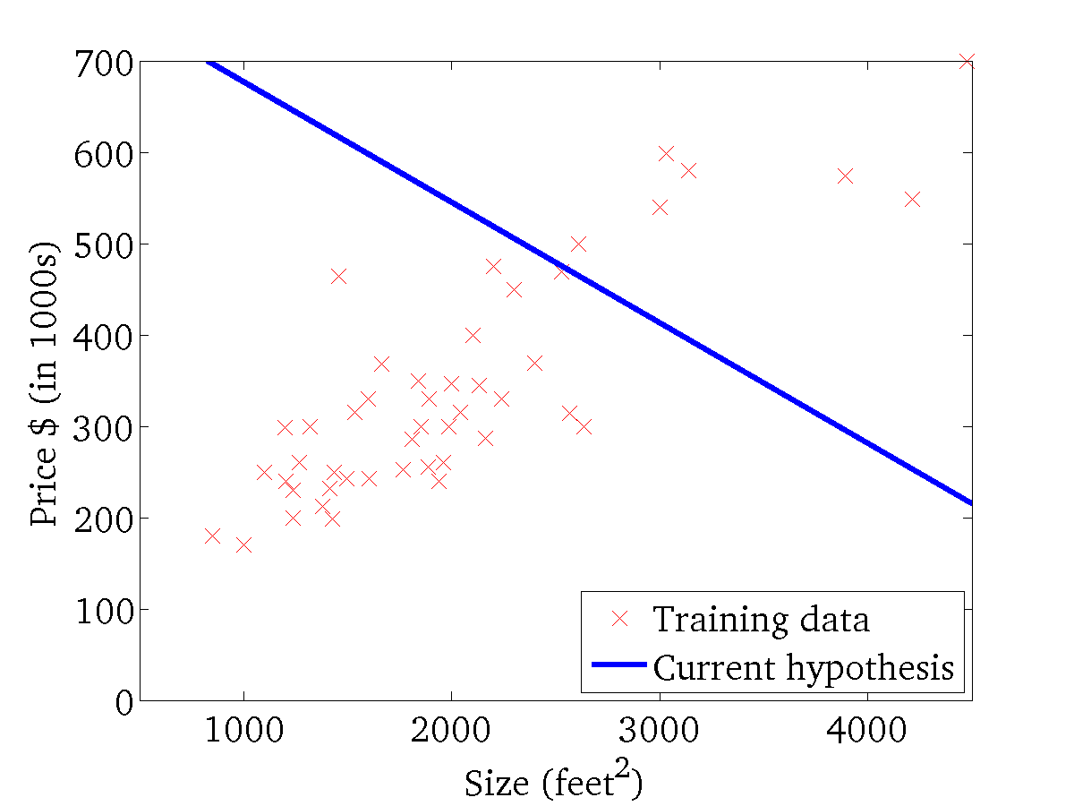
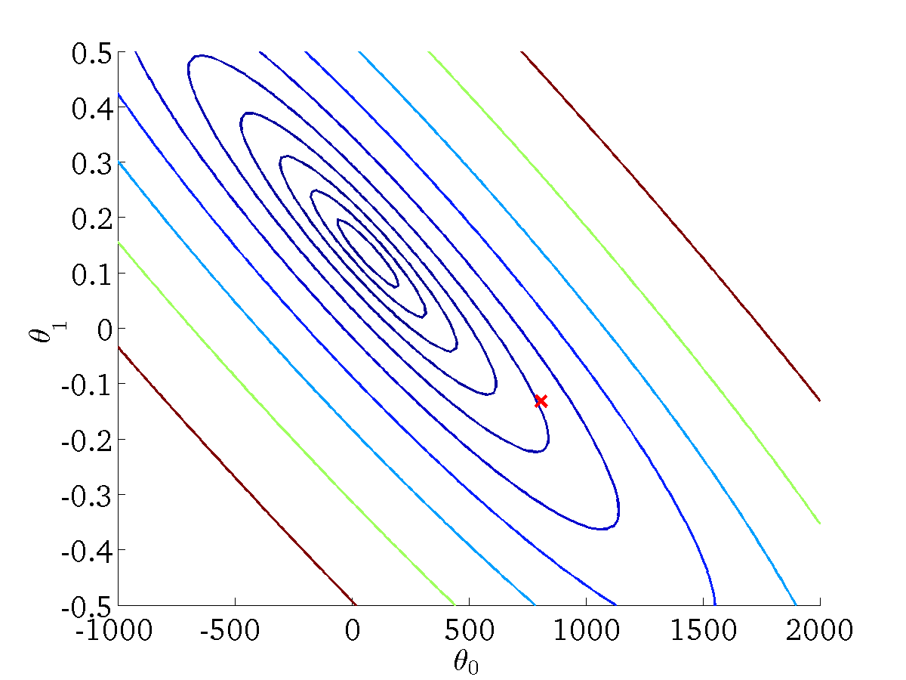
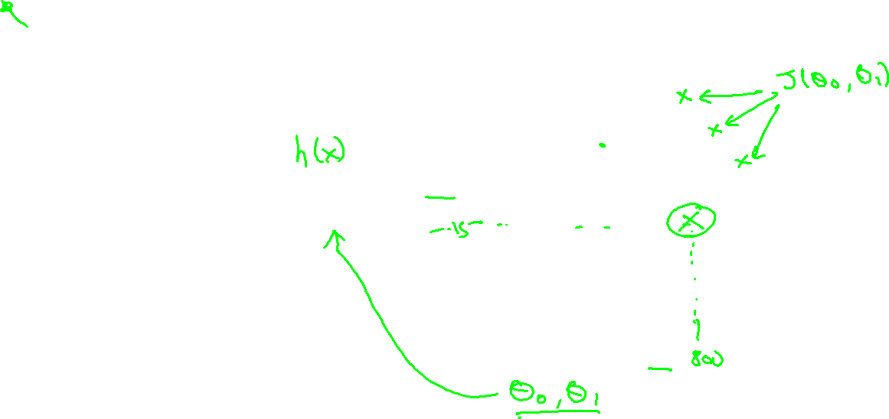
(for fixed , this is a function of x)
(function of the parameters )
Andrew Ng

Slide 50
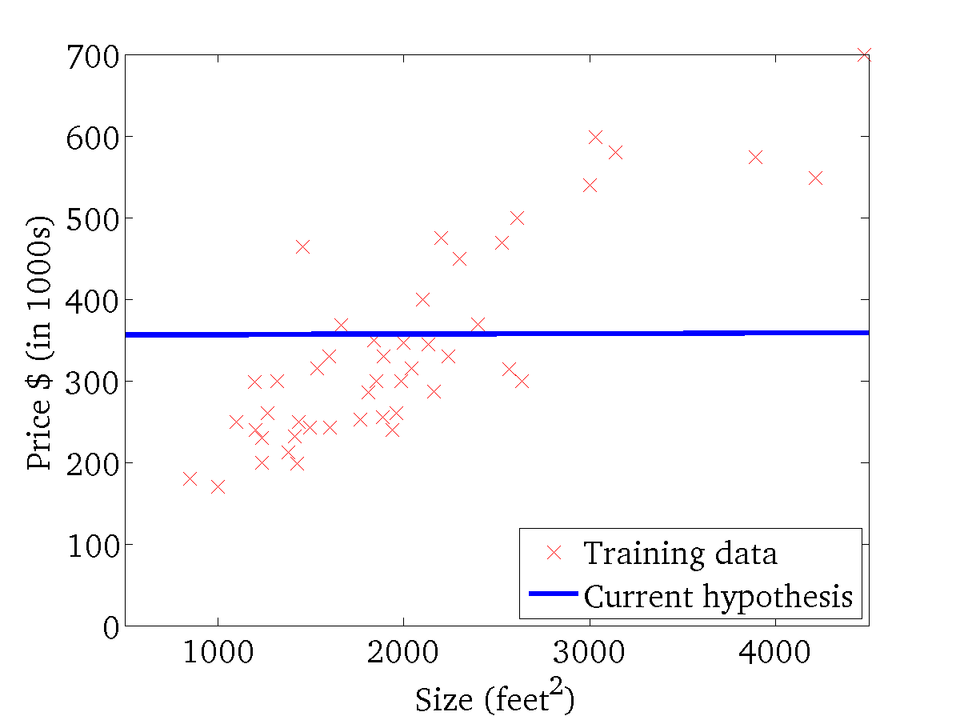
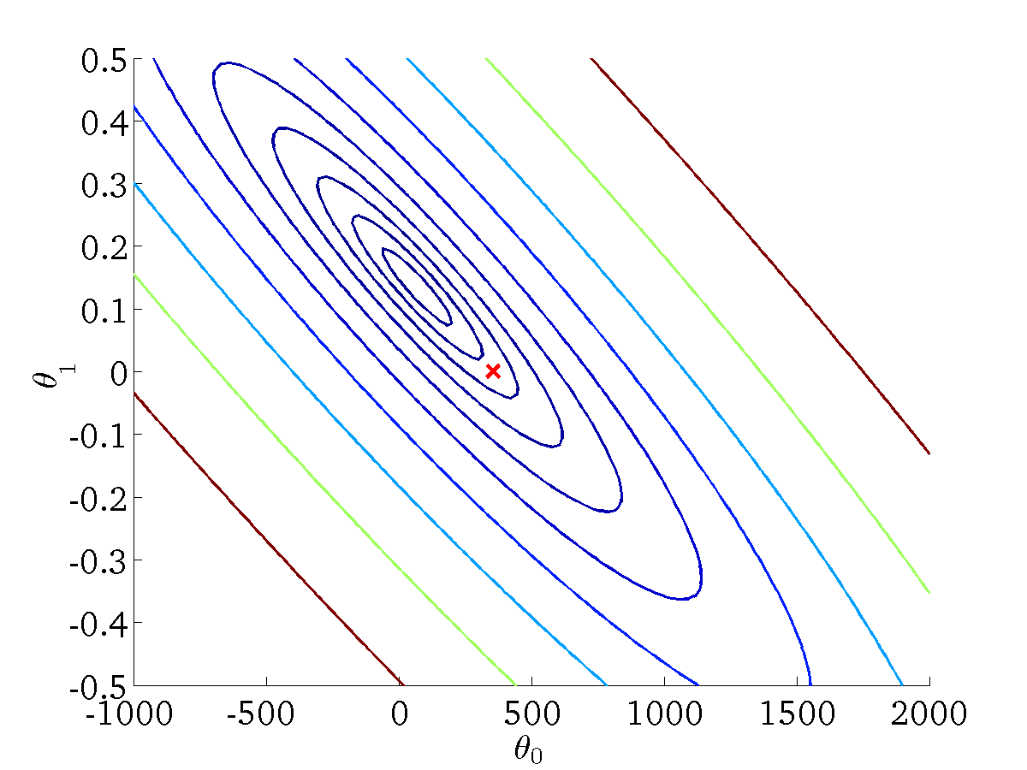
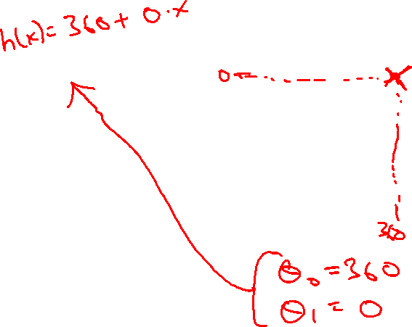
(for fixed , this is a function of x)
(function of the parameters )
Andrew Ng

Slide 51
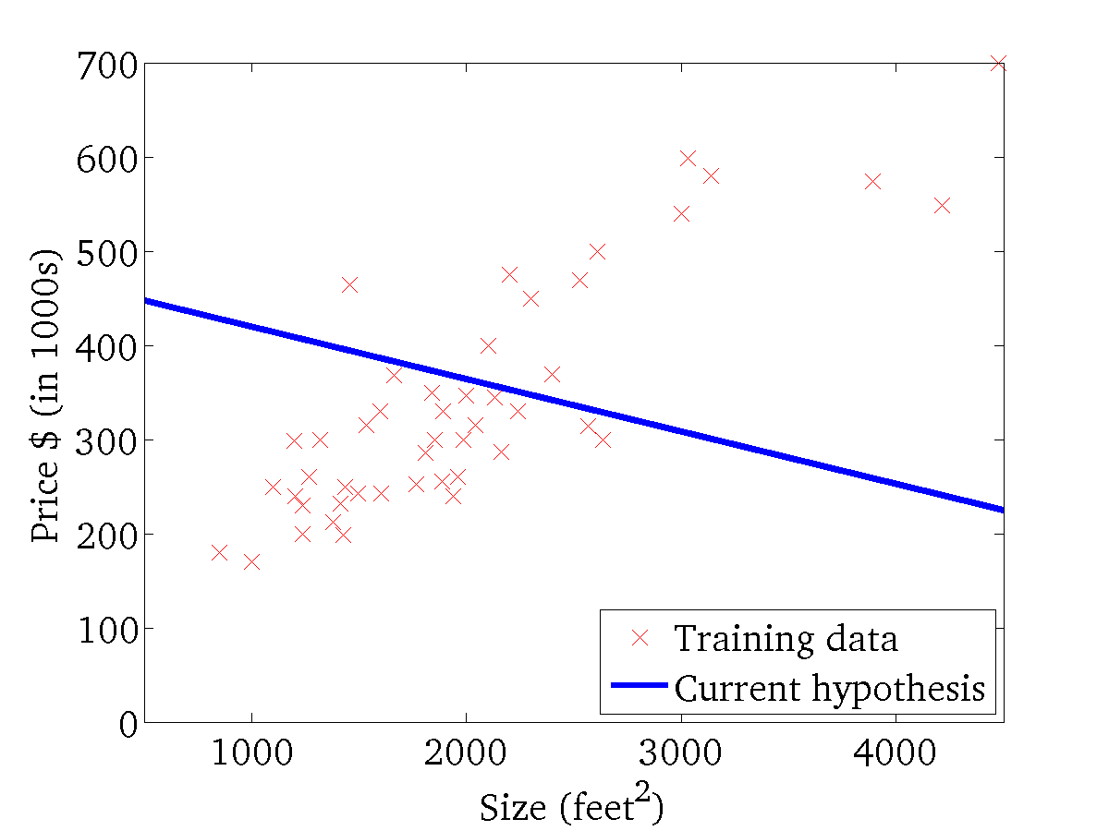

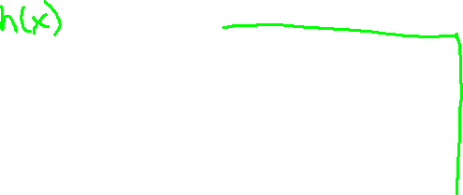
(for fixed , this is a function of x)
(function of the parameters )
Andrew Ng

Slide 52
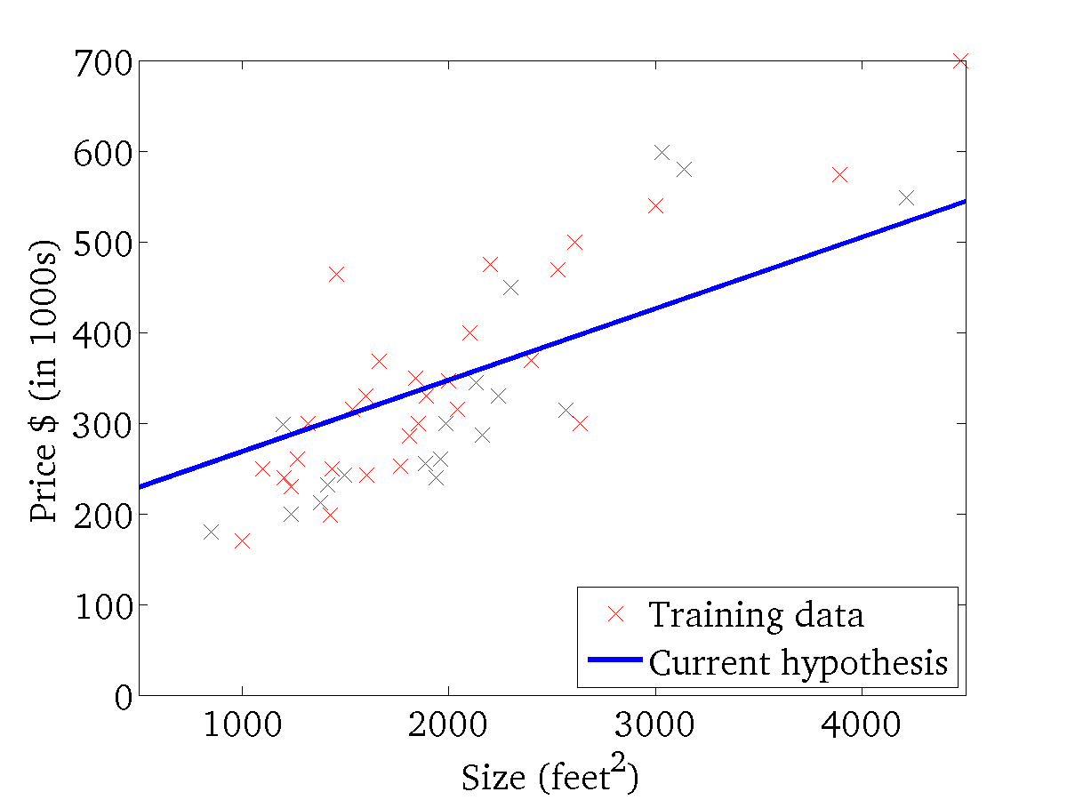
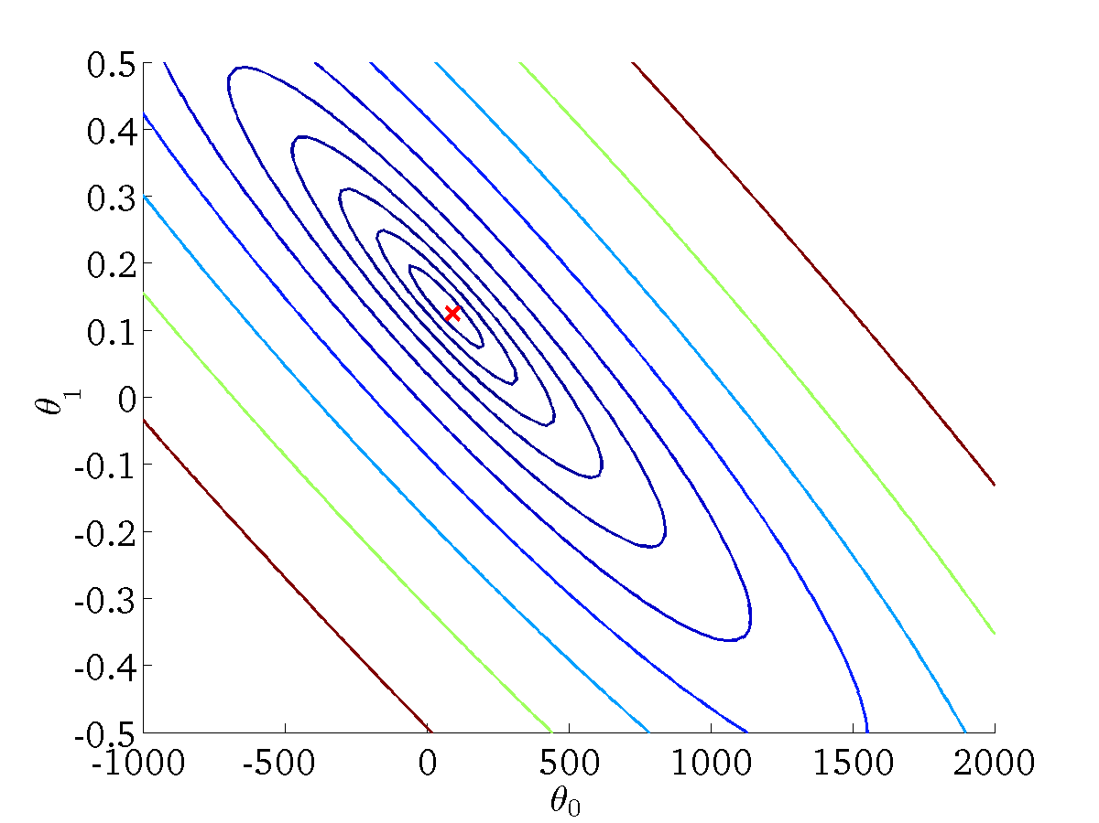
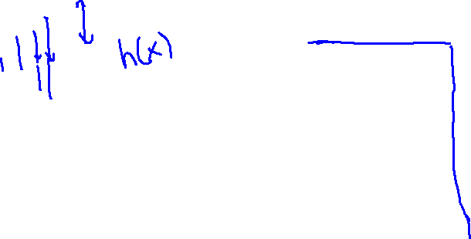
(for fixed , this is a function of x)
(function of the parameters )
Andrew Ng

Slide 53
Logistic Regression
Classification

Slide 54
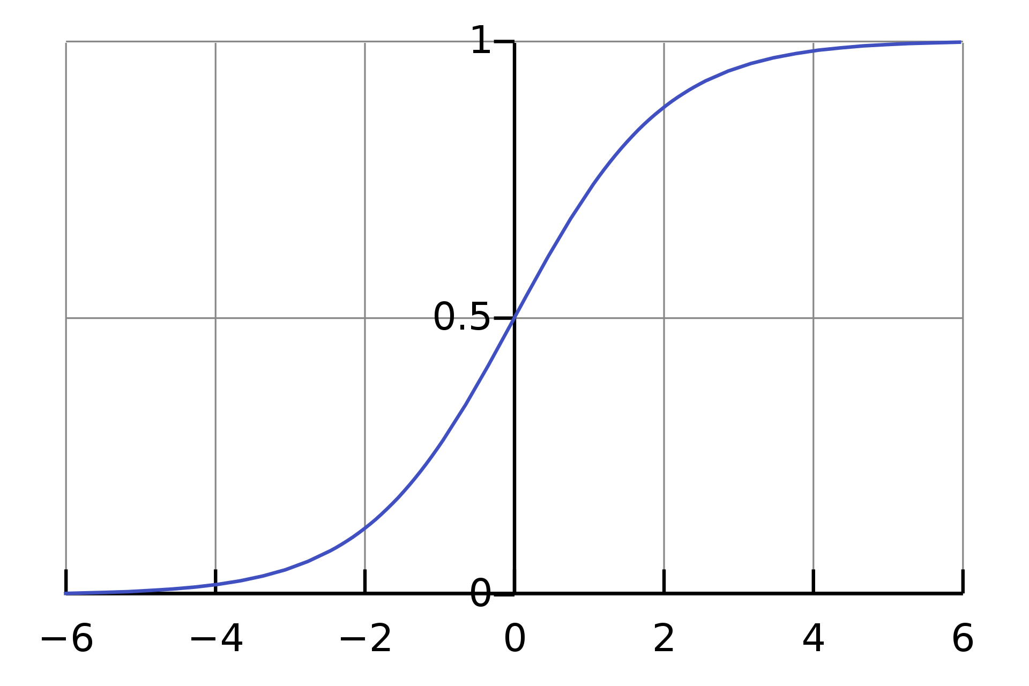

Logistic Regression
Classification algorithm
0$<h\left(x\right)≤1$
$h_{θ}\left(x\right)= \frac{1}{1+ e^{−θ^{T}}x}$

Slide 55

Logistic Regression
$h_{θ}\left(x\right)=0.7$
70% chance of tumor being malignant.

Slide 56
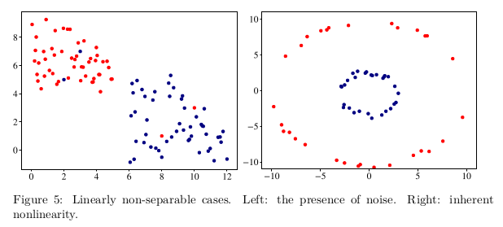
SVM
What if there’s noise in the data and no hyperplane can perfectly separate positive examples from negative ones?
What if the data cannot be separated using a plane, but could be separated by a higher-order polynomial?

Slide 57
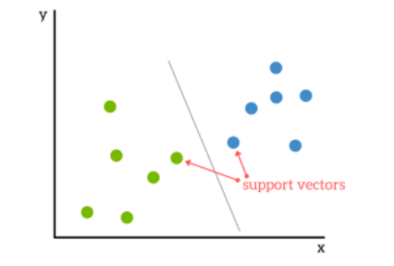
SVM: Support Vectors
https://www.kdnuggets.com/2016/07/support-vector-machines-simple-explanation.html

Slide 58
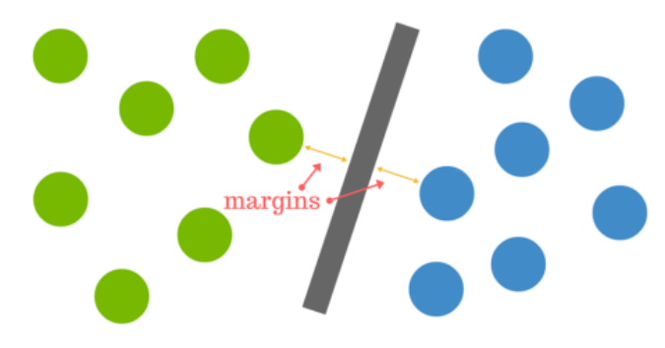
SVM: Plane
https://www.kdnuggets.com/2016/07/support-vector-machines-simple-explanation.html

Slide 59
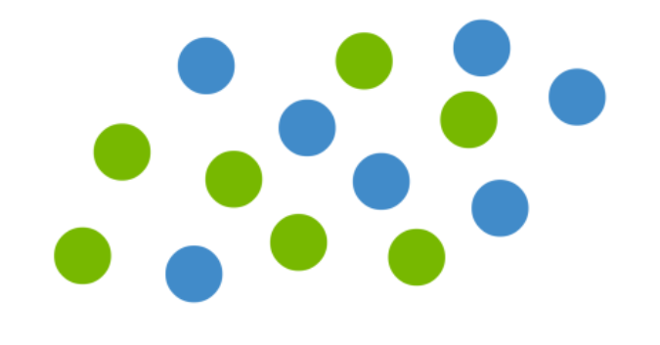
Not linearly separable
https://www.kdnuggets.com/2016/07/support-vector-machines-simple-explanation.html

Slide 60
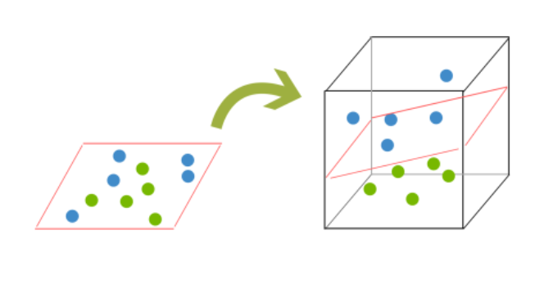
Kernels
https://www.kdnuggets.com/2016/07/support-vector-machines-simple-explanation.html

Slide 61
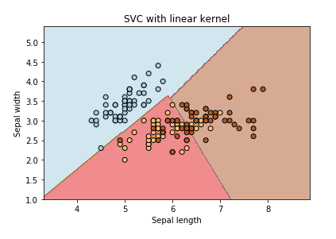
Linear Kernel
https://www.kaggle.com/code/residentmario/kernels-and-support-vector-machine-regularization

Slide 62
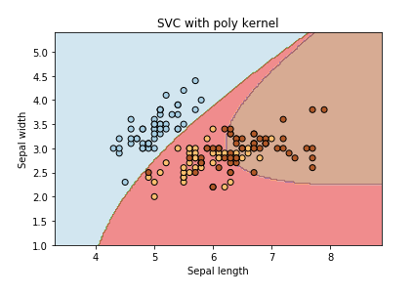
Polynomial Kernel
https://www.kaggle.com/code/residentmario/kernels-and-support-vector-machine-regularization

Slide 63
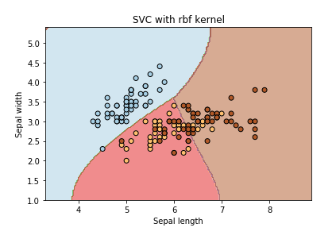
RBF Kernel
- Radial Basis Function (Gaussian)
- default in sklearn
https://www.kaggle.com/code/residentmario/kernels-and-support-vector-machine-regularization

Slide 64
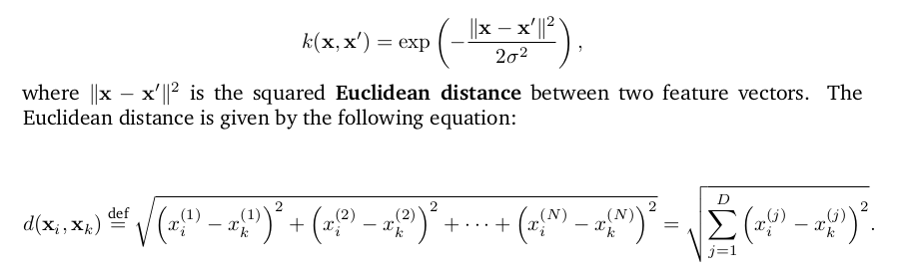
RBF Kernel
By varying the hyperparameter σ, the data analyst can choose between getting a smooth or curvy decision boundary in the original space.

Slide 65

SVM
$wx−b=0$
Satisfy the following constraints:
$wx_{i}−b≥1 if y_{i}=+1$
$wx_{i}−b≤−1 if y_{i}=−1$
We also need to minimize $\left\|w\right\|$

Slide 66
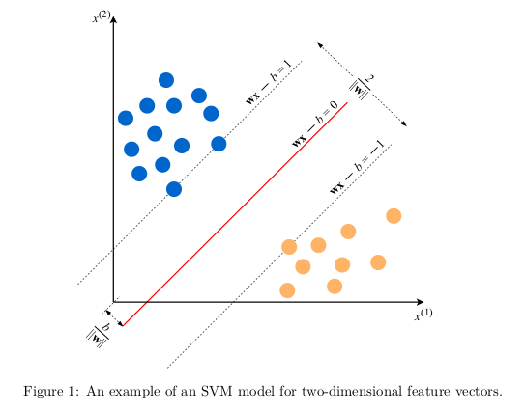
SVM
From The Hundred-Page Machine Learning Book

Slide 67
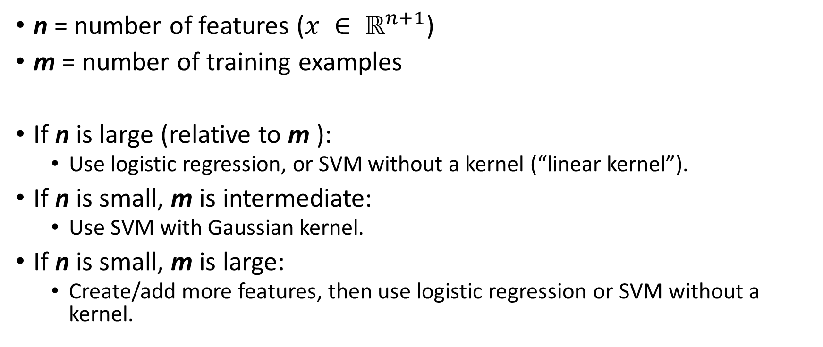
SVM vs. Logistic Regression
n = number of features ($x ∈ ℝ^{n+1}$)
m = number of training examples
If n is large (relative to m ):
Use logistic regression, or SVM without a kernel (“linear kernel”).
If n is small, m is intermediate:
Use SVM with Gaussian kernel.
If n is small, m is large:
Create/add more features, then use logistic regression or SVM without a kernel.
Andrew Ng

Slide 68
Decision Trees
Let’s look at this example and build a decision tree:
Let’s do some entropy and information gain calculations.
Weather | Parents | Decision
Rain | No | Stay_home
Overcast | No | Stay_home
Sunny | Yes | Go_out

Slide 69
Decision Trees
Parents
yes
no
weather
weather
sunny
rain
overcast
Go_out
Stay_home
Stay_home

Slide 70
Neural Networks and Deep Learning
Neural Networks
Feed-forward Neural Networks
Multilayer Perceptron (MLP)

Slide 71
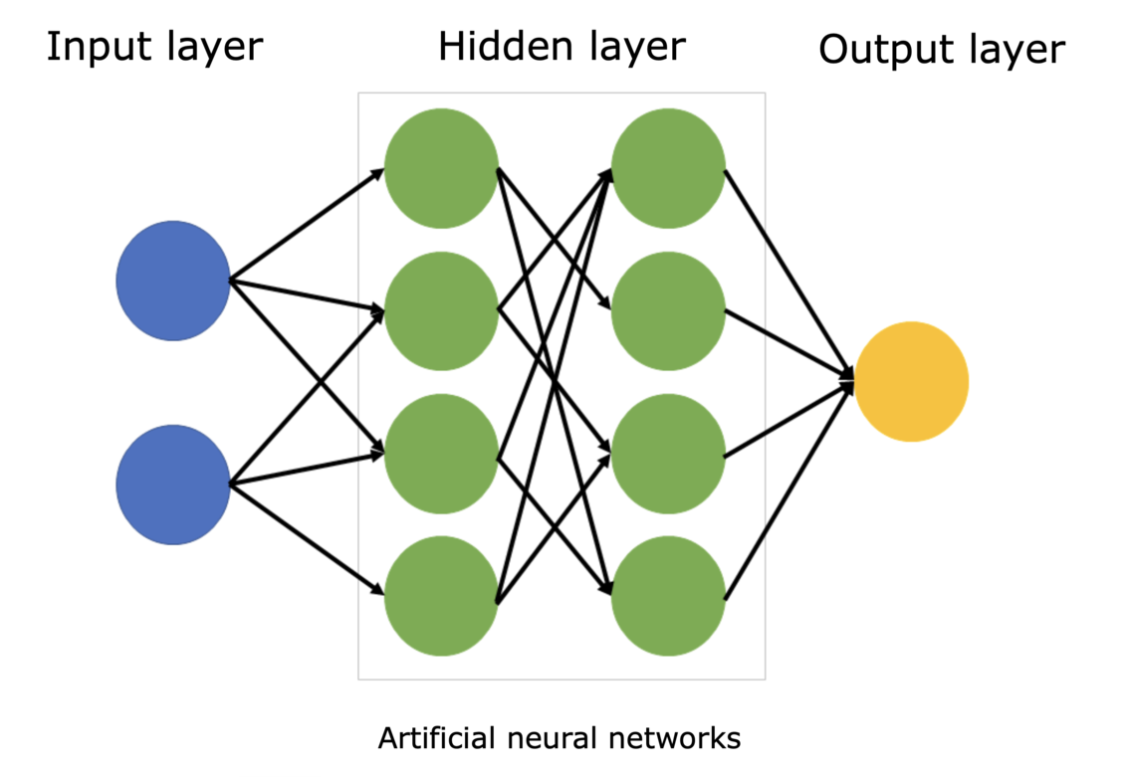
Neural Networks
Figure from: https://www.sciencelearn.org.nz/images/5156-neural-network-diagram

Slide 72
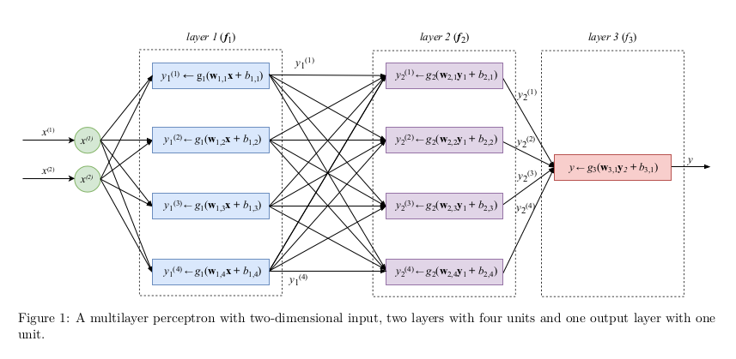
Multilayer Perceptron
The Hundred-Page Machine Learning Book

Slide 73
Neural Networks and Back Propagation
If you have time, watch this tutorial on neural nets and back propagation:
https://www.youtube.com/watch?v=VMj-3S1tku0

Slide 74
Deep Learning
Deep Learning
Convolution Neural Network (CNN)
Long Short-Term Memory (LSTM)

Slide 75
Linear Regression
Tutorial (Jupyter Notebook)
https://colab.research.google.com/drive/1Xcgnkm2GxOBJtLxnTAx5vztnw4cOsWgm?usp=sharing
Useful resources
Animation
https://mlu-explain.github.io/linear-regression/

Slide 76
SVM tutorial
Jupyter Notebook based on
https://scikit-learn.org/stable/auto_examples/classification/plot_digits_classification.html
https://colab.research.google.com/drive/1Xcgnkm2GxOBJtLxnTAx5vztnw4cOsWgm?usp=sharing

Slide 77
Code Samples
Underfitting, Overfitting
https://colab.research.google.com/drive/1oMWxppsnhsrU3lkEy0uzwJbcrMRUqr3C?usp=sharing
Validation Curve
https://colab.research.google.com/drive/171dADTSrX6sCF3Rll5SQTnpjr-KIhmut?usp=sharing
Linear Regression, SVM, kNN
https://colab.research.google.com/drive/1Xcgnkm2GxOBJtLxnTAx5vztnw4cOsWgm?usp=sharing

