Slide 1

Are You Credit_worthy
Group 4
Olivia Yu
Oliver James Uy
Liwei Jiang
11 June 2024

Slide 2
Aims
This project aims to
generate a well-performing prediction model for assessing the eligibility for a credit card.
given the historical data to evaluate the determining factors considered by financial institutions when assessing an individual’s eligibility for a credit card.
explore how to improve the accuracy of modelling to assist with assessing individuals’ eligibility for a credit card.

Slide 3
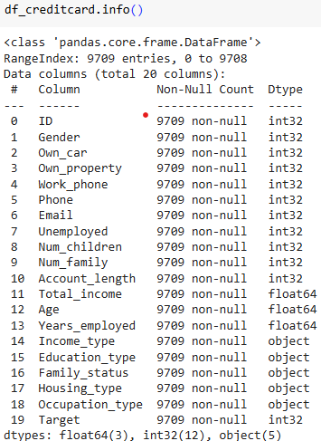
Methodology
Data:
Credit Card Eligibility Data: Determining Factors (kaggle.com)
A wide range of features including demographic, financial, personal attributes
9709 non-null rows

Slide 4
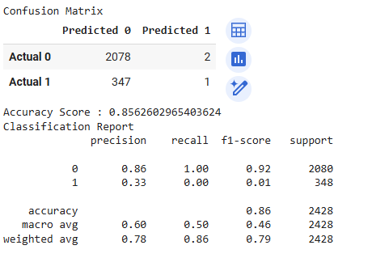
Methodology
Random Forest Model

Slide 5
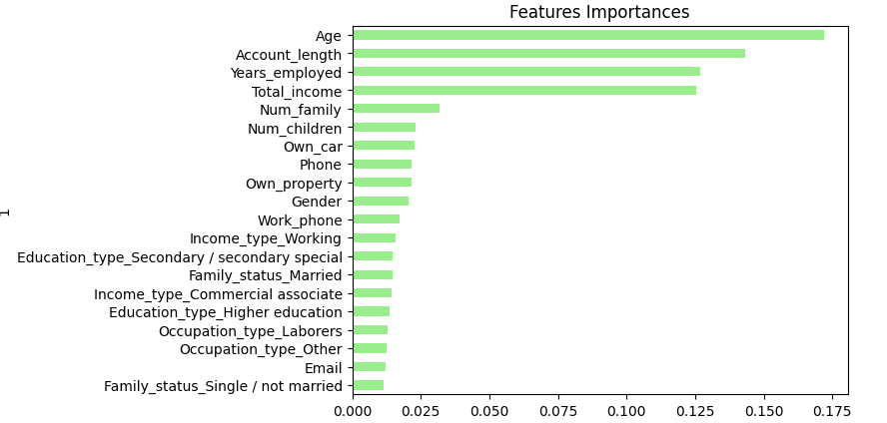
Methodology
Random Forest Model (cont.)

Slide 6
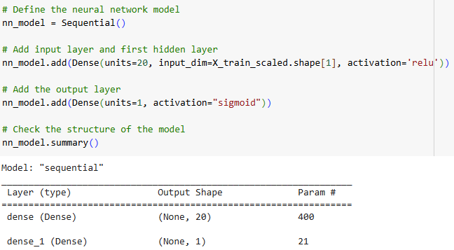
Optimise the Model
Neural network model
Winsorised the continuous features
Keep only the 20 most important determining factors (features)

Slide 7
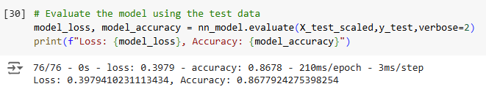
Optimise the Model
Neural network model (cont.): performance comparison

Slide 8
Thank you

