Slide 1
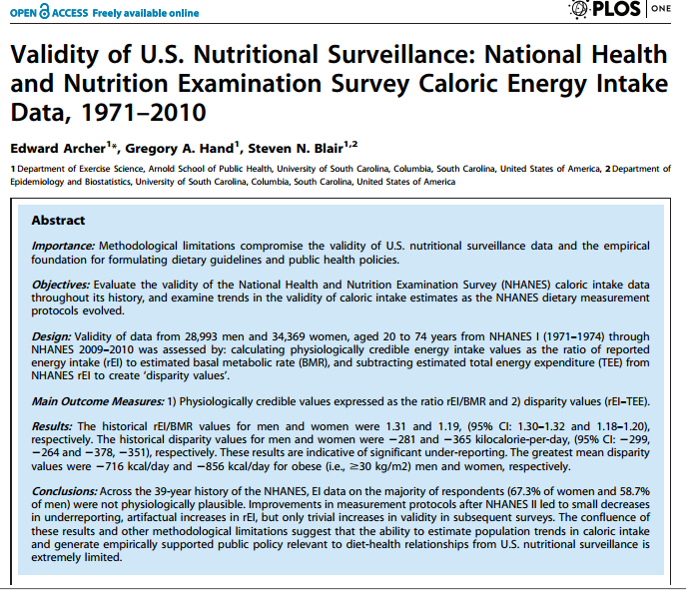

Slide 2
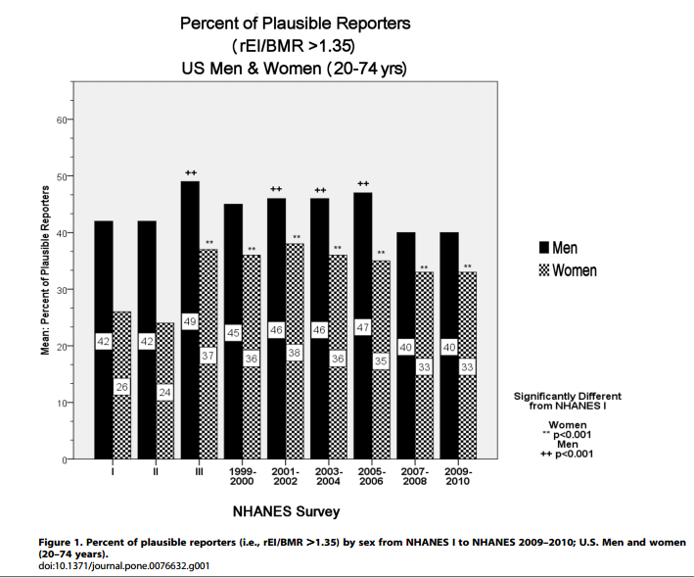

Slide 3
Household food insecurity: another window into problems of nutrition inequity in Canada

Slide 4
“Food security exists when
all people, at all times, have physical and economic access to sufficient, safe and nutritious food to meet their dietary needs and food preferences for an active and healthy life”
Canada’s Action Plan on Food Security, 1998.

Slide 5
Food security
Individual/household Community
access food system

Slide 6
household food insecurity:
insecure or inadequate access to food due to financial constraints

Slide 7



Slide 8
Measuring ‘hunger’ on national surveys:
1994:
Has your child ever experienced being hungry because the family has run out of food or money to buy food?
1996:
Which of the following best describes the food situation in your household?
always enough food to eat
sometimes not enough food to eat, or
often not enough food to eat?
1998:
In the past 12 months, did you or anyone in your household
worry that there would not be enough food to eat because of a lack of money?
not eat the quality or variety of foods that you wanted because of a lack of money?
not have enough food to eat because of a lack of money?

Slide 9
Household Food Security Survey Module
(administered on the Canadian Community Health Survey since 2004)
18 questions, differentiating adults’ and children’s experiences over last 12 months:
Worry about not having enough food
Reliance on low-cost foods
Not being able to afford balanced meals
Adults/children skip meals
Adults/children cut size of meals
Adults/children not having enough to eat
Adults/children not eating for whole day
“because there wasn’t enough money to buy food?”

Slide 10
Canadian Community Health Survey
Conducted annually by Statistics Canada to monitor the health of the population.
Surveys a nationally representative sample of approximately 60,000 Canadians, 12 years of age and older
  Omits people living on reserves and in institutions, members of the Armed Forces, and people who are homeless.
Food security module is not always part of the common content, and on years when it has been optional, some provinces and territories have opted out.

Slide 11
Conceptualization of household food insecurity underpinning survey module (HFSSM): household food insecurity as a managed process.
Anxiety
Qualitative compromises in
food selection
Quantitative compromises in
food intake, hunger

Slide 12
Conceptualization of household food insecurity underpinning survey module (HFSSM): household food insecurity as a managed process.
Anxiety
Qualitative compromises in
food selection
Quantitative compromises in
food intake, hunger

Slide 13
Comparing the experience of household food insecurity as captured across 22 scales and related ethnographies from 15 different countries:
Commonalities:
Uncertainty and worry about food
Inadequate food quality
Insufficient food quantity
Domain recognized in ethnographic work but not represented on scales:
Social unacceptability
Consequences (vs core elements) of the experience:
Hunger and other physiological consequences – present on most scales
Alienation (Hamelin et al, ) – absent
(Coates et al, J Nutr, 2006)

Slide 14
Quebec adults’ accounts of their experiences of food insecurity:
a profound lack of food choice, monotony of diet
disruptions to familial dining patterns
need to engage in highly stigmatized means of food acquisition
strong feelings of powerlessness, inequity, frustration → alienation
(Hamelin et al., Soc Sci & Medicine, 2002)

Slide 15
Health Canada’s coding
Household food insecurity: ≥ 2 affirmatives
 | 10-item adult scale | 8-item child scale
Food secure | 0-1 affirmatives | 0-1 affirmatives
Moderately food insecure | 2-5 affirmatives | 2-4 affirmatives
Severely food insecure | ≥ 6 affirmatives | ≥ 5 affirmatives

Slide 16
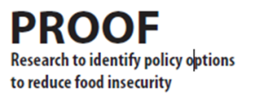
Household food insecurity
Canadian Community Health Survey, 2011
Moderate food insecurity
5.6%
Severe food insecurity
2.5%
12.3% of Canadian households experienced some food insecurity in 2011
= 3.9 million people,
including 1.1 million children.
Marginal food insecurity 4.1%

Slide 17
Food insecurity increased from 11.3% in 2008 to 12.3% in 2011 → meaning 450,000 more Canadians were affected.

Slide 18
Inconsistent measurement on early surveys means that prevalence estimates cannot be compared over time.
1994 National Longitudinal Survey of Children & Youth | Child hunger | 1.2%
1996-97 National Population Health Survey | Household food insufficiency | 4.0%
1998-99 National Population Health Survey | Worry, quality, quantity* | 10.4%
2000-01 Canadian Community Health Survey | Worry, quality, quantity* | 14.7%
2004 Canadian Community Health Survey (Cycle 2.2) | 18-item Food Security Module** | 9.2%
2007-08 Canadian Community Health Survey | 18-item Food Security Module** | 7.7%
*response categories differ, so not comparable.
**differences in sampling limit comparability.

Slide 19
USDA’s coding of 18-item module
Household food insecurity = ≥ 3 affirmatives
 | 10-item adult scale | 8-item child scale
Food secure | 0-2 affirmatives | 0-1 affirmatives
Low food security | 3-5 affirmatives | 2-4 affirmatives
Very low food security | ≥ 6 affirmatives | ≥ 5 affirmatives

Slide 20
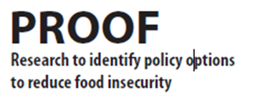
Food insecurity in Canada and the US in 2011
 | Canada |  | US
 | Households (000s) | % | Households (000s) | %
Total food insecure | 831.8 | 6.4 | 17,853 | 14.9
Low food security | 504.9 | 3.9 | 11,014 | 9.2
Very low food security | 327.0 | 2.5 | 6,839 | 5.7

Slide 22
Nunavut Inuit Child Health Survey, 2007-08
Random sample of 388 children, 3-5 yrs
18-item food security module, Health Canada’s coding.
Results:
Household food insecurity: 70%
Child food insecurity: 56%
→ 31% moderate + 25% severe food insecurity
(Egeland et al, CMAJ, 2010.)

Slide 24
 | Food Insecure |  | Marginal | Moderate | Severe
 | Number (000s) | Percent | Percent | Percent | Percent
All Households | 1,592.4 | 12.3% | 4.1% | 5.6% | 2.5%
Household composition:
With children under 18 | 613.8 | 16.0% | 5.6% | 7.9% | 2.6%
With children under 6 | 270.4 | 17.1% | 6.1% | 8.9% | 2.2%
Couple, with children | 348.3 | 11.7% | 4.5% | 5.9% | 1.3%
Female lone parent | 212.8 | 35.1% | 10.8% | 15.4% | 8.9%
Male lone parent | 27.2 | 19.6% | 5.9% | 12.6% | 1.1%
Other³ | 18.0 | 24.9% | 6.7% | 13.9% | 4.2%
With no children < 18 | 978.7 | 10.7% | 3.4% | 4.7% | 2.5%
Unattached, living alone or with others | 639.6 | 15.8% | 4.6% | 6.8% | 4.5%
Couple, no children | 196.8 | 5.5% | 2.2% | 2.4% | 0.8%
Couple, with children | 68.7 | 7.0% | 2.7% | 3.7% | 0.6%
Female lone parent | 56.0 | 15.4% | 5.4% | 6.5% | 3.4%
Male lone parent | 11.8 | 11.6% | 2.3% | 4.9% | 4.3%
Other | 4.5 | 8.0% | 1.9% | 6.1% | 0.0%
Elderly living alone | 73.5 | 6.3% | 3.0% | 2.5% | 0.8%

Slide 25
 | Food Insecure |  | Marginal | Moderate | Severe
 | Number (000s) | Percent | Percent | Percent | Percent
All Households | 1,592.4 | 12.3% | 4.1% | 5.6% | 2.5%
Household composition:
With children under 18 | 613.8 | 16.0% | 5.6% | 7.9% | 2.6%
With children under 6 | 270.4 | 17.1% | 6.1% | 8.9% | 2.2%
Couple, with children | 348.3 | 11.7% | 4.5% | 5.9% | 1.3%
Female lone parent | 212.8 | 35.1% | 10.8% | 15.4% | 8.9%
Male lone parent | 27.2 | 19.6% | 5.9% | 12.6% | 1.1%
Other³ | 18.0 | 24.9% | 6.7% | 13.9% | 4.2%
With no children < 18 | 978.7 | 10.7% | 3.4% | 4.7% | 2.5%
Unattached, living alone or with others | 639.6 | 15.8% | 4.6% | 6.8% | 4.5%
Couple, no children | 196.8 | 5.5% | 2.2% | 2.4% | 0.8%
Couple, with children | 68.7 | 7.0% | 2.7% | 3.7% | 0.6%
Female lone parent | 56.0 | 15.4% | 5.4% | 6.5% | 3.4%
Male lone parent | 11.8 | 11.6% | 2.3% | 4.9% | 4.3%
Other | 4.5 | 8.0% | 1.9% | 6.1% | 0.0%
Elderly living alone | 73.5 | 6.3% | 3.0% | 2.5% | 0.8%

Slide 26
 | Food Insecure |  | Marginal | Moderate | Severe
 | Number (000s) | Percent | Percent | Percent | Percent
All Households | 1,592.4 | 12.3% | 4.1% | 5.6% | 2.5%
Household composition:
With children under 18 | 613.8 | 16.0% | 5.6% | 7.9% | 2.6%
With children under 6 | 270.4 | 17.1% | 6.1% | 8.9% | 2.2%
Couple, with children | 348.3 | 11.7% | 4.5% | 5.9% | 1.3%
Female lone parent | 212.8 | 35.1% | 10.8% | 15.4% | 8.9%
Male lone parent | 27.2 | 19.6% | 5.9% | 12.6% | 1.1%
Other³ | 18.0 | 24.9% | 6.7% | 13.9% | 4.2%
With no children < 18 | 978.7 | 10.7% | 3.4% | 4.7% | 2.5%
Unattached, living alone or with others | 639.6 | 15.8% | 4.6% | 6.8% | 4.5%
Couple, no children | 196.8 | 5.5% | 2.2% | 2.4% | 0.8%
Couple, with children | 68.7 | 7.0% | 2.7% | 3.7% | 0.6%
Female lone parent | 56.0 | 15.4% | 5.4% | 6.5% | 3.4%
Male lone parent | 11.8 | 11.6% | 2.3% | 4.9% | 4.3%
Other | 4.5 | 8.0% | 1.9% | 6.1% | 0.0%
Elderly living alone | 73.5 | 6.3% | 3.0% | 2.5% | 0.8%

Slide 27
16.1% of households with children under 18 were food insecure in 2011.

Slide 28
Prevalence of household food insecurity by income (2011)

Slide 29
In addition to income, 4 other predictors of food insecurity are consistently identified in multivariate analyses of population surveys:
Lack of home ownership
Aboriginal status
Lone-motherhood
Reliance on social assistance
(McIntyre et al, Canadian Medical Association Journal 2000; Che & Chen, Health Reports, 2001; Vozoris & Tarasuk, Journal of Nutrition 2003; Ledrou & Gervais, Health Reports 2005; Health Canada, 2007; Tarasuk & Vogt, Canadian Journal of Public Health 2009; Willows et al, Public Health Nutrition 2008.)

Slide 31
Social assistance
65% of households reliant on social assistance are food insecure.
Incomes fall below basic living costs in most jurisdictions.
Limits on assets mean no capacity to buffer sudden increases in expenses or interruptions in income.
Most provinces do not index social assistance incomes to inflation.

Slide 32
Benefits to senior citizens
7% of households reliant on seniors’ incomes are food insecure.
Seniors have guaranteed annual incomes, indexed to inflation, and
drug coverage, transit subsidies, ‘seniors days’ discounts, ….

Slide 33
For next week, please read
Seligman HK, Schillinger D. Hunger and socioeconomic disparities in chronic disease. New England Journal of Medicine, 2010; 363(1): 6-9.
Kirkpatrick et al. Child hunger and long-term adverse consequences for health. Archives of Pediatrics and Adolescent Medicine. 2010; 164(8):754-762.
Tarasuk et al. Chronic Physical and Mental Health Conditions among Adults May Increase Vulnerability to Household Food Insecurity. Journal of Nutrition 2013.

