Slide 1
Household income, food insecurity and nutrition in Canadian youth.
Mark et al, Can J Public Health 2012; 103(2): 94-99.
Analysis of single 24-hr recalls and measured anthropometric data from CCHS 2004 for 8,938 youth, 9-18 yr.
Significant income gradients were observed for:
Height
Calcium among girls
Milk products, calcium, and vitamin D among boys
No significant income-related differences observed for fruit and vegetables, sweetened beverages, fibre, or saturated fat.
adjusted for energy

Slide 2
Mean height percentiles of Canadian youth, 9-18 yr, by adequacy of household income (Mark et al, 2012)
*
*
Test for trend in income: p = 0.047 for boys
p=0.001 for girls.
* p < 0.05 with high-income as the referent category.

Slide 3
Mean calcium intakes of Canadian youth, 9-18 yr, by adequacy of household income (Mark et al, 2012)
*
*
*
Test for trend in income, adjusting for energy intake:
p = 0.005 for boys and p < 0.001 for girls.
* p < 0.05 with high-income as the referent category.

Slide 4
Household food insecurity: another window into problems of nutrition inequity in Canada

Slide 5


“Food security exists when
all people, at all times, have physical and economic access to sufficient, safe and nutritious food to meet their dietary needs and food preferences for an active and healthy life”
(Canada’s Action Plan on Food Security, 1998)
food supply
access

Slide 6

Household food insecurity:
insecure or inadequate access to food due to financial constraints
- popularly termed “hunger”

Slide 7
Conceptualization of household food insecurity as a managed process:
Anxiety
Qualitative compromises in
food selection
Quantitative compromises in
food intake, hunger

Slide 8
Measuring ‘hunger’ on national surveys:
1994 – National Longitudinal Survey of Children and Youth:
Has your child ever experienced being hungry because the family has run out of food or money to buy food?
1996 – National Population Health Survey:
Which of the following best describes the food situation in your household?
always enough food to eat
sometimes not enough food to eat, or
often not enough food to eat?
1998 – National Population Health Survey:
In the past 12 months, did you or anyone in your household
worry that there would not be enough food to eat because of a lack of money?
not eat the quality or variety of foods that you wanted because of a lack of money?
not have enough food to eat because of a lack of money?

Slide 9
Household Food Security Survey Module
(administered on the Canadian Community Health Survey (CCHS) since 2004)
18 questions, differentiating adults’ and children’s experiences over last 12 months:
Worry about not having enough food
Reliance on low-cost foods
Not being able to afford balanced meals
Adults/children skip meals
Adults/children cut size of meals
Adults/children not having enough to eat
Adults/children not eating for whole day
“because there wasn’t enough money to buy food?”

Slide 10
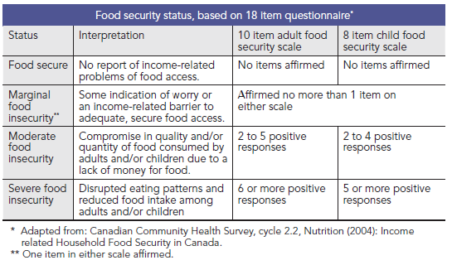
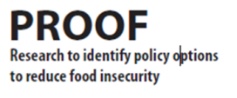
Note: Prevalence estimates published by Statistics Canada and Health Canada only include moderate and severe food insecurity.

Slide 11
Why consider marginal food insecurity as a distinct level of food insecurity instead of grouping it with ‘food secure’?
  Marginally food insecure households report conditions of reduced food access and anxiety about the availability of food.
Compared to food secure, they are more likely to show other indications of material hardship.
  e.g., Marginally food-insecure families were more likely to have borrowed money for rent; delayed bill payments and cancelled telephone, TV or internet services as a way to free up money for food. (Loopstra & Tarasuk, Journal of Hunger and Environmental Nutrition, 2013)
Research in Canada and the US suggests that a 3-category definition is most appropriate because there are meaningful distinctions among marginal, moderate, and severe food insecurity. (Coleman-Jensen, Social Indicators Research 2010)

Slide 12
Household Food Insecurity in Canada, 2007 - 2012
Worry about running out of food and/or limit food selection because of lack of money for food.
Compromise in quality and/or quantity of food due to a lack of money for food.
Miss meals, reduce food intake and at the most extreme go day(s) without food.
Data Source: Statistics Canada, Canadian Community Health Survey (CCHS), 2007, 2008, 2011 and 2012.

Slide 13
Household Food Insecurity in Canada in 2012
12.6% of households reported some food insecurity.
4 million Canadians lived in food-insecure households in 2012.
  This includes 1.15 million children (i.e., 1 in 6 Canadian children) under the age of 18.
CCHS must underestimate the true prevalence of food insecurity in Canada because this survey does not include people living on reserves, homeless people, and residents in some remote locations.
(Tarasuk, Mitchell & Dachner, Household Food Insecurity in Canada, 2012. 2014.)

Slide 14
Inconsistent measurement on early surveys means that national prevalence estimates prior to 2007 are not comparable even with each other.
1994 National Longitudinal Survey of Children & Youth | Child hunger | 1.2%
1996-97 National Population Health Survey | Household food insufficiency | 4.0%
1998-99 National Population Health Survey | Worry, quality, quantity* | 10.4%
2000-01 Canadian Community Health Survey | Worry, quality, quantity* | 14.7%
2004 Canadian Community Health Survey (Cycle 2.2) | 18-item Food Security Module** | 9.2%
2007-08 Canadian Community Health Survey | 18-item Food Security Module** | 7.7%
= moderate + severe food insecurity
*response categories differ, so not comparable.
**differences in sampling limit comparability.

Slide 15
Canada-US differences in the coding of food insecurity using the HFSSM mean prevalence estimates cannot be compared directly.
USDA’s coding of 18-item module:
 | 10-item adult scale | 8-item child scale
Food secure | 0-2 affirmatives | 0-1 affirmatives
Low food security | 3-5 affirmatives | 2-4 affirmatives
Very low food security | ≥ 6 affirmatives | ≥ 5 affirmatives
Household food insecurity = ≥ 3 affirmatives

Slide 16
Food insecurity in Canada and the US in 2011, using USDA’s coding to classify households:
 | Canada |  | US
 | Households (000s) | % | Households (000s) | %
Food Insecure | 898.5 | 6.8 | 17,632 | 14.5
Low food security | 570.4 | 4.3 | 10,679 | 8.8
Very low food security | 328.1 | 2.5 | 6,953 | 5.7

Slide 17
Geographic distribution and socio-demographic correlates of household food insecurity in 2011-12

Slide 18
12.6%
13.4%
16.2%
17.5%
15.6%
13.5%
11.7%
12.1%
12.5%
11.5%
12.7%
17.1%
20.4%
45.2%
Data Source: Statistics Canada, Canadian Community Health Survey (CCHS), 2012.

Slide 19
Nunavut Inuit Child Health Survey, 2007-08
Random sample of 388 children, 3-5 yrs
18-item food security module, Health Canada’s coding.
Results:
Household food insecurity: 70%
Child food insecurity: 56%
→ 31% moderate + 25% severe food insecurity
(Egeland et al, CMAJ, 2010.)

Slide 20
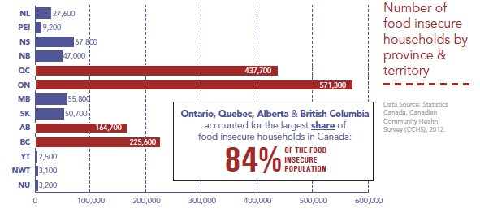
(Tarasuk, Mitchell & Dachner, Household Food Insecurity in Canada, 2012. Forthcoming.)

Slide 21
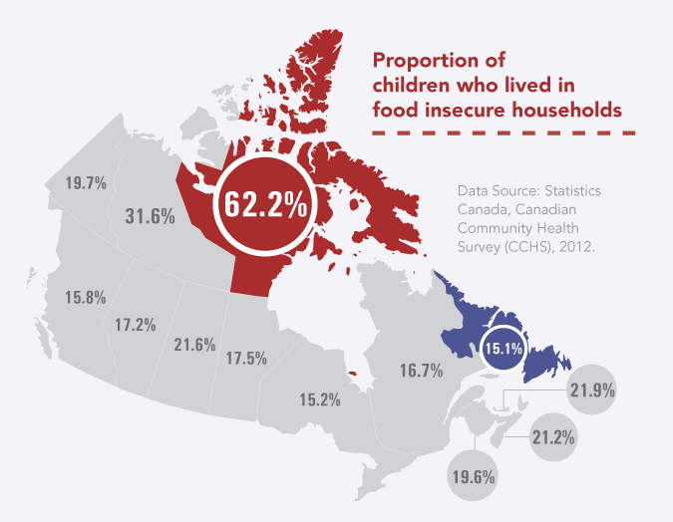
1 in 6 children under the age of 18 lived in a food-insecure household in 2012.
(Tarasuk, Mitchell & Dachner, Household Food Insecurity in Canada, 2012. Forthcoming.)

Slide 22
Single best predictor of household food insecurity = income.
Prevalence of food insecurity by household income (CCHS 2011)
Food insecurity captures material deprivation.
the product of
income (size, security, stability)
assets, savings
access to credit
shelter costs
other expenses (food, medications, debt, etc)

Slide 23
In addition to income, 4 other predictors of food insecurity have been consistently identified in multivariate analyses of population surveys:
Lack of home ownership
Aboriginal status
Lone-motherhood
Reliance on social assistance
(McIntyre et al, Canadian Medical Association Journal 2000; Che & Chen, Health Reports, 2001; Vozoris & Tarasuk, Journal of Nutrition 2003; Ledrou & Gervais, Health Reports 2005; Health Canada, 2007; Tarasuk & Vogt, Canadian Journal of Public Health 2009; Willows et al, Public Health Nutrition 2008.)

Slide 24
relationship between food bank statistics and food insecurity prevalence rates

Slide 25
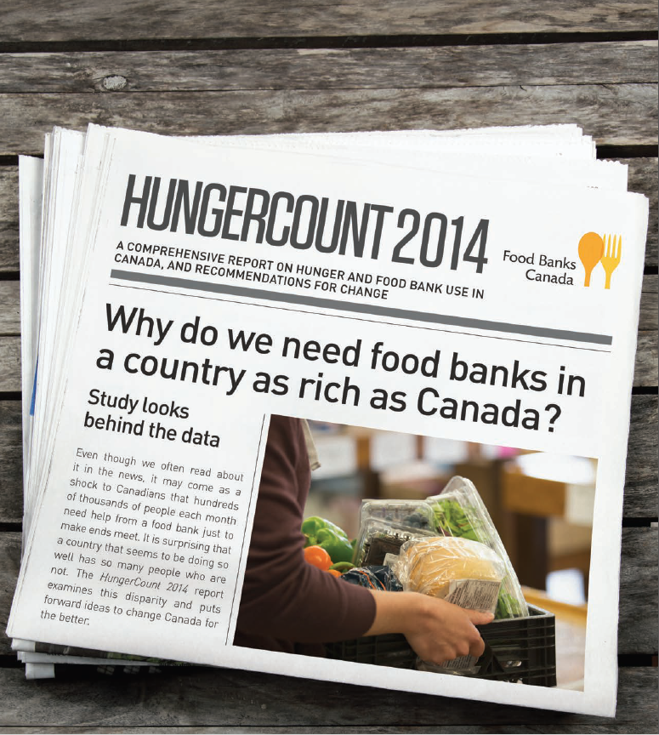

Slide 26
Number of Canadians using food banks in one month: March, 1989-2014
Source: Canadian Association of Food Banks/Food Banks Canada, 'HungerCounts' 2002-2014.

Slide 27
Relationship between national prevalence estimates and annual HungerCounts of Food Banks Canada?
12.6% of households were estimated to be food insecure (including marginal, moderate, and severe levels of food insecurity) in Canada in 2012 (CCHS) →
an estimated 4 million people.
HungerCount 2012 reported that 882,188 individuals received assistance from food banks in March 2012.
Why the disconnect?
Surveys suggest less than ¼ of food insecure Canadians use food banks. (Loopstra-Masters & Tarasuk, Canadian Public Policy, 2013)

Slide 28
Differences in the demographic profile of food bank users and food insecure households:
Social assistance recipients typically comprise about half of food bank users, but only about one-quarter of food-insecure households.
The ‘working poor’ comprise over 60% of food-insecure Canadians, but only 12% of Food Bank Canada’s clientele.
→ Food bank data yield a somewhat different understanding of the problem and the needs for policy reforms.

Slide 29
The experience of food insecurity

Slide 30
Food insecurity is reflects the imbalance of available financial resources and necessary expenses.
Housing costs
Other expenses: food, medications, debts, etc
Financial resources:
Size, stability, security of income
Assets, savings, access to credit

Slide 31
Conceptualization of household food insecurity underpinning survey module (HFSSM):
Anxiety
Qualitative compromises in
food selection
Quantitative compromises in
food intake, hunger

Slide 32
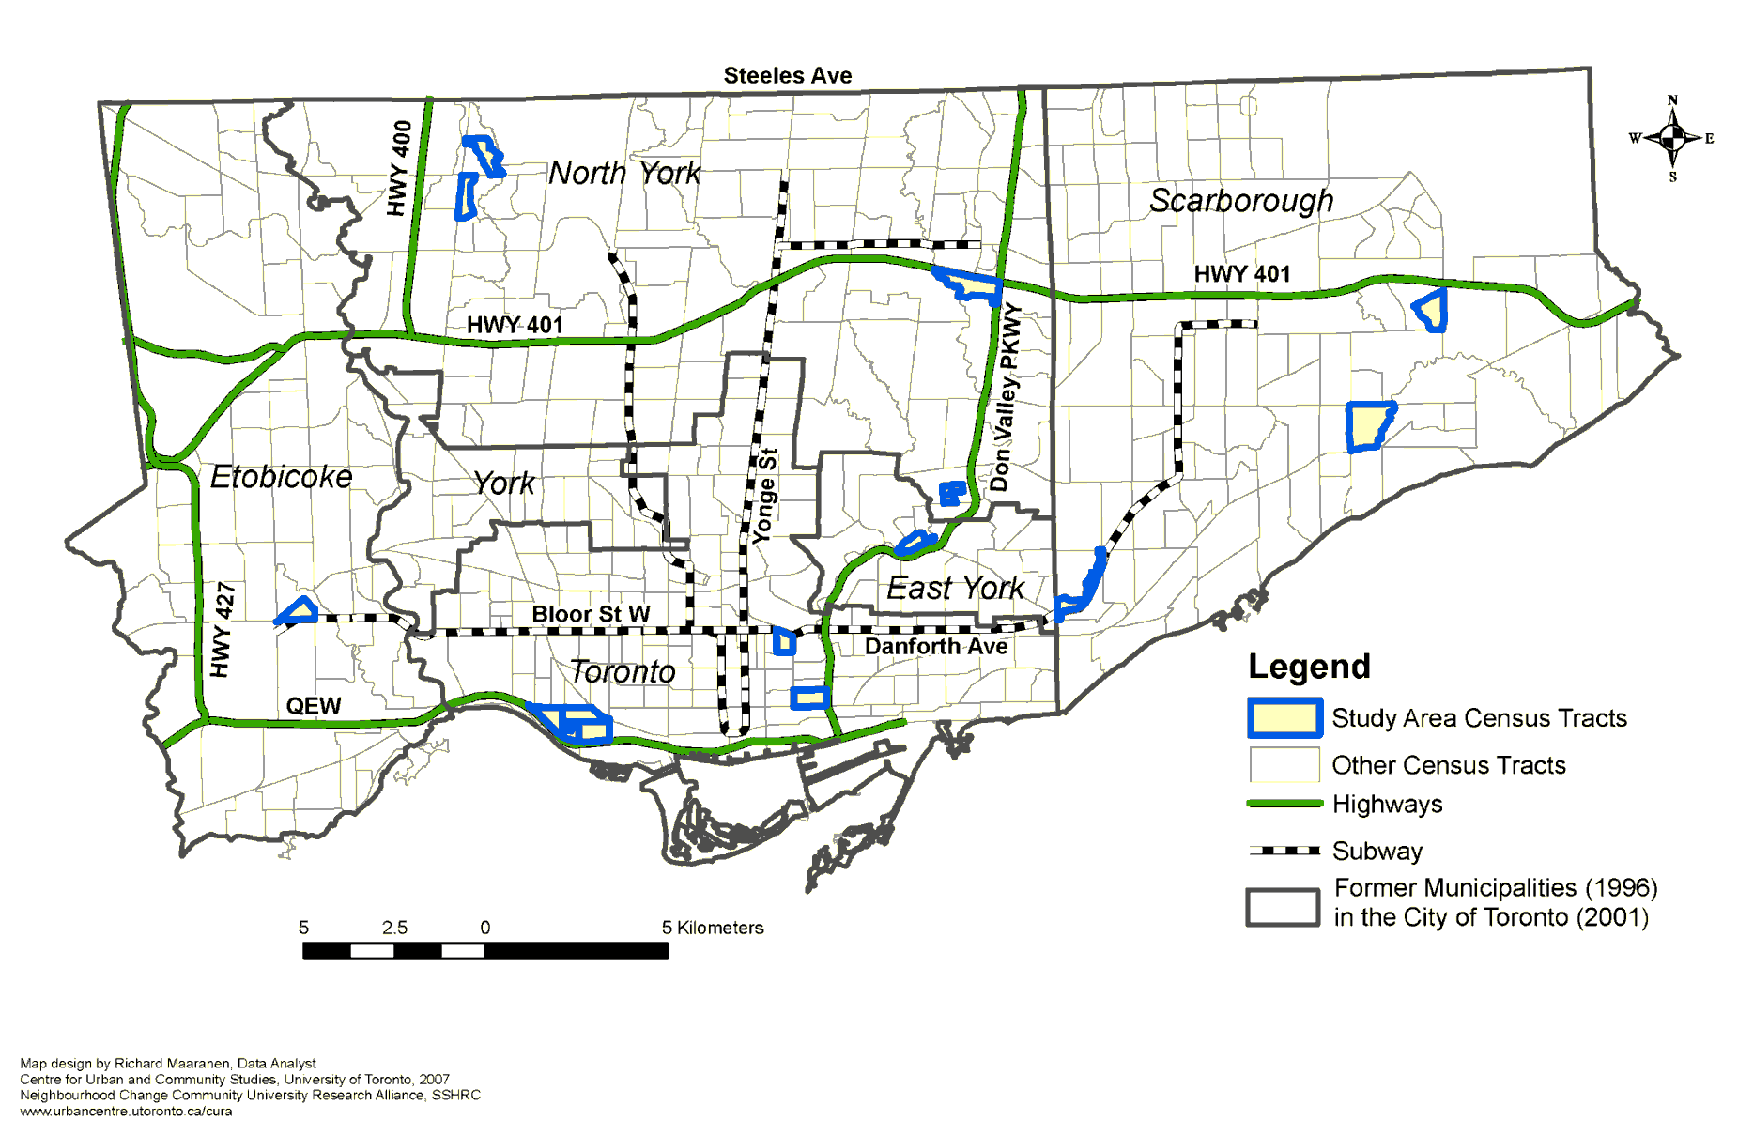
Insights from 2005-08 study of 501 low-income, tenant families in 12 high-poverty Toronto neighbourhoods
Acknowledgement: Funded by the Canadian Institutes for Health Research (IGP-74207, MOP-77766, MOP-81173) and Neighbourhood Change & Building Inclusive Communities from Within Community University Research Alliance (CURA) program of the Social Sciences and Humanities Research Council of Canada. Conducted in collaboration with the City of Toronto Shelter, Housing & Support Division and Toronto Public Health.

Slide 33
Budgeting in the context of limited resources:
Rent was prioritized over everything else.
Bills were paid only enough to avoid losing services.
Participants stretched their food dollars through thrifty shopping (using lists, coupons, sales, etc) and cooking with less.
  As food insecurity intensified, price became the sole consideration in food purchases.
(Dachner et al, Canadian Journal of Dietetic Practice and Research. 2010; 71(3): e50-e56)

Slide 34
Strategies families used in the past 12 months, when facing food shortages:
%

Slide 35
Food is not the only problem facing food-insecure households.
Food insecure households face multiple financial challenges:
Inadequate and insecure housing
Compromises in spending on other necessities such as prescription medications, telephone, transportation, clothing, etc.
Debt
→ stress, marginalization, and social isolation

Slide 36
Quebec adults’ accounts of their experiences of food insecurity:
a profound lack of food choice, monotony of diet
disruptions to familial dining patterns
need to engage in highly stigmatized means of food acquisition
strong feelings of powerlessness, inequity, frustration → alienation
(Hamelin et al., Soc Sci & Medicine, 2002)

Slide 37
Comparing the experience of household food insecurity as captured across 22 scales and related ethnographies from 15 different countries:
Commonalities:
Uncertainty and worry about food
Inadequate food quality
Insufficient food quantity
Domain recognized in ethnographic work but not represented on scales:
Social unacceptability
Consequences (vs core elements) of the experience:
Hunger and other physiological consequences – present on most scales
Alienation (Hamelin et al, 2002) – absent
(Coates et al, J Nutr, 2006)

Slide 38
How do children experience food insecurity?
Current measures based on adults’ conceptualization
  assumes adults manage household food situation, employing a sequence of strategies to minimize children’s experiences of deprivation.
(Fram et al, J Nutr 2011.)

Slide 39
Children’s experience of household food insecurity:
Awareness at cognitive, emotional and physical levels
Taking responsibility for managing food resources
  participating in adult resource management strategies, but also initiating strategies to extend existing food resources and augment them.
(Fram et al, J Nutr 2011.)

Slide 40
Implications for food security measurement:
Survey module may be underestimating the extent and severity of food insecurity experienced by children and adolescents.
Solution?

Slide 41
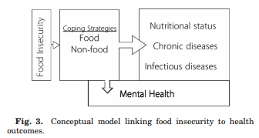
Coping with food insecurity:
a vast array of food and non-food responses
with negative immediate and long-term consequences for health and well-being.
(Hadley & Crooks, Yrbk Phys Anthropol 2012)

Slide 42
Dietary intakes in the context of household food insecurity

Slide 43
Comparison of the dietary intakes of Canadians by household food security status, CCHS 2004:
Little evidence of dietary inadequacies among young children in Canada, and few differences in relation to household food security status.
Adults and adolescents in moderately or severely food insecure households had
  poorer quality diets (i.e., fewer servings of milk products, fruits and vegetables, and for some groups, meat and alternatives)
  higher risk of inadequate intakes for protein, vitamin A, folate, magnesium, phosphorus, zinc, iron (women), vitamin B6 (adults), vitamin B12 (adults).
(Kirkpatrick & Tarasuk, J Nutr, 2008: 138: 604-612)

Slide 44
Adults’ fruit and vegetable consumption by food security status
*
*
*
*
*
Food secure
# of servings
Food insecure
Age/sex group
* Significant difference between food-secure & food-insecure subgroups, p<0.05
(Kirkpatrick & Tarasuk, J Nutr, 2008: 138: 604-612)

Slide 45
Adults’ milk & milk product consumption by food security status
*
*
*
*
*
*
Food secure
# of servings
Food insecure
Age/sex group
* Significant difference between food-secure & food-insecure subgroups, p<0.05

Slide 46
Prevalence of inadequate protein intakes, by age, sex, and food security status.
*
Estimated usual intakes were compared to requirements expressed as g/kg/day, including only participants with measured heights.
*Prevalence < 10% for males 19-30 yr in food secure households.
(Kirkpatrick & Tarasuk, J Nutr, 2008: 138: 604-612)

Slide 47
Mean SODIUM intake (mg/day), by age, sex and household food security status:
a
a
a,b
a: P < 0.05, comparison of transformed intakes; b: P<0.05, ANOVA adjusted for income, education, immigrant status, household composition, and current smoking.
(Kirkpatrick & Tarasuk, J Nutr, 2008: 138: 604-612)

Slide 48
Mean FAT intake (g/day), by age, sex and household food security status:
*
*
*
*
*P < 0.05, comparison of transformed intakes; No significant differences when adjusted for income, education, immigrant status, household composition, and current smoking.
(Kirkpatrick & Tarasuk, J Nutr, 2008: 138: 604-612)

Slide 49
Results of OLS regression, predicting vitamin A intake (µg/d) using data from single 24-hour dietary intake recalls for Ontario adults, CCHS 2004:
 | Men, 19 years + (n=2688) beta (p-value) | Women, 19 years + (n=3580) beta (p-value)
Model 1:
Household food insecurity | - 234 (0.0002) | - 280 (0.0274)
Income adequacy | 38 (NS) | - 66 (NS)
Respondent’s education | -11 (NS) | 81 (NS)
Model 2:
Household food insecurity | -275 (< 0.0001) | - 229 (0.0010)
Note: Income adequacy and education were treated as ordinal variables, and age was included in all models. Population weights were included, using SAS SURVEYREG.
(Vogt & Tarasuk, 2007, available at http://www.phred-redsp.on.ca/)

Slide 50
Results of OLS regression, predicting calcium intake (mg/d) using data from single 24-hour dietary intake recalls for Ontario adults, CCHS 2004:
 | Men, 19 years + (n=2688) beta (p-value) | Women, 19 years + (n=3580) beta (p-value)
Model 1:
Household food insecurity | - 268 (0.0007) | - 238 (0.0616)
Income adequacy | - 5 (NS) | - 43 (NS)
Respondent’s education | 8 (NS) | 99 (NS)
Model 2:
Household food insecurity | -265 (< 0.0001) | - 227 (0.0014)
Note: Income adequacy and education were treated as ordinal variables, and age was included in all models. Population weights were included, using SAS SURVEYREG.

Slide 51
For next week, please read
Seligman HK, Schillinger D. Hunger and socioeconomic disparities in chronic disease. New England Journal of Medicine, 2010; 363(1): 6-9.
Kirkpatrick et al. Child hunger and long-term adverse consequences for health. Archives of Pediatrics and Adolescent Medicine. 2010; 164(8):754-762.
Frongillo EA. Confronting myths about household food insecurity and excess weight. Cad Saude Publica. 2013.
Hruschka D. Do economic constraints on food choice make people fat? A critical review of two hypotheses for the poverty-obesity paradox. Am J Hum Biol 2012; 24: 277-285.

