Slide 2
Our social safety net provides better protection against food insecurity for some groups than others.
12% are on old-age pensions (under-represented)
guaranteed annual incomes, indexed to inflation.
drug coverage, transit subsidies, ‘seniors days’, …
16% are on social assistance (over-represented)
incomes below basic living costs in most jurisdictions
benefits not indexed to inflation in most provinces
limits on assets mean no capacity to buffer income shocks.

Slide 3
Welfare Incomes in Ontario
(expressed in 2010 constant dollars)
Source: National Council of Welfare, 2012.

Slide 4
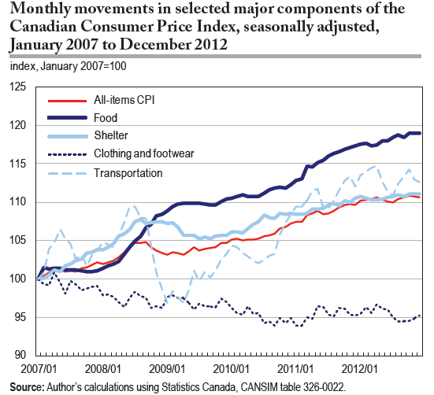
(A-M Rollin, Statistics Canada, Economic Insights, no. 027, June 2013.)

Slide 5
Monthly budget for family of 4 (2 adults, boy 14yr, girl 8yr) on welfare (‘Ontario Works’) in Hamilton:
Income | Basic expenses
Basic allowance 453 Shelter allowance 695 Child/family benefits 736 GST/HST Benefit 66 ON Trillium Benefit 139 Total income: $2112 | Food 741 Rent 988 Total expenses: $1729
Income remaining = $383
From the City of Hamilton, Medical Officer of Health. Report to the Board of Health, Oct 21, 2013.

Slide 6
Monthly budget for one-parent family (boy 14yr, girl 8yr) on welfare (‘Ontario Works’) in Hamilton:
Income | Basic expenses
Basic allowance 350 Shelter allowance 641 Child/family benefits 759 GST/HST Benefit 66 ON Trillium Benefit 111 Total income: $1927 | Food 560 Rent 820 Total expenses: $1380
Income remaining = $547
From the City of Hamilton, Medical Officer of Health. Report to the Board of Health, Oct 21, 2013.

Slide 7
Monthly budget for one man (31-50 yr) on welfare (‘Ontario Works’) in Hamilton:
Income | Basic expenses
Basic allowance 230 Shelter allowance 376 GST/HST Benefit 22 ON Trillium Benefit 60 Total income: $688 | Food 249 Rent (bachelor) 543 Total expenses: $792
Deficit = $104
From the City of Hamilton, Medical Officer of Health. Report to the Board of Health, Oct 21, 2013.

Slide 8
Monthly budget for one man (31-50 yr) on Ontario Disability Support Program in Hamilton:
Income | Basic expenses
Basic allowance 596 Shelter allowance 479 GST/HST Benefit 29 ON Trillium Benefit 63 Total income: $1167 | Food 249 Rent (1 bedroom) 694 Total expenses: $943
Income remaining = $224
From the City of Hamilton, Medical Officer of Health. Report to the Board of Health, Oct 21, 2013.

Slide 9
Monthly budget for one man (70+ yr) on Old Age Security/Guaranteed Income Supplement:
Income | Basic expenses
Old Age Security/GIS 1287 ON Guaranteed Annual Income System 83 GST/HST Benefit 33 ON Trillium Benefit 96 | Food 238 Rent (1 bedroom) 649
Total income: $1499 | Total expenses: $887
Income remaining = $612
Adapted from the City of Hamilton, Medical Officer of Health. Report to the Board of Health, Oct 21, 2013.

Slide 10
61% of households reliant on employment incomes are food insecure.
low-waged jobs
short-term, part-time employment
single (vs dual) earner households
inadequacy of income transfers provided to supplement low employment incomes.

Slide 11
When working is not enough: food insecurity in the Canadian labour force.
McIntyre et al, Public Health Nutrition 2012.
Compared to workers in food-secure households, primary earners in food-insecure households were more likely to
report multiple jobs
report higher job stress
have not completed high school
be visible minorities
Workers living in Quebec had almost 60% lower odds of being food insecure compared to those in Ontario.

Slide 12
Two other population subgroups that are very vulnerable to food insecurity but not included in national population health surveys:
Aboriginals living on reserves
People who are homeless

Slide 13
Limited data for on-reserve First Nations people:
Kangiqsujuaq, Nunavik, PQ, 2002:
  40% of households food insecure
Kugaaruk, Nunavut, 2001:
  83% of households food insecure
Fort Severn, Ontario, 2002:
  70% of households food insecure
Food Mail Pilot Project Baseline Surveys, INAC, 2003-4

Slide 14
The experience of food insecurity

Slide 15
Food insecurity is reflects the imbalance of available financial resources and necessary expenses.

Slide 16
Conceptualization of household food insecurity underpinning survey module (HFSSM):
Anxiety
Qualitative compromises in
food selection
Quantitative compromises in
food intake, hunger

Slide 17
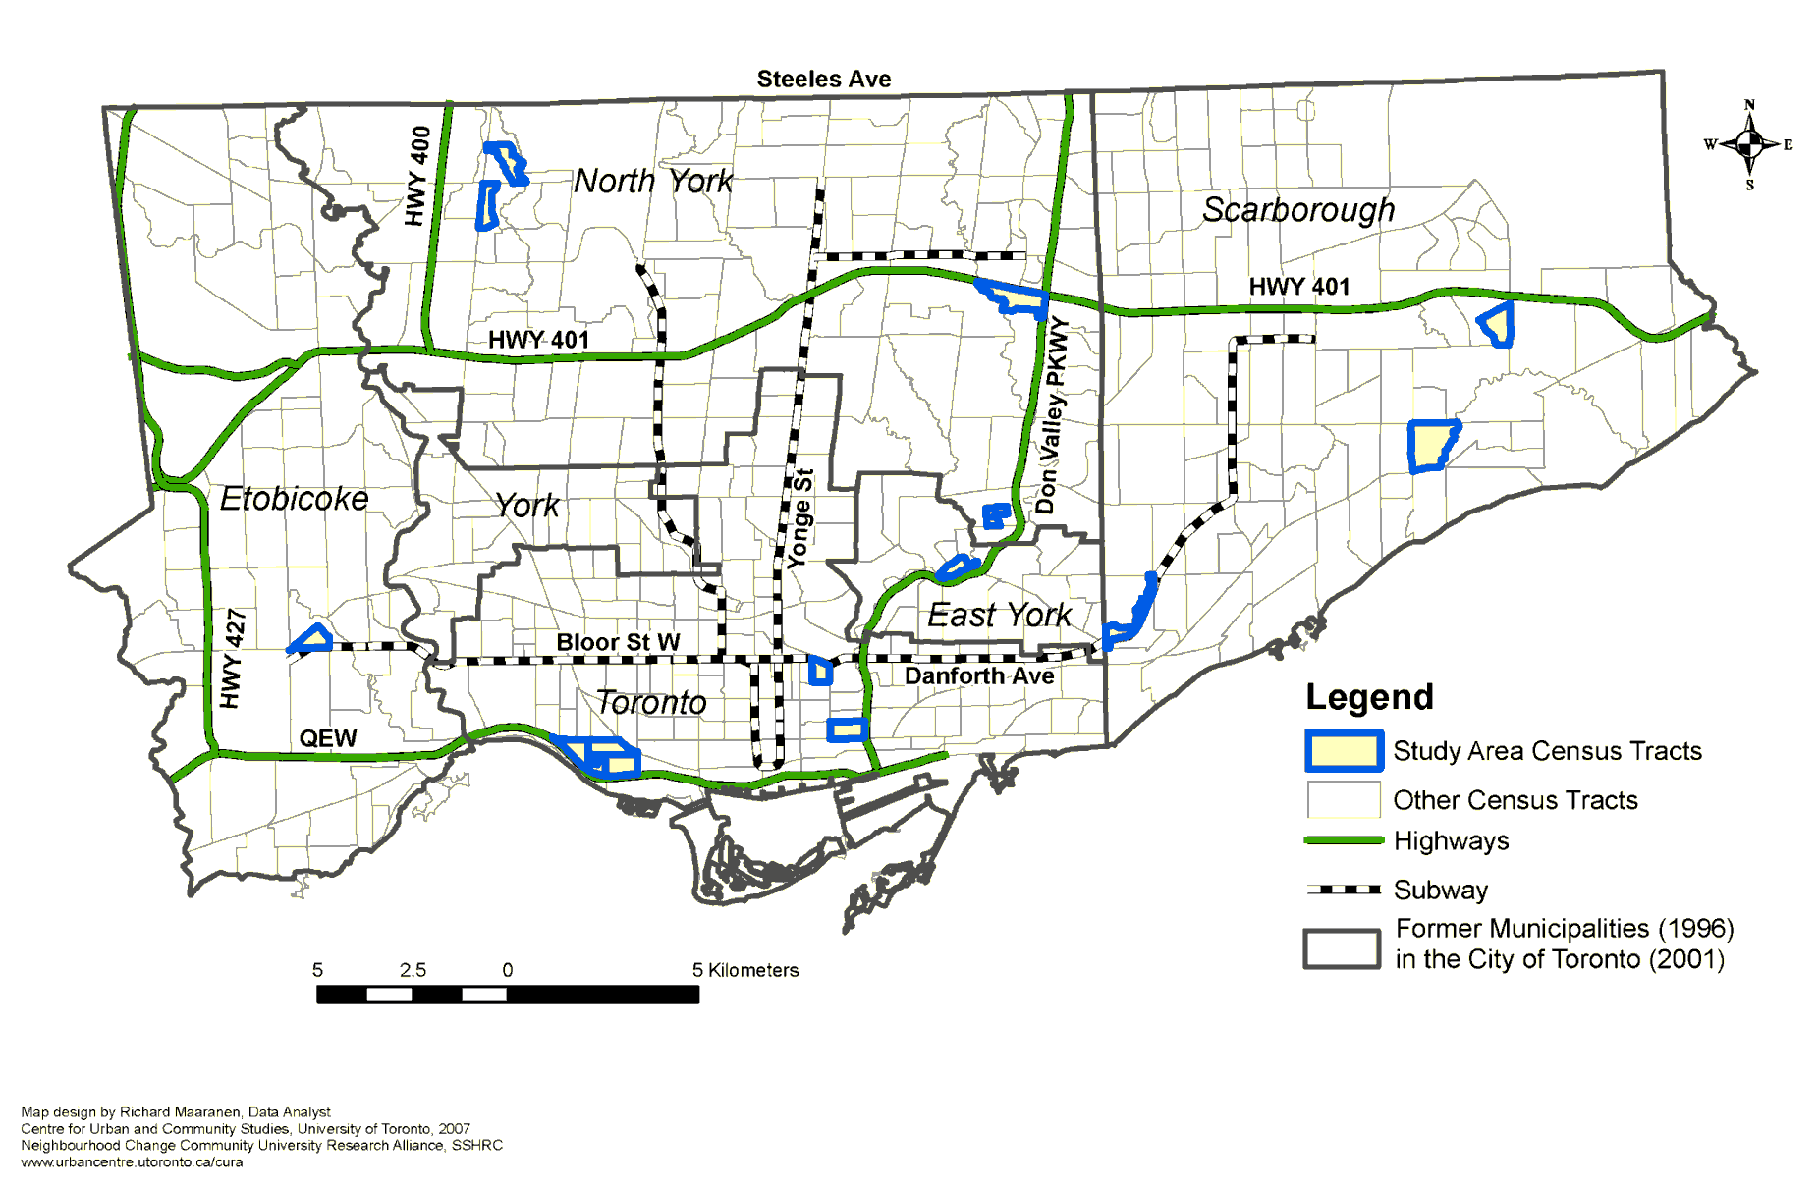
Insights from 2005-08 study of 501 low-income, tenant families in 12 high-poverty Toronto neighbourhoods
Acknowledgement: Funded by the Canadian Institutes for Health Research (IGP-74207, MOP-77766, MOP-81173) and Neighbourhood Change & Building Inclusive Communities from Within Community University Research Alliance (CURA) program of the Social Sciences and Humanities Research Council of Canada. Conducted in collaboration with the City of Toronto Shelter, Housing & Support Division and Toronto Public Health.

Slide 18
Budgeting in the context of limited resources:
Rent was prioritized over everything else.
Bills were paid only enough to avoid losing services.
Participants stretched their food dollars through thrifty shopping (using lists, coupons, sales, etc) and cooking with less.
  As food insecurity intensified, price became the sole consideration in food purchases.
(Dachner et al, Canadian Journal of Dietetic Practice and Research. 2010; 71(3): e50-e56)

Slide 19
Strategies families used in the past 12 months, when facing food shortages:
%

Slide 20
Food is not the only problem facing food-insecure households.
Food insecure households face multiple financial challenges:
Inadequate and insecure housing
Compromises in spending on other necessities such as prescription medications, telephone, transportation, clothing, etc.
Debt
→ stress, marginalization, and social isolation

Slide 21
How do children experience food insecurity?
Current measures based on adults’ conceptualization
  assumes adults manage household food situation, employing a sequence of strategies to minimize children’s experiences of deprivation.
(Fram et al, J Nutr 2011.)

Slide 22
Children’s experience of household food insecurity:
Awareness at cognitive, emotional and physical levels
Taking responsibility for managing food resources
  participating in adult resource management strategies, but also initiating strategies to extend existing food resources and augment them.
(Fram et al, J Nutr 2011.)

Slide 23
Implications for food security measurement:
Survey module may be underestimating the extent and severity of food insecurity experienced by children and adolescents.
Solution?

Slide 24
Dietary intake in the context of household food insecurity?
Insights from CCHS 2004, comparing intakes of individuals in food secure vs moderately or severely food insecure households.
Kirkpatrick & Tarasuk, J Nutr 2008; 138: 604-612
Danyliw et al, Public Health Nutrition 2011; 14: 1961-69
Mark et al, Can J Public Health 2012; 103(2): 94-99

Slide 25
Adults’ fruit and vegetable consumption by food security status
*
*
*
*
*
Food secure
# of servings
Food insecure
Age/sex group
* Significant difference between food-secure & food-insecure subgroups, p<0.05

Slide 26
Adults’ milk & milk product consumption by food security status
*
*
*
*
*
*
Food secure
# of servings
Food insecure
Age/sex group
* Significant difference between food-secure & food-insecure subgroups, p<0.05

Slide 27
Nutrient adequacy: adults
Higher prevalence of inadequacy among food-insecure subgroups for:
Protein Magnesium
Vitamin A Zinc
Vitamin B6 Iron (women)
Vitamin B12 Folate
Inadequacy > 10% for thiamin, riboflavin, and phosphorus, only among food-insecure subgroups. No inadequacy for niacin, irrespective of food security status.
(Kirkpatrick & Tarasuk, J Nutr 2008;138:604-612)

Slide 28
Prevalence of inadequate vitamin A intakes, by age and sex
%
*
*
*
*
Food secure
Food insecure

Slide 29
Prevalence of inadequate protein¹ intakes, by age and sex
%
Food secure
Food insecure
¹ Protein was expressed in g/kg/d. Prevalences of inadequacy were estimated based on respondents with measured anthropometric data.

Slide 30
Children’s fruit and vegetable consumption by food security status
*
*
Food secure
# of servings
Food insecure
Age/sex group
* Significant difference between food-secure & food-insecure subgroups, p<0.05

Slide 31
Children’s milk & milk product consumption by food security status
*
*
Food secure
# of servings
Food insecure
Age/sex group
* Significant difference between food-secure & food-insecure subgroups, p<0.05

Slide 32
Beverage intake patterns differed significantly by household food security status among adolescents (12-18 yr).
Analysis of beverage intake patterns among Canadian children and adolescents, CCHS 2004.
(Danyliw et al, Public Health Nutrition 2011; 14: 1961-69.)

Slide 33
Nutrient adequacy: children
No prevalence of nutrient inadequacy > 10% for children 1-3 yr and 4-8 yr, irrespective of household food security status.
(Kirkpatrick & Tarasuk, J Nutr 2008;138:604-612)

Slide 34
Nutrient adequacy: older children and adolescents
Substantial levels of inadequacy among those 9-13 yr and 14-18 yr for:
  Protein
  Vitamin A
  Magnesium
  Phosphorous
  Zinc
  Folate (females)
Prevalences were typically higher among food-insecure subgroups
(Kirkpatrick & Tarasuk, J Nutr 2008;138:604-612)

Slide 35
Relationship between food insecurity and health?

Slide 36
Food insecurity in childhood takes a lasting toll on health.
Analyses of National Longitudinal Survey of Children and Youth (10+ years of follow-up):
Children and youth who experienced hunger (ever) were more likely to have poorer health.
Multiple episodes of hunger were associated with higher odds of chronic conditions, including asthma.
Child hunger predicted depression and suicidal ideation in late adolescence and early adulthood.
(Kirkpatrick et al., Archives of Pediatric and Adolescent Medicine 2010; McIntyre et al., Journal of Affective Disorders 2013.)

Slide 37
Cross-sectional associations between household food insecurity and adults’ health:
Independent of other social determinants of health, adults with some indication of household food insecurity have higher odds of
poor self-rated health
poor mental, physical, and oral health
multiple chronic conditions
e.g., diabetes, heart disease, hypertension, depression, fibromyalgia
(Che & Chen, Health Rep 2001; Fuller-Thompson et al, Rheumatol Int 2011; Gucciardi et al, Diabetes Care 2009; Muirhead et al, Community Dent Oral Epidemiol 2009; Vozoris & Tarasuk, J Nutr 2003; Willows et al, Health Reports, 2011)

Slide 38
Prevalence of chronic conditions among adults, 18-64 years, by household food security status, CCHS 2007-08
Conditions:
asthma
arthritis
back problems bowel disorders diabetes
heart disease hypertension
migraines
mood/anxiety disorder
stomach/intes-tinal ulcers
%
(Tarasuk et al., Journal of Nutrition, 2013)

Slide 39
Proportion of Canadian adults (18 - 64 years) reporting selected chronic conditions, by food security status
%
Heart disease
Diabetes
Mood or anxiety disorder

Slide 40
Relationship between food insecurity and health?
food insecurity
dietary compromises
diet-related chronic diseases
mental and physical health problems
stress
(e.g., Parker et al, Ann Epidemiol 2010; Seligman et al, J Gen Intern Med 2007; Seligman and Schillinger, N Engl J Med 2010; Whitaker et al, Pediatrics 2006.)

Slide 41
Relationship between food insecurity and health?
poor health
food insecurity
resource constraints
(e.g., Heflin et al, Soc Sci Med 2005; Heflin et al, Social Service Review 2007; Huang et al, Social Science Research 2010; Laraia et al, J Nutr 2006.)

Slide 42
Relationship between adult’s disease status and the presence and severity of household food insecurity?
Analysis of CCHS 2007-08, n=77,053 adults, 18–64 y.
Key findings:
Independent of other socio-demographic correlates of household food insecurity,
a strong dose-response relationship between adult’s number of chronic conditions and odds of household food insecurity.
higher odds of food insecurity and more severe food insecurity among adults with most conditions assessed.
The pairing of a mood or anxiety disorder with any other condition heightened risk.
(Tarasuk et al., Journal of Nutrition, 2013)

Slide 43
Potential mechanisms by which chronic illness can heighten risk of food insecurity:
Chronic disease can diminish adults’ earning power.
- but our findings persist after accounting for household income, income source, home ownership.
Adult’s chronic ill-health may pose additional demands on household’s financial resources.
Adults’ ill-health may constrain their ability to cope in situations of scarce financial resources.
(Tarasuk et al., Journal of Nutrition, 2013)

Slide 44
For next week, please read
Seligman HK, Schillinger D. Hunger and socioeconomic disparities in chronic disease. New England Journal of Medicine, 2010; 363(1): 6-9.
Frongillo EA. Confronting myths about household food insecurity and excess weight. Cad Saude Publica. 2013.
Tarasuk, V. & Eakin, J. M. Charitable food assistance as symbolic gesture: an ethnographic study of food banks in Ontario. Social Science and Medicine. 2003
Loopstra R, Tarasuk V. The relationship between food banks and household food insecurity among low-income Toronto families. Canadian Public Policy 2012.

