Slide 1
Food insecurity is reflects the imbalance of available financial resources and necessary expenses.
Housing costs
Other expenses: food, medications, debts, etc
Financial resources:
Size, stability, security of income
Assets, savings, access to credit

Slide 2
Food is not the only problem facing food-insecure households.
Food insecure households face multiple financial challenges:
Inadequate and insecure housing
Compromises in spending on other necessities such as prescription medications, telephone, transportation, clothing, etc.
Debt
→ stress, marginalization, and social isolation

Slide 3
Quebec adults’ accounts of their experiences of food insecurity:
a profound lack of food choice, monotony of diet
disruptions to familial dining patterns
need to engage in highly stigmatized means of food acquisition
strong feelings of powerlessness, inequity, frustration → alienation
(Hamelin et al., Soc Sci & Medicine, 2002)

Slide 4
Household Food Security Survey Module
(administered on the Canadian Community Health Survey (CCHS) since 2004)
18 questions, differentiating adults’ and children’s experiences over last 12 months:
Worry about not having enough food
Reliance on low-cost foods
Not being able to afford balanced meals
Adults/children skip meals
Adults/children cut size of meals
Adults/children not having enough to eat
Adults/children not eating for whole day
“because there wasn’t enough money to buy food?”

Slide 5
Comparing the experience of household food insecurity as captured across 22 scales and related ethnographies from 15 different countries:
Commonalities:
Uncertainty and worry about food
Inadequate food quality
Insufficient food quantity
Domain recognized in ethnographic work but not represented on scales:
Social unacceptability
Consequences (vs core elements) of the experience:
Hunger and other physiological consequences – present on most scales
Alienation (Hamelin et al, 2002) – absent
(Coates et al, J Nutr, 2006)

Slide 6
How do children experience food insecurity?
Current measures based on adults’ conceptualization
  assumes adults manage household food situation, employing a sequence of strategies to minimize children’s experiences of deprivation.
(Fram et al, J Nutr 2011.)

Slide 7
Children’s experience of household food insecurity:
Awareness at cognitive, emotional and physical levels
Taking responsibility for managing food resources
  participating in adult resource management strategies, but also initiating strategies to extend existing food resources and augment them.
(Fram et al, J Nutr 2011.)

Slide 8
Implications for food security measurement:
Survey module may be underestimating the extent and severity of food insecurity experienced by children and adolescents.
Solution?

Slide 9
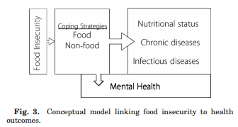
Coping with food insecurity:
a vast array of food and non-food responses
with negative immediate and long-term consequences for health and well-being.
(Hadley & Crooks, Yrbk Phys Anthropol 2012)

Slide 10
Dietary intakes in the context of household food insecurity

Slide 11
Comparison of the dietary intakes of Canadians by household food security status, CCHS 2004:
Little evidence of dietary inadequacies among young children in Canada, and few differences in relation to household food security status.
Adults and adolescents in moderately or severely food insecure households had
  poorer quality diets (i.e., fewer servings of milk products, fruits and vegetables, and for some groups, meat and alternatives)
  higher risk of inadequate intakes for protein, vitamin A, folate, magnesium, phosphorus, zinc, iron (women), vitamin B6 (adults), vitamin B12 (adults).
(Kirkpatrick & Tarasuk, J Nutr, 2008: 138: 604-612)

Slide 12
Adults’ fruit and vegetable consumption by food security status
*
*
*
*
*
Food secure
# of servings
Food insecure
Age/sex group
* Significant difference between food-secure & food-insecure subgroups, p<0.05
(Kirkpatrick & Tarasuk, J Nutr, 2008: 138: 604-612)

Slide 13
Adults’ milk & milk product consumption by food security status
*
*
*
*
*
*
Food secure
# of servings
Food insecure
Age/sex group
* Significant difference between food-secure & food-insecure subgroups, p<0.05

Slide 14
Prevalence of inadequate protein intakes, by age, sex, and food security status.
*
Estimated usual intakes were compared to requirements expressed as g/kg/day, including only participants with measured heights.
*Prevalence < 10% for males 19-30 yr in food secure households.
(Kirkpatrick & Tarasuk, J Nutr, 2008: 138: 604-612)

Slide 15
Mean SODIUM intake (mg/day), by age, sex and household food security status:
a
a
a,b
a: P < 0.05, comparison of transformed intakes; b: P<0.05, ANOVA adjusted for income, education, immigrant status, household composition, and current smoking.
(Kirkpatrick & Tarasuk, J Nutr, 2008: 138: 604-612)

Slide 16
Mean FAT intake (g/day), by age, sex and household food security status:
*
*
*
*
*P < 0.05, comparison of transformed intakes; No significant differences when adjusted for income, education, immigrant status, household composition, and current smoking.
(Kirkpatrick & Tarasuk, J Nutr, 2008: 138: 604-612)

Slide 17
Results of OLS regression, predicting vitamin A intake (µg/d) using data from single 24-hour dietary intake recalls for Ontario adults, CCHS 2004:
 | Men, 19 years + (n=2688) beta (p-value) | Women, 19 years + (n=3580) beta (p-value)
Model 1:
Household food insecurity | - 234 (0.0002) | - 280 (0.0274)
Income adequacy | 38 (NS) | - 66 (NS)
Respondent’s education | -11 (NS) | 81 (NS)
Model 2:
Household food insecurity | -275 (< 0.0001) | - 229 (0.0010)
Note: Income adequacy and education were treated as ordinal variables, and age was included in all models. Population weights were included, using SAS SURVEYREG.
(Vogt & Tarasuk, 2007, available at http://www.phred-redsp.on.ca/)

Slide 18
Results of OLS regression, predicting calcium intake (mg/d) using data from single 24-hour dietary intake recalls for Ontario adults, CCHS 2004:
 | Men, 19 years + (n=2688) beta (p-value) | Women, 19 years + (n=3580) beta (p-value)
Model 1:
Household food insecurity | - 268 (0.0007) | - 238 (0.0616)
Income adequacy | - 5 (NS) | - 43 (NS)
Respondent’s education | 8 (NS) | 99 (NS)
Model 2:
Household food insecurity | -265 (< 0.0001) | - 227 (0.0014)
Note: Income adequacy and education were treated as ordinal variables, and age was included in all models. Population weights were included, using SAS SURVEYREG.

Slide 19
The Prevalence of Food Insecurity Is High and the Diet Quality Poor in Inuit Communities. Huet, Rosol & Egeland, J Nutr 2012.
Inuit Health Survey: 1901 Inuit households, 2007-08
33.6% moderately food insecure.
29.1% severely food insecure.
Food insecurity was associated with household crowding, income assistance, public housing, single adult household, home in need of major repair, and having no active hunter in the home.
Adults from food insecure households had a significantly lower Healthy Eating Index score; consumed fewer vegetables and fruit, grains, and dairy products; and consumed a greater percent of energy from high-sugar foods.

Slide 20
Food insecurity and nutritional biomarkers in relation to stature in Inuit children from Nunavik. Pirkle et al, CJPH 2014.
Survey of 294 school-aged children drawn from 2 birth cohorts.
Food insecurity assessed with 3 questions (enough to eat; adults/children cut size of meals)
  49.7% classed as food insecure.
Prevalence of iron depletion: 33%
  Food insecure children were marginally more likely to be anemic and had significantly lower hemoglobin levels.
Prevalence of short stature: 18.7%
  Food insecure children were on average 2 cm shorter than food secure (p < 0.01)

Slide 21
Relationship between food insecurity and health?

Slide 22
Analyses of National Longitudinal Survey of Children and Youth (10+ years of follow-up):
Children and youth who experienced hunger (ever) were more likely to have poorer health.
Multiple episodes of hunger were associated with higher odds of chronic conditions, including asthma.
Child hunger predicted depression and suicidal ideation in late adolescence and early adulthood.
(Kirkpatrick et al., Archives of Pediatric and Adolescent Medicine 2010; McIntyre et al., Journal of Affective Disorders 2013.)

Slide 23
Cross-sectional associations between household food insecurity and adults’ health:
Independent of other social determinants of health, adults with some indication of household food insecurity have higher odds of
poor self-rated health
poor mental, physical, and oral health
multiple chronic conditions
e.g., diabetes, heart disease, hypertension, depression, fibromyalgia
(Che & Chen, Health Rep 2001; Fuller-Thompson et al, Rheumatol Int 2011; Gucciardi et al, Diabetes Care 2009; Muirhead et al, Community Dent Oral Epidemiol 2009; Vozoris & Tarasuk, J Nutr 2003; Willows et al, Health Reports, 2011)

Slide 24
Relationship between food insecurity and health?
food insecurity
dietary compromises
diet-related chronic diseases
mental and physical health problems
stress
(e.g., Parker et al, Ann Epidemiol 2010; Seligman et al, J Gen Intern Med 2007; Seligman and Schillinger, N Engl J Med 2010; Whitaker et al, Pediatrics 2006.)

Slide 25
Relationship between food insecurity and health?
poor health
food insecurity
resource constraints
(e.g., Heflin et al, Soc Sci Med 2005; Heflin et al, Social Service Review 2007; Huang et al, Social Science Research 2010; Laraia et al, J Nutr 2006.)

Slide 26
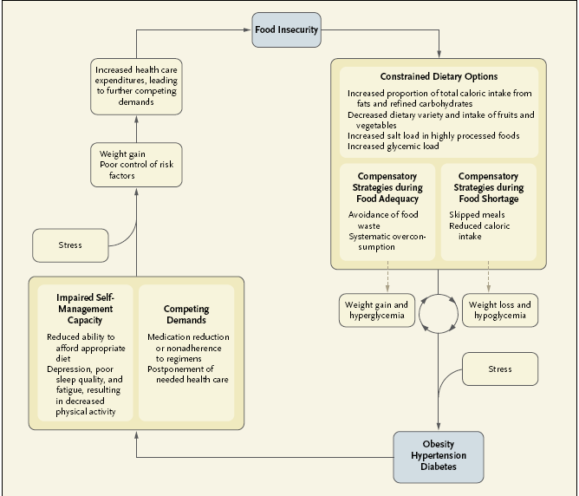
(Seligman & Schillinger, NEJM 2010).

Slide 27
Prevalence of chronic conditions among adults, 18-64 years, by household food security status, CCHS 2007-08
Conditions:
asthma
arthritis
back problems bowel disorders diabetes
heart disease hypertension
migraines
mood/anxiety disorder
stomach/intes-tinal ulcers
%
(Tarasuk et al., Journal of Nutrition, 2013)

Slide 28
Proportion of Canadian adults (18 - 64 years) reporting selected chronic conditions, by food security status
%
Heart disease
Diabetes
Mood or anxiety disorder

Slide 29
Increased odds with severity of household food insecurity for both men and women:
Asthma
Arthritis
Back problems
Bowel disorders
Diabetes
Heart disease
Hypertension – women only
Migraines
Mood and anxiety disorders
Stomach and intestinal ulcers

Slide 30
Relationship between adult’s disease status and the presence and severity of household food insecurity?
Key findings:
Independent of other socio-demographic correlates of household food insecurity,
a strong dose-response relationship between adult’s number of chronic conditions and odds of household food insecurity.
higher odds of food insecurity and more severe food insecurity among adults with most conditions assessed.
The pairing of a mood or anxiety disorder with any other condition heightened risk.
(Tarasuk et al., Journal of Nutrition, 2013)

Slide 31
Potential mechanisms by which chronic illness can heighten risk of food insecurity:
Chronic disease can diminish adults’ earning power.
- but our findings persist after accounting for household income, income source, home ownership.
Adult’s chronic ill-health may pose additional demands on household’s financial resources.
Adults’ ill-health may constrain their ability to cope in situations of scarce financial resources.
(Tarasuk et al., Journal of Nutrition, 2013)

Slide 32
Relationship between food insecurity and body weight?
A paradox?

Slide 33
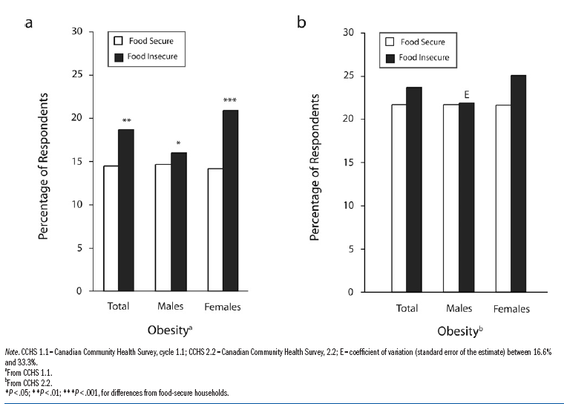
Obesity rates for respondents 12 yr and older by food security status:
Self-reported height and weight (CCHS 1.1, 2000-01)
Measured height and weight (CCHS 2.2, 2004)
(Lyons et al, Am J Public Health 2007)

Slide 34
Adjusted Odds* of Obesity (95%) with
Household Food Insecurity - CCHS 2.2
(including adults with measured height and weight)
 | Men | Women
Food secure | 1.00 | 1.00
Insecure without hunger | 1.02 (0.55, 1.88) | 0.95 (0.60, 1.50)
Insecure with mild hunger | 1.77 (0.74, 4.27) | 2.72 (1.43. 5.16)
Insecure with severe hunger | 1.18 (0.31, 4.48) | 2.04 (0.74, 5.59)
*Adjusted for age, household income, education, ethnicity, marital status, and place of residence. (Lyons et al, Am J Public Health 2007)

Slide 35
Household income, food insecurity and nutrition in Canadian youth.
Mark et al, Can J Public Health 2012; 103(2): 94-99.
Among youth in low-income households, food insecurity was associated with
BMI > 85th percentile in boys, but not girls.
Greater consumption of sweetened beverages and lower consumption of milk products among girls.
Food insecurity was not associated with calcium, fibre, saturated fat, or energy, energy intake/estimated energy expenditure.

Slide 36
The Prevalence of Food Insecurity Is High and the Diet Quality Poor in Inuit Communities. Huet, Rosol & Egeland, J Nutr 2012.
Inuit Health Survey: 1901 Inuit households, 2007-08
33.6% moderately food insecure.
29.1% severely food insecure.
Among adults, food insecurity associated with significantly lower prevalence of elevated BMI, waist circumference, and percent body fat, particularly in severely food insecure households.
Authors noted that regardless of food security status, there was a high degree of adiposity and high prevalence of poor diet quality – suggesting whole population could benefit from nutritional interventions.

Slide 37
Relationship between food insecurity and body weight?
Most consistent evidence of association is for adult women – not men or children.
Some limitations of existing research:
Cross-sectional
Food insecurity measured for last 12 months → what is relevant period of exposure?
Self-reported height and weight data
Confounding by parity, chronic physical or mental health problems, family structure, etc.

Slide 38
Whitaker & Sarin, J Nutr 2007; 137: 2134-2139.
Are changes in women’s food security status associated with changes in their body weight?
Design:
2 yr follow-up of 1707 mothers of preschool children; measured height and weight; food security status assessed with HFSSM.
Results:
Changes in food security status over 2 yr were not significantly associated with changes in weight.
No evidence of a causal association between food insecurity and obesity.

Slide 39
Confronting myths about household food insecurity and excess body weight. EA Frongillo, 2013.
Food insecurity is a measure of material deprivation, but not necessarily manifested as starvation.
Hunger and malnutrition (i.e., undernutrition and obesity) are potential, but not necessary, consequences of household food insecurity.
Severe food insecurity → weight deficit
In some contexts, moderate food insecurity → weight excess.
Material deprivation leads to bad outcomes across multiple domains; that one of these should be excess weight is not a ‘paradox’.

Slide 40
Determinants of Food insecurity in Canada?

Slide 41
Single best predictor of household food insecurity = income.
Prevalence of food insecurity by household income (CCHS 2011)
Food insecurity captures material deprivation.
the product of
income (size, security, stability)
assets, savings
access to credit
shelter costs
other expenses (food, medications, debt, etc)

Slide 42
Our social safety net:
A myriad of federal and provincial programs designed to support people facing financial hardships.
e.g., Employment Insurance, welfare, disability supports, old-age pensions, subsidized housing, tax credits, etc.
None of these programs are specifically designed to achieve household food security, and they appear to yield very different results.

Slide 43
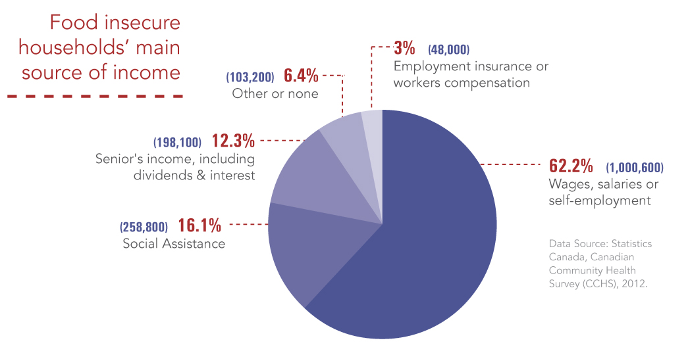

Distribution of food insecure households in Canada in 2012 by main source of income:

Slide 44
Case #1:
Benefits to seniors protect most from food insecurity.
In 2012, 7% of households reliant on seniors’ incomes were food insecure.
  versus 11% among those reliant on employment and 70% among those on social assistance.
Seniors have guaranteed annual incomes, indexed to inflation, and drug coverage, transit subsidies, ‘seniors days’ discounts.
Turning 65 drops the risk of food insecurity in half for low-income adults. (Emery, Fleisch and McIntyre. How a Guaranteed Annual Income Could Put Food Banks out of Business, University of Calgary SPP Research Papers, Dec 2013)

Slide 45
Case #2:
Being on social assistance almost guarantees food insecurity.
Data Source: CCHS 2011-12
Note: PEI and Northwest Territories have been omitted because of the small size of the samples there.

Slide 46
Why are social assistance recipients so vulnerable?
Incomes fall below basic living costs in most jurisdictions, as evidenced by Nutritious Food Basket costing comparisons.
Most provinces do not index benefits to inflation.
Limits on allowable assets mean recipients have typically have no savings and therefore no capacity to buffer sudden increases in expenses or interruptions in income.
The exception: Newfoundland and Labrador
Poverty Reduction Strategy launched in 2006, tackling breadth and depth of poverty.
  Social assistance benefits were increased and indexed to inflation.
  Asset limits and earnings exemptions were raised

Slide 47
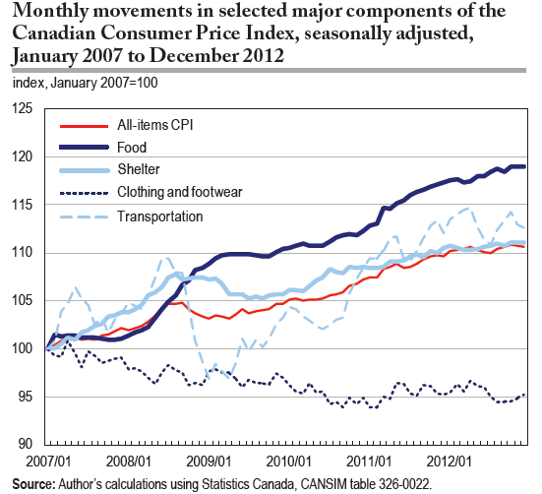
(A-M Rollin, Statistics Canada, Economic Insights, no. 027, June 2013.)

Slide 48
Monthly budget for family of 4 (2 adults, boy 14yr, girl 8yr) on welfare (‘Ontario Works’) in Hamilton:
Income | Basic expenses
Basic allowance 453 Shelter allowance 695 Child/family benefits 736 GST/HST Benefit 66 ON Trillium Benefit 139 Total income: $2112 | Food 741 Rent 988 Total expenses: $1729
Income remaining = $383
From the City of Hamilton, Medical Officer of Health. Report to the Board of Health, Oct 21, 2013.

Slide 49
Monthly budget for one-parent family (boy 14yr, girl 8yr) on welfare (‘Ontario Works’) in Hamilton:
Income | Basic expenses
Basic allowance 350 Shelter allowance 641 Child/family benefits 759 GST/HST Benefit 66 ON Trillium Benefit 111 Total income: $1927 | Food 560 Rent 820 Total expenses: $1380
Income remaining = $547
From the City of Hamilton, Medical Officer of Health. Report to the Board of Health, Oct 21, 2013.

Slide 50
Monthly budget for one man (31-50 yr) on welfare (‘Ontario Works’) in Hamilton:
Income | Basic expenses
Basic allowance 230 Shelter allowance 376 GST/HST Benefit 22 ON Trillium Benefit 60 Total income: $688 | Food 249 Rent (bachelor) 543 Total expenses: $792
Deficit = $104
From the City of Hamilton, Medical Officer of Health. Report to the Board of Health, Oct 21, 2013.

Slide 51
Monthly budget for one man (31-50 yr) on Ontario Disability Support Program in Hamilton:
Income | Basic expenses
Basic allowance 596 Shelter allowance 479 GST/HST Benefit 29 ON Trillium Benefit 63 Total income: $1167 | Food 249 Rent (1 bedroom) 694 Total expenses: $943
Income remaining = $224
From the City of Hamilton, Medical Officer of Health. Report to the Board of Health, Oct 21, 2013.

Slide 52
Monthly budget for one man (70+ yr) on Old Age Security/Guaranteed Income Supplement:
Income | Basic expenses
Old Age Security/GIS 1287 ON Guaranteed Annual Income System 83 GST/HST Benefit 33 ON Trillium Benefit 96 | Food 238 Rent (1 bedroom) 649
Total income: $1499 | Total expenses: $887
Income remaining = $612
Adapted from the City of Hamilton, Medical Officer of Health. Report to the Board of Health, Oct 21, 2013.

Slide 53
Case #3:
Employment does not protect Canadians from food insecurity.
Prevalence of household food insecurity by province/territory in 2011-12, differentiating main source of income.
% food insecure
Data Source: CCHS 2011-12

Slide 54
Why are so many households reliant on employment incomes food insecure?
low-waged jobs
short-term, part-time employment
single (vs dual) earner households
greater vulnerability among workers who are visible minorities and those with limited education (McIntyre et al, Public Health Nutrition 2012)
coupled with ….
inadequacy of income transfers provided to supplement low employment incomes

Slide 55
For next week, please read
Tarasuk, V. & Eakin, J. M. Charitable food assistance as symbolic gesture: an ethnographic study of food banks in Ontario. Social Science and Medicine. 2003
Loopstra R, Tarasuk V. The relationship between food banks and household food insecurity among low-income Toronto families. Canadian Public Policy 2012.

