Slide 1
NFS484 Tutorials
TA: Luke Johnston
Luke.johnston@mail.utoronto.ca
Format:
Problem-based learning
Problems are similar format to assignments and exams
Appreciation of current research and develop skills to interpret and integrate primary research
You will get MUCH more out of the tutorial if you have reviewed the problem in advance and actively participate

Slide 2
Components of Experimentation
Research Hypothesis
The research question
2. Experimental Design
Purpose: To design a set of procedures which tests a set of conditions in such a way that differences in observed outcomes can be unambiguously attributed to critical differences among the various treatment conditions.
Questions:
Are the treatment conditions appropriate to test the hypothesis? -- i.e. is it logical?
Do differences among different treatment groups really answer the original question, or have other features changed as well? -- are there confounding variables?

Slide 3
Components of Experimentation
3. Data Collection
4. Interpretation of Results
Purpose:
To determine the repeatability (strength) of any differences observed in the experiment.
Methods:
  Repeat experiment over and over again to determine if these differences are ‘real’ – usually not feasible because it is too expensive to verify results this way.
2.Conduct single experiment and use statistical analyses to help decide whether the same results are likely to occur if the experiment was repeated – usual method used.

Slide 4
Components of Experimentation
5. Assimilation of Results
Facts not known prior to experiment are now integrated into body of knowledge already known.
Questions:
What do the results mean with respect to the original theory that generated the hypothesis?
What are the theoretical explanations if none are currently known?

Slide 5
Objectives of Experimental Design
Inclusion of appropriate controls
Ideally, would like to control for all conditions except the one being tested. In reality this is impossible.
Methods to deal with lack of total control:
*Minimize experimental variation
Try to keep as many features constant across levels of the experiment as possible. For example, do all tests in same room, by same experimenter, with same equipment and testing procedure
*Randomization
Order of treatments
Subjects
Purpose: want to neutralize all factors other than the independent variable

Slide 6
Basic Experimental Designs
1. Between-subjects design:
Subjects are randomly allocated into treatments
Often used of matching of subjects to minimize biological variability
Usually equal number of subjects per treatment
Advantages: *Do not have to worry about carry-over effects
  *Easier to understand and analyze statistically
  Disadvantages: *Large number of subjects required
    *Lack of sensitivity in detecting treatment affects when they are present
    *Matching of groups is never exact

Slide 7
Basic Experimental Designs
2. Within-subject design (Repeated measures):
Subjects experience all treatments
  Advantages: *Use the same subject in each condition thus each subject serves as his/her own control
  *Requires fewer subjects
  *More sensitive: decreased ‘noise’ from biologic variation
  Disadvantages: *Subjects can change during the experiment (baseline may be shifting)
    *Carry over effects

Slide 8
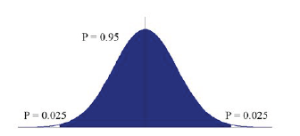
Interpretation of Results
Descriptive
Mean (µ)
Standard Deviation (σ)
Standard Error of the Mean
Tests of Statistical Significance
Is the response due to the independent variable or is it chance?
A difference is viewed as significant if the probability of making a mistake is under 1/20 (p<0.05)
2σ
µ
2σ
Modified from: Stone and Ellis, 2006

Slide 9
Interpretation of Results
Tests used when there are only 2 treatment groups:
Student t-test
Used in between-subject designs in which subjects receive treatment 1 or 2, but not both
Paired t-test
Used in within-subject designs in which subjects receive both treatments
Example of reading results:
Experiment 1
* p<0.05, different from treatment 1
Results:
(A) after treatment 2 is greater than after treatment 1 (p <0.05)
(B) was not different between groups
(C) was less after treatment 2 than after treatment 1 (p <0.05)
Variable Measured | Treatment 1 | Treatment 2
(A) | 2345±25 | 5678±20*
(B) | 10±3 | 12±4
(C) | 54±8 | 35±10*

Slide 10
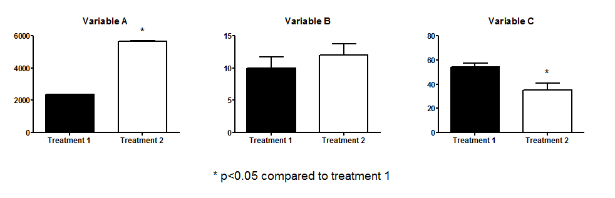
Interpretation of Results
Example of reading results:
Experiment 1
Results:
(A) after treatment 2 is greater than after treatment 1 (p <0.05)
(B) was not different between groups
(C) was less after treatment 2 than after treatment 1 (p <0.05)
Notes:
Added this slide to show the same data from the previous table in graphs.

Slide 11
Interpretation of Results
Tests used when there are more than 2 treatment groups:
Analysis of variance (ANOVA)
  Used in between-subject designs in which subjects receive only one of all possible treatments
Repeated Measures ANOVA
  Used in within-subject designs in which subjects receive all treatments
In both cases, a significant difference (p <0.05) between treatment means is indicated by the overall F value.
*does not tell you which groups are actually different from each other
*Planned/Post-Hoc Tests: Bonferroni, Dunn, Scheffe, Tukey, Duncan’s

Slide 12
Interpretation of Results
Tests used when there are more than 2 treatment groups:
Example:
Experiment 2
abc Values in each row not sharing the same superscript
are significantly difference, p <0.05, based on one-way ANOVA and Duncan’s New Multiple Range Test
Results:
(A) treatment 1 < treatment 2 < treatment 3 (p <0.05)
(B) treatment 1 < treatment 3, but treatment 2 not different from treatment 1 or 3 (p <0.05)
(C) was no difference between the three treatment groups
Variable Measured | Treatment 1 | Treatment 2 | Treatment 3
(A) | 2345±25a | 3456±22b | 5678±20c
(B) | 16±3a | 20±5ab | 23±4b
(C) | 54±8 | 40±20 | 46±17

Slide 13
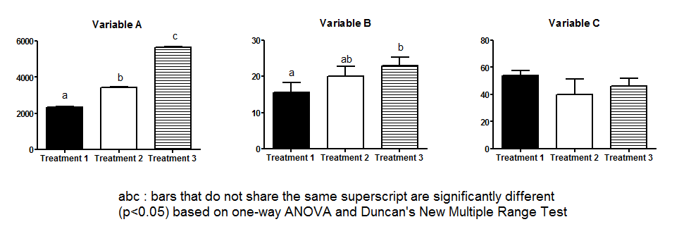
Example:
Experiment 2
Results:
(A) treatment 1 < treatment 2 < treatment 3 (p <0.05)
(B) treatment 1 < treatment 3, but treatment 2 not different from treatment 1 or 3 (p <0.05)
(C) was no difference between the three treatment groups

Slide 14
Interpretation of Results – An Easy Guide
What are we interpreting?
Experiments are conducted to see if changing one thing (the variable) causes a difference between groups.
Example: Brand X Cholesterol Lowering Drug (expensive) versus Brand Y Cholesterol Lowering Drug (cheap) : Which one worked better? Was there any difference at all between the two drugs?
Epidemiological studies are conducted to see if a difference in one thing (the variable) is related to a difference in a fixed other thing (the outcome).
Example: The people of Scienceland country have very low rates of breast cancer compared to Canada (the outcome). How much fish do they eat (the variable)?
Statistics are done to tell us whether a difference likely really exists. If p<0.05, then we as scientist agree to accept that a difference seen likely is actually a difference (not just a fluke).

Slide 15
How is it done? (a step by step guide for full marks)
Step 1
Is there a significant difference between two treatments (or groups)?
(i) if P is ≥ 0.05 then NO
(ii) if P is ANY number <0.05 then YES
IF YES: TELL US WHAT THE P VALUE IS!
Step 2
If a difference exists: In what direction is the difference? UP or DOWN
i.e. Did the treatment result in an increase or a decrease?

Slide 16
Step 3
What groups or treatments are you comparing? Tell us about it and BE SPECIFIC!!
e.g. Cholesterol Lowering Drug Brand X versus Brand Y
Mean daily fish consumption by the people of Scienceland versus the people of Canada
Step 4
What difference was compared? READ THE LEGEND!!
e.g. The fasting plasma total cholesterol level in subjects on the Brand X drug versus fasting plasma total cholesterol level in subjects taking the BRAND Y drug
e.g. The change from baseline in fasting plasma total cholesterol level in subjects taking BRAND X versus subjects taking BRAND Y.

