Slide 1
Tutorial #3
October 1, 2013

Slide 2
Practice Assignment
OVERALL BACKGROUND
The prevalence of type-2 diabetes (T2DM) is increasing steadily throughout the world, and has reached epidemic proportions with prevalence estimated to double within the next 25 years. This epidemic has serious implications for global health because T2DM is associated with a number of secondary complications, and is strongly associated with cardiovascular disease which is a major source of diabetic mortality. The magnitude of increase in blood glucose following a carbohydrate-containing meal, or postprandial glycemia (PPG), is associated with the incidence of T2DM, diabetic complications, and comorbid cardiovascular disease. Therefore, strategies to control PPG in both diabetic and non-diabetic individuals are a growing area of nutritional research. One strategy relies on modulating the action of “incretins” which are hormones secreted from the small intestine following a meal. Incretin hormones influence many processes including postprandial insulin secretion and the rate of gastric emptying. Two important incretins are glucagon-like peptide-1 (GLP-1) and glucose-dependent insulinotropic peptide (GIP).

Slide 3
Key points from the background
Prevalence of T2DM is increasing
T2DM associated with cardiovascular disease (CVD) which is a major cause of diabetic mortality
PPG associated with incidence of T2DM, diabetic complications and comorbid CVD
Incretins are secreted from the small intestine following a meal and influence processes including postprandial insulin secretion and the rate of gastric emptying
Examples of incretins are GLP-1 and GIP
Notes:
I have added this slide in order to emphasize what I think are the key messages from the background

Slide 4
STUDY 1
The incretin response to glucose ingestion may be modulated by co-ingestion of fat or protein. In this study, oral glucose was fed to fasted mice with or without the addition of oleic acid (OA) or whey protein (WP). Blood glucose and insulin concentrations were measured serially over the following two hours, and the area under the curve (AUC) was calculated in order to quantify the overall magnitude of glucose and insulin responses throughout the observation period. The GLP-1, GIP, and early insulin responses (EIR) were measured as blood concentrations at 15-minutes after feeding that reflect concentrations of these hormones at only that single point in time. The overall rate of gastric emptying during the two hour observation period was determined using paracetamol technique in which a lower AUC value represents a slower rate of gastric emptying. The small intestine was removed immediately after the mice were killed, and the activity of dipeptidyl peptidase-IV (DPP-4) was measured. DPP-4 rapidly inactivates hormones, like GLP-1 and GIP, such that total circulating GLP-1 and GIP consists of both inactive and bioactive/intact forms. Short protein fragments, like those resulting from partial protein digestion, can decrease DPP-4 activity by binding to the active site on the enzyme and preventing the binding of hormone substrates. Usually, studies only measure the total circulating concentration of incretins that mostly reflects incretin secretion from the intestine. This study is unique because it measures both total and intact/active incretin concentrations.

Slide 5

Study 1 Design
0
min
15
min
120
min
Fasted
Intestinal DPP-4 activity
Glucose
Glucose + OA
Glucose + WP
GLP-1
GIP
EIR
Total &
intact
Serial measures of blood glucose and insulin concentrations → AUC to represent total glucose and insulin response
Rate of gastric emptying (paracetamol technique)

Slide 6
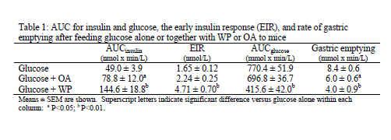
Question 1: Describe the results from Table 1. (2/50 marks)
AUCinsulin was significantly greater after co-ingestion of OA (P<0.05) and WP (P<0.01) with glucose compared to glucose alone.
EIR was significantly greater and after co-ingestion of WP with glucose compared to glucose alone (P<0.01). Co-ingestion of OA with glucose did not affect EIR compared to glucose alone.
AUCglucose was significantly lower after after co-ingestion of WP with glucose compared to glucose alone (P<0.01). Co-ingestion of OA with glucose did not affect AUCglucose compared to glucose alone.
Gastric emptying was significantly slower after co-ingestion of OA (P<0.05) and WP (P<0.01) with glucose compared to glucose alone.

Slide 7

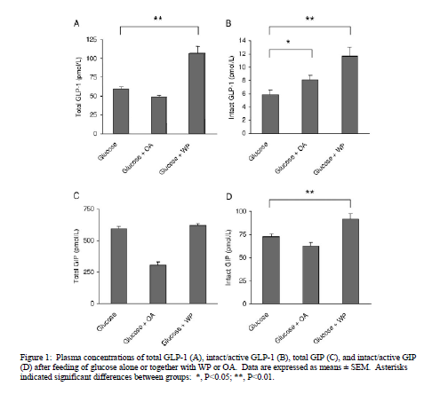
Total GLP-1 (pmol/L)
Intact GLP-1 (pmol/L)
Question 2: Describe the results displayed in Figure 1. (2/50 marks)
Total GLP-1 and intact GIP were significantly greater after after co-ingestion of WP with glucose compared to glucose alone (P<0.01). Co-ingestion of OA with glucose did not affect these variables.
Intact GLP-1 significantly greater after after co-ingestion of OA (P<0.05) and WP (P<0.01) with glucose compared to glucose alone (P<0.01).
There were no significant differences in total GIP according to treatments
Total GIP (pmol/L)
Intact GIP (pmol/L)

Slide 8
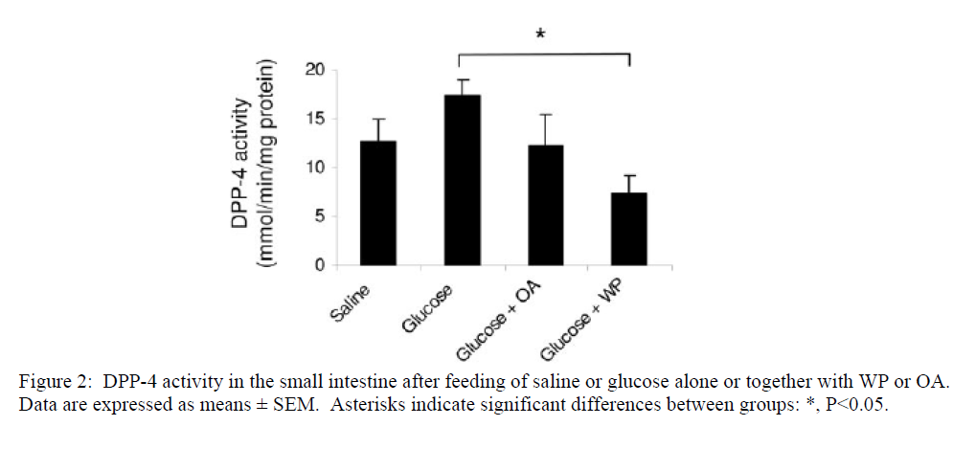
Question 3: Describe the results displayed in Figure 2. (1/50 marks)
DPP-4 activity was significantly lower after co-ingestion of WP compared to glucose alone.

Slide 9
Question 4: Using Table 1, identify which variable is the most important modulator of postprandial glycemia. Be sure to defend your answers based on the data in the table, and argue why you are selecting one measure over another. (3/50 marks)
The EIR is the most important modulator (measured variable) of PPG because it is the only measurement that exactly matches changes in glucose AUC/PPG.
While insulin AUC also reflects serum insulin concentrations, it is a measure of the overall insulin response (Background). These results indicate that the early insulin response is more important in determining the extent of postprandial glycemia.

Slide 10
Question 5: Based on the background, Figure 1, and Figure 2 how does the co-ingestion of carbohydrate with fat or protein influence the postprandial incretin response? What role, if any, does DPP-4 play in this response? (4/50 marks)
Protein increases secretion (total concentrations) of GLP-1 and decreases degradation/deactivation (intact concentrations) of GIP and GLP-1 resulting in higher bioactive concentrations of both incretins (Background and Figure 1).
Figure 2 indicates that whey protein decreases the activity of DPP-4 likely through the inhibitory effect of protein fragments produced during partial digestion (Background). Since DPP-4 acts to deactivate incretins, therefore, whey protein inhibits degradation of GIP and GLP-1 by inhibiting DPP-4.
In contrast to protein, fat only influences the degradation of GLP-1 and does not appear to alter incretin secretion.
DPP-4 does not appear to be influenced by fat co-ingestion, and therefore, cannot explain lower degradation of GLP-1.

Slide 11
Question 6: Based on the background information and the data in Study 1, explain how fat and protein influence PPG. Be specific and ensure you explain any differences between the influence of fat and protein on PPG. (6/50 marks)
Insulin secretion and slowing gastric emptying are important determinants of PPG (Background and Table 1).
In Table 1, both protein and fat lower gastric emptying rates probably through the action of GLP-1 whose intact/bioactive concentrations are elevated with co-ingestion of these nutrients. Therefore, gastric emptying does not explain the different effects of fat and protein on PPG.
Unlike fat, protein co-ingestion resulted in elevated concentrations of both GLP-1 and GIP
Dual augmentation of the bioactive concentrations of both incretins appears necessary to significantly increase the EIR which is the determining factor in reducing PPG (Table 1).
Protein augmented bioactive incretin concentrations by inhibiting DPP-4 which deactivates incretins.
Therefore, protein co-ingestion lowers PPG when fat does not because protein is able to maintain higher bioactive concentrations of incretins resulting in a more robust EIR.

Slide 12
STUDY 2
Ingestion of whey protein increases blood concentrations of the amino acids leucine, isoleucine, valine, lysine and threonine in proportion to their content in whey. These amino acids may suppress extraction of insulin from blood by the liver resulting in a higher blood insulin concentration. In this study, healthy volunteers were served drinks consisting of pure glucose (reference drink) or glucose supplemented with the previously mentioned group of five free amino acids (AA5) or intact whey protein. The proportion and amounts of amino acids composing the AA5 drink were similar to their content in the whey protein drink. The subjects arrived at the test facility following an overnight fast, and the drinks were provided as breakfasts in random order on different days under standardized conditions. A peripheral catheter inserted into a vein was used to sample blood from fasting to 120 minutes post-drink consumption. These blood samples were analyzed for the total incretin, insulin, and glucose responses which were expressed in AUC units over the 120 minute period.

Slide 13

Study 2 Design
0
min
120
min
Fasted
Glucose
Glucose + WP
Glucose + AA5
Serial measures of blood glucose, insulin and incretin concentrations → AUC to represent total glucose, insulin and incretin responses

Slide 14
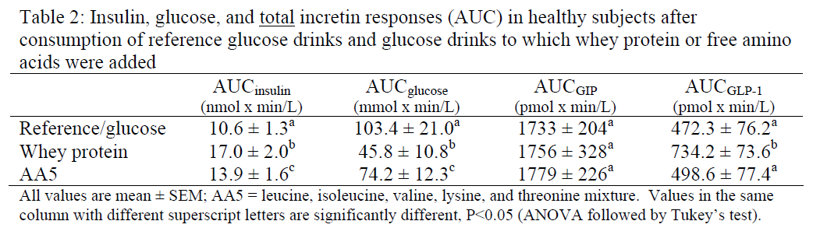
Question 7: Describe the results from Table 2. (3/50 marks)
AUCinsulin and AUCglucose values were all significantly different from each other in the following decreasing order according to treatment: WP, AA5, reference.
AUCGLP-1 was significantly greater after co-ingestion of WP compared to AA5 and reference drinks which didn’t significantly differ from each other.
There were no significant differences in AUCGIP according to treatment.

Slide 15
Intact whey protein (WP) results in higher GLP-1 secretion (total concentration expressed as the AUC) compared to the reference/glucose, but free amino acids (AA5) do not. This difference may result from the inability of AA5 to stimulate GLP-1 secretion or inhibit deactivation
Based on the results of Study 1, however, we would expect that this difference is explained by the impact that protein has on incretin deactivation by DPP-4.
DPP-4 is inhibited by short protein fragments produced by partial digestion of WP which are not produced after ingestion of free amino acids.
Therefore, DPP-4 is not inhibited after AA5 ingestion and DPP-4 can continue to deactivate GLP-1 . In contrast, ingestion of intact whey protein results in DPP-4 inhibition and a reduction in the deactivation of GLP-1.

Slide 16
Question 9: Based on the information presented to this point, what is the best explanation for why the effects of whey protein and its constituent amino acids on postprandial glycemia are different? Make sure to defend your answer using the data from this question and information that you know from the previous question. (6/50 marks)
Study 2 indicates that AA5 co-ingestion lowers postprandial glycemia compared to reference, but not as much as intact WP.
Study 1 indicates that WP stimulates incretin secretion and inhibits incretin degradation resulting in augmented insulin secretion and slower gastric emptying compared to glucose alone.
Protein digestion into di- and tripeptides is responsible for inhibited incretin degradation as these protein fragments inhibit the activity of DPP-4.
Higher bioactive incretin concentrations will lead to increased insulin secretion and serum concentrations.
It is also likely that AA5 amino acids produced during protein digestion inhibit hepatic insulin extraction which would also contribute to a higher serum insulin and glucose disposal (background).

Slide 17
Question 9: Based on the information presented to this point, what is the best explanation for why the effects of whey protein and its constituent amino acids on postprandial glycemia are different? Make sure to defend your answer using the data from this question and information that you know from the previous question. (6/50 marks)
Administration of these amino acids by themselves likely only results in reduced hepatic insulin extraction, but does not augment insulin secretion. This finding is supported by the insignificant effect of AA5 on incretin responses compared to glucose in Study 2 and the fact that serum insulin concentrations are lower compared to co-ingestion of WP, but higher than the reference drink.
Therefore, WP exerts a greater reduction in PPG than AA5 because it was able to promote insulin secretion and suppress hepatic insulin extraction resulting in greater glucose disposal. The amino acids only suppress hepatic insulin extraction.

Slide 18
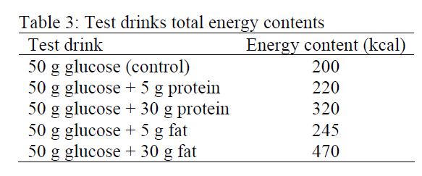
STUDY 3
The influence of different amounts of fat and protein on PPG is unknown. In this study, healthy volunteers consumed glucose drinks with 0-30 gram doses of oleic acid or whey protein on nine separate occasions after fasting overnight (See Table 3). Blood was sampled from fasting to 120 minutes postprandial, and analyzed to produce AUC values for glucose, insulin, and total GLP-1. An index was calculated based on blood analysis representing the degree of hepatic insulin extraction (HIE) for which higher HIE-values indicated higher postprandial removal of insulin from the blood by the liver compared to lower values.

Slide 19
Study 3 Design
0
min
120
min
Fasted
50 g Glucose (control)
50 g Glucose + 5g protein
50 g Glucose + 30g protein
50 g Glucose + 5g fat
50 g Glucose + 30g fat
Serial measures of blood glucose, insulin and GLP-1 concentrations → AUC to represent total glucose, insulin and GLP-1 responses
Hepatix Insulin Extraction (HIE)

Slide 20
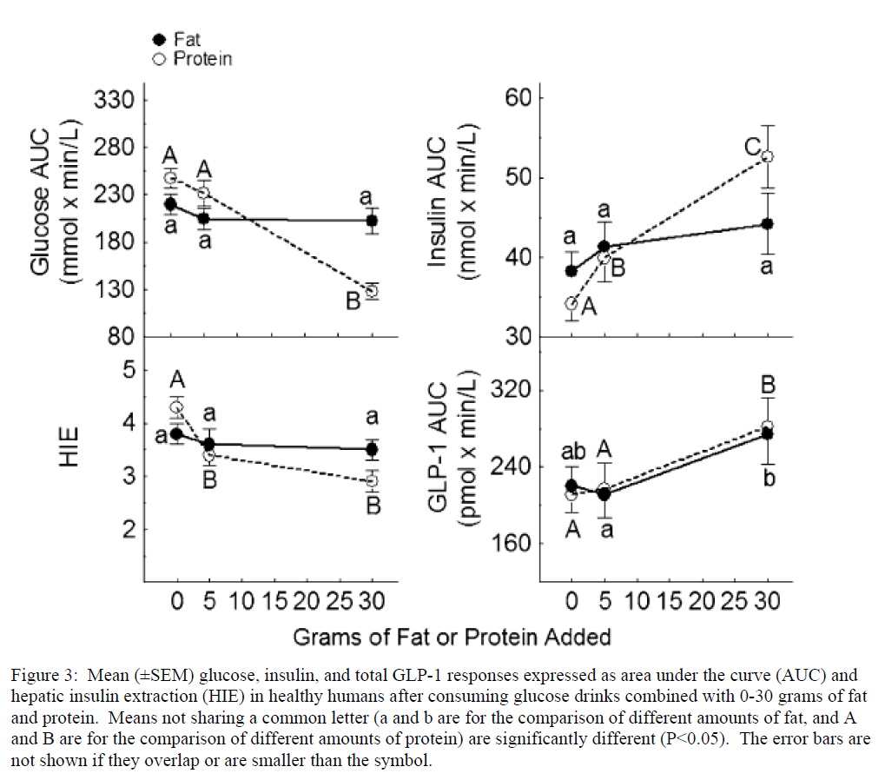
Question 10: Describe the statistically significant findings displayed in Figure 3. (3/50 marks)
Glucose AUC is significantly less after co-ingestion of 30 grams of protein compared to 5 and 0 grams.
Insulin AUC values are all significantly different from each other at all levels of protein co-ingestion in the following ascending order: 0 g, 5 g, 30 g.
HIE after co-ingestion of 30 and 5 grams of protein was significantly greater than after consumption of glucose alone.
GLP-1 AUC was significantly greater after co-ingestion of 30 grams of protein compared to 5 and 0 grams.
GLP-1 AUC was significantly greater after co-ingestion of 30 grams of fat compared to 5 grams.

Slide 21
Question 11: What do the results of Study 3 indicate about the impact of fat and protein quantity on PPG? What inferences can be made about the physiological mechanisms underlying these impacts? Considering all the information presented in this assignment, would you add any additional measurements to Study 3 in order to help you make these inferences? Why? (8/50 marks)
Study 3 indicates that there is a dose-response relationship (exact wording not required) between the amount of protein consumed and reduction of PPG. No such relationship exists for fat.
The reason that the dose-response relationship exists for protein and not fat appears to be dependent on the dose-response relationship between protein co-ingestion and serum insulin (AUC).
Possible mechanisms that are known to contribute to the insulin AUC are incretin-stimulated secretion and suppression of hepatic insulin extraction
Both mechanisms are related to protein digestion which produces the fragments which inhibit DPP-4 leading to incretin deactivation (Study 1), as well as, the amino acids that suppress HIE (Study 2).

Slide 22
Question 11: What do the results of Study 3 indicate about the impact of fat and protein quantity on PPG? What inferences can be made about the physiological mechanisms underlying these impacts? Considering all the information presented in this assignment, would you add any additional measurements to Study 3 in order to help you make these inferences? Why? (8/50 marks)
It is unclear whether both or only one of these mechanisms is responsible for the dose-response relationship observed between PPG and protein intake, or the lack of such a relationship with fat, because one cannot definitively link protein co-ingestion with changes in active incretins and DPP-4 activity. (Other indications that the student was critically appraising the possible mechanisms and acknowledging their ambiguity were given credit)
Although HIE does not appear to be dose-dependent after 5 grams, we cannot say for certain that increased insulin AUC is due to incretin activity.
Additional measurements of DPP-4 activity, total and intact GLP-1 and GIP would be useful in confirming the importance of incretin-stimulated glucose secretion versus HIE. These measurements would allow us to determine if the dose of protein increases the activity of the incretins shown to be involved in suppressing PPG in Study 1. (Other well defended suggestions will also be given credit)

Slide 23
Question 12: If you knew that total incretin secretion was influenced by the energy content of the ingested nutrients, would this change your overall interpretation of Study 3? Why? (2/50 marks)
No, because higher amounts of both fat and protein quantity increase the GLP-1 response despite the fact that the fat drink contains more calories, but only protein has a dose-response relationship with PPG/glucose AUC. (“Yes” answers given partial credit; Not taking a stand resulted in a max of 0.5 marks being credited).

Slide 24
Question 13: Based on all of the information presented in this assignment, what specific advice would you give a friend who frequently consumes sugary food and wishes to reduce their risk of developing type-2 diabetes by altering her diet? Defend your advice by summarizing the conclusions of each study. (6/50 marks)
It is important that dietary strategies to lower PPG are recommended because high PPG is related to the development of T2DM.
Study 1 indicates that protein more effectively lower PPG than fat because it is able to maintain higher bioactive levels of incretins in circulation that ultimately lead to a more robust EIR than fat.
This suggests that Friend should co-ingest WP with sugary meals and not fat.
Study 3 indicates that there is a dose-response relationship between protein co-ingestion and lower PPG due to the dose-response relationship between protein ingestion and HIE
Therefore, friend should consume greater than 5 grams of protein per 50 grams of sugar as this dose was observed to produce the lowest PPG/glucose AUC.

Slide 25
Question 13: Based on all of the information presented in this assignment, what specific advice would you give a friend who frequently consumes sugary food and wishes to reduce their risk of developing type-2 diabetes by altering her diet? Defend your advice by summarizing the conclusions of each study. (6/50 marks)
Study 2 indicates that protein influences incretin activity and HIE at different stages of digestion. The effect of whole protein results from the combination of protein fragments from partial digestion augmenting the incretin response, and amino acids from full digestion influence HIE.
Therefore, friend should consume the whole protein rather than its constituent amino acids because it will involve all mechanisms shown to be related to lowering PPG.

