Slide 1
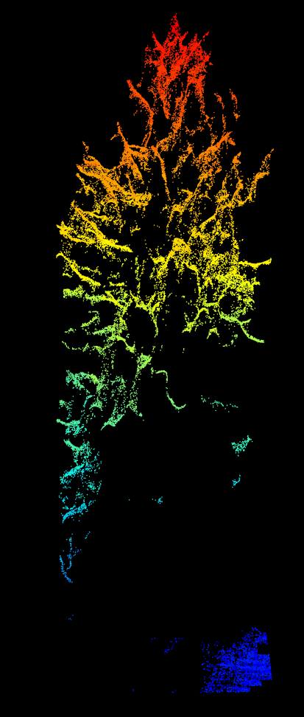
Terra-package
Praktikum – Datenanalyse in der
Fernerkundung
SoSe 2023
Benedikt Hartweg

Slide 2
Overview
Provides functions to read and write raster and vector data in R
Interface to gdal
Allows basic raster and vector data manipulation such as
  Reprojection
  Raster algebra
  Raster-vector data conversion
  Queries of raster data at vector locations
  ...

Slide 3
Main classes
SpatRaster
  Allows to store and manipulate raster files (stored locally or in RAM, singel and multiband files are supported)
  Provides basic support of raster algebra
  Raster files can be plotted
SpatVector
  Same as above but for vector data
  Vectors can be polygons, lines or points
  Fully supports Shapefiles and GeoJson ...

Slide 4
Further information
Tutorial of terra package: https://rspatial.org/
Robin Lovelace’s open book “Geocomputation with R”: https://r.geocompx.org
CRAN help pages

